Slide 1
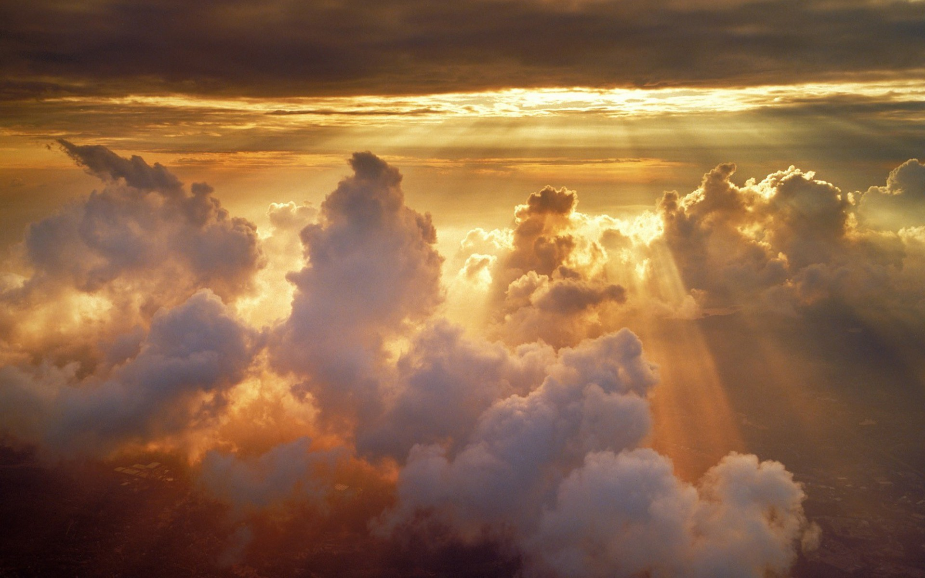
The Joy of
Jerusalem
Isaiah 62
Dr Randall Price World of the Bible Ministries • www.worldofthebible.com Uploaded by Dr. Rick Griffith • Jordan Evangelical Theological Seminary Files in many languages for free download at BibleStudyDownloads.org

Slide 2
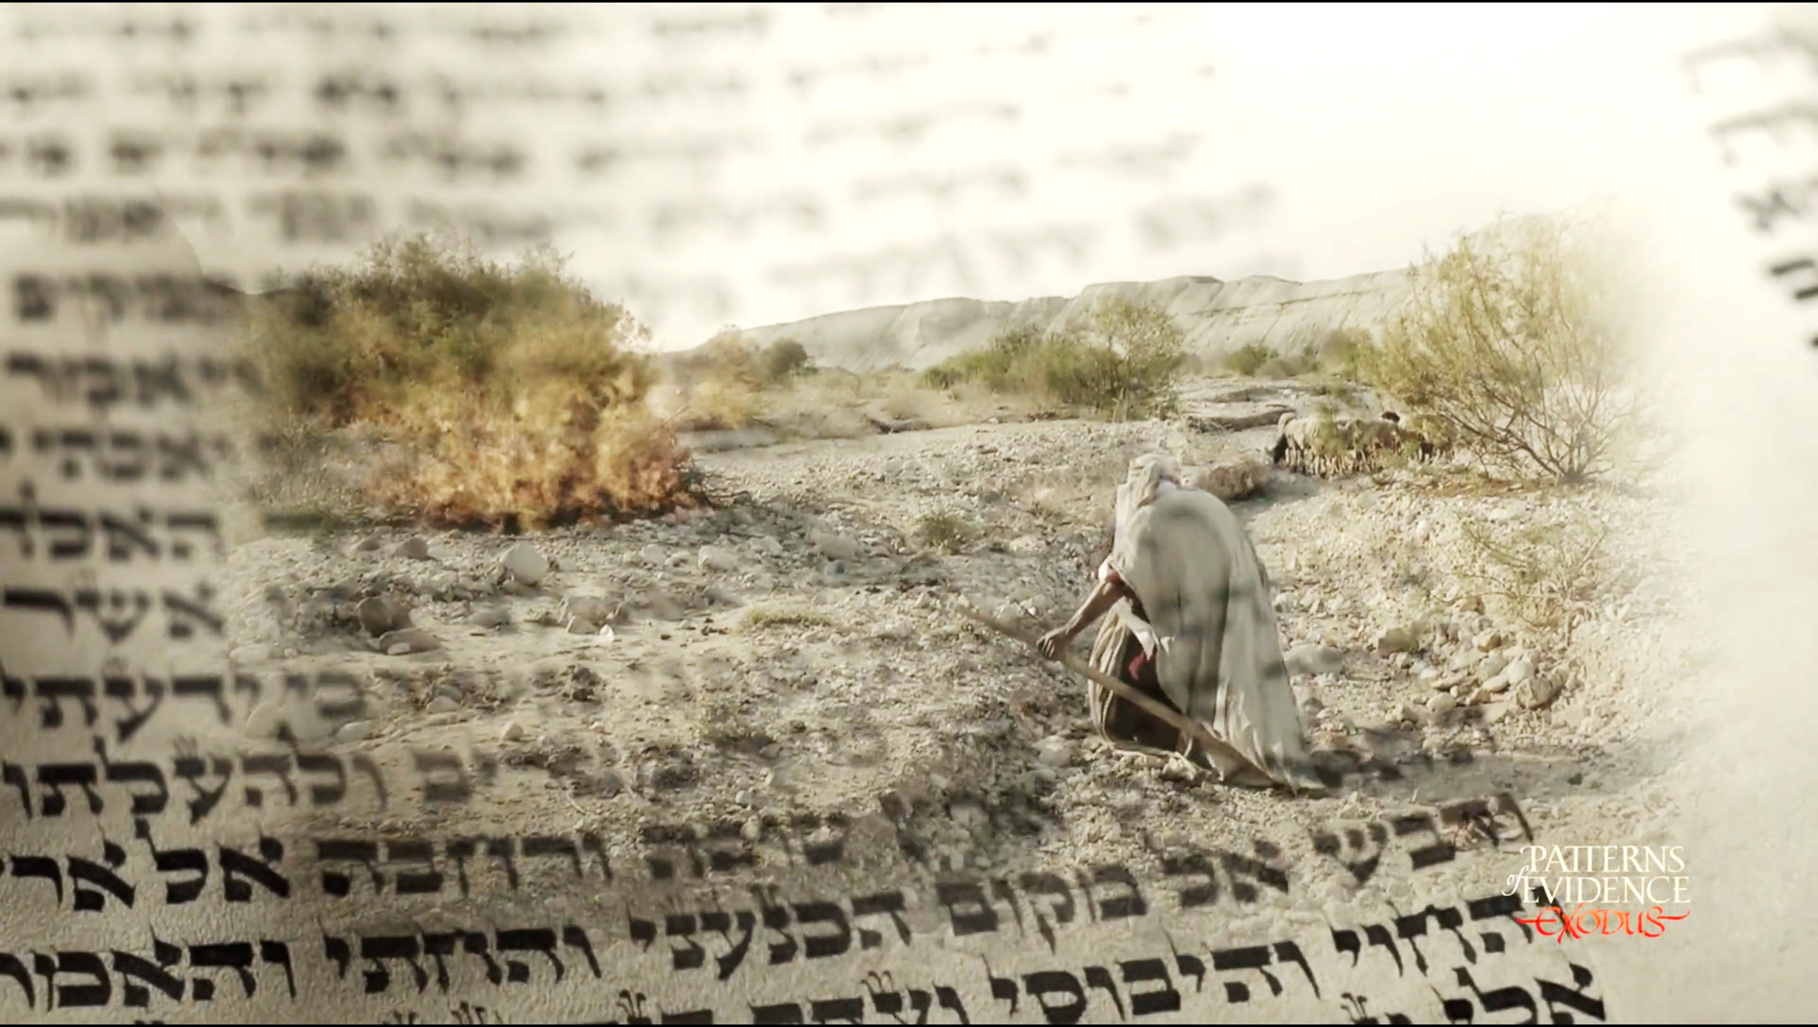
Welcome to
THRU THE BIBLE

Slide 3
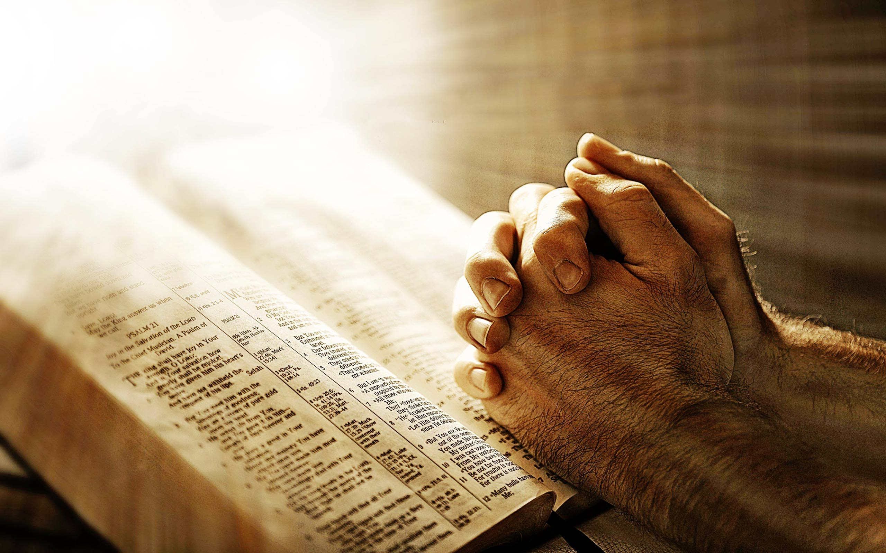
Prayer
Time
“In the morning, O LORD, Thou wilt hear my voice; In the morning I will order my prayer to Thee and eagerly watch.” Psalm 5:3

Slide 4
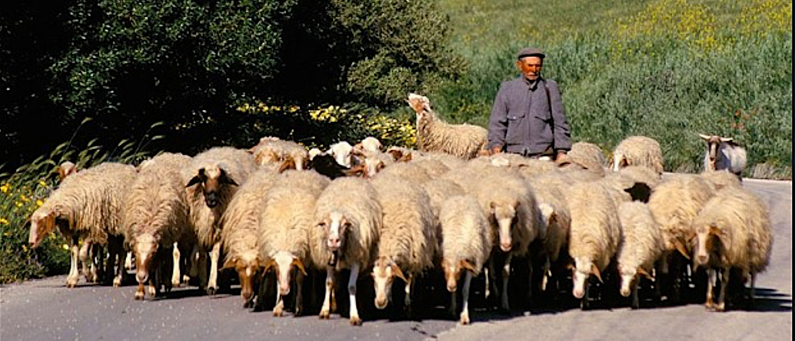
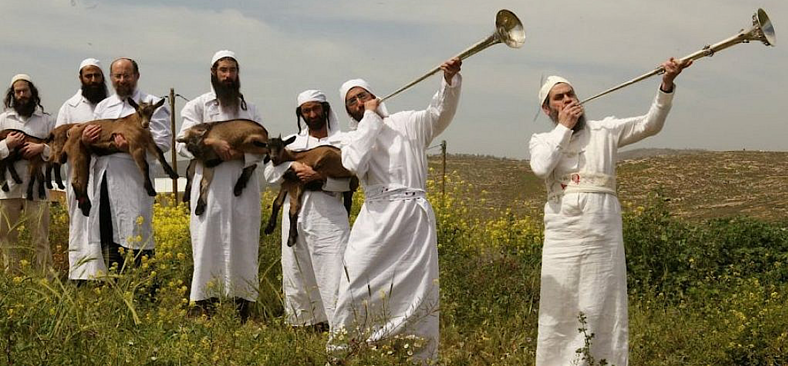
Work Roles in the Millennial Kingdom
“And strangers will stand and pasture your flocks, and foreigners will be your farmers and your vinedressers. But you will be called the priests of the LORD; You will be spoken of as ministers of our God. You will eat the wealth of nations, and in their riches you will boast. vss. 5–6
The Gentile nations (“strangers”) will serve Israel (who they formerly oppressed) throughout the Millennium. Two work roles are given as shepherds and farmers, but these are only examples of this future service.
The Nation of Israel will work as priests serving the LORD in fulfillment of Exodus 19:6. Whereas the Jewish People had suffered loss because of the nations, now it will be blessed and will live from the gifts of the Gentiles.

Slide 5
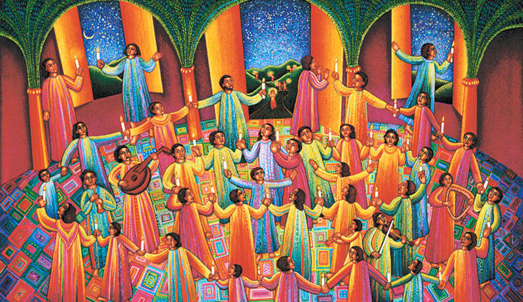
“For I, the LORD, love justice, I hate robbery in the burnt offering; And I will faithfully give them their recompense, and I will make an everlasting covenant with them. Then their offspring will be known among the nations, and their descendants in the midst of the peoples. All who see them will recognize them because they are the offspring whom the LORD has blessed.” Isaiah 61:8–9
Throughout Israel’s past it suffered shame and humiliation under God’s discipline among the nations. Now Israel will experience the fulfillment of all of its biblical covenants, being restored to the LORD and the Land. This will be an undeniable witness of God’s favor on them before the nations.
According to the Law of the Firstborn (Deut. 21:17), the firstborn son received a double portion of the inheritance. Because of their national disobedience, Israel received a double punishment, being exiled from their Land and scattered among the nations. Now that it has returned to the LORD, Israel will receive its promised inheritance of blessing and be known worldwide as God’s Chosen People.

Slide 6
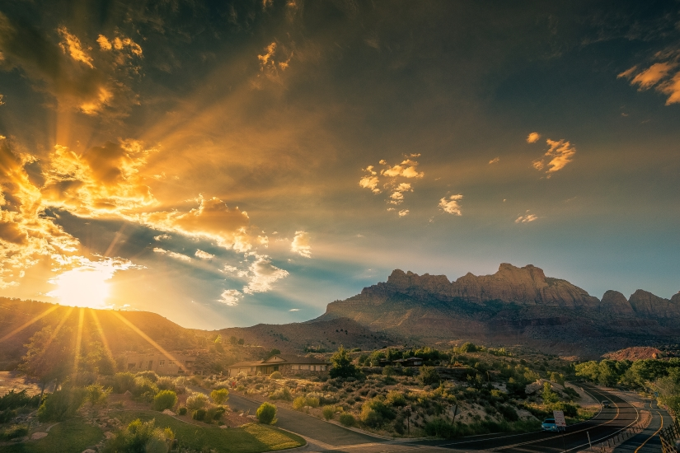
“I will rejoice greatly in the LORD, my soul will exult in my God; For He has clothed me with garments of salvation. He has wrapped me with a robe of righteousness, as a bridegroom decks himself with a garland, and as a bride adorns herself with her jewels. For as the earth brings forth its sprouts, and as a garden causes the things sown in it to spring up, so the Lord GOD will cause righteousness and praise to spring up before all the nations.” Isaiah 61:10–11
Glories of the
Millennium

Slide 7

Lessons from Isaiah 61
1. There is nothing that we may need that Jesus cannot provide. He can comfort, deliver, heal and give life. Are we first bringing our needs to Him or to others? vss. 1-2
2. God’s promised plan for Israel will be fulfilled. How do we think about the Jewish People today and what are we doing to bring the Good News to them so they may inherit these promises tomorrow? vss. 4-8
3. We will experience the joy of Christ’s rule and blessings in the Millennial Kingdom. Since we as the Church experience the spiritual blessings of the New Covenant today, are we rejoicing in the LORD as we should? vss. 9-11

Slide 8
The Joy of
Jerusalem
Isaiah 62

Slide 9
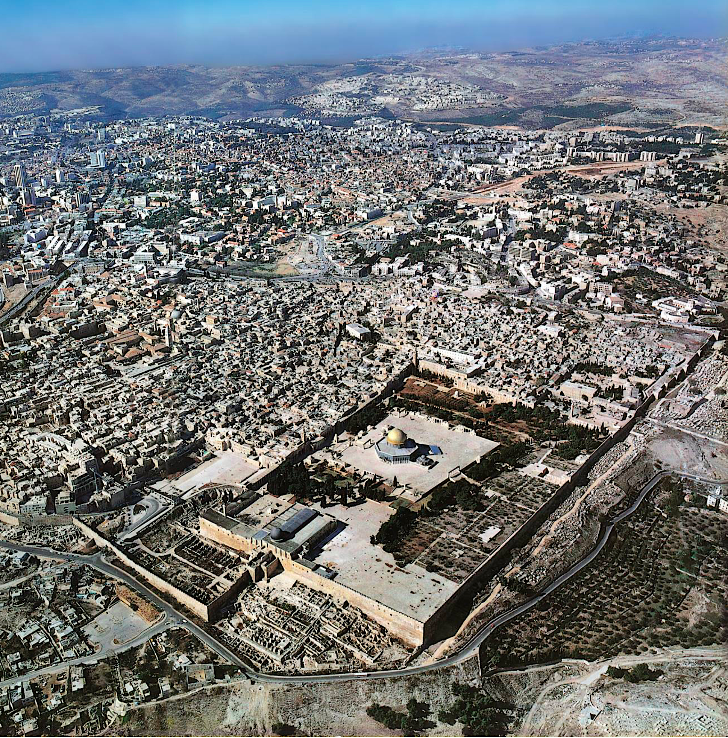
"The view of Jerusalem is the history of the world; it is more, it is the history of earth and of heaven.”
Benjamin Disraeli, Statesman

Slide 10
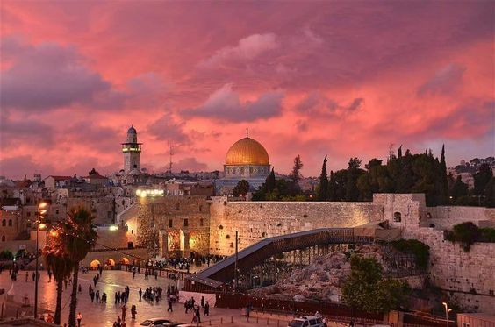
This chapter continues the Millennial theme of chapters 60-61. The days of Israel’s discipline and of the nations’ judgment in the Tribulation are past and the Prophet Isaiah is showing us what God has revealed about the glorious time of Christ’s rule on the earth and His restoration of the City of Jerusalem, the center of the Millennial Kingdom on earth. Whereas Jerusalem as the capital of Israel and the past center of Jewish defection from God and Christ received the brunt of divine justice in the destruction of its Temple and city, in the future it will become the center of worship for the world. All of the nations that once despised Jerusalem will now praise God for its glorious position and the benefits of peace that flow from it.

Slide 11
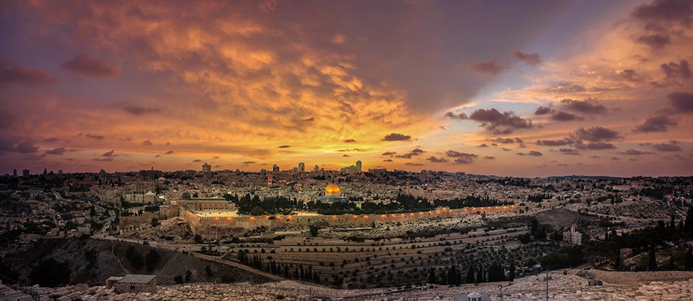
Outline of Isaiah 62
I. God’s Plan to Exalt Jerusalem. vss. 1-2
II. God’s Program to Bless Jerusalem. vss. 3-5
III. God’s Plan for Prayer for Jerusalem. vss. 6-7
IV. God’s Promise to Protect Jerusalem. vss. 8-9
V. God’s Preparation for the World to Come to Jerusalem. vs. 10
VI. God’s Presence Restored to Jerusalem. vss. 11-12

Slide 12
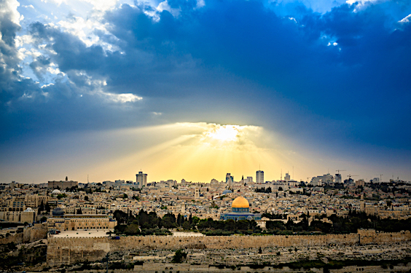
God’s Plan to Exalt Jerusalem
“For Zion’s sake I will not keep silent, and for Jerusalem’s sake I will not keep quiet, until her righteousness goes forth like brightness, and her salvation like a torch that is burning. And the nations will see your righteousness, and all kings your glory; And you will be called by a new name, which the mouth of the LORD will designate. ” Isaiah 62:1-2

Slide 13
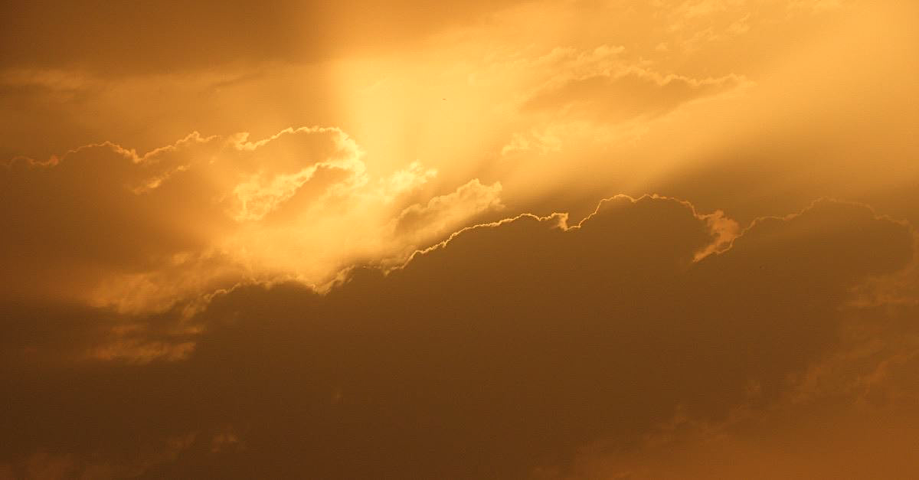
A change in relationship with God
often resulted in a change of name by God
SARI
“contentious”
SARAH
“princess”
ABRAM
“exalted father”
ABRAHAM
“father of a multitude”
JACOB
“supplanter”
ISRAEL
“he who wrestles with God”

Slide 14
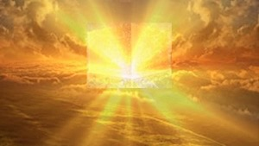
“He who has an ear, let him hear what the Spirit says to the churches. To him who overcomes, to him I will give some of the hidden manna, and I will give him a white stone, and a new name written on the stone which no one knows but he who receives it … He who overcomes, I will make him a pillar in the temple of My God, and he will not go out from it anymore; and I will write upon him the name of My God, and the name of the city of My God, the new Jerusalem, which comes down out of heaven from My God, and My new name.” Revelation 2:17; 3:12

Slide 15
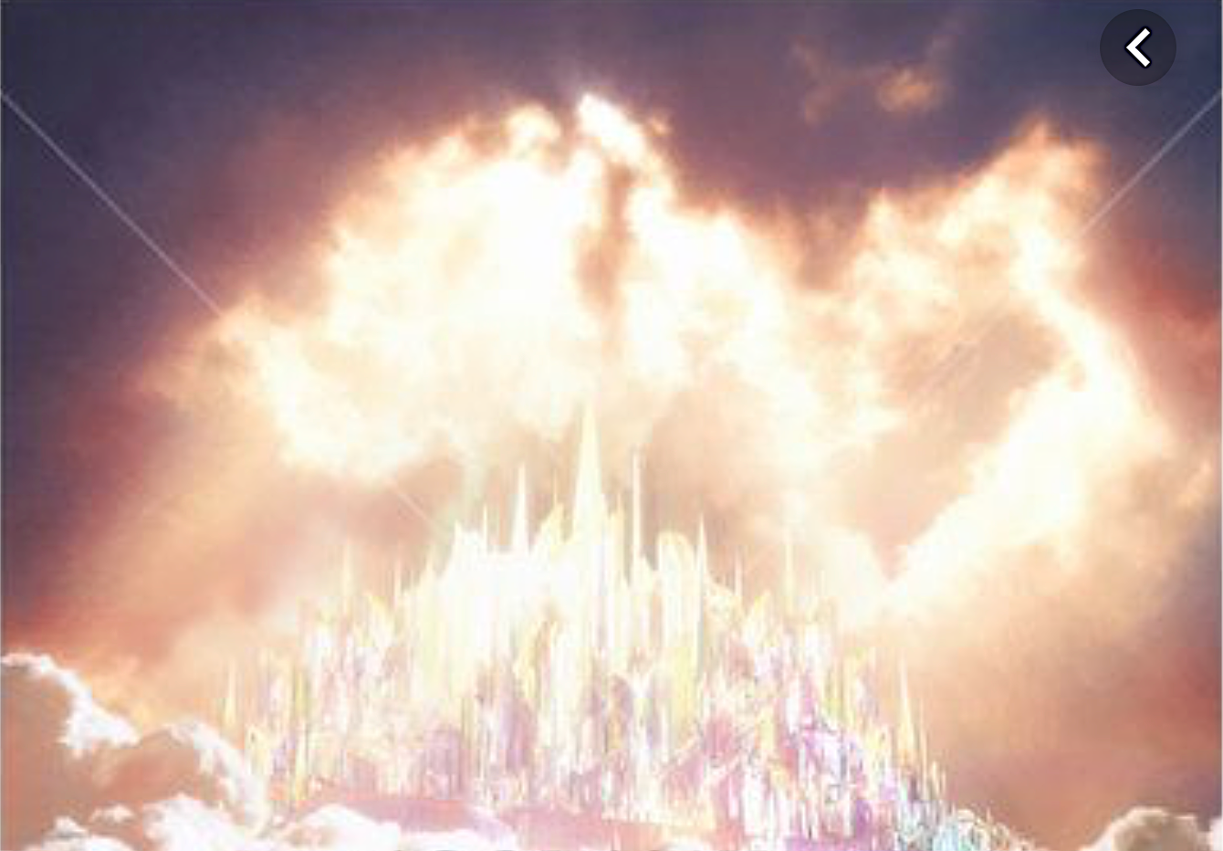

God’s Program to Bless Jerusalem
“You will also be a crown of beauty in the hand of the LORD, and a royal diadem in the hand of your God. It will no longer be said to you, ‘Forsaken,’ Nor to your land will it any longer be said, ‘Desolate’; But you will be called, ‘My delight is in her,’ And your land, ‘Married’; For the LORD delights in you, and to Him your land will be married. For as a young man marries a virgin, so your sons will marry you; And as the bridegroom rejoices over the bride, so your God will rejoice over you.” Isaiah 62:3-5

Slide 16
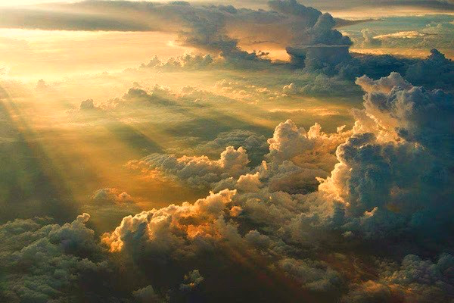
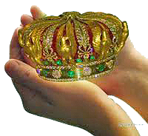
The LORD’s hand represents His power. So the diadem, which represents Israel, in His Hand indicates His help and protection of His People.

Slide 17
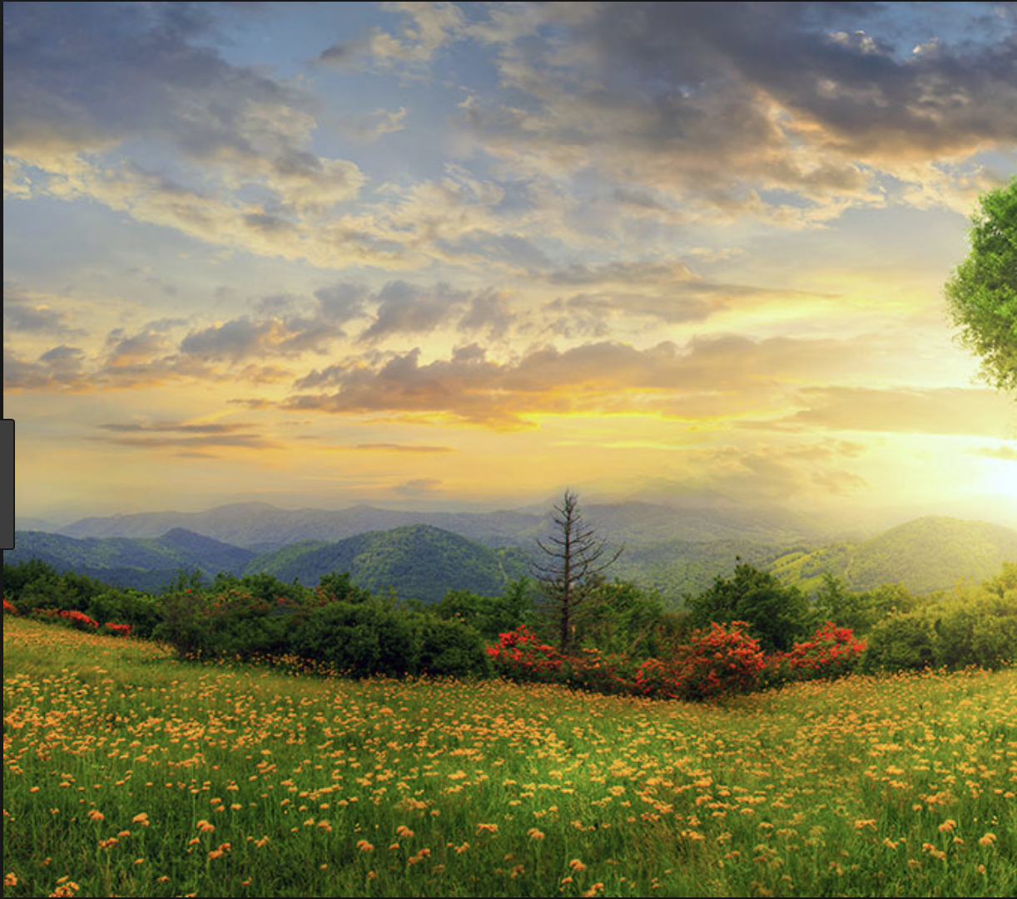
“It will no longer be said to you, ‘Forsaken,’ nor to your land will it any longer be said, “Desolate”; But you will be called, ‘My delight is in her,’ and your land, ‘Married’; For the LORD delights in you, and to Him your land will be married.” Isaiah 62:4
בְּעוּלָה
חֶפְצִי־בָהּ
שְׁמָמָה
עֲזוּבָה
B^{e}’ulah
Cheptzi-Bah
sh^{e}mamah
‘azuvah
“Married”
“My delight
is in her”
“Desolate”
“Forsaken”
(Isaiah 54:1)
(Isaiah 6:11-12)
(Genesis 2:25)
(2 Kings 21:1)

Slide 18
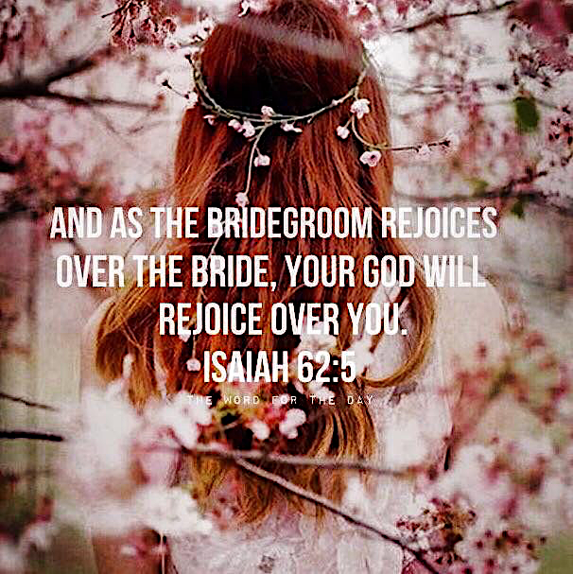

Slide 19
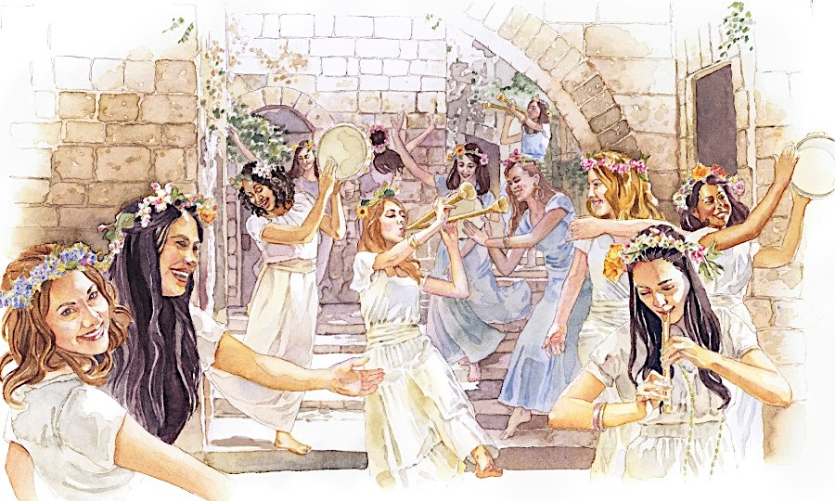
“For as a young man marries a virgin, So your sons will marry you; And as the bridegroom rejoices over the bride, So your God will rejoice over you.” Isaiah 62:5

Slide 20


Britain’s Queen Victoria married in 1840 and started a tradition that continues in the West to this day: the white wedding dress. Her choice started a trend which became a custom, and white wedding gown came to symbolize fidelity and purity.
A grander wedding ceremony is coming: the Marriage Supper of the Lamb. The groom will be Christ Himself, and the Bride will be His Church. As John saw this scene in heaven, he saw that the Bride of Christ was dressed in “fine linen, clean and bright” which symbolized “the righteous acts of the saints.” No white wedding dress on earth can make a bride pure and righteous on her wedding day, but nothing less than clean, bright linen will do for the saints-made-holy when they meet Christ to be united forever.
Are you prepared for that day? Do you anticipate being made completely pure and righteous in heaven? Your garment of righteousness is waiting for you.

Slide 21
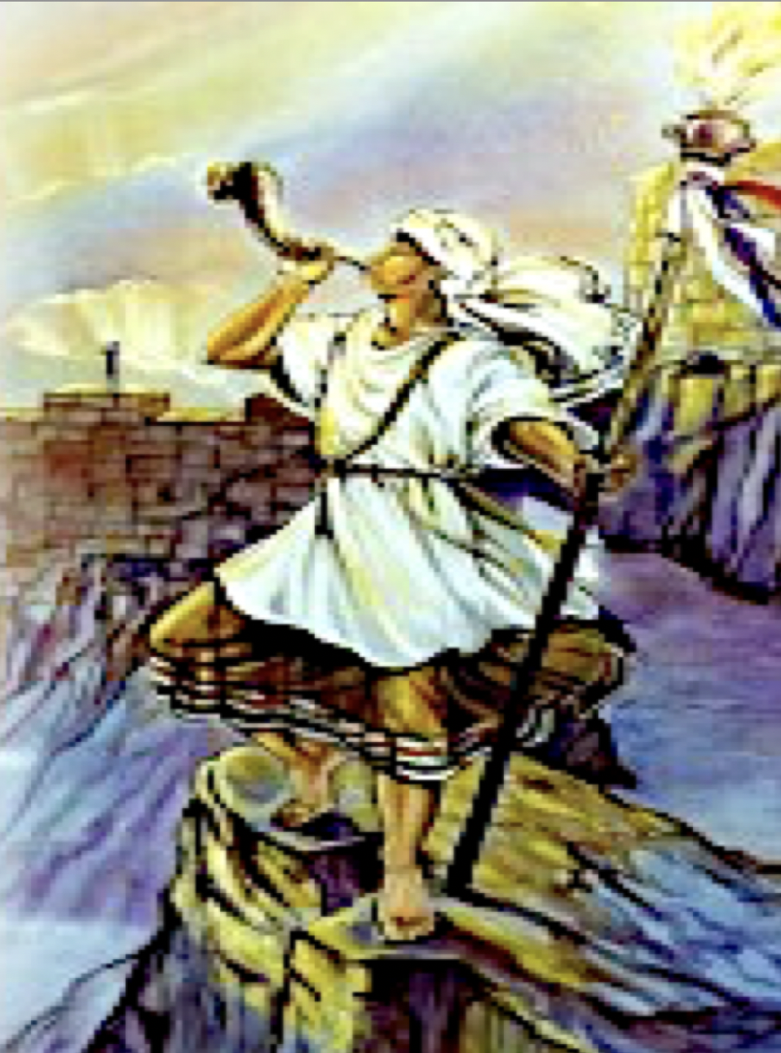
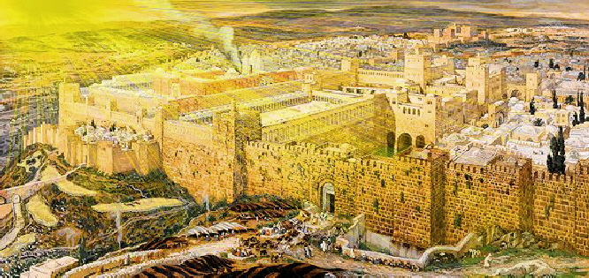
God’s Plan for Prayer for Jerusalem
“On your walls, O Jerusalem, I have appointed watchmen; All day and all night, they will never keep silent. You who remind the LORD, take no rest for yourselves; And give Him no rest until He establishes and makes Jerusalem a praise in the earth.” Isaiah 62:6–7

Slide 22
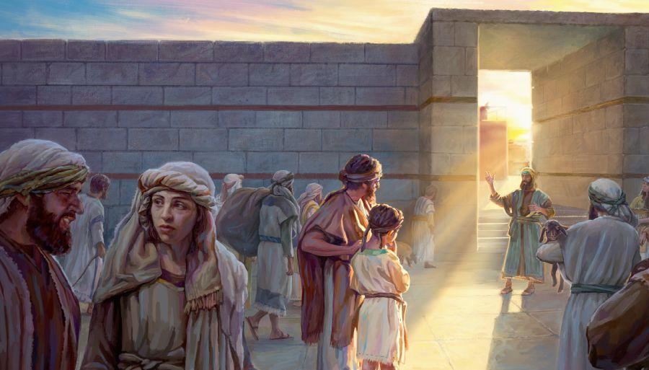
“Son of man, I have appointed you a watchman to the house of Israel; whenever you hear a word from My mouth, warn them from Me.” Ezekiel 3:17
These watchmen are the prophets God sent to Israel to warn, exhort and encourage it, but above all, to intercede with God its behalf.

Slide 23
“Pray for the peace of Jerusalem:
‘May they prosper who love you.
May peace be within your walls,
and prosperity within your palaces.
For the sake of my brothers and my friends,
I will now say, May peace be within you.
For the sake of the house
of the LORD our God
I will seek your good.’”
Psalm 122:6–9

Slide 24
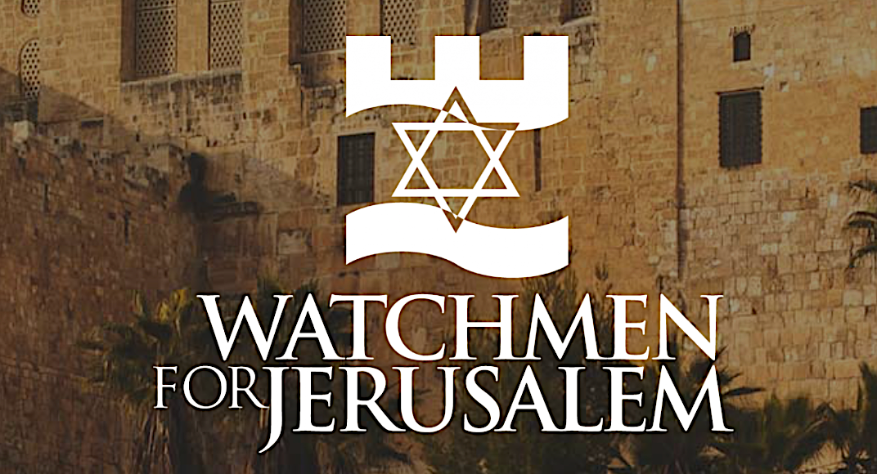
“Unless the LORD guards the city, the watchman keeps awake in vain.” Psalm 127:1
“‘But if the watchman sees the sword coming and does not blow the trumpet, and the people are not warned, and a sword comes and takes a person from them, he is taken away in his iniquity; but his blood I will require from the watchman’s hand.” Ezekiel 33:6
“My soul waits for the Lord More than the watchmen for the morning; Indeed, more than the watchmen for the morning.” Psalm 130:6

Slide 25
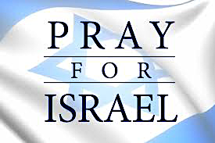
“Brethren, my heart’s desire and my prayer to God for them is for their salvation.”
Romans 10:1

Slide 26
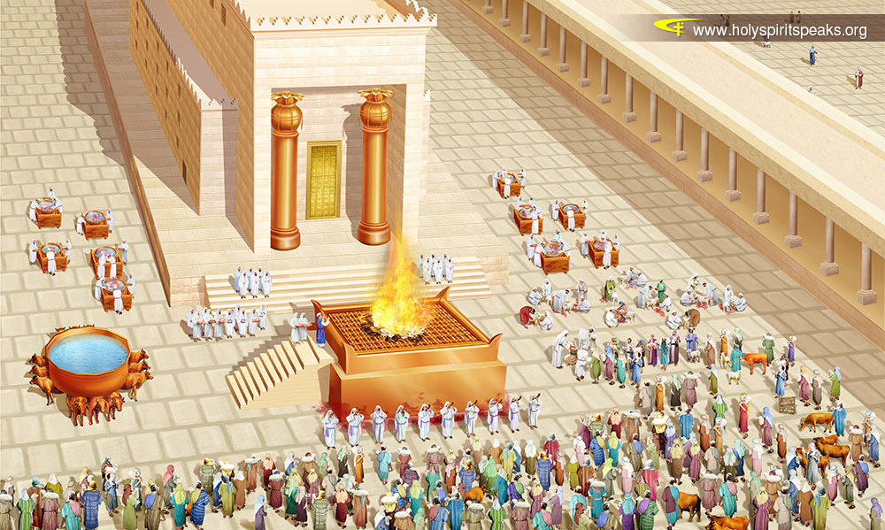
God’s Promise to Protect Jerusalem
“The LORD has sworn by His right hand and by His strong arm, ‘I will never again give your grain as food for your enemies; Nor will foreigners drink your new wine, for which you have labored.’ But those who garner it will eat it, and praise the LORD; And those who gather it will drink it in the courts of My sanctuary.” Isaiah 62:8–9

Slide 27
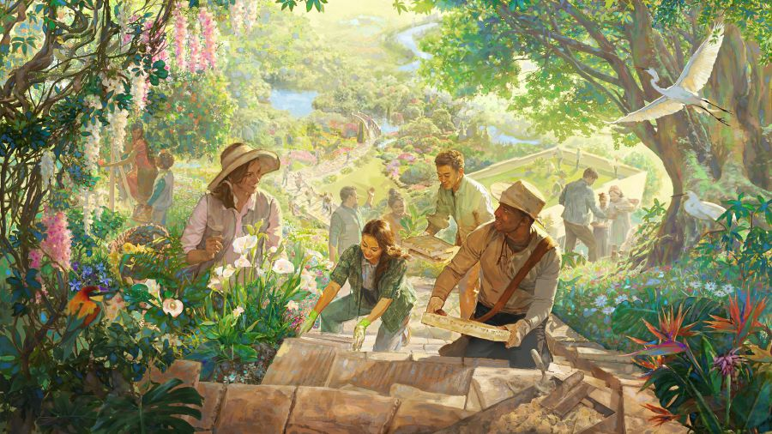
God’s Preparation for the World to Come to Jerusalem
“Go through, go through the gates; Clear the way for the people; Build up, build up the highway; Remove the stones, lift up a standard over the peoples.” Isaiah 62:10

Slide 28

“Now it will come about that in the last days, the mountain of the house of the LORD will be established as the chief of the mountains, and will be raised above the hills; And all the nations will stream to it. And many people will come and say, “Come, let us go up to the mountain of the LORD, to the house of the God of Jacob, that He may teach us concerning His ways, and that we may walk in His paths.” For the law will go forth from Zion, and the word of the LORD from Jerusalem.” Isaiah 2:2–3
JERUSALEM

Slide 29
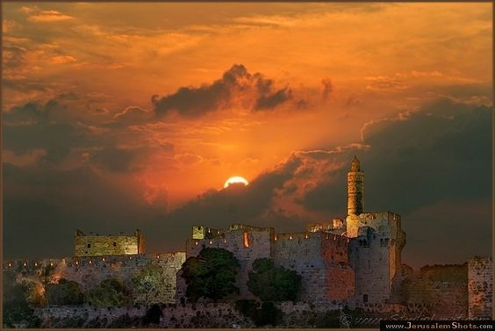
God’s Presence Restored to Jerusalem
“Behold, the LORD has proclaimed to the end of the earth, say to the daughter of Zion, ‘Lo, your salvation comes; Behold His reward is with Him, and His recompense before Him. And they will call them, ‘The holy people, the redeemed of the LORD’; And you will be called, ‘Sought out, a city not forsaken.’” Isaiah 62:11-12

Slide 30
עַם־הַקֹּדֶשׁ גְּאוּלֵי יְהוָה
Geuley ‘Adonai
‘Am-Haqodesh
“the Redeemed
of the LORD”
“the Holy People”
Now that the Savior has returned and restored Israel and made Jerusalem His residence, the Gentile nations recognize Israel’s status as redeemed and in their position as a kingdom of priests, a holy people.

Slide 31
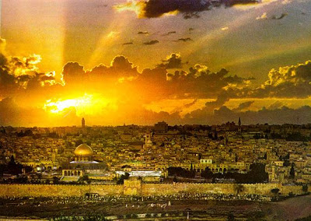
דְרוּשָׁה עִיר לֹא נֶעֱזָבָה
Ne’^{e}zabah
‘lo’
‘ir
Derusha
“Not Forsaken”
“City”
“Sought”
These names indicate that the Lord Jesus has made this His own city , the capital of His Millennial Kingdom.

Slide 32
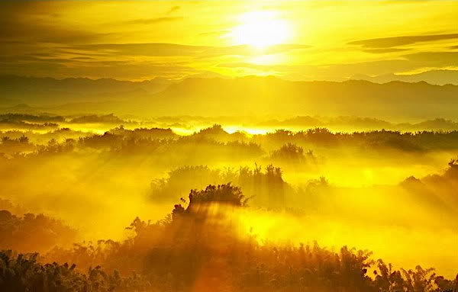
Lessons from Isaiah 62
God will keep His promise. If He can redeem and restore Jerusalem, He can redeem and restore anyone.
Prayer changes things. We should become intercessors for Jerusalem, which will result in God’s blessings for the world.
God will protect His people from their enemies. Have YOU asked Him for protection
today from temptation and wrong responses to the trails of life (cf. James 1:3-5).
God has said He will one day give YOU a new name (Revelation 3:12). Are you living up to the name He has already given you – Christian?
5. There promised great rejoicing over God’s marriage to the Land of Israel. Do you look
forward to the promised joyful wedding supper of the Lamb when your union with
Christ is complete?

Slide 33
Black

Slide 34


OT Preaching link at BibleStudyDownloads.org
Get this presentation for free!
Notes:
OT Preaching (op)

