Slide 1
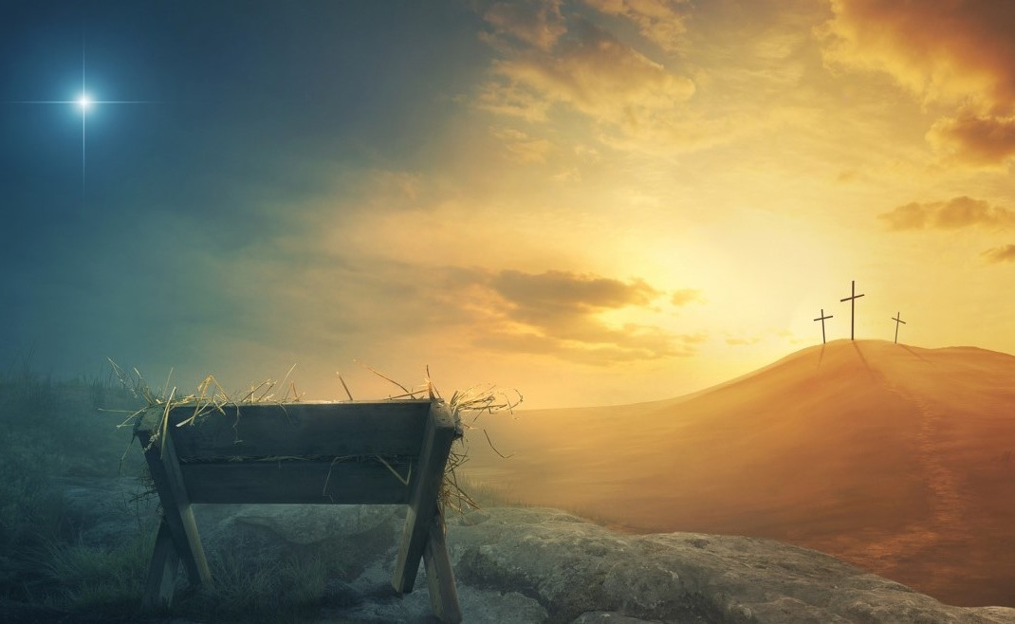
The Hope of the Coming Messiah
Isaiah 61
Preached by Dr. Jim Harmeling at Crossroads International Church Singapore • cicfamily.com Uploaded by Dr. Rick Griffith • Singapore Bible College Files in many languages for free download at BibleStudyDownloads.org

Slide 3
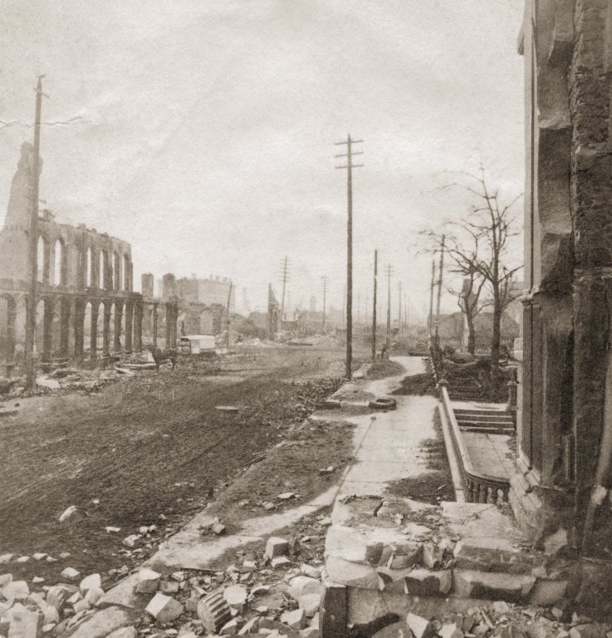

Slide 4
“Everything lost except wife, children, and hope. Business will be resumed as usual tomorrow morning.”

Slide 6
The Hope of the Coming Messiah
Isaiah 61

Slide 7
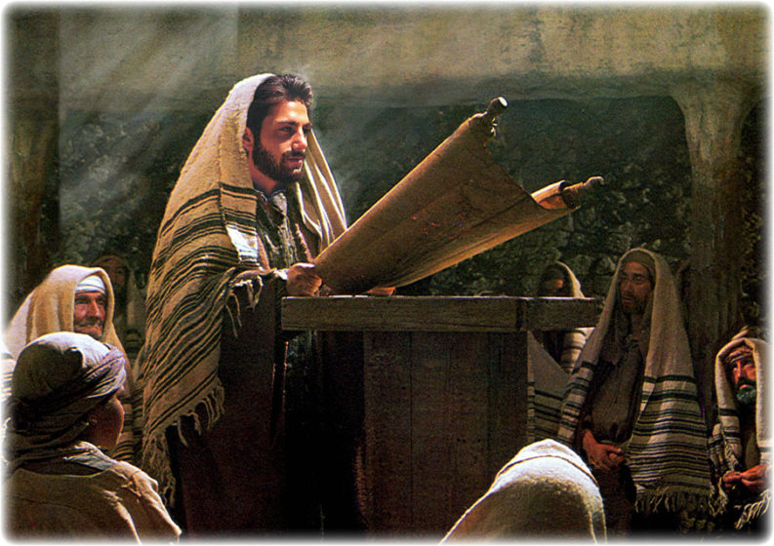
Luke 4:16-22

Slide 8
Jesus restores us to God (vs. 1-3)

Slide 9
Leviticus 25
¹⁰ And you shall consecrate the fiftieth year, and proclaim liberty throughout the land to all its inhabitants. It shall be a jubilee for you, when each of you shall return to his property and each of you shall return to his clan.
²⁵ If your brother becomes poor and sells part of his property, then his nearest redeemer shall come and redeem what his brother has sold.
³⁵ If your brother becomes poor and cannot maintain himself with you, you shall support him as though he were a stranger and a sojourner, and he shall live with you.

Slide 10
John 3:16-19
¹⁶ For God so loved the world, that he gave his only Son, that whoever believes in him should not perish but have eternal life. ¹⁷ For God did not send his Son into the world to condemn the world, but in order that the world might be saved through him. ¹⁸ Whoever believes in him is not condemned, but whoever does not believe is condemned already, because he has not believed in the name of the only Son of God. ¹⁹ And this is the judgment: the light has come into the world, and people loved the darkness rather than the light because their works were evil.

Slide 11
John 5:22-29
²² For the Father judges no one, but has given all judgment to the Son,
²⁷ And he has given him authority to execute judgment, because he is the Son of Man. ²⁸ Do not marvel at this, for an hour is coming when all who are in the tombs will hear his voice ²⁹ and come out, those who have done good to the resurrection of life, and those who have done evil to the resurrection of judgment.

Slide 12
Psalm 45:7-9
⁷ you have loved righteousness and hated wickedness. Therefore God, your God, has anointed you with the oil of gladness beyond your companions; ⁸ your robes are all fragrant with myrrh and aloes and cassia. From ivory palaces stringed instruments make you glad; ⁹ daughters of kings are among your ladies of honor; at your right hand stands the queen in gold of Ophir.

Slide 13
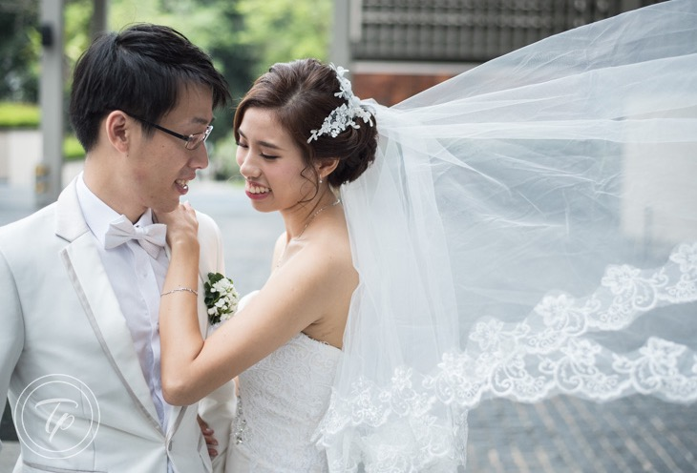
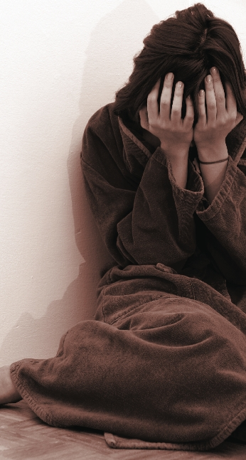

Slide 14
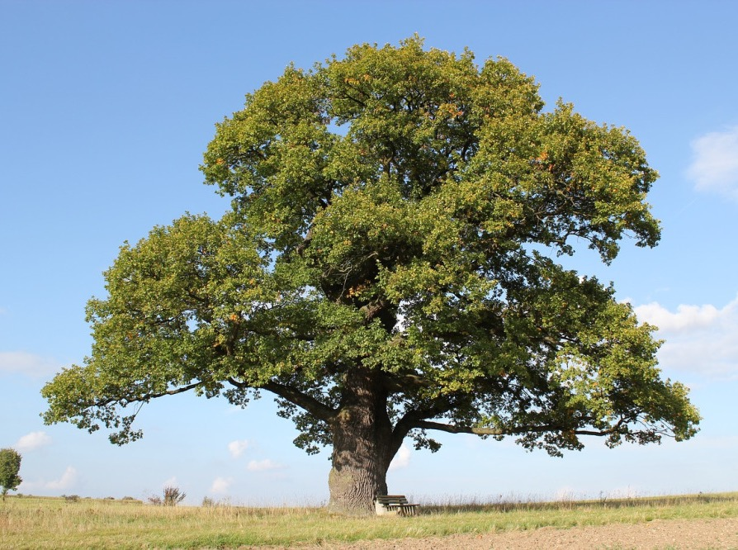
Oaks of Righteousness

Slide 15
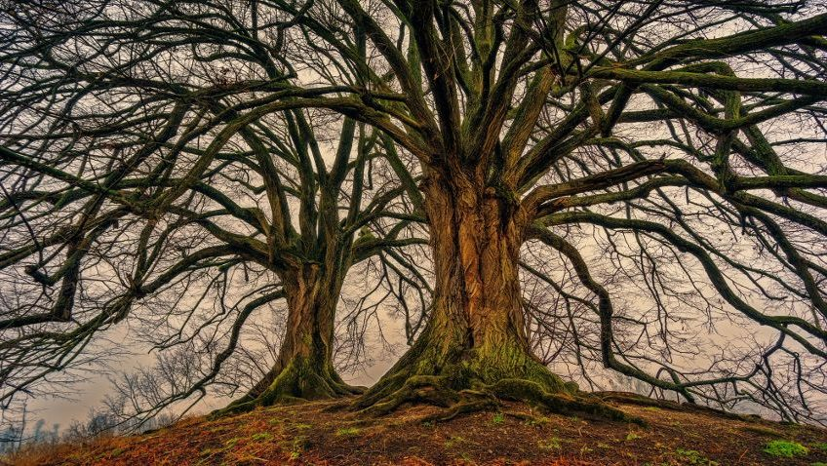
Isaiah 1:30
“For you shall be like an oak whose leaf withers”

Slide 16
Servant
Isaiah 61:1-3
Jesus
Matthew 5:3-6
to bring good news to the poor . . . faint spirit to comfort all who mourn;
they may be called oaks of righteousness
³ “Blessed are the poor in spirit, for theirs is the kingdom of heaven.
⁴ “Blessed are those who mourn, for they shall be comforted.
⁶ “Blessed are those who hunger and thirst for righteousness, for they shall be satisfied.

Slide 17
Jesus restores us to God (vs. 1-3)
Jesus fulfills God’s promise to Israel (vs. 4-9)

Slide 18
Exodus 19:5-6
⁵ Now therefore, if you will indeed obey my voice and keep my covenant, you shall be my treasured possession among all peoples, for all the earth is mine; ⁶ and you shall be to me a kingdom of priests and a holy nation.’ These are the words that you shall speak to the people of Israel.

Slide 19
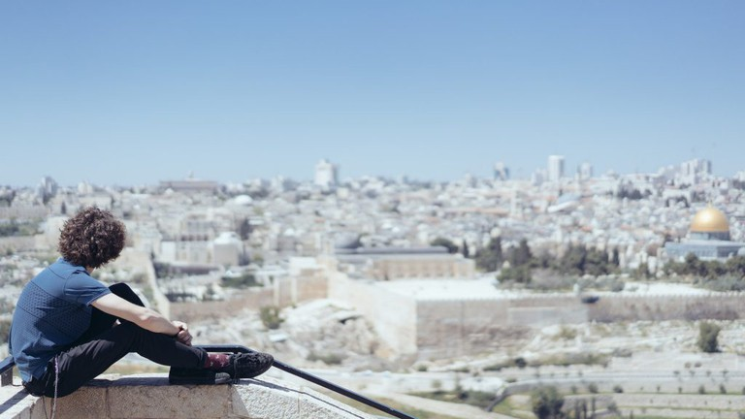
Initial Fulfillment = return to the land (Nehemiah, Ezra)
Ultimate Fulfillment = Jesus’ kingdom
Romans 3:1-3
¹ Then what advantage has the Jew? Or what is the value of circumcision? ² Much in every way. To begin with, the Jews were entrusted with the oracles of God. ³ What if some were unfaithful? Does their faithlessness nullify the faithfulness of God? ⁴ By no means! Let God be true though every one were a liar

Slide 20
Ezekiel 37
Luke 1:31-33
³¹ And behold, you will conceive in your womb and bear a son, and you shall call his name Jesus. ³² He will be great and will be called the Son of the Most High. And the Lord God will give to him the throne of his father David, ³³ and he will reign over the house of Jacob forever, and of his kingdom there will be no end.

Slide 21
Jesus restores us to God (vs. 1-3)
Jesus fulfills God’s promise to Israel (vs. 4-9)
Jesus brings praise to God (vs. 10-11)

Slide 22
Black

Slide 23
OT Preaching link at BibleStudyDownloads.org
Get this presentation for free!
Notes:
OT Preaching (op)

