Slide 1
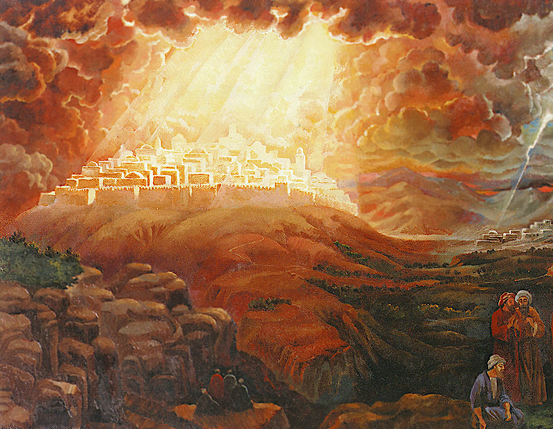
Jerusalem in the Kingdom
Isaiah 60
Dr Randall Price World of the Bible Ministries • www.worldofthebible.com Uploaded by Dr. Rick Griffith • Jordan Evangelical Theological Seminary Files in many languages for free download at BibleStudyDownloads.org

Slide 2
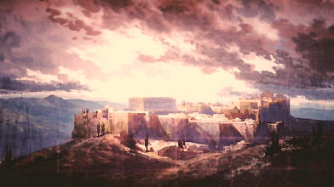
Outline of Isaiah 60:1-22
I. The Glory of Jerusalem in the Millennial Kingdom vss. 1-9
A. Restoration of God’s Glory to Jerusalem vss. 1-2
B. Response of the Nations to Jerusalem vss. 3-9
II. The Gifts to Jerusalem in the Millennial Kingdom vss. 10-22
A. The Gift of Recognition vss. 10-14
B. The Gift of Reversal vss. 15-20
C. The Gift of Righteousness vss. 21-22

Slide 3
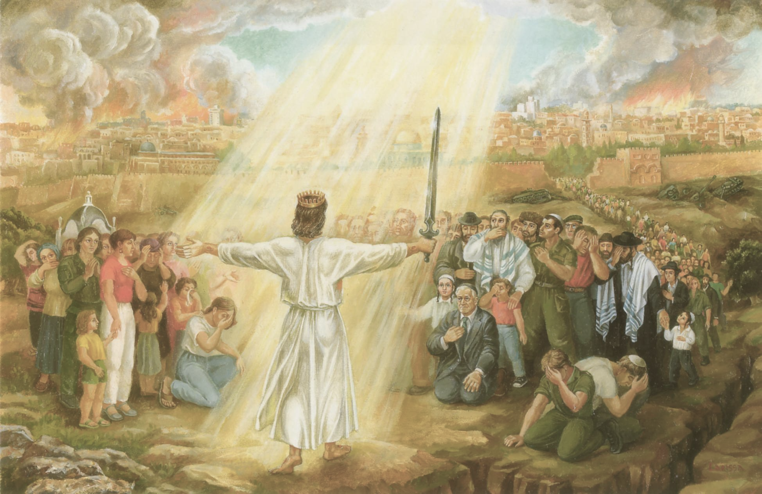
“So they will fear the name of the LORD from the west and His glory from the rising of the sun, for He will come like a rushing stream, which the wind of the LORD drives. And a Redeemer will come to Zion, and to those who turn from transgression in Jacob, declares the LORD.” Isaiah 59:19–20

Slide 4
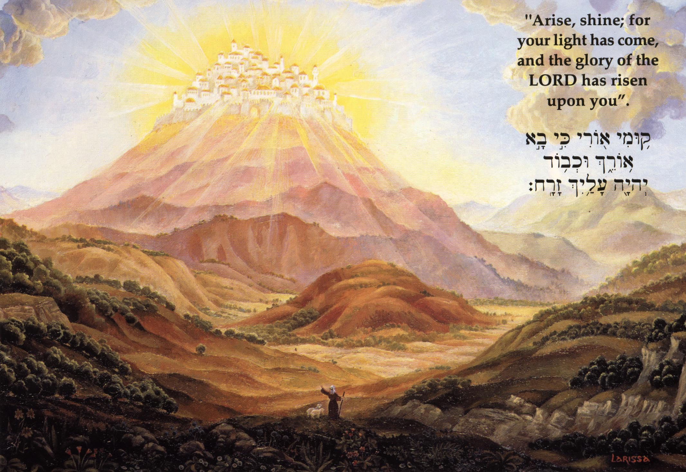
“Arise, shine; for your light has come, and the glory of the LORD has risen upon you. For behold, darkness will cover the earth, and deep darkness the peoples; But the LORD will rise upon you, and His glory will appear upon you.” Isaiah 60:1–2
“All the land will be changed into a plain from Geba to Rimmon south of Jerusalem; but Jerusalem will rise and remain on its site … And people will live in it, and there will be no more curse, for Jerusalem will dwell in security.” Zechariah 14:10-11

Slide 5
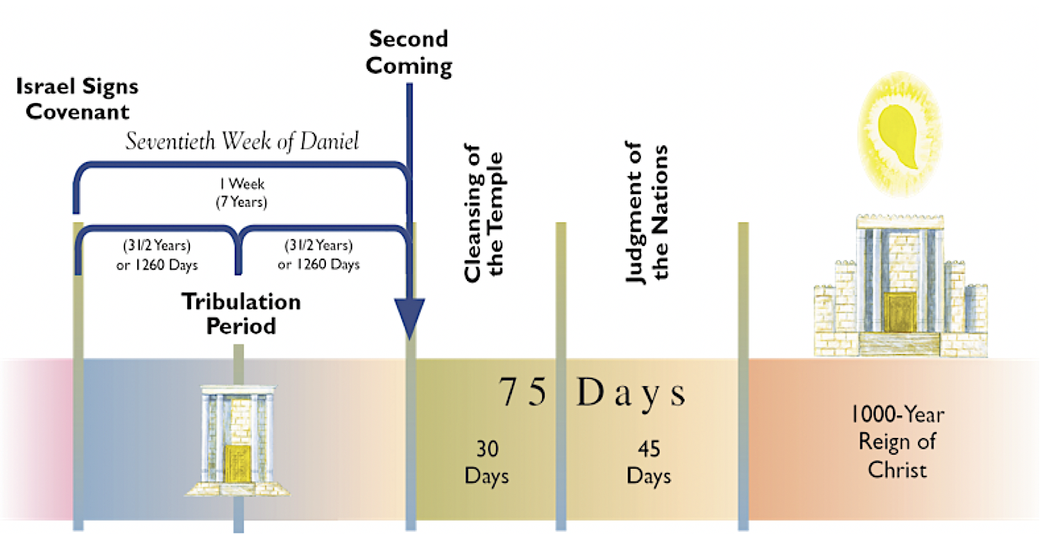
Beginning
of the
Millennial
Kingdom
“I, the LORD, will hasten it in its time.” Isaiah 60:22b

Slide 6
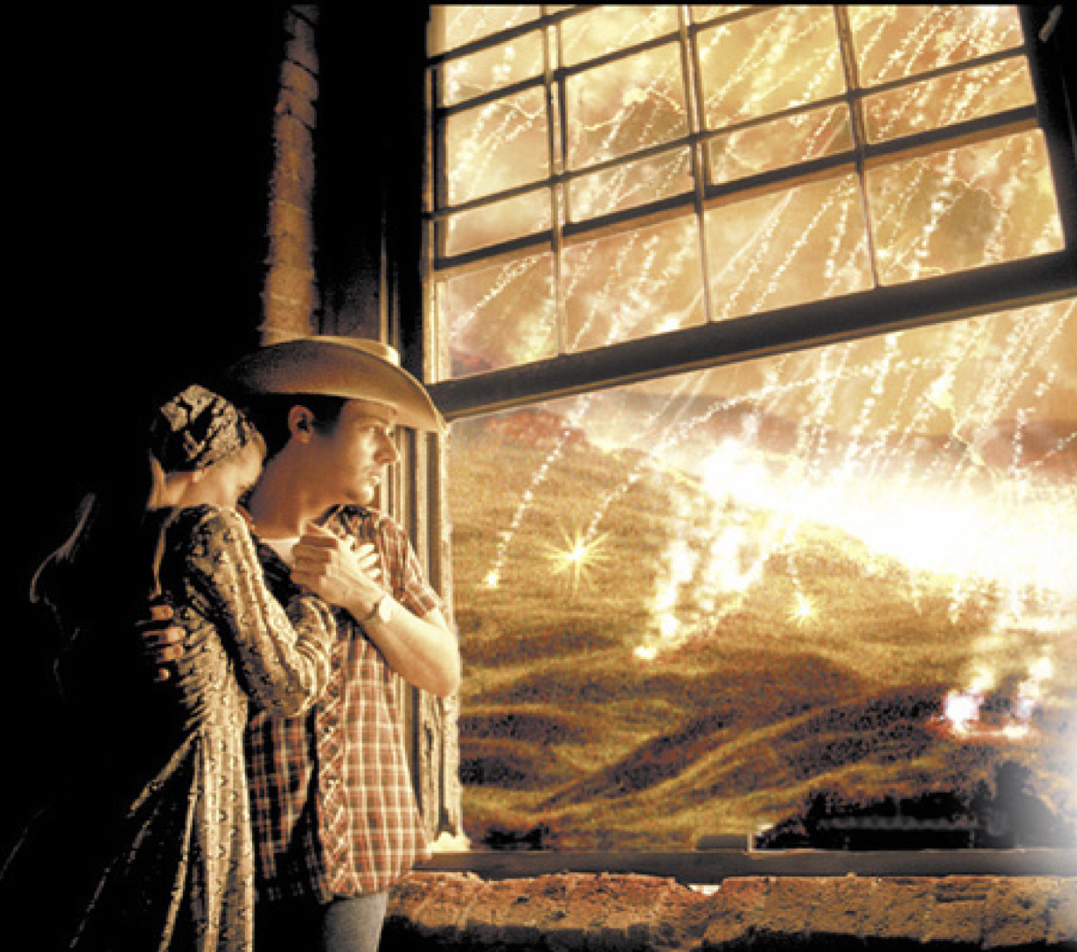
For then there will be a great Tribulation,
such as has not occurred since the beginning
of the world until now, nor ever shall. Mt. 24:21
“But immediately after the tribulation of those days the sun will be darkened, and the moon will not give its light, and the stars will fall from the sky, and the powers of the heavens will be shaken, and then the sign of
the Son of Man
will appear in
the sky, and
then all the
tribes
of the earth
will mourn …”
Matthew 24:29–30

Slide 7
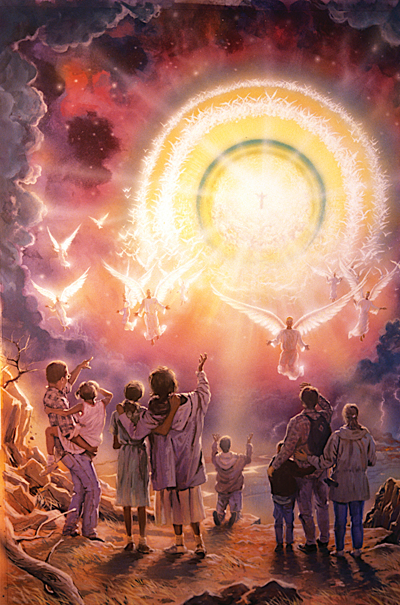
“ … they will see the Son of Man coming on the clouds of the sky with power and great glory …” Matthew 24:30-31

Slide 8
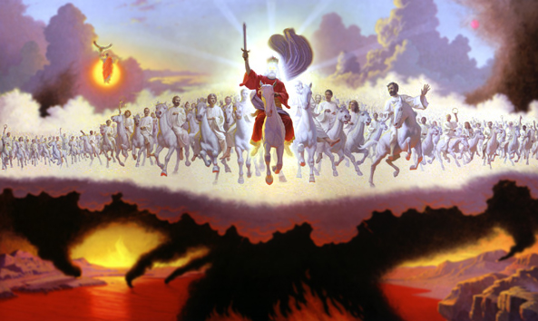
And I saw heaven opened; and behold, a white horse, and He who sat upon it is called Faithful and True; and in righteous-ness He judges and wages war … And the armies which are in heaven, clothed in fine linen, white and clean, were follow-ing Him on white horses. And from His mouth comes a sharp sword, so that with it He may smite the nations; and He will rule them with a rod of iron; and He treads the wine press of the fierce wrath of God, the Almighty. Revelation 19:11-15

Slide 9
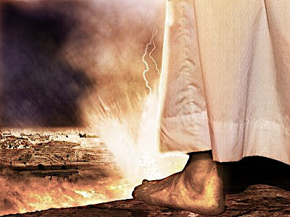
“His feet shall stand
on that day
upon the Mt. of Olives,
which is
before Jerusalem
on the east …”
Zechariah 14:3

Slide 10
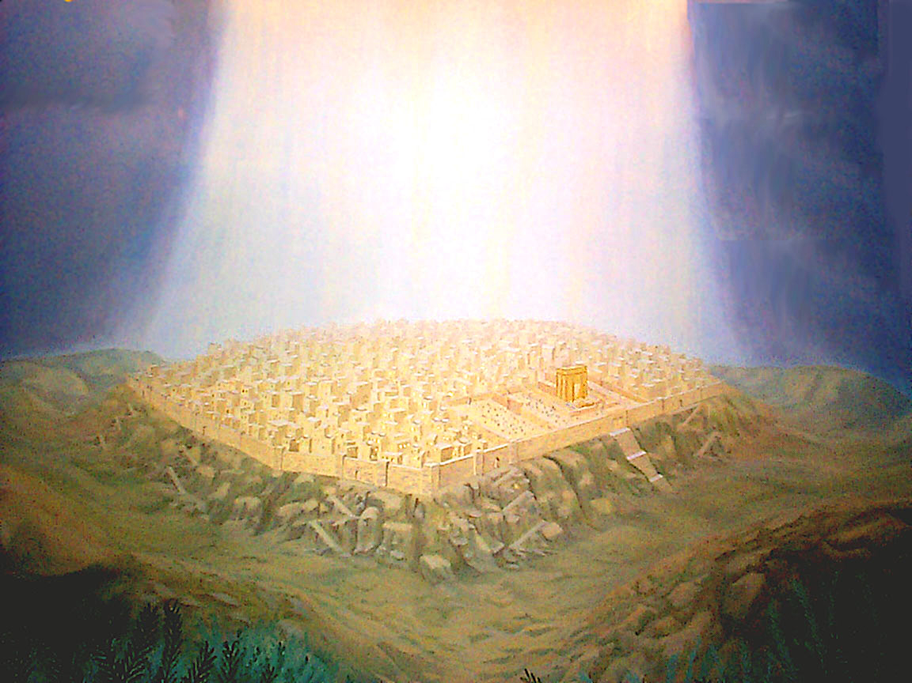
“But the LORD will rise upon you, and His glory
will appear upon you.”
Isaiah 60:2
“… I will set up one of your descendants after you, who shall be of your sons; and I will establish his kingdom. He shall build for Me a house, and I will establish his throne forever. I will be his father, and he shall be My son; and I will not take My lovingkindness away from him … But I will settle him in My house and in My kingdom forever, and his throne shall be established forever.” 1 Chronicles 17:11-14

Slide 11
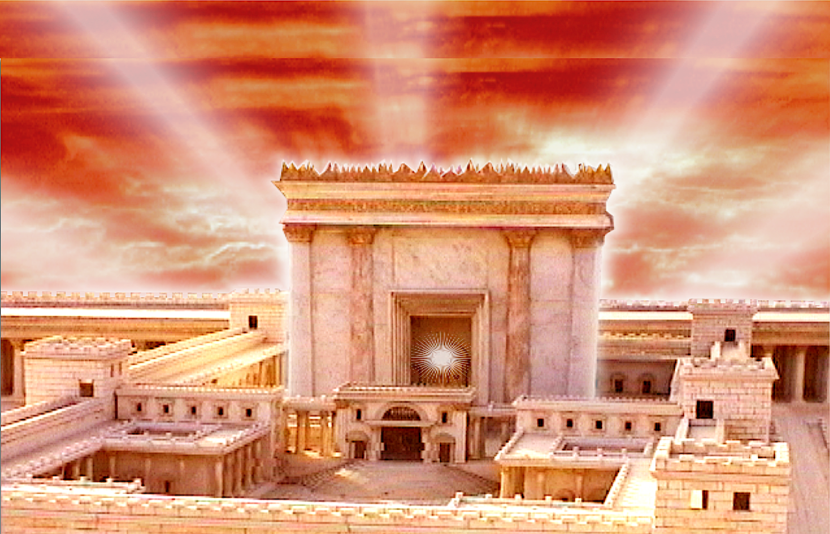
“Then he led me to the gate, the gate facing toward the east; and behold, the glory of the God of Israel was coming from the way of the east. And His voice was like the sound of many waters; and the earth shone with His glory … And the glory of the LORD came into the house by the way of the gate facing toward the east. And the Spirit lifted me up and brought me into the inner court; and behold, the glory of the LORD filled the house. Then I heard one speaking to me from the house…
And He said to me, “this is the place of
My throne and the place of the soles of
My feet, where I will dwell among the
sons of Israel forever.” Ezekiel 43:1–7

Slide 12
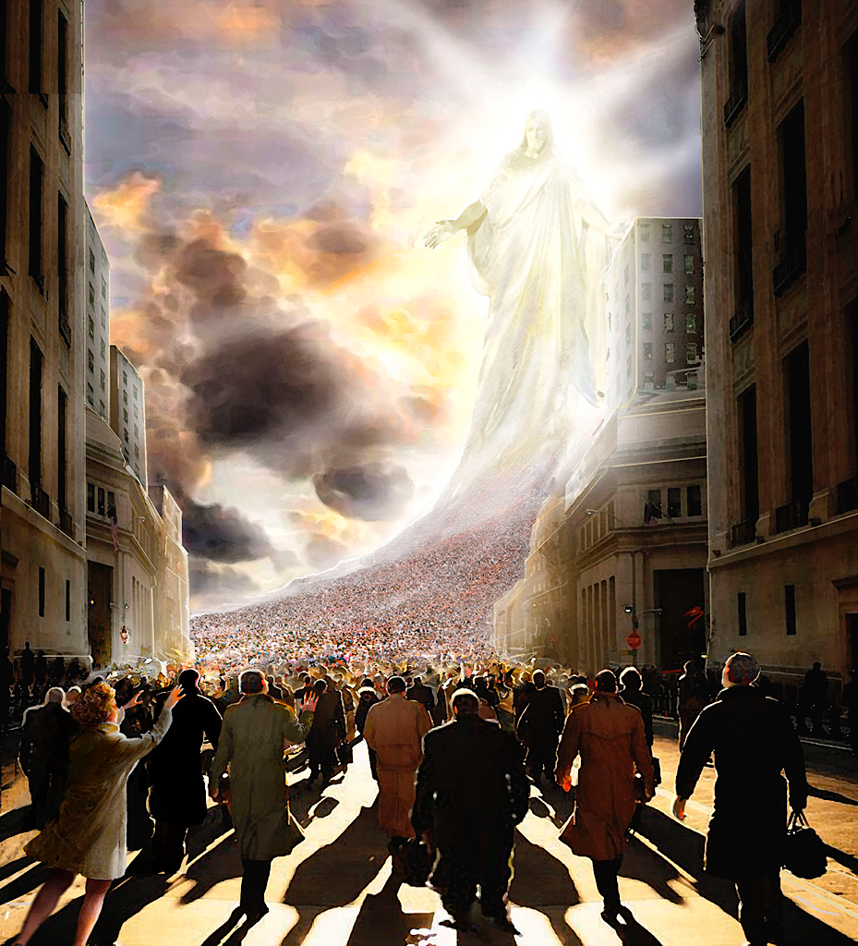
But when the Son of Man comes in His glory, and all the angels with Him, then He will sit on His glorious throne. And all the nations will be gathered before Him …
Matt. 25:30-31

Slide 13
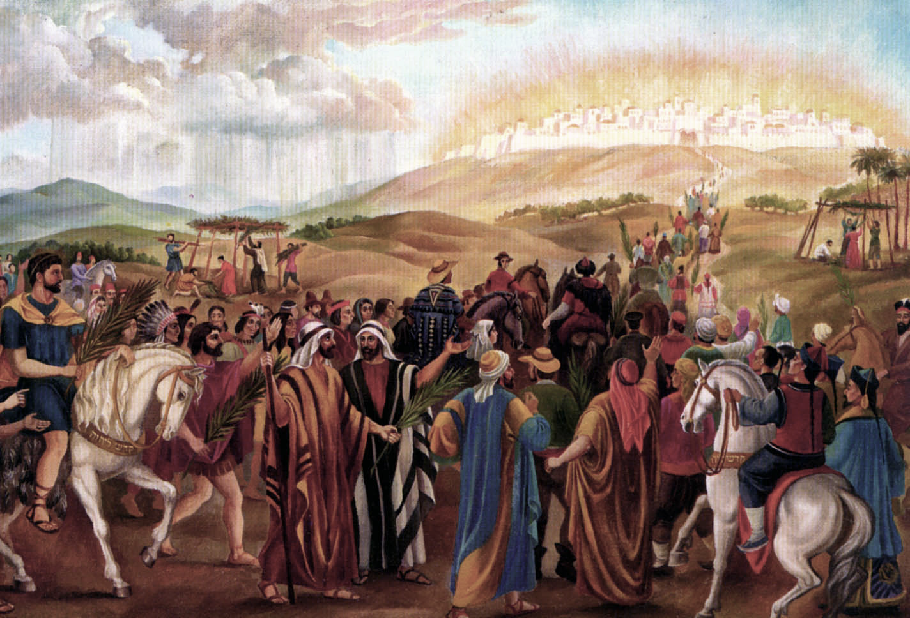
“And nations will come to your light, and kings to the brightness of your rising. Lift up your eyes round about you and see; They all gather together, they come to you. Your sons will come from afar, and your daughters will be carried in arms.” Isaiah 60:3-4

Slide 14
“Then you will see and be radiant, and your heart will thrill and rejoice; Because the abundance of the sea will be turned to you, the wealth of the nations will come to you.” Isaiah 60:5

Slide 15
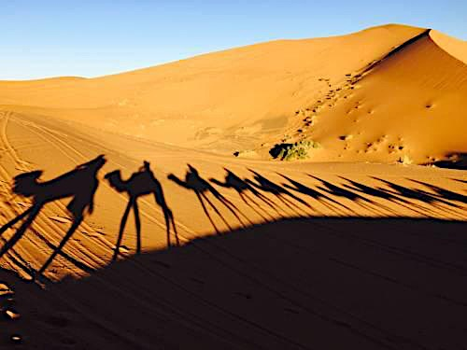
“A multitude of camels will cover you, The young camels of Midian and Ephah; All those from Sheba will come; They will bring gold and frankincense, And will bear good news of the praises of the LORD.” Isaiah 60:6

Slide 16
“All the flocks of Kedar will be gathered together to you, the rams of Nebaioth will minister to you…” Isaiah 60:7a

Slide 17
“They will go up with acceptance on My altar, and I shall glorify My glorious house.” Isaiah 60:7b

Slide 18

“Thus says the LORD, ‘I will return to Zion and dwell in the midst of Jerusalem. Then Jerusalem will be called the City of Truth, and the mountain of the LORD of hosts will be called the Holy Mountain.” Zechariah 8:3

Slide 19
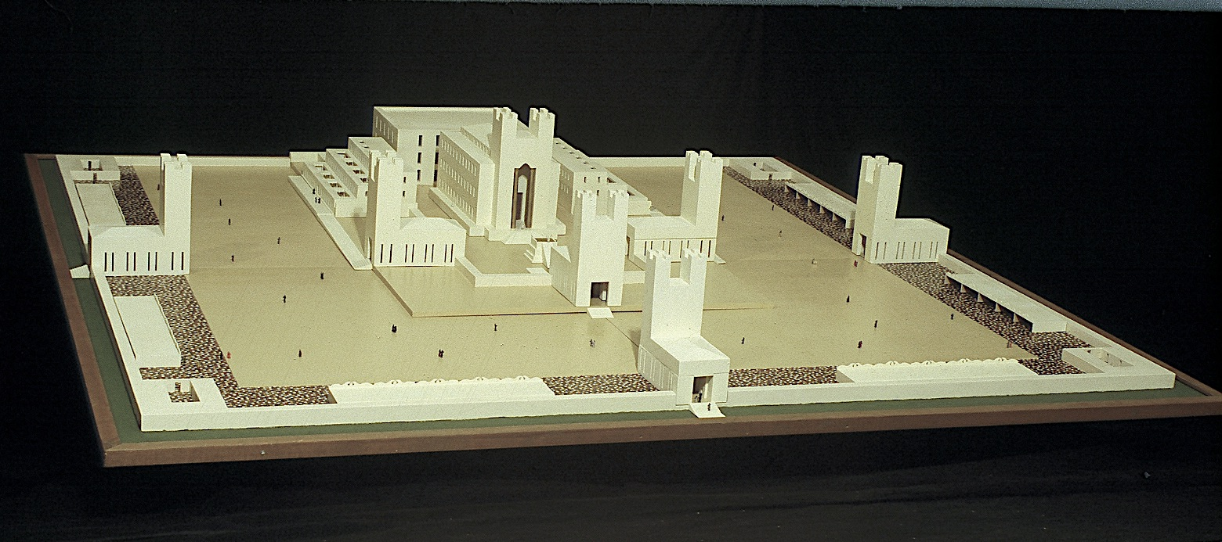

Slide 20
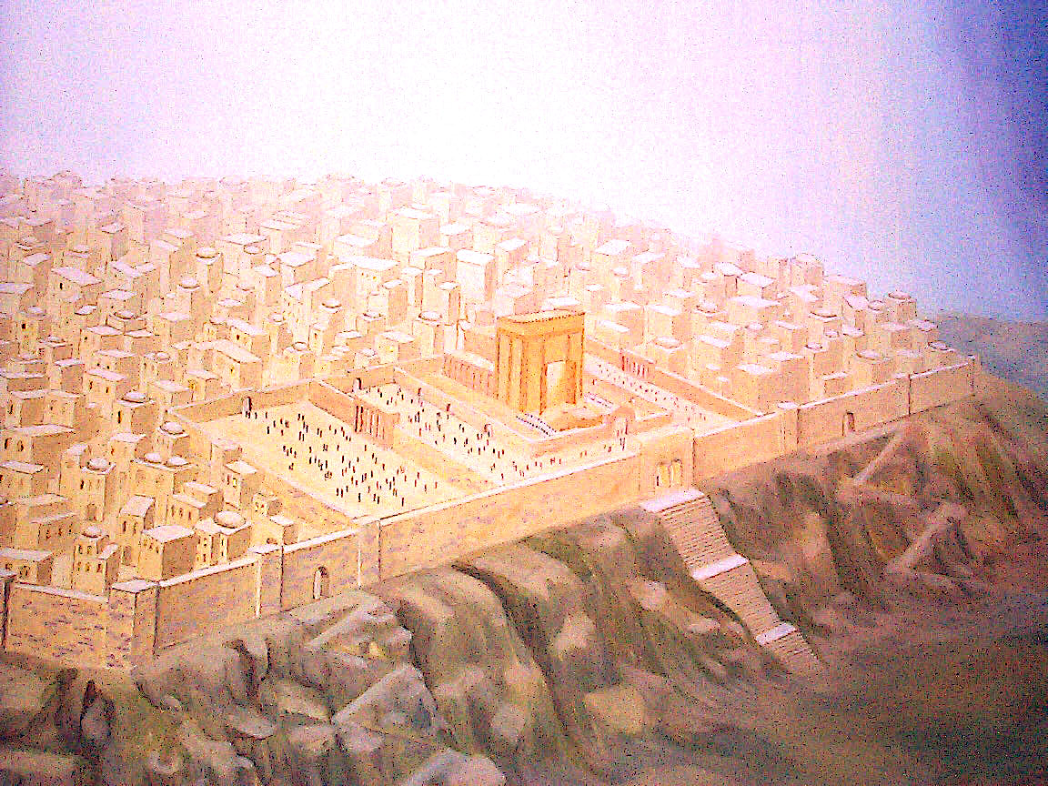
“And I will make a covenant of peace with them; it will be an everlasting covenant with them. And I will place them and multiply them, and will set My Sanctuary in their midst forever. My dwelling place also will be with them; and I will be My people. And the nations will know that I am the Lord who sanctifies Israel, when My Sanctuary is in their midst forever.” Ezekiel 37:27-28

Slide 21
“Who are these who fly like a cloud, and like the doves to their lattices? Surely the coastlands will wait for Me; And the ships of Tarshish will come first, to bring your sons from afar, their silver and their gold with them….” Isaiah 60:8

Slide 22
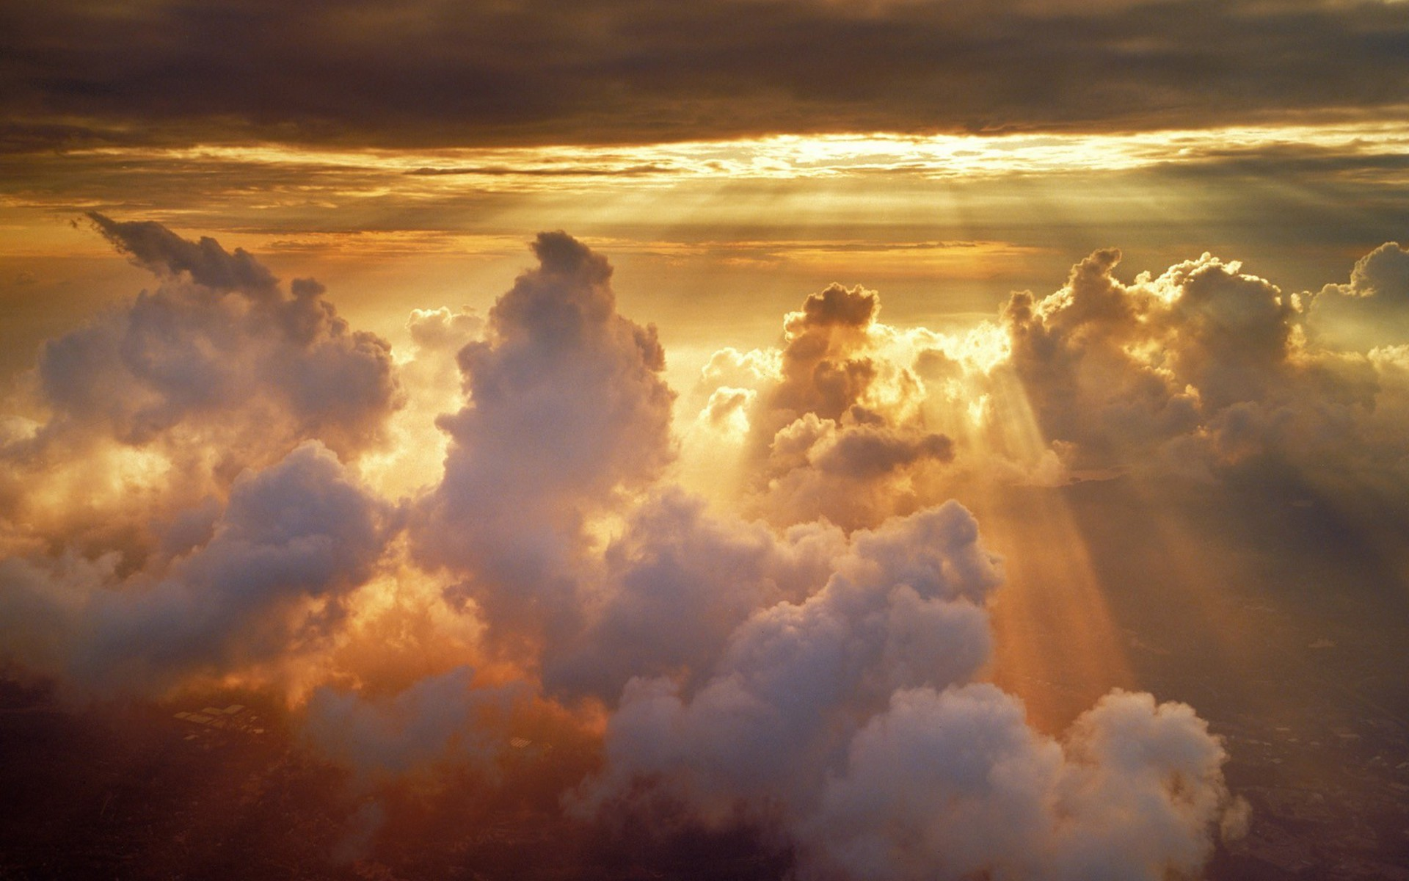
קְדוֹשׁ יִשְׂרָאֵל
“for the name of the LORD your God,
and for the Holy One of Israel
because He has glorified you.”
Isaiah 60:9
“And they will call you the city of the LORD,
the Zion of the Holy One of Israel.”
Isaiah 60:14
“And we have believed and have come to know that You (Jesus) are the Holy One of God.”
John 6:69

Slide 23
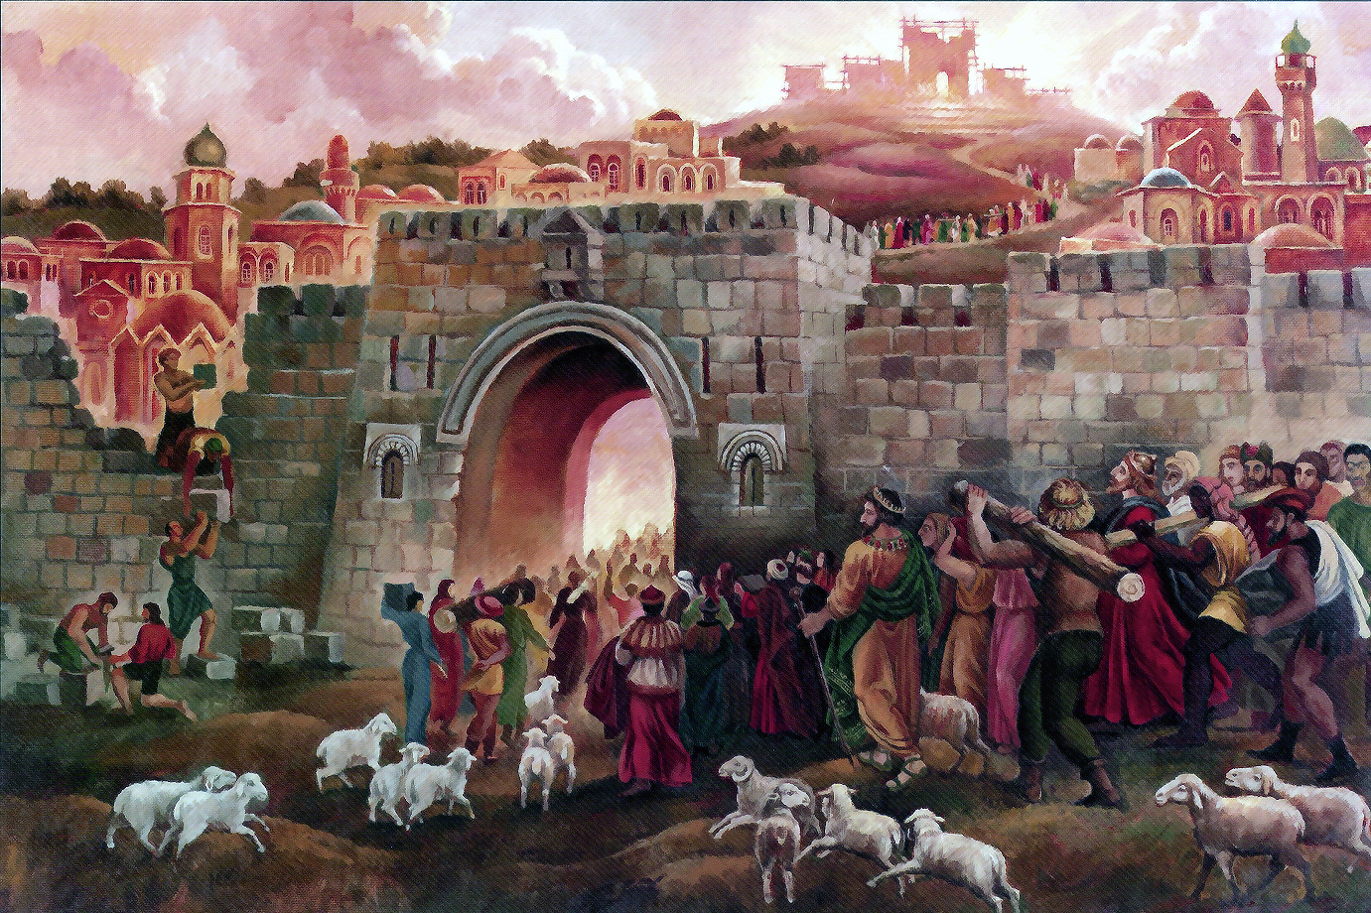
“And foreigners will build up your walls, And their kings will minister to you; For in My wrath I struck you, and in My favor I have had compassion on you. And your gates will be open continually; They will not be closed day or night, so that men may bring to you the wealth of the nations, with their kings led in procession. For the nation and the kingdom which will not serve you will perish, and the nations will be utterly ruined.” Isaiah 60:10–12

Slide 24
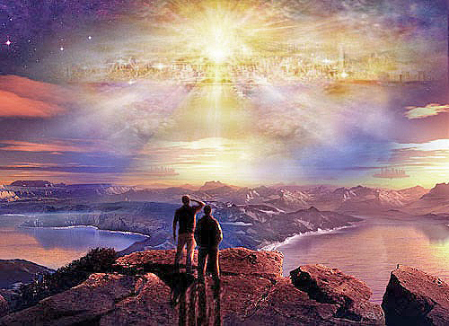
“And the nations shall walk by its light, and the kings of the earth shall bring their glory into it. And in the daytime (for there shall be no night there) its gates shall never be closed; and they shall bring the glory and the honor of the nations into it …” Revelation 21:24–26

Slide 25
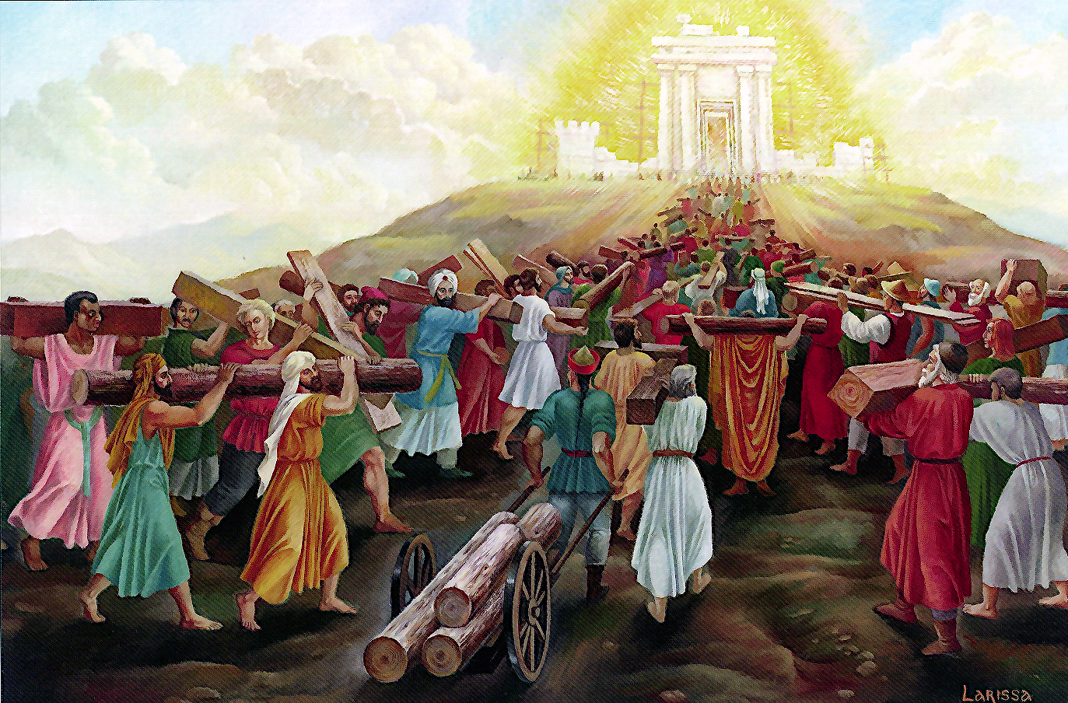
“For the nation and the kingdom which will not serve you will perish… The glory of Lebanon will come to you, the juniper, the box tree, and the cypress together, to beautify the place of My Sanctuary; and I shall make the place of My feet glorious.” Isaiah 60:13

Slide 26
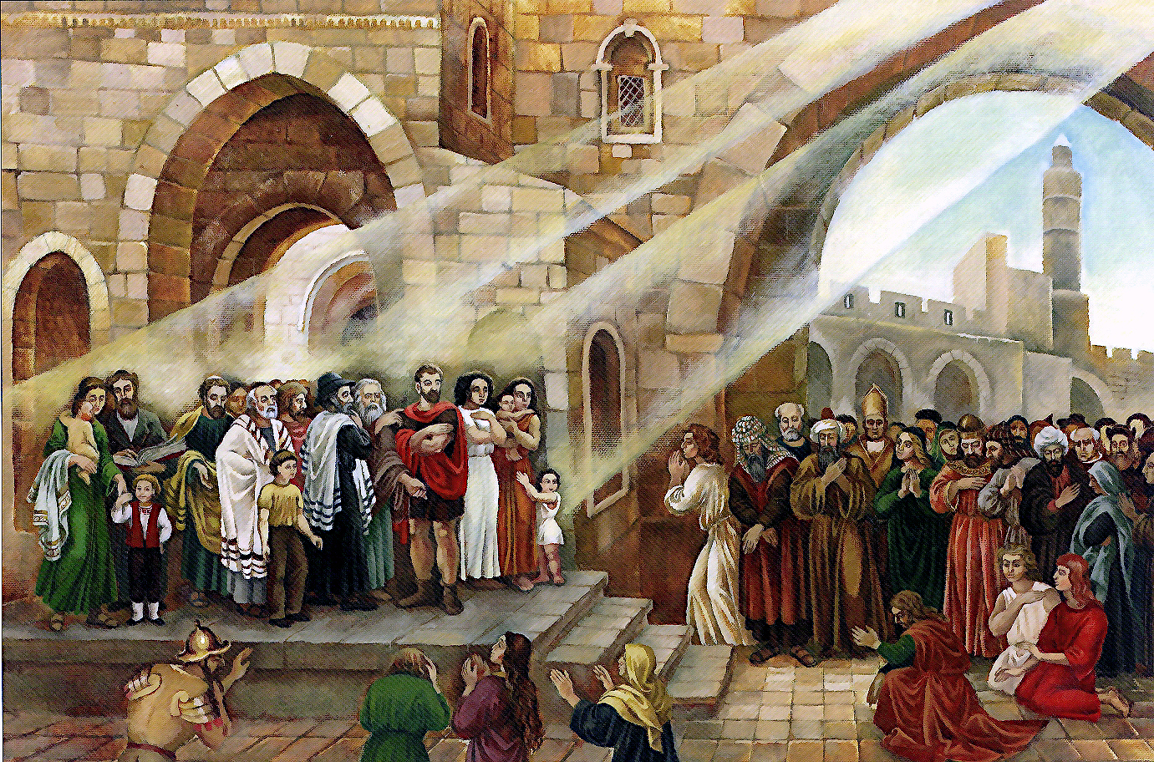
“The sons of those who afflicted you will come bowing to you, and those who despised you will bow themselves at the soles of your feet; and they will call you the city of the LORD, the Zion of the Holy One of Israel.” Isaiah 60:14

Slide 27

The Gift of Reversal vss. 15-20
“Whereas you have been forsaken and hated with no one passing through, I will make you an everlasting pride, A joy from generation to generation. “You will also suck the milk of nations, and will suck the breast of kings; Then you will know that I, the LORD, am your Savior, and your Redeemer, the Mighty One of Jacob. Instead of bronze, I will bring gold, and instead of iron, silver, and instead of wood, bronze, and instead of stones, iron. And I will make peace your administrators, and righteousness your overseers. Violence will not be heard again in your land, nor devastation or destruction within your borders; But you will call your walls salvation, and your gates praise. No longer will you have the sun for light by day, nor for brightness will the moon give you light; But you will have the LORD for an everlasting light, and your God for your glory. Your sun will set no more, neither will your moon wane; For you will have the LORD for an everlasting light, And the days of your mourning will be finished.” Isaiah 60:15–20

Slide 28
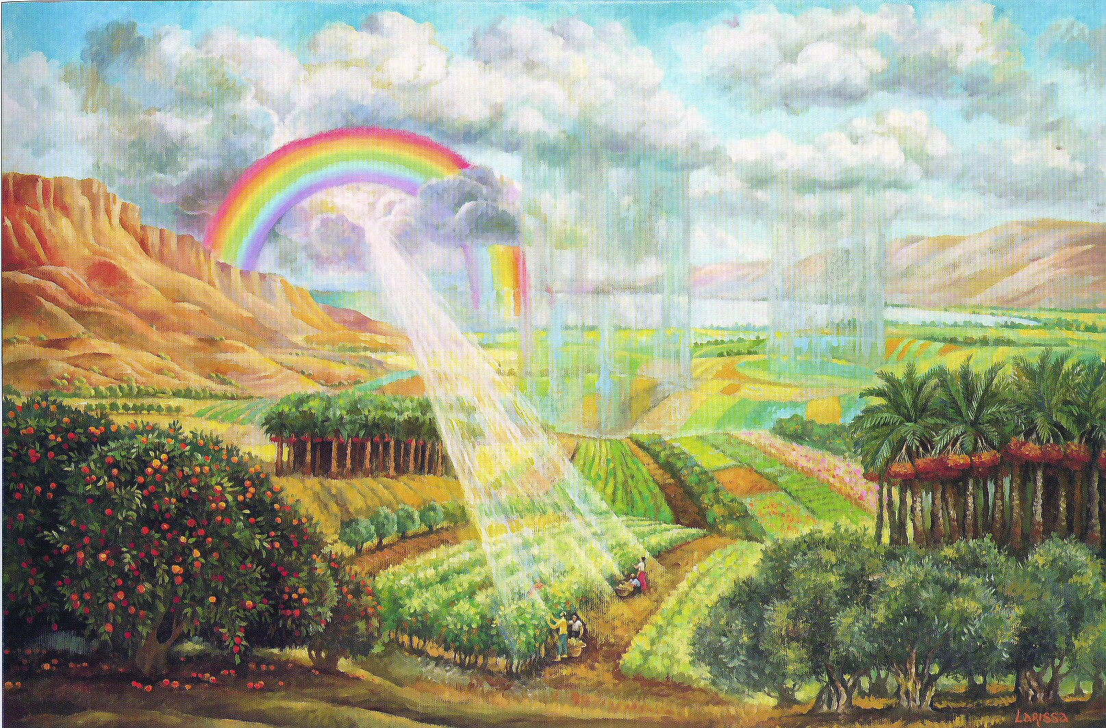
“In days to come Jacob will take root, Israel will blossom and sprout; and they will fill the whole world with fruit.” Isaiah 27:6
“For the seed shall be prosperous; the vine shall give her fruit, and the ground shall give her increase, and the heavens shall give their dew.” Zechariah 8:12

Slide 29
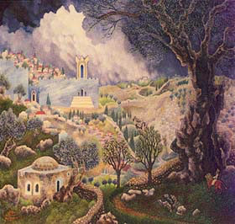
“And each of them will sit under his vine and under his fig tree, with no one to make them afraid, for the mouth of the LORD of hosts has spoken.” Micah 4:4

Slide 30
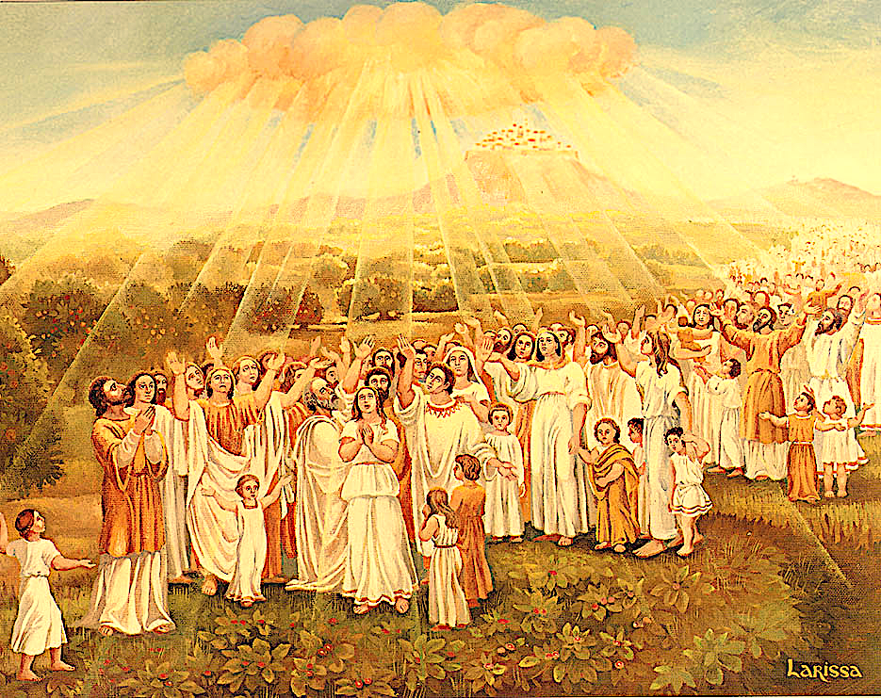
“Then all your people will be righteous; They will possess the land forever, the branch of My planting, the work of My hands, that I may be glorified.” Isaiah 60:21

Slide 31
Black

Slide 32


OT Preaching link at BibleStudyDownloads.org
Get this presentation for free!
Notes:
OT Preaching (op)

