Slide 1
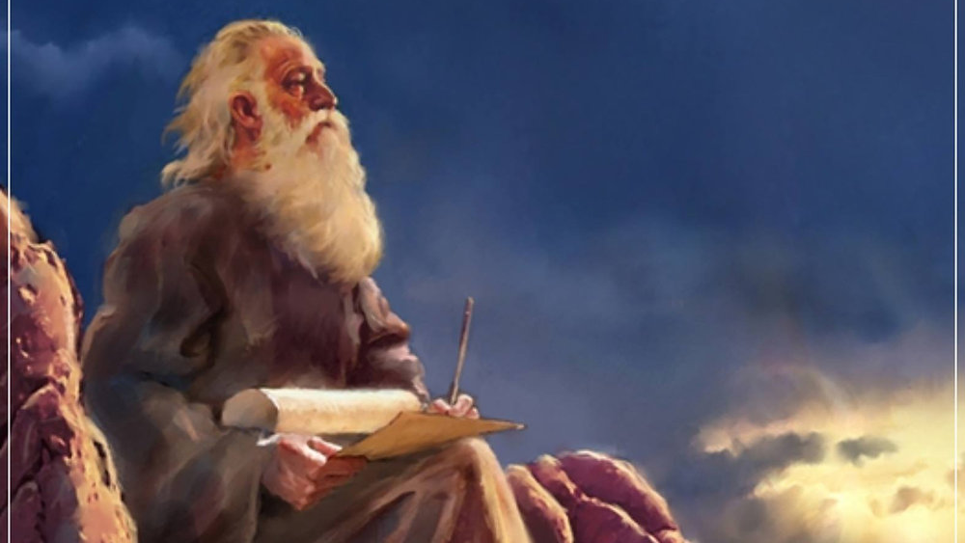
The Prophecy
Of
Isaiah
Isaiah 55
The Great Invitation!
Preached by Dan Bridges
Amman International Church, Jordan (AmmanChurch.org)
Uploaded by Dr. Rick Griffith • Jordan Evangelical Theological Seminary
Files in many languages for free download at BibleStudyDownloads.org

Slide 2
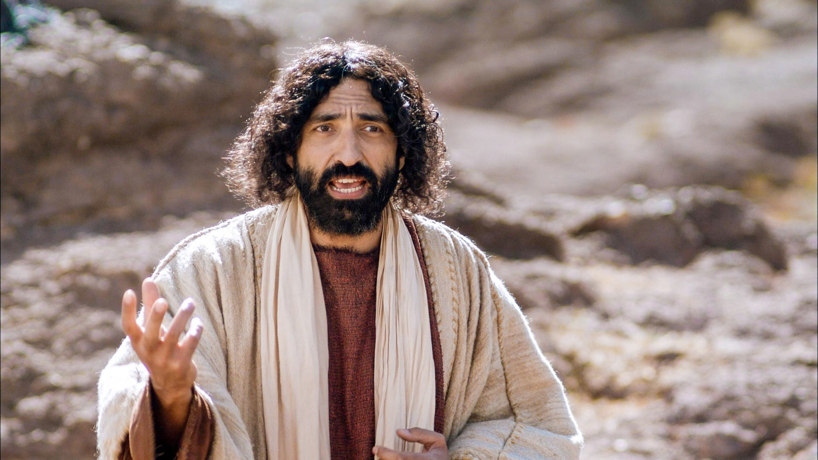
“On the last day of the feast, the great day, Jesus stood up and cried out, ‘If anyone thirsts, let him come to me and drink. Whoever believes in me, as the Scripture has said, “Out of his heart will flow rivers of living water.”’” John 7:37-38
What thirst was Jesus talking about?
If they had a thirst for God, they would have already come!

Slide 3
“On the last day of the feast, the great day, Jesus stood up and cried out, ‘If anyone thirsts, let him come to me and drink. Whoever believes in me, as the Scripture has said, “Out of his heart will flow rivers of living water.”’” John 7:37-38
A thirsty person is not satisfied with their life… Something is missing.

Slide 4
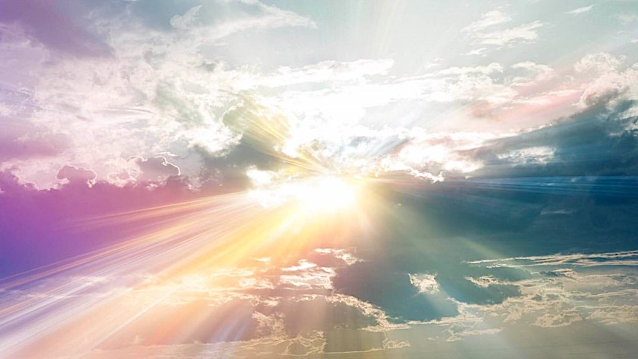
Isaiah 55 – The Great Invitation!
The Invitation (1-5)
Responding to the Invitation (6-13)

Slide 5
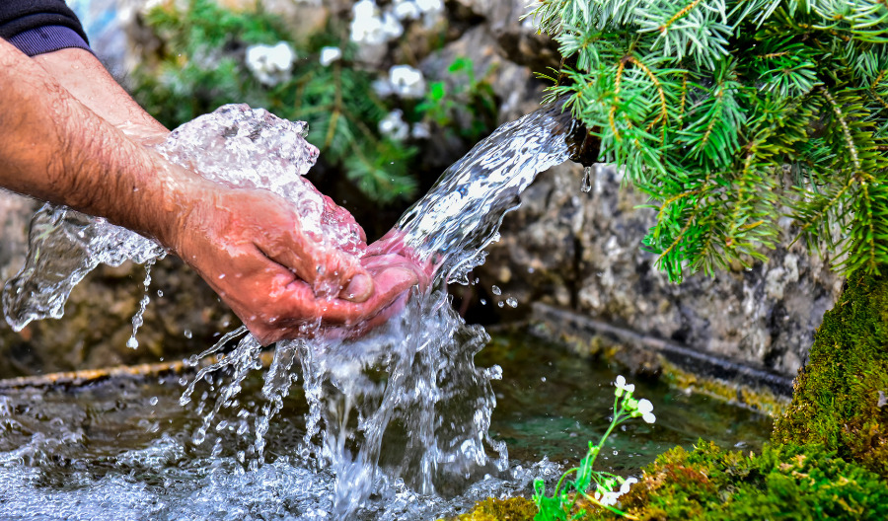
“Come, everyone who thirsts, come to the waters;
and he who has no money, come, buy and eat!
Come, buy wine and milk without money and without price.” Isaiah 55:1

Slide 6
Ho – A cry out to get attention
(Like a street vendor)
“Come, everyone who thirsts, come to the waters;
and he who has no money, come, buy and eat!
Come, buy wine and milk without money and without price.” Isaiah 55:1

Slide 7
The invitation is to those who know something is missing…
“Come, everyone who thirsts, come to the waters;
and he who has no money, come, buy and eat!
Come, buy wine and milk without money and without price.” Isaiah 55:1

Slide 8
“With joy you will draw water from the wells of salvation.” Isaiah 12:3
The first “come” emphasizes what we’re being invited to.
“Come, everyone who thirsts, come to the waters;
and he who has no money, come, buy and eat!
Come, buy wine and milk without money and without price.” Isaiah 55:1

Slide 9
The second “come” emphasizes the poverty of those who are invited.
“Come, everyone who thirsts, come to the waters;
and he who has no money, come, buy and eat!
Come, buy wine and milk without money and without price.” Isaiah 55:1

Slide 10

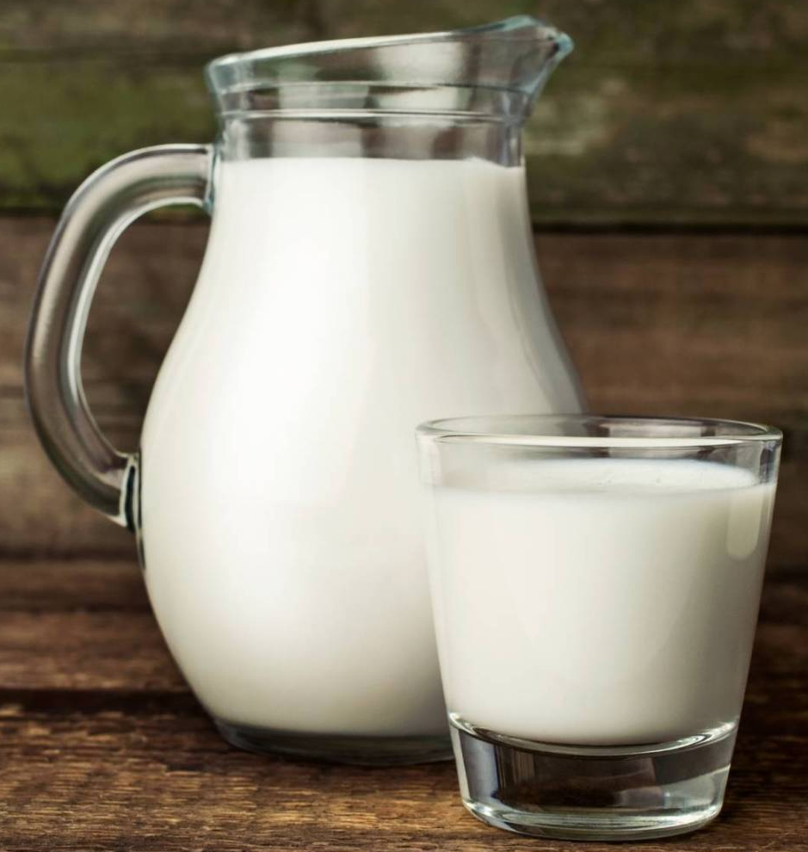
“Come, everyone who thirsts, come to the waters;
and he who has no money, come, buy and eat!
Come, buy wine and milk without money and without price.” Isaiah 55:1
The third “come” emphasizes the richness of what the invitation is for!

Slide 11
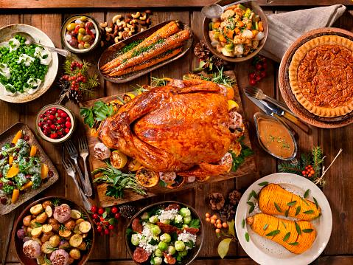
“Why do you spend your money for that which is not bread, and your labor for that which does not satisfy?
Listen diligently to me, and eat what is good, and delight yourselves in rich food.” Isaiah 55:2

Slide 12
The invitation is to what will truly satisfy us!
“Why do you spend your money for that which is not bread, and your labor for that which does not satisfy?
Listen diligently to me, and eat what is good, and delight yourselves in rich food.” Isaiah 55:2

Slide 13
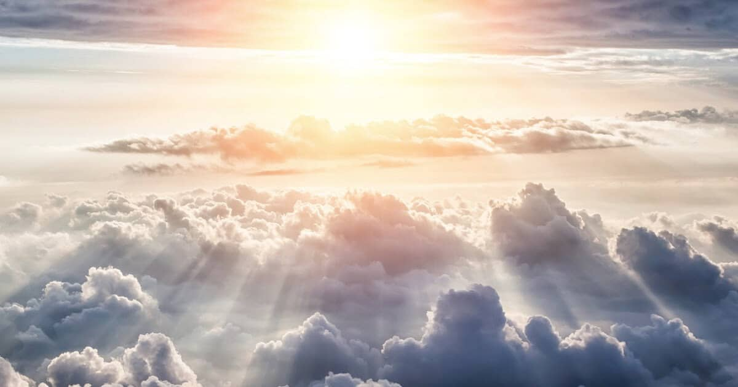
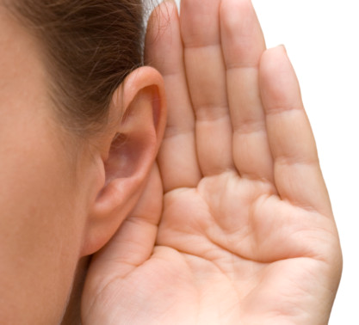
Come to the waters = Come to me!
“Incline your ear, and come to me;
hear, that your soul may live;
and I will make with you an everlasting covenant,
my steadfast, sure love for David.” Isaiah 55:3

Slide 14
Listen to what?
Ch. 53 – The work of the servant (peace with God, healing)
Ch. 54 – The heritage of the servant’s offspring
Ch. 55 – The invitation
“Incline your ear, and come to me;
hear, that your soul may live;
and I will make with you an everlasting covenant,
my steadfast, sure love for David.” Isaiah 55:3

Slide 15
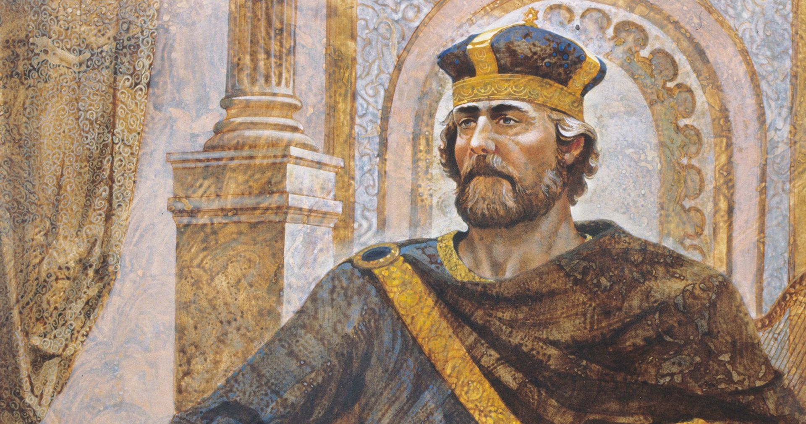
“Incline your ear, and come to me;
hear, that your soul may live;
and I will make with you an everlasting covenant,
my steadfast, sure love for David.” Isaiah 55:3

Slide 16
The Messiah!
“You have said, “I have made a covenant with
my chosen one;
I have sworn to David my servant:
‘I will establish your offspring forever,
and build your throne for all generations.’”
Psalm 89:3-4

Slide 17
“And I will make him the firstborn,
the highest of the kings of the earth.
My steadfast love I will keep for him forever,
and my covenant will stand firm for him.
I will establish his offspring forever
and his throne as the days of the heavens.”
Psalm 89:27-29
Messiah
Messiah’s offspring

Slide 18
Responding to the invitation makes us offspring of the Messiah!
“Incline your ear, and come to me;
hear, that your soul may live;
and I will make with you an everlasting covenant,
my steadfast, sure love for David.” Isaiah 55:3

Slide 19
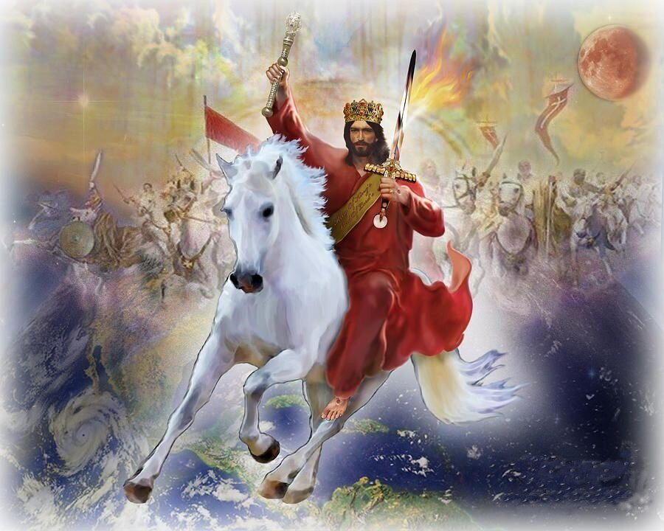
“Behold, I made him a witness to the peoples,
a leader and commander for the peoples.”
Isaiah 55:4

Slide 20
“And I will make him the firstborn,
the highest of the kings of the earth.
My steadfast love I will keep for him forever,
and my covenant will stand firm for him.
I will establish his offspring forever
and his throne as the days of the heavens.”
Psalm 89:27-29
Messiah
“Behold, I made him a witness to the peoples,
a leader and commander for the peoples.”
Isaiah 55:4

Slide 21
“…Jesus Christ the faithful witness, the firstborn of the dead, and the ruler of kings on earth.”
Revelation 1:5
“Ruler” in Revelation 1:5 is same Greek word used in Isaiah 55:4 in Septuagint
“Behold, I made him a witness to the peoples,
a leader and commander for the peoples.”
Isaiah 55:4

Slide 22
“Behold, I made [my Messiah] a witness to the peoples,
a leader and commander for the peoples.”
Isaiah 55:4

Slide 23
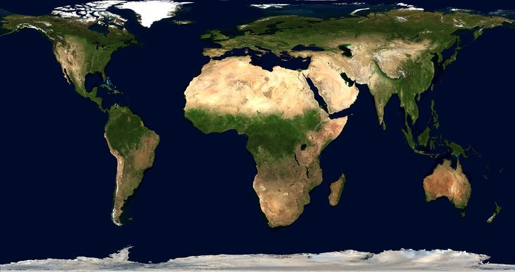
“Behold, you shall call a nation that you do not know,
and a nation that did not know you shall run to you,
because of the LORD your God, and of the Holy One of Israel,
for he has glorified you.” Isaiah 55:5

Slide 24
You is plural in verses 1-3, but here is singular…
Yahweh is speaking to the Servant… the Messiah
“Behold, you shall call a nation that you do not know,
and a nation that did not know you shall run to you,
because of the LORD your God, and of the Holy One of Israel,
for he has glorified you.” Isaiah 55:5

Slide 25
The invitation is universal – to all nations!
“Behold, you shall call a nation that you do not know,
and a nation that did not know you shall run to you,
because of the LORD your God, and of the Holy One of Israel,
for he has glorified you.” Isaiah 55:5

Slide 26
Jesus said:
“I am the light of the world.” John 8:12
“You are the light of the world.” Matthew 5:16
“Behold, you shall call a nation that you do not know,
and a nation that did not know you shall run to you,
because of the LORD your God, and of the Holy One of Israel,
for he has glorified you.” Isaiah 55:5

Slide 27
This verse is a promise to you and me as offspring of the Messiah!
“Behold, you shall call a nation that you do not know,
and a nation that did not know you shall run to you,
because of the LORD your God, and of the Holy One of Israel,
for he has glorified you.” Isaiah 55:5

Slide 28
Isaiah 55 – The Great Invitation!
The Invitation (1-5)
Responding to the Invitation (6-13)

Slide 29
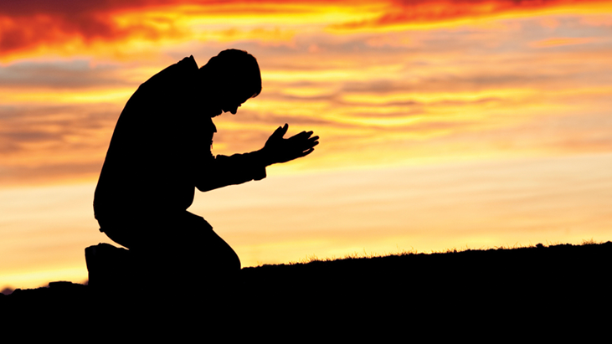
“Seek the LORD while he may be found;
call upon him while he is near;
let the wicked forsake his way,
and the unrighteous man his thoughts;
let him return to the LORD, that he may have compassion on him,
and to our God, for he will abundantly pardon.” Isaiah 55:6-7

Slide 30
“Seek the LORD while he may be found;
call upon him while he is near;
let the wicked forsake his way,
and the unrighteous man his thoughts;
let him return to the LORD, that he may have compassion on him,
and to our God, for he will abundantly pardon.” Isaiah 55:6-7
The invitation is given again…

Slide 31
Now there is opportunity… but that will end!
“Seek the LORD while he may be found;
call upon him while he is near;
let the wicked forsake his way,
and the unrighteous man his thoughts;
let him return to the LORD, that he may have compassion on him,
and to our God, for he will abundantly pardon.” Isaiah 55:6-7

Slide 32
We cannot respond to the invitation without repentance.
“Seek the LORD while he may be found;
call upon him while he is near;
let the wicked forsake his way,
and the unrighteous man his thoughts;
let him return to the LORD, that he may have compassion on him,
and to our God, for he will abundantly pardon.” Isaiah 55:6-7

Slide 33
When we repent, God will always respond!
“Seek the LORD while he may be found;
call upon him while he is near;
let the wicked forsake his way,
and the unrighteous man his thoughts;
let him return to the LORD, that he may have compassion on him,
and to our God, for he will abundantly pardon.” Isaiah 55:6-7

Slide 34
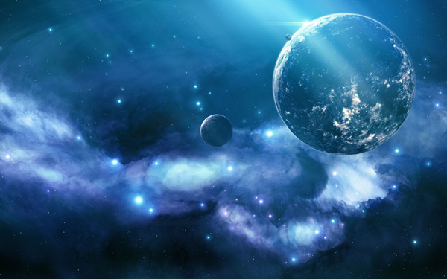
What can bridge this infinite gap between God and man?
“For my thoughts are not your thoughts,
neither are your ways my ways, declares the LORD.
For as the heavens are higher than the earth,
so are my ways higher than your ways
and my thoughts than your thoughts.” Isaiah 55:8-9

Slide 35
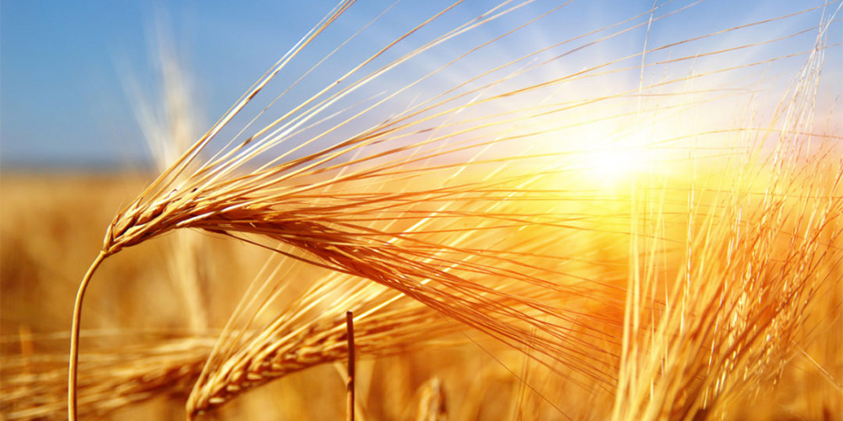
“For as the rain and the snow come down from heaven
and do not return there but water the earth,
making it bring forth and sprout,
giving seed to the sower and bread to the eater,
so shall my word be that goes out from my mouth;
it shall not return to me empty,
but it shall accomplish that which I purpose,
and shall succeed in the thing for which I sent it.”
Isaiah 55:10-11

Slide 36
“For as the rain and the snow come down from heaven
and do not return there but water the earth,
making it bring forth and sprout,
giving seed to the sower and bread to the eater,
so shall my word be that goes out from my mouth;
it shall not return to me empty,
but it shall accomplish that which I purpose,
and shall succeed in the thing for which I sent it.”
Isaiah 55:10-11
God has bridged the gap!

Slide 37
“For as the rain and the snow come down from heaven
and do not return there but water the earth,
making it bring forth and sprout,
giving seed to the sower and bread to the eater,
so shall my word be that goes out from my mouth;
it shall not return to me empty,
but it shall accomplish that which I purpose,
and shall succeed in the thing for which I sent it.”
Isaiah 55:10-11
The purpose of the rain and snow is to bring “fruit” to the earth.

Slide 38
“For as the rain and the snow come down from heaven
and do not return there but water the earth,
making it bring forth and sprout,
giving seed to the sower and bread to the eater,
so shall my word be that goes out from my mouth;
it shall not return to me empty,
but it shall accomplish that which I purpose,
and shall succeed in the thing for which I sent it.”
Isaiah 55:10-11
For what purpose does God send forth his word?
To produce spiritual fruit!

Slide 39
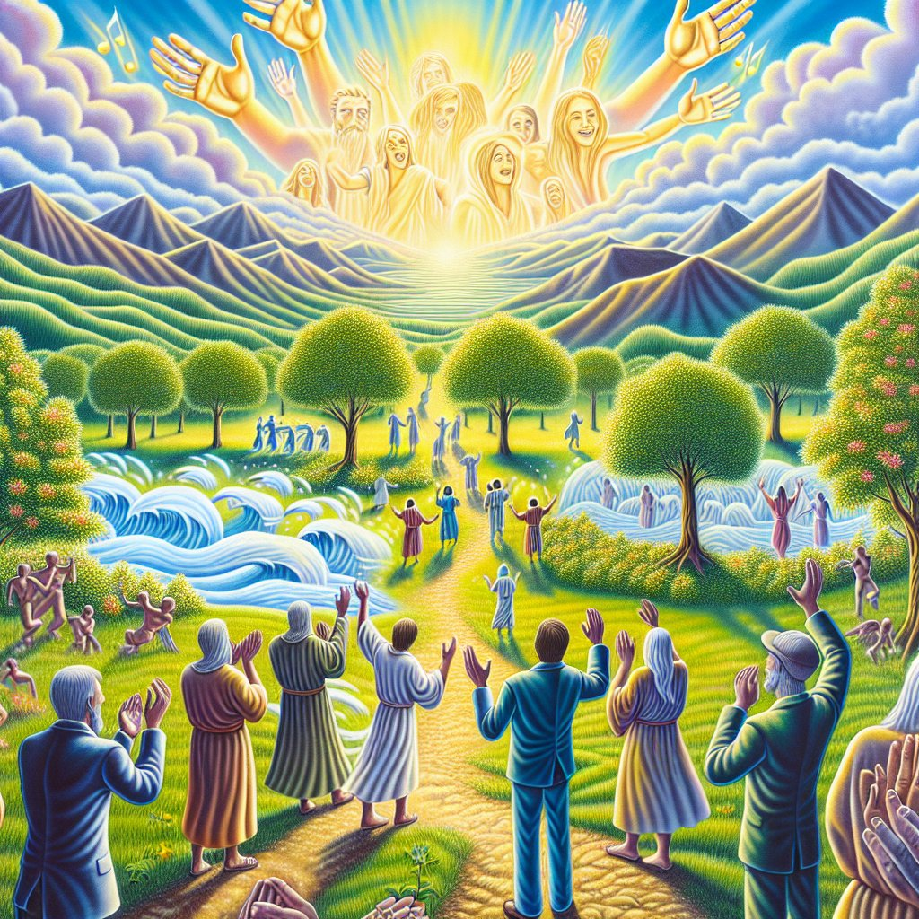
“For you shall go out in joy and be led forth in peace;
the mountains and the hills before you
shall break forth into singing,
and all the trees of the field shall clap their hands.”
Isaiah 55:12

Slide 40
“For you shall go out in joy and be led forth in peace;
the mountains and the hills before you
shall break forth into singing,
and all the trees of the field shall clap their hands.”
Isaiah 55:12
Who is the “you”?
Those who have responded to the invitation!

Slide 41
“For you shall go out in joy and be led forth in peace;
the mountains and the hills before you
shall break forth into singing,
and all the trees of the field shall clap their hands.”
Isaiah 55:12
When is this referring to?

Slide 42
“For you shall go out in joy and be led forth in peace;
the mountains and the hills before you
shall break forth into singing,
and all the trees of the field shall clap their hands.
Instead of the thorn shall come up the cypress;
instead of the brier shall come up the myrtle;
and it shall make a name for the LORD,
an everlasting sign that shall not be cut off.”
Isaiah 55:12-13

Slide 43
“Instead of the thorn shall come up the cypress;
instead of the brier shall come up the myrtle;
and it shall make a name for the LORD,
an everlasting sign that shall not be cut off.”
Isaiah 55:13
“…cursed is the ground because of you;
in pain you shall eat of it all the days of your life;
thorns and thistles it shall bring forth for you…”
Genesis 3:17-18

Slide 44
“Instead of the thorn shall come up the cypress;
instead of the brier shall come up the myrtle;
and it shall make a name for the LORD,
an everlasting sign that shall not be cut off.”
Isaiah 55:13
What is “it”?
The restoration of creation (vss. 12-13)
God’s salvation and satisfaction of the thirsty (Ch. 55)
The completion of redemption (Ch. 40-55)

Slide 45
“Instead of the thorn shall come up the cypress;
instead of the brier shall come up the myrtle;
and it shall make a name for the LORD,
an everlasting sign that shall not be cut off.”
Isaiah 55:13
God receives his greatest glory in the redemption and satisfaction of his people!

Slide 46
Isaiah 55 – The Great Invitation!
The Invitation (1-5)
Responding to the Invitation (6-13)

Slide 47
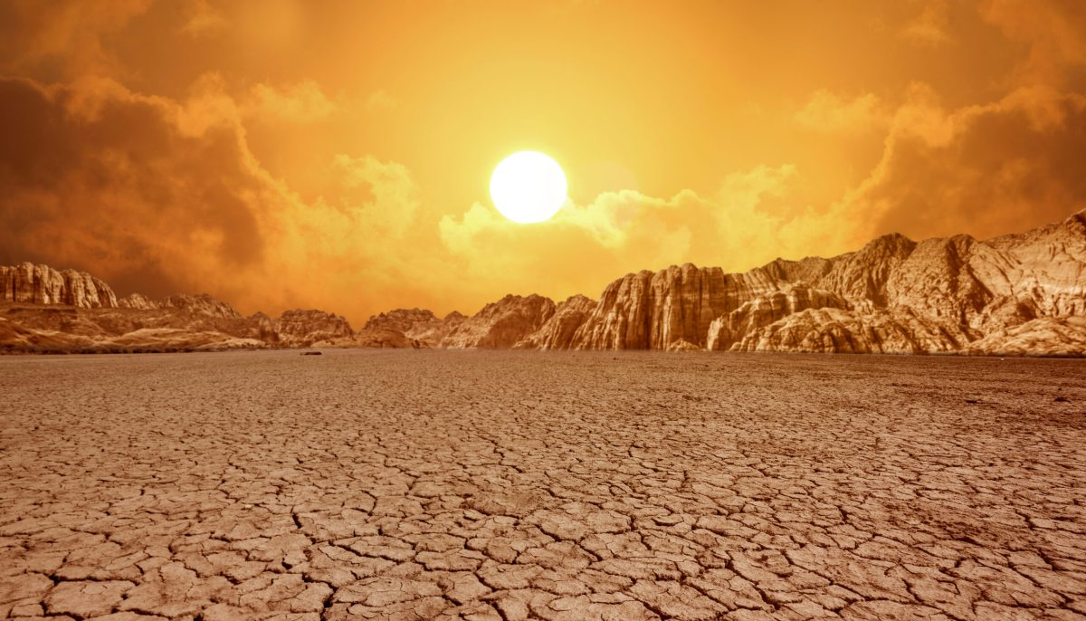
Whether we realize it or not, these are all legitimate, God-given thirsts! He has promised to meet all of these needs… and only he CAN truly meet them!
In what ways are we thirsty?
To be loved and pursued
To have glory, honor and significance
To have pleasure and satisfaction
To be forgiven and accepted as we are

Slide 48
It’s not that the thirsts in and of themselves are wrong… The problem comes when we try to satisfy them in ways/things other than God.
“Why do you spend your money for that which is not bread, and your labor for that which does not satisfy?
Listen diligently to me, and eat what is good, and delight yourselves in rich food.” Isaiah 55:2

Slide 49
For Men
Common Legitimate Thirsts: significance, strength, respect, honor, pleasure and satisfaction
Common counterfeit things we turn to:
Women, lust, porn, other pleasures
Focus on tasks and successful careers to the harm of relationships with family and others
Avoidance of deep relationships (especially with wives & kids) that make us feel vulnerable

Slide 50
For Women
Common Legitimate Thirsts: love, acceptance, security, pleasure
Common counterfeit things we turn to:
Romance novels and movies
Controlling/Manipulating circumstances to feel accepted and secure
Anger and frustration at husbands or others who don’t love you or keep you safe in the way you feel you need it

Slide 51
“You make known to me the path of life;
in your presence there is fullness of joy;
at your right hand are pleasures forevermore.”
Psalm 16:11
“Why do you spend your money for that which is not bread, and your labor for that which does not satisfy?
Listen diligently to me, and eat what is good, and delight yourselves in rich food.” Isaiah 55:2

Slide 52
God is inviting us because he wants us to be satisfied!
“Why do you spend your money for that which is not bread, and your labor for that which does not satisfy?
Listen diligently to me, and eat what is good, and delight yourselves in rich food.” Isaiah 55:2

Slide 53
Today, God is inviting each of us to enter into deeper relationship and satisfaction in him!
Come to the waters
Come, buy and eat
Come, buy wine and milk
Eat what is good… Delight yourselves in rich food
Seek the LORD while he may be found;
Call on him while he is near.
Let the wicked forsake his way
And the unrighteous man his thoughts

Slide 55


OT Preaching link at BibleStudyDownloads.org
Get this presentation for free!
Notes:
OT Preaching (op)

