Slide 1
The Uncomfortable Truth About Jesus
Isaiah 52:13–53:12
Preached by Dr. Jim Harmeling at Crossroads International Church Singapore • cicfamily.com Uploaded by Dr. Rick Griffith • Singapore Bible College Files in many languages for free download at BibleStudyDownloads.org

Slide 2
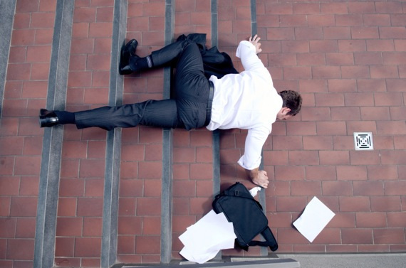
Disappoint = “to fail to meet the expectation or hope of.”

Slide 3
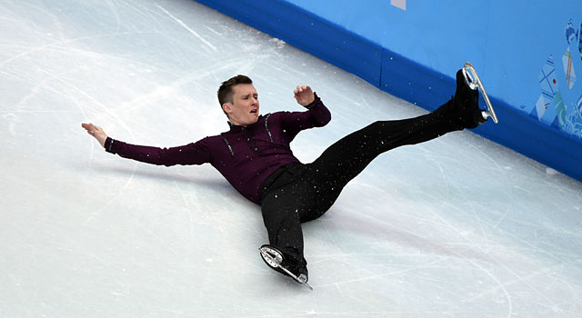

Slide 4
The Uncomfortable Truth About Jesus
Isaiah 52:13–53:12

Slide 5
“Servant Songs” of Isaiah
Isaiah 40:1-9 =he is gentle, covenant making, and God honoring
2. Isaiah 49:1-7=he restores Israel and rules all nations
3. Isaiah 50:4-9 =he suffers, but God vindicates him in the end

Slide 6
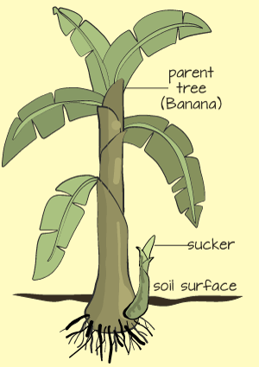
Jesus is not who we expect to solve problems (52:13-15)
Jesus does not look like who we want to solve problems (53:1-3)
He was common (v. 2)

Slide 7
Jesus?

Slide 8
Jesus is not who we expect to solve problems (52:13-15)
Jesus does not look like who we want to solve problems (53:1-3)
He was common (v. 2)
He was publicly despised (v. 3)

Slide 9
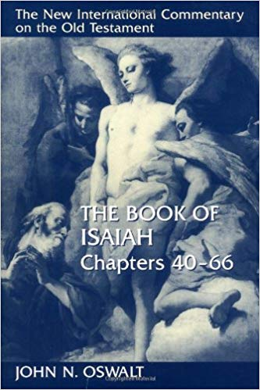
“Not only does he lack any particularly attractive features to draw us to him, but he is full of his own problems. He is not one of the winners, he is one of the losers. It is axiomatic that losers cannot deliver other losers. He is a man of pain and sickness; What can he do for the rest of us?”

Slide 10
Jesus is not who we expect to solve problems (52:13-15)
Jesus does not look like who we want to solve problems (53:1-3)
Jesus does not act in the way we want to solve problems (53:4-12)
He suffered to pay for our sin (4-6)
“smitten by God” “stricken” “afflicted” “pierced” “crushed”

Slide 11
Our transgressions
Our iniquities
Our transgressions
Our iniquities
Our iniquities
Our transgressions

Slide 12
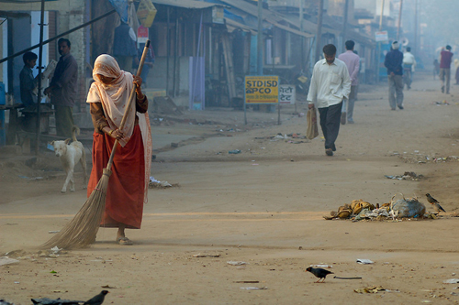
Would Messiah do this?

Slide 13
Would Messiah clean this?

Slide 14
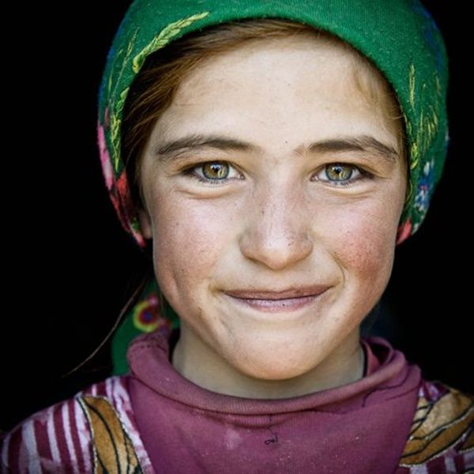
Brought us peace
We are healed
We are healed
Brought us peace
We are healed
Brought us peace

Slide 15
Jesus is not who we expect to solve problems (52:13-15)
Jesus does not look like who we want to solve problems (53:1-3)
Jesus does not act in the way we want to solve problems (53:4-12)
He suffered to pay for our sin (4-6)
He willingly received injustice for our guilt (vs. 7-12)

Slide 16
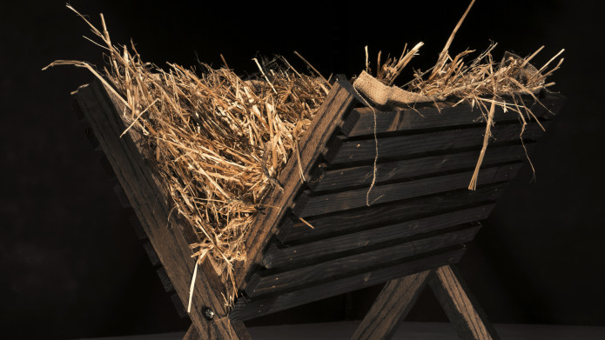
Do I understand Christmas?
Has Jesus the Messiah cleansed my sin?

Slide 17
Black

Slide 18
OT Preaching link at BibleStudyDownloads.org
Get this presentation for free!
Notes:
OT Preaching (op)

