Slide 1
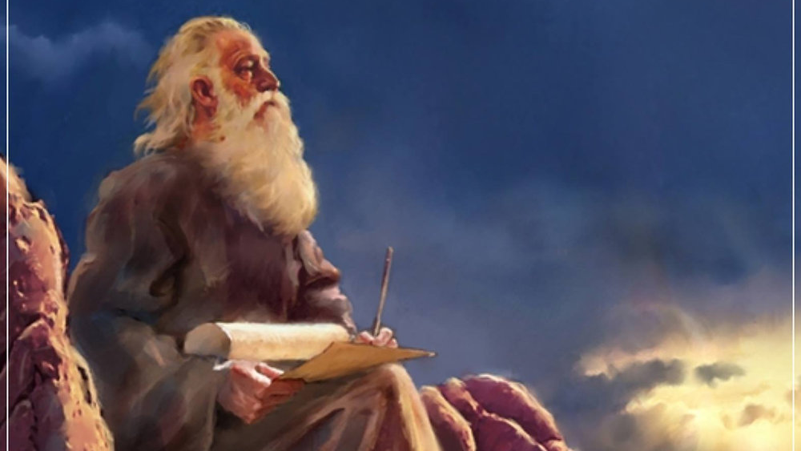
The Prophecy
Of
Isaiah
Isaiah 49:14 – 50:3
How Great is the Father’s Love!
Preached by Dan Bridges Amman International Church, Jordan (AmmanChurch.org) Uploaded by Dr. Rick Griffith • Jordan Evangelical Theological Seminary Files in many languages for free download at BibleStudyDownloads.org

Slide 2
My Love and Baby’s Love
“Do I withhold my love until I know she loves me?
Am I waiting for her to do something worthy of my love before extending it?”
Notes:
My Love and Baby’s Love
Taken from Encyclopedia of 7700 Illustrations – 1996 Edition by Paul Lee Tan
A man who was a Christian became seriously ill. He became troubled about the little love he felt in his heart for God, and spoke of this to a friend. The friend answered:
“When I go home from here, I expect to take my baby on my knee, look into her sweet eyes, listen to her charming gurgling and, tired as I am, her presence will rest me; for I love that child with unutterable tenderness. But she loves me little. If my heart were breaking it would not disturb her sleep. If my body were racked with pain, it would not interrupt her play. If I were dead, she would forget me in a few days. Besides this, she has never brought me a penny, but is a constant expense to me. Yet I would not sell her for all the money in the world!
“How is it? Does she love me, or do I love her? Do I withhold my love until I know she loves me? Am I waiting for her to do something worthy of my love before extending it?”
This practical illustration of the love of God for his children caused the tears to roll down the sick man’s face. “Oh, I see,” he exclaimed, “it is not my love for God, but God’s love for me that I should be thinking of. And I do love Him now as I never loved Him before!”

Slide 3
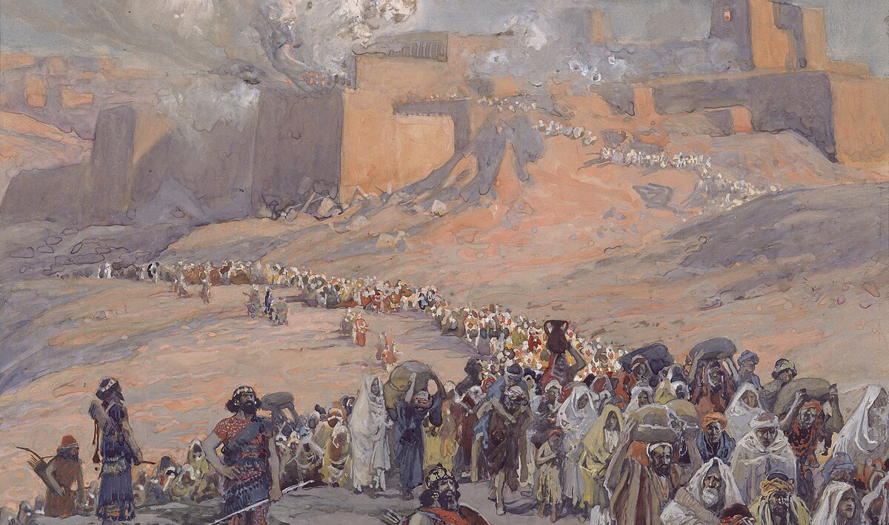
Context
Isaiah is writing around 700 BC
He is writing to a future audience – the people of Judah living in exile in Babylon
He is writing to give them hope of a future return – both physically and spiritually.

Slide 4
Isaiah 49:14 – 50:3: How Great is the Father’s Love!
God’s Love
Never Changes (49:14-16)
Exceeds All Expectations (49:17-23)
Works for Our Salvation (49:24-26)
Tells Us What is True (50:1-3)

Slide 5
God has comforted his people by his promise to reestablish them as a people!
“Sing for joy, O heavens, and exult, O earth;
break forth, O mountains, into singing!
For the LORD has comforted his people
and will have compassion on his afflicted.”
Isaiah 49:13

Slide 6
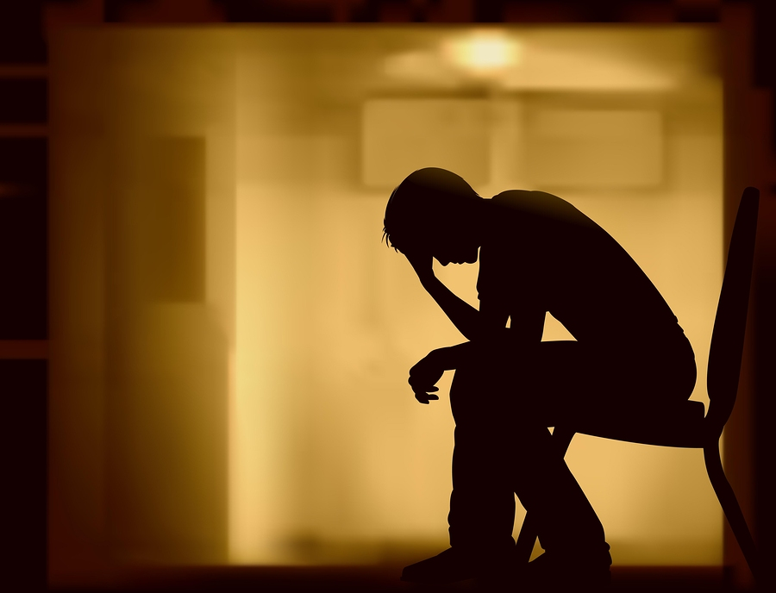
“But Zion said, ‘The LORD has forsaken me;
my Lord has forgotten me.’”
Isaiah 49:14

Slide 7
“But Zion said, ‘The LORD has forsaken me;
my Lord has forgotten me.’”
Isaiah 49:14

Slide 8
The hopelessness of exile…
Jerusalem destroyed, country devastated
Youth slaughtered or carried into exile
No known way to get back or be a people again
What has happened to the “chosen people”?

Slide 9
Two charges:
Yahweh has forsaken (deserted) me
Adonai has forgotten me
How would you respond if you were God?
“But Zion said, ‘The LORD has forsaken me;
my Lord has forgotten me.’”
Isaiah 49:14

Slide 10
“Can a woman forget her nursing child, that she should have no compassion on the son of her womb?
Even these may forget, yet I will not forget you.”
Isaiah 49:15

Slide 11
“Can a woman forget her nursing child, that she should have no compassion on the son of her womb?
Even these may forget, yet I will not forget you.”
Isaiah 49:15

Slide 12
“Can a woman forget her nursing child, that she should have no compassion on the son of her womb?
Even these may forget, yet I will not forget you.”
Isaiah 49:15
No matter how it feels, it is impossible for God to forget his people!!!

Slide 13
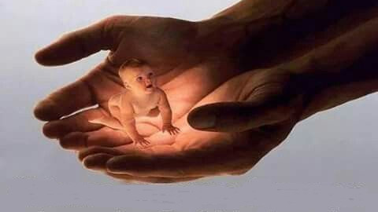
“Behold, I have engraved you on the palms of my hands;
your walls are continually before me.”
Isaiah 49:16
Not only does God not desert his people, but every detail of our lives is constantly before him!

Slide 14
Isaiah 49:14 – 50:3: How Great is the Father’s Love!
God’s Love
Never Changes (49:14-16)
Exceeds All Expectations (49:17-23)
Works for Our Salvation (49:24-26)
Tells Us What is True (50:1-3)

Slide 15
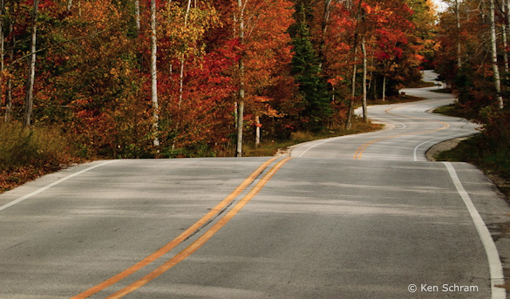
God loves his people by giving promises about our future.
Then God delivers on those promises in ways that far exceed our expectations!
“For thus says the Lord: When seventy years are completed for Babylon, I will visit you, and I will fulfill to you my promise and bring you back to this place. For I know the plans I have for you, declares the Lord, plans for welfare and not for evil, to give you a future and a hope.” Jeremiah 29:10-11

Slide 16
Isaiah 49:17-23 is an “Isaianic” version of Jeremiah 29:11!
“For thus says the Lord: When seventy years are completed for Babylon, I will visit you, and I will fulfill to you my promise and bring you back to this place. For I know the plans I have for you, declares the Lord, plans for welfare and not for evil, to give you a future and a hope.” Jeremiah 29:10-11

Slide 17
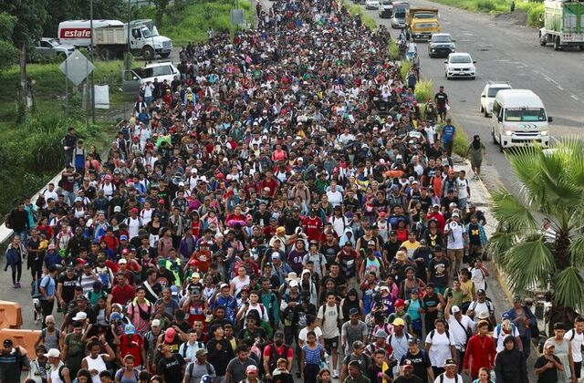
“Your builders (sons) make haste;
your destroyers and those who laid you waste go out from you.”
Isaiah 49:17

Slide 18
God has not forsaken or forgotten his people – he will restore and regather them!
“Your builders (sons) make haste;
your destroyers and those who laid you waste go out from you.”
Isaiah 49:17

Slide 19
“Your builders (sons) make haste;
your destroyers and those who laid you waste go out from you.”
Isaiah 49:17

Slide 20
“Lift up your eyes around and see;
they all gather, they come to you.
As I live, declares the LORD,
you shall put them all on as an ornament;
you shall bind them on as a bride does.”
Isaiah 49:18

Slide 21
God will not stop restoring Zion until she is adorned with all of her children!
“Lift up your eyes around and see;
they all gather, they come to you.
As I live, declares the LORD,
you shall put them all on as an ornament;
you shall bind them on as a bride does.”
Isaiah 49:18

Slide 22
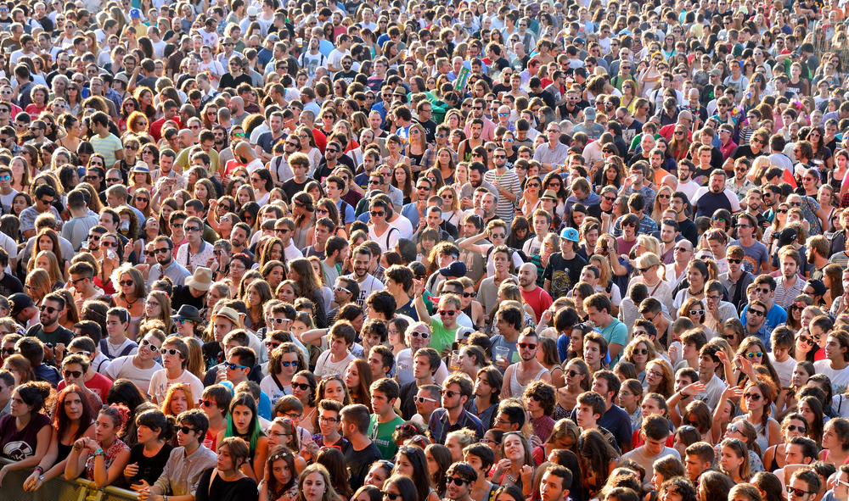
“Surely your waste and your desolate places
and your devastated land—
surely now you will be too narrow for your inhabitants,
and those who swallowed you up will be far away.
The children of your bereavement
will yet say in your ears:
‘The place is too narrow for me;
make room for me to dwell in.’” Isaiah 49:19-20

Slide 23
God will regather his people with even more than before the exile!
“Surely your waste and your desolate places
and your devastated land—
surely now you will be too narrow for your inhabitants,
and those who swallowed you up will be far away.
The children of your bereavement
will yet say in your ears:
‘The place is too narrow for me;
make room for me to dwell in.’” Isaiah 49:19-20

Slide 24
God will add offspring to his people miraculously – in ways other than natural means.
“Then you will say in your heart: ‘Who has borne me these?
I was bereaved and barren, exiled and put away,
but who has brought up these?
Behold, I was left alone; from where have these come?’”
Isaiah 49:21

Slide 25
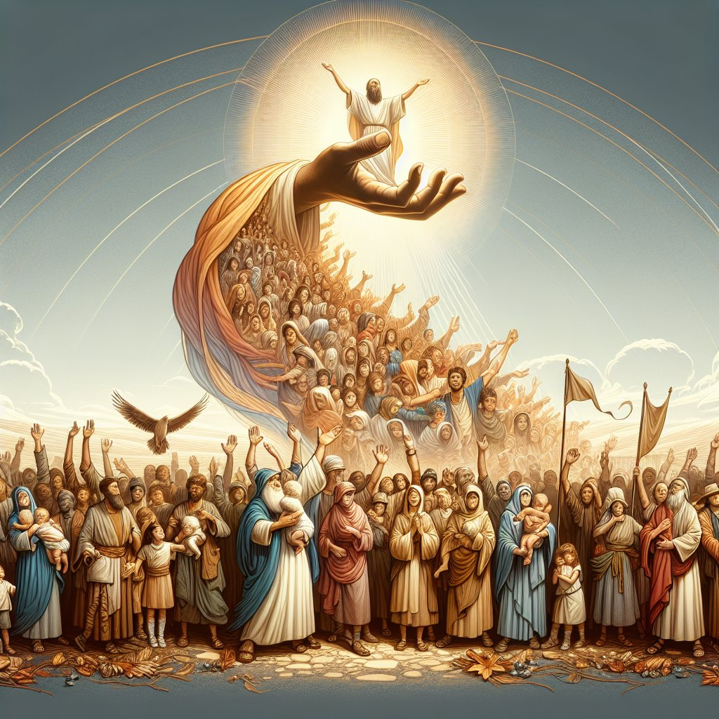
“Thus says the LORD God:
‘Behold, I will lift up my hand to the nations, and raise my signal to the peoples;
and they shall bring your sons in their arms, and your daughters shall be carried on their shoulders.’”
Isaiah 49:22

Slide 26
“Thus says the LORD God:
‘Behold, I will lift up my hand to the nations, and raise my signal to the peoples;
and they shall bring your sons in their arms, and your daughters shall be carried on their shoulders.’”
Isaiah 49:22
“And I, when I am lifted up from the earth, will draw all people to myself.”
John 12:32

Slide 27
“Thus says the LORD God:
‘Behold, I will lift up my hand to the nations, and raise my signal to the peoples;
and they shall bring your sons in their arms, and your daughters shall be carried on their shoulders.’”
Isaiah 49:22
A picture of families from the nations streaming to Zion!

Slide 28
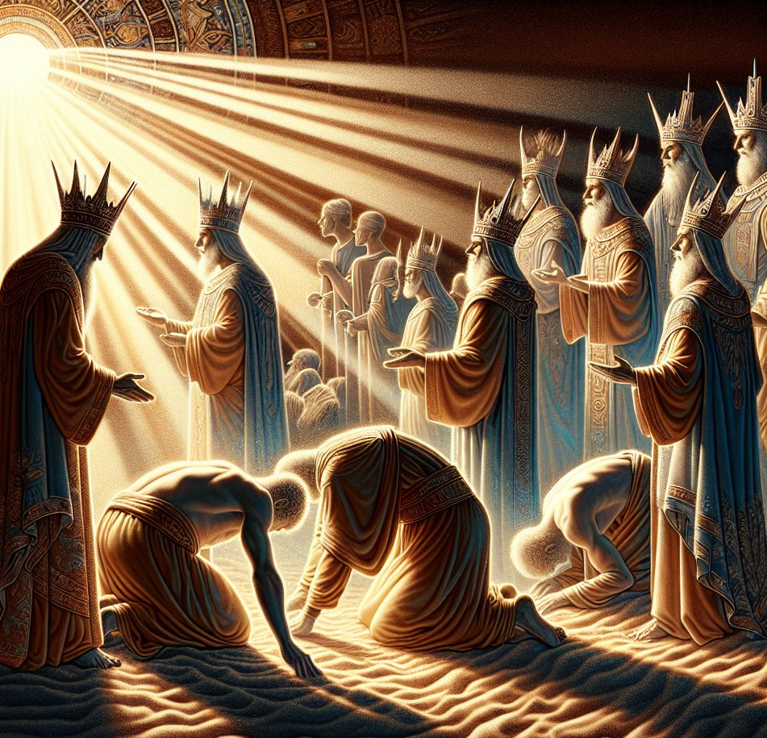
“‘Kings shall be your foster fathers, and their queens your nursing mothers.
With their faces to the ground they shall bow down to you, and lick the dust of your feet.’”
Isaiah 49:23a
Acknowledging that God’s people showed them the truth!

Slide 29
God indeed knew the plans he had for them!
God was not only going to bring them back and restore them, but he was going to use them to bring the nations to God!
“Then you will know that I am the LORD;
those who wait for me shall not be put to shame.”
Isaiah 49:23b

Slide 30
“Then you will know that I am the LORD;
those who wait for me shall not be put to shame.”
Isaiah 49:23b

Slide 31
Isaiah 49:14 – 50:3: How Great is the Father’s Love!
God’s Love
Never Changes (49:14-16)
Exceeds All Expectations (49:17-23)
Works for Our Salvation (49:24-26)
Tells Us What is True (50:1-3)

Slide 32
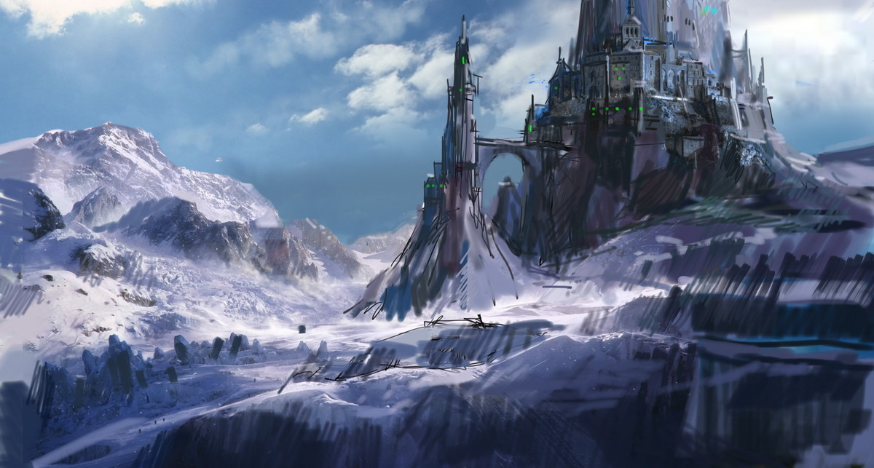
“Can the prey be taken from the mighty,
or the captives of a tyrant be rescued?”
Isaiah 49:24
YES!!!

Slide 33
“For thus says the LORD:
‘Even the captives of the mighty shall be taken,
and the prey of the tyrant be rescued,
for I will contend with those who contend with you,
and I will save your children.’” Isaiah 49:25

Slide 34
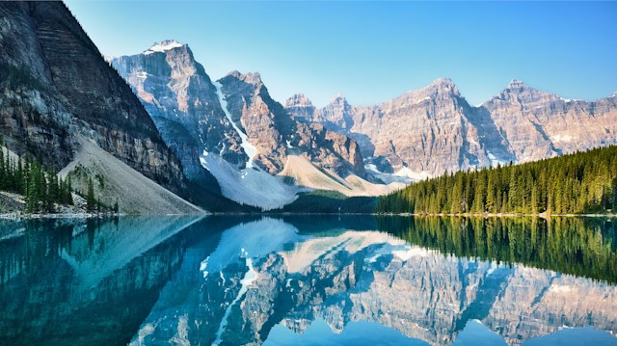
“I will make your oppressors eat their own flesh,
and they shall be drunk with their own blood as with wine.
Then all flesh shall know that I am the LORD your Savior,
and your Redeemer, the Mighty One of Jacob.”
Isaiah 49:26

Slide 35
Isaiah 49:14 – 50:3: How Great is the Father’s Love!
God’s Love
Never Changes (49:14-16)
Exceeds All Expectations (49:17-23)
Works for Our Salvation (49:24-26)
Tells Us What is True (50:1-3)

Slide 36
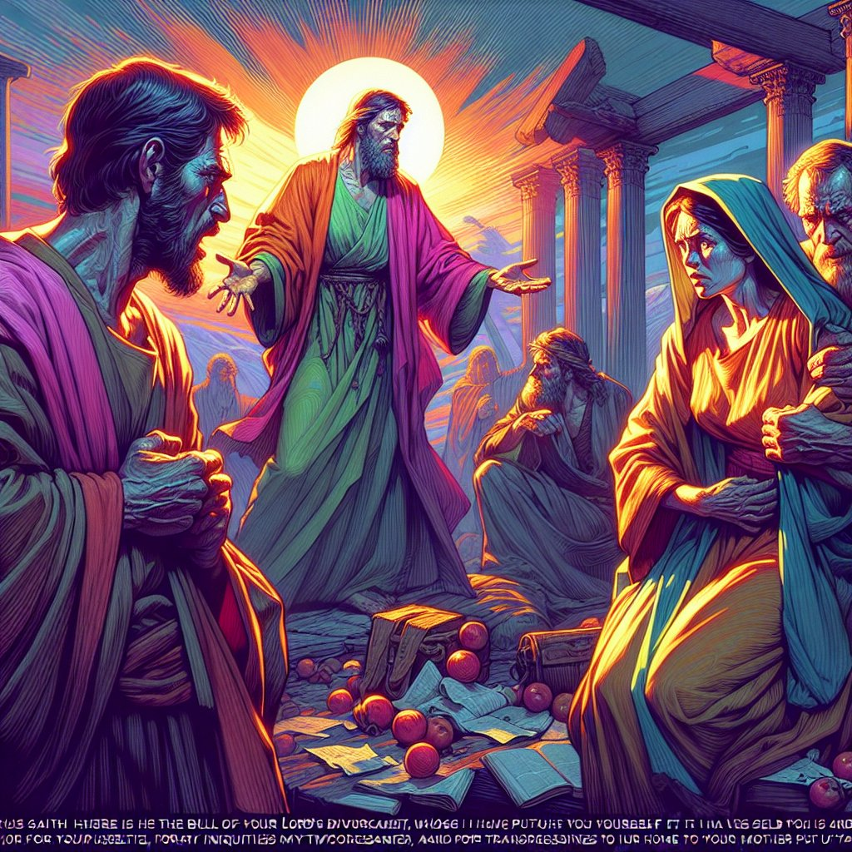
“‘Thus says the LORD:
‘Where is your mother's certificate of divorce, with which I sent her away?
Or which of my creditors is it to whom I have sold you?’”
Isaiah 50:1a

Slide 37
“‘Thus says the LORD:
‘Where is your mother's certificate of divorce, with which I sent her away?
Or which of my creditors is it to whom I have sold you?’”
Isaiah 50:1a
A divorced woman who remarried could never again marry her first husband – Dueteronomy 24

Slide 38
“‘Thus says the LORD:
‘Where is your mother's certificate of divorce, with which I sent her away?
Or which of my creditors is it to whom I have sold you?’”
Isaiah 50:1a
But God had never divorced his true people – there was no certificate!

Slide 39
“‘Thus says the LORD:
‘Where is your mother's certificate of divorce, with which I sent her away?
Or which of my creditors is it to whom I have sold you?’”
Isaiah 50:1a
Who has God ever owed anything to? He had never been forced to sell his people!

Slide 40
“Behold, for your iniquities you were sold,
and for your transgressions your mother was sent away.”
Isaiah 50:1b
They had been sold / sent away due to their sin – but they were still redeemable!

Slide 41
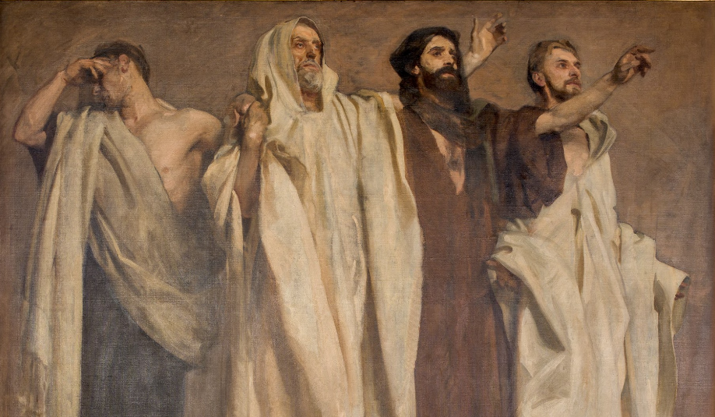
They had not listened to prophet after prophet…
“Why, when I came, was there no man;
why, when I called, was there no one to answer?”
Isaiah 50:2a

Slide 42
The truth:
God had not forsaken or forgotten them, but they had forsaken and forgotten God!
“Why, when I came, was there no man;
why, when I called, was there no one to answer?”
Isaiah 50:2a

Slide 43
“Is my hand shortened, that it cannot redeem?
Or have I no power to deliver?”
Isaiah 50:2b

Slide 44
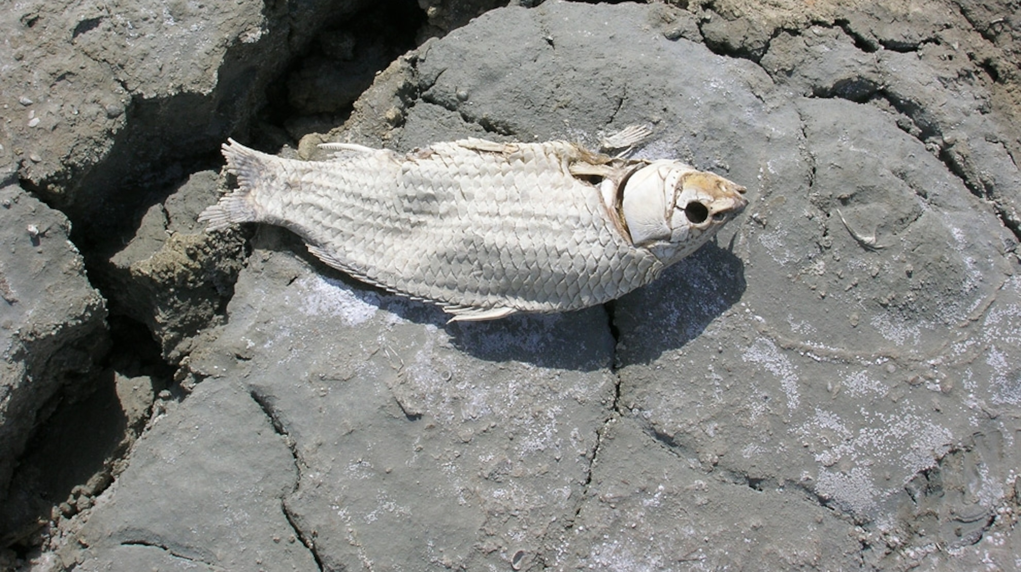
God had both the love and power to deliver – the problem was unbelief…
“Behold, by my rebuke I dry up the sea,
I make the rivers a desert;
their fish stink for lack of water
and die of thirst.
I clothe the heavens with blackness
and make sackcloth their covering.” Isaiah 50:2c-3

Slide 45
Isaiah 49:14 – 50:3: How Great is the Father’s Love!
God’s Love
Never Changes (49:14-16)
Exceeds All Expectations (49:17-23)
Works for Our Salvation (49:24-26)
Tells Us What is True (50:1-3)

Slide 46
How could these words be a comfort to those who would die in Babylon?
When they could not see and feel God’s love, God was calling them to live by faith in his character, his promises and his power!

Slide 47
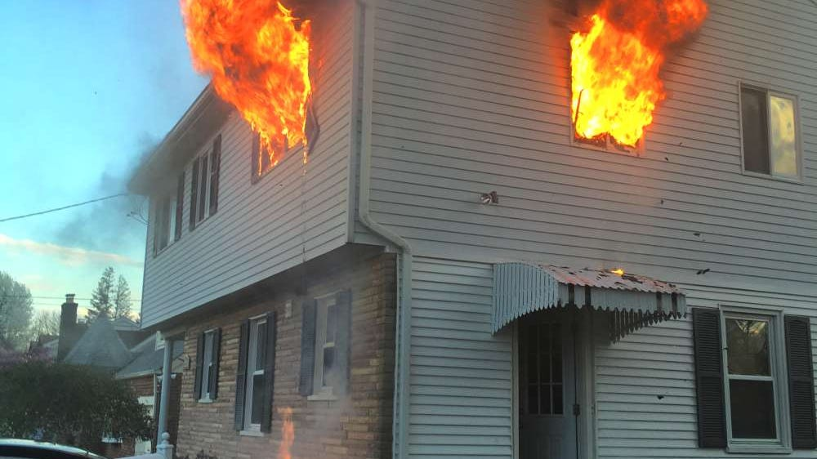
The Marks of Love
“…instead of saying anything he merely held up his scarred hand...”
Notes:
He Merely Showed His Hands
Taken from Encyclopedia of 7700 Illustrations – 1996 Edition by Paul Lee Tan
William Dixon lived in Brackenthwaite, England. He was a widower who had also lost his only son. One day he saw that the house of one of his neighbors was on fire. Although the aged owner was rescued, her orphaned grandson was trapped in the blaze. Dixon climbed an iron pipe on the side of the house and lowered the boy to safety. His hand that held on to the pipe was badly burned.
Shortly after the fire, the grandmother died. The townspeople wondered who would care for the boy. Two volunteers appeared before the town council. One was a father who had lost his son and wanted to adopt the orphan as his own. William Dixon was to speak next, but instead of saying anything he merely held up his scarred hand. When the vote was taken, the boy was given to him.

Slide 48
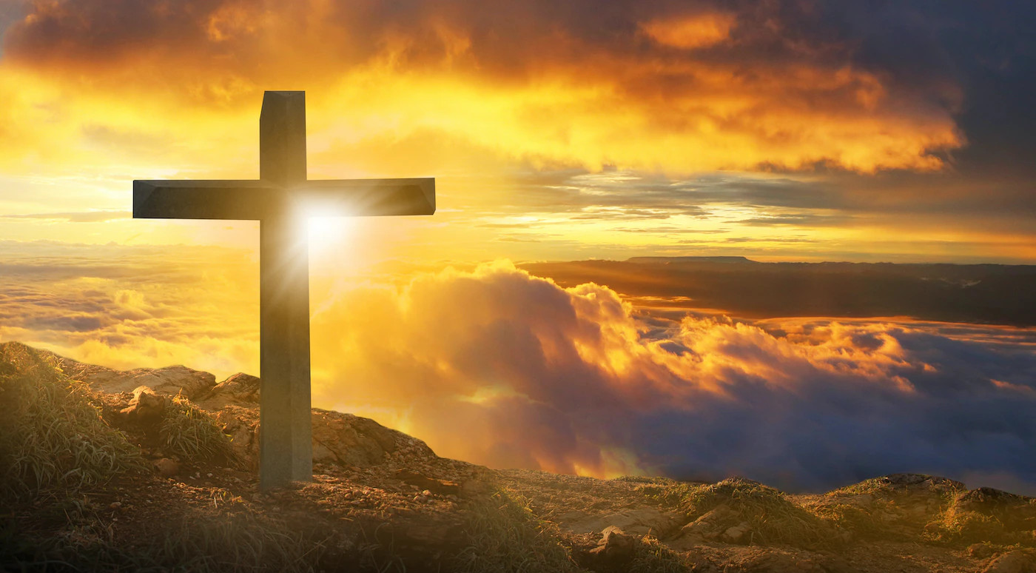
The Marks of Love
“God shows his love for us in that while we were still sinners, Christ died for us.”
Romans 5:8

Slide 50
OT Preaching link at BibleStudyDownloads.org
Get this presentation for free!
Notes:
OT Preaching (op)

