Slide 1
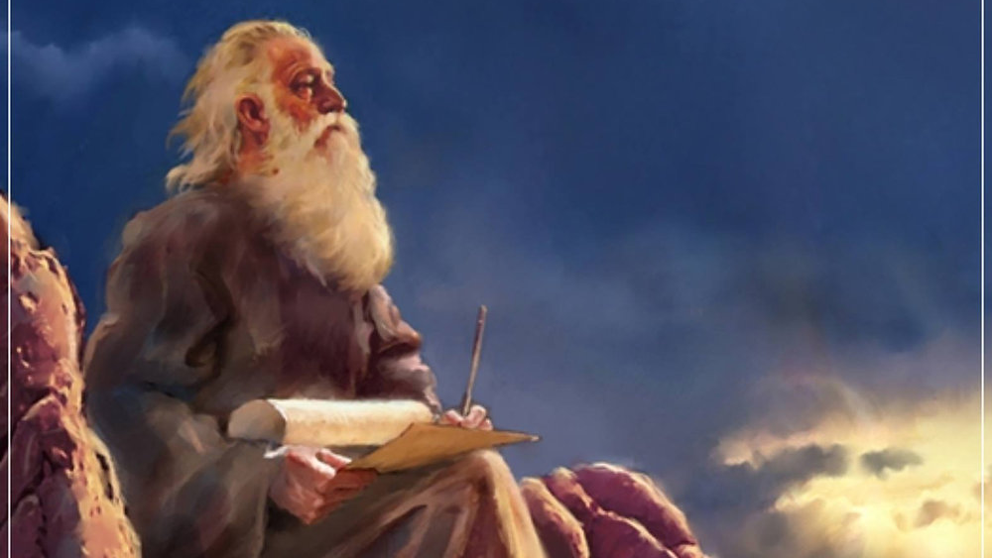
The Prophecy
Of
Isaiah
Isaiah 44:1-23
Yahweh – the Only True God
Preached by Dan Bridges Amman International Church, Jordan (AmmanChurch.org) Uploaded by Dr. Rick Griffith • Jordan Evangelical Theological Seminary Files in many languages for free download at BibleStudyDownloads.org

Slide 2
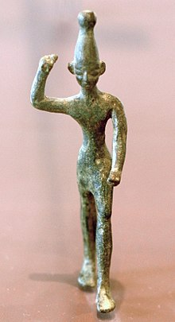
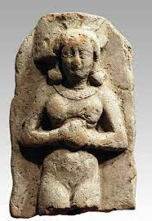
What would cause people to worship gods like this???

Slide 3
1. Worship of idols is an attempt to meet felt needs – to control what seems out of control
Ancient World:
Rain, children, protection from enemies
Modern World?
Job Loss, Cancer / Other Health Needs, Loneliness, Need to Feel Loved / Significant…

Slide 4
2. Worship of Idols is Self-serving
Give the god what they want…
The god gives you what you want.

Slide 5
What’s Wrong with Idolatry?
“You shall have no other gods before me.
You shall not make for yourself a carved image, or any likeness of anything that is in heaven above, or that is in the earth beneath, or that is in the water under the earth. You shall not bow down to them or serve them, for I the LORD your God am a jealous God, visiting the iniquity of the fathers on the children to the third and the fourth generation of those who hate me, but showing steadfast love to thousands of those who love me and keep my commandments.” Exodus 20:3-6
Idolatry is wrong because it is loving something more than God.

Slide 6
What’s Wrong with Idolatry?
“An idol is anything more important to you than God, anything that absorbs your heart and imagination more than God, anything you seek to give you what only God can give.” Tim Keller
“You shall have no other gods before me.
You shall not make for yourself a carved image, or any likeness of anything that is in heaven above, or that is in the earth beneath, or that is in the water under the earth. You shall not bow down to them or serve them, for I the LORD your God am a jealous God, visiting the iniquity of the fathers on the children to the third and the fourth generation of those who hate me, but showing steadfast love to thousands of those who love me and keep my commandments.” Exodus 20:3-6

Slide 7
Common Idols in our Society
Money / Possessions / Financial Security
Love
Sex & Sexual Freedom
Entertainment / Sports / Pleasure
Education / Knowledge
Popularity / Success – Even in Ministry!

Slide 8
Isaiah 44:1-23 – Yahweh – the Only True God
The Nature of the True God (1-8)
The Insanity of Idolatry (9-20)
Responding to the True God (21-23)

Slide 9
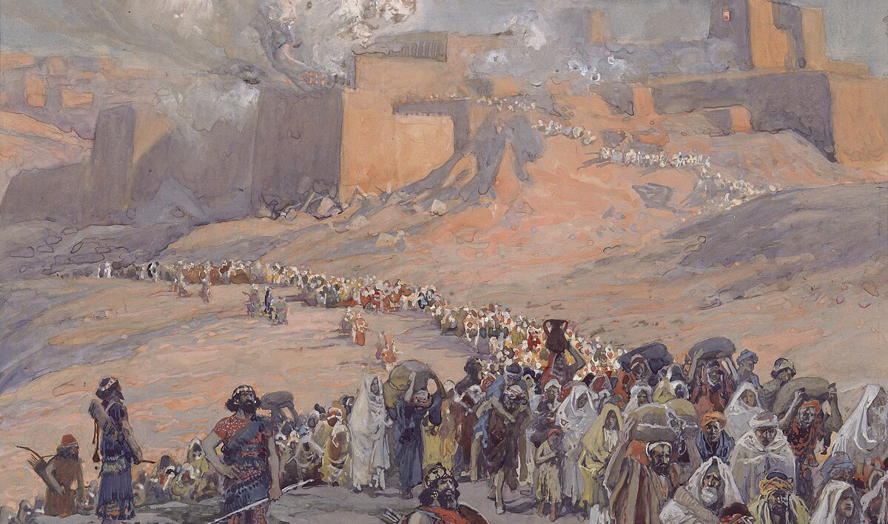
Review…
“Therefore I will profane the princes of the sanctuary,
and deliver Jacob to utter destruction and Israel to reviling.” Isaiah 43:28
Is there any room for hope?

Slide 10
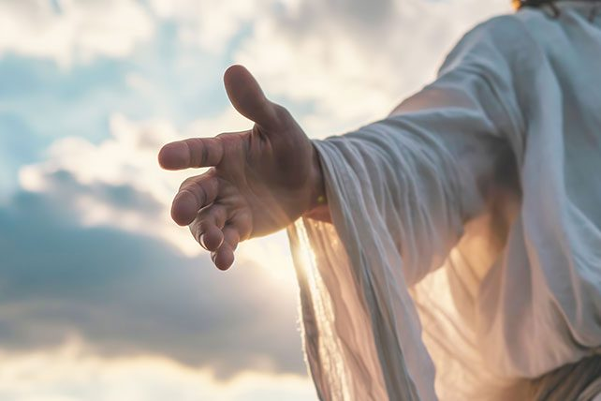
“But now hear, O Jacob my servant,
Israel whom I have chosen!
Thus says the LORD who made you,
who formed you from the womb and will help you:
Fear not, O Jacob my servant,
Jeshurun whom I have chosen.” Isaiah 44:1-2

Slide 11
The True God is always faithful to his promises – no matter what his people have done!
“But now hear, O Jacob my servant,
Israel whom I have chosen!
Thus says the LORD who made you,
who formed you from the womb and will help you:
Fear not, O Jacob my servant,
Jeshurun whom I have chosen.” Isaiah 44:1-2

Slide 12
The True God’s love and loyalty to his people never changes!
“But now hear, O Jacob my servant,
Israel whom I have chosen!
Thus says the LORD who made you,
who formed you from the womb and will help you:
Fear not, O Jacob my servant,
Jeshurun whom I have chosen.” Isaiah 44:1-2
My dear, upright people!

Slide 13
What would God’s true people be afraid of?
What would the dark days of exile do to them?
Had God abandoned them in exile?
“But now hear, O Jacob my servant,
Israel whom I have chosen!
Thus says the LORD who made you,
who formed you from the womb and will help you:
Fear not, O Jacob my servant,
Jeshurun whom I have chosen.” Isaiah 44:1-2

Slide 14
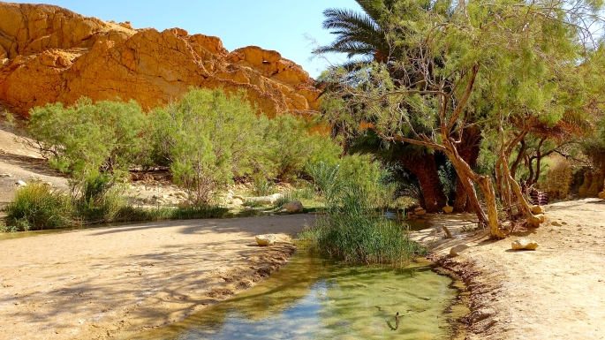
“For I will pour water on the thirsty land,
and streams on the dry ground;”
Isaiah 44:3a

Slide 15
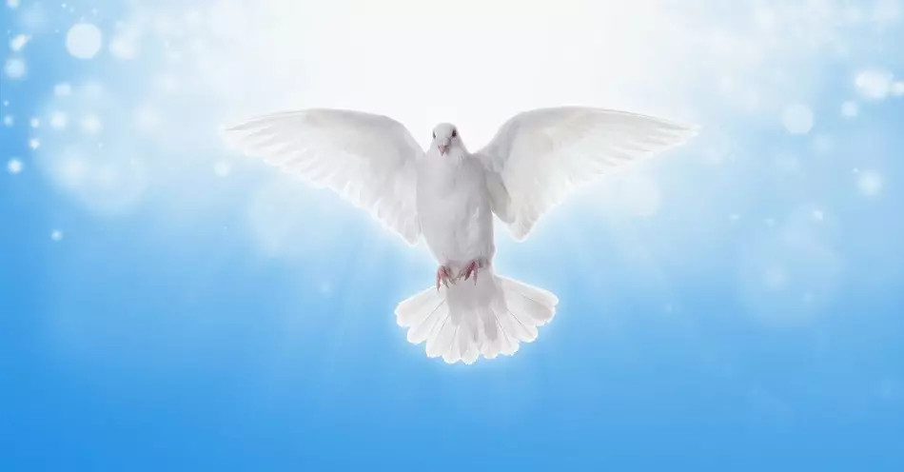
“I will pour my Spirit upon your offspring,
and my blessing on your descendants.”
Isaiah 44:3b

Slide 16
“They shall spring up among the grass
like willows by flowing streams.”
Isaiah 44:4

Slide 17
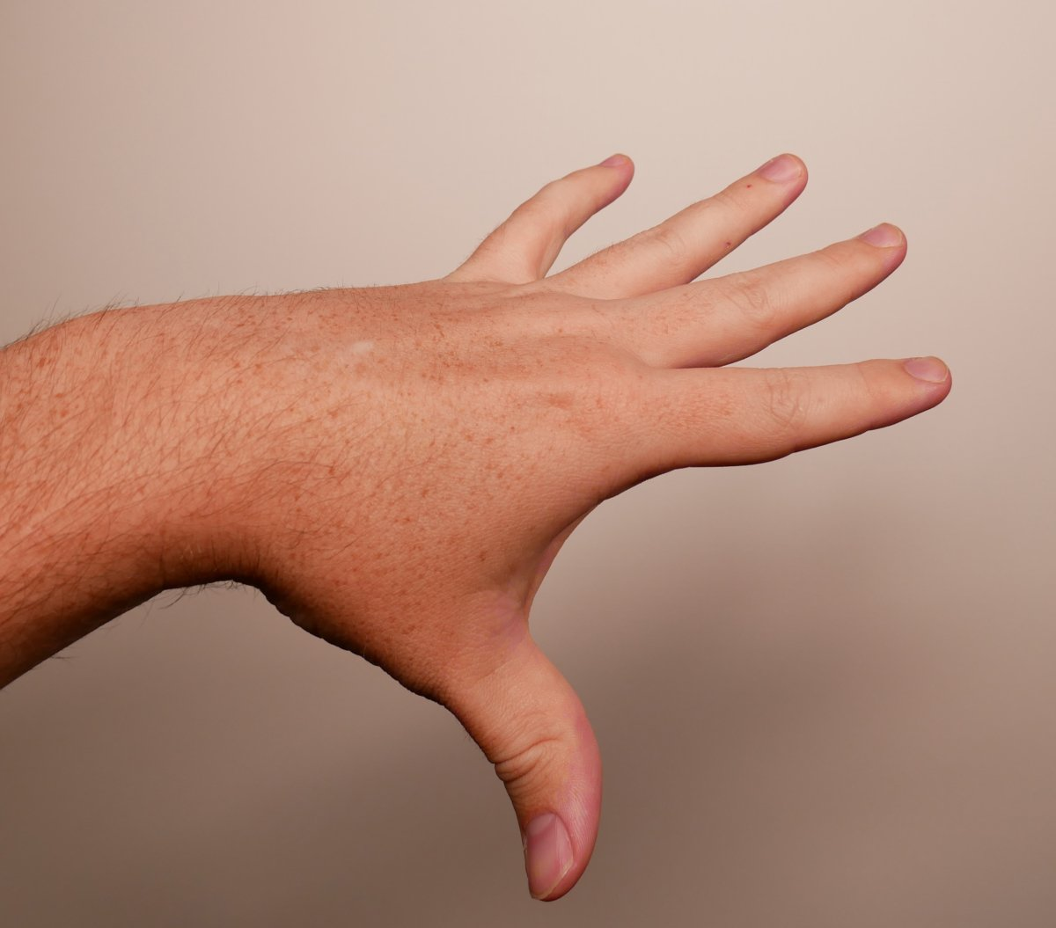
The True God is able to give true spiritual life!
The
LORD's
“This one will say, ‘I am the LORD's,’
another will call on the name of Jacob,
and another will write on his hand, ‘The LORD's,’
and name himself by the name of Israel.”
Isaiah 44:5

Slide 18
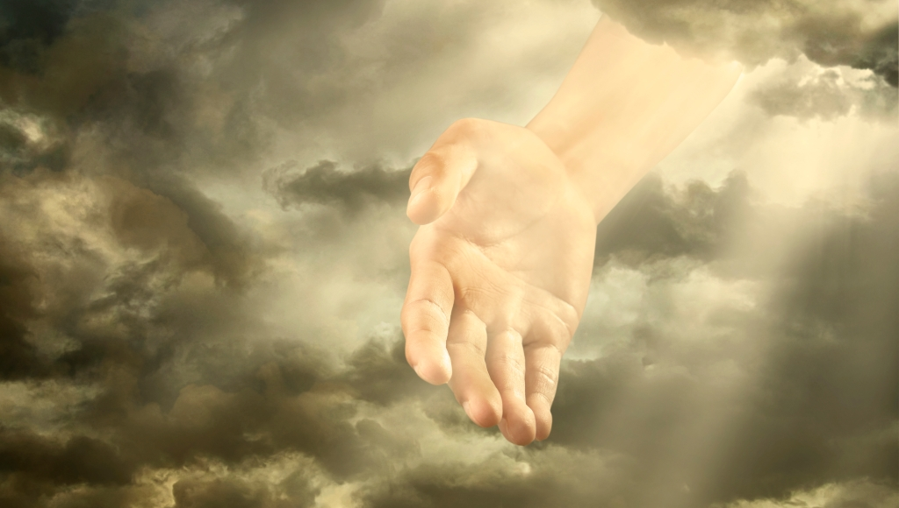
Old City and Kidron Valley from north
The True God
Is Israel’s King (even in exile!)
Is the proven redeemer
Is the God of angel armies
Is the eternally existent one
Is without equal or competition
“Thus says the LORD, the King of Israel
and his Redeemer, the LORD of hosts:
“I am the first and I am the last;
besides me there is no god.”
Isaiah 44:6

Slide 19
Old City and Kidron Valley from north
The True God is sovereign over history
The True God accurately predicts the future
“Who is like me?
Let him step forward and prove to you his power.
Let him do as I have done since ancient times
when I established a people and explained its future.”
Isaiah 44:7 (NLT)
“Who is like me? Let him proclaim it.
Let him declare and set it before me,
since I appointed an ancient people.
Let them declare what is to come, and what will happen.”
Isaiah 44:7

Slide 20
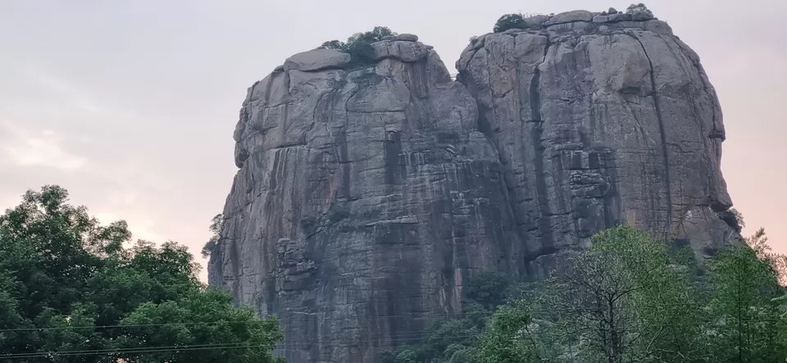
Old City and Kidron Valley from north
The True God is the only solid foundation to depend upon
“Fear not, nor be afraid;
have I not told you from of old and declared it?
And you are my witnesses!
Is there a God besides me?
There is no Rock; I know not any.” Isaiah 44:8

Slide 21
Old City and Kidron Valley from north
The Only True God is:
Always faithful to his promises
Unchanging in his love and loyalty to his people
Able to give true spiritual life
Israel’s King (even in exile!)
The proven redeemer
The God of angel armies
The eternally existent one
Without equal or competition
Sovereign over human history
The only one who accurately predicts the future
The only solid foundation to depend on

Slide 22
Isaiah 44:1-23 – Yahweh – the Only True God
The Nature of the True God (1-8)
The Insanity of Idolatry (9-20)
Responding to the True God (21-23)

Slide 23
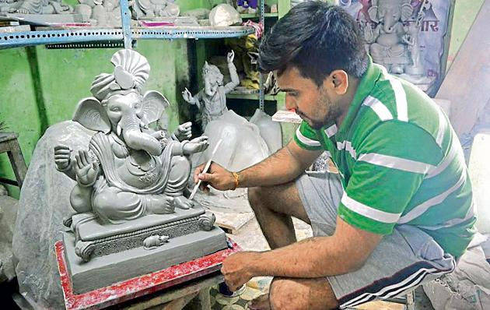
Old City and Kidron Valley from north
Idols neither see nor know…
“All who fashion idols are nothing, and the things they delight in do not profit. Their witnesses neither see nor know, that they may be put to shame.”
Isaiah 44:9

Slide 24
Old City and Kidron Valley from north
How can they help humans when their makers are human?
“Who fashions a god or casts an idol that is profitable for nothing? Behold, all his companions shall be put to shame, and the craftsmen are only human. Let them all assemble, let them stand forth. They shall be terrified; they shall be put to shame together.” Isaiah 44:10-11

Slide 25
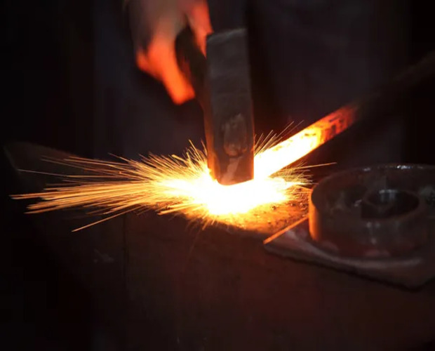
Old City and Kidron Valley from north
“The ironsmith takes a cutting tool and works it over the coals. He fashions it with hammers and works it with his strong arm. He becomes hungry, and his strength fails; he drinks no water and is faint.”
Isaiah 44:12
Metal idols… Created by strong people whose strength is still limited by human weakness.

Slide 26
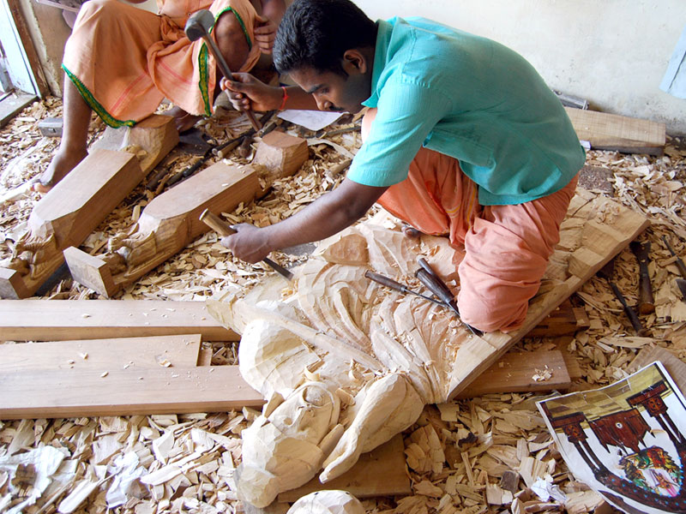
Old City and Kidron Valley from north
Wooden idols… Dependent on what God has created for design ideas!
“The carpenter stretches a line; he marks it out with a pencil. He shapes it with planes and marks it with a compass. He shapes it into the figure of a man, with the beauty of a man, to dwell in a house.”
Isaiah 44:13

Slide 27
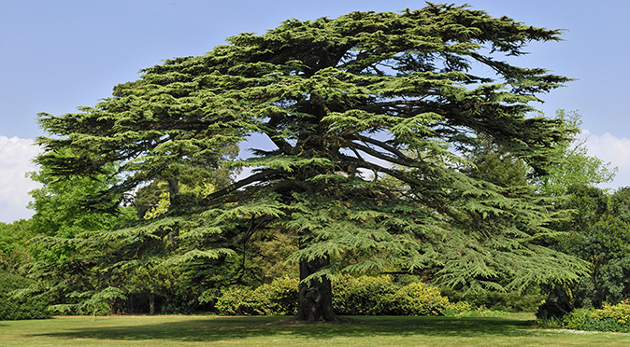
Old City and Kidron Valley from north
Wooden idols… Dependent on what God has created for raw materials!
“He cuts down cedars, or he chooses a cypress tree or an oak and lets it grow strong among the trees of the forest. He plants a cedar and the rain nourishes it.”
Isaiah 44:14

Slide 28
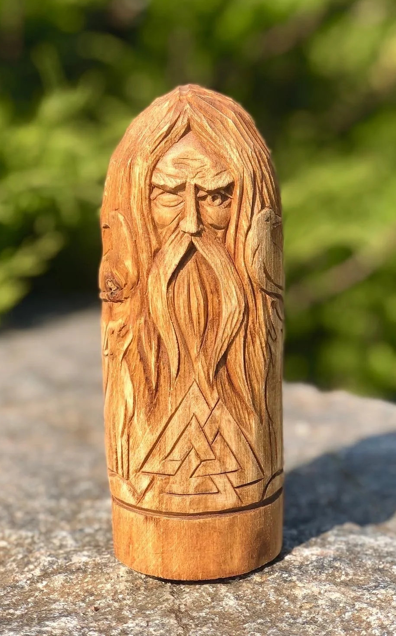
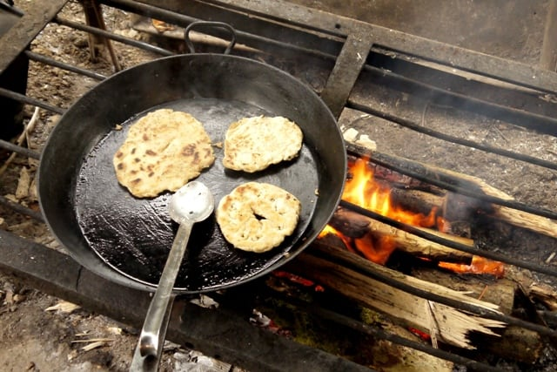
Old City and Kidron Valley from north
“Then it becomes fuel for a man. He takes a part of it and warms himself; he kindles a fire and bakes bread. Also he makes a god and worships it; he makes it an idol and falls down before it.” Isaiah 44:15

Slide 29
Old City and Kidron Valley from north
“Half of it he burns in the fire. Over the half he eats meat; he roasts it and is satisfied. Also he warms himself and says, “Aha, I am warm, I have seen the fire!” Isaiah 44:16

Slide 30
Old City and Kidron Valley from north
The idol worshipper actually expects this god to have more strength than he has!
“And the rest of it he makes into a god, his idol, and falls down to it and worships it. He prays to it and says, “Deliver me, for you are my god!” Isaiah 44:17

Slide 31
Old City and Kidron Valley from north
“They know not, nor do they discern, for he has shut their eyes, so that they cannot see, and their hearts, so that they cannot understand. No one considers, nor is there knowledge or discernment to say, ‘Half of it I burned in the fire; I also baked bread on its coals; I roasted meat and have eaten. And shall I make the rest of it an abomination? Shall I fall down before a block of wood?’ He feeds on ashes; a deluded heart has led him astray, and he cannot deliver himself or say, ‘Is there not a lie in my right hand?’” Isaiah 44:18-20

Slide 32
Isaiah 44:1-23 – Yahweh – the Only True God
The Nature of the True God (1-8)
The Insanity of Idolatry (9-20)
Responding to the True God (21-23)

Slide 33
In the middle of dark or difficult days…
Remember who the True God is and what he’s like.
Remember what the idols are – the works of man.
“Remember these things, O Jacob,
and Israel, for you are my servant;
I formed you; you are my servant;
O Israel, you will not be forgotten by me.”
Isaiah 44:21

Slide 34
“Are not two sparrows sold for a penny? And not one of them will fall to the ground apart from your Father. But even the hairs of your head are all numbered. Fear not, therefore; you are of more value than many sparrows.”
Matthew 10:29-31
“Remember these things, O Jacob,
and Israel, for you are my servant;
I formed you; you are my servant;
O Israel, you will not be forgotten by me.”
Isaiah 44:21

Slide 35
The price of your spiritual redemption has already been paid!
“I have blotted out your transgressions like a cloud
and your sins like mist;
return to me, for I have redeemed you.”
Isaiah 44:22

Slide 36
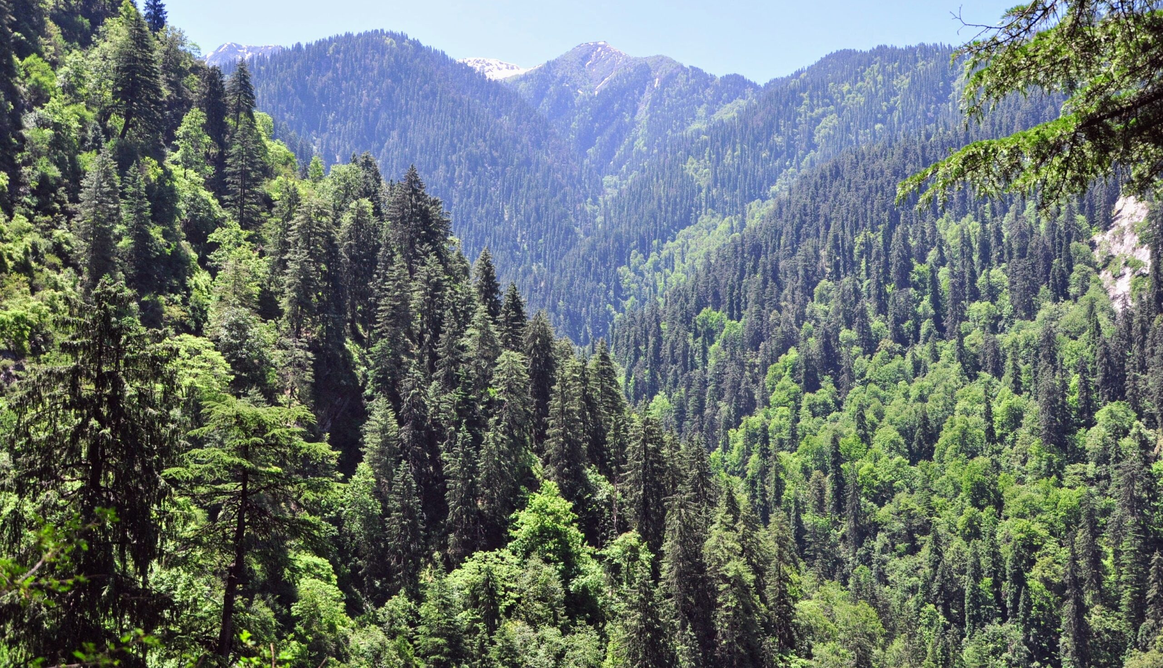
The most powerful work of God in all of human history is the redemption of his people from their spiritual bondage!
“Sing, O heavens, for the LORD has done it;
shout, O depths of the earth;
break forth into singing, O mountains,
O forest, and every tree in it!
For the LORD has redeemed Jacob,
and will be glorified in Israel.” Isaiah 44:23

Slide 37
The creation man had tried to turn into his gods is called to worship the True God!
“Sing, O heavens, for the LORD has done it;
shout, O depths of the earth;
break forth into singing, O mountains,
O forest, and every tree in it!
For the LORD has redeemed Jacob,
and will be glorified in Israel.” Isaiah 44:23

Slide 38
Isaiah 44:1-23 – Yahweh – the Only True God
The Nature of the True God (1-8)
The Insanity of Idolatry (9-20)
Responding to the True God (21-23)

Slide 39
What difficult circumstances are you facing?
What areas of life seem out of control?
Job Loss, Cancer / Other Health Needs, Loneliness, Need to Feel Loved / Significant…
Where will you turn – to God or to an idol?

Slide 40
Common Idols in our Society
All of these are subject to human frailty
None of these can bring lasting satisfaction
Money / Possessions / Financial Security
Love
Sex & Sexual Freedom
Entertainment / Sports / Pleasure
Education / Knowledge
Popularity / Success – Even in Ministry!

Slide 41
“Remember these things, O Jacob,
and Israel, for you are my servant;
I formed you; you are my servant;
O Israel, you will not be forgotten by me.”
Isaiah 44:21

Slide 43
OT Preaching link at BibleStudyDownloads.org
Get this presentation for free!
Notes:
OT Preaching (op)

