Slide 1
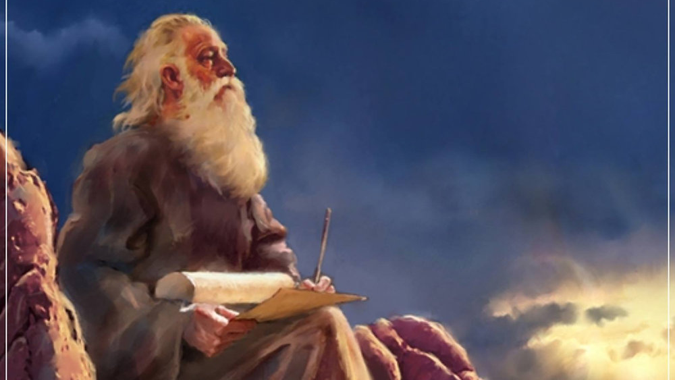
The Prophecy
Of
Isaiah
Isaiah 42:18 – 43:7
Amazing Redemption!
Preached by Dan Bridges at Amman International Church, Jordan • AmmanChurch.com Uploaded by Dr. Rick Griffith • Jordan Evangelical Theological Seminary Files in many languages for free download at BibleStudyDownloads.org

Slide 2
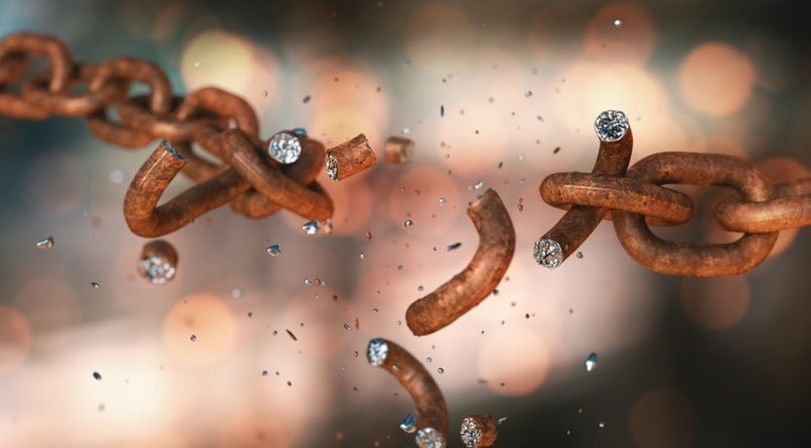
What do the words
“redemption” or “redeem”
mean?

Slide 3
Redemption – the payment of a ransom price to secure the release of someone or something.

Slide 4
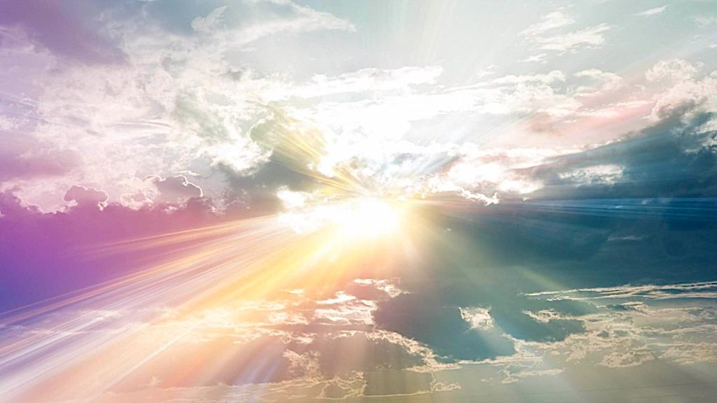
Isaiah 42:18 – 43:7 – Amazing Redemption!
Because of God and God Alone:
A Failed, Broken People (42:18-25)
become…
A Precious, Redeemed People (43:1-7)!

Slide 5
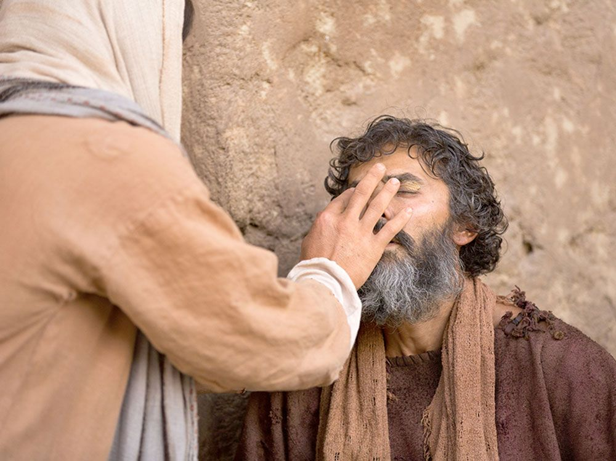
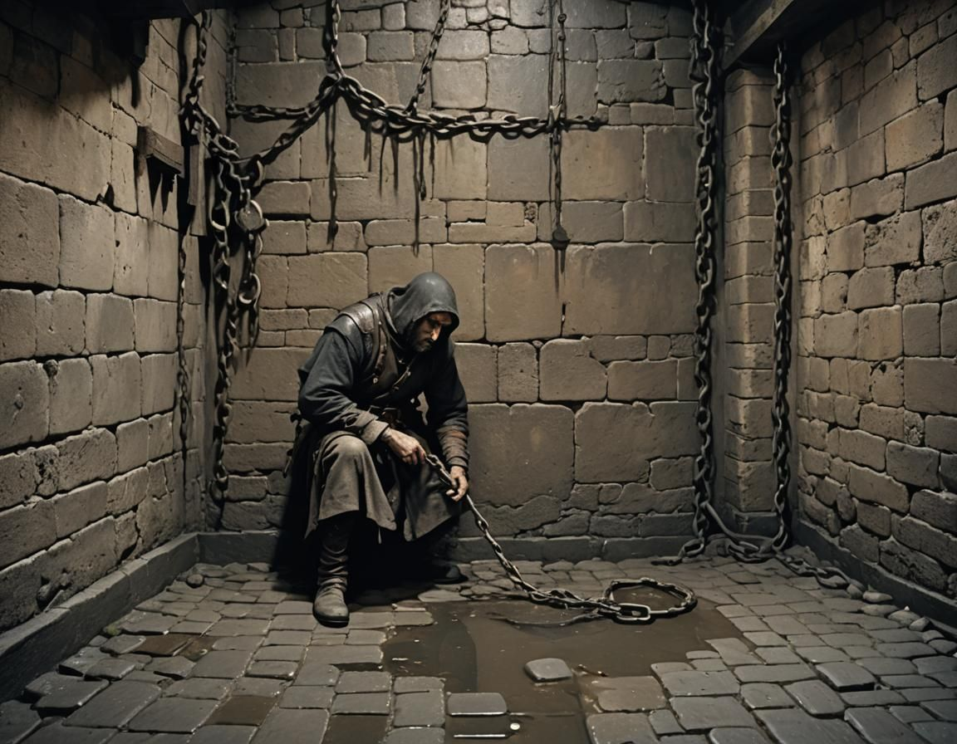
Review…

Slide 6
The Servant of the LORD
Who are the blind?
The spiritually blind from all the nations
“I will give you… as a light for the nations,
to open the eyes that are blind,
to bring out the prisoners from the dungeon,
from the prison those who sit in darkness.”
Isaiah 42:6-7

Slide 7
Promise of Salvation
for God’s people of all nations!
“And I will lead the blind
in a way that they do not know,
in paths that they have not known
I will guide them.”
Isaiah 42:16a

Slide 8
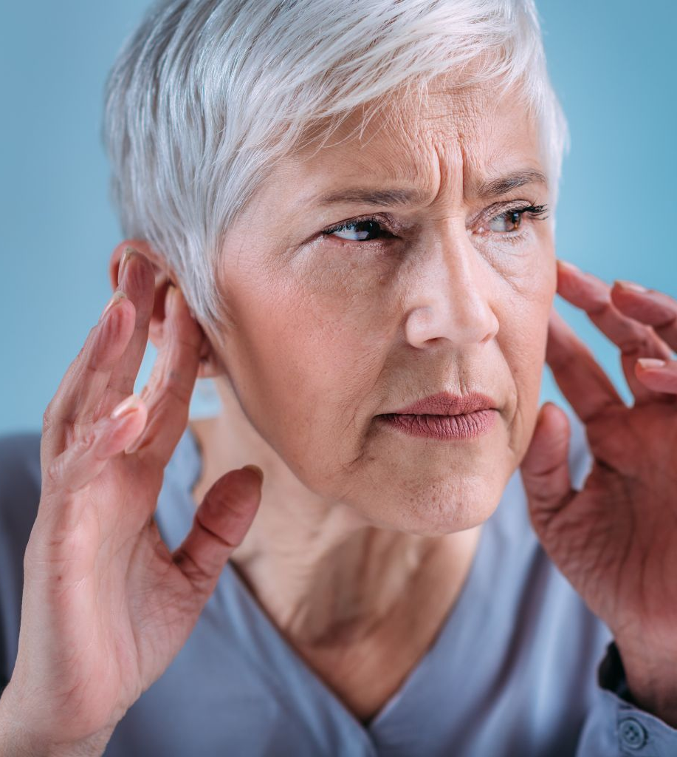
Calling out to the nations…
But there’s a problem…
“Hear, you deaf,
and look, you blind, that you may see!”
Isaiah 42:18

Slide 9
“Who is blind but my servant,
or deaf as my messenger whom I send?
Who is blind as my dedicated one,
or blind as the servant of the LORD?
He sees many things, but does not observe them;
his ears are open, but he does not hear.”
Isaiah 42:19-20

Slide 10
Who is this servant?
Israel (Isaiah 41:8-9)?
Jesus (Isaiah 42:1-9)?
“Who is blind but my servant,
or deaf as my messenger whom I send?
Who is blind as my dedicated one,
or blind as the servant of the LORD?
He sees many things, but does not observe them;
his ears are open, but he does not hear.”
Isaiah 42:19-20

Slide 11
Who is this servant?
Israel (Isaiah 41:8-9) (Also “Jacob” in 42:24)
Jesus (Isaiah 42:1-9)?
“Who is blind but my servant,
or deaf as my messenger whom I send?
Who is blind as my dedicated one,
or blind as the servant of the LORD?
He sees many things, but does not observe them;
his ears are open, but he does not hear.”
Isaiah 42:19-20

Slide 12
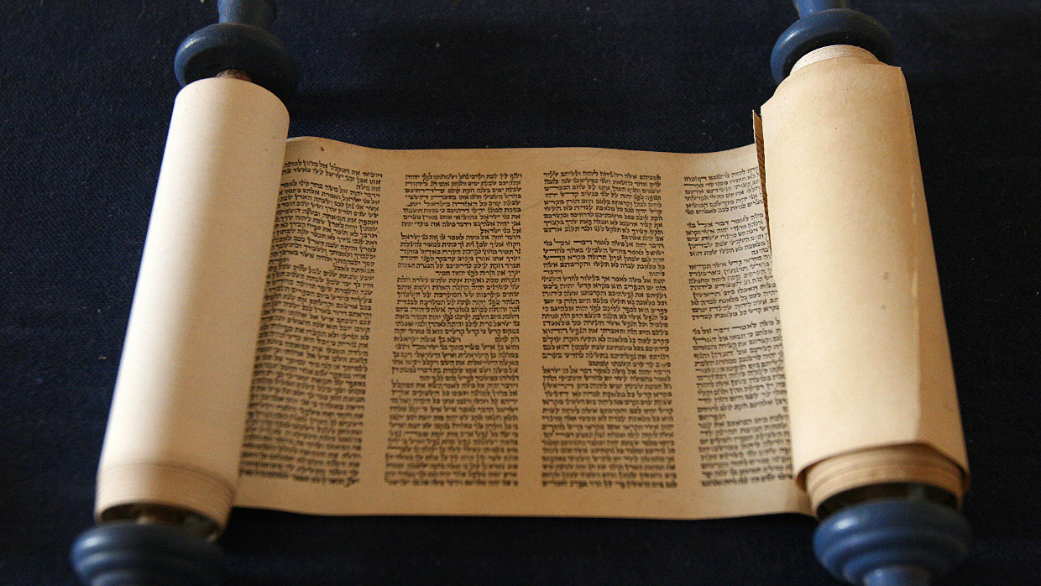
“The LORD was pleased, for his righteousness' sake,
to magnify his law and make it glorious.”
Isaiah 42:21

Slide 13
“Keep [my statutes] and do them, for that will be your wisdom and your understanding in the sight of the peoples, who, when they hear all these statutes, will say, ‘Surely this great nation is a wise and understanding people.’ For what great nation is there that has a god so near to it as the LORD our God is to us, whenever we call upon him? And what great nation is there, that has statutes and rules so righteous as all this law that I set before you today?”
Deuteronomy 4:6-8

Slide 14
“The LORD was pleased, for his righteousness' sake,
to magnify his law and make it glorious.”
Isaiah 42:21

Slide 15
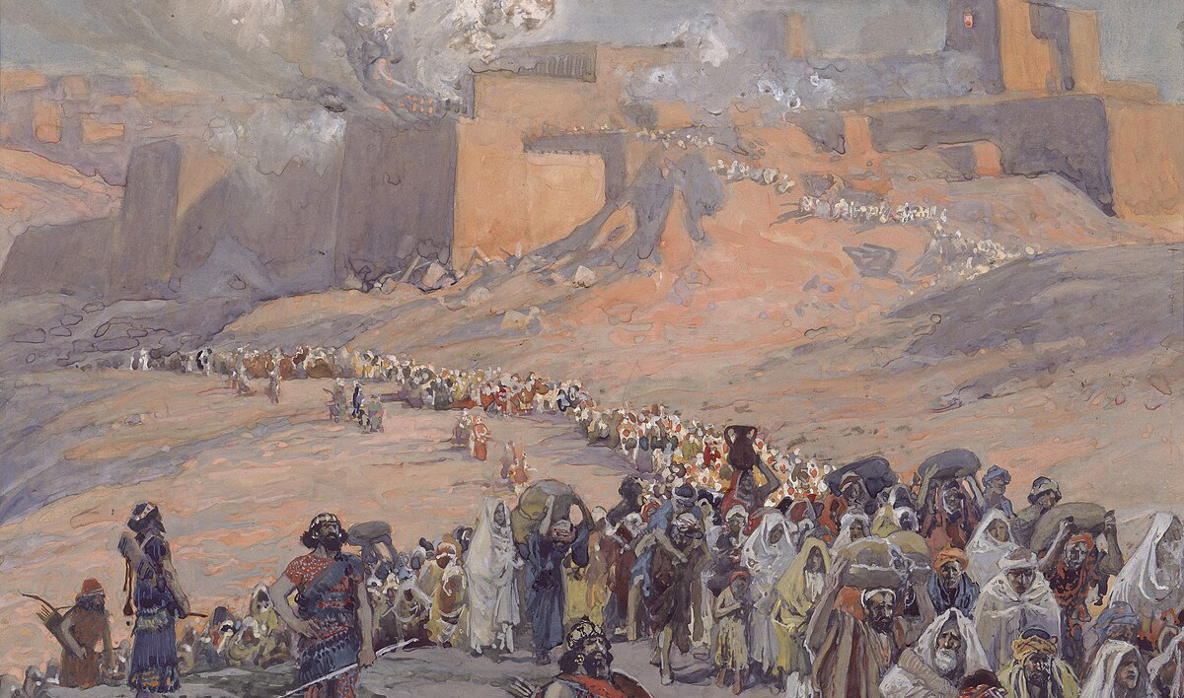
“But this is a people plundered and looted;
they are all of them trapped in holes
and hidden in prisons;
they have become plunder with none to rescue,
spoil with none to say, ‘Restore!’”
Isaiah 42:22
The Problem:
God’s servant – the light for the nations – had become the plunder of the nations!

Slide 16
“Who among you will give ear to this,
will attend and listen for the time to come?
Who gave up Jacob to the looter,
and Israel to the plunderers?”
Isaiah 42:23 -24a

Slide 17
“Was it not the LORD, against whom we have sinned,
in whose ways they would not walk,
and whose law they would not obey?
So he poured on him the heat of his anger
and the might of battle;
it set him on fire all around, but he did not understand;
it burned him up, but he did not take it to heart.”
Isaiah 42:24b-25
The Babylonians took them into exile… but God said it was really him!

Slide 18
This is a people who have earned the “heat of God’s anger”.
Is God finished with them?
“Was it not the LORD, against whom we have sinned,
in whose ways they would not walk,
and whose law they would not obey?
So he poured on him the heat of his anger
and the might of battle;
it set him on fire all around, but he did not understand;
it burned him up, but he did not take it to heart.”
Isaiah 42:24b-25

Slide 19
Isaiah 42:18 – 43:7 – Amazing Redemption!
Because of God and God Alone:
A Failed, Broken People (42:18-25)
become…
A Precious, Redeemed People (43:1-7)!

Slide 20
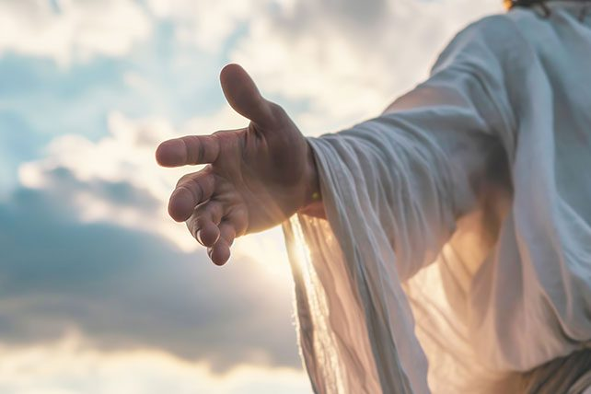
Who is God speaking to here?
The very same people upon whom he was pouring out his anger!
“But now thus says the LORD,
he who created you, O Jacob,
he who formed you, O Israel:
“Fear not, for I have redeemed you;
I have called you by name, you are mine.”
Isaiah 43:1

Slide 21
“Now then…”
“But now thus says the LORD,
he who created you, O Jacob,
he who formed you, O Israel:
“Fear not, for I have redeemed you;
I have called you by name, you are mine.”
Isaiah 43:1

Slide 22
“So God created man in his own image…”
Genesis 1:27
“Then the LORD God formed the man of dust from the ground…” Genesis 2:7
“But now thus says the LORD,
he who created you, O Jacob,
he who formed you, O Israel:
“Fear not, for I have redeemed you;
I have called you by name, you are mine.”
Isaiah 43:1

Slide 23
“But now thus says the LORD,
he who created you, O Jacob,
he who formed you, O Israel:
“Fear not, for I have redeemed you;
I have called you by name, you are mine.”
Isaiah 43:1

Slide 24
Meaning here:
“I will certainly redeem you”
(prophetic perfect)
“But now thus says the LORD,
he who created you, O Jacob,
he who formed you, O Israel:
“Fear not, for I have redeemed you;
I have called you by name, you are mine.”
Isaiah 43:1

Slide 25
Personal / Intimate
“But now thus says the LORD,
he who created you, O Jacob,
he who formed you, O Israel:
“Fear not, for I have redeemed you;
I have called you by name, you are mine.”
Isaiah 43:1

Slide 26
God delights in his people!
“You are MINE!”
“But now thus says the LORD,
he who created you, O Jacob,
he who formed you, O Israel:
“Fear not, for I have redeemed you;
I have called you by name, you are mine.”
Isaiah 43:1

Slide 27
“But now thus says the LORD,
he who created you, O Jacob,
he who formed you, O Israel:
‘Fear not, for I have redeemed you;
I have called you by name,
you are mine.’”
Is this declaration of love and commitment ours to claim?
“And if you are Christ's, then you are Abraham's offspring, heirs according to promise.” Galatians 3:29

Slide 28
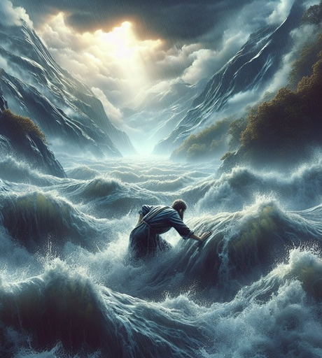
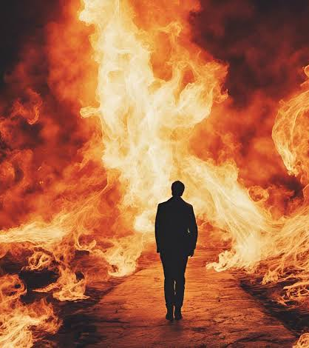
“When you pass through the waters, I will be with you;
and through the rivers, they shall not overwhelm you;
when you walk through fire you shall not be burned,
and the flame shall not consume you.” Isaiah 43:2
Water and fire – Representing life’s biggest trials

Slide 29
“When you pass through the waters, I will be with you;
and through the rivers, they shall not overwhelm you;
when you walk through fire you shall not be burned,
and the flame shall not consume you.” Isaiah 43:2
Fear not! Even the worst trials and disasters cannot separate God’s people from God’s presence!

Slide 30
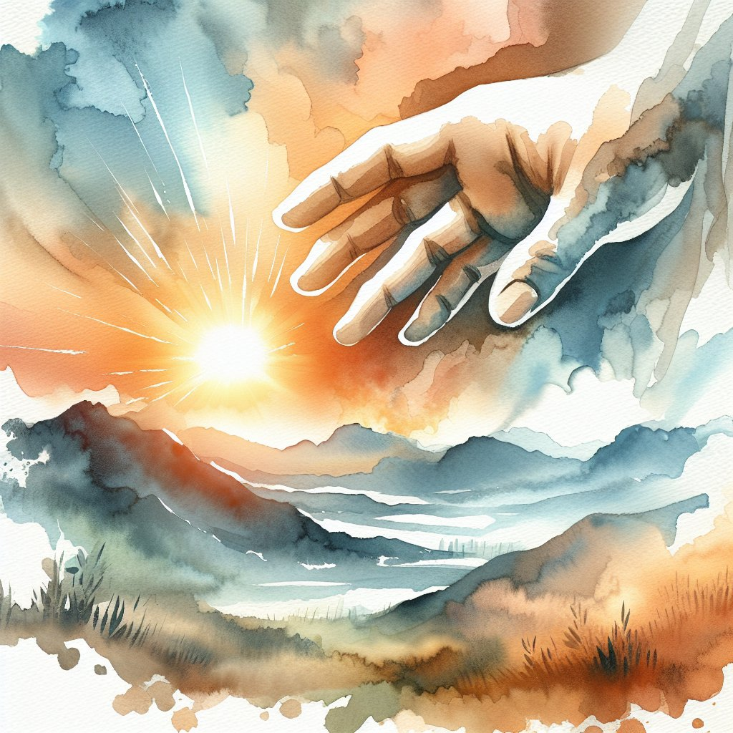
“For I am the LORD your God,
the Holy One of Israel, your Savior.
I give Egypt as your ransom,
Cush and Seba in exchange for you.
Because you are precious in my eyes,
and honored, and I love you,
I give men in return for you,
peoples in exchange for your life.”
Isaiah 43:3-4

Slide 31
Yahweh!
“For I am the LORD your God,
the Holy One of Israel, your Savior.
I give Egypt as your ransom,
Cush and Seba in exchange for you.
Because you are precious in my eyes,
and honored, and I love you,
I give men in return for you,
peoples in exchange for your life.”
Isaiah 43:3-4

Slide 32
“For I am the LORD your God,
the Holy One of Israel, your Savior.
I give Egypt as your ransom,
Cush and Seba in exchange for you.
Because you are precious in my eyes,
and honored, and I love you,
I give men in return for you,
peoples in exchange for your life.”
Isaiah 43:3-4
In days past, God redeemed his people at the expense of Egypt.

Slide 33
“For I am the LORD your God,
the Holy One of Israel, your Savior.
I give Egypt as your ransom,
Cush and Seba in exchange for you.
Because you are precious in my eyes,
and honored, and I love you,
I give men in return for you,
peoples in exchange for your life.”
Isaiah 43:3-4
We are precious to the most important being in the universe!

Slide 34
Imagine God saying to you:
“You are precious in my eyes…
You are honored in my eyes…
I love you!”
“For I am the LORD your God,
the Holy One of Israel, your Savior.
I give Egypt as your ransom,
Cush and Seba in exchange for you.
Because you are precious in my eyes,
and honored, and I love you,
I give men in return for you,
peoples in exchange for your life.”
Isaiah 43:3-4

Slide 35
“For I am the LORD your God,
the Holy One of Israel, your Savior.
I give Egypt as your ransom,
Cush and Seba in exchange for you.
Because you are precious in my eyes,
and honored, and I love you,
I give men in return for you,
peoples in exchange for your life.”
Isaiah 43:3-4
“There is no price I wouldn’t pay for you!”

Slide 36
“For I am the LORD your God,
the Holy One of Israel, your Savior.
I give Egypt as your ransom,
Cush and Seba in exchange for you.
Because you are precious in my eyes,
and honored, and I love you,
I give men in return for you,
peoples in exchange for your life.”
Isaiah 43:3-4
Whom did God ultimately give in exchange for our lives?
His Son!

Slide 37
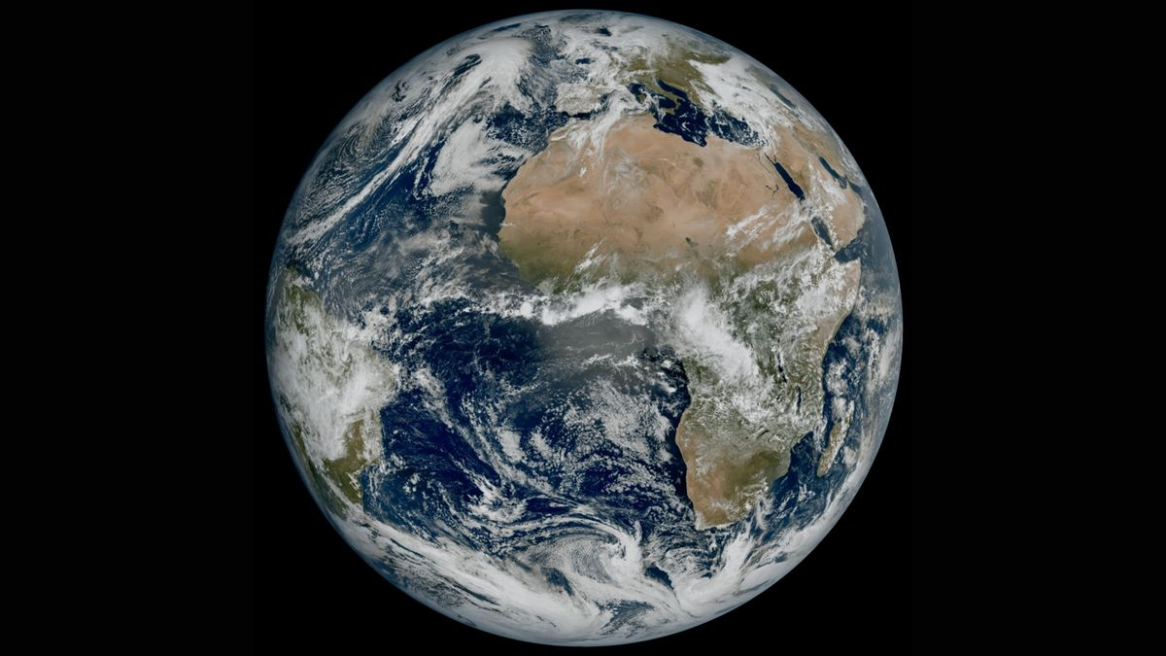
“Fear not, for I am with you;
I will bring your offspring from the east,
and from the west I will gather you.
I will say to the north, Give up,
and to the south, Do not withhold;
bring my sons from afar
and my daughters from the end of the earth,
everyone who is called by my name,
whom I created for my glory,
whom I formed and made.” Isaiah 43:5-7

Slide 38
“Fear not, for I am with you;
I will bring your offspring from the east,
and from the west I will gather you.
I will say to the north, Give up,
and to the south, Do not withhold;
bring my sons from afar
and my daughters from the end of the earth,
everyone who is called by my name,
whom I created for my glory,
whom I formed and made.” Isaiah 43:5-7

Slide 39
“Fear not, for I am with you;
I will bring your offspring from the east,
and from the west I will gather you.
I will say to the north, Give up,
and to the south, Do not withhold;
bring my sons from afar
and my daughters from the end of the earth,
everyone who is called by my name,
whom I created for my glory,
whom I formed and made.” Isaiah 43:5-7
A promised regathering of God’s people from the “end of the earth”
How is this fulfilled?

Slide 40
Regathering of God’s people from the ends of the earth:
Initially fulfilled in the return of the exiles from Babylon
(This was a “type” of the full fulfillment to come.)
Jeremiah 16:14-16 – God would send fishermen and hunters to seek his people out.

Slide 41
“Therefore, behold, the days are coming, declares the LORD, when it shall no longer be said, ‘As the LORD lives who brought up the people of Israel out of the land of Egypt,’ but ‘As the LORD lives who brought up the people of Israel out of the north country and out of all the countries where he had driven them.’ For I will bring them back to their own land that I gave to their fathers.
Behold, I am sending for many fishers, declares the LORD, and they shall catch them. And afterward I will send for many hunters, and they shall hunt them from every mountain and every hill, and out of the clefts of the rocks.”
Jeremiah 16:14-16

Slide 42
Regathering of God’s people from the ends of the earth:
Initially fulfilled in the return of the exiles from Babylon
Jeremiah 16:14-16 – God would send fishermen and hunters to seek his people out.
Matthew 4:19 – Jesus called his disciples to be “fishers of men”. (Why 12 disciples?)
Acts 1:15 – 120 believers (the “remnant” of Israel)
Acts 2:5 – Pentecost – Jews “from every nation under heaven” (Acts 2-8: 1000s of Jews came to faith!)
Rest of Acts until today – Gathering of Jews & Gentiles
At this point, has Isaiah 43:5-6 been fulfilled?
Then what happened?

Slide 43
“Fear not, for I am with you;
I will bring your offspring from the east,
and from the west I will gather you.
I will say to the north, Give up,
and to the south, Do not withhold;
bring my sons from afar
and my daughters from the end of the earth,
everyone who is called by my name,
whom I created for my glory,
whom I formed and made.” Isaiah 43:5-7
Why does God use the creation picture here?
God is re-creating / re-forming a people for himself
Our purpose is to bring him glory by
Worshipping him in all of life
Living in ways that bring glory to him

Slide 44
Isaiah 42:18 – 43:7 – Amazing Redemption!
Because of God and God Alone:
A Failed, Broken People (42:18-25)
become…
A Precious, Redeemed People (43:1-7)!

Slide 45
So what is the basis for God’s redemption of his people?
God redeems his people because of
Who he is
Who they are in relation to him

Slide 46
Basis of Redemption:
Who God’s People are:
Created/Formed/Redeemed
Called by name
Called “Mine” by God
Precious in God’s eyes
Honored in God’s eyes
Loved by God
Worth any price
Called sons and daughters
Called by God’s name
Created for God’s glory
Formed by God
Who God is:
The LORD (Yahweh)
(Faithful to his covenant)
Creator of Jacob
One who formed Israel
Yahweh your God
Holy One of Israel
Savior of his people
Lord of the nations
How can we respond to this?

Slide 47
“And if you call on him as Father who judges impartially according to each one's deeds, conduct yourselves with fear throughout the time of your exile, knowing that you were ransomed from the futile ways inherited from your forefathers, not with perishable things such as silver or gold, but with the precious blood of Christ, like that of a lamb without blemish or spot.”
1 Peter 1:17-19

Slide 48
“But you are a chosen race, a royal priesthood, a holy nation, a people for his own possession, that you may proclaim the excellencies of him who called you out of darkness into his marvelous light.”
1 Peter 2:9
We too are God’s chosen people – set apart to be light in the world. How are we doing?
What should distinguish us from unbelievers?
LOVE!

Slide 49
“A new commandment I give to you, that you love one another: just as I have loved you, you also are to love one another. By this all people will know that you are my disciples, if you have love for one another.”
John 13:34-35
Does loving those who are easy to love distinguish us?
This is unusual love!
Has its foundation in God’s love for me
It means valuing God’s reputation more than my rights
It means loving those who are my enemies
It means loving those who are difficult to love

Slide 50
Isaiah 42:18 – 43:7 – Amazing Redemption!
Because of God and God Alone:
A Failed, Broken People (42:18-25)
become…
A Precious, Redeemed People (43:1-7)!
So that We Can Bring Him GLORY!

Slide 51
“A new commandment I give to you, that you love one another: just as I have loved you, you also are to love one another. By this all people will know that you are my disciples, if you have love for one another.”
John 13:34-35

Slide 53
OT Preaching link at BibleStudyDownloads.org
Get this presentation for free!
Notes:
OT Preaching (op)

