Slide 1
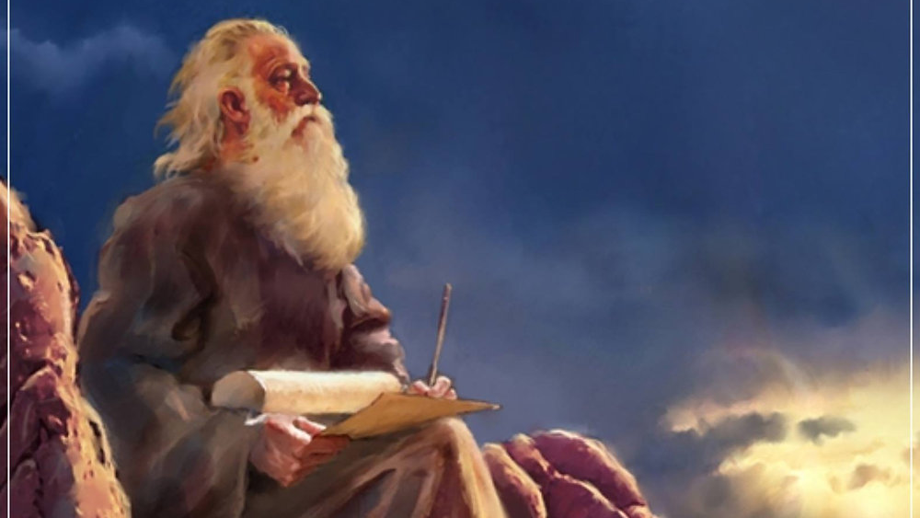
The Prophecy
Of
Isaiah
Isaiah 42:1-17
Behold My Servant!
Preached by Dan Bridges at Amman International Church, Jordan • AmmanChurch.com Uploaded by Dr. Rick Griffith • Jordan Evangelical Theological Seminary Files in many languages for free download at BibleStudyDownloads.org

Slide 2
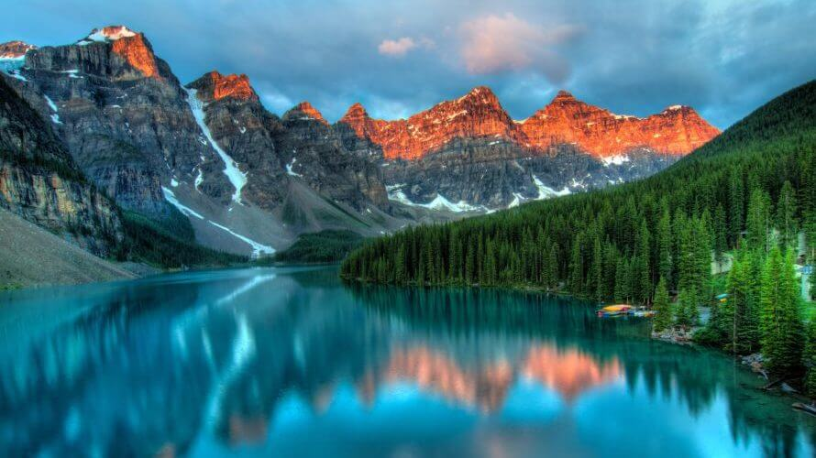
“What is more, I consider everything a loss compared to the surpassing greatness of knowing Christ Jesus my Lord...”
Philippians 3:8

Slide 3
Major Themes in Isaiah 40–66:
Four “Servant Songs”
Isaiah 42:1-9
Isaiah 49:5-7
Isaiah 50:4-9
Isaiah 52:13–53:12
The Servant of the LORD would be the one to ultimately save his people from their bondage!

Slide 4
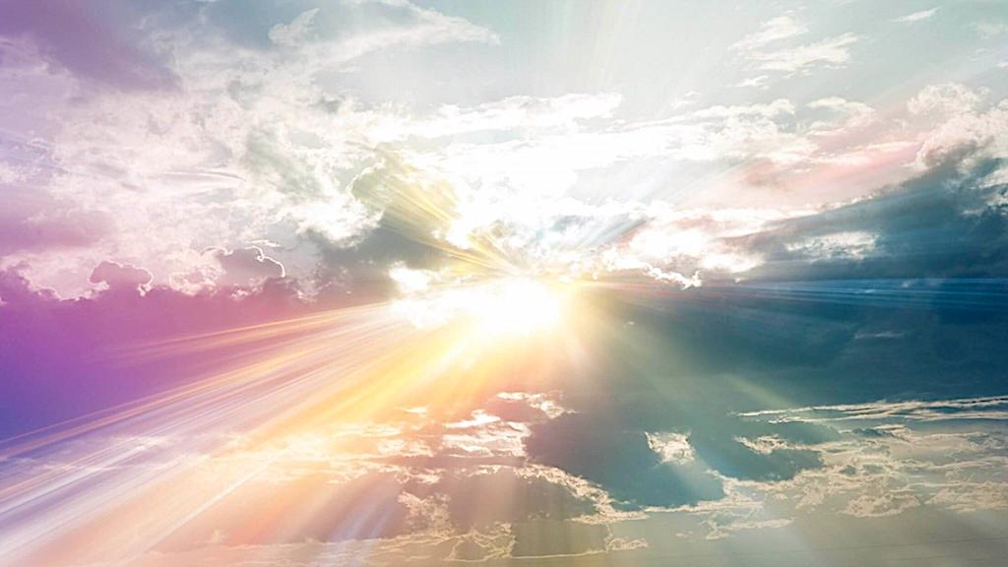
Isaiah 42:1-17 – Behold My Servant!
The Servant’s Identity (1-4)
The Servant’s Calling (5-9)
The Response of the Nations (10-12)
The Servant’s Victory (13-17)

Slide 5
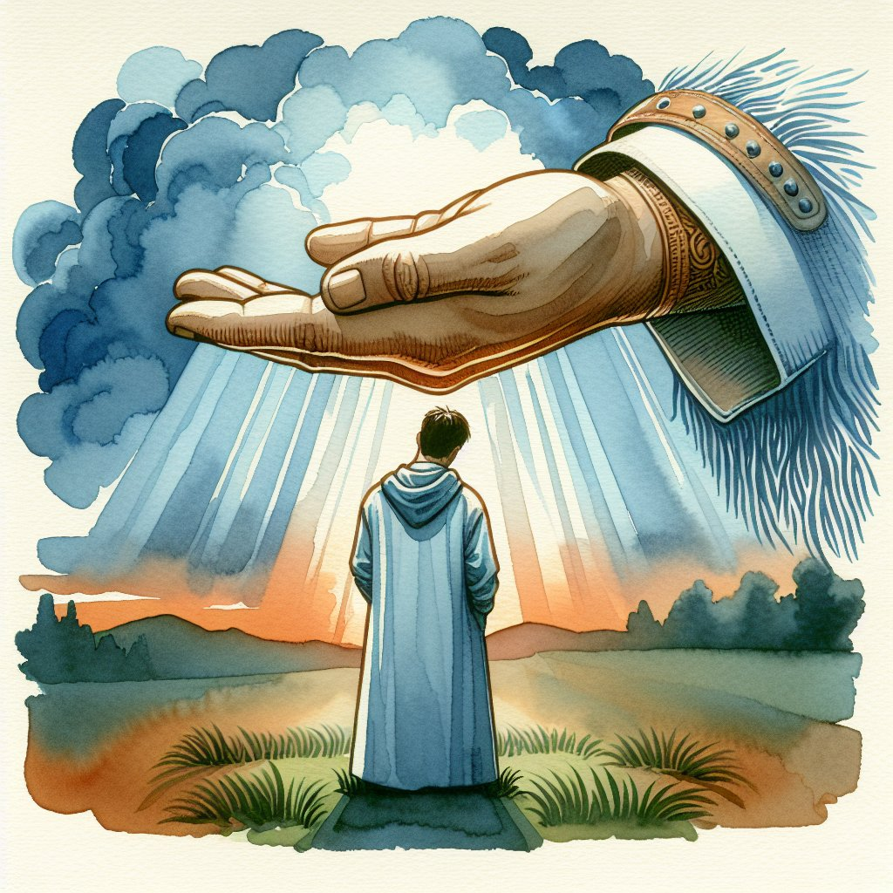
“Behold my servant,
whom I uphold,
my chosen, in whom
my soul delights;
I have put my Spirit
upon him;
he will bring forth
justice to the
nations.”
Isaiah 42:1
Who is God talking about?
Nation of Israel (Isaiah 41:8-9)?
Someone else?

Slide 6
“Behold my servant,
whom I uphold,
my chosen, in whom
my soul delights;
I have put my Spirit
upon him;
he will bring forth
justice to the
nations.”
Isaiah 42:1
Isaiah 42:1-4 is quoted in Matthew 12:18-21 as referring to Jesus.

Slide 7
“Behold my servant,
whom I uphold,
my chosen, in whom
my soul delights;
I have put my Spirit
upon him;
he will bring forth
justice to the
nations.”
Isaiah 42:1
‛eḇeḏ:
a servant, a slave
officer, official, ambassador of a king

Slide 8
“Behold my servant,
whom I uphold,
my chosen, in whom
my soul delights;
I have put my Spirit
upon him;
he will bring forth
justice to the
nations.”
Isaiah 42:1

Slide 9
“Behold my servant,
whom I uphold,
my chosen, in whom
my soul delights;
I have put my Spirit
upon him;
he will bring forth
justice to the
nations.”
Isaiah 42:1

Slide 10
“Behold my servant,
whom I uphold,
my chosen, in whom
my soul delights;
I have put my Spirit
upon him;
he will bring forth
justice to the
nations.”
Isaiah 42:1

Slide 11
“Behold my servant,
whom I uphold,
my chosen, in whom
my soul delights;
I have put my Spirit
upon him;
he will bring forth
justice to the
nations.”
Isaiah 42:1

Slide 12
“Behold my servant,
whom I uphold,
my chosen, in whom
my soul delights;
I have put my Spirit
upon him;
he will bring forth
justice to the
nations.”
Isaiah 42:1
Justice:
Putting everything right

Slide 13
“Behold my servant,
whom I uphold,
my chosen, in whom
my soul delights;
I have put my Spirit
upon him;
he will bring forth
justice to the
nations.”
Isaiah 42:1
Justice:
The job of a king…
but this is a servant!

Slide 14
“Behold my servant,
whom I uphold,
my chosen, in whom
my soul delights;
I have put my Spirit
upon him;
he will bring forth
justice to the
nations.”
Isaiah 42:1
Methods of a King:
To conquer
To enforce with power
To control the narrative

Slide 15
“Behold my servant,
whom I uphold,
my chosen, in whom
my soul delights;
I have put my Spirit
upon him;
he will bring forth
justice to the
nations.”
Isaiah 42:1
What are the methods of the Servant of the LORD?

Slide 16
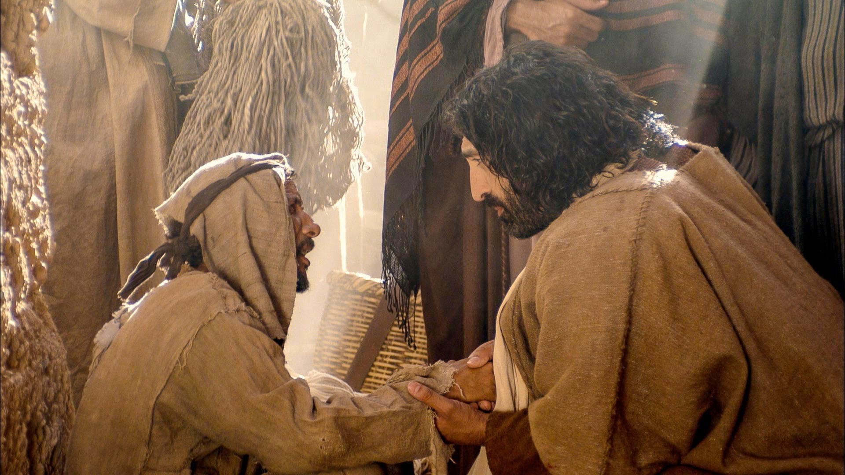
“He will not cry aloud or lift up his voice,
or make it heard in the street;”
Isaiah 42:2

Slide 17
“He will not quarrel…”
Matthew 12:19
“He will not cry aloud or lift up his voice,
or make it heard in the street;”
Isaiah 42:2

Slide 18
An attempt to dominate or shout others down
“He will not cry aloud or lift up his voice,
or make it heard in the street;”
Isaiah 42:2

Slide 19
Draw attention to himself
“He will not cry aloud or lift up his voice,
or make it heard in the street;”
Isaiah 42:2

Slide 20
“But the Pharisees went out and conspired against him, how to destroy him.
Jesus, aware of this, withdrew from there. And many followed him, and he healed them all and ordered them not to make him known. This was to fulfill what was spoken by the prophet Isaiah…”
Matthew 12:14-17
“He will not cry aloud or lift up his voice,
or make it heard in the street;”
Isaiah 42:2

Slide 21
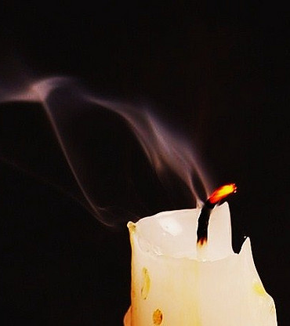
a bruised reed he will not break,
and a faintly burning wick he will not quench;
he will faithfully bring forth justice.”
Isaiah 42:3

Slide 22
Bruised:
Crushed, broken but attached
A deep wound that has damaged internal organs
The oppressed
a bruised reed he will not break,
and a faintly burning wick he will not quench;
he will faithfully bring forth justice.”
Isaiah 42:3

Slide 23
The weak, the oppressed, the broken, the hopeless cases
a bruised reed he will not break,
and a faintly burning wick he will not quench;
he will faithfully bring forth justice.”
Isaiah 42:3

Slide 24
“The Spirit of the Lord God is upon me,
because the Lord has anointed me
to bring good news to the poor;
he has sent me to bind up the brokenhearted,
to proclaim liberty to the captives,
and the opening of the prison to those who are bound;”
Isaiah 61:1
a bruised reed he will not break,
and a faintly burning wick he will not quench;
he will faithfully bring forth justice.”
Isaiah 42:3

Slide 25
How is justice brought forth like this?
As part of loving the weak, he denounced hypocrisy and injustice
He died to defeat Satan – the ultimate cause of injustice
a bruised reed he will not break,
and a faintly burning wick he will not quench;
he will faithfully bring forth justice.”
Isaiah 42:3

Slide 26
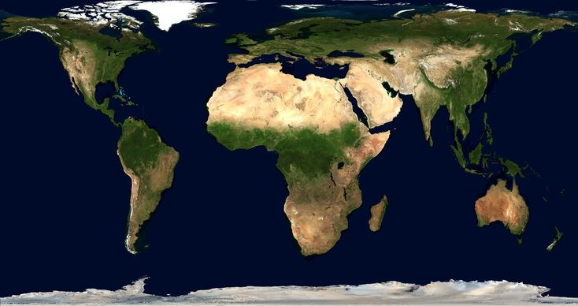
“He will not grow faint or be discouraged
till he has established justice in the earth;
and the coastlands wait for his law.”
Isaiah 42:4

Slide 27
“He will not grow faint or be discouraged
till he has established justice in the earth;
and the coastlands wait for his law.”
Isaiah 42:4

Slide 28
Isaiah 42:1-17 – Behold My Servant!
The Servant’s Identity (1-4)
The Servant’s Calling (5-9)
The Response of the Nations (10-12)
The Servant’s Victory (13-17)

Slide 29
5 Thus says God, the LORD,
who created the heavens and stretched them out,
who spread out the earth and what comes from it,
who gives breath to the people on it
and spirit to those who walk in it:
6 “I am the LORD; I have called you in righteousness;
I will take you by the hand and keep you;
I will give you as a covenant for the people, a light for the nations,
7 to open the eyes that are blind,
to bring out the prisoners from the dungeon,
from the prison those who sit in darkness.
8 I am the LORD; that is my name;
my glory I give to no other,
nor my praise to carved idols.
9 Behold, the former things have come to pass,
and new things I now declare;
before they spring forth I tell you of them.” Isaiah 42:5-9
Yahweh – Lord of Creation
Yahweh – Lord of the Servant
Yahweh – Lord of history and false gods

Slide 30
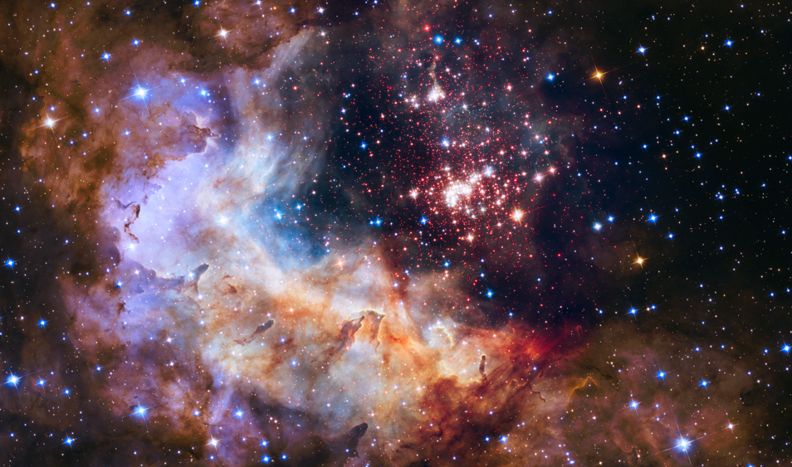
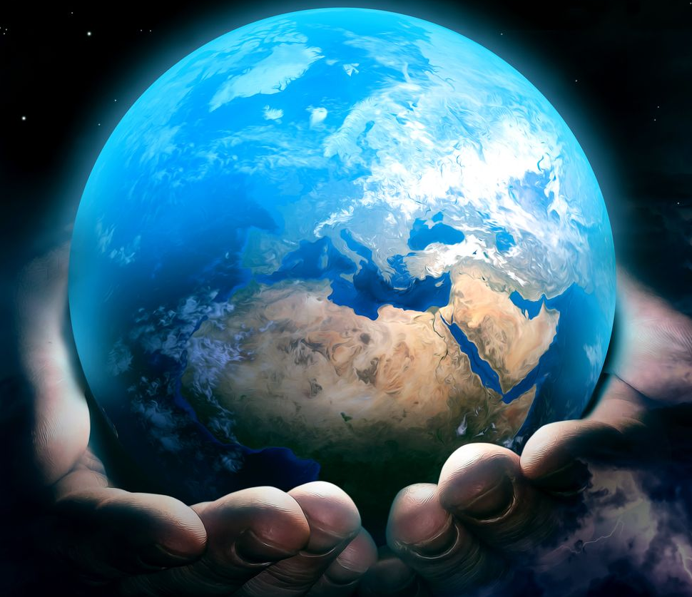
Lord of Creation
“Thus says God, the LORD,
who created the heavens and
stretched them out,
who spread out the earth and
what comes from it,
who gives breath to the people on it
and spirit to those who walk in it:”
Isaiah 42:5

Slide 31
Lord of Creation
“Thus says God, the LORD,
who created the heavens and
stretched them out,
who spread out the earth and
what comes from it,
who gives breath to the people on it
and spirit to those who walk in it:”
Isaiah 42:5
Yahweh is THE creator God!

Slide 32
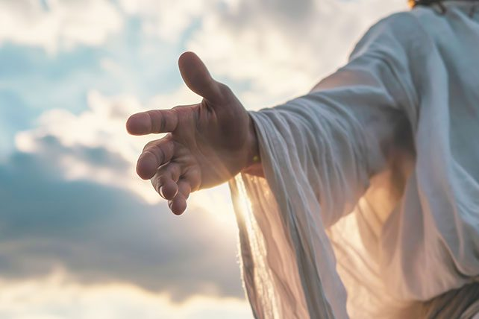
Lord of the Servant
“‘I am the LORD; I have called you in righteousness;
I will take you by the hand and keep you;
I will give you as a covenant for the people,
a light for the nations,” Isaiah 42:6

Slide 33
Lord of the Servant
Now Yahweh is speaking directly to his servant…
“‘I am the LORD; I have called you in righteousness;
I will take you by the hand and keep you;
I will give you as a covenant for the people,
a light for the nations,” Isaiah 42:6

Slide 34
Lord of the Servant
Called to accomplish God’s righteous purposes
“‘I am the LORD; I have called you in righteousness;
I will take you by the hand and keep you;
I will give you as a covenant for the people,
a light for the nations,” Isaiah 42:6

Slide 35
Lord of the Servant
“‘I am the LORD; I have called you in righteousness;
I will take you by the hand and keep you;
I will give you as a covenant for the people,
a light for the nations,” Isaiah 42:6

Slide 36
The servant IS the covenant!
Blessings of the New Covenant:
(Jeremiah 31:31-34)
Forgiveness of sins – once for all
New relationship with God
New hearts that have God’s law in them
“‘I am the LORD; I have called you in righteousness;
I will take you by the hand and keep you;
I will give you as a covenant for the people,
a light for the nations,” Isaiah 42:6

Slide 37
Lord of the Servant
The servant himself is the light – the means of salvation!
“‘I am the LORD; I have called you in righteousness;
I will take you by the hand and keep you;
I will give you as a covenant for the people,
a light for the nations,” Isaiah 42:6

Slide 38
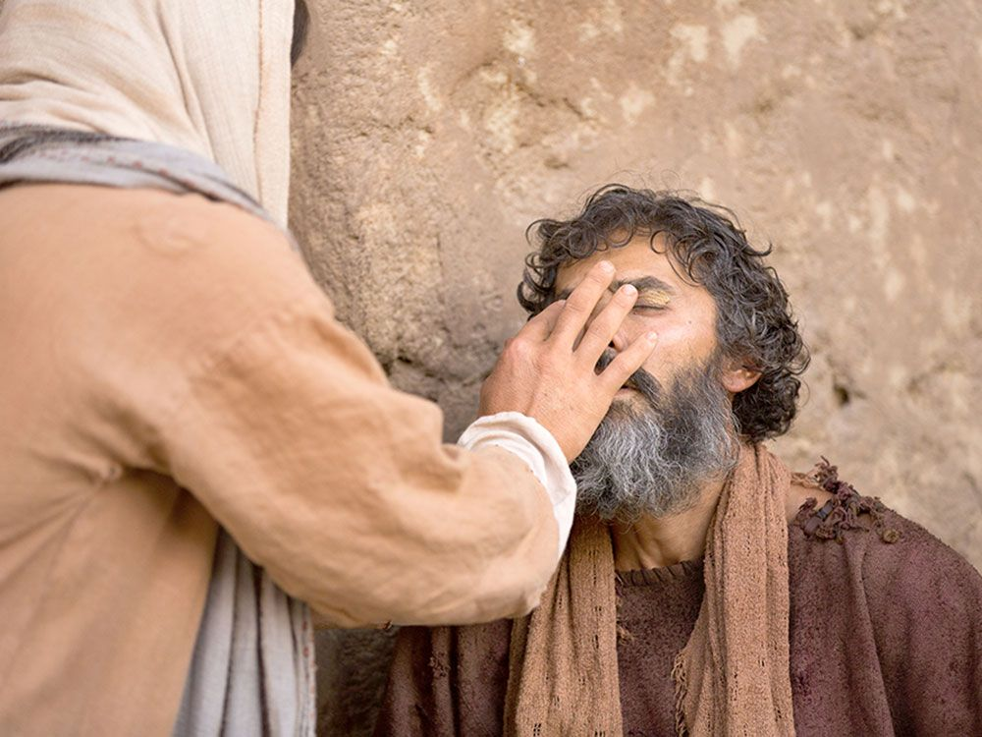
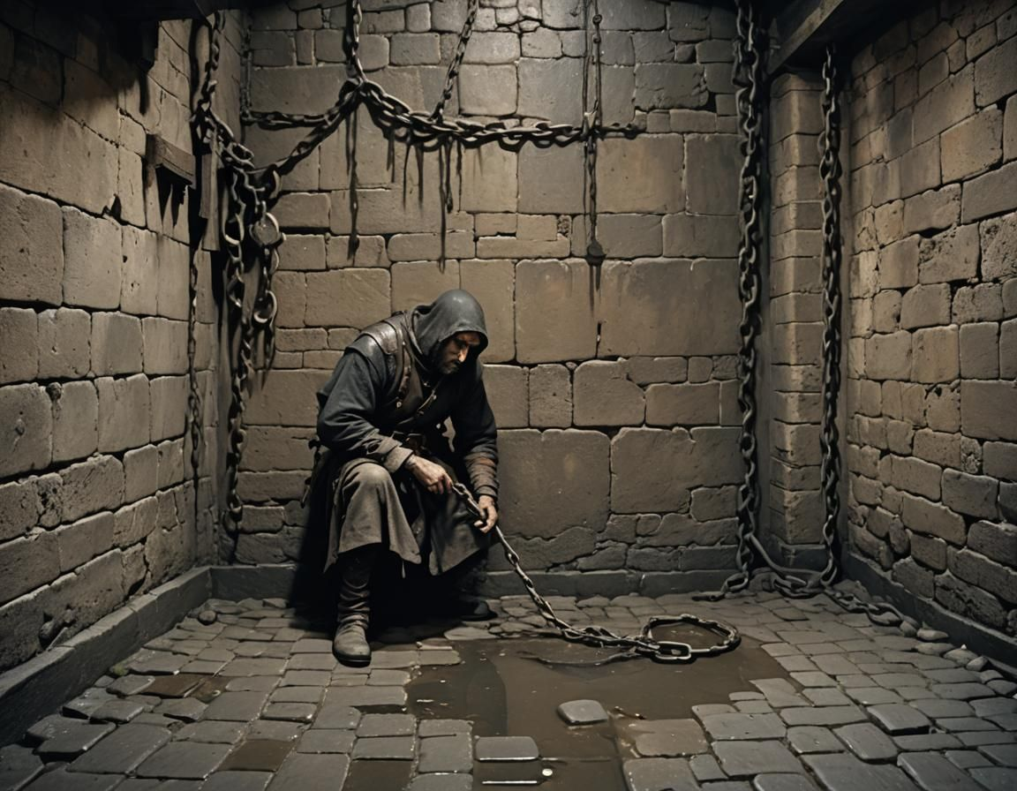
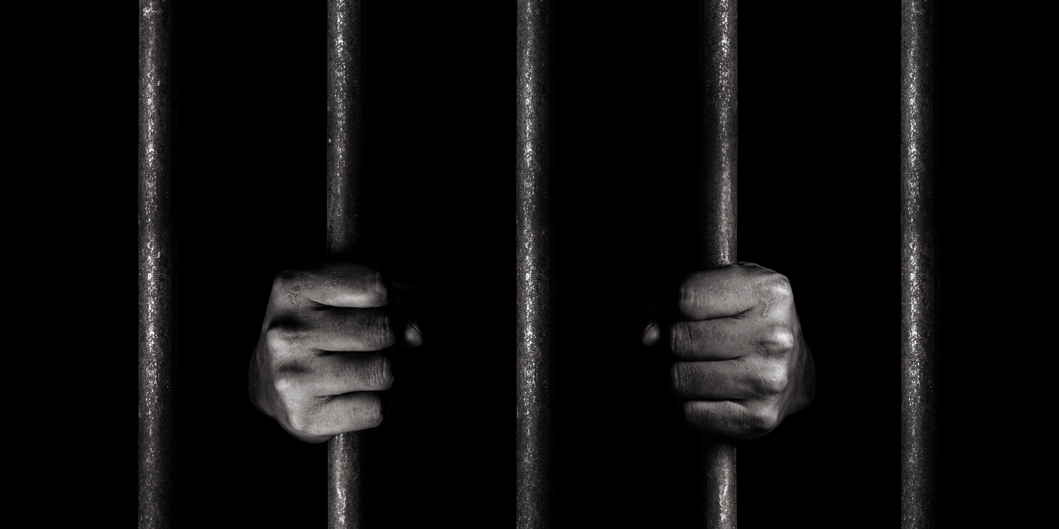
“‘to open the eyes that are blind,
to bring out the prisoners from the dungeon,
from the prison those who sit in darkness.’”
Isaiah 42:7
The “bruised reeds” – Ministry to those blinded and set captive by sin…

Slide 39
Lord of history
And false gods
“I am the LORD; that is my name;
my glory I give to no other,
nor my praise to carved idols.”
Isaiah 42:8
YAHWEH

Slide 40
Lord of history
And false gods
“‘Behold, the former things have come to pass,
and new things I now declare;
before they spring forth
I tell you of them.’” Isaiah 42:9

Slide 41
Lord of history
And false gods
Prophecies about Assyria, Babylon, Cyrus, etc.
“‘Behold, the former things have come to pass,
and new things I now declare;
before they spring forth
I tell you of them.’” Isaiah 42:9

Slide 42
Lord of history
And false gods
The coming of the Servant of the LORD!
“‘Behold, the former things have come to pass,
and new things I now declare;
before they spring forth
I tell you of them.’” Isaiah 42:9

Slide 43
Isaiah 42:1-17 – Behold My Servant!
The Servant’s Identity (1-4)
The Servant’s Calling (5-9)
The Response of the Nations (10-12)
The Servant’s Victory (13-17)

Slide 44
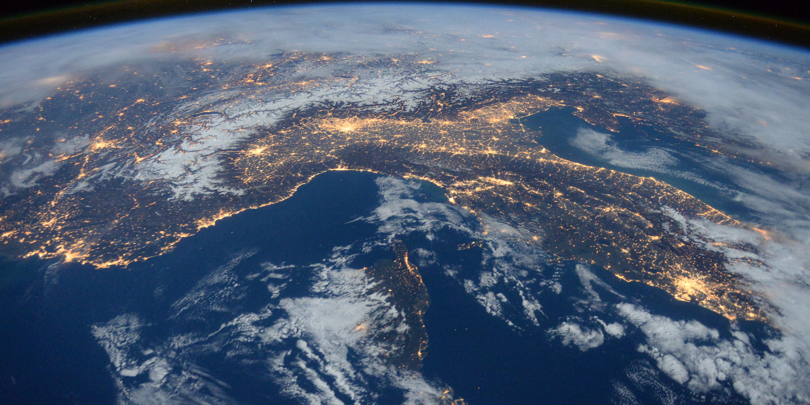
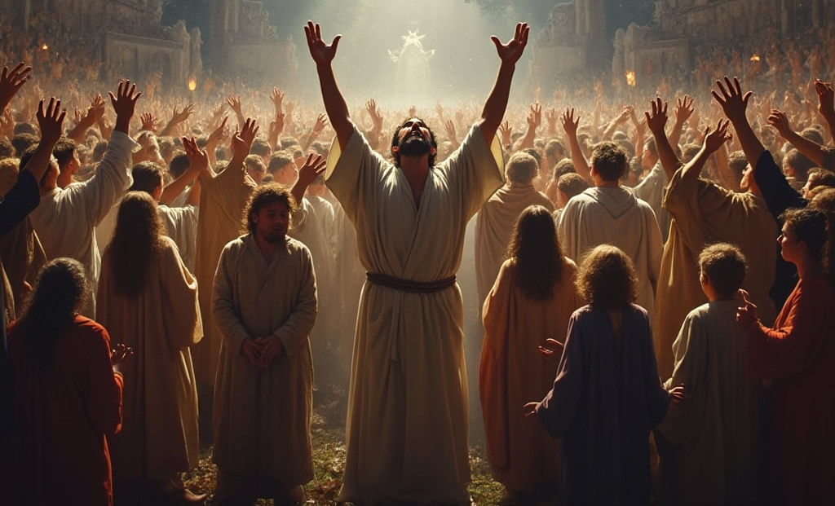
Immediate context of these chapters:
God’s rescuing of the exiles from Babylon
The work of the Servant is GLOBAL!
“Sing to the LORD a new song,
his praise from the end of the earth,
you who go down to the sea, and all that fills it,
the coastlands and their inhabitants.” Isaiah 42:10

Slide 45
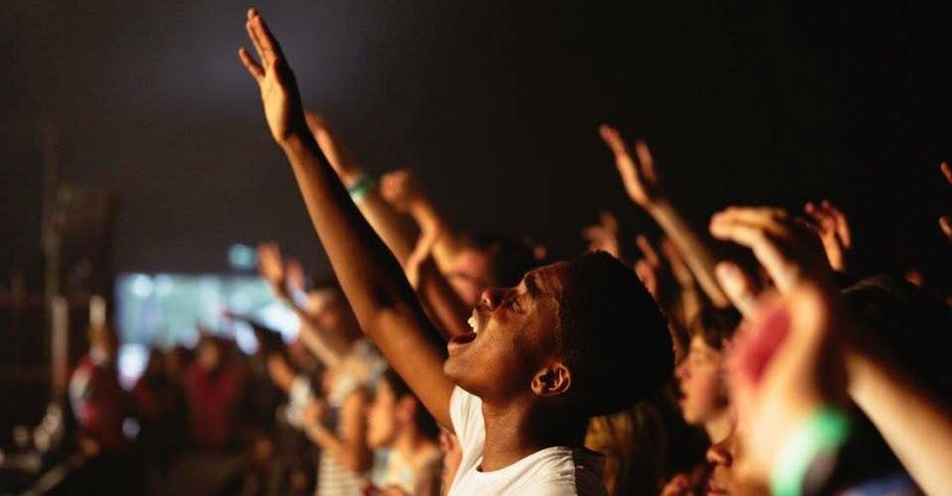
“Let the desert and its cities lift up their voice,
the villages that Kedar inhabits;
let the habitants of Sela sing for joy,
let them shout from the top of the mountains.”
Isaiah 42:11
Arabs!
Edom!

Slide 46
“Let them give glory to the LORD,
and declare his praise in the coastlands.”
Isaiah 42:12

Slide 47
Isaiah 42:1-17 – Behold My Servant!
The Servant’s Identity (1-4)
The Servant’s Calling (5-9)
The Response of the Nations (10-12)
The Servant’s Victory (13-17)

Slide 48
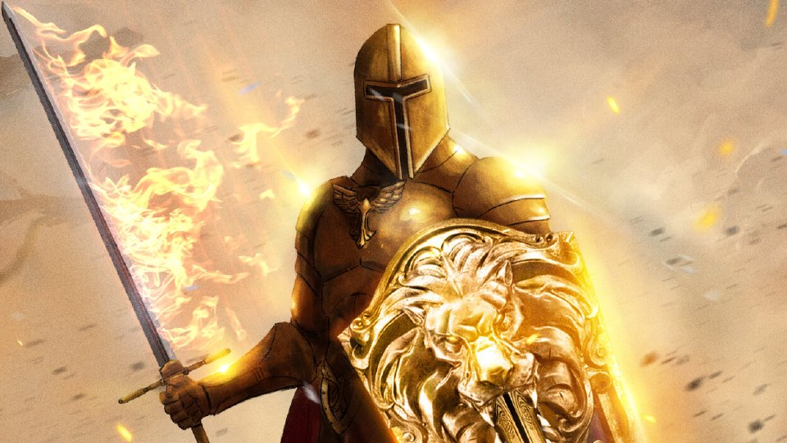
Context?
God’s sending of his servant
“The LORD goes out like a mighty man,
like a man of war he stirs up his zeal;
he cries out, he shouts aloud,
he shows himself mighty against his foes.”
Isaiah 42:13

Slide 49
God has been waiting…
For what?
“For a long time I have held my peace;
I have kept still and restrained myself;”
Isaiah 42:14a

Slide 50
“Some great thing, with which Jehovah has, as it were, long been pregnant, is now about to be born.”
Franz Delitzsch
“now I will cry out like a woman in labor;
I will gasp and pant.” Isaiah 42:14b

Slide 51
“But when the fullness of time had come, God sent forth his Son, born of woman, born under the law, to redeem those who were under the law, so that we might receive adoption as sons.” Galatians 4:4-5

Slide 52
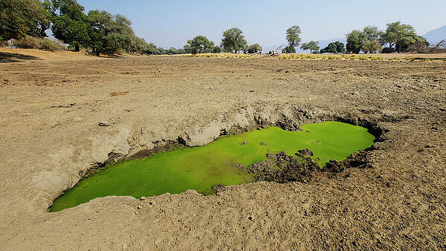
“I will lay waste mountains and hills,
and dry up all their vegetation;
I will turn the rivers into islands,
and dry up the pools.” Isaiah 42:15
Total, radical, all-embracing change…
Judgment for worshippers of idols and

Slide 53
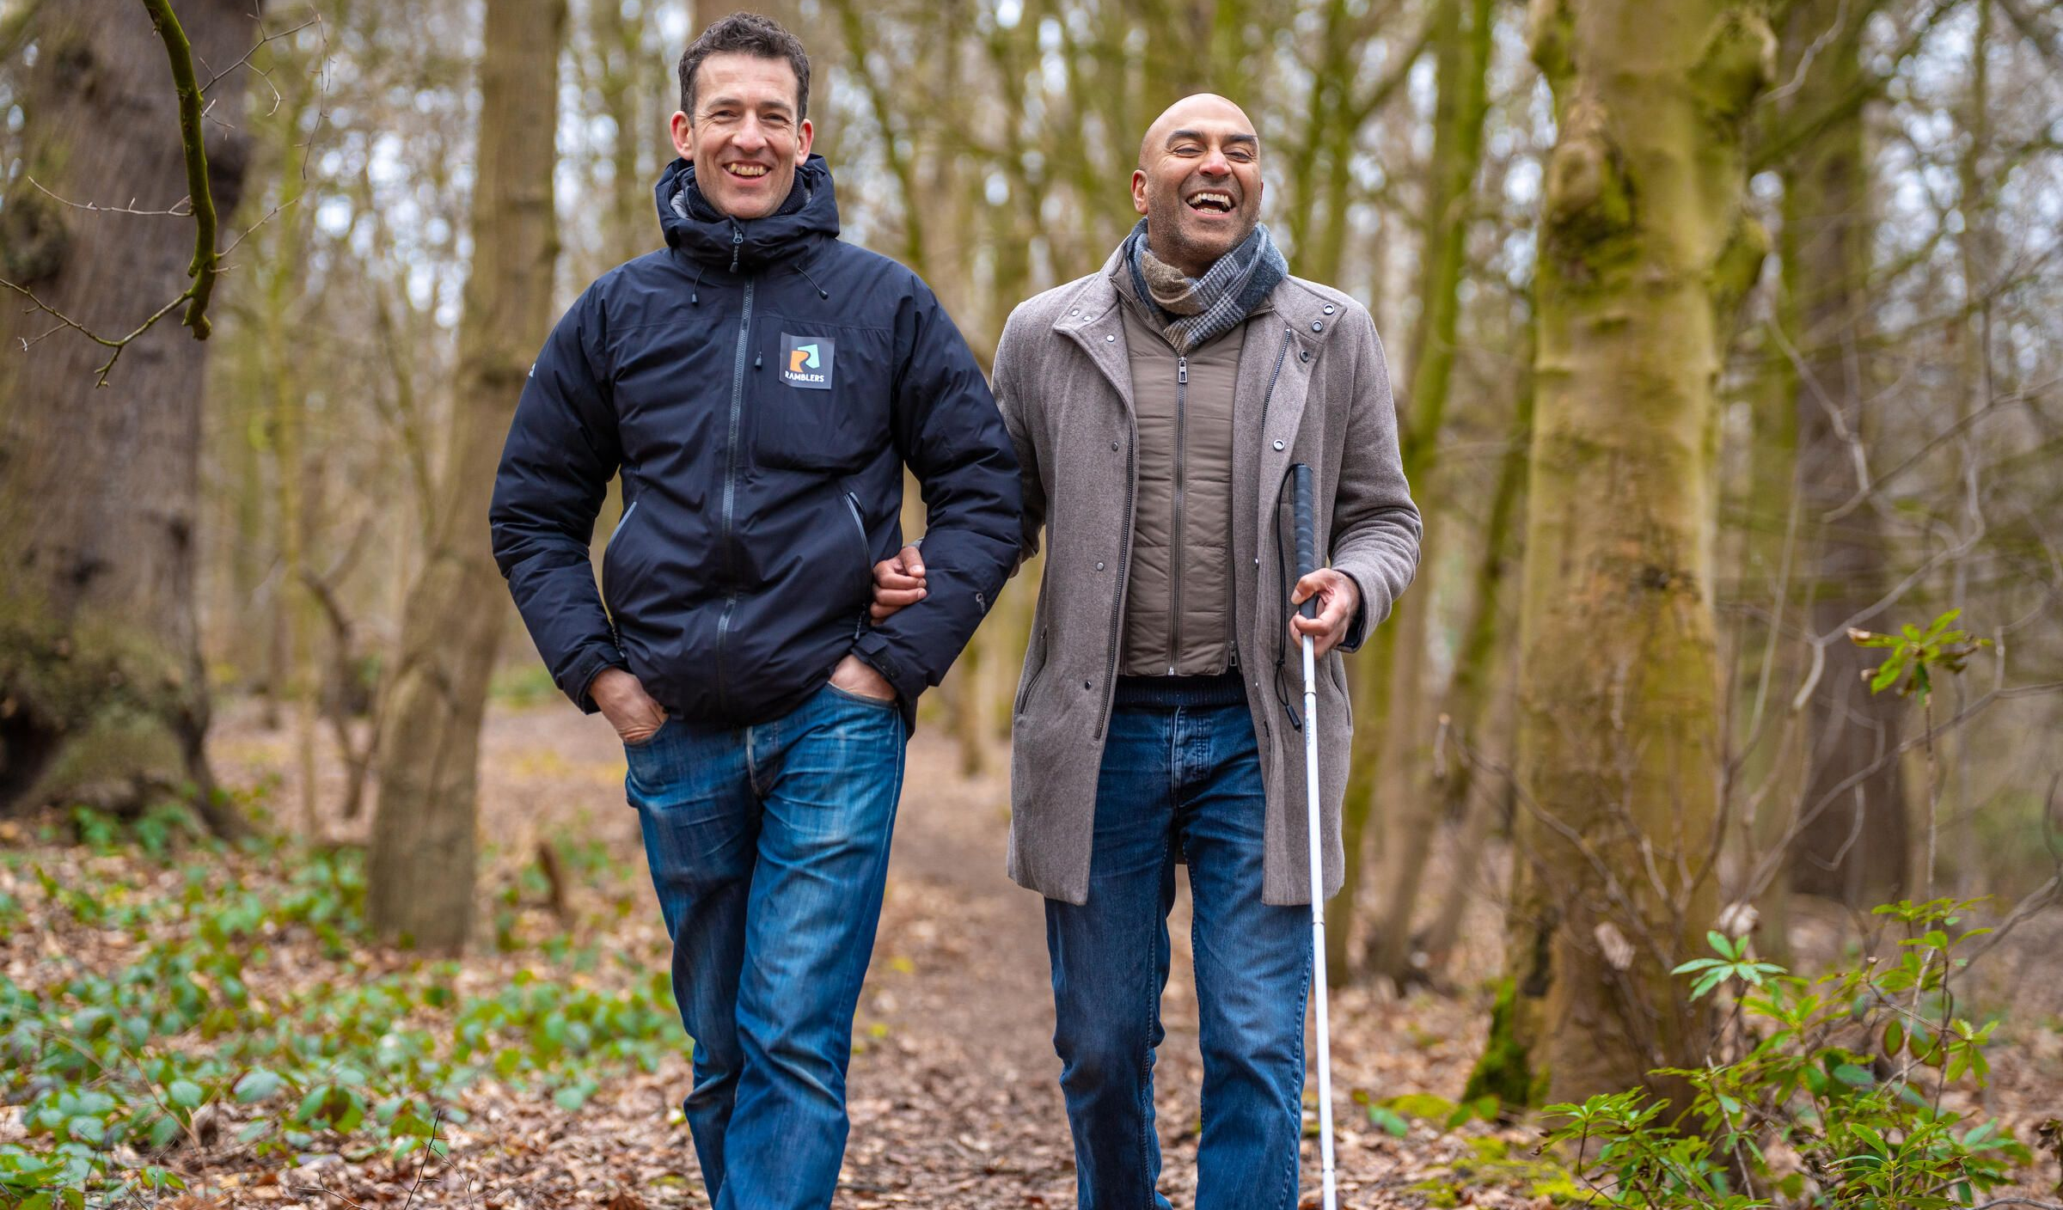
Salvation for God’s people of all nations!
“And I will lead the blind
in a way that they do not know,
in paths that they have not known
I will guide them.”
Isaiah 42:16a

Slide 54
“And I will lead the blind
in a way that they do not know,
in paths that they have not known
I will guide them.”
Isaiah 42:16a
Who ministers to the blind?
vs 7 – Servant
vs 16 – Yahweh

Slide 55
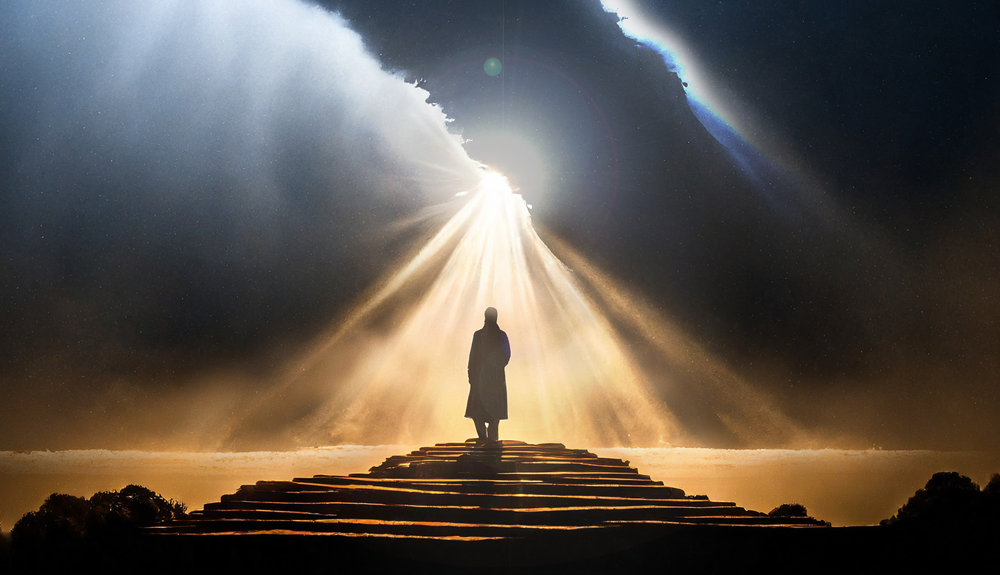
“I will turn the darkness before them into light,
the rough places into level ground.
These are the things I do, and I do not forsake them.”
Isaiah 42:16b

Slide 56
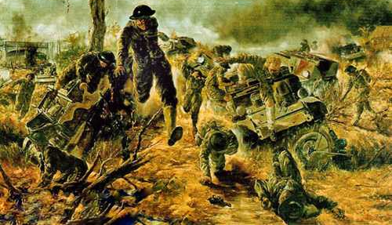
Those who trust in idols…
Those who do NOT trust in Yahweh and in his Servant!
“They are turned back and utterly put to shame,
who trust in carved idols,
who say to metal images, ‘You are our gods’.”
Isaiah 42:17

Slide 57
Isaiah 42:1-17 – Behold My Servant!
The Servant’s Identity (1-4)
The Servant’s Calling (5-9)
The Response of the Nations (10-12)
The Servant’s Victory (13-17)

Slide 58
What are the Implications for Us?
We are called to be Christ-like!
In relation to God
In relation to people

Slide 59
Christ-Like in Relation to God
Isaiah 42:1
My servant
Whom I uphold
My chosen
In whom my soul delights
I have put my Spirit upon him

Slide 60
Christ-Like in Relation to People
Isaiah 42:2-3
The methods of a servant:
Quiet, Unobtrusive, Anonymous
Bringing life and hope to bruised reeds and smoldering wicks

Slide 62
OT Preaching link at BibleStudyDownloads.org
Get this presentation for free!
Notes:
OT Preaching (op)

