Slide 1
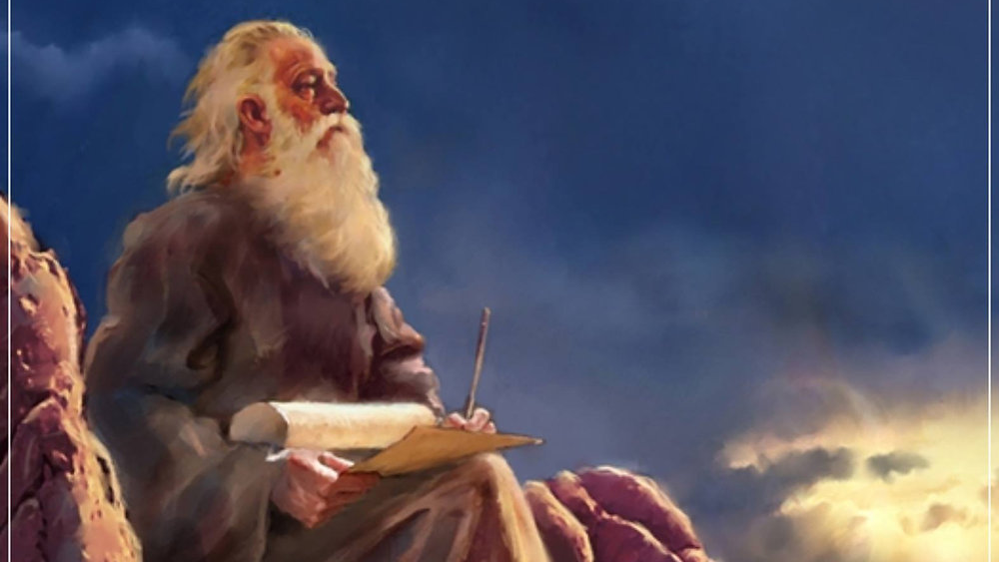
The Prophecy
Of
Isaiah
Isaiah 41
I Am Your God!
Preached by Dan Bridges at Amman International Church, Jordan • AmmanChurch.com Uploaded by Dr. Rick Griffith • Jordan Evangelical Theological Seminary Files in many languages for free download at BibleStudyDownloads.org

Slide 2
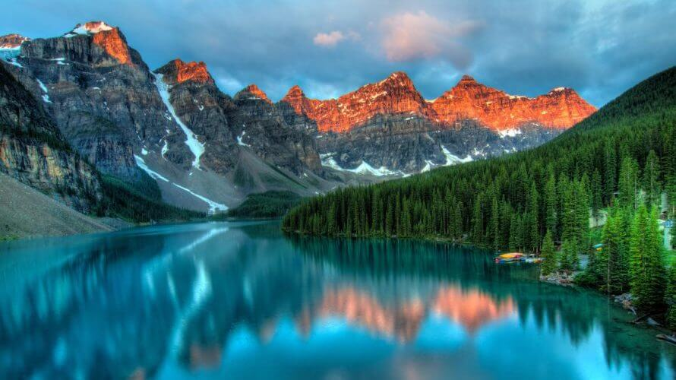
So do not fear, for I am with you;
do not be dismayed, for I am your God.
I will strengthen you and help you;
I will uphold you with my righteous right hand.
Isaiah 41:10

Slide 3
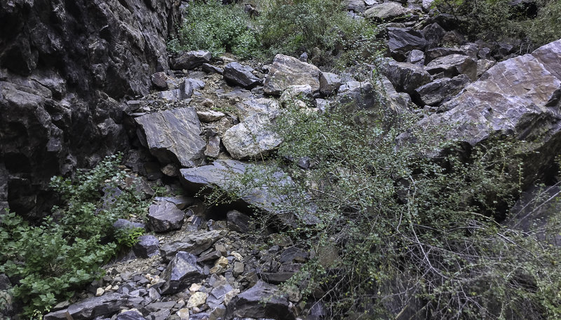
Fears that Lead to Broken Relationships
Fear of Conflict………………..
Fear of Giving up Control…
Fear of Rejection……………..
Fear of Losing Freedom……
Fear of Being Inadequate…
Unresolved issues, shallow relationships
Domineering, controlling
Appeasing, manipulating
Avoiding relationships, not engaging deeply
Demanding affirmation

Slide 4
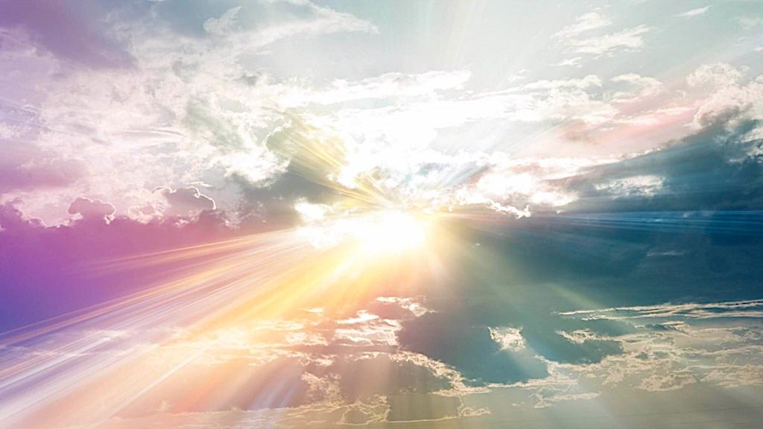
Isaiah 41 – I Am Your God!
Isaiah 41 addresses our fear problem head-on by reminding us of who God is!
God’s People Don’t Need to Fear Because…
God is the Controller of History (1-7)
God is the God of His People (8-20)
God is the Only Truly God (21-29)

Slide 5
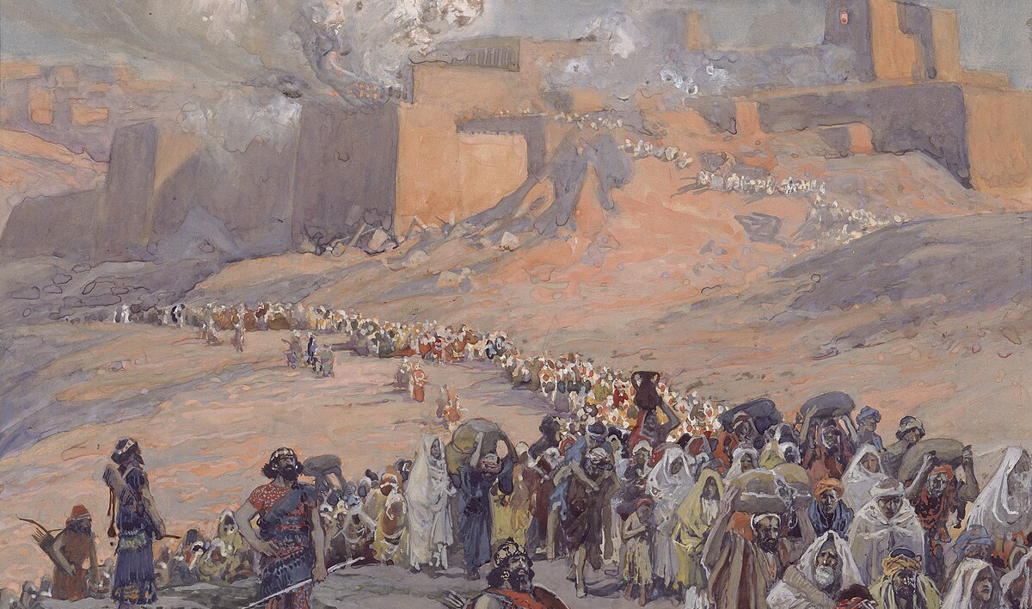
Context of Isaiah 41
God’s people in exile in Babylon…
Was hope lost?

Slide 6
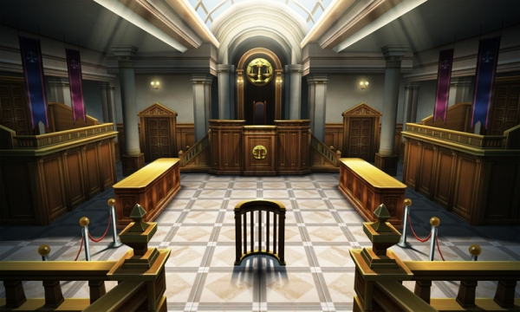
The Cosmic Courtroom
“Listen to me in silence, O coastlands;
let the peoples renew their strength;
let them approach, then let them speak;
let us together draw near for judgment.”
Isaiah 41:1

Slide 7
The Cosmic Courtroom
“Listen to me in silence, O coastlands;
let the peoples renew their strength;
let them approach, then let them speak;
let us together draw near for judgment.”
Isaiah 41:1

Slide 8
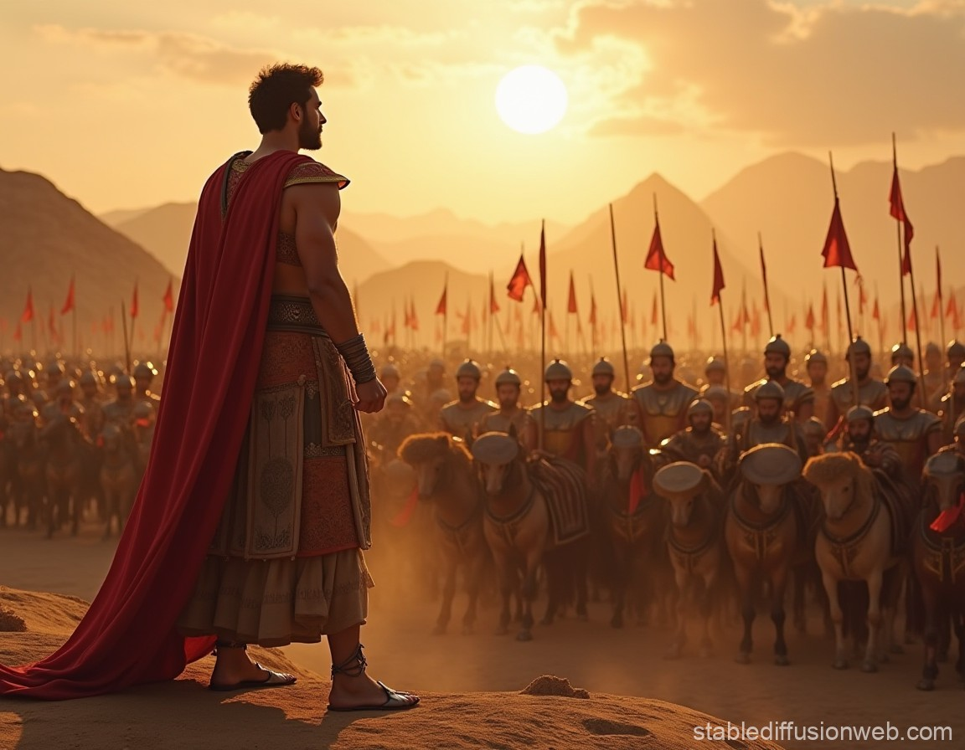
“Who stirred up one from the east
whom victory meets at every step?
Isaiah 41:2a

Slide 9
“He gives up nations before him,
so that he tramples kings underfoot;”
he makes them like dust with his sword,
like driven stubble with his bow.
He pursues them and passes on safely,
by paths his feet have not trod.”
Isaiah 41:2b-3

Slide 10
“Who has performed and done this,
calling the generations from the beginning?
I, the LORD, the first, and with the last; I am he.”
Isaiah 41:4

Slide 11
“Who has performed and done this,
calling the generations from the beginning?
I, the LORD, the first, and with the last; I am he.”
Isaiah 41:4

Slide 12
“Who has performed and done this,
calling the generations from the beginning?
I, the LORD, the first, and with the last; I am he.”
Isaiah 41:4

Slide 13
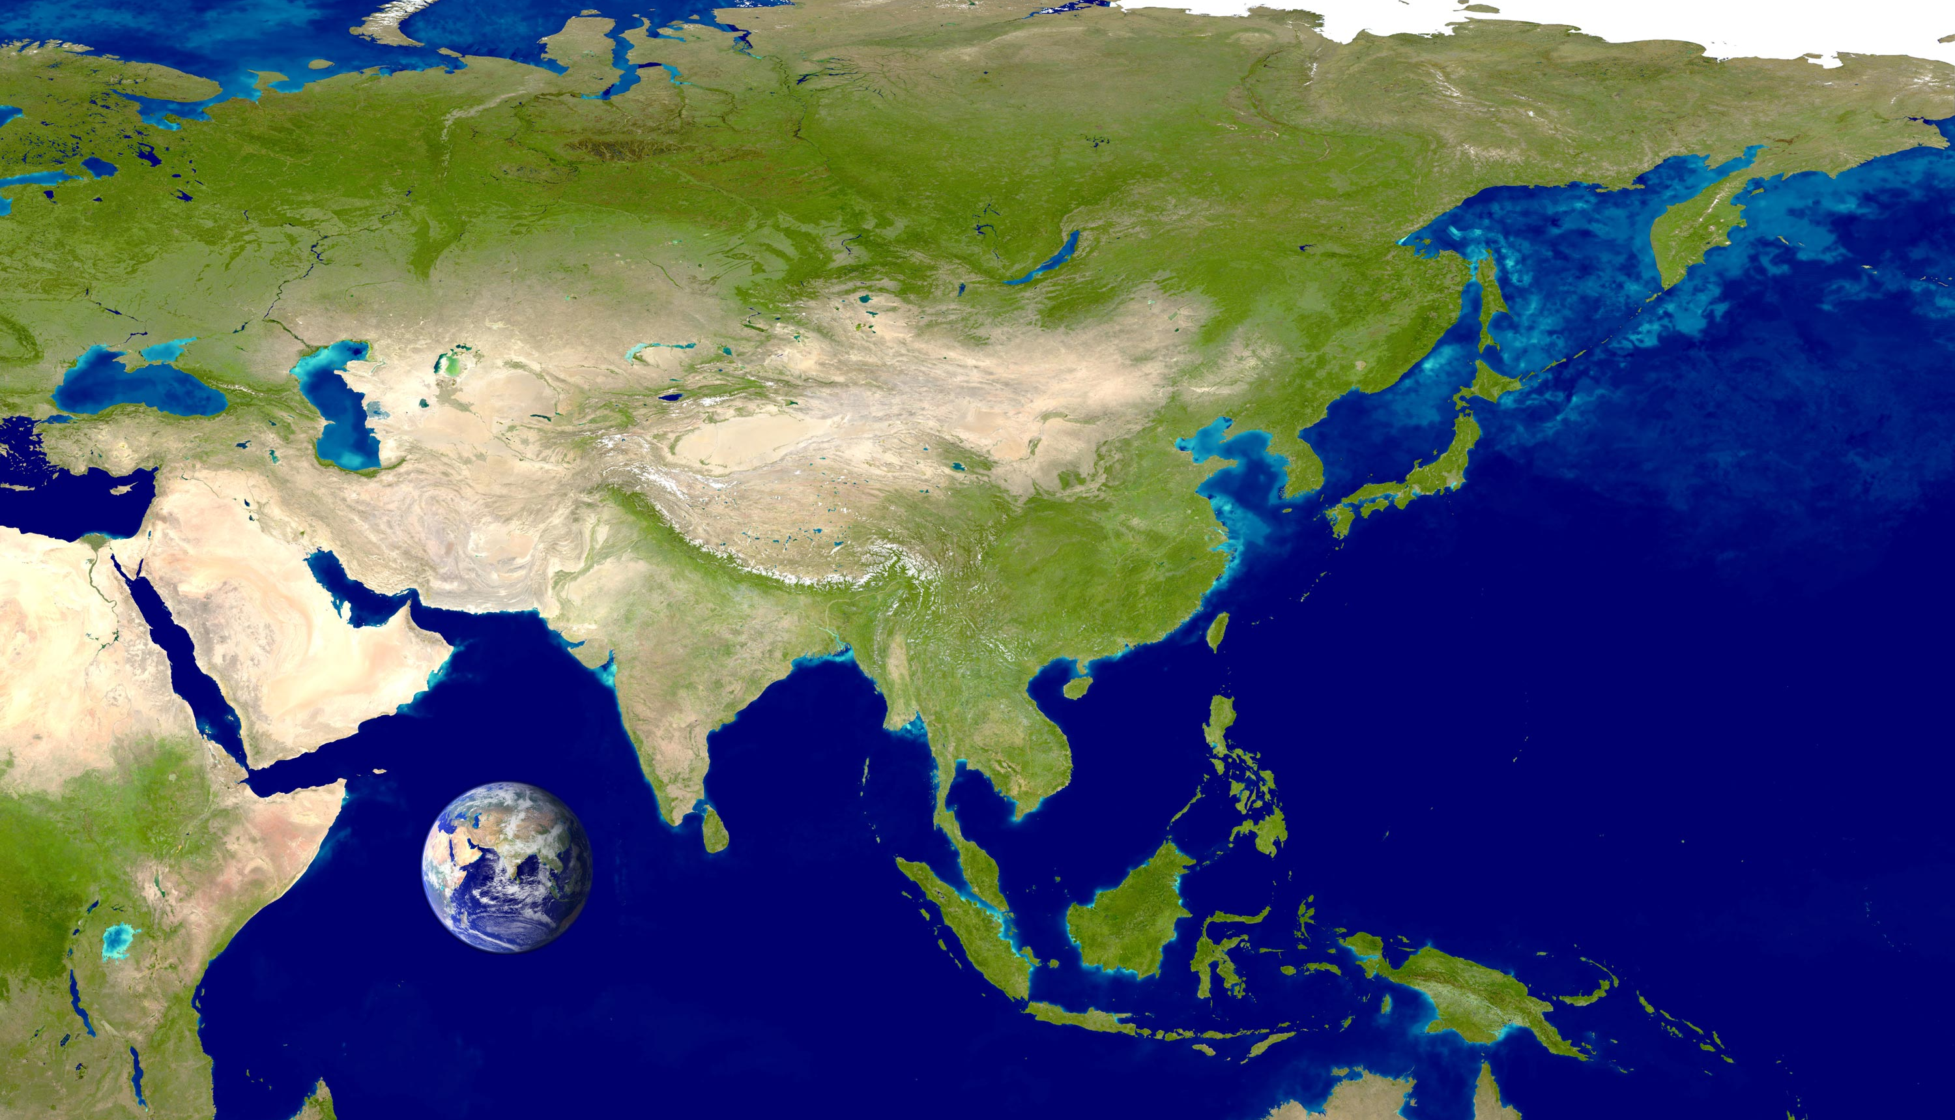
“The coastlands have seen and are afraid;
the ends of the earth tremble;
they have drawn near and come.
Everyone helps his neighbor
and says to his brother, ‘Be strong!’”
Isaiah 41:5-6

Slide 14
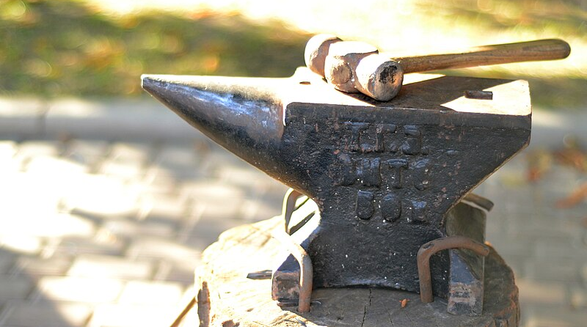
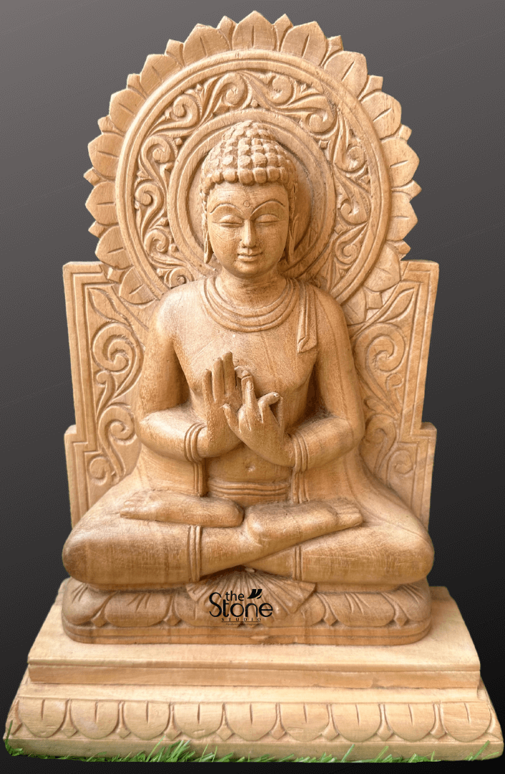
“The craftsman strengthens the goldsmith,
and he who smooths with the hammer him
who strikes the anvil,
saying of the soldering, 'It is good';
and they strengthen it with nails so that it
cannot be moved.” Isaiah 41:7

Slide 15
Isaiah 41 – I Am Your God!
God’s People Don’t Need to Fear Because…
God is the Controller of History (1-7)
God is the God of His People (8-20)
God is the Only Truly God (21-29)

Slide 16
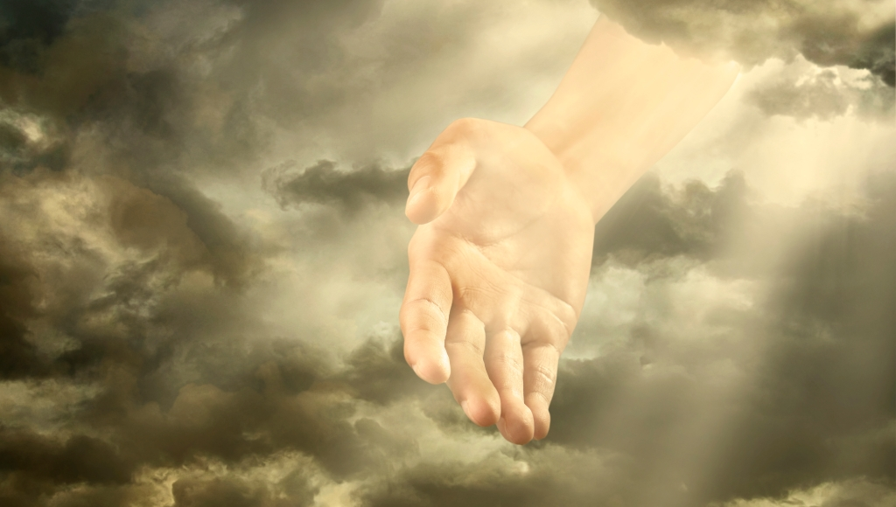
Old City and Kidron Valley from north
You will be my people, I will be your God…
(Exodus 6:7)
What is the significance of this? What does it mean?
God
Chooses his people (8-9)
Is committed to his people (10)
Protects his people (11-13)
Empowers his people (14-16)
Provides for his people (17-20)

Slide 17
Old City and Kidron Valley from north
1. God Chooses His People
“But you, Israel, my servant,
Jacob, whom I have chosen,
the offspring of Abraham, my friend;
you whom I took from the ends of the earth,
and called from its farthest corners,
saying to you, ‘You are my servant,
I have chosen you and not cast you off’;”
Isaiah 41:8-9

Slide 18
Old City and Kidron Valley from north
1. God Chooses His People
“But you, Israel, my servant,
Jacob, whom I have chosen,
the offspring of Abraham, my friend;
you whom I took from the ends of the earth,
and called from its farthest corners,
saying to you, ‘You are my servant,
I have chosen you and not cast you off’;”
Isaiah 41:8-9

Slide 19
Old City and Kidron Valley from north
1. God Chooses His People
“But you, Israel, my servant,
Jacob, whom I have chosen,
the offspring of Abraham, my friend;
you whom I took from the ends of the earth,
and called from its farthest corners,
saying to you, ‘You are my servant,
I have chosen you and not cast you off’;”
Isaiah 41:8-9
“But you are a chosen race, a royal priesthood, a holy nation, a people for his own possession…” 1 Peter 2:9

Slide 20
Old City and Kidron Valley from north
1. God Chooses His People
“But you, Israel, my servant,
Jacob, whom I have chosen,
the offspring of Abraham, my friend;
you whom I took from the ends of the earth,
and called from its farthest corners,
saying to you, ‘You are my servant,
I have chosen you and not cast you off’;”
Isaiah 41:8-9
“And if you are Christ's, then you are Abraham's offspring, heirs according to promise.” Galatians 3:29

Slide 21
Old City and Kidron Valley from north
1. God Chooses His People
“But you, Israel, my servant,
Jacob, whom I have chosen,
the offspring of Abraham, my friend;
you whom I took from the ends of the earth,
and called from its farthest corners,
saying to you, ‘You are my servant,
I have chosen you and not cast you off’;”
Isaiah 41:8-9

Slide 22
Old City and Kidron Valley from north
1. God Chooses His People
“But you, Israel, my servant,
Jacob, whom I have chosen,
the offspring of Abraham, my friend;
you whom I took from the ends of the earth,
and called from its farthest corners,
saying to you, ‘You are my servant,
I have chosen you and not cast you off’;”
Isaiah 41:8-9

Slide 23
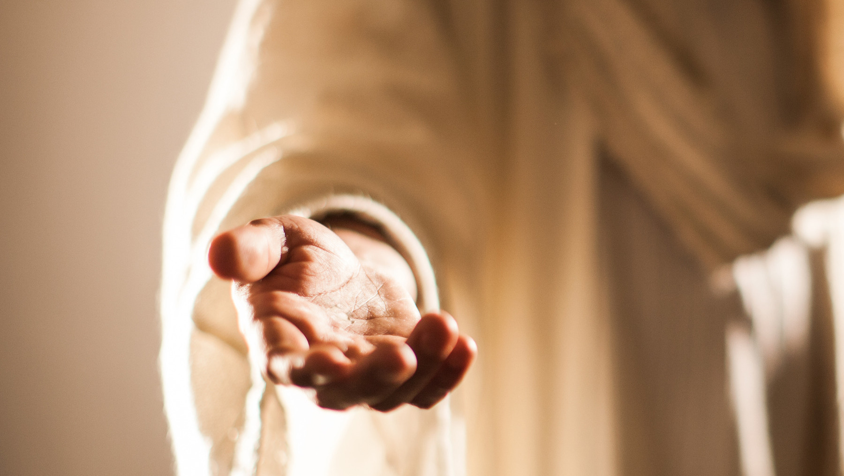
Old City and Kidron Valley from north
2. God is Committed to His People
“fear not, for I am with you;
be not dismayed, for I am your God;
I will strengthen you, I will help you,
I will uphold you with my righteous right hand.”
Isaiah 41:10

Slide 24
Old City and Kidron Valley from north
2. God is Committed to His People
“fear not, for I am with you;
be not dismayed, for I am your God;
I will strengthen you, I will help you,
I will uphold you with my righteous right hand.”
Isaiah 41:10

Slide 25
Old City and Kidron Valley from north
2. God is Committed to His People
“fear not, for I am with you;
be not dismayed, for I am your God;
I will strengthen you, I will help you,
I will uphold you with my righteous right hand.”
Isaiah 41:10

Slide 26
Old City and Kidron Valley from north
2. God is Committed to His People
“fear not, for I am with you;
be not dismayed, for I am your God;
I will strengthen you, I will help you,
I will uphold you with my righteous right hand.”
Isaiah 41:10

Slide 27
Old City and Kidron Valley from north
2. God is Committed to His People
“fear not, for I am with you;
be not dismayed, for I am your God;
I will strengthen you, I will help you,
I will uphold you with my righteous right hand.”
Isaiah 41:10

Slide 28
Old City and Kidron Valley from north
2. God is Committed to His People
“fear not, for I am with you;
be not dismayed, for I am your God;
I will strengthen you, I will help you,
I will uphold you with my righteous right hand.”
Isaiah 41:10

Slide 29
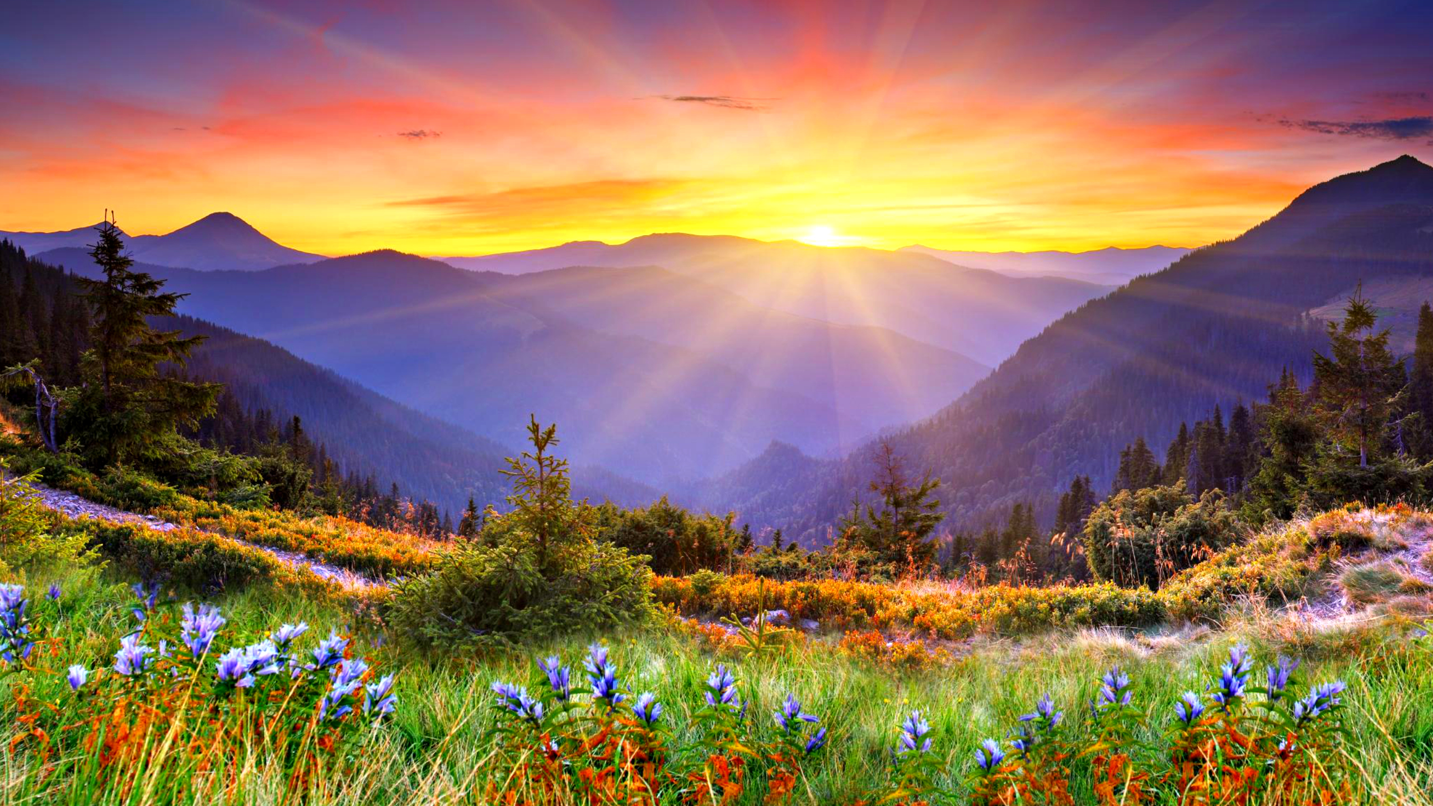
Old City and Kidron Valley from north
3. God Protects His People
“Behold, all who are incensed against you
shall be put to shame and confounded;
those who strive against you
shall be as nothing and shall perish.
You shall seek those who contend with you,
but you shall not find them;
those who war against you
shall be as nothing at all.”
Isaiah 41:11-12
Short-term:
Babylonians

Slide 30
Old City and Kidron Valley from north
3. God Protects His People
“Behold, all who are incensed against you
shall be put to shame and confounded;
those who strive against you
shall be as nothing and shall perish.
You shall seek those who contend with you,
but you shall not find them;
those who war against you
shall be as nothing at all.”
Isaiah 41:11-12
Long-term:
Any who oppose God
(especially Satan)

Slide 31
Old City and Kidron Valley from north
3. God Protects His People
“For I, the LORD your God,
hold your right hand;
it is I who say to you, ‘Fear not,
I am the one who helps you.’”
Isaiah 41:11-13

Slide 32
Old City and Kidron Valley from north
3. God Protects His People
“For I, the LORD your God,
hold your right hand;
it is I who say to you, ‘Fear not,
I am the one who helps you.’”
Isaiah 41:11-13

Slide 33
Old City and Kidron Valley from north
3. God Protects His People
“For I, the LORD your God,
hold your right hand;
it is I who say to you, ‘Fear not,
I am the one who helps you.’”
Isaiah 41:11-13

Slide 34
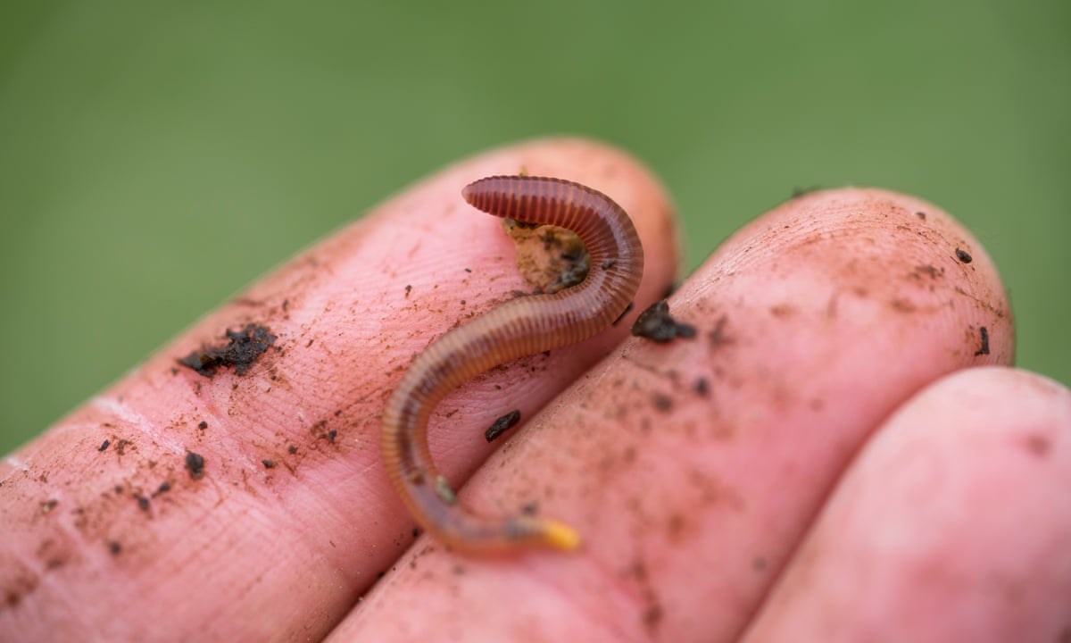
Old City and Kidron Valley from north
4. God Empowers His People
The wonderful freedom of admitting our weakness!
“Fear not, you worm Jacob,
you men of Israel!”
Isaiah 41:14a

Slide 35
Old City and Kidron Valley from north
4. God Empowers His People
“I am the one who helps you, declares the LORD;
your Redeemer is the Holy One of Israel.”
Isaiah 41:14b

Slide 36
Old City and Kidron Valley from north
4. God Empowers His People
“I am the one who helps you, declares the LORD;
your Redeemer is the Holy One of Israel.”
Isaiah 41:14b
Redeemer: Kinsman-Redeemer
The one who takes upon himself the needs of his next-of-kin

Slide 37
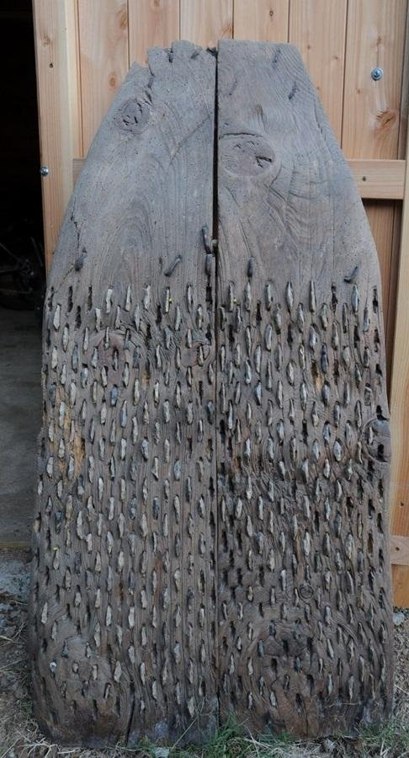
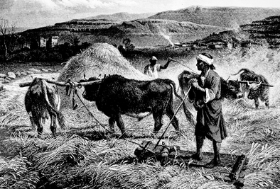
Old City and Kidron Valley from north
“Behold, I make of you a threshing sledge,
new, sharp, and having teeth;
you shall thresh the mountains and crush them,
and you shall make the hills like chaff;”
Isaiah 41:15

Slide 38
Old City and Kidron Valley from north
“Behold, I make of you a threshing sledge,
new, sharp, and having teeth;”
God takes his weak, inadequate people, and equips and empowers them to do all he calls them to do!

Slide 39
Old City and Kidron Valley from north
“you shall thresh the mountains and crush them,
and you shall make the hills like chaff;”
The mountains are barriers to God’s people. With God’s power, seemingly insurmountable obstacles are overcome!

Slide 40
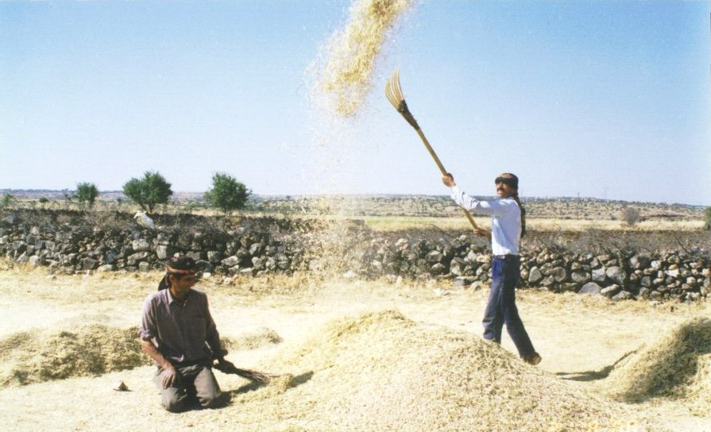
Old City and Kidron Valley from north
4. God Empowers His People
“you shall winnow them,
and the wind shall carry them away,
and the tempest shall scatter them.
And you shall rejoice in the LORD;
in the Holy One of Israel you shall glory.”
Isaiah 41:16

Slide 41
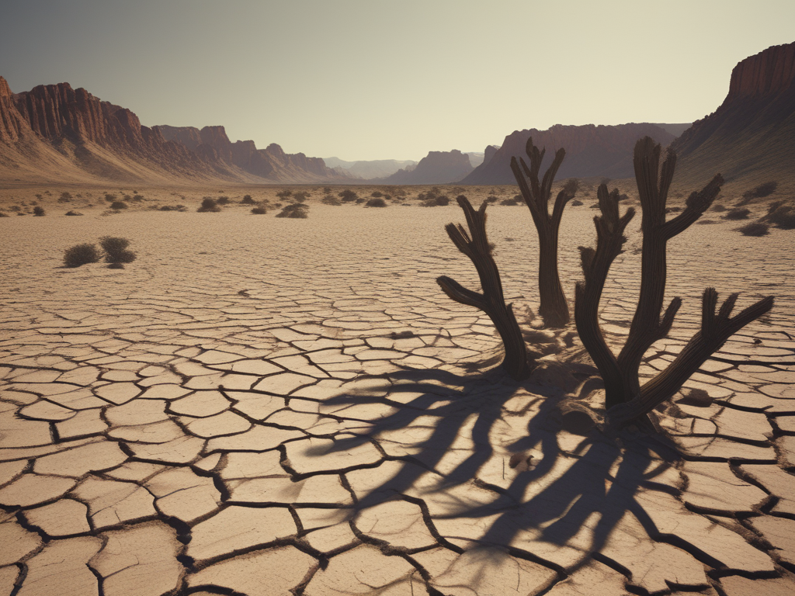
Old City and Kidron Valley from north
5. God Provides for His People
“When the poor and needy seek water,
and there is none,
and their tongue is parched with thirst,
I the LORD will answer them;
I the God of Israel will not forsake them.”
Isaiah 41:17

Slide 42
Old City and Kidron Valley from north
5. God Provides for His People
There is no human solution to this problem!
“When the poor and needy seek water,
and there is none,
and their tongue is parched with thirst,
I the LORD will answer them;
I the God of Israel will not forsake them.”
Isaiah 41:17

Slide 43
Old City and Kidron Valley from north
5. God Provides for His People
“When the poor and needy seek water,
and there is none,
and their tongue is parched with thirst,
I the LORD will answer them;
I the God of Israel will not forsake them.”
Isaiah 41:17

Slide 44
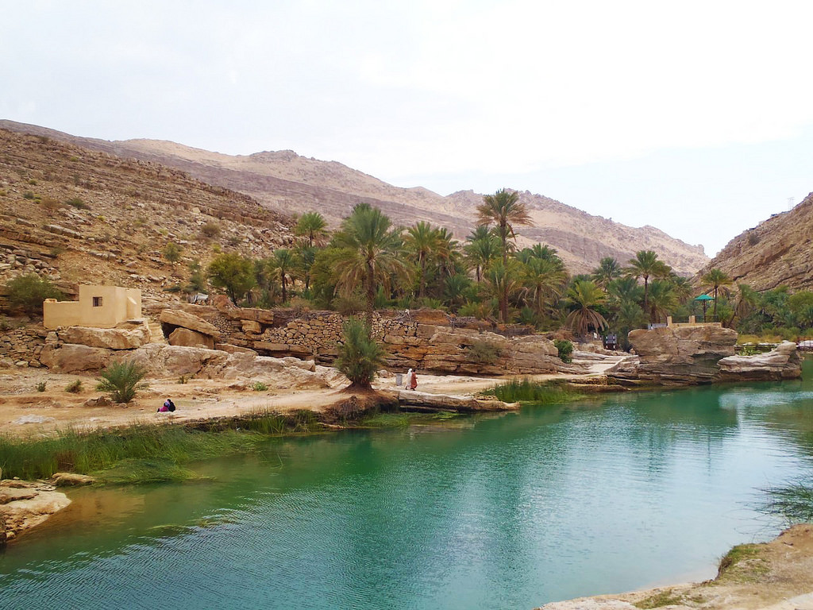
Old City and Kidron Valley from north
5. God Provides for His People
“I will open rivers on the bare heights,
and fountains in the midst of the valleys.
I will make the wilderness a pool of water,
and the dry land springs of water.”
Isaiah 41:18

Slide 45
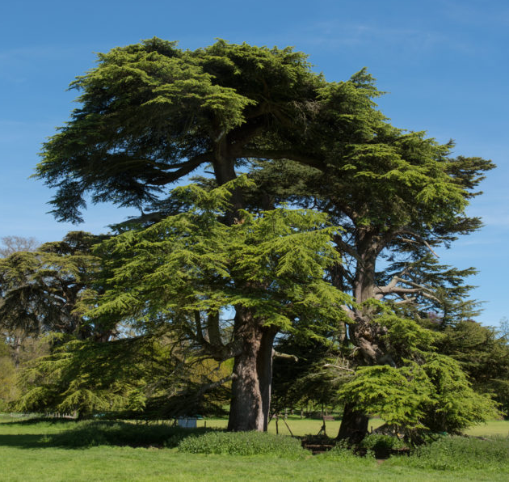
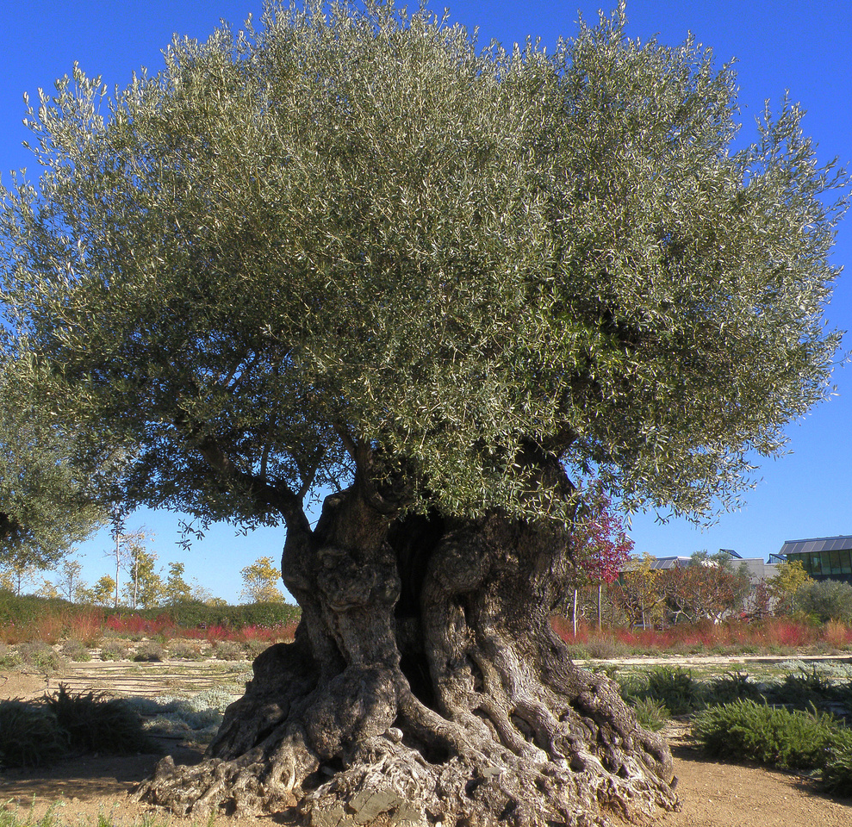
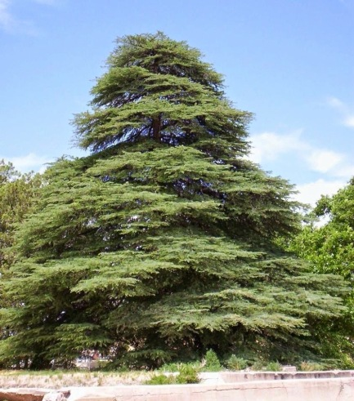
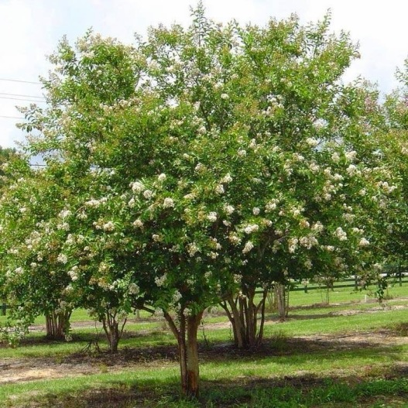
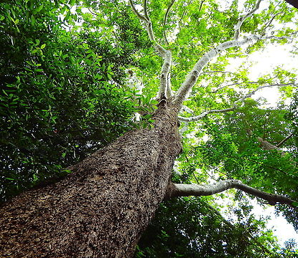
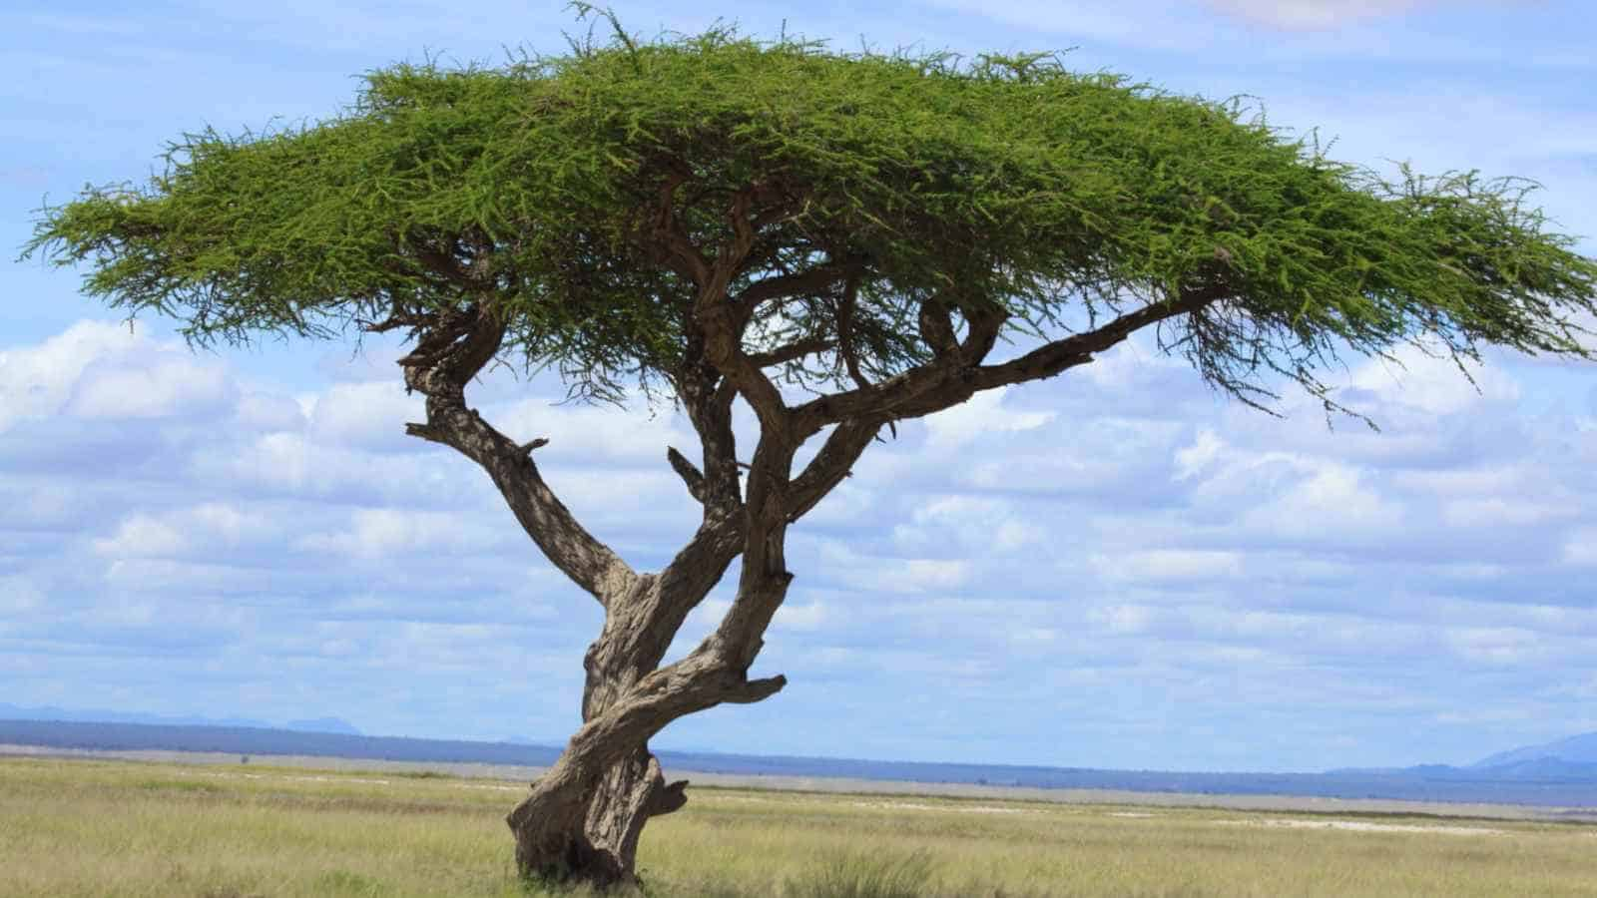
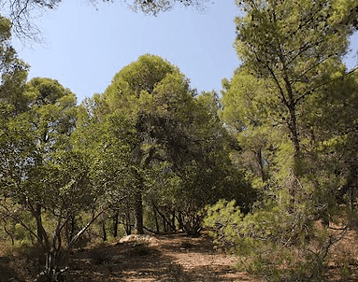
Old City and Kidron Valley from north
Cedar
Olive
Cypress
Myrtle
“I will put in the wilderness the cedar,
the acacia, the myrtle, and the olive.
I will set in the desert the cypress,
the plane and the pine together,” Isaiah 41:19
Plane
Acacia
Pine

Slide 46
Old City and Kidron Valley from north
Cedar
Olive
Cypress
Myrtle
“that they may see and know,
may consider and understand together,
that the hand of the LORD has done this,
the Holy One of Israel has created it. Isaiah 41:20
Plane
Acacia
Pine

Slide 47
Old City and Kidron Valley from north
You will be my people, I will be your God…
What is the significance of this? What does it mean?
God
Chooses his people (8-9)
Is committed to his people (10)
Protects his people (11-13)
Empowers his people (14-16)
Provides for his people (17-20)

Slide 48
Isaiah 41 – I Am Your God!
God’s People Don’t Need to Fear Because…
God is the Controller of History (1-7)
God is the God of His People (8-20)
God is the Only Truly God (21-29)

Slide 49
The Cosmic Courtroom
“Set forth your case, says the LORD;
bring your proofs, says the King of Jacob.
Let them bring them, and tell us
what is to happen.
Tell us the former things, what they are,
that we may consider them,
that we may know their outcome;
or declare to us the things to come.”
Isaiah 41:21-22

Slide 50
The Cosmic Courtroom
“Set forth your case, says the LORD;
bring your proofs, says the King of Jacob.
Let them bring them, and tell us
what is to happen.
Tell us the former things, what they are,
that we may consider them,
that we may know their outcome;
or declare to us the things to come.”
Isaiah 41:21-22

Slide 51
The Cosmic Courtroom
“Set forth your case, says the LORD;
bring your proofs, says the King of Jacob.
Let them bring them, and tell us
what is to happen.
Tell us the former things, what they are,
that we may consider them,
that we may know their outcome;
or declare to us the things to come.”
Isaiah 41:21-22

Slide 52
The Cosmic Courtroom
“Tell us what is to come hereafter,
that we may know that you are gods;
do good, or do harm,
that we may be dismayed and terrified.
Behold, you are nothing,
and your work is less than nothing;
an abomination is he who chooses you.”
Isaiah 41:23-24

Slide 53
The Cosmic Courtroom
“Tell us what is to come hereafter,
that we may know that you are gods;
do good, or do harm,
that we may be dismayed and terrified.
Behold, you are nothing,
and your work is less than nothing;
an abomination is he who chooses you.”
Isaiah 41:23-24

Slide 54
The Cosmic Courtroom
“Tell us what is to come hereafter,
that we may know that you are gods;
do good, or do harm,
that we may be dismayed and terrified.
Behold, you are nothing,
and your work is less than nothing;
an abomination is he who chooses you.”
Isaiah 41:23-24

Slide 55
“I stirred up one from the north, and he has come,
from the rising of the sun, and he shall call upon my name;
he shall trample on rulers as on mortar,
as the potter treads clay.” Isaiah 41:25

Slide 56
Who declared it from the beginning, that we might know,
and beforehand, that we might say, “He is right”?
There was none who declared it, none who proclaimed,
none who heard your words.
I was the first to say to Zion, “Behold, here they are!”
and I give to Jerusalem a herald of good news.
Isaiah 41:26-27

Slide 57
“But when I look, there is no one;
among these there is no counselor
who, when I ask, gives an answer.
Behold, they are all a delusion;
their works are nothing;
their metal images are empty wind.”
Isaiah 41:28-29

Slide 58
Isaiah 41 – I Am Your God!
God’s People Don’t Need to Fear Because…
God is the Controller of History (1-7)
God is the God of His People (8-20)
God is the Only Truly God (21-29)

Slide 59
Fears that Lead to Broken Relationships
Fear of Conflict………………..
Fear of Giving up Control…
Fear of Rejection……………..
Fear of Losing Freedom……
Fear of Being Inadequate…
Imagine the freedom we can find in applying Isaiah 41 to these fears!
Unresolved issues, shallow relationships
Dominant, controlling
Appeasing, manipulating
Avoiding relationships, not engaging deeply
Demanding affirmation

Slide 61
OT Preaching link at BibleStudyDownloads.org
Get this presentation for free!
Notes:
OT Preaching (op)

