Slide 1
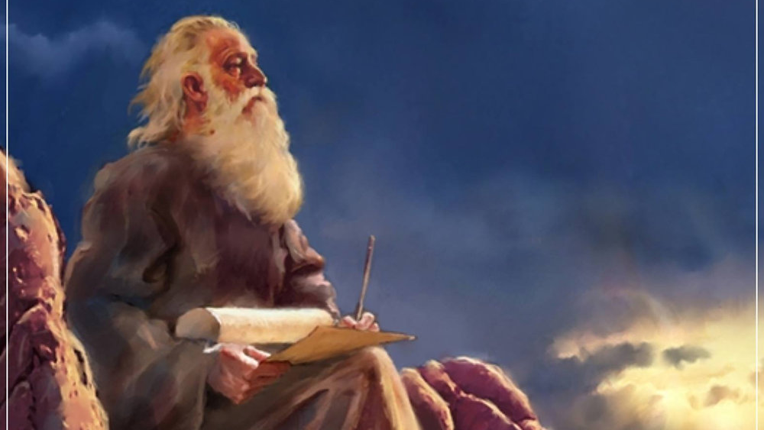
The Prophecy
Of
Isaiah
Isaiah 40:12-31
The Greatness of God!
Preached by Dan Bridges at Amman International Church, Jordan • AmmanChurch.com Uploaded by Dr. Rick Griffith • Jordan Evangelical Theological Seminary Files in many languages for free download at BibleStudyDownloads.org

Slide 2
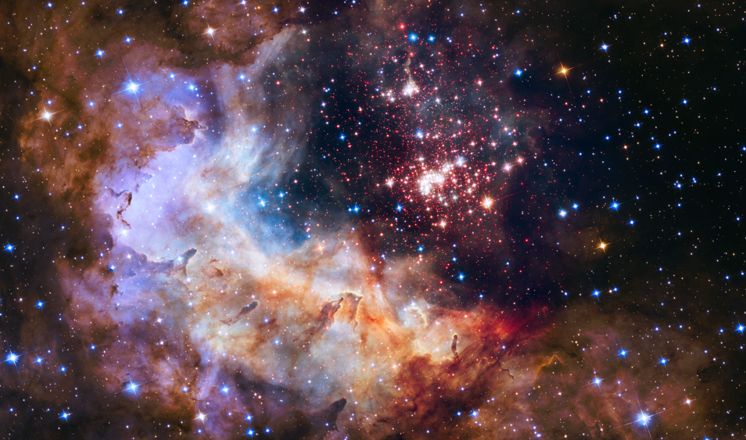
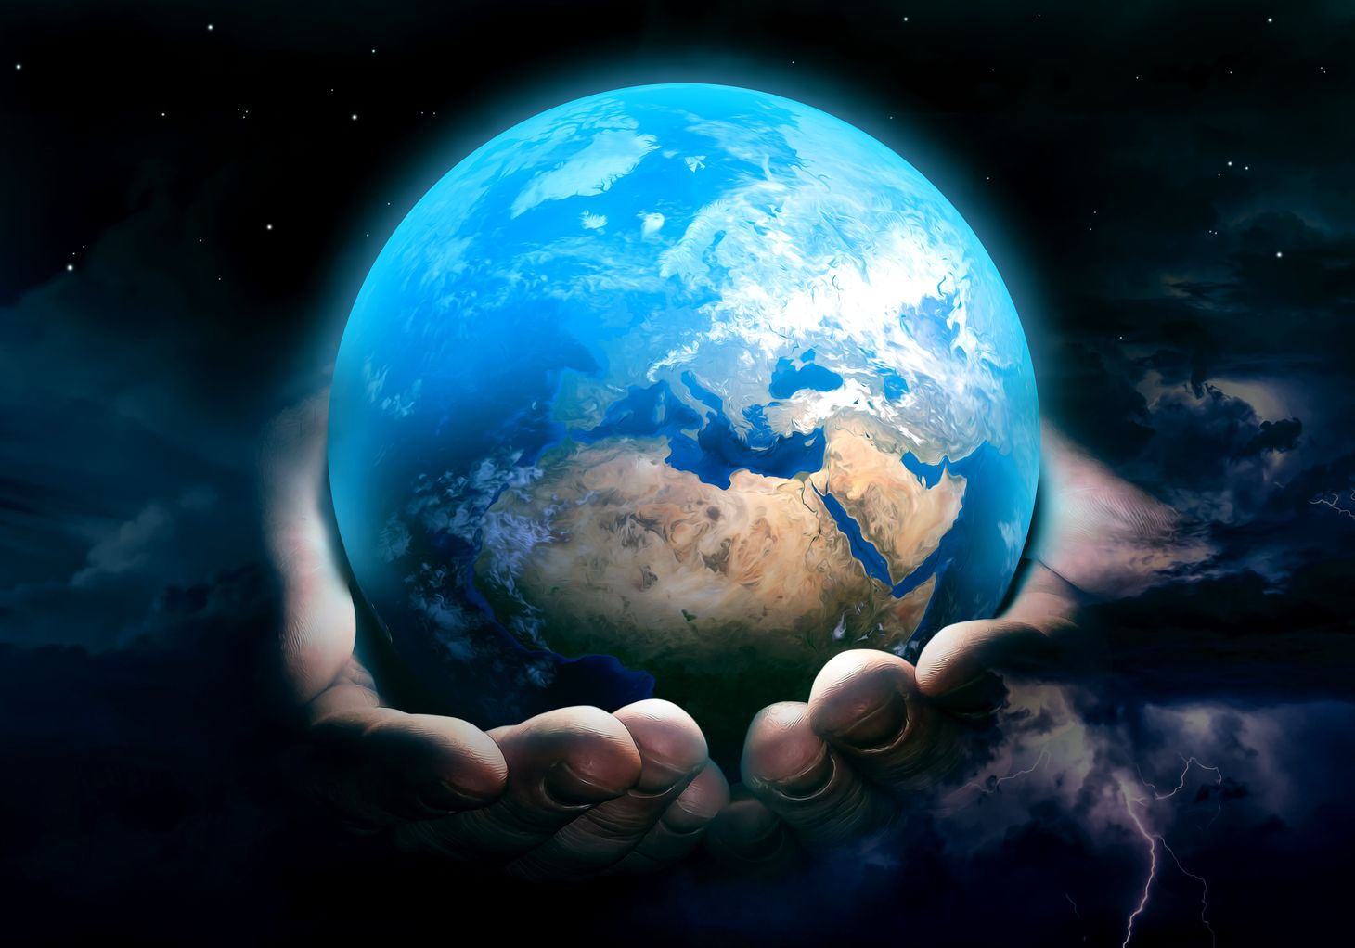
“In the beginning, God created the heavens and the earth.” Genesis 1:1

Slide 3
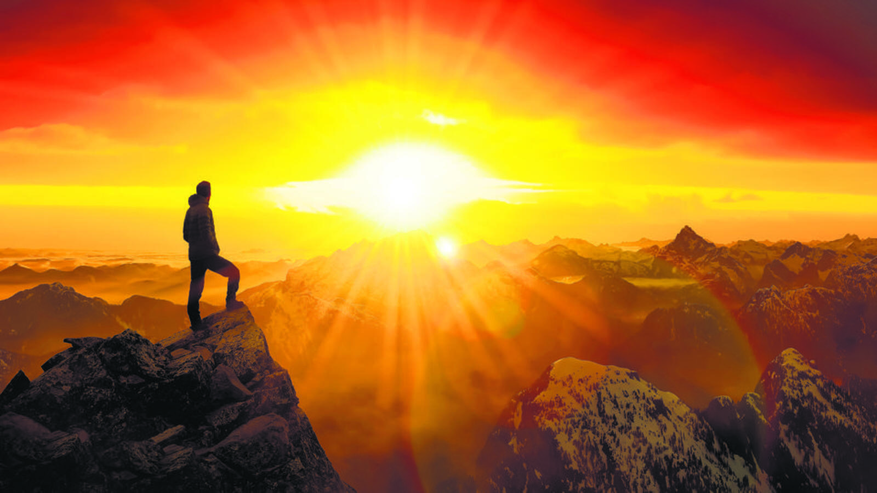
Intro to Isaiah 40
Isaiah 1–39 Contains many beautiful and hopeful promises of a coming Messiah!

Slide 4
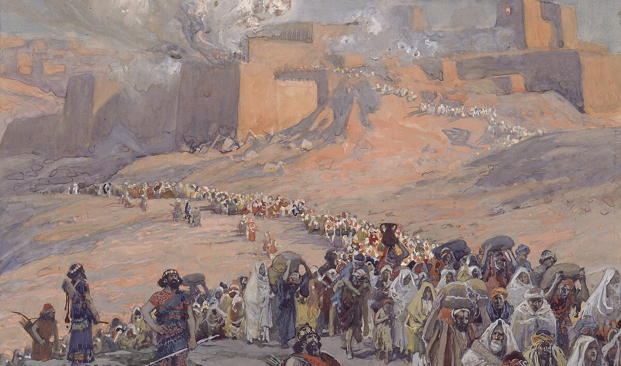
Isaiah 39 closed with a message of future disaster and exile to Babylon…

Slide 5
Fast forward 150 years…
God’s people are now in exile.
What would happen now?

Slide 6
Was God either unable or unwilling to fulfill his promises?
Was hope lost?

Slide 7
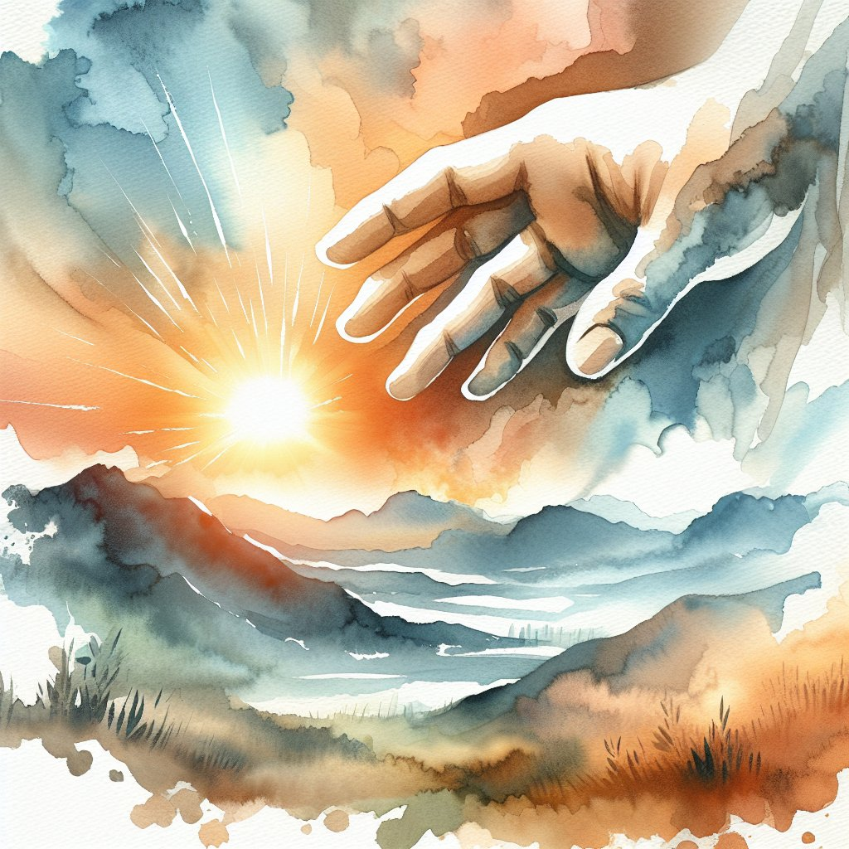
“Comfort, comfort my people, says your God.”
Isaiah 40:1
Isaiah 40–66 is a message of comfort and hope to God’s people in exile!
And also to God’s people at all times!

Slide 8
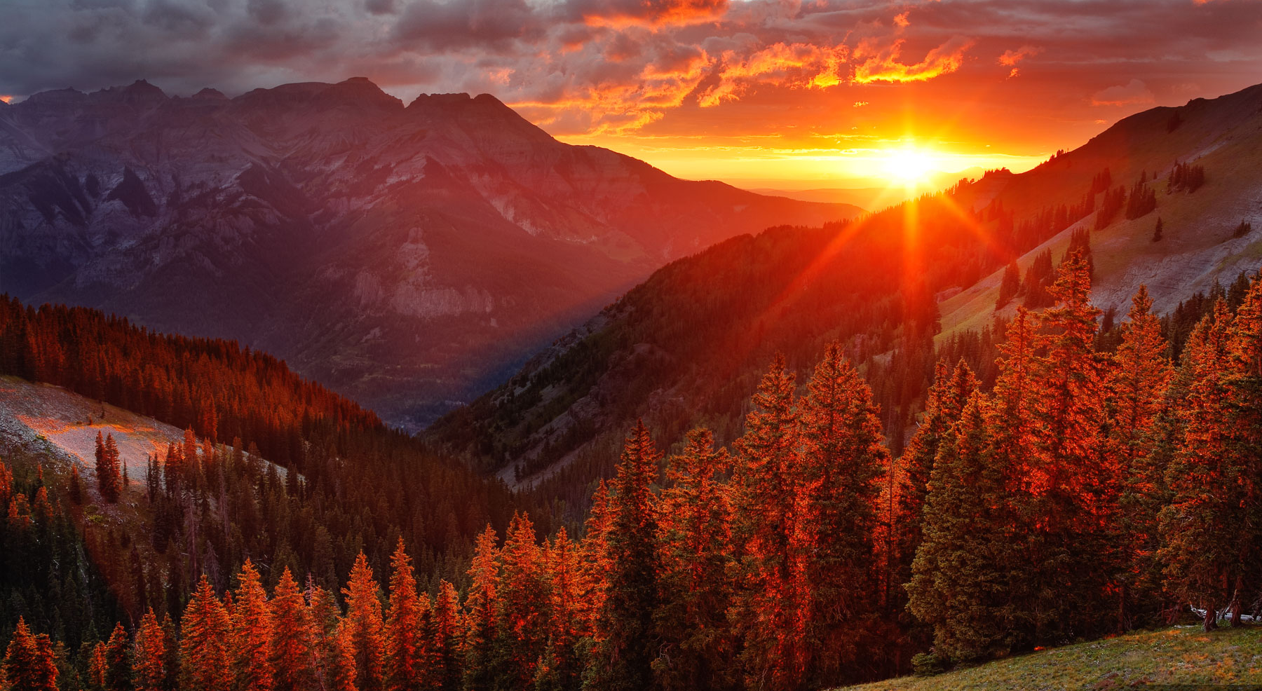
“Go on up to a high mountain,
O Zion, herald of good news…
say to the cities of Judah,
“Behold your God!”.
Isaiah 40:9

Slide 9
Isaiah 40:12-31
The Incomparable Greatness of God!
God is Distinct From Creation (12-14)
God is Supreme Above Creation (15-20)
God is Sovereign Over Creation (21-26)
How this Applies to His People (27-31)

Slide 10
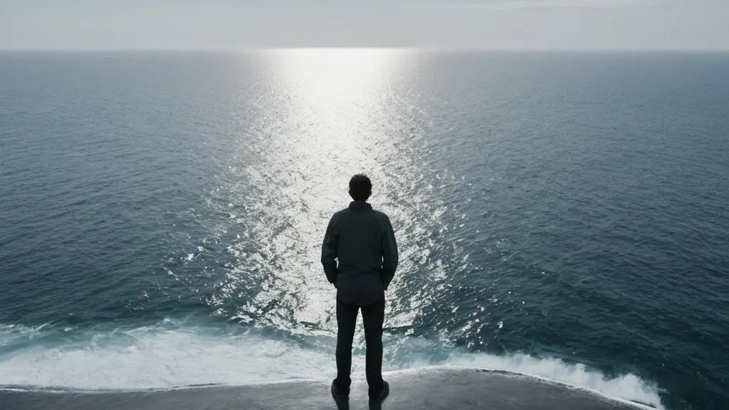
“Who has measured the waters in the hollow of his hand” Isaiah 40:12a

Slide 11
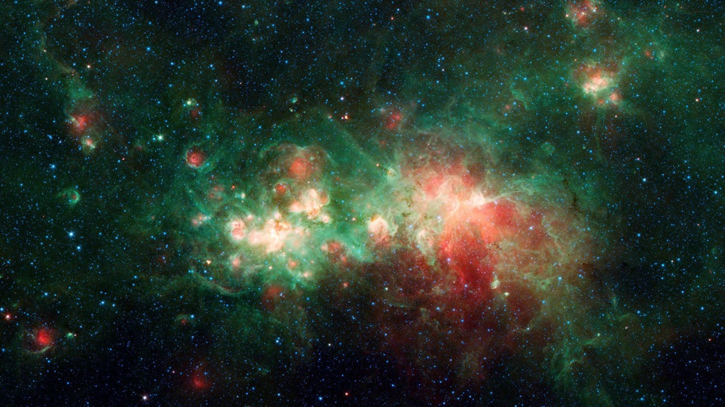
“and marked off the heavens with a span,”
Isaiah 40:12b

Slide 12
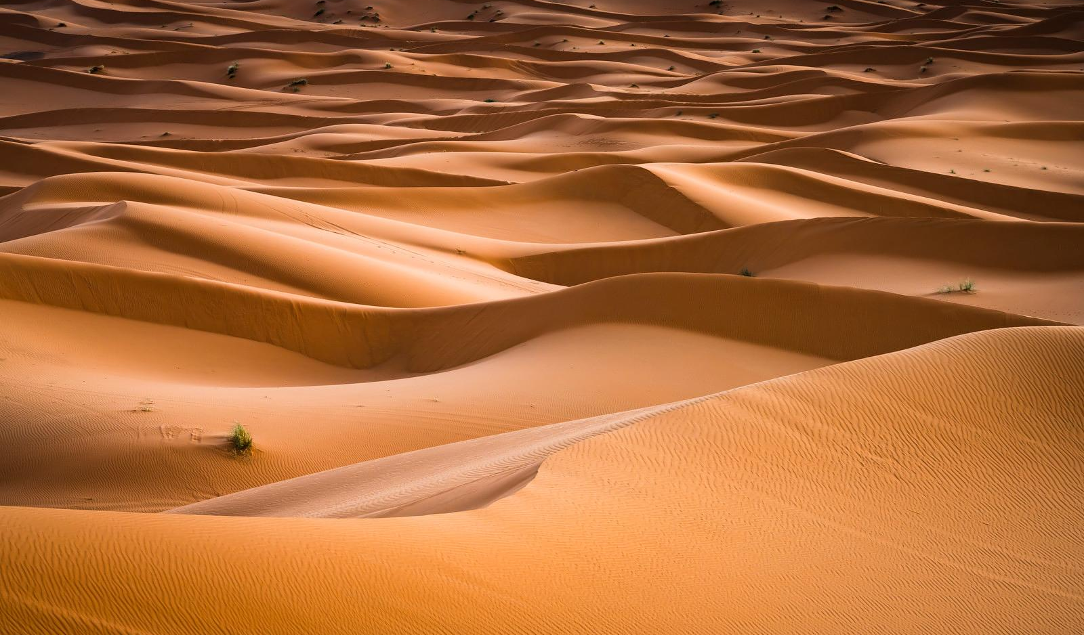
“enclosed the dust of the earth in a measure”
Isaiah 40:12c

Slide 13
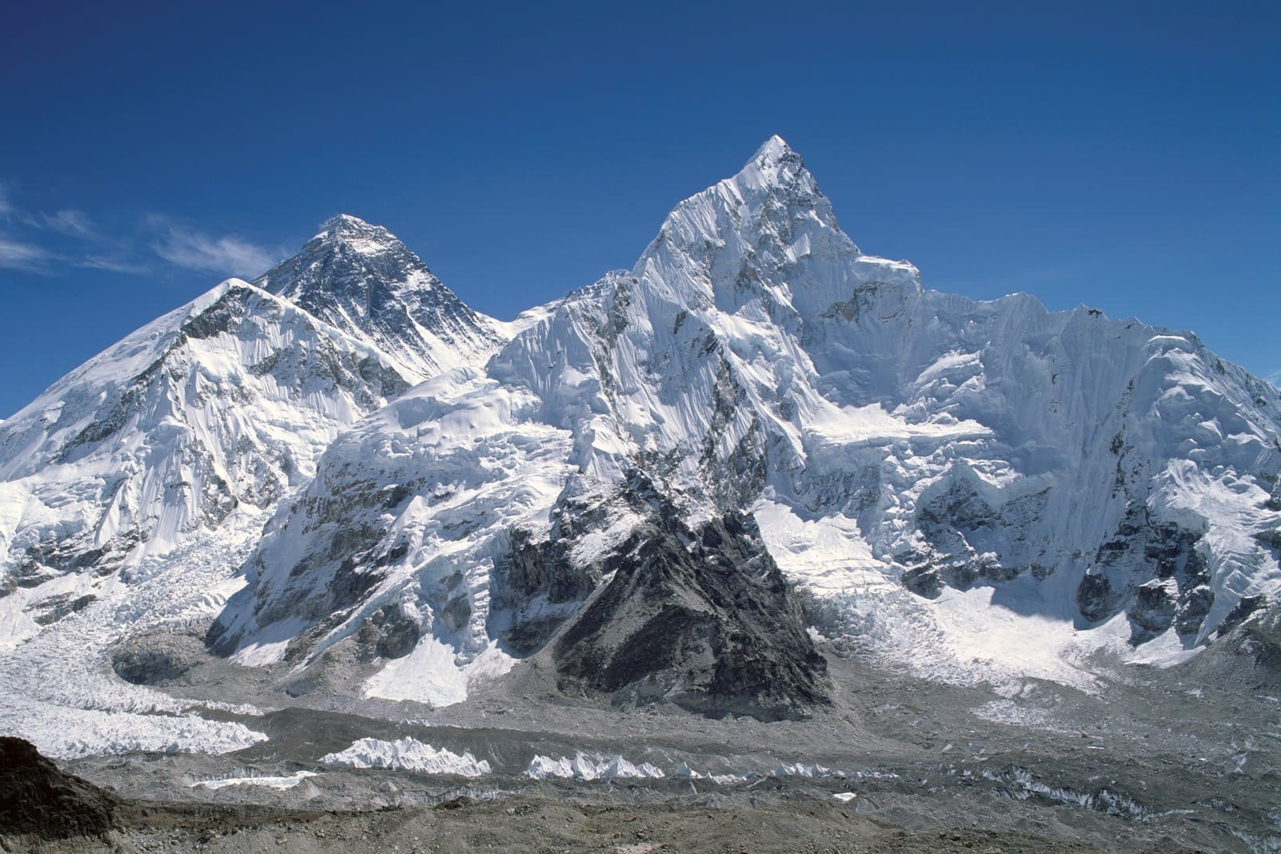
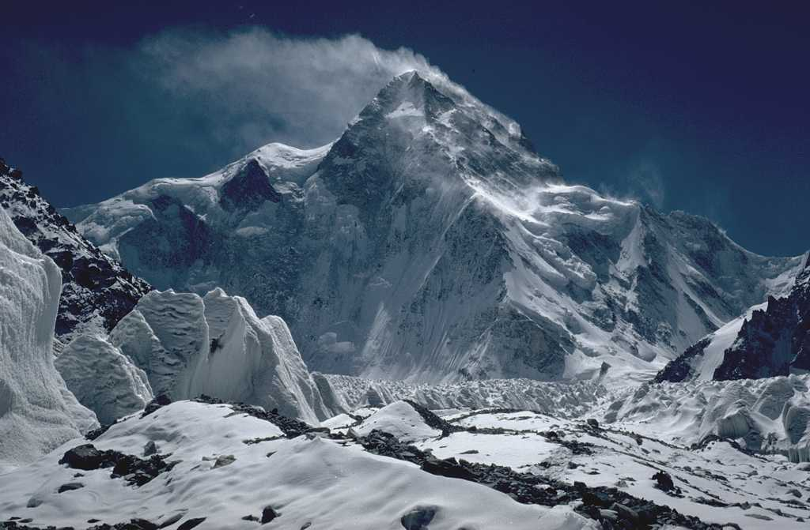
Everest
K2
“and weighed the mountains in scales and the hills in a balance?” Isaiah 40:12d

Slide 14
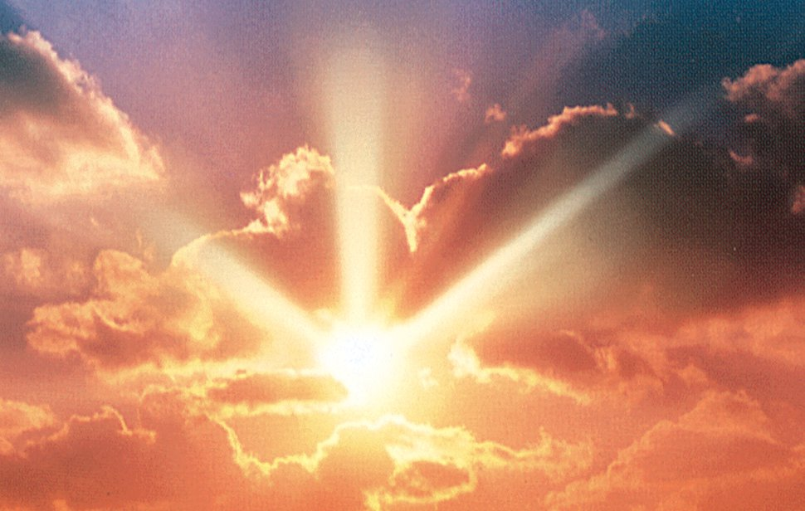
“Who has measured the Spirit of the LORD,
or what man shows him his counsel?”
Isaiah 40:13
“Who has understood the mind of the LORD,
or instructed him as his counselor?”
Isaiah 40:13 (NIV)

Slide 15
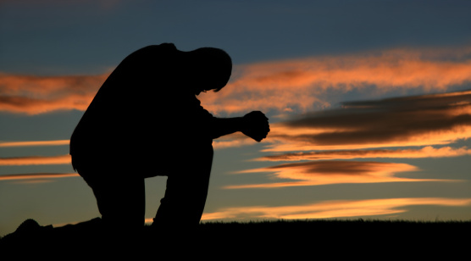
“Whom did he consult,
and who made him understand?
Who taught him the path of justice,
and taught him knowledge,
and showed him the way of understanding?”
Isaiah 40:14

Slide 16
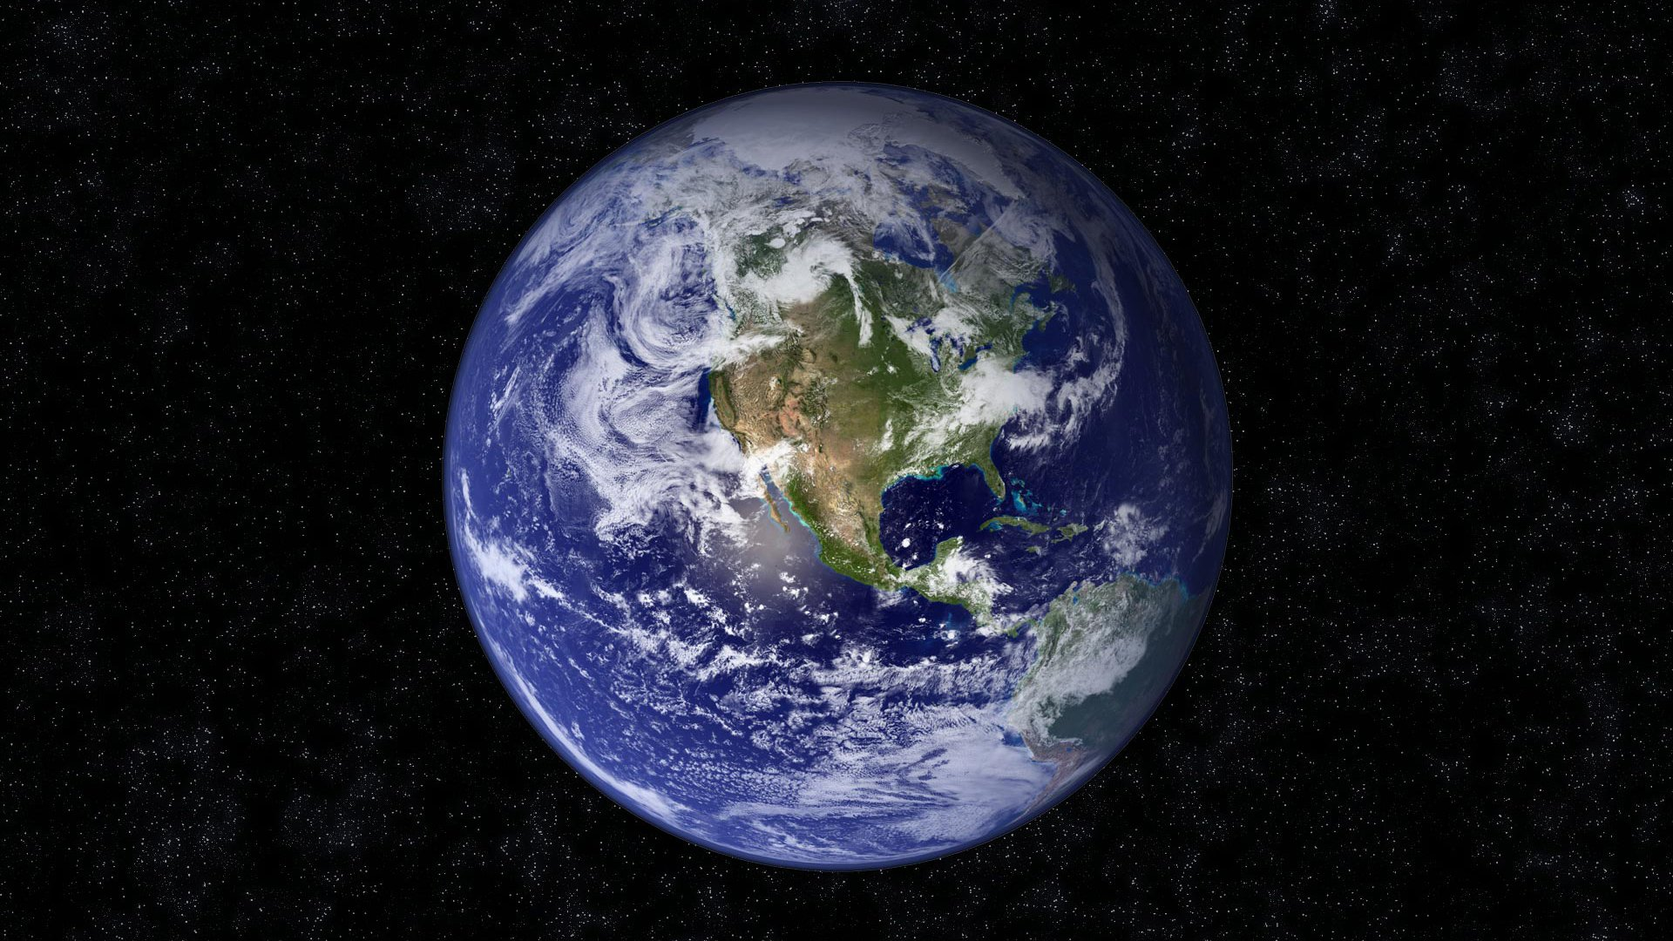
“The LORD by wisdom founded the earth;
by understanding he established the heavens;”
Proverbs 3:19

Slide 17
Isaiah 40:12-31
The Incomparable Greatness of God!
God is Distinct From Creation (12-14)
God is Supreme Above Creation (15-20)
God is Sovereign Over Creation (21-26)
How this Applies to His People (27-31)

Slide 18
“Behold, the nations are like a drop from a bucket,” Isaiah 40:15a

Slide 19
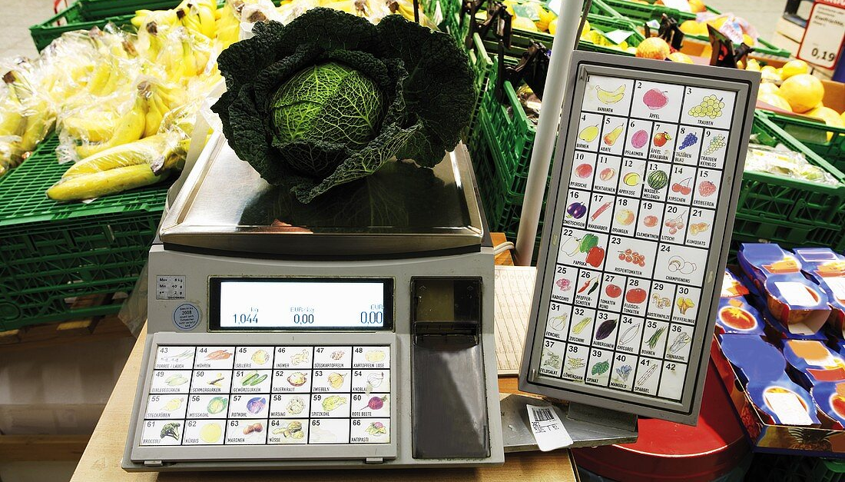
“and are accounted as the dust on the scales;”
Isaiah 40:15b

Slide 20
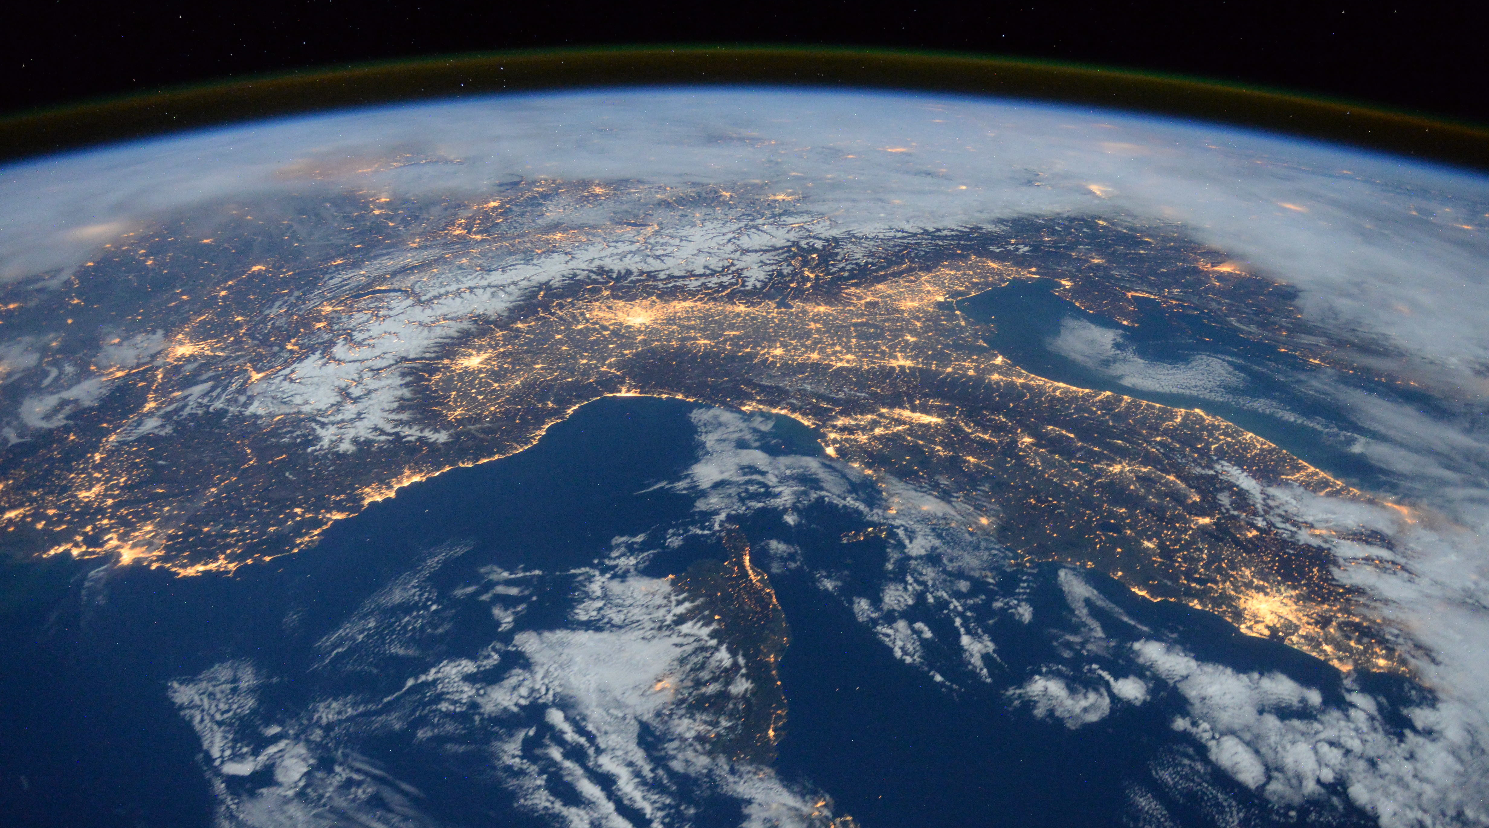
“behold, he takes up the coastlands like fine dust.”
Isaiah 40:15c

Slide 21
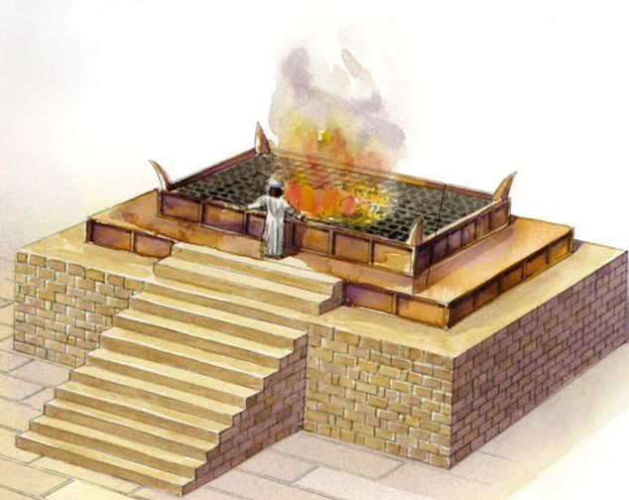
“Lebanon would not suffice for fuel,
nor are its beasts enough for a burnt offering.”
Isaiah 40:16

Slide 22
“All the nations are as nothing before him,
they are accounted by him as less than nothing and emptiness.”
Isaiah 40:17

Slide 23
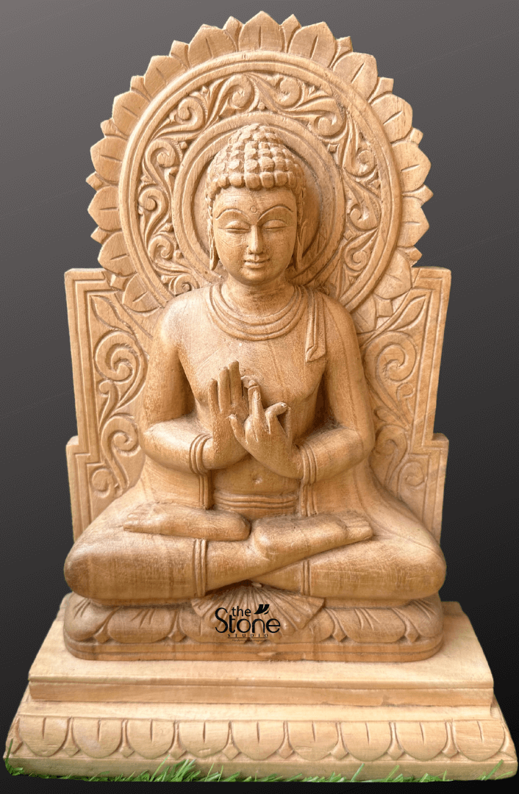
“To whom then will you liken God,
or what likeness compare with him?
An idol! A craftsman casts it, and a goldsmith overlays it with gold and casts for it silver chains.
He who is too impoverished for an offering chooses wood that will not rot; he seeks out a skillful craftsman
to set up an idol that will not move.”
Isaiah 40:18-20

Slide 24
Isaiah 40:12-31
The Incomparable Greatness of God!
God is Distinct From Creation (12-14)
God is Supreme Above Creation (15-20)
God is Sovereign Over Creation (21-26)
How this Applies to His People (27-31)

Slide 25
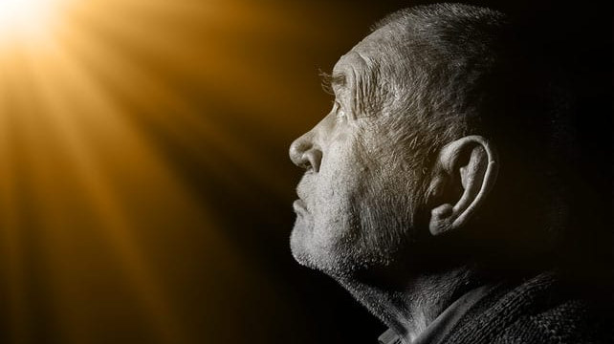
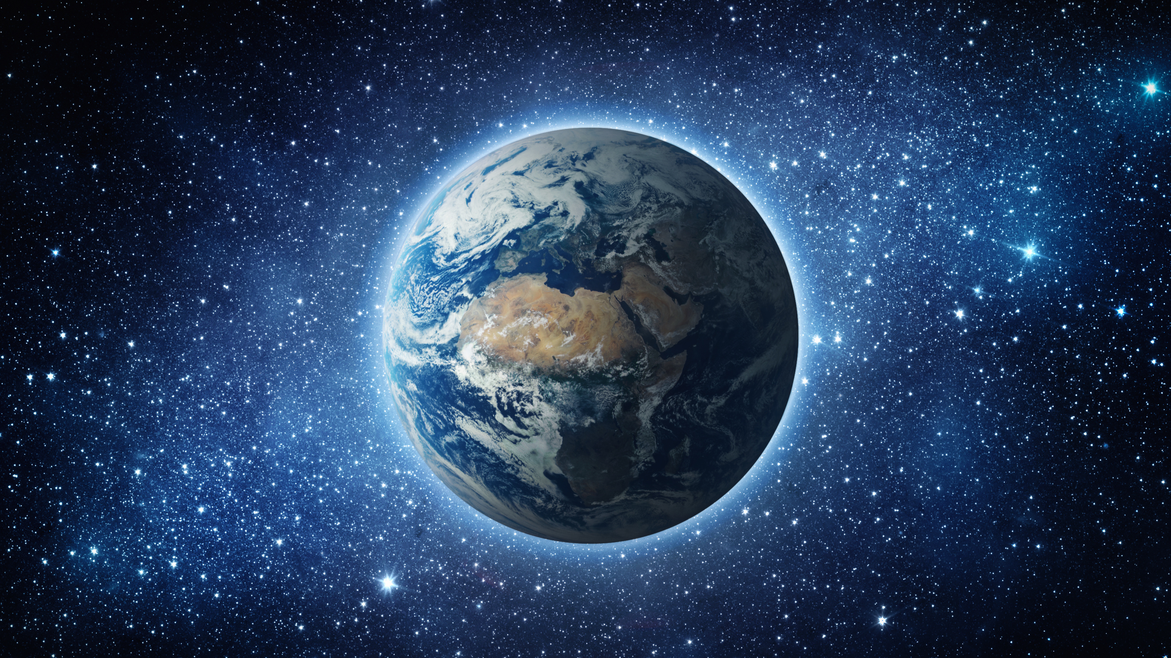
Do you not know?
Do you not hear?
Will you not know? Will you not hear?
Isaiah 40:21
Has it not been told you from the beginning?
Have you not understood from the foundations of the earth?

Slide 26
“It is he who sits above the circle of the earth,
and its inhabitants are like grasshoppers;
who stretches out the heavens like a curtain,
and spreads them like a tent to dwell in;”
Isaiah 40:22

Slide 27
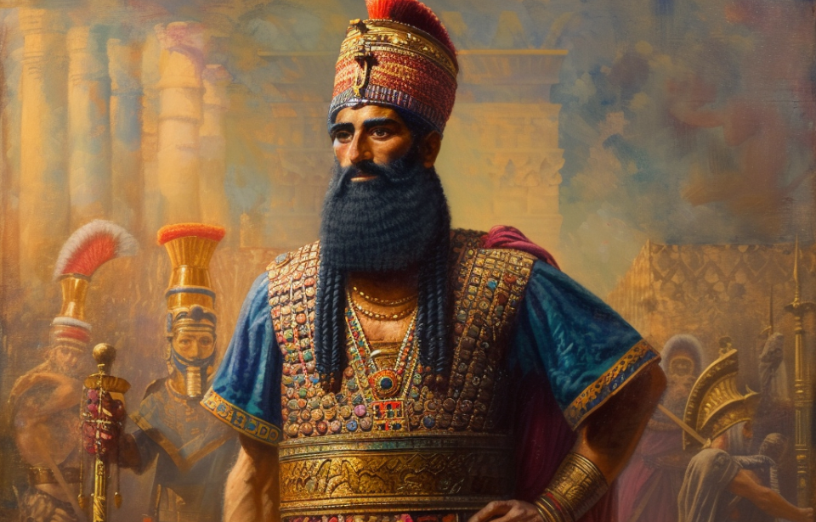
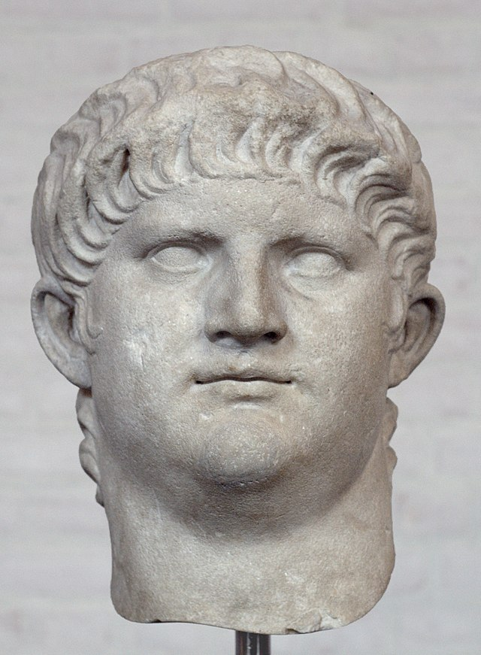
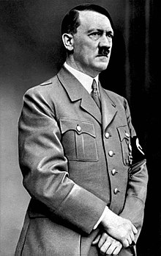
“who brings princes to nothing,
and makes the rulers of the earth as emptiness.”
Isaiah 40:23
Nebuchadnezzar
Nero
Adolf Hitler

Slide 28
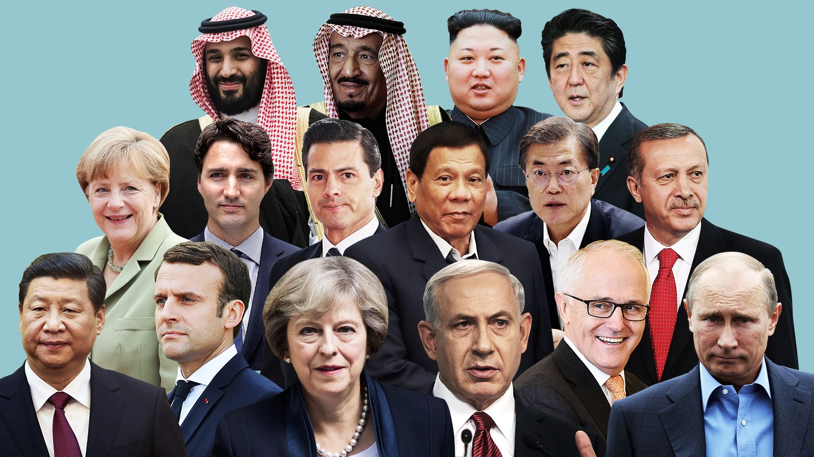
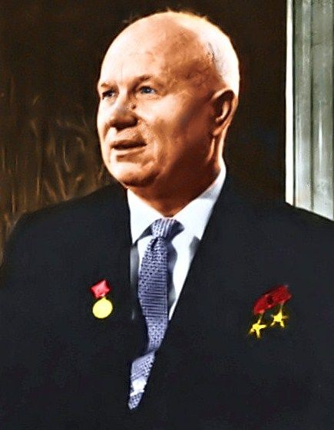
“Scarcely are they planted, scarcely sown,
scarcely has their stem taken root in the earth,
when he blows on them, and they wither,
and the tempest carries them off like stubble.”
Isaiah 40:24

Slide 29
Nikita Khrushchev
Leader of Soviet Union
1953-1964
“Gagarin flew into space, but didn't see any god there.”
“...he blows on them, and they wither…”

Slide 30
“To whom then will you compare me,
that I should be like him? says the Holy One.
Lift up your eyes on high and see:
who created these?
He who brings out their host by number,
calling them all by name;
by the greatness of his might
and because he is strong in power,
not one is missing.” Isaiah 40:25-26

Slide 31
Isaiah 40:12-31
The Incomparable Greatness of God!
God is Distinct From Creation (12-14)
God is Supreme Above Creation (15-20)
God is Sovereign Over Creation (21-26)
How this Applies to His People (27-31)

Slide 32
“Why do you say, O Jacob,
and speak, O Israel,
‘My way is hidden from the LORD,
and my right is disregarded by my God’?”
Isaiah 40:27

Slide 33
“Why do you say, O Jacob,
and speak, O Israel,
‘My way is hidden from the LORD,
and my right is disregarded by my God’?”
Isaiah 40:27
God doesn’t know…

Slide 34
“Why do you say, O Jacob,
and speak, O Israel,
‘My way is hidden from the LORD,
and my right is disregarded by my God’?”
Isaiah 40:27
God doesn’t care…

Slide 35
Isaiah 40 Context: Exile in Babylon
What hard / hopeless situations are we in?
War and oppression
Discrimination
Difficult marriages or other relationships
Challenges with children
Difficult jobs
Frustrations in ministry
Discouragement or Depression

Slide 36
“Have you not known? Have you not heard?
The LORD is the everlasting God,
the Creator of the ends of the earth.
He does not faint or grow weary;
his understanding is unsearchable.”
Isaiah 40:28

Slide 37
“Have you not known? Have you not heard?
The LORD is the everlasting God,
the Creator of the ends of the earth.
He does not faint or grow weary;
his understanding is unsearchable.”
Isaiah 40:28
God is eternal – not bound by time.

Slide 38
“Have you not known? Have you not heard?
The LORD is the everlasting God,
the Creator of the ends of the earth.
He does not faint or grow weary;
his understanding is unsearchable.”
Isaiah 40:28
God is both creative and all-powerful.

Slide 39
“Have you not known? Have you not heard?
The LORD is the everlasting God,
the Creator of the ends of the earth.
He does not faint or grow weary;
his understanding is unsearchable.”
Isaiah 40:28
God is infinite in energy.

Slide 40
“Have you not known? Have you not heard?
The LORD is the everlasting God,
the Creator of the ends of the earth.
He does not faint or grow weary;
his understanding is unsearchable.”
Isaiah 40:28
God is infinite in wisdom.

Slide 41
God, in his nature, is eternal, all-powerful, etc. (vs 28)
God, in his nature, also gives power and strength to those who need it!
“He gives power to the faint,
and to him who has no might he increases strength.”
Isaiah 40:29

Slide 42
God does NOT promise to change our situations…
But he DOES promise power and strength to face them!
“He gives power to the faint,
and to him who has no might he increases strength.”
Isaiah 40:29

Slide 43
“Even youths shall faint and be weary,
and young men shall fall exhausted;”
Isaiah 40:30

Slide 44
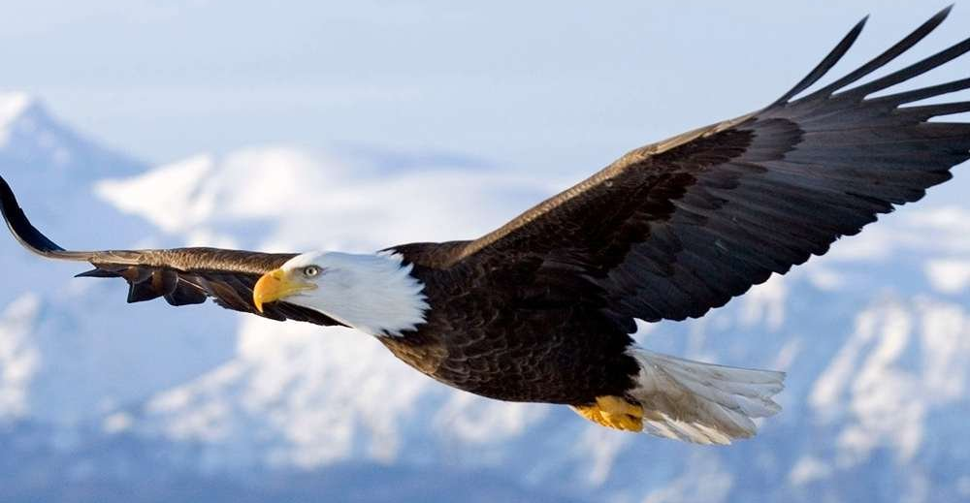
“but they who wait for the LORD shall renew their strength;
they shall mount up with wings like eagles;
they shall run and not be weary; they shall walk and not faint.”
Isaiah 40:31

Slide 45
How do we wait for the LORD?
“but they who wait for the LORD shall renew their strength;
they shall mount up with wings like eagles;
they shall run and not be weary; they shall walk and not faint.”
Isaiah 40:31

Slide 46
Wait: to look for, to hope for, to wait with expectaion
“but they who wait for the LORD shall renew their strength;
they shall mount up with wings like eagles;
they shall run and not be weary; they shall walk and not faint.”
Isaiah 40:31

Slide 47
For the people of Judah:
To believe that God really would fulfill his promise to rescue them from Babylon
To believe that God’s Messiah really would come and set things right
What about for us?
“but they who wait for the LORD shall renew their strength;
they shall mount up with wings like eagles;
they shall run and not be weary; they shall walk and not faint.”
Isaiah 40:31

Slide 48
Isaiah 40 Context: Exile in Babylon
What hard / hopeless situations are we in?
War and oppression
Discrimination
Difficult marriages or other relationships
Challenges with children
Difficult jobs
Lack of fruit in ministry
Discouragement or Depression
Sinful human solutions:
Revenge (physical, verbal)
Break off relationships
Take out frustrations on others
Blame others
Give up hope / Quit
Walk away from God

Slide 49
Waiting on God:
Depending on God to resolve situations
Waiting in hope & expectation
Believing God’s promises
Not resorting to our own sinful solutions
Taking steps of obedience as God leads
Isaiah 40 Context: Exile in Babylon
What hard / hopeless situations are we in?
War and oppression
Discrimination
Difficult marriages or other relationships
Challenges with children
Difficult jobs
Lack of fruit in ministry
Discouragement or Depression

Slide 50
God’s Promise
“but they who wait for the LORD shall renew their strength;
they shall mount up with wings like eagles;
they shall run and not be weary; they shall walk and not faint.”
Isaiah 40:31

Slide 52
OT Preaching link at BibleStudyDownloads.org
Get this presentation for free!
Notes:
OT Preaching (op)

