Slide 1
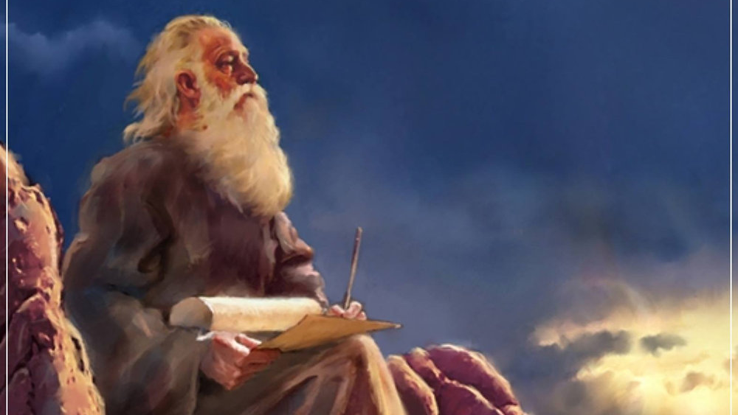
The Prophecy
Of
Isaiah
Isaiah 39
The Problem with Success
Preached by Dan Bridges at Amman International Church, Jordan • AmmanChurch.com Uploaded by Dr. Rick Griffith • Jordan Evangelical Theological Seminary Files in many languages for free download at BibleStudyDownloads.org

Slide 2
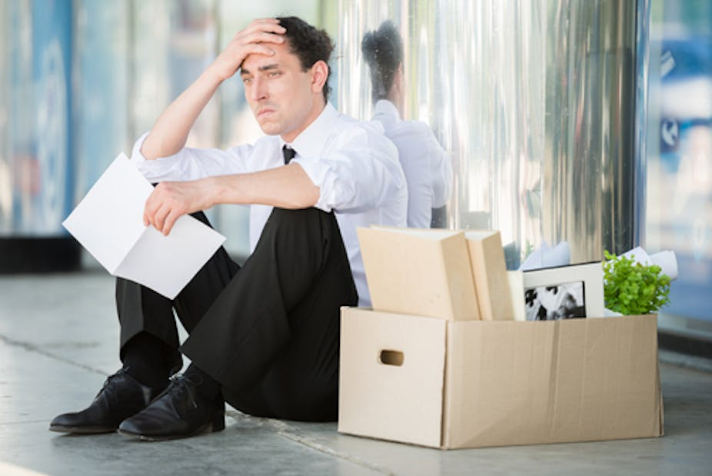
How does it affect…
A devastating job loss…
Pride & Humility?
Relationship with God?
A great job offer…

Slide 3
Danger!
Success can be devastating to humility and dependence on God!

Slide 4
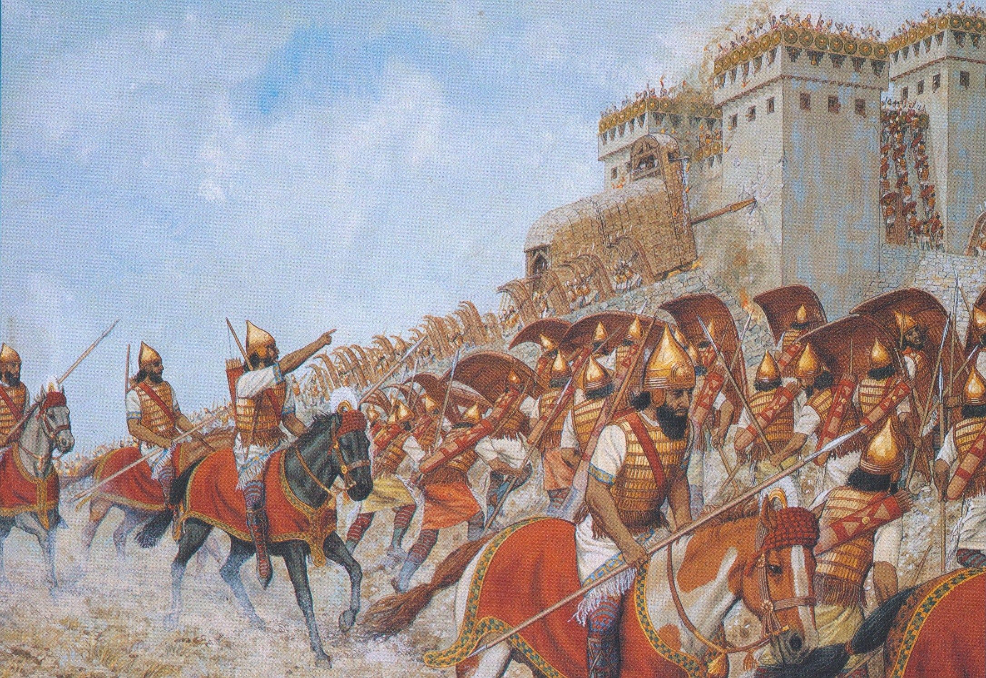
Purpose of Isaiah 36-39 Narrative
Three Stories:
36-37: God’s Defeat of the Assyrian Army
38: Hezekiah’s Sickness and Recovery
39: Envoys from Babylon
Chronologically, 38-39 happened before 36-37!
Why are they out of order?

Slide 5
The Book of Isaiah
Chapters 1-39 – Judgment
Chapters 40-66 – Restoration
Primary Audience:
People of Isaiah’s Day
Primary Context:
Assyrian Crisis
Primary Audience:
People of the exile & after
(150-200 years in future)
Primary Context:
Babylonian Captivity
Chapters 36-37 conclude this!
Chapters 38-39 introduce this!

Slide 6
Purpose of Isaiah 36-39 Narrative
Three Stories:
36-37: God’s Defeat of the Assyrian Army
38: Hezekiah’s Sickness and Recovery
39: Envoys from Babylon
Chapters 36-39 are the bridge between Chapters 1-35 and Chapters 40-66

Slide 7
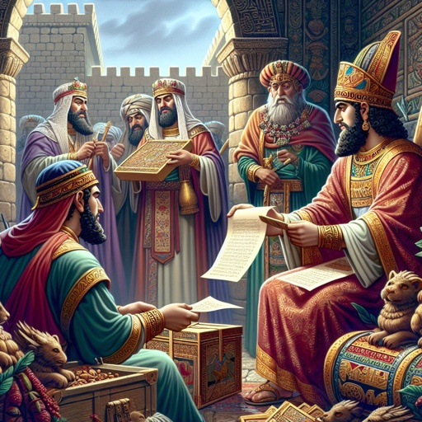
Isaiah 39
The Babylonian Envoys
Background to the Story
The Story – Isaiah 39:1-8
What Can We Learn from This?

Slide 8
“1 At that time Merodach-baladan the son of Baladan, king of Babylon, sent envoys with letters and a present to Hezekiah, for he heard that he had been sick and had recovered.”
Isaiah 39:1

Slide 9
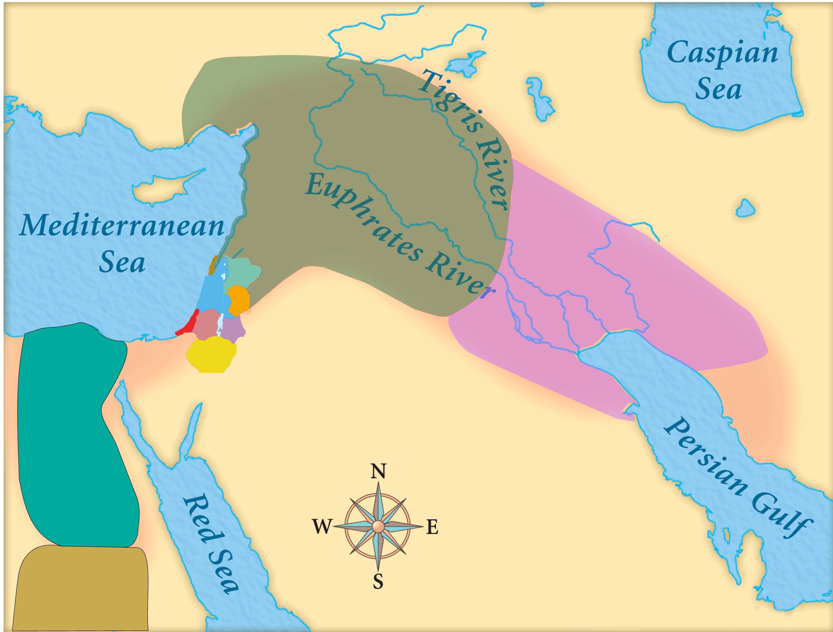
Isaiah 39
Political Background
Assyria
Babylon
Judah
Merodoch-baladan:
Babylonian King 722-710BC
Defeated by Sargon in 710BC
Regained throne in 705BC
Defeated by Sennacherib in 702BC

Slide 10
Isaiah 39
Political Background
Assyria
Babylon
Judah
Merodoch-baladan:
Anticipating an attack by Sennacherib
Seeking to prompt a diversionary uprising in the west

Slide 11
Isaiah 39
Political Background
Assyria
Babylon
Judah
King Hezekiah:
Had rebelled against the king of Assyria
Was anticipating an attack by Sennacherib

Slide 12
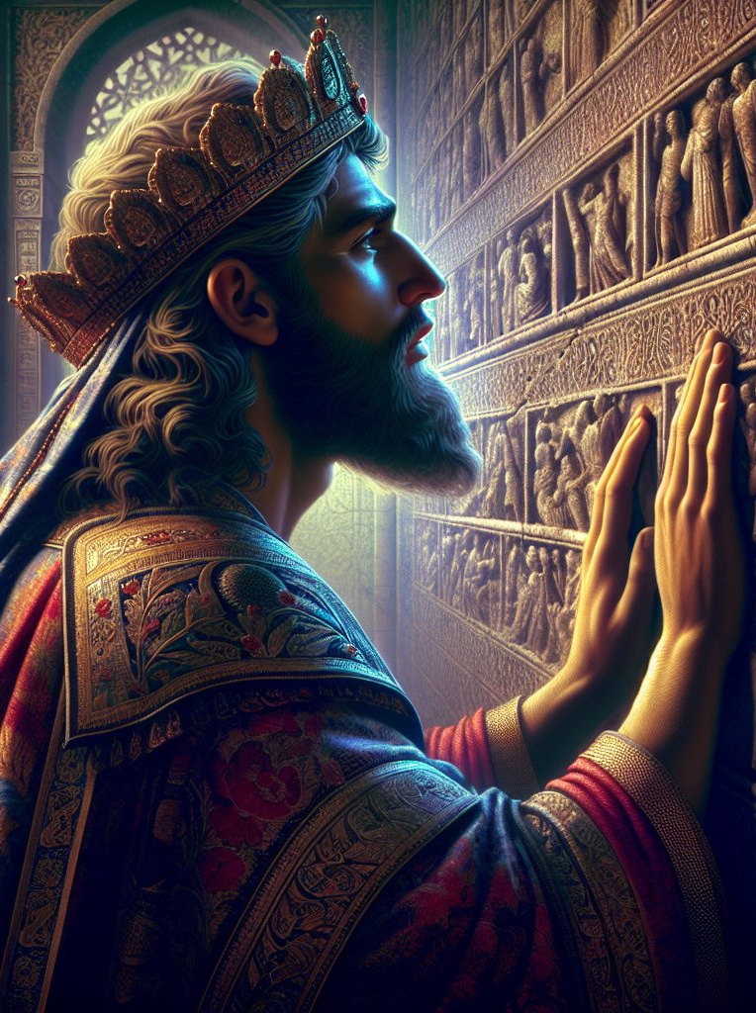
Hezekiah – Personal Background
From Isaiah 38, we know:
He knew God had delivered him through his prayer (38:5,14) and had forgiven his sins (38:17).
He had committed to live the rest of his life in care and humility (38:15).

Slide 13
Hezekiah – Personal Background
“24 In those days Hezekiah became sick and was at the point of death, and he prayed to the LORD, and he answered him and gave him a sign. 25 But Hezekiah did not make return according to the benefit done to him, for his heart was proud.”
2 Chronicles 32:24-25
He did not follow through on his commitment to live humbly…

Slide 14
Hezekiah – Personal Background
“31 And so in the matter of the envoys of the princes of Babylon, who had been sent to him to inquire about the sign that had been done in the land, God left him to himself, in order to test him and to know all that was in his heart.”
2 Chronicles 32:31
The envoys were a test for him from God.

Slide 15
Isaiah 39
The Babylonian Envoys
Background to the Story
The Story – Isaiah 39:1-8
What Can We Learn from This?

Slide 16
“1 At that time Merodach-baladan the son of Baladan, king of Babylon, sent envoys with letters and a present to Hezekiah, for he heard that he had been sick and had recovered.”
Isaiah 39:1
Why had they really come?
To prompt Judah to ally with them by rising up against Assyria…

Slide 17
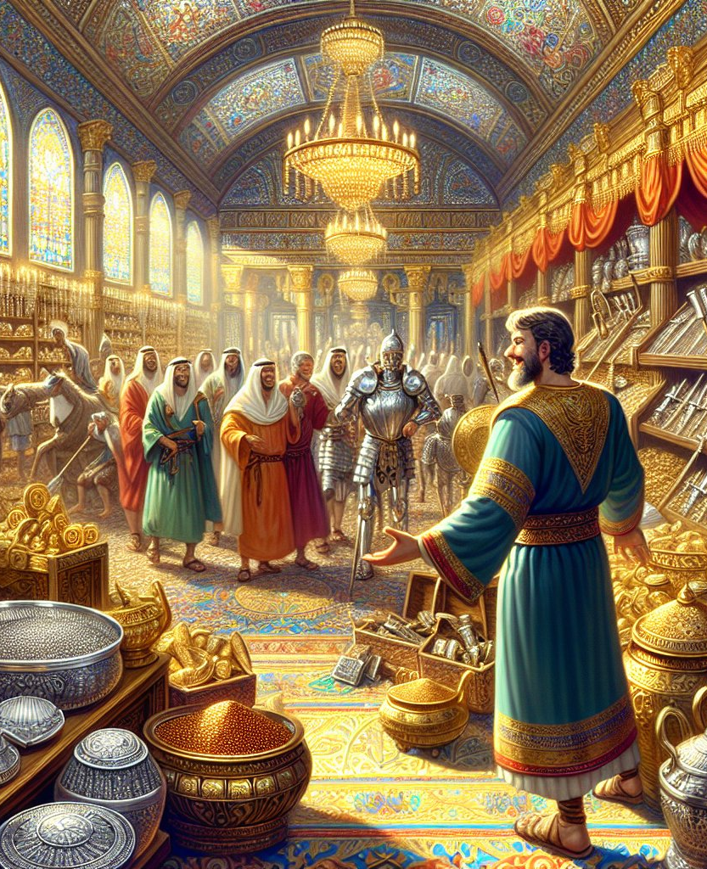
“2 And Hezekiah welcomed them gladly. And he showed them his treasure house, the silver, the gold, the spices, the precious oil, his whole armory, all that was found in his storehouses. There was nothing in his house or in all his realm that Hezekiah did not show them.”
Isaiah 39:2
Why did he welcome them gladly?
Attention from a great nation (He was flattered!)
Solution to the Assyria threat

Slide 18
“2 And Hezekiah welcomed them gladly. And he showed them his treasure house, the silver, the gold, the spices, the precious oil, his whole armory, all that was found in his storehouses. There was nothing in his house or in all his realm that Hezekiah did not show them.”
Isaiah 39:2

Slide 19
Where had all this come from?
“27 And Hezekiah had very great riches and honor, and he made for himself treasuries for silver, for gold, for precious stones, for spices, for shields, and for all kinds of costly vessels… 29 for God had given him very great possessions.”
2 Chronicles 32:27,29
His wealth and power were a blessing from God.

Slide 20
“2 And Hezekiah welcomed them gladly. And he showed them his treasure house, the silver, the gold, the spices, the precious oil, his whole armory, all that was found in his storehouses. There was nothing in his house or in all his realm that Hezekiah did not show them.”
Isaiah 39:2
Why did he show them everything?
In his pride, he was showing them how great he was.
He was showing them that Judah would be a good ally.

Slide 21
The missed opportunities:
To credit God with his healing
To credit God with the sign
To credit God for his wealth
To describe how they were trusting God for protection against Assyria

Slide 22
Daniel in Babylon
“²⁶ The king declared to Daniel, “Are you able to make known to me the dream that I have seen and its interpretation?”
²⁷ Daniel answered the king and said, “No wise men, enchanters, magicians, or astrologers can show to the king the mystery that the king has asked, ²⁸ but there is a God in heaven who reveals mysteries...”
Daniel 2:26-28

Slide 23
Daniel in Babylon
“³⁰ But as for me, this mystery has been revealed to me, not because of any wisdom that I have more than all the living, but in order that the interpretation may be made known to the king, and that you may know the thoughts of your mind.”
Daniel 2:30

Slide 24
Daniel in Babylon
“⁴⁷ The king answered and said to Daniel, ‘Truly, your God is God of gods and Lord of kings, and a revealer of mysteries, for you have been able to reveal this mystery.’”
Daniel 2:47

Slide 25
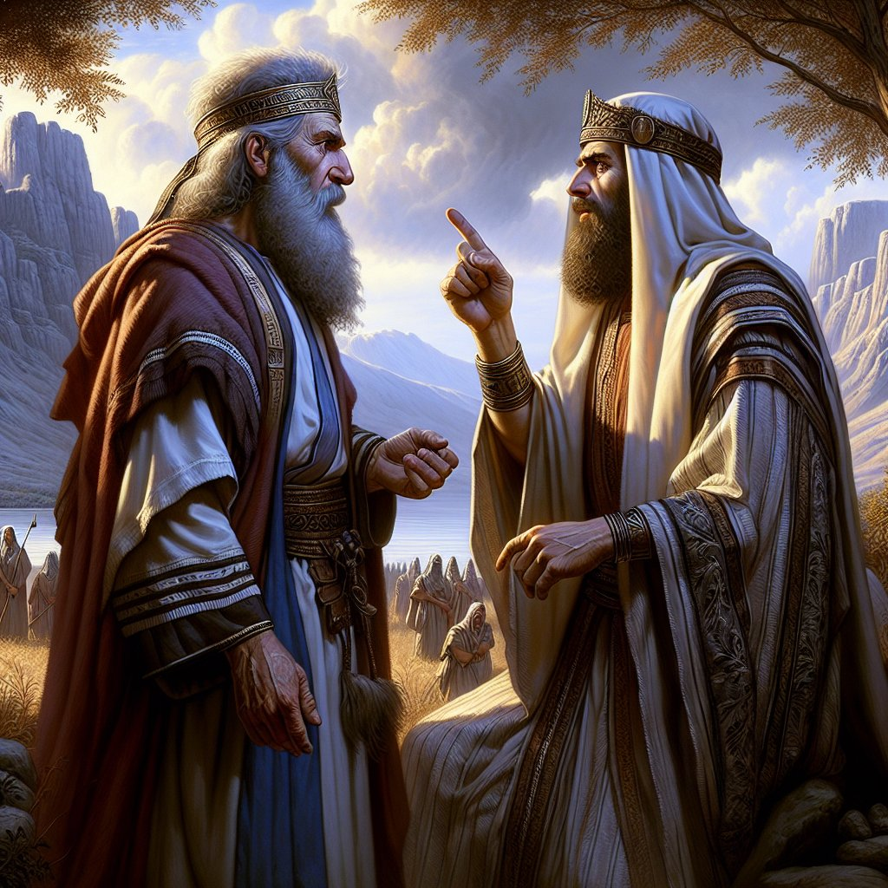
“3 Then Isaiah the prophet came to King Hezekiah, and said to him, ‘What did these men say? And from where did they come to you?’ Hezekiah said, ‘They have come to me from a far country, from Babylon.’”
Isaiah 39:3
Two Questions:
What did they say?
Where were they from?

Slide 26
“3 Then Isaiah the prophet came to King Hezekiah, and said to him, ‘What did these men say? And from where did they come to you?’ Hezekiah said, ‘They have come to me from a far country, from Babylon.’”
Isaiah 39:3
One answer:
No response
From Babylon!

Slide 27
“4 He said, ‘What have they seen in your house?’ Hezekiah answered, ‘They have seen all that is in my house. There is nothing in my storehouses that I did not show them.’”
Isaiah 39:4
Isaiah recognized the Babylonians as potential enemies…

Slide 28
“4 He said, ‘What have they seen in your house?’ Hezekiah answered, ‘They have seen all that is in my house. There is nothing in my storehouses that I did not show them.’”
Isaiah 39:4
Hezekiah’s pride had caused him to act foolishly…

Slide 29
“5 Then Isaiah said to Hezekiah, ‘Hear the word of the LORD of hosts: 6 Behold, the days are coming, when all that is in your house, and that which your fathers have stored up till this day, shall be carried to Babylon. Nothing shall be left, says the LORD.’”
Isaiah 39:5-6
Hezekiah’s pride and foolishness had sowed the seed for a future Babylonian invasion!

Slide 30
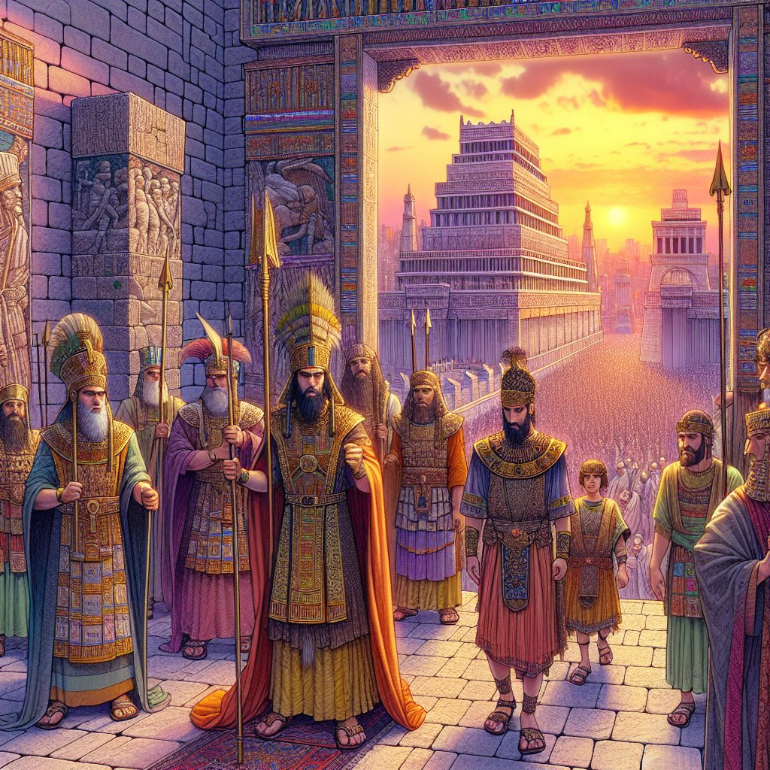
“7 And some of your own sons, who will come from you, whom you will father, shall be taken away, and they shall be eunuchs in the palace of the king of Babylon.”
Isaiah 39:7

Slide 31
“8 Then Hezekiah said to Isaiah, ‘The word of the LORD that you have spoken is good.’ For he thought, ‘There will be peace and security in my days.’”
Isaiah 39:8
Hezekiah’s pride had caused him to become self-focused…

Slide 32
Isaiah 39
The Babylonian Envoys
Background to the Story
The Story – Isaiah 39:1-8
What Can We Learn from This?

Slide 33
Has God given you success?
Who is getting credit for your success?

Slide 34
“What do you have that you did not receive? If then you received it, why do you boast as if you did not receive it?”
1 Corinthians 4:7

Slide 35
Has God given you success?
The greatest danger in success is pride!

Slide 36
Some Dangerous Effects of Pride:
We take credit for what God has done.
We believe flattery and behave foolishly.
We become self-focused.
We become self-reliant.
We rely on our past spiritual growth.

Slide 37
Dealing with Pride:
“⁵ Clothe yourselves, all of you, with humility toward one another, for ‘God opposes the proud but gives grace to the humble.’
⁶ Humble yourselves, therefore, under the mighty hand of God so that at the proper time he may exalt you.”
1 Peter 5:5-6
The primary environment for dealing with pride is in our relationships with people!

Slide 38
Dealing with Pride:
“⁵ Clothe yourselves, all of you, with humility toward one another, for ‘God opposes the proud but gives grace to the humble.’
⁶ Humble yourselves, therefore, under the mighty hand of God so that at the proper time he may exalt you.”
1 Peter 5:5-6
God is committed to dealing with our pride!

Slide 39
Dealing with Pride:
“⁵ Clothe yourselves, all of you, with humility toward one another, for ‘God opposes the proud but gives grace to the humble.’
⁶ Humble yourselves, therefore, under the mighty hand of God so that at the proper time he may exalt you.”
1 Peter 5:5-6
It is our responsibility to take the initiative to humble ourselves!

Slide 40
The Best Antidote for Pride:
“²⁷ Now is my soul troubled. And what shall I say? ‘Father, save me from this hour’? But for this purpose I have come to this hour. ²⁸ ‘Father, glorify your name.’ Then a voice came from heaven: ‘I have glorified it, and I will glorify it again.’”
John 12:27-28
In all of life, focus on giving God glory!

Slide 42
OT Preaching link at BibleStudyDownloads.org
Get this presentation for free!
Notes:
OT Preaching (op)

