Slide 1
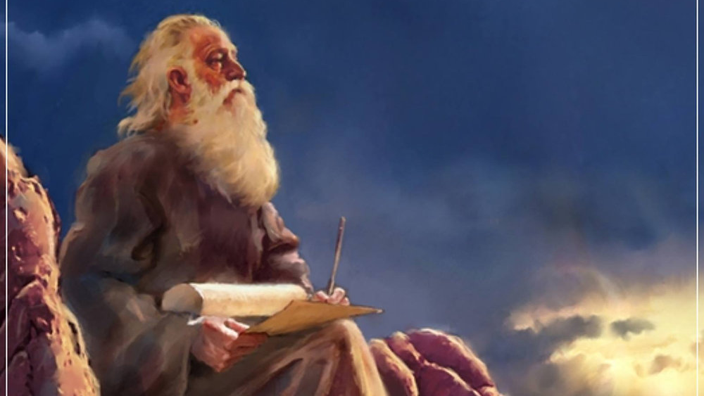
The Prophecy
Of
Isaiah
Isaiah 34–35
Rivers of Living Water!
Preached by Dan Bridges at Amman International Church, Jordan • AmmanChurch.com Uploaded by Dr. Rick Griffith • Jordan Evangelical Theological Seminary Files in many languages for free download at BibleStudyDownloads.org

Slide 2
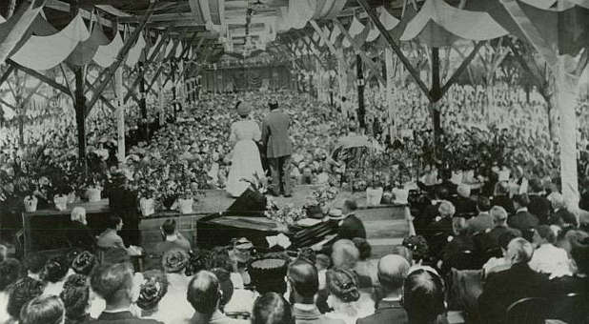
Stories of the Welsh Revival
of 1904-1906

Slide 3
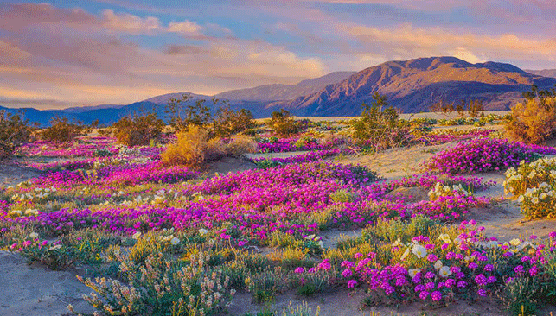
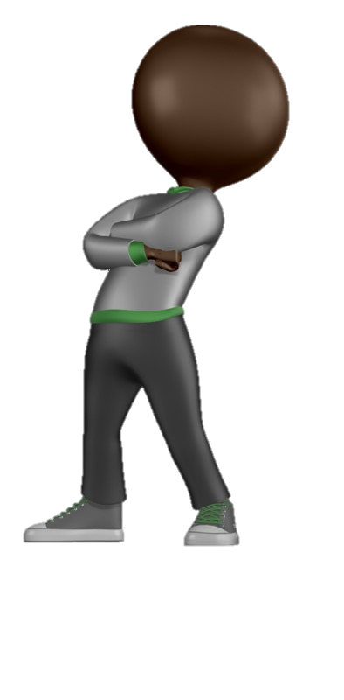
Isaiah 34-35:
God’s Sovereignty in Judgment and Salvation
34 – Sovereignty in Judgment
The Fruitful Land Becomes a Wilderness
35 – Sovereignty in Salvation
The Wilderness Becomes a Fruitful Land
Sovereignty –
Supreme or absolute power that cannot be
limited by anyone or anything

Slide 4
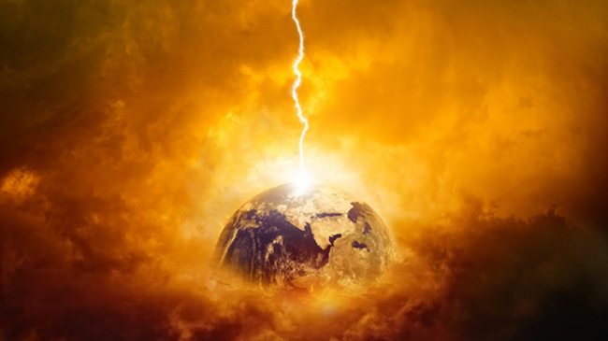
Isaiah 34 – Sovereignty in Judgment
God’s Rage Against All Nations (1-4)
God’s Judgment Against Edom (5-17)

Slide 5
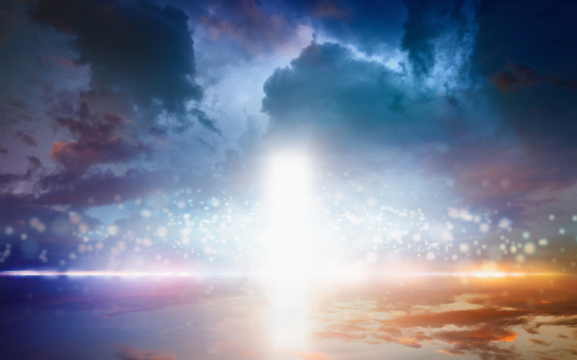
1 Draw near, O nations, to hear, and give attention,
O peoples!
Let the earth hear, and all that fills it;
the world, and all that comes from it.
A universal summons to all nations

Slide 6
2 For the LORD is enraged against all the nations,
and furious against all their host;
he has devoted them to destruction, has given
them over for slaughter.
3 Their slain shall be cast out,
and the stench of their corpses shall rise;
the mountains shall flow with their blood.

Slide 7
This Judgment is:
Personal & Intended (not just a “natural disaster”)
2 For the LORD is enraged against all the nations,
and furious against all their host;
he has devoted them to destruction, has given
them over for slaughter.
3 Their slain shall be cast out,
and the stench of their corpses shall rise;
the mountains shall flow with their blood.

Slide 8
This Judgment is:
Personal & Intended (not just a “natural disaster”)
World-wide (He is the God of all nations)
2 For the LORD is enraged against all the nations,
and furious against all their host;
he has devoted them to destruction, has given
them over for slaughter.
3 Their slain shall be cast out,
and the stench of their corpses shall rise;
the mountains shall flow with their blood.

Slide 9
This Judgment is:
Personal & Intended (not just a “natural disaster”)
World-wide (He is the God of all nations)
Final (Not in order to bring them back to him)
2 For the LORD is enraged against all the nations,
and furious against all their host;
he has devoted them to destruction, has given
them over for slaughter.
3 Their slain shall be cast out,
and the stench of their corpses shall rise;
the mountains shall flow with their blood.

Slide 10
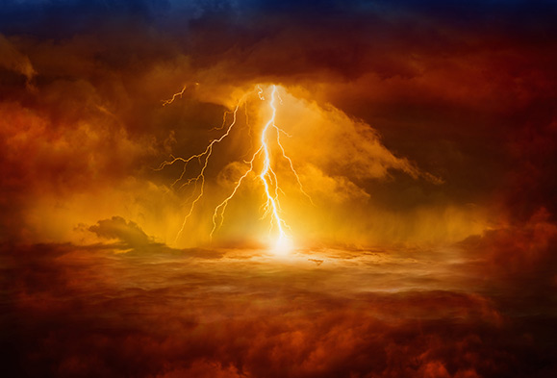
Old City and Kidron Valley from north
This Judgment is:
Personal & Intended (not just a “natural disaster”)
World-wide (He is the God of all nations)
Final (Not in order to bring them back to him)
Universal (Destruction of the entire universe)
4 All the host of heaven shall rot away,
and the skies roll up like a scroll.
All their host shall fall,
as leaves fall from the vine,
like leaves falling from the fig tree.

Slide 11
Old City and Kidron Valley from north
Isaiah 34 – God’s Universal Judgment
God’s Rage Against All Nations (1-4)
God’s Judgment Against Edom (5-17)

Slide 12
Old City and Kidron Valley from north
5 For my sword has drunk its fill in
the heavens;
behold, it descends for judgment
upon Edom,
upon the people I have devoted to
destruction.
Why Edom (descendants of Esau)?
Represent long-term and continuous enemies of God and his people

Slide 13
Old City and Kidron Valley from north
Four Images of Judgment:
Sword
5 For my sword has drunk its fill in
the heavens;
behold, it descends for judgment
upon Edom,
upon the people I have devoted to
destruction.

Slide 14
Old City and Kidron Valley from north
Four Images of Judgment:
Sword
Sacrifice
6 The LORD has a sword;
it is sated with blood;
it is gorged with fat,
with the blood of lambs and goats,
with the fat of the kidneys of rams.
For the LORD has a sacrifice in Bozrah,
a great slaughter in the land of Edom.

Slide 15
Old City and Kidron Valley from north
Four Images of Judgment:
Sword
Sacrifice
Sulfur and Burning Pitch
9 And the streams of Edom shall be turned into pitch,
and her soil into sulfur;
her land shall become burning pitch.
10a Night and day it shall not be quenched;
its smoke shall go up forever.

Slide 16
Old City and Kidron Valley from north
Four Images of Judgment:
Sword
Sacrifice
Sulfur and Burning Pitch
Everlasting wilderness / Wasteland
10b From generation to generation it shall lie waste;
none shall pass through it forever and ever.
11 But the hawk and the porcupine shall possess it,
the owl and the raven shall dwell in it.
He shall stretch the line of confusion over it,
and the plumb line of emptiness.

Slide 17
Old City and Kidron Valley from north
12 Its nobles—there is no one there to call it a kingdom,
and all its princes shall be nothing.
13 Thorns shall grow over its strongholds,
nettles and thistles in its fortresses.
It shall be the haunt of jackals,
an abode for ostriches.

Slide 18
Old City and Kidron Valley from north
14 And wild animals shall meet with hyenas;
the wild goat shall cry to his fellow;
indeed, there the night bird settles
and finds for herself a resting place.
15 There the owl nests and lays
and hatches and gathers her young in her shadow;
indeed, there the hawks are gathered,
each one with her mate.

Slide 19
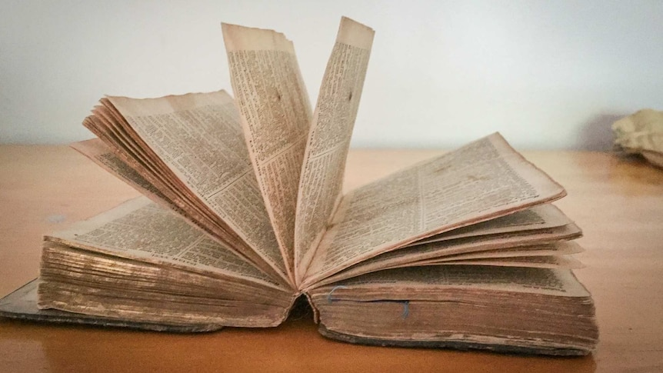
Old City and Kidron Valley from north
16 Seek and read from the book of the LORD:
Not one of these shall be missing;
none shall be without her mate.
For the mouth of the LORD has commanded,
and his Spirit has gathered them.
17 He has cast the lot for them;
his hand has portioned it out to them with the line;
they shall possess it forever;
from generation to generation they shall dwell in it.

Slide 20
Old City and Kidron Valley from north
God, in his sovereignty, will accomplish every detail of the prophecy!
16 Seek and read from the book of the LORD:
Not one of these shall be missing;
none shall be without her mate.
For the mouth of the LORD has commanded,
and his Spirit has gathered them.
17 He has cast the lot for them;
his hand has portioned it out to them with the line;
they shall possess it forever;
from generation to generation they shall dwell in it.

Slide 21
Old City and Kidron Valley from north
Isaiah 34-35:
God’s Sovereignty in Judgment and Salvation
34 – Sovereignty in Judgment
The Fruitful Land Becomes a Wilderness
35 – Sovereignty in Salvation
The Wilderness Becomes a Fruitful Land

Slide 22
Old City and Kidron Valley from north
Isaiah 35 – Sovereignty in Salvation!
Blossoming Desert (1-2)
Call to Courage (3-4)
Rivers in the Desert (5-7)
The Way of Holiness (8-10)

Slide 23
Old City and Kidron Valley from north
1 The wilderness and the dry land shall be glad;
the desert shall rejoice and blossom like the crocus;
2 it shall blossom abundantly
and rejoice with joy and singing.
The glory of Lebanon shall be given to it,
the majesty of Carmel and Sharon.
They shall see the glory of the LORD,
the majesty of our God.

Slide 24
Old City and Kidron Valley from north
1 The wilderness and the dry land shall be glad;
the desert shall rejoice and blossom like the crocus;
2 it shall blossom abundantly
and rejoice with joy and singing.
The glory of Lebanon shall be given to it,
the majesty of Carmel and Sharon.
They shall see the glory of the LORD,
the majesty of our God.
Restoration of the wilderness and water in the desert are common themes in Isaiah – why?

Slide 25
Old City and Kidron Valley from north
1 The wilderness and the dry land shall be glad;
the desert shall rejoice and blossom like the crocus;
2 it shall blossom abundantly
and rejoice with joy and singing.
The glory of Lebanon shall be given to it,
the majesty of Carmel and Sharon.
They shall see the glory of the LORD,
the majesty of our Go
For the LORD comforts Zion; he comforts all her waste places and makes her wilderness like Eden, her desert like the garden of the LORD; joy and gladness will be found in her, thanksgiving and the voice of song.
Isaiah 51:3

Slide 26
Old City and Kidron Valley from north
1 The wilderness and the dry land shall be glad;
the desert shall rejoice and blossom like the crocus;
2 it shall blossom abundantly
and rejoice with joy and singing.
The glory of Lebanon shall be given to it,
the majesty of Carmel and Sharon.
They shall see the glory of the LORD,
the majesty of ou
The wilderness and the desert in Scripture often represent life outside of Eden – life dominated by sin, judgment and chaos. Even as believers, we live in this.

Slide 27
Old City and Kidron Valley from north
1 The wilderness and the dry land shall be glad;
the desert shall rejoice and blossom like the crocus;
2 it shall blossom abundantly
and rejoice with joy and singing.
The glory of Lebanon shall be given to it,
the majesty of Carmel and Sharon.
They shall see the glory of the LORD,
the majesty of our God.
But God is restoring the wilderness!
Setting creation free from its bondage to decay
(Romans 8:21)
Setting people free from their bondage to sin

Slide 28
Old City and Kidron Valley from north
1 The wilderness and the dry land shall be glad;
the desert shall rejoice and blossom like the crocus;
2 it shall blossom abundantly
and rejoice with joy and singing.
The glory of Lebanon shall be given to it,
the majesty of Carmel and Sharon.
They shall see the glory of the LORD,
the majesty of our God.
God’s glory will be revealed!
When will this happen?

Slide 29
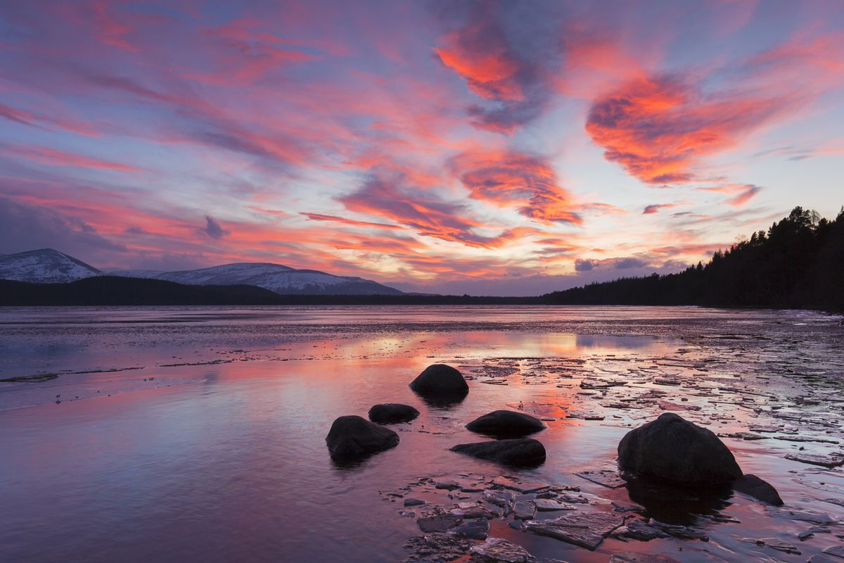
The “Latter” or “Last” Days
Isaiah 35
End of Time
OT
Prophet
Messianic Age

Slide 30
Old City and Kidron Valley from north
1 The wilderness and the dry land shall be glad;
the desert shall rejoice and blossom like the crocus;
2 it shall blossom abundantly
and rejoice with joy and singing.
The glory of Lebanon shall be given to it,
the majesty of Carmel and Sharon.
They shall see the glory of the LORD,
the majesty of our God.
God’s glory will be revealed!
“And the Word became flesh and dwelt among us, and we have seen his glory, glory as of the only Son from the Father, full of grace and truth.” John 1:14

Slide 31
Old City and Kidron Valley from north
1 The wilderness and the dry land shall be glad;
the desert shall rejoice and blossom like the crocus;
2 it shall blossom abundantly
and rejoice with joy and singing.
The glory of Lebanon shall be given to it,
the majesty of Carmel and Sharon.
They shall see the glory of the LORD,
the majesty of our God.
God’s glory will be revealed!
“Then will appear in heaven the sign of the Son of Man, and then all the tribes of the earth … will see the Son of Man coming on the clouds of heaven with power and great glory.” Matthew 24:30

Slide 32
Old City and Kidron Valley from north
Isaiah 35 – Sovereignty in Salvation!
Blossoming Desert (1-2)
Call to Courage (3-4)
Rivers in the Desert (5-7)
The Way of Holiness (8-10)

Slide 33
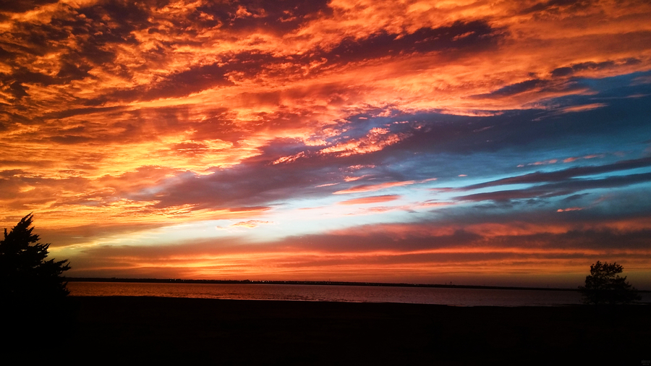
Old City and Kidron Valley from north
God is bringing complete restoration… But in the meantime…
3 Strengthen the weak hands,
and make firm the feeble knees.
4 Say to those who have an anxious heart,
“Be strong; fear not!
Behold, your God will come with vengeance,
with the recompense of God.
He will come and save you.”

Slide 34
Old City and Kidron Valley from north
God’s words to Joshua – Dueteronomy 31:6
3 Strengthen the weak hands,
and make firm the feeble knees.
4 Say to those who have an anxious heart,
“Be strong; fear not!
Behold, your God will come with vengeance,
with the recompense of God.
He will come and save you.”

Slide 35
Old City and Kidron Valley from north
Do we believe this?
3 Strengthen the weak hands,
and make firm the feeble knees.
4 Say to those who have an anxious heart,
“Be strong; fear not!
Behold, your God will come with vengeance,
with the recompense of God.
He will come and save you.”

Slide 36
Old City and Kidron Valley from north
Isaiah 35 – Sovereignty in Salvation!
Blossoming Desert (1-2)
Call to Courage (3-4)
Rivers in the Desert (5-7)
The Way of Holiness (8-10)

Slide 37
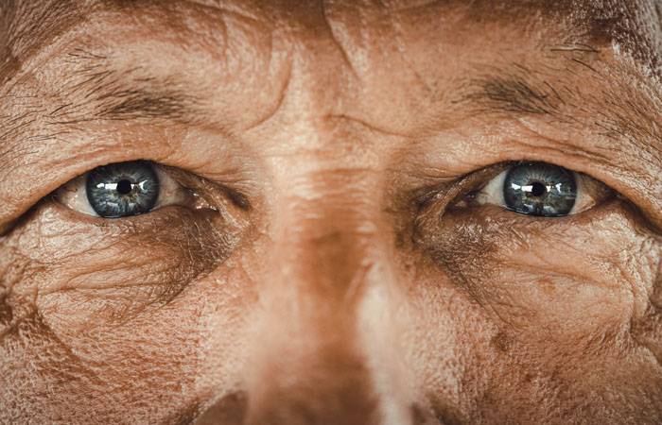
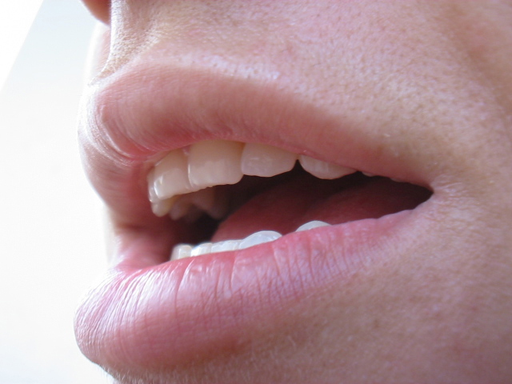
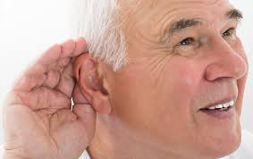
Old City and Kidron Valley from north
5 Then the eyes of the blind shall be opened,
and the ears of the deaf unstopped;
6a then shall the lame man leap like a deer,
and the tongue of the mute sing for joy.
When will this happen?

Slide 38
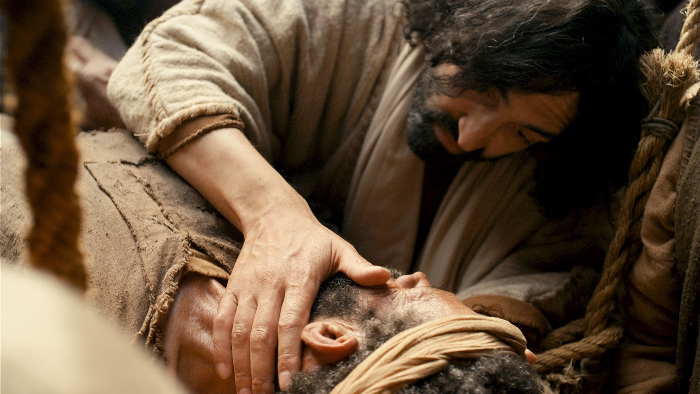
Old City and Kidron Valley from north
4 And Jesus answered them, “Go and tell John what you hear and see:
5 the blind receive their sight and the lame walk, lepers are cleansed and the deaf hear, and the dead are raised up, and the poor have good news preached to them.”
Matthew 11:4-5
Why do you think Jesus used these words?

Slide 39
Old City and Kidron Valley from north
5 Then the eyes of the blind shall be opened,
and the ears of the deaf unstopped;
6a then shall the lame man leap like a deer,
and the tongue of the mute sing for joy.
Was physical healing Jesus’ primary goal?

Slide 40
Old City and Kidron Valley from north
9 “Go, and say to this people:
“‘Keep on hearing, but do not understand;
keep on seeing, but do not perceive.’
10 Make the heart of this people dull,
and their ears heavy,
and blind their eyes;
lest they see with their eyes,
and hear with their ears,
and understand with their hearts,
and turn and be healed.”
Isaiah 6:9-10
The true miracle is spiritual sight!

Slide 41
Old City and Kidron Valley from north
5 Then the eyes of the blind shall be opened,
and the ears of the deaf unstopped;
6a then shall the lame man leap like a deer,
and the tongue of the mute sing for joy.
What enables these miracles to happen?

Slide 42
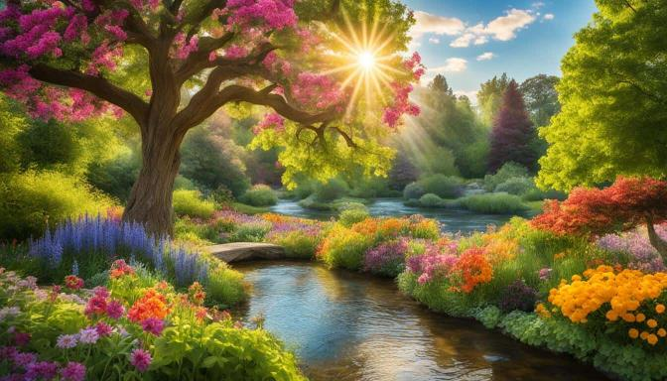
Old City and Kidron Valley from north
6b For waters break forth in the wilderness,
and streams in the desert;
7 the burning sand shall become a pool,
and the thirsty ground springs of water;
in the haunt of jackals, where they lie down,
the grass shall become reeds and rushes.

Slide 43
Old City and Kidron Valley from north
How does water in the wilderness bring about this physical or spiritual healing?
6b For waters break forth in the wilderness,
and streams in the desert;
7 the burning sand shall become a pool,
and the thirsty ground springs of water;
in the haunt of jackals, where they lie down,
the grass shall become reeds and rushes.

Slide 44
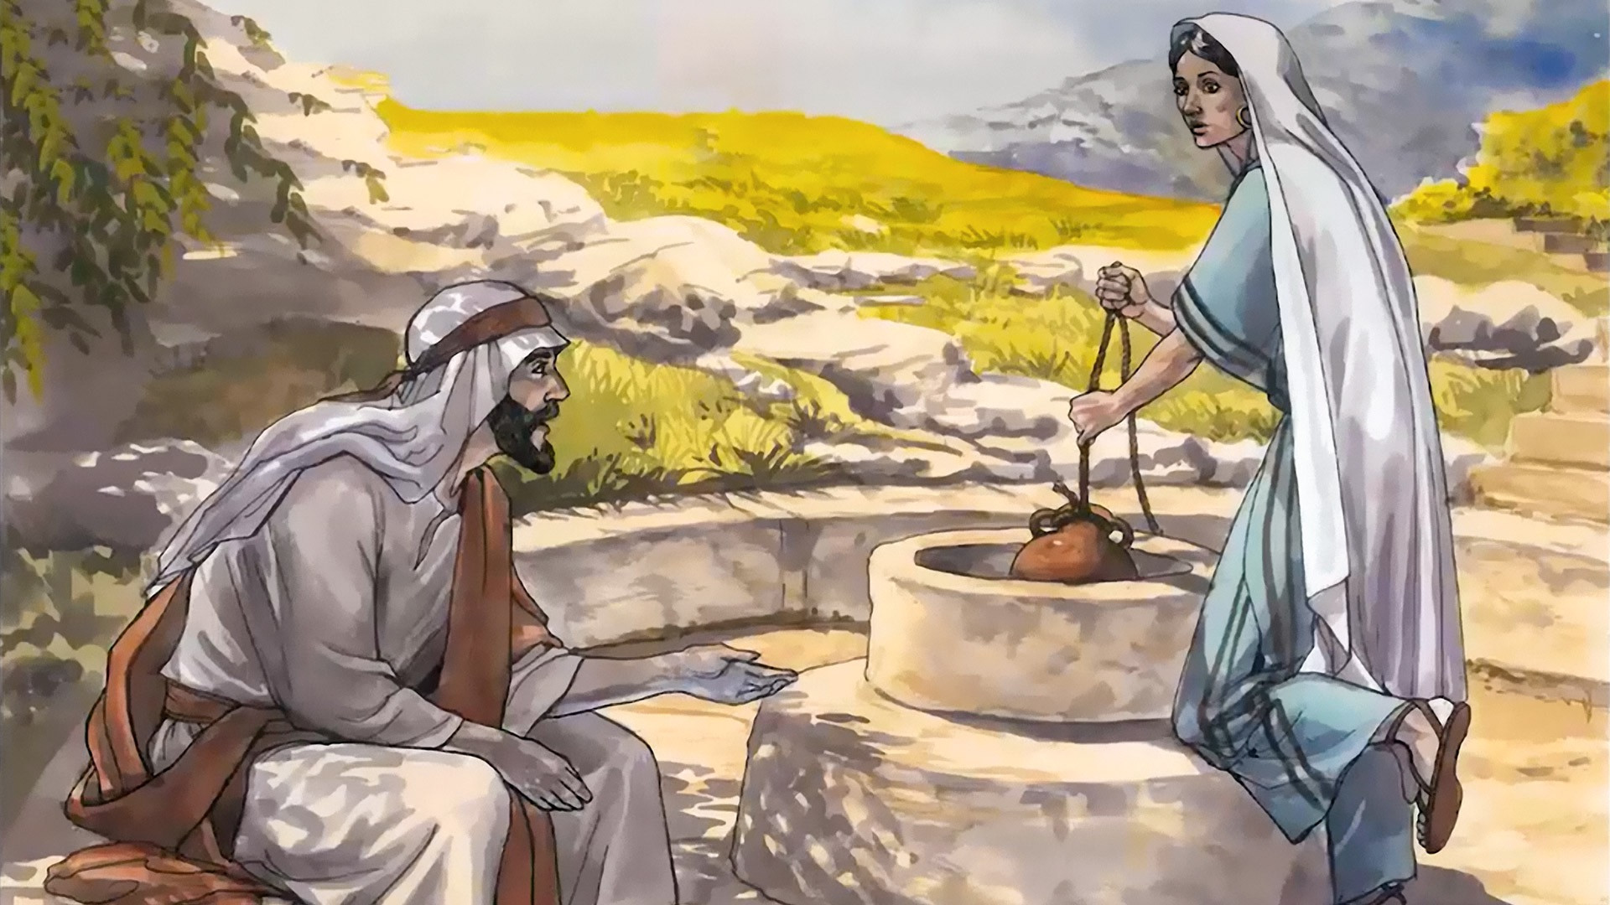
Old City and Kidron Valley from north
Jesus himself is the fulfillment of this water of life that brings healing!
13 Jesus said to her, “Everyone who drinks of this water will be thirsty again, 14 but whoever drinks of the water that I will give him will never be thirsty again. The water that I will give him will become in him a spring of water welling up to eternal life.” John 4:13-14

Slide 45
Old City and Kidron Valley from north
Throughout the Bible, water is a symbol of salvation and the Holy Spirit!
2 “Behold, God is my salvation; I will trust, and will not be afraid; for the LORD God is my strength and my song, and he has become my salvation.”
3 With joy you will draw water from the wells of salvation. Isaiah 12:2-3

Slide 46
Old City and Kidron Valley from north
Throughout the Bible, water is a symbol of salvation and the Holy Spirit!
3 For I will pour water on the thirsty land,
and streams on the dry ground;
I will pour my Spirit upon your offspring,
and my blessing on your descendants.
4 They shall spring up among the grass
like willows by flowing streams.
5 This one will say, ‘I am the LORD's,’
another will call on the name of Jacob,
and another will write on his hand, ‘The LORD's,’
and name himself by the name of Israel.
Isaiah 44:3-5

Slide 47
Old City and Kidron Valley from north
Jesus not only fulfilled this prophecy in his time, but is still doing so today!
6b For waters break forth in the wilderness,
and streams in the desert;
7 the burning sand shall become a pool,
and the thirsty ground springs of water;
in the haunt of jackals, where they lie down,
the grass shall become reeds and rushes.

Slide 48
Old City and Kidron Valley from north
This is a picture of revival – both corporate and individual!
Examples of Corporate Revival:
Pentecost (Acts 2)
Samaria (Acts 8)
Cornelius’ family (Acts 10)
Antioch (Acts 12)
Ephesus and Aisa-minor (Acts 19)
Revivals from NT times until today!
6b For waters break forth in the wilderness,
and streams in the desert;
7 the burning sand shall become a pool,
and the thirsty ground springs of water;
in the haunt of jackals, where they lie down,
the grass shall become reeds and rushes.

Slide 49
Old City and Kidron Valley from north
Isaiah 35 – Sovereignty in Salvation!
Blossoming Desert (1-2)
Call to Courage (3-4)
Rivers in the Desert (5-7)
The Way of Holiness (8-10)

Slide 50
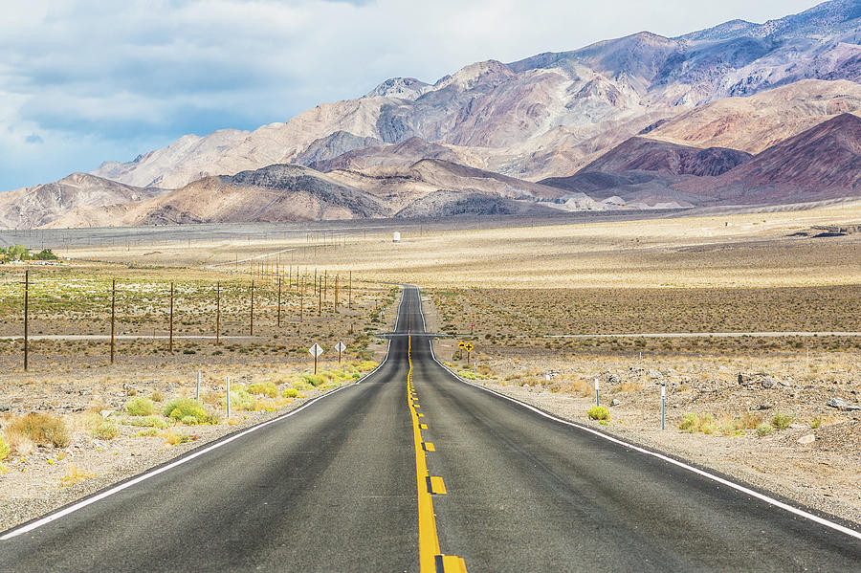
Old City and Kidron Valley from north
8 And a highway shall be there,
and it shall be called the Way of Holiness;
the unclean shall not pass over it.
It shall belong to those who walk on the way;
even if they are fools, they shall not go astray. 9a No lion shall be there,
nor shall any ravenous beast come up on it;
they shall not be found there,

Slide 51
Old City and Kidron Valley from north
8 And a highway shall be there,
and it shall be called the Way of Holiness;
the unclean shall not pass over it.
It shall belong to those who walk on the way;
even if they are fools, they shall not go astray. 9a No lion shall be there,
nor shall any ravenous beast come up on it;
they shall not be found there,
What is this “Way of Holiness”?

Slide 52
Old City and Kidron Valley from north
8 And a highway shall be there,
and it shall be called the Way of Holiness;
the unclean shall not pass over it.
It shall belong to those who walk on the way;
even if they are fools, they shall not go astray. 9a No lion shall be there,
nor shall any ravenous beast come up on it;
they shall not be found there,
Only for the “clean”

Slide 53
Old City and Kidron Valley from north
19 “Therefore, brothers, since we have confidence to enter the holy places by the blood of Jesus…
22 let us draw near with a true heart in full assurance of faith, with our hearts sprinkled clean from an evil conscience and our bodies washed with pure water.”
Hebrews 10:19,22
Only for the “clean”

Slide 54
Old City and Kidron Valley from north
9b but the redeemed shall walk there.
10 And the ransomed of the LORD shall return
and come to Zion with singing;
everlasting joy shall be upon their heads;
they shall obtain gladness and joy,
and sorrow and sighing shall flee away.
Only for the “clean”
Only for the “redeemed” / “ransomed”

Slide 55
Old City and Kidron Valley from north
9b but the redeemed shall walk there.
10 And the ransomed of the LORD shall return
and come to Zion with singing;
everlasting joy shall be upon their heads;
they shall obtain gladness and joy,
and sorrow and sighing shall flee away.
Only for the “clean”
Only for the “redeemed” / “ransomed”
It is the way to “Zion”

Slide 56
Old City and Kidron Valley from north
9b but the redeemed shall walk there.
10 And the ransomed of the LORD shall return
and come to Zion with singing;
everlasting joy shall be upon their heads;
they shall obtain gladness and joy,
and sorrow and sighing shall flee away.
“But you have come to Mount Zion and to the city of the living God, the heavenly Jerusalem…” Hebrews 12:22

Slide 57
Old City and Kidron Valley from north
Isaiah 35 – Sovereignty in Salvation!
Blossoming Desert (1-2)
Call to Courage (3-4)
Rivers in the Desert (5-7)
The Way of Holiness (8-10)

Slide 58
Old City and Kidron Valley from north
Connection Between Isaiah 35 and Us
To the people of Israel, a highway in the wilderness represented a safe return from slavery or exile.

Slide 59
Old City and Kidron Valley from north
Connection Between Isaiah 35 and Us
God has also provided a way for us to go through the wilderness of this life – his presence with us all the way!

Slide 60
Old City and Kidron Valley from north
Connection Between Isaiah 35 and Us
We are living in the middle of Isaiah 35!
Jesus has come! God, in his sovereignty, has started this process of renewal.
We can be confident that he will finish it!
We can be a part of it!

Slide 61
Old City and Kidron Valley from north
Connection Between Isaiah 35 and Us
Let’s go forward in the faith of Isaiah 35:4
“Be strong, fear not! Behold, your God… will come and save you.”
Are you willing to start praying for revival at AIC, in Amman and in this country?

Slide 63
OT Preaching link at BibleStudyDownloads.org
Get this presentation for free!
Notes:
OT Preaching (op)

