Slide 1
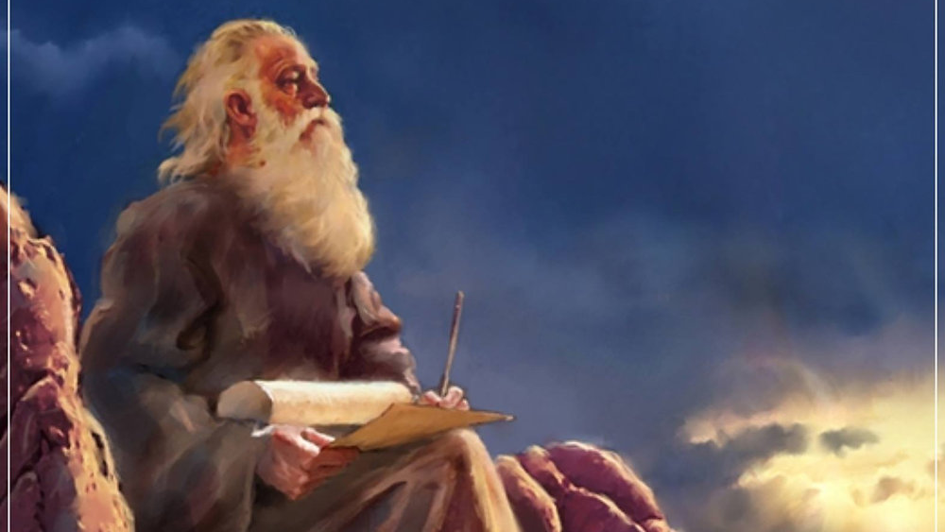
The Prophecy
Of
Isaiah
Isaiah 32 The Coming Kingdom!
Preached by Dan Bridges at Amman International Church, Jordan • AmmanChurch.com Uploaded by Dr. Rick Griffith • Jordan Evangelical Theological Seminary Files in many languages for free download at BibleStudyDownloads.org

Slide 2
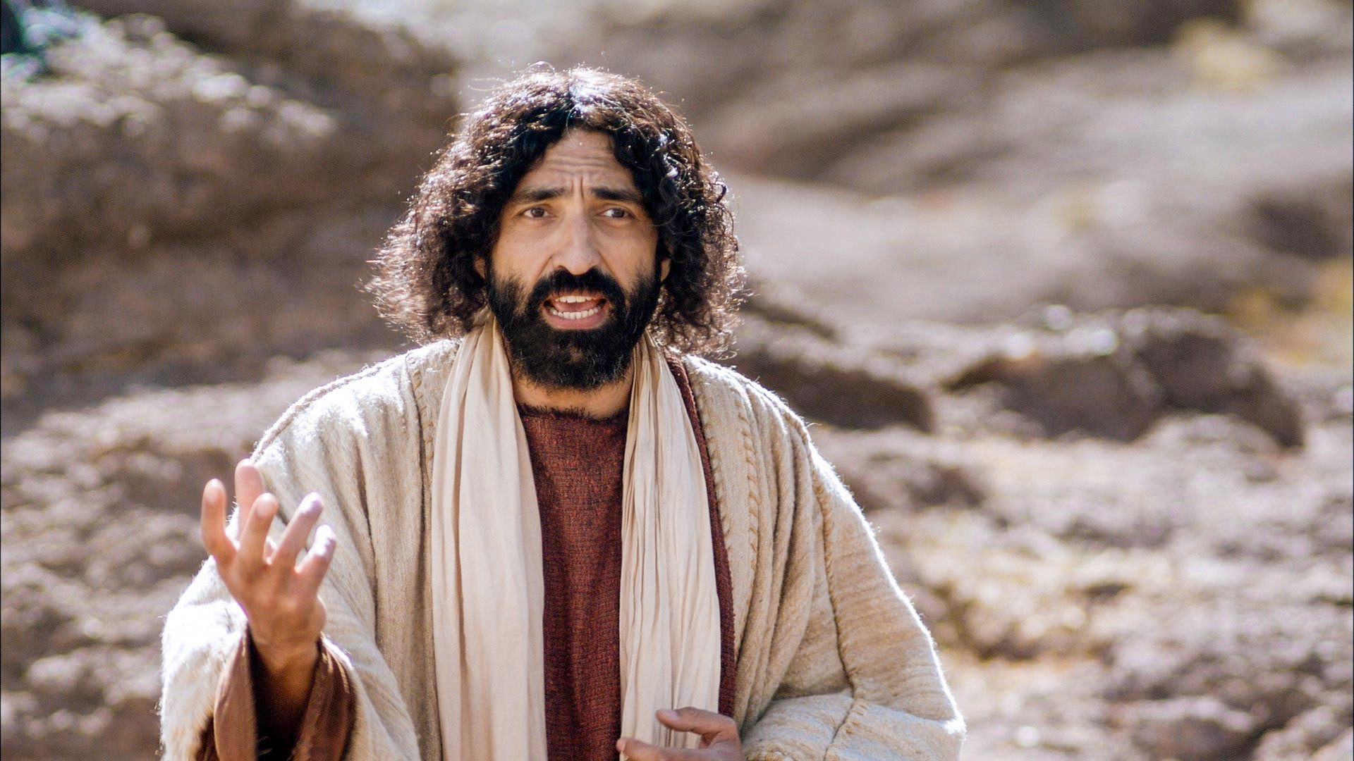
Jesus came into Galilee, proclaiming the gospel of God, and saying, “The time is fulfilled, and the kingdom of God is at hand; repent and believe in the gospel.”
Mark 1:14-15
What did Jesus mean by
“The time is fulfilled and the kingdom of God is at hand”?

Slide 3
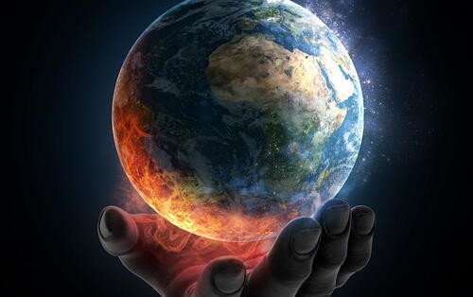
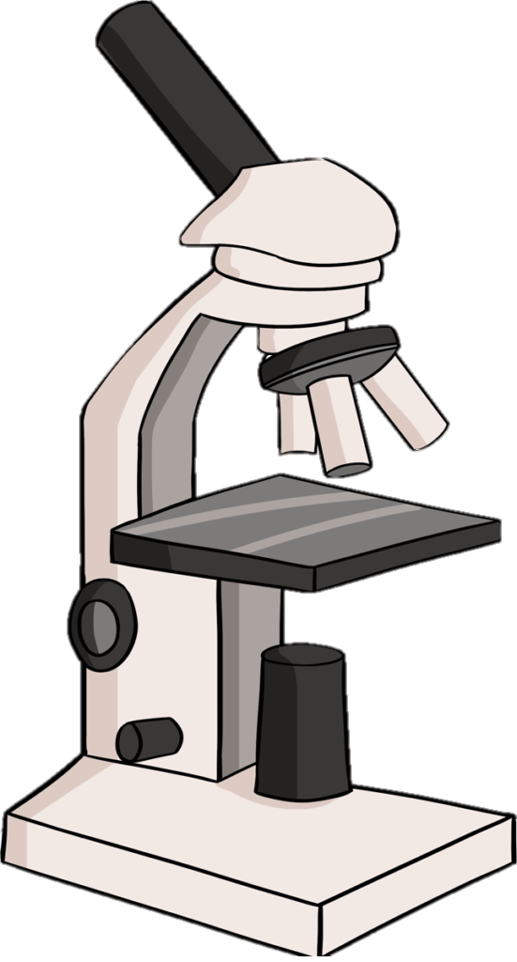
Isaiah 31-32: The Certainty of God’s Purposes
Judah Could Trust God because of the Certainty of His Purposes!
In Judging and Saving Judah (31:1-9)
In Establishing a New Kingdom (32:1-8)
In Dealing with Complacency (32:9-14)
In Bringing Spiritual Renewal (32:15-20)

Slide 4
Isaiah 31-32: The Certainty of God’s Purposes
Judah Could Trust God because of the Certainty of His Purposes!
In Judging and Saving Judah (31:1-9)
In Establishing a New Kingdom (32:1-8)
In Dealing with Complacency (32:9-14)
In Bringing Spiritual Renewal (32:15-20)

Slide 5
Isaiah 31-32: The Certainty of God’s Purposes
Judah Could Trust God because of the Certainty of His Purposes!
In Judging and Saving Judah (31:1-9)
In Establishing a New Kingdom (32:1-8)
In Dealing with Complacency (32:9-14)
In Bringing Spiritual Renewal (32:15-20)

Slide 6
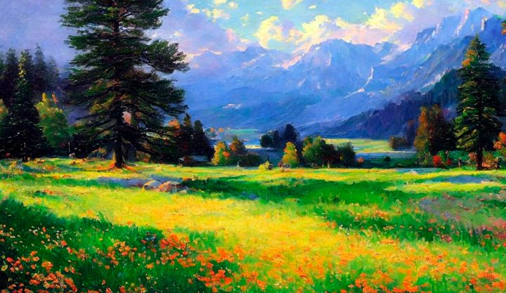
Isaiah 32 – The Coming Kingdom!
The Certainty of God’s Purposes
In Establishing a New Kingdom (32:1-8)
In Dealing with Complacency (32:9-14)
In Bringing Spiritual Renewal (32:15-20)

Slide 7
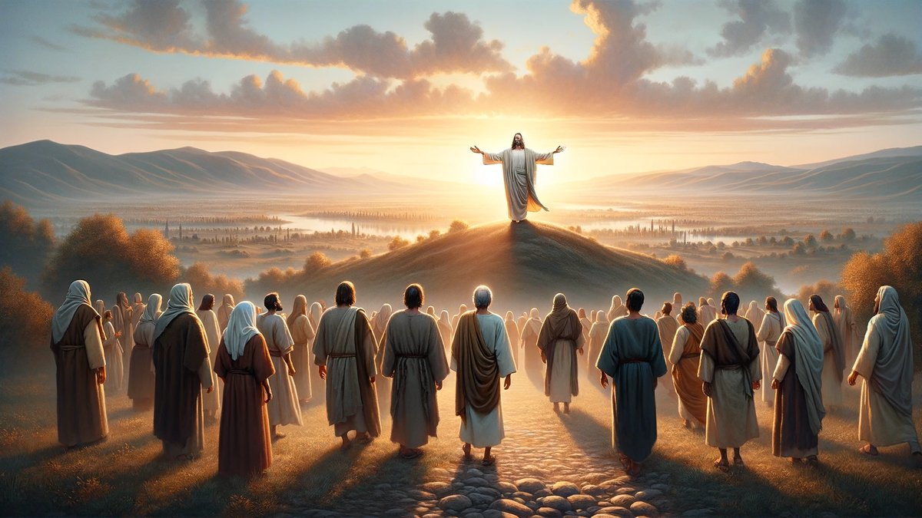
Old City and Kidron Valley from north
1 Behold, a king will reign in righteousness,
and princes will rule in justice.
2 Each will be like a hiding place from the wind,
a shelter from the storm,
like streams of water in a dry place,
like the shade of a great rock in a weary land.

Slide 8
Old City and Kidron Valley from north
1 Behold, a king will reign in righteousness,
and princes will rule in justice.
2 Each will be like a hiding place from the wind,
a shelter from the storm,
like streams of water in a dry place,
like the shade of a great rock in a weary land.

Slide 9
Old City and Kidron Valley from north
Why is this kingdom first described in terms of righteousness and justice?
It’s the world as God designed it to be!
1 Behold, a king will reign in righteousness,
and princes will rule in justice.
2 Each will be like a hiding place from the wind,
a shelter from the storm,
like streams of water in a dry place,
like the shade of a great rock in a weary land.

Slide 10
Old City and Kidron Valley from north
Righteousness Defined
Implication:
Righteousness is defined by who God is and what he is like.
Righteousness: “The quality of being right in the eyes of God, including character, attitude, action, and word. Righteousness is, therefore, based upon God’s standard…”
Christianity.com

Slide 11
Old City and Kidron Valley from north
God – The Standard of Justice & Righteousness
Psalm 89:14 Righteousness and justice are the foundation of Your throne; lovingkindness and truth go before You.
Isaiah 5:16 But the LORD of hosts is exalted in justice, and the Holy God shows himself holy in righteousness.

Slide 12
Old City and Kidron Valley from north
God’s Expectation of Justice & Righteousness
Isaiah 5:7 …the vineyard of the LORD of hosts is the house of Israel… he looked for justice, but behold, bloodshed; for righteousness, but behold, an outcry!

Slide 13
Old City and Kidron Valley from north
Justice & Righteousness of the Messiah in Isaiah
9:7 …on the throne of David and over his kingdom… to uphold it with justice and with righteousness...
11:4 …with righteousness he shall judge the poor, and decide with equity for the meek of the earth…
16:5 …on [the throne] will sit in faithfulness in the tent of David one who judges and seeks justice and is swift to do righteousness.
28:16-17 Behold, I am the one who has laid as a foundation in Zion, a stone, a tested stone… And I will make justice the line, and righteousness the plumb line…

Slide 14
Old City and Kidron Valley from north
1 Behold, a king will reign in righteousness,
and princes will rule in justice.
2 Each will be like a hiding place from the wind,
a shelter from the storm,
like streams of water in a dry place,
like the shade of a great rock in a weary land.

Slide 15
Old City and Kidron Valley from north
Government that gives true peace, protection and provision for its people!
1 Behold, a king will reign in righteousness,
and princes will rule in justice.
2 Each will be like a hiding place from the wind,
a shelter from the storm,
like streams of water in a dry place,
like the shade of a great rock in a weary land.

Slide 16
Old City and Kidron Valley from north
Characteristics of the Rule of the Messiah
3 Then the eyes of those who see will not be closed,
and the ears of those who hear will give attention.
4 The heart of the hasty will understand and know,
and the tongue of the stammerers will hasten to
speak distinctly.
5 The fool will no more be called noble, nor the
scoundrel said to be honorable.

Slide 17
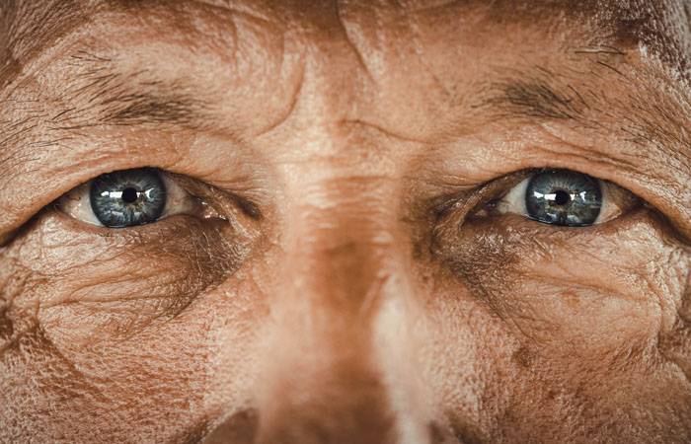
Old City and Kidron Valley from north
3 Then the eyes of those who see will not be closed,

Slide 18
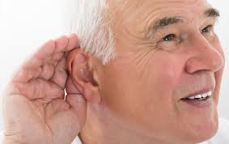
Old City and Kidron Valley from north
3 Then the eyes of those who see will not be closed,
and the ears of those who hear will give attention.

Slide 19
Old City and Kidron Valley from north
4 The heart of the hasty will understand and know,

Slide 20
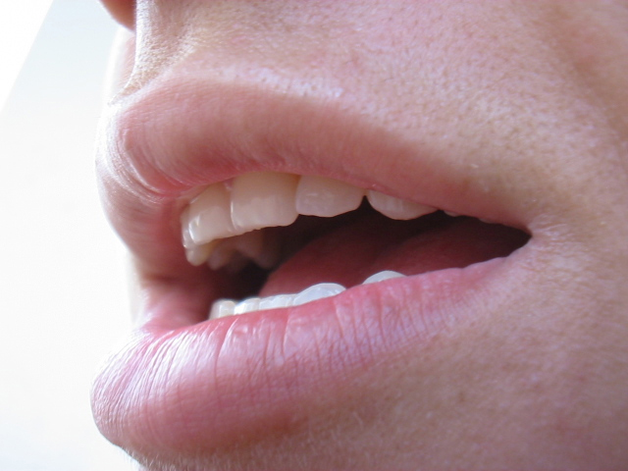
Old City and Kidron Valley from north
4 The heart of the hasty will understand and know,
and the tongue of the stammerers will hasten to speak distinctly.

Slide 21
Old City and Kidron Valley from north
What is this describing?
3 Then the eyes of those who see will not be closed,
and the ears of those who hear will give attention.
4 The heart of the hasty will understand and know,
and the tongue of the stammerers will hasten to
speak distinctly.

Slide 22
Old City and Kidron Valley from north
Make the heart of this people dull, and their ears heavy, and blind their eyes; lest they see with their eyes, and hear with their ears, and understand with their hearts, and turn and be healed. Isaiah 6:10
For the LORD has poured out upon you a spirit of deep sleep, and has closed your eyes (the prophets), and covered your heads (the seers). Isaiah 29:10
In that day the deaf shall hear the words of a book, and out of their gloom and darkness the eyes of the blind shall see. Isaiah 29:18
This is a reversal of the curse of Isaiah 6:10!
This is primarily about spiritual eyes, ears, hearts…

Slide 23
Old City and Kidron Valley from north
3 Then the eyes of those who see will not be closed,
and the ears of those who hear will give attention.
4 The heart of the hasty will understand and know,
and the tongue of the stammerers will hasten to
speak distinctly.

Slide 24
Old City and Kidron Valley from north
In Messiah’s kingdom, character will matter!
5 The fool will no more be called noble,
nor the scoundrel said to be honorable.

Slide 25
Jesus came into Galilee, proclaiming the gospel of God, and saying, “The time is fulfilled, and the kingdom of God is at hand; repent and believe in the gospel.”
Mark 1:14-15
What did Jesus mean by
“The time is fulfilled and the kingdom of God is at hand”?

Slide 26
How did fulfillment of this start in Jesus’ day?
Jesus Clarified Righteousness – not law-based, but:
What’s in our hearts (the source of murder, adultery, etc.)
Something we get persecuted for (“Blessed are those who are persecuted for the sake of righteousness.”)
Something we hunger and thirst for (“Blessed are those who hunger and thirst for righteousness…”)

Slide 27
How did fulfillment of this start in Jesus’ day?
Jesus Clarified Righteousness – not law-based, but:
Caring compassionately for the marginalized (the righteous in the Parable of the Sheep and Goats)
Something we do not have, but only God can give us
“God, have mercy on me, a sinner.”
Daily prayer for forgiveness (Lord’s Prayer)

Slide 28
How did fulfillment of this start in Jesus’ day?
Opening of eyes, ears, hearts, minds and mouths:
Physical healing that was symbolic of spiritual healing
Spiritual healing: “…blessed are your eyes, for they see, and your ears, for they hear.” Matthew 13:16

Slide 29
How did fulfillment of this start in Jesus’ day?
Opening of eyes, ears, hearts, minds and mouths:
“Now when they heard this they were cut to the heart, and said to Peter and the rest of the apostles, ‘Brothers, what shall we do?’” Acts 2:37
“…something like scales fell from his eyes, and he regained his sight… he rose and was baptized…” Acts 9:18

Slide 30
How did fulfillment of this start in Jesus’ day?
Opening of eyes, ears, hearts, minds and mouths:
“When they saw the courage of Peter and John, and realized they were unschooled, ordinary men, they were astonished and took note that these men had been with Jesus.” Acts 4:13

Slide 31
How did fulfillment of this start in Jesus’ day?
Redefining who is noble:
James 2:1-7 Rich man and Poor man…
⁵ Listen, my beloved brothers, has not God chosen those who are poor in the world to be rich in faith and heirs of the kingdom, which he has promised to those who love him? ⁶ But you have dishonored the poor man. Are not the rich the ones who oppress you, and the ones who drag you into court? ⁷ Are they not the ones who blaspheme the honorable name by which you were called?

Slide 32
Isaiah 32 – The Coming Kingdom!
The Certainty of God’s Purposes
In Establishing a New Kingdom (32:1-8)
In Dealing with Complacency (32:9-14)
In Bringing Spiritual Renewal (32:15-20)

Slide 33
Old City and Kidron Valley from north
9 Rise up, you women who are at ease, hear my voice;
you complacent daughters, give ear to my speech.
10 In little more than a year
you will shudder, you complacent women;
for the grape harvest fails,
the fruit harvest will not come.

Slide 34
Old City and Kidron Valley from north
9 Rise up, you women who are at ease, hear my voice;
you complacent daughters, give ear to my speech.
10 In little more than a year
you will shudder, you complacent women;
for the grape harvest fails,
the fruit harvest will not come.
Complacency:
Self-satisfaction accompanied by unawareness of actual dangers or deficiencies

Slide 35
Old City and Kidron Valley from north
9 Rise up, you women who are at ease, hear my voice;
you complacent daughters, give ear to my speech.
10 In little more than a year
you will shudder, you complacent women;
for the grape harvest fails,
the fruit harvest will not come.
9-10: God’s Judgment
The coming Assyrian invasion

Slide 36
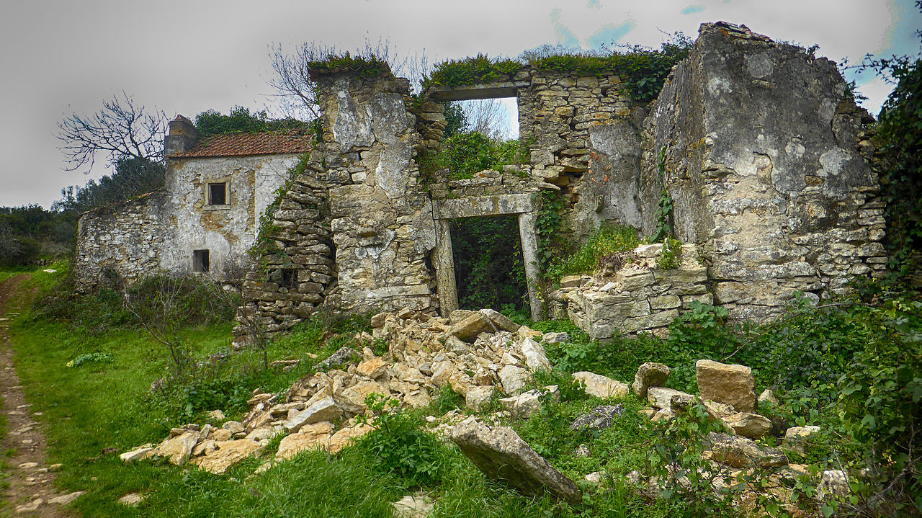
Old City and Kidron Valley from north
11 Tremble, you women who are at ease, shudder, you complacent ones; strip, and make yourselves bare, and tie sackcloth around your waist. 12 Beat your breasts for the pleasant fields, for the fruitful vine, 13 for the soil of my people growing up in thorns and briers, yes, for all the joyous houses in the exultant city. 14 For the palace is forsaken, the populous city deserted; the hill and the watchtower will become dens forever, a joy of wild donkeys, a pasture of flocks;
11-14: God’s Judgment
The coming destruction of Jerusalem (Babylonians)

Slide 37
Isaiah 32 – The Coming Kingdom!
The Certainty of God’s Purposes
In Establishing a New Kingdom (32:1-8)
In Dealing with Complacency (32:9-14)
In Bringing Spiritual Renewal (32:15-20)

Slide 38
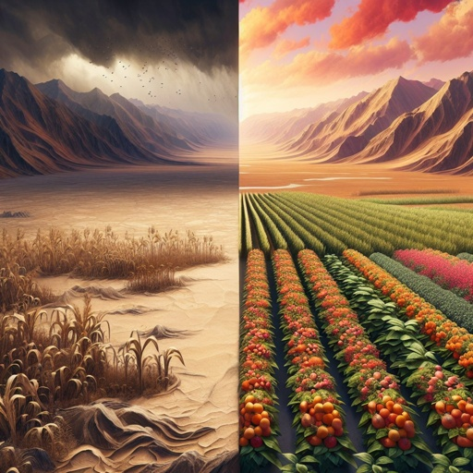
Old City and Kidron Valley from north
15 until the Spirit is poured upon us from on high,
and the wilderness becomes a fruitful field,
and the fruitful field is deemed a forest.
16 Then justice will dwell in the wilderness,
and righteousness abide in the fruitful field.

Slide 39
Old City and Kidron Valley from north
Pentecost!
15 until the Spirit is poured upon us from on high,
and the wilderness becomes a fruitful field,
and the fruitful field is deemed a forest.
16 Then justice will dwell in the wilderness,
and righteousness abide in the fruitful field.

Slide 40
Old City and Kidron Valley from north
Did this happen at Pentecost?
15 until the Spirit is poured upon us from on high,
and the wilderness becomes a fruitful field,
and the fruitful field is deemed a forest.
16 Then justice will dwell in the wilderness,
and righteousness abide in the fruitful field.

Slide 41
Old City and Kidron Valley from north
Justice and righteousness dwell in people – not in nature!
15 until the Spirit is poured upon us from on high,
and the wilderness becomes a fruitful field,
and the fruitful field is deemed a forest.
16 Then justice will dwell in the wilderness,
and righteousness abide in the fruitful field.
The primary meaning is the life God is giving to the spiritual wilderness of sin.

Slide 42
Old City and Kidron Valley from north
God’s people – his vineyard – had become a desolate wilderness!
“Many shepherds have destroyed my vineyard;
they have trampled down my portion;
they have made my pleasant portion
a desolate wilderness.” Jeremiah 12:10

Slide 43
Old City and Kidron Valley from north
People – not places – are comforted
Isaiah 51 is about God’s work of spiritual restoration!
“For the LORD comforts Zion;
he comforts all her waste places
and makes her wilderness like Eden,
her desert like the garden of the LORD;
joy and gladness will be found in her,
thanksgiving and the voice of song.”
Isaiah 51:3

Slide 44
Old City and Kidron Valley from north
“A voice cries:
‘In the wilderness prepare the way of the LORD;
make straight in the desert a highway for our God.
Every valley shall be lifted up,
and every mountain and hill be made low;
the uneven ground shall become level,
and the rough places a plain.’”
Isaiah 40:3
Why “In the wilderness…”?
It’s describing the spiritual state of the people!

Slide 45
Old City and Kidron Valley from north
15 until the Spirit is poured upon us from on high,
and the wilderness becomes a fruitful field,
and the fruitful field is deemed a forest.
16 Then justice will dwell in the wilderness,
and righteousness abide in the fruitful field.

Slide 46
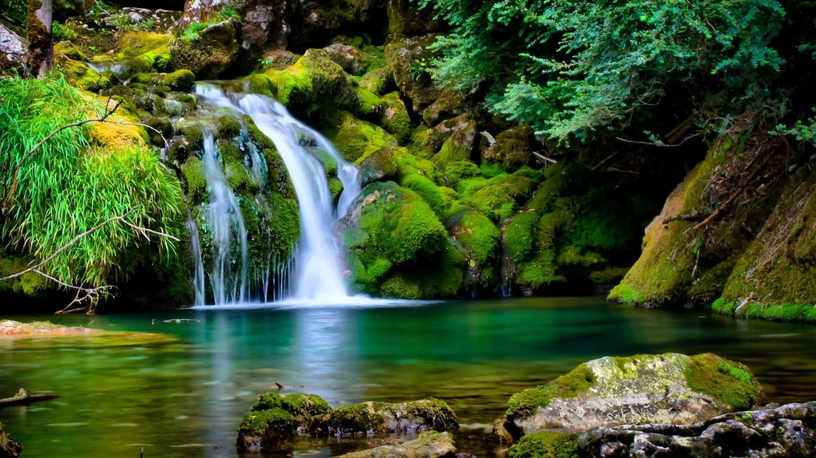
Old City and Kidron Valley from north
Imagine living in a place where
Everyone is committed to living in God’s way
Everyone loves each other as themselves
Everyone looks out for each other
Everyone can be completely trusted
Complete peace and security reigns
17 And the effect of righteousness will be peace,
and the result of righteousness, quietness and
trust forever.
18 My people will abide in a peaceful habitation,
in secure dwellings, and in quiet resting places.

Slide 47
Old City and Kidron Valley from north
19 And it will hail when the forest falls down,
and the city will be utterly laid low.

Slide 48
Old City and Kidron Valley from north
20 Happy are you who sow beside all waters,
who let the feet of the ox and the donkey range free.

Slide 49
Old City and Kidron Valley from north
Messiah’s kingdom is a place of promised peace and rest…
19 And it will hail when the forest falls down,
and the city will be utterly laid low.
20 Happy are you who sow beside all waters,
who let the feet of the ox and the donkey range free.

Slide 50
Old City and Kidron Valley from north
19 And it will hail when the forest falls down,
and the city will be utterly laid low.
20 Happy are you who sow beside all waters,
who let the feet of the ox and the donkey range free.
But it will be established in judgment as well as in restoration!

Slide 51
Isaiah 32 – The Coming Kingdom!
The Certainty of God’s Purposes
In Establishing a New Kingdom (32:1-8)
In Dealing with Complacency (32:9-14)
In Bringing Spiritual Renewal (32:15-20)

Slide 52
How Does this Relate to Us Today?
“But seek first the kingdom of God and his righteousness, and all these things will be added to you.” Matthew 6:33
Notes:
6

Slide 53
Seeking first the kingdom of God and his righteousness
Promoting the Kingdom of God on earth:
Seeking a righteousness that only God can give
Hungering and thirsting for a righteousness of the heart
Caring compassionately for the marginalized
Standing up for the gospel and for justice, understanding it may bring persecution…

Slide 55
OT Preaching link at BibleStudyDownloads.org
Get this presentation for free!
Notes:
OT Preaching (op)

