Slide 1
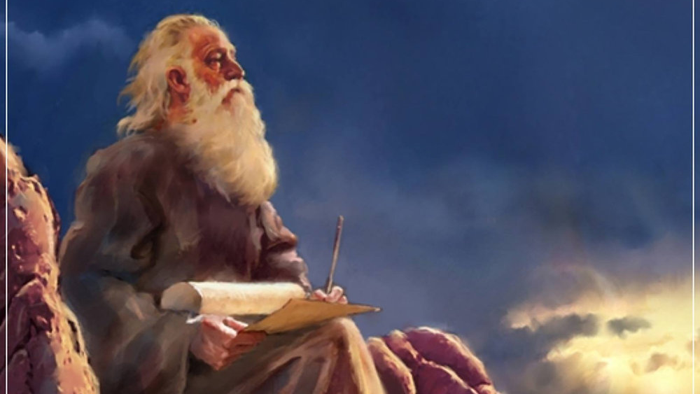
The Prophecy
Of
Isaiah
Isaiah 30
What are You Trusting In?
Preached by Dan Bridges at Amman International Church, Jordan • AmmanChurch.com Uploaded by Dr. Rick Griffith • Jordan Evangelical Theological Seminary Files in many languages for free download at BibleStudyDownloads.org

Slide 2
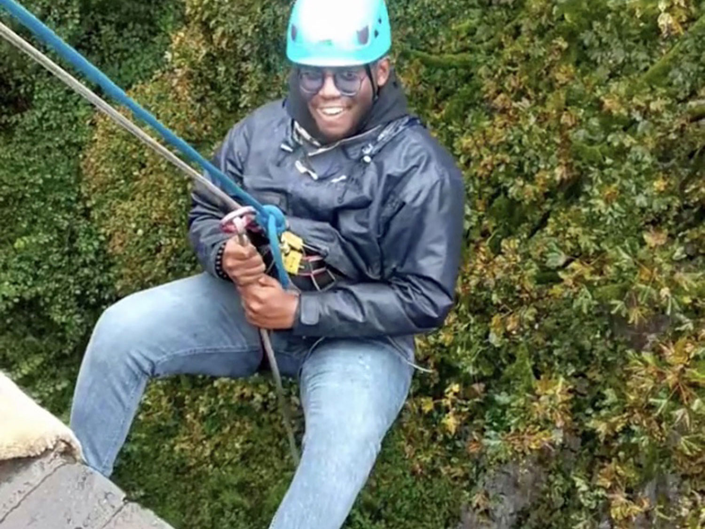
We all need to depend on people or things outside of ourselves to get through life.

Slide 3
Apart from God, we depend on…
Money
Education
Schools
Family
Transportation
Governments
Jobs
Teachers
Doctors
Friends
Stores
Police

Slide 4
Thus says the Lord:
“Cursed is the man who trusts in man
and makes flesh his strength,
whose heart turns away from the Lord.”
Jeremiah 17:5
When does it become wrong to trust things other than God?

Slide 5
The Book of Isaiah
Chapters 1-39 - Judgment
Chapters 40-66 - Restoration
Focus: Isaiah’s Day
1-6: Introduction
7-12: Assyrian Invasion /
Messiah
13-27: God’s Universal
Kingdom
28-39: God as the Lord of
History
Focus: Future

Slide 6
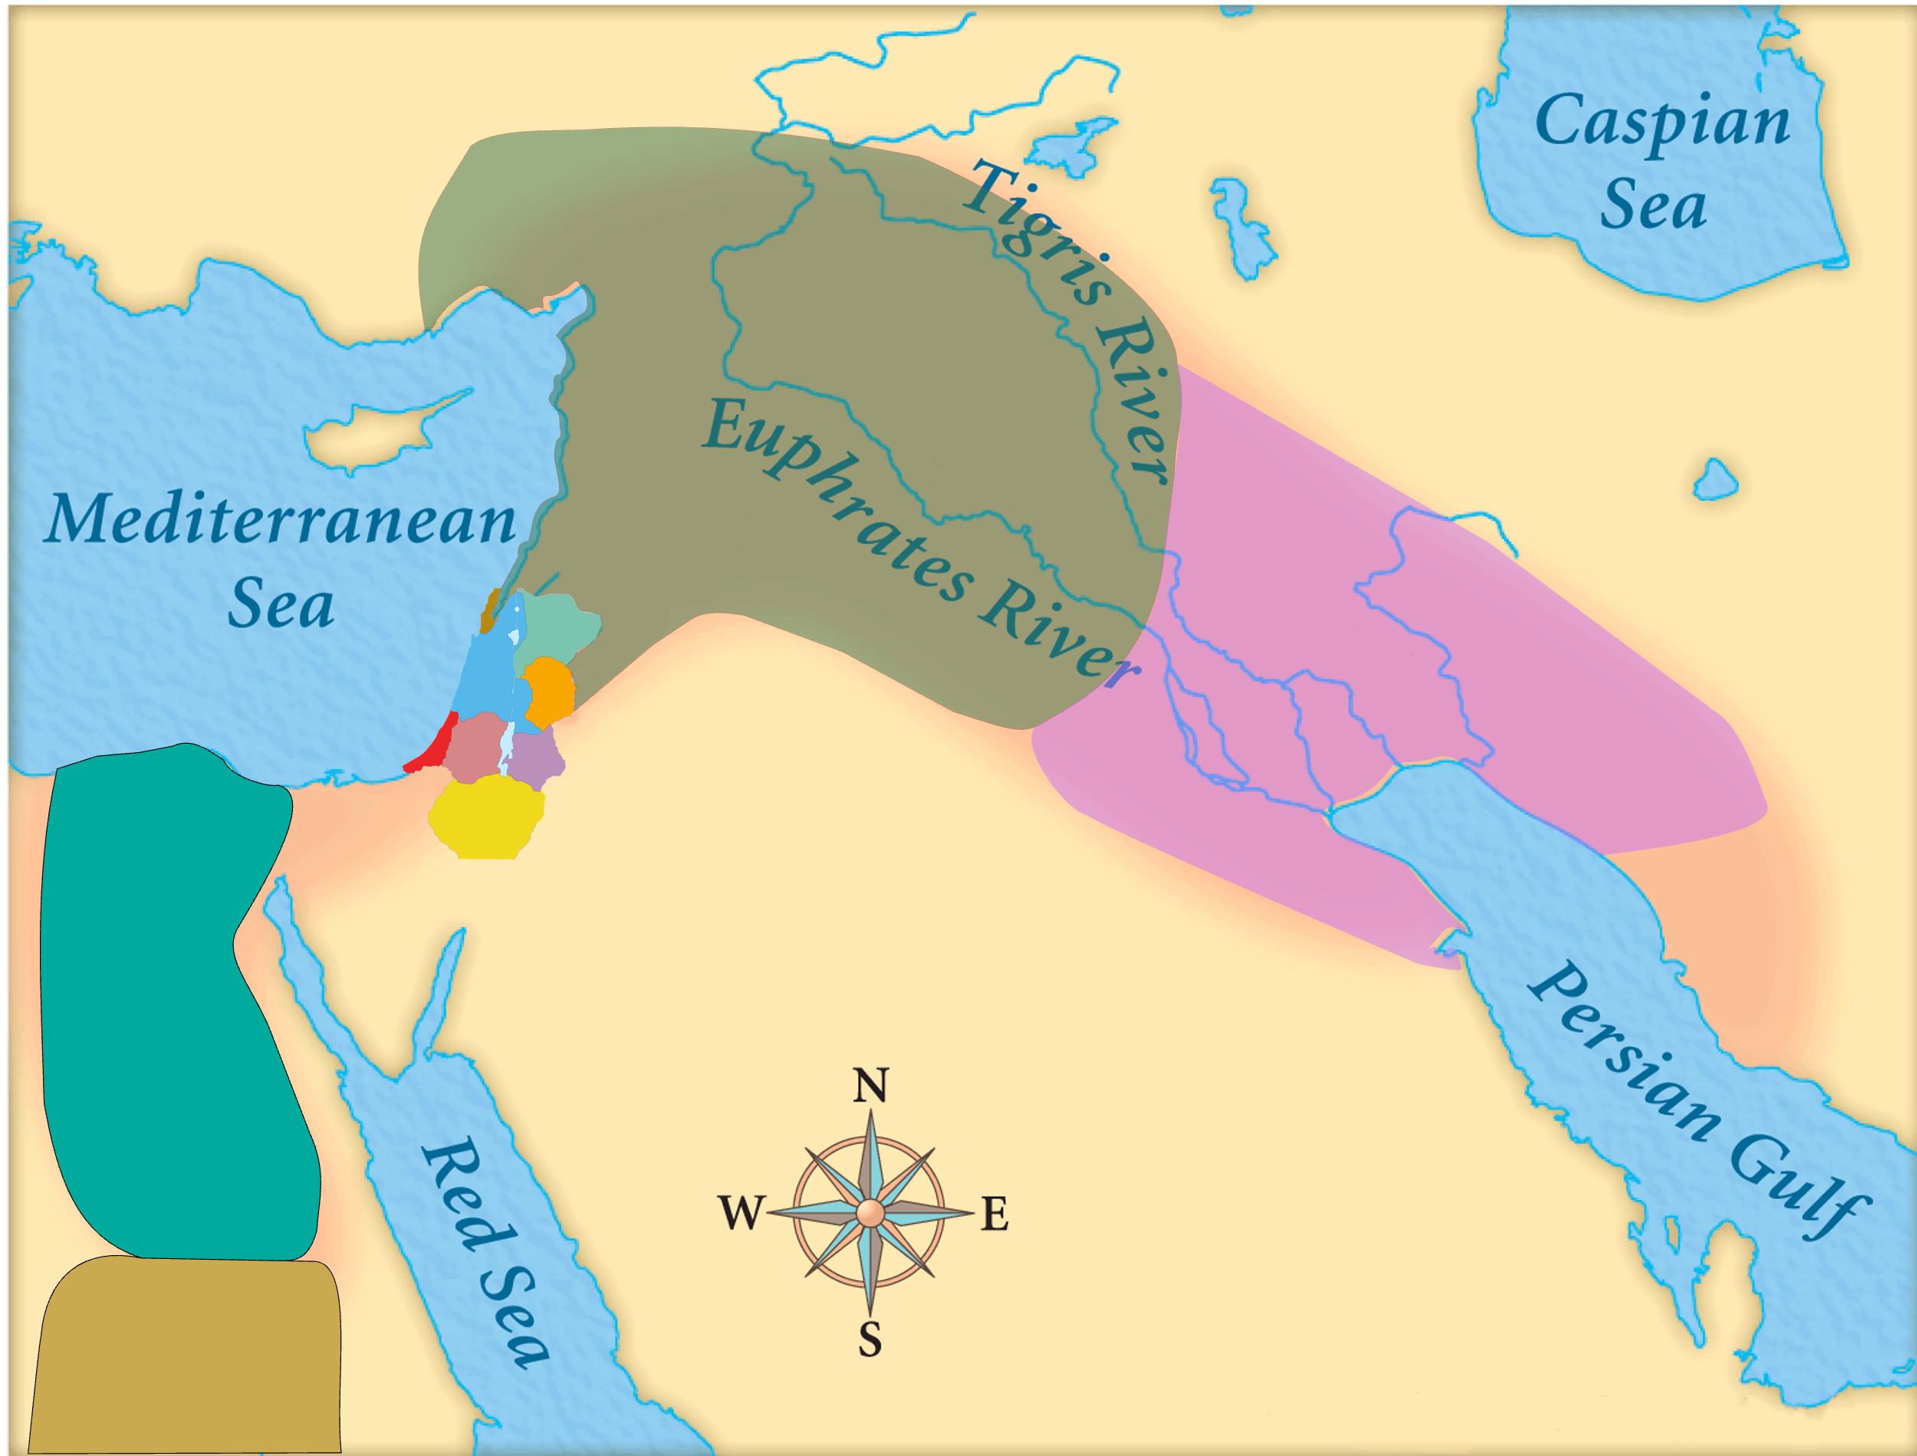
Judah’s Concern:
Who will protect us from Assyria?
God’s Concern:
Glorifying his name among the nations!
Assyria
Babylon
Judah
Egypt
Isaiah’s World
(Isaiah 28-39)

Slide 7
Time
Period
(Isaiah 28-39)
Primary time period
Of Isaiah 28-39
701 BC:
Assyria
Invades
Judah
Ahaz
Hezekiah
725
720
715
710
705
700

Slide 8
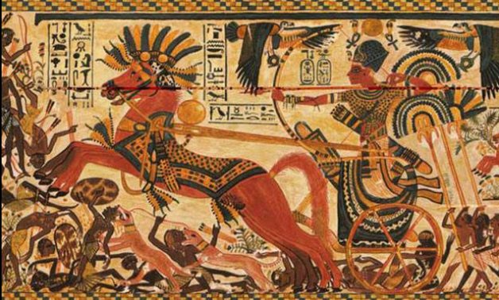
Isaiah 30
A Sinful Alliance (1-7)
A Rebellious People (8-17)
A Trustworthy God – Ultimate Future (18-26)
A Trustworthy God – Near Future (27-33)

Slide 9
Old City and Kidron Valley from north
1 “Ah, stubborn children,” declares the Lord,
“who carry out a plan, but not mine,
and who make an alliance, but not of my Spirit,
that they may add sin to sin;
2 who set out to go down to Egypt,
without asking for my direction,
to take refuge in the protection of Pharaoh
and to seek shelter in the shadow of Egypt!

Slide 10
Old City and Kidron Valley from north
What’s going on?
1 “Ah, stubborn children,” declares the Lord,
“who carry out a plan, but not mine,
and who make an alliance, but not of my Spirit,
that they may add sin to sin;
2 who set out to go down to Egypt,
without asking for my direction,
to take refuge in the protection of Pharaoh
and to seek shelter in the shadow of Egypt!
Why’s it wrong?

Slide 11
Old City and Kidron Valley from north
Carrying out plans without consulting God…
1 “Ah, stubborn children,” declares the Lord,
“who carry out a plan, but not mine,
and who make an alliance, but not of my Spirit,
that they may add sin to sin;
2 who set out to go down to Egypt,
without asking for my direction,
to take refuge in the protection of Pharaoh
and to seek shelter in the shadow of Egypt!
Seeking refuge in a person instead of in God

Slide 12
Old City and Kidron Valley from north
Three reasons it was wrong:
Self-reliance: Carrying out plans without consulting God
Idolatry: Seeking refuge / protection in someone instead of in God
Disobedience: God had told them to not return to Egypt (Deuteronomy 17:16)

Slide 13
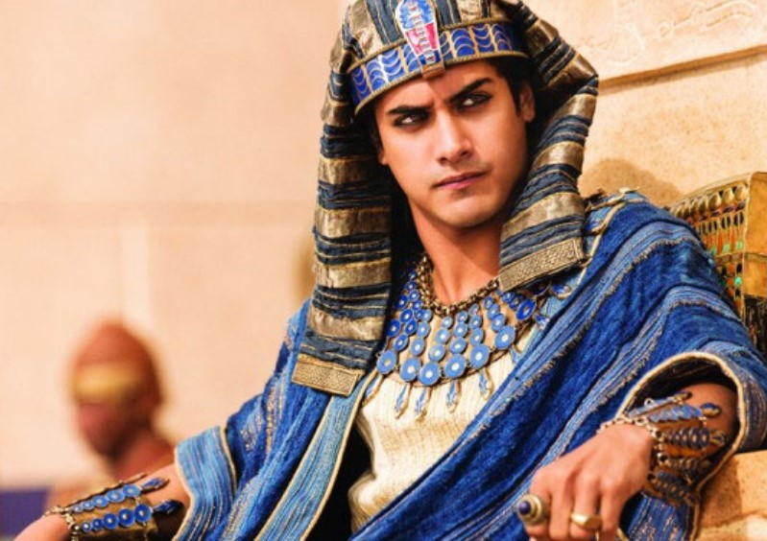
Old City and Kidron Valley from north
3 Therefore shall the protection of Pharaoh turn to your shame,
and the shelter in the shadow of Egypt to your humiliation.
4 For though his officials are at Zoan and his envoys reach Hanes,
5 everyone comes to shame
through a people that cannot profit them,
that brings neither help nor profit, but shame and disgrace.

Slide 14
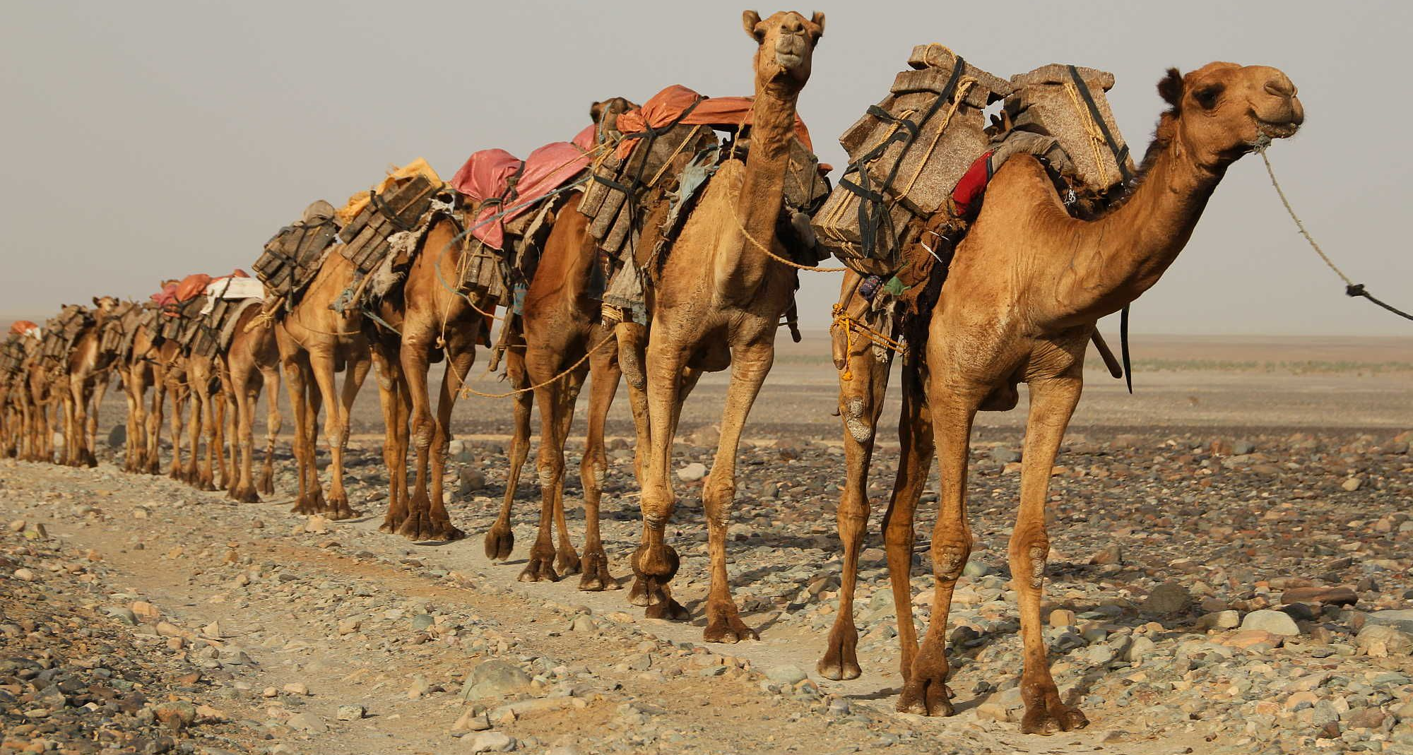
Old City and Kidron Valley from north
6 An oracle on the beasts of the Negeb.
Through a land of trouble and anguish,
from where come the lioness and the lion,
the adder and the flying fiery serpent,
they carry their riches on the backs of donkeys,
and their treasures on the humps of camels,
to a people that cannot profit them.
7 Egypt's help is worthless and empty;
therefore I have called her
“Rahab who sits still.”

Slide 15
Isaiah 30
A Sinful Alliance (1-7)
A Rebellious People (8-17)
A Trustworthy God – Ultimate Future (18-26)
A Trustworthy God – Near Future (27-33)

Slide 16
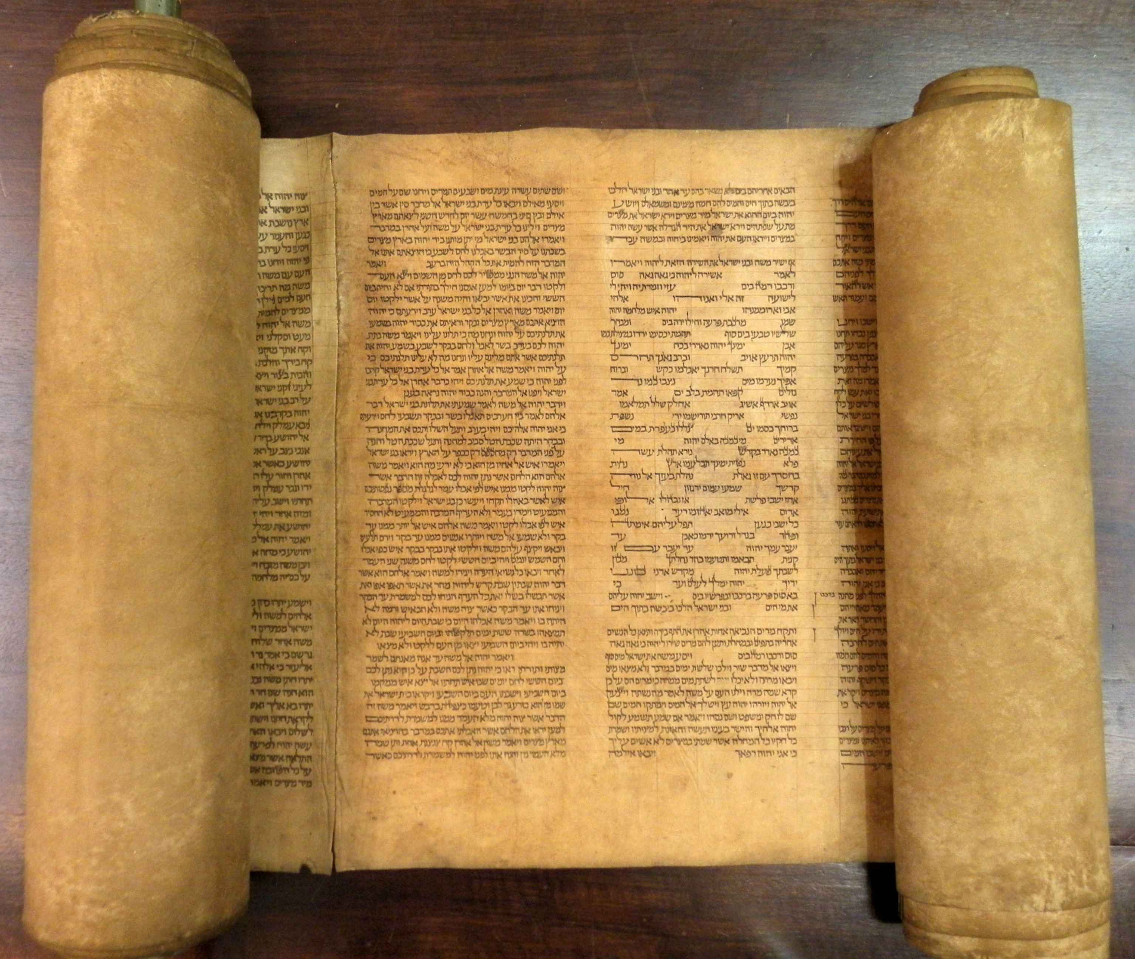
Old City and Kidron Valley from north
8 “And now, go, write it before them on a tablet
and inscribe it in a book,
that it may be for the time to come as a witness forever.
9 For they are a rebellious people, lying children,
children unwilling to hear the instruction of the Lord;

Slide 17
Old City and Kidron Valley from north
What would you call people who trusted in normal human means?
8 “And now, go, write it before them on a tablet
and inscribe it in a book,
that it may be for the time to come as a witness forever.
9 For they are a rebellious people, lying children,
children unwilling to hear the instruction of the Lord;

Slide 18
Old City and Kidron Valley from north
“Disappointing”,
“Failing to be what they ought to be”
8 “And now, go, write it before them on a tablet
and inscribe it in a book,
that it may be for the time to come as a witness forever.
9 For they are a rebellious people, lying children,
children unwilling to hear the instruction of the Lord;

Slide 19
Old City and Kidron Valley from north
They were convinced they knew better than God what was best for them…
8 “And now, go, write it before them on a tablet
and inscribe it in a book,
that it may be for the time to come as a witness forever.
9 For they are a rebellious people, lying children,
children unwilling to hear the instruction of the Lord;

Slide 20
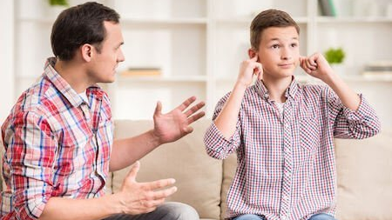
Old City and Kidron Valley from north
They didn’t want God interfering with their religious systems and teachings!
10 who say to the seers, “Do not see,”
and to the prophets, “Do not prophesy to us what is right;
speak to us smooth things, prophesy illusions,
11 leave the way, turn aside from the path,
let us hear no more about the Holy One of Israel.”

Slide 21
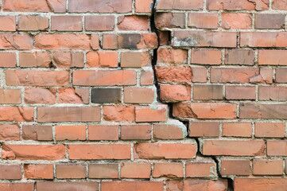
Old City and Kidron Valley from north
12 Therefore thus says the Holy One of Israel,
“Because you despise this word and trust in oppression and perverseness and rely on them,
13 therefore this iniquity shall be to you like a breach in a high wall, bulging out and about to collapse, whose breaking comes suddenly, in an instant;

Slide 22
Old City and Kidron Valley from north
14 and its breaking is like that of a potter's vessel
that is smashed so ruthlessly
that among its fragments not a shard is found
with which to take fire from the hearth,
or to dip up water out of the cistern.

Slide 23
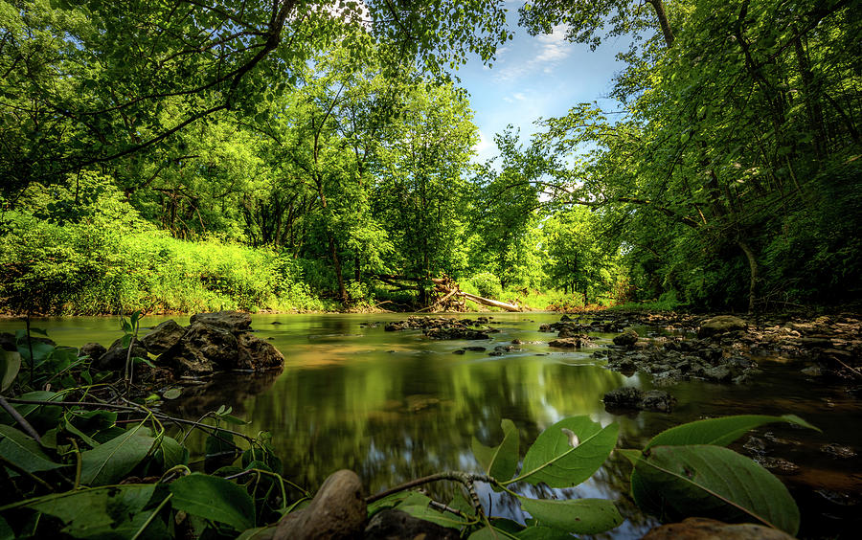
Old City and Kidron Valley from north
15 For thus said the Lord God, the Holy One of Israel,
“In returning and rest you shall be saved;
in quietness and in trust shall be your strength.” But you were unwilling…

Slide 24
Old City and Kidron Valley from north
15 For thus said the Lord God, the Holy One of Israel,
“In returning and rest you shall be saved;
in quietness and in trust shall be your strength.” But you were unwilling…
~734BC:
And say to [Ahaz], ‘Be careful, be quiet, do not fear, and do not let your heart be faint… Isaiah 7:4
This had been Isaiah’s message for 30+ years!

Slide 25
Old City and Kidron Valley from north
15 For thus said the Lord God, the Holy One of Israel,
“In returning and rest you shall be saved;
in quietness and in trust shall be your strength.” But you were unwilling…
Why were they unwilling?

Slide 26
Assyria
Babylon
Judah
Egypt
Isaiah’s World
(Isaiah 28-39)

Slide 27
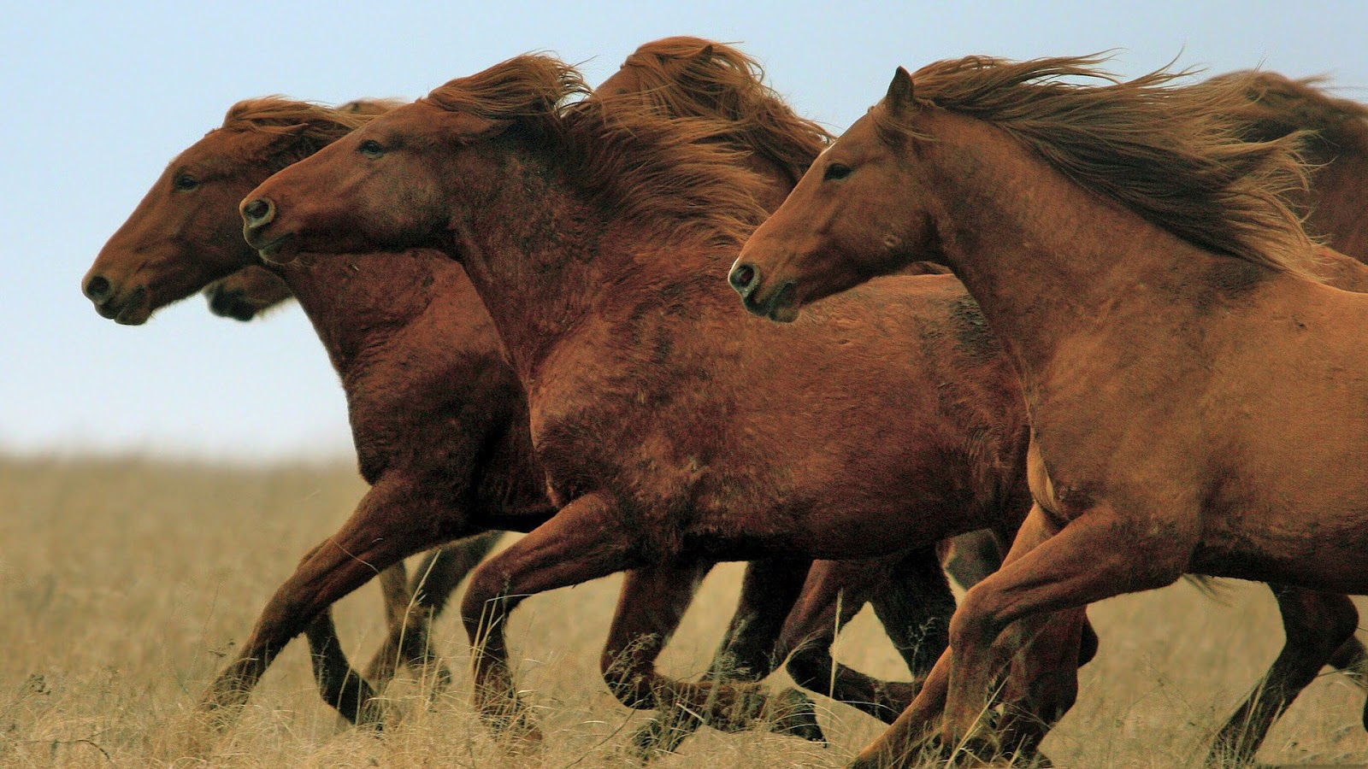
Old City and Kidron Valley from north
They were afraid… and thought they could protect themselves better than God!
But you were unwilling, 16 and you said,
“No! We will flee upon horses”;
therefore you shall flee away;
and, “We will ride upon swift steeds”;
therefore your pursuers shall be swift.
17 A thousand shall flee at the threat of one;
at the threat of five you shall flee,
till you are left like a flagstaff on the top of a
mountain, like a signal on a hill.

Slide 28
Old City and Kidron Valley from north
They were actually causing God to need to work against them!
But you were unwilling, 16 and you said,
“No! We will flee upon horses”;
therefore you shall flee away;
and, “We will ride upon swift steeds”;
therefore your pursuers shall be swift.
17 A thousand shall flee at the threat of one;
at the threat of five you shall flee,
till you are left like a flagstaff on the top of a
mountain, like a signal on a hill.

Slide 29
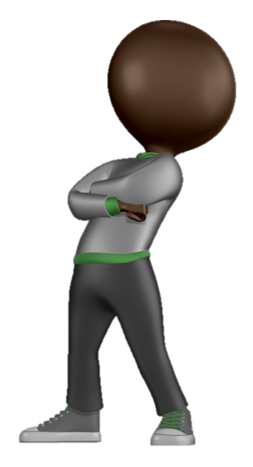
Isaiah 30
A Sinful Alliance (1-7)
A Rebellious People (8-17)
A Trustworthy God – Ultimate Future (18-26)
A Trustworthy God – Near Future (27-33)

Slide 30
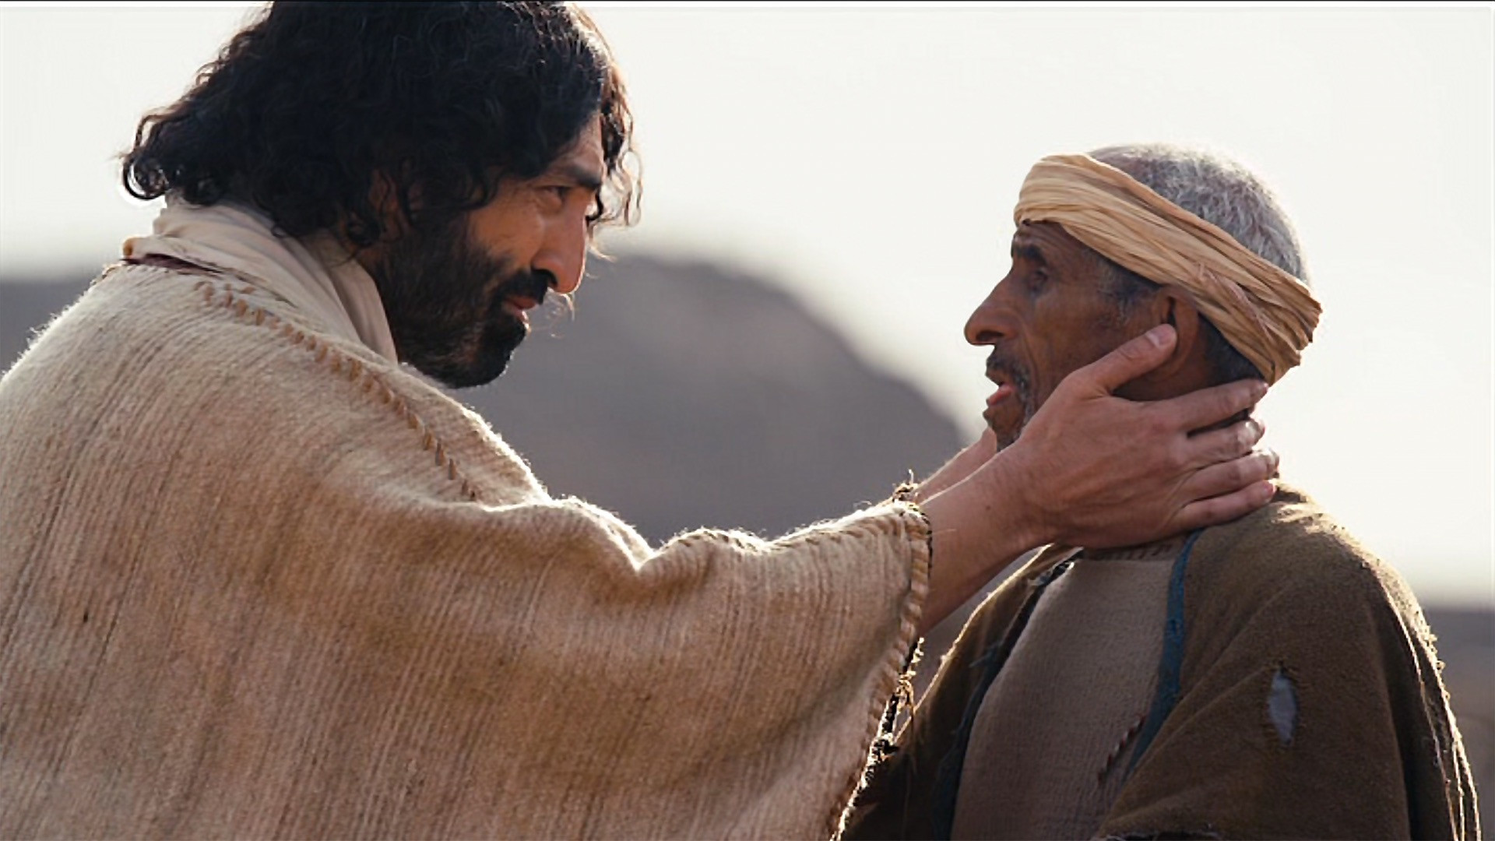
Old City and Kidron Valley from north
Transition Verse
18 Therefore the Lord waits to be gracious to you,
and therefore he exalts himself to show mercy to you.
For the Lord is a God of justice;
blessed are all those who wait for him.

Slide 31
Old City and Kidron Valley from north
“Because of your rebellion, I’ll have to wait to be gracious!”
18 Therefore the Lord waits to be gracious to you,
and therefore he exalts himself to show mercy to you.
For the Lord is a God of justice;
blessed are all those who wait for him.

Slide 32
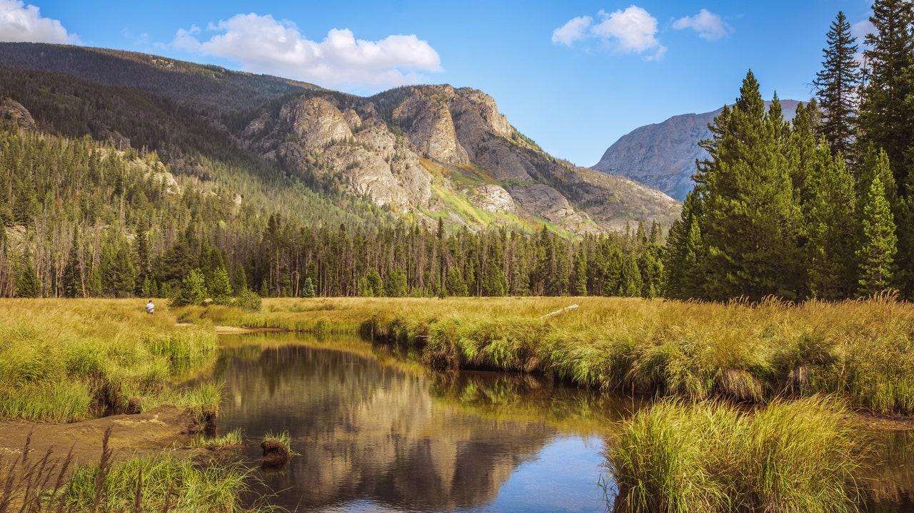
Old City and Kidron Valley from north
19 For a people shall dwell in Zion, in Jerusalem; you shall weep no more. He will surely be gracious to you at the sound of your cry. As soon as he hears it, he answers you.
20 And though the Lord give you the bread of adversity and the water of affliction, yet your Teacher will not hide himself anymore, but your eyes shall see your Teacher. 21 And your ears shall hear a word behind you, saying, “This is the way, walk in it,” when you turn to the right or when you turn to the left.

Slide 33
Old City and Kidron Valley from north
19 For a people shall dwell in Zion, in Jerusalem; you shall weep no more. He will surely be gracious to you at the sound of your cry. As soon as he hears it, he answers you.
20 And though the Lord give you the bread of adversity and the water of affliction, yet your Teacher will not hide himself anymore, but your eyes shall see your Teacher. 21 And your ears shall hear a word behind you, saying, “This is the way, walk in it,” when you turn to the right or when you turn to the left.

Slide 34
Old City and Kidron Valley from north
19 For a people shall dwell in Zion, in Jerusalem; you shall weep no more. He will surely be gracious to you at the sound of your cry. As soon as he hears it, he answers you.
20 And though the Lord give you the bread of adversity and the water of affliction, yet your Teacher will not hide himself anymore, but your eyes shall see your Teacher. 21 And your ears shall hear a word behind you, saying, “This is the way, walk in it,” when you turn to the right or when you turn to the left.
Time of promised restoration:
Restored relationship with God
Restored spiritual sight and hearing

Slide 35
Old City and Kidron Valley from north
Time of promised restoration:
Restored relationship with God!
Restored spiritual sight and hearing
Verses 22-26
Idols destroyed
Restoration and blessing of nature
God’s ultimate victory

Slide 36
Old City and Kidron Valley from north
Why this sudden description of restoration?
God can be trusted!
He will fulfill his promises.
He is sovereign – His purposes cannot be frustrated by human unfaithfulness!

Slide 37
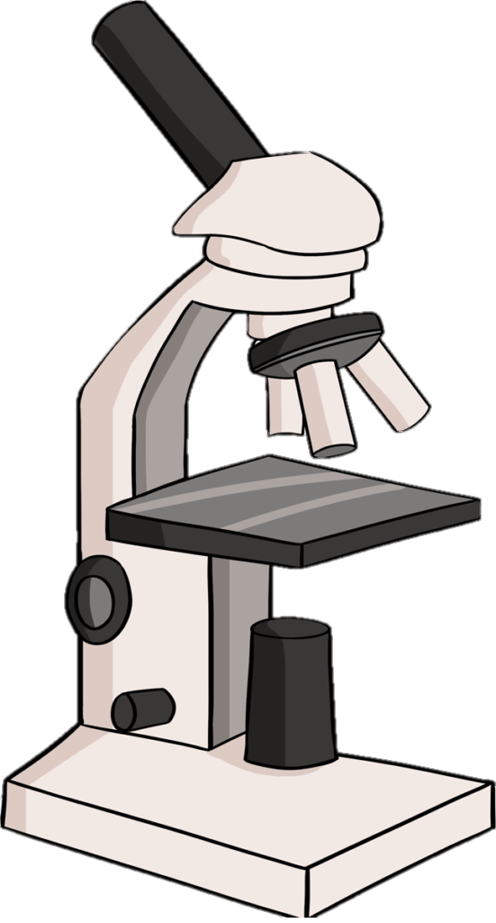
Isaiah 30
A Sinful Alliance (1-7)
A Rebellious People (8-17)
A Trustworthy God – Ultimate Future (18-26)
A Trustworthy God – Near Future (27-33)

Slide 38
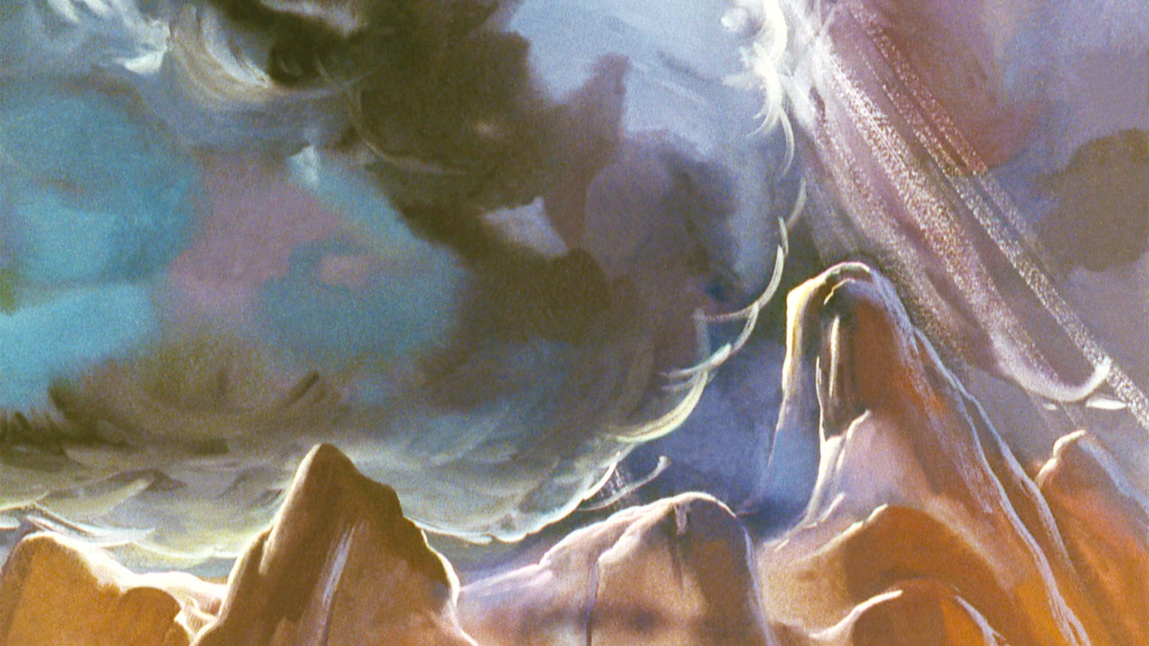
Old City and Kidron Valley from north
27-33: Colorful and poetic description of God’s
defeat of Assyria!
27 Behold, the name of the Lord comes from afar,
burning with his anger, and in thick rising smoke;
his lips are full of fury, and his tongue is like a devouring fire;
28 his breath is like an overflowing stream
that reaches up to the neck;
to sift the nations with the sieve of destruction,
and to place on the jaws of the peoples a bridle
that leads astray.

Slide 39
Old City and Kidron Valley from north
Exodus-type language!
27 Behold, the name of the Lord comes from afar,
burning with his anger, and in thick rising smoke;
his lips are full of fury, and his tongue is like a devouring fire;
28 his breath is like an overflowing stream
that reaches up to the neck;
to sift the nations with the sieve of destruction,
and to place on the jaws of the peoples a bridle
that leads astray.

Slide 40
Old City and Kidron Valley from north
Description of Assyrian invasion in Isaiah 8!
27 Behold, the name of the Lord comes from afar,
burning with his anger, and in thick rising smoke;
his lips are full of fury, and his tongue is like a devouring fire;
28 his breath is like an overflowing stream
that reaches up to the neck;
to sift the nations with the sieve of destruction,
and to place on the jaws of the peoples a bridle
that leads astray.

Slide 41
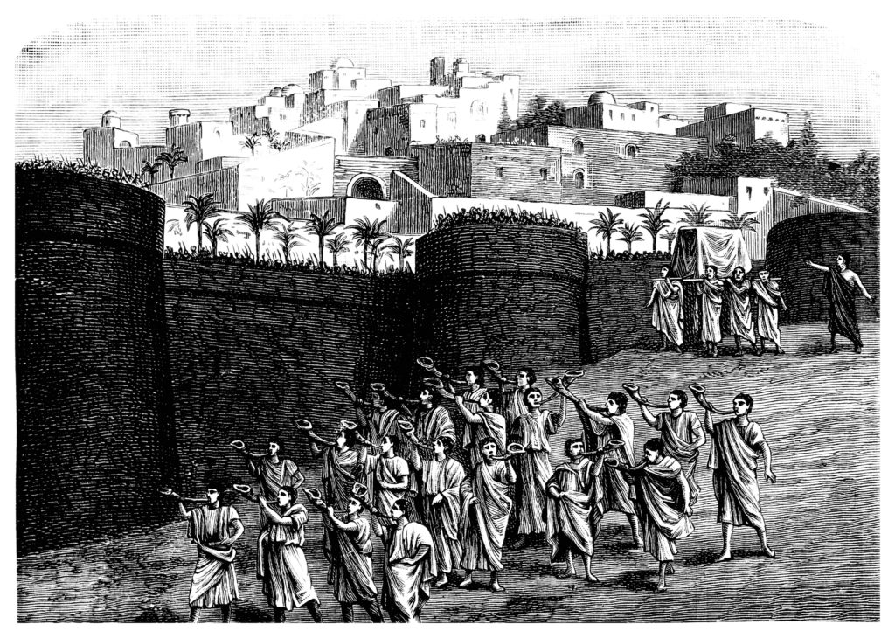
Old City and Kidron Valley from north
God’s people singing as he judges – Revelation 19
29 You shall have a song as in the night when a holy feast is kept, and gladness of heart, as when one sets out to the sound of the flute to go to the mountain of the Lord, to the Rock of Israel.

Slide 42
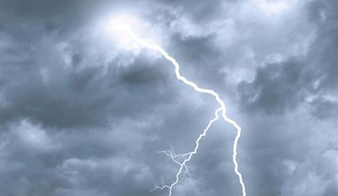
Old City and Kidron Valley from north
30 And the Lord will cause his majestic voice to be heard and the descending blow of his arm to be seen, in furious anger and a flame of devouring fire, with a cloudburst and storm and hailstones.

Slide 43
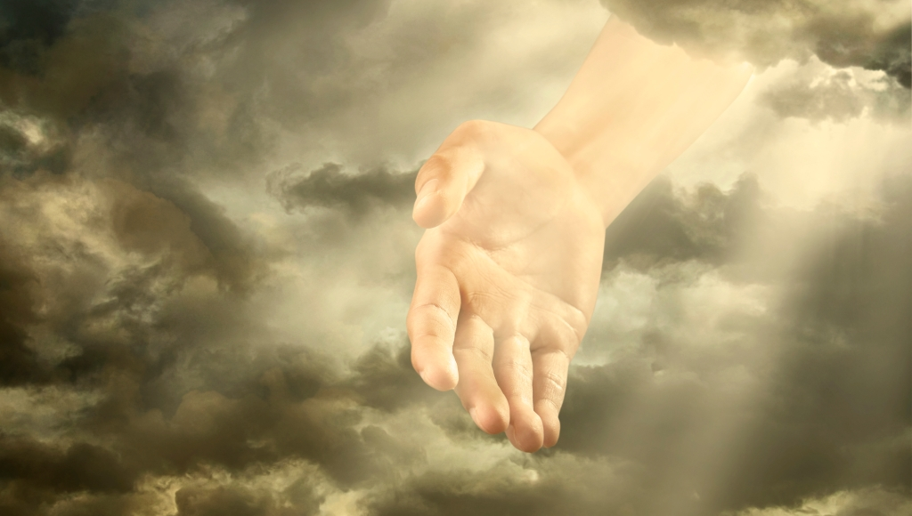
Old City and Kidron Valley from north
31 The Assyrians will be terror-stricken at the voice of the Lord, when he strikes with his rod. 32 And every stroke of the appointed staff that the Lord lays on them will be to the sound of tambourines and lyres. Battling with brandished arm, he will fight with them.

Slide 44
Old City and Kidron Valley from north
31 The Assyrians will be terror-stricken at the voice of the Lord, when he strikes with his rod. 32 And every stroke of the appointed staff that the Lord lays on them will be to the sound of tambourines and lyres. Battling with brandished arm, he will fight with them.

Slide 45
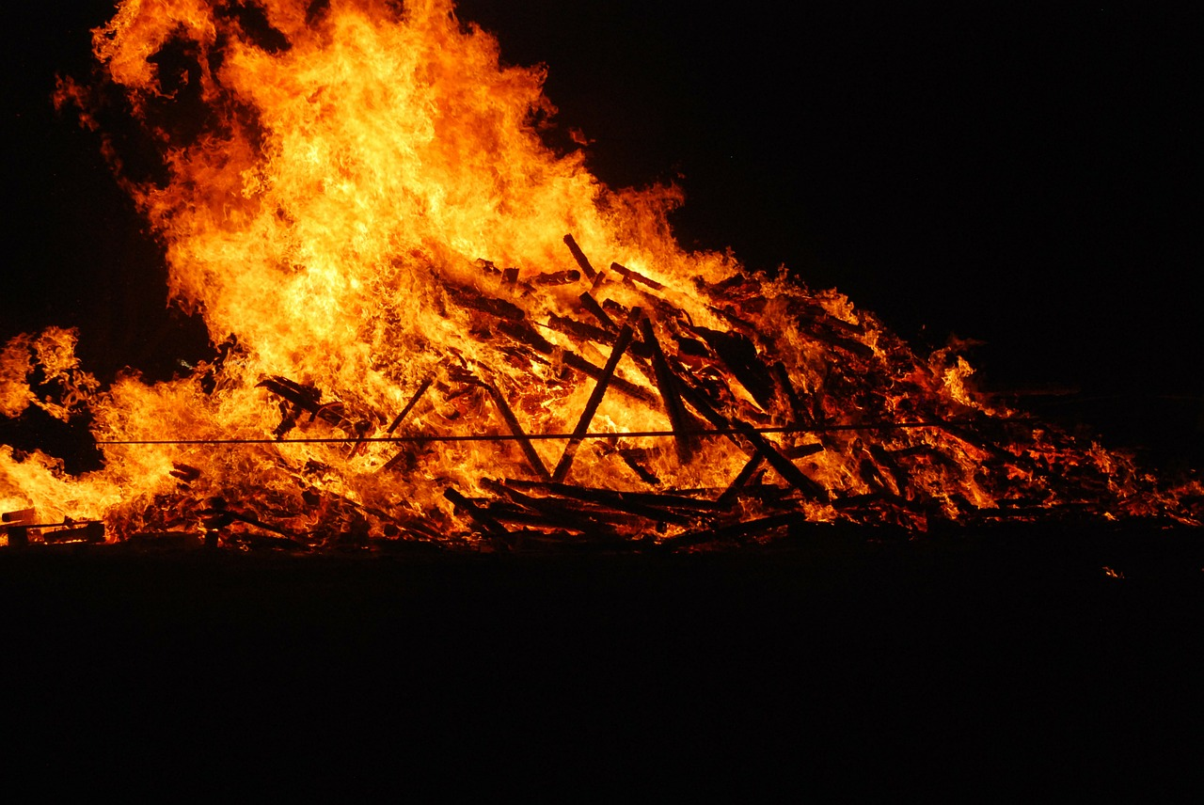
Old City and Kidron Valley from north
The king of Assyria marching to his own funeral pyre!
33 For a burning place has long been prepared; indeed, for the king it is made ready, its pyre made deep and wide, with fire and wood in abundance; the breath of the Lord, like a stream of sulfur, kindles it.

Slide 46
Old City and Kidron Valley from north
Why this colorful, poetic description of God’s defeat of the Assyrian army?
God can be trusted!
His purposes will be accomplished not just in long-term history, but in this specific challenge!

Slide 47
Isaiah 30
A Sinful Alliance (1-7)
A Rebellious People (8-17)
A Trustworthy God – Ultimate Future (18-26)
A Trustworthy God – Near Future (27-33)

Slide 48
Old City and Kidron Valley from north
How does this relate to us today?
Reasons it was wrong:
Self-reliance: Carrying out plans without consulting God
Idolatry: Seeking refuge / protection in someone instead of in God

Slide 49
Old City and Kidron Valley from north
Self-Reliance
When we carry out our plans without consulting God, we end up working against his purposes…
“I made the whole house of Israel and the whole house of Judah cling to me, declares the Lord, that they might be for me a people, a name, a praise, and a glory, but they would not listen.”
Jeremiah 13:11

Slide 50
Old City and Kidron Valley from north
Idolatry
When we trust in anything or anyone instead of in God because we end up worshipping that…
“Thus says the Lord:
‘Cursed is the man who trusts in man
and makes flesh his strength,
whose heart turns away from the Lord.’”
Jeremiah 17:5

Slide 51
Old City and Kidron Valley from north
Idolatry
When does it become wrong to trust things other than God?
It becomes wrong when we’re unable to give it up if God asks us to do that.
When we trust in anything or anyone instead of in God because we end up worshipping that…
“Thus says the Lord:
‘Cursed is the man who trusts in man
and makes flesh his strength,
whose heart turns away from the Lord.’”
Jeremiah 17:5

Slide 52
Old City and Kidron Valley from north
Radical Trust!
God can be trusted!!!
God has called us to live our lives in radical trust…
Depend on him constantly for guidance
“Trust in the Lord with all your heart…”
Proverbs 3:5-6
Depend on him constantly as our primary source of protection and provision.
“Blessed is the man who trusts in the Lord…”
Jeremiah 17:7

Slide 53
Is this a picture of your life?

Slide 55
OT Preaching link at BibleStudyDownloads.org
Get this presentation for free!
Notes:
OT Preaching (op)

