Slide 1
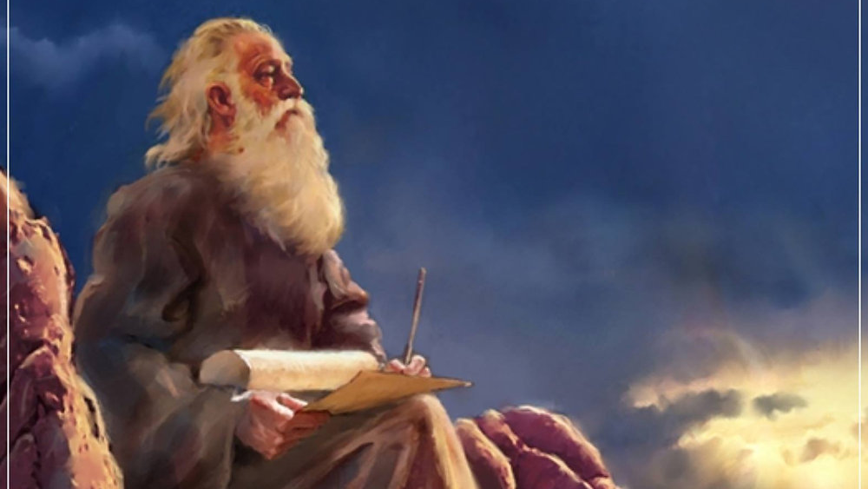
The Prophecy
Of
Isaiah
Isaiah 27
Our Present and Future Savior!
Preached by Dan Bridges at Amman International Church Singapore • AmmanChurch.com Uploaded by Dr. Rick Griffith • Jordan Evangelical Theological Seminary Files in many languages for free download at BibleStudyDownloads.org

Slide 2
Old City and Kidron Valley from north
“You’re all grown up!”
This is true… But not in its final sense.

Slide 3
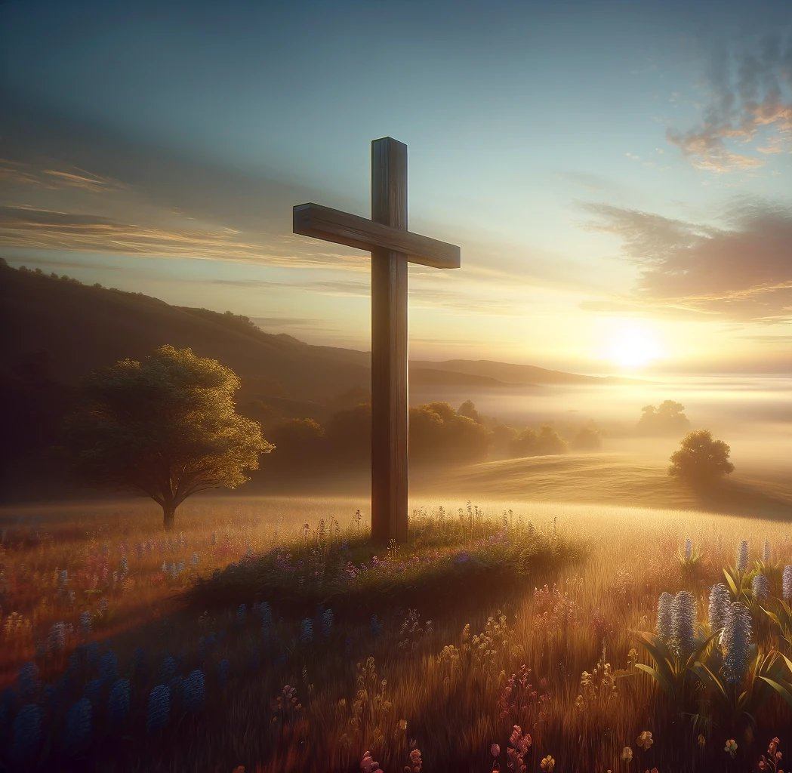
Old City and Kidron Valley from north
Already… But not yet
Jesus – in his death and resurrection – started the fulfillment of many prophecies that are not yet complete.

Slide 4
Isaiah 13-27: God’s Universal Kingdom
Chapters 13-23: 10 Oracles Regarding the Nations
Babylon (13:1-14:27)
Philistia (14:28-32)
Moab (15:1-16:14)
Syria/Israel/Cush (17:1-18:7)
Egypt (19:1-20:6)
Babylon (21:1-10)
Edom (21:11-12)
Arabia (21:13-17)
Jerusalem (22:1-25)
Tyre (23:1-18)
Chapter 24: Worldwide Judgment
Chapter 25: Fulfillment of God’s Plans
Chapter 26: The People of God
Chapter 27: Israel Fulfills its Purpose
Isaiah’s Mini Apocalypse

Slide 5
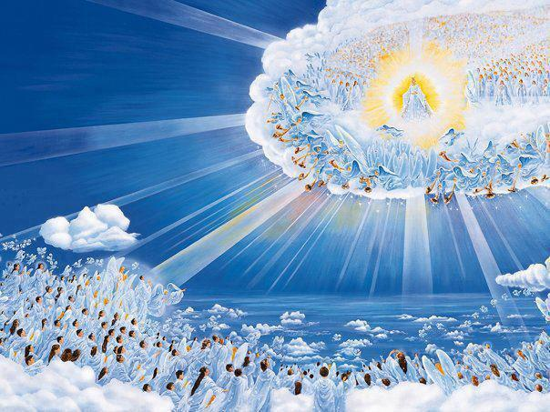
Old City and Kidron Valley from north
Isaiah 27 – God Fulfills His Purposes For His People
Isaiah 27
Looking forward through the years to see God gathering his people and making them into who he intended them to be

Slide 6
Old City and Kidron Valley from north
Isaiah 27 – God Fulfills His Purposes For His People
God’s Victory over His Enemies (1)
God’s True Vineyard (2-6)
God’s Process of Redemption (7-11)
God’s Gathering of His Remnant (12-13)

Slide 7
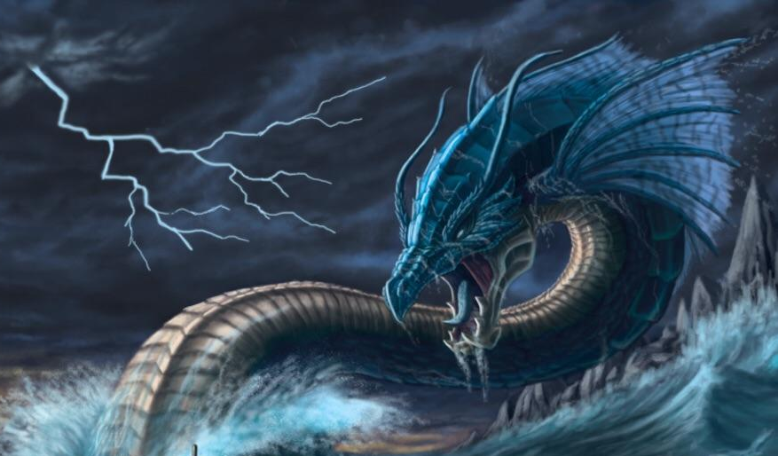
Old City and Kidron Valley from north
1 In that day the Lord with his hard and great and strong sword will punish Leviathan the fleeing serpent, Leviathan the twisting serpent, and he will slay the dragon that is in the sea.

Slide 8
Old City and Kidron Valley from north
1 In that day the Lord with his hard and great and strong sword will punish Leviathan the fleeing serpent, Leviathan the twisting serpent, and he will slay the dragon that is in the sea.
Who or what is God defeating?

Slide 9
Old City and Kidron Valley from north
10 How long, O God, is the foe to scoff?
Is the enemy to revile your name forever?
…
13 You divided the sea by your might;
you broke the heads of the sea monsters on the waters.
14 You crushed the heads of Leviathan;
you gave him as food for the creatures of the wilderness.
Psalm 74:10-14
Leviathan – The enemies of God

Slide 10
Old City and Kidron Valley from north
Dragon – Egypt
(Enemy of God’s People)
Awake, awake, put on strength, O arm of the Lord;
awake, as in days of old, the generations of long ago.
Was it not you who cut Rahab in pieces,
who pierced the dragon?
Isaiah 51:9
And the great dragon was thrown down, that ancient serpent, who is called the devil and Satan, the deceiver of the whole world—he was thrown down to the earth…
Revelation 12:9
Dragon – Satan
(Ultimate Enemy of God’s People)

Slide 11
Old City and Kidron Valley from north
God’s defeat of his enemies… How does this happen?
1 In that day the Lord with his hard and great and strong sword will punish Leviathan the fleeing serpent, Leviathan the twisting serpent, and he will slay the dragon that is in the sea.

Slide 12
Old City and Kidron Valley from north
He disarmed the rulers and authorities and put them to open shame, by triumphing over them in him [on the cross].
Colossians 2:15
How is this triumph already… but not yet?
…he himself likewise partook of [flesh and blood], that through death he might destroy the one who has the power of death, that is, the devil…
Hebrews 2:14

Slide 13
Old City and Kidron Valley from north
How is this triumph already… but not yet?
…and the devil who had deceived them was thrown into the lake of fire and sulfur where the beast and the false prophet were, and they will be tormented day and night forever and ever.
Revelation 20:10

Slide 14
Old City and Kidron Valley from north
Isaiah 27 – God Fulfills His Purposes For His People
God’s Victory over His Enemies (1)
God’s True Vineyard (2-6)
God’s Process of Redemption (7-11)
God’s Gathering of His Remnant (12-13)

Slide 15
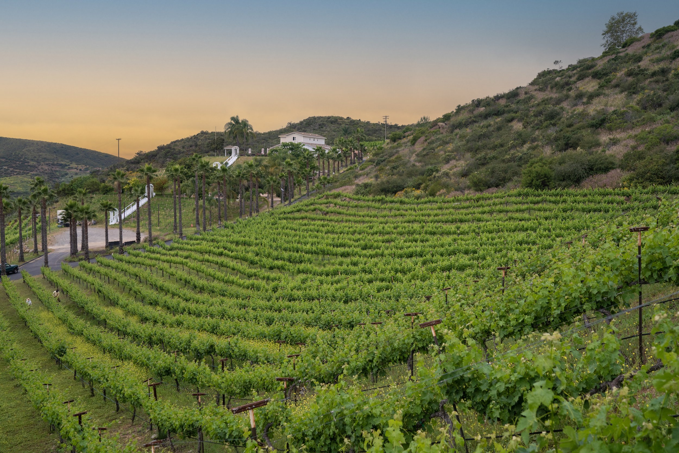
² In that day,
A vineyard of wine, sing of it!
³ “I, the Lord, am its keeper;
I water it every moment.
So that no one will damage it,
I guard it night and day. (NASB)
Result of God’s great victory!

Slide 16
³ And now, O inhabitants of Jerusalem
and men of Judah,
judge between me and my vineyard.
⁴ What more was there to do for my vineyard,
that I have not done in it?
When I looked for it to yield grapes,
why did it yield wild grapes?
Isaiah 5:3-4
Literally – “Stinky things”!

Slide 17
² In that day,
A vineyard of wine, sing of it!
³ “I, the Lord, am its keeper;
I water it every moment.
So that no one will damage it,
I guard it night and day. (NASB)
What is different? Why will this be a fruitful vineyard?

Slide 18
Who was the vine/vineyard of Isaiah 5?
Ethnic Israel
Who is the vine/vineyard of Isaiah 27?
Remnant / True believers
Jesus is the vine!

Slide 19
¹ I am the true vine, and my Father is the vinedresser…
⁴ Abide in me, and I in you. As the branch cannot bear fruit by itself, unless it abides in the vine, neither can you, unless you abide in me. ⁵ I am the vine; you are the branches. Whoever abides in me and I in him, he it is that bears much fruit, for apart from me you can do nothing.
John 15:1,4-5

Slide 20
⁴ I have no wrath.
Would that I had thorns and briers to battle!
I would march against them,
I would burn them up together.
⁵ Or let them lay hold of my protection,
let them make peace with me,
let them make peace with me.

Slide 21
⁴ I have no wrath.
Would that I had thorns and briers to battle!
I would march against them,
I would burn them up together.
⁵ Or let them lay hold of my protection,
let them make peace with me,
let them make peace with me.
Why no wrath?
Since, therefore, we have now been justified by his blood, much more shall we be saved by him from the wrath of God. Romans 5:9

Slide 22
⁴ I have no wrath.
Would that I had thorns and briers to battle!
I would march against them,
I would burn them up together.
⁵ Or let them lay hold of my protection,
let them make peace with me,
let them make peace with me.
A desire to show his passion for his people!

Slide 23
A vineyard of grace – even God’s enemies can come in!
⁴ I have no wrath.
Would that I had thorns and briers to battle!
I would march against them,
I would burn them up together.
⁵ Or let them lay hold of my protection,
let them make peace with me,
let them make peace with me.”

Slide 24
⁹ Since, therefore, we have now been justified by his blood, much more shall we be saved by him from the wrath of God. ¹⁰ For if while we were enemies we were reconciled to God by the death of his Son, much more, now that we are reconciled, shall we be saved by his life.
Romans 5:9-10

Slide 25
Who is this talking about?
Jacob / Israel –God’s ethnic people (context)
The remnant (true believers)
⁶ In days to come Jacob shall take root,
Israel shall blossom and put forth shoots
and fill the whole world with fruit.

Slide 26
What is this talking about?
God’s ethnic people fulfilling who God had called them to be!
Channel of God’s blessing – Genesis 12:3
Kingdom of priests – Exodus 19:5-6
⁶ In days to come Jacob shall take root,
Israel shall blossom and put forth shoots
and fill the whole world with fruit.

Slide 27
When will this happen?
Already… But not yet!
⁶ In days to come Jacob shall take root,
Israel shall blossom and put forth shoots
and fill the whole world with fruit.

Slide 28
How is it going to happen?
Rest of Isaiah 27!
⁶ In days to come Jacob shall take root,
Israel shall blossom and put forth shoots
and fill the whole world with fruit.

Slide 29
Old City and Kidron Valley from north
Isaiah 27 – God Fulfills His Purposes For His People
God’s Victory over His Enemies (1)
God’s True Vineyard (2-6)
God’s Process of Redemption (7-11)
God’s Gathering of His Remnant (12-13)

Slide 30
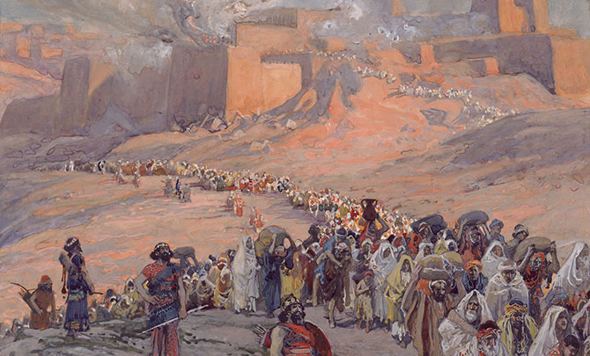
⁷ Has he struck them
as he struck those who struck them?
Or have they been slain as their slayers were slain?
⁸ Measure by measure,
by exile you contended with them;
he removed them with his fierce breath
in the day of the east wind.

Slide 31
⁷ Has he struck them
as he struck those who struck them?
Or have they been slain as their slayers were slain?
⁸ Measure by measure,
by exile you contended with them;
he removed them with his fierce breath
in the day of the east wind.

Slide 32
⁷ Has he struck them
as he struck those who struck them?
Or have they been slain as their slayers were slain?
⁸ Measure by measure,
by exile you contended with them;
he removed them with his fierce breath
in the day of the east wind.

Slide 33
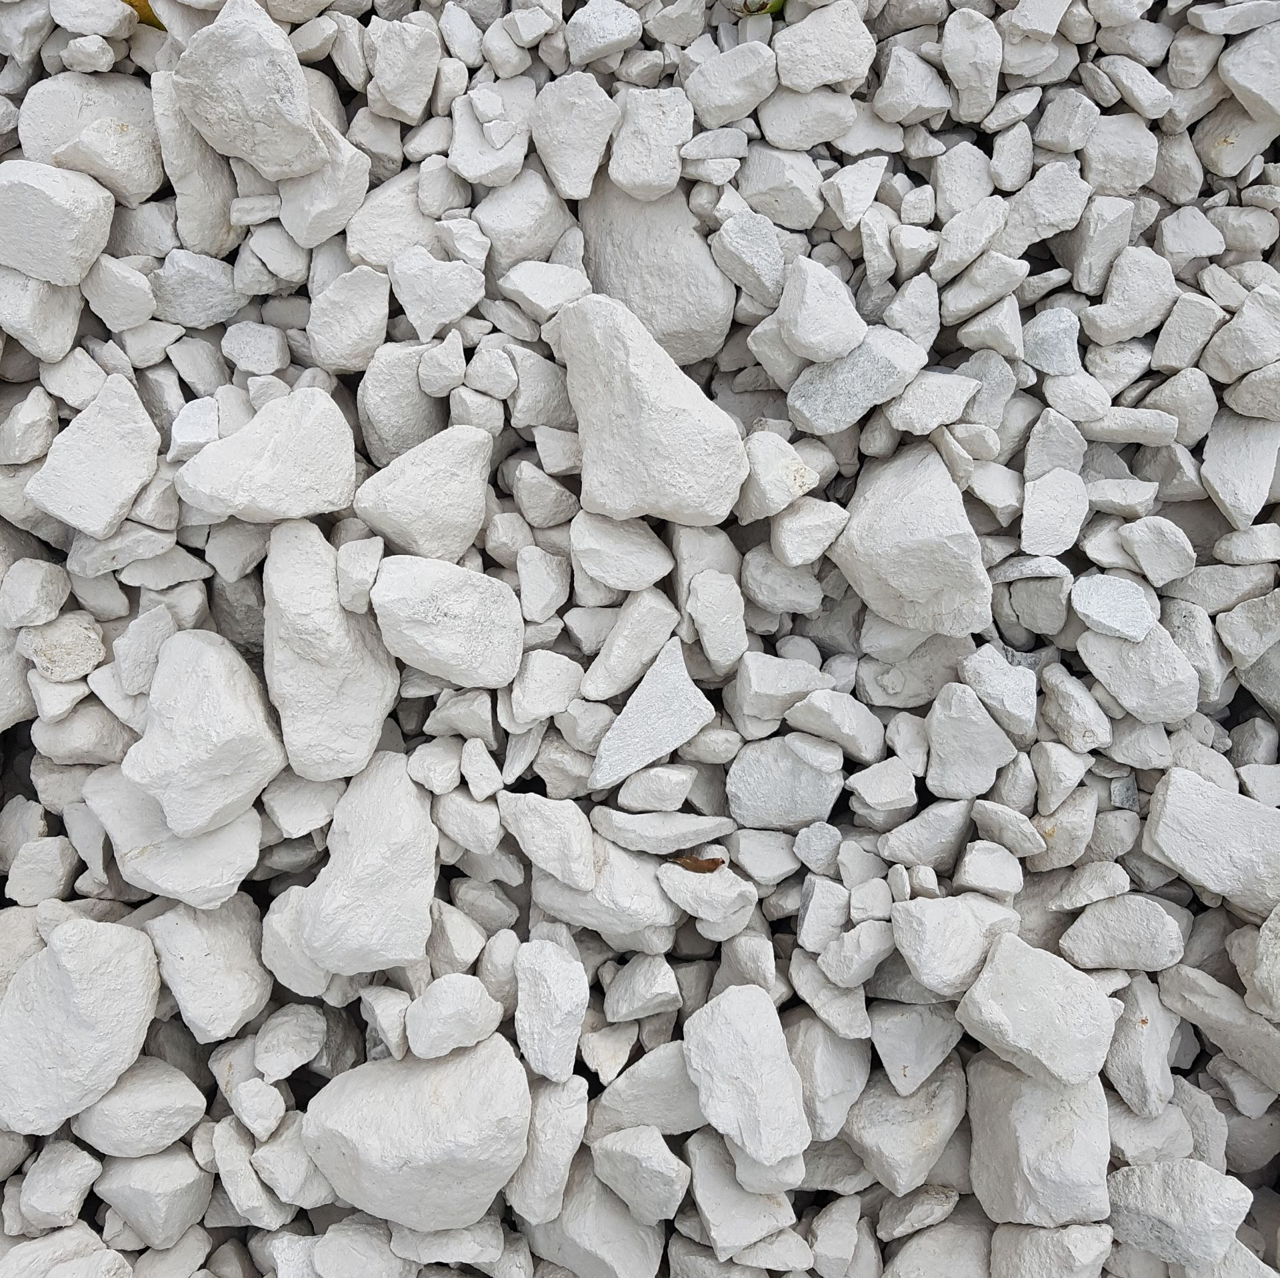
⁹ Therefore by this the guilt of Jacob will be atoned for,
and this will be the full fruit of the removal of his sin:
when he makes all the stones of the altars
like chalkstones crushed to pieces,
no Asherim or incense altars will remain standing.

Slide 34
Exile was the means God used to bring them to repentance
Exile was NOT the payment for their atonement
⁹ Therefore by this the guilt of Jacob will be atoned for,
and this will be the full fruit of the removal of his sin:
when he makes all the stones of the altars
like chalkstones crushed to pieces,
no Asherim or incense altars will remain standing.

Slide 35
Changed lives would be the fruit of their repentance – especially the hatred of idolatry.
⁹ Therefore by this the guilt of Jacob will be atoned for,
and this will be the full fruit of the removal of his sin:
when he makes all the stones of the altars
like chalkstones crushed to pieces,
no Asherim or incense altars will remain standing.

Slide 36
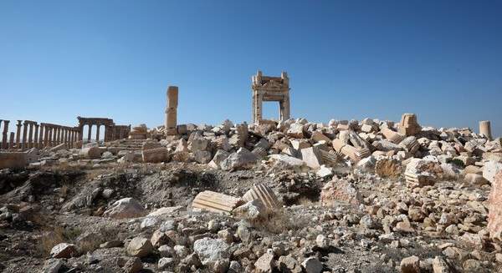
¹⁰ For the fortified city is solitary,
a habitation deserted and forsaken,
like the wilderness;
there the calf grazes;
there it lies down and strips its branches.
What is this talking about?
Happened literally to Jerusalem (Lamentations 1:1)
Applies more generally to the “City of Man”

Slide 37
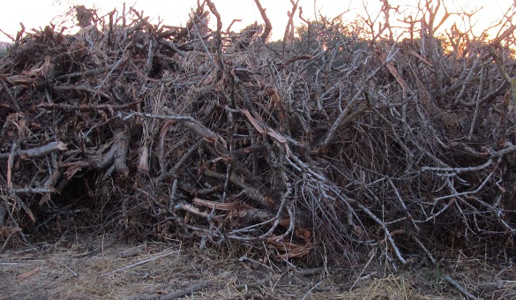
¹¹ When its boughs are dry, they are broken;
women come and make a fire of them.
For this is a people without discernment;
therefore he who made them will not have compassion on them;
he who formed them will show them no favor.

Slide 38
The purpose of exile was to bring them to repentance
Those without discernment missed God’s message
¹¹ When its boughs are dry, they are broken;
women come and make a fire of them.
For this is a people without discernment;
therefore he who made them will not have compassion on them;
he who formed them will show them no favor.

Slide 39
Old City and Kidron Valley from north
Isaiah 27 – God Fulfills His Purposes For His People
God’s Victory over His Enemies (1)
God’s True Vineyard (2-6)
God’s Process of Redemption (7-11)
God’s Gathering of His Remnant (12-13)

Slide 40
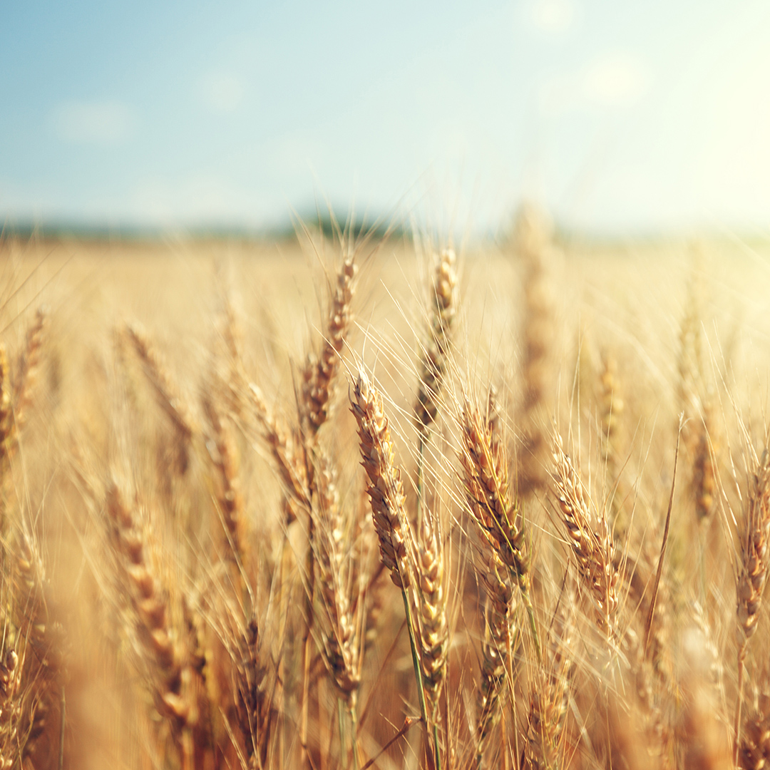
¹² In that day from the river Euphrates to the Brook of Egypt the Lord will thresh out the grain, and you will be gleaned one by one, O people of Israel.

Slide 41
Borders of the original promised land
¹² In that day from the river Euphrates to the Brook of Egypt the Lord will thresh out the grain, and you will be gleaned one by one, O people of Israel.

Slide 42
Borders of the original promised land
Either separating wheat from chaff or beating olives off of the tree
¹² In that day from the river Euphrates to the Brook of Egypt the Lord will thresh out the grain, and you will be gleaned one by one, O people of Israel.

Slide 43
Borders of the original promised land
Either separating wheat from chaff or beating olives off of the tree
Gathering the remnant of ethnic Israel
¹² In that day from the river Euphrates to the Brook of Egypt the Lord will thresh out the grain, and you will be gleaned one by one, O people of Israel.

Slide 44
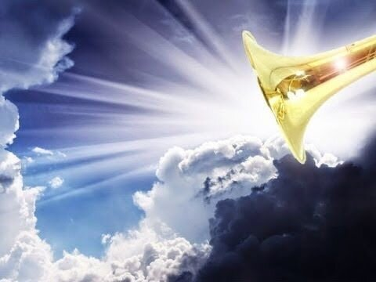
¹³ It will come about also on that day that a great trumpet will be blown, and those who were perishing in the land of Assyria and who were scattered in the land of Egypt will come and worship the Lord on the holy mountain in Jerusalem. (NASB)

Slide 45
Perishing
(“a wandering Aramean” – Deuteronomy 26:5)
Scattered
(Animals – Deuteronomy 22:1; Moab – Isaiah 16:3-4)
Idea: Not exile, but spiritually lost people
¹³ It will come about also on that day that a great trumpet will be blown, and those who were perishing in the land of Assyria and who were scattered in the land of Egypt will come and worship the Lord on the holy mountain in Jerusalem. (NASB)

Slide 46
Lands of Assyria and Egypt – People living in Gentile areas
Similar to Isaiah 19:24-25 – the ingathering of the Gentiles
¹³ It will come about also on that day that a great trumpet will be blown, and those who were perishing in the land of Assyria and who were scattered in the land of Egypt will come and worship the Lord on the holy mountain in Jerusalem. (NASB)

Slide 47
I am the good shepherd. I know my own and my own know me…And I have other sheep that are not of this fold. I must bring them also, and they will listen to my voice. So there will be one flock, one shepherd.
John 10:14,16
¹³ It will come about also on that day that a great trumpet will be blown, and those who were perishing in the land of Assyria and who were scattered in the land of Egypt will come and worship the Lord on the holy mountain in Jerusalem. (NASB)

Slide 48
Isaiah 2:2-4 Fulfilled!
Already… But not yet!
¹³ And in that day a great trumpet will be blown, and those who were lost in the land of Assyria and those who were driven out to the land of Egypt will come and worship the Lord on the holy mountain at Jerusalem.

Slide 49
Old City and Kidron Valley from north
Isaiah 27 – God Fulfills His Purposes For His People
Isaiah 27
Looking forward through the years to see God gathering his people and making them into who he intended them to be
Already… But not yet…

Slide 50
Old City and Kidron Valley from north
The Role of Jesus
The one who has defeated Satan – Colossians 2:15, Hebrews 2:14
The true vine – John 15:1
The one who produces fruit – John 15:4-5
The one who turns away God’s wrath – Romans 5:9
The Good Shepherd who gathers all of his people – John 10:14-16

Slide 52
OT Preaching link at BibleStudyDownloads.org
Get this presentation for free!
Notes:
OT Preaching (op)

