Slide 1
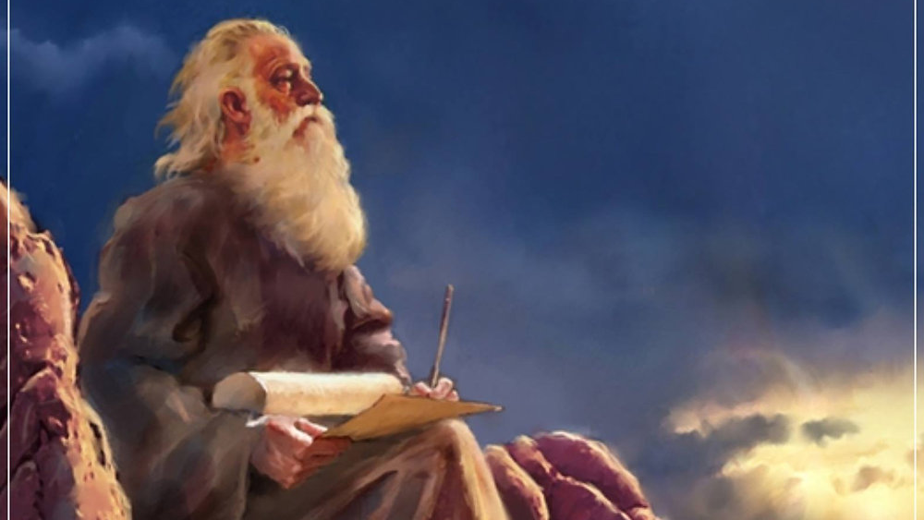
The Prophecy
Of
Isaiah
Isaiah 26
God-Centered Waiting
Preached by Dan Bridges at Amman International Church Singapore • AmmanChurch.com Uploaded by Dr. Rick Griffith • Jordan Evangelical Theological Seminary Files in many languages for free download at BibleStudyDownloads.org

Slide 2
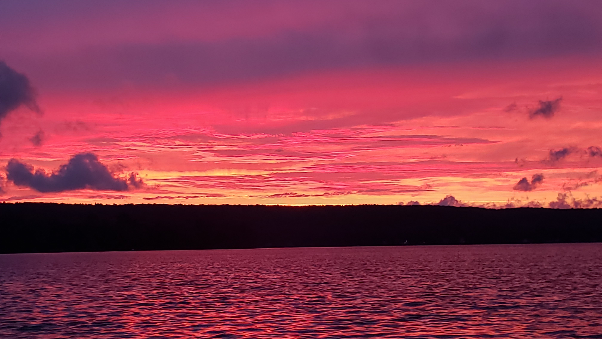
Old City and Kidron Valley from north
You keep him in perfect peace
whose mind is stayed on you,
because he trusts in you.
Isaiah 26:3

Slide 3
Isaiah 13-27: God’s Universal Kingdom
Chapters 13-23: 10 Oracles Regarding the Nations
Babylon (13:1-14:27)
Philistia (14:28-32)
Moab (15:1-16:14)
Syria/Israel/Cush (17:1-18:7)
Egypt (19:1-20:6)
Babylon (21:1-10)
Edom (21:11-12)
Arabia (21:13-17)
Jerusalem (22:1-25)
Tyre (23:1-18)
Chapter 24: Worldwide Judgment
Chapter 25: Fulfillment of God’s Plans
Chapter 26: The People of God
Chapter 27: Israel Fulfills its Purpose
Isaiah’s Mini Apocalypse

Slide 4
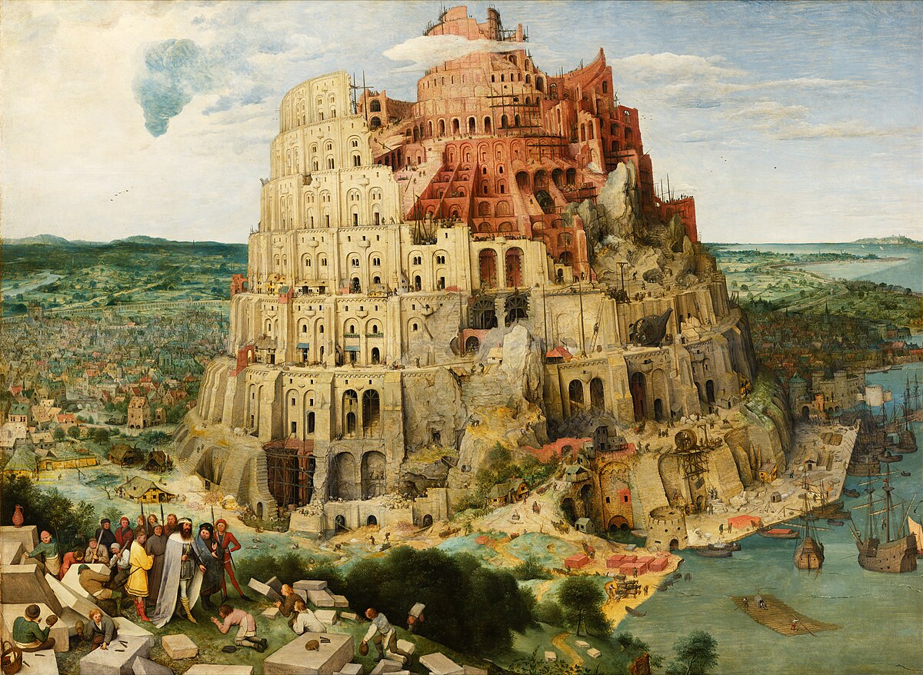
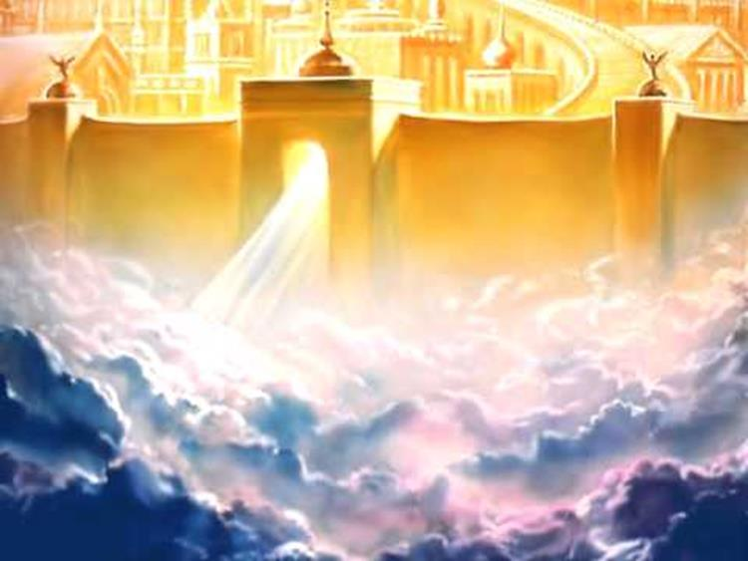
Two Cities
Of
Isaiah 24-27
City of Man
City of God
City of the nations
(Babylon, Tyre, Moab, etc.)
Characterized by pride and self-sufficiency
Represents man apart from God - Glorifies man
End is destruction
Mount Zion
(New Jerusalem)
Characterized by humility and dependence on God
Glorifies God
End is eternal glory

Slide 5
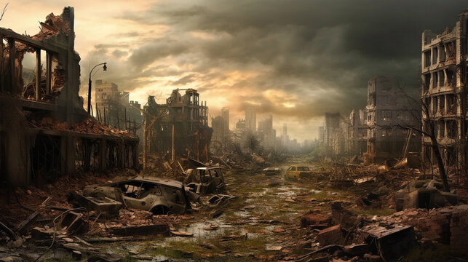
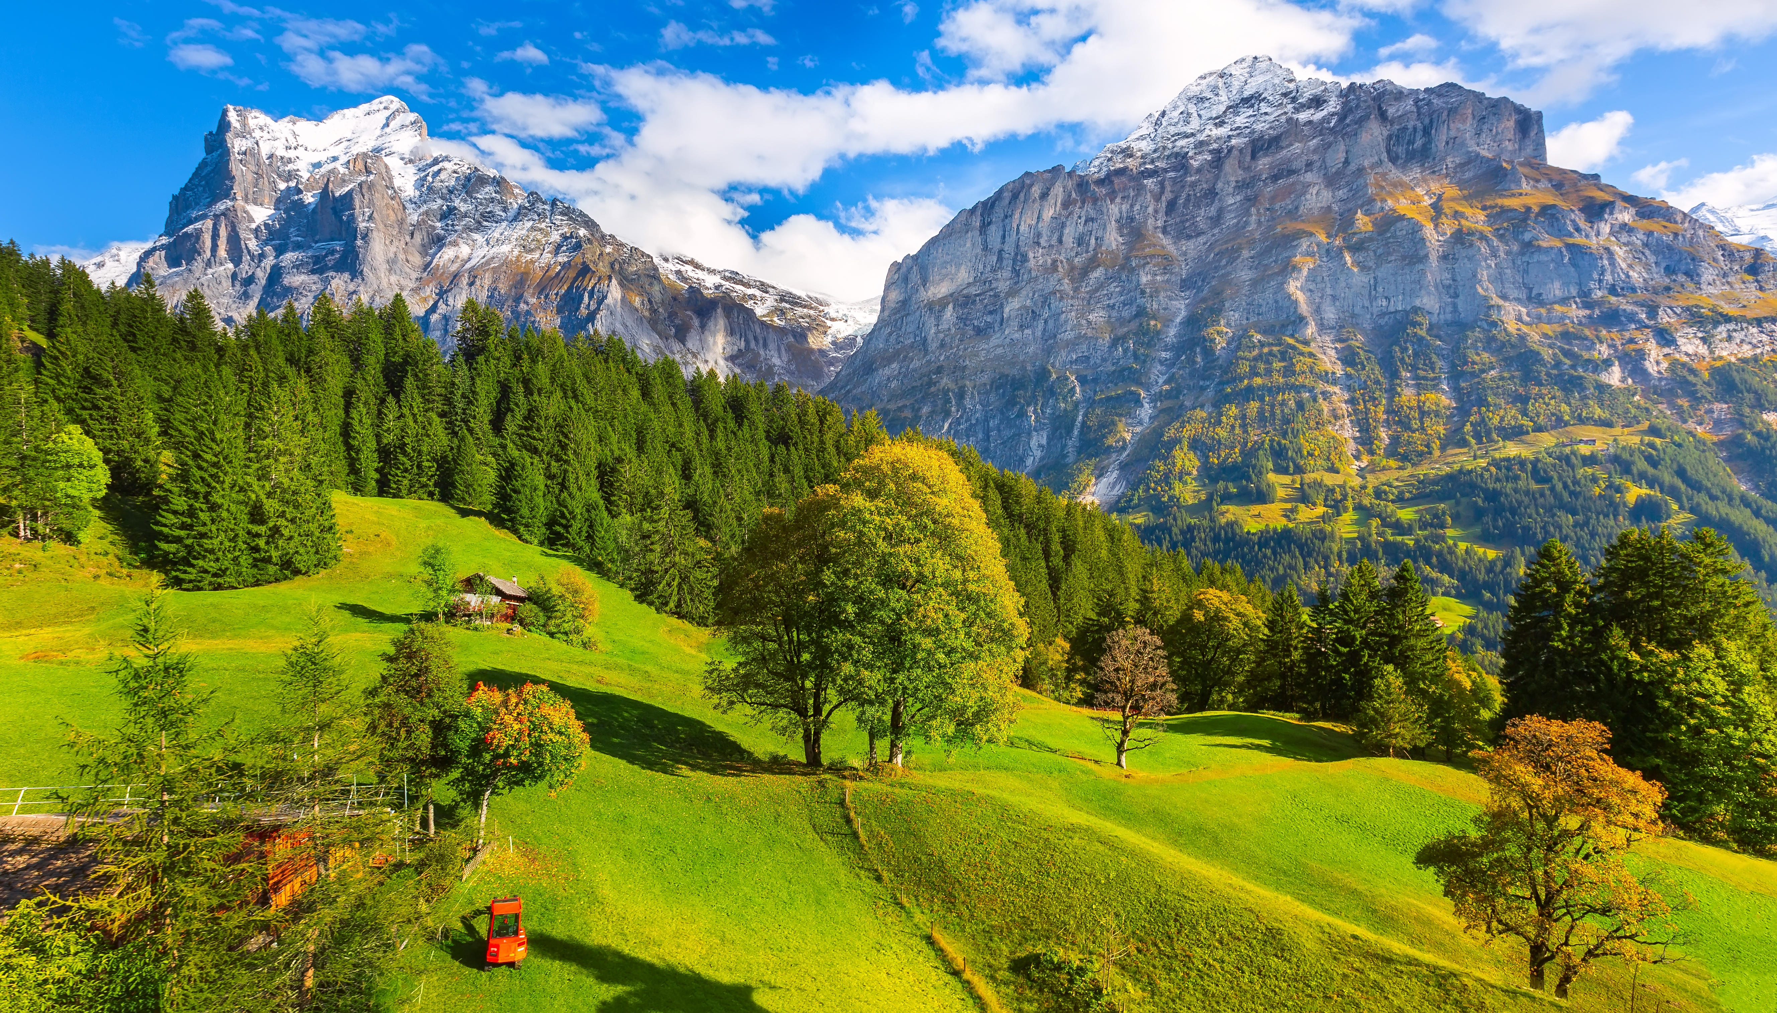
Old City and Kidron Valley from north
Isaiah 24
Isaiah 25
God’s Judgment
City of Man Destroyed
God’s Restoration
City of God Established

Slide 6
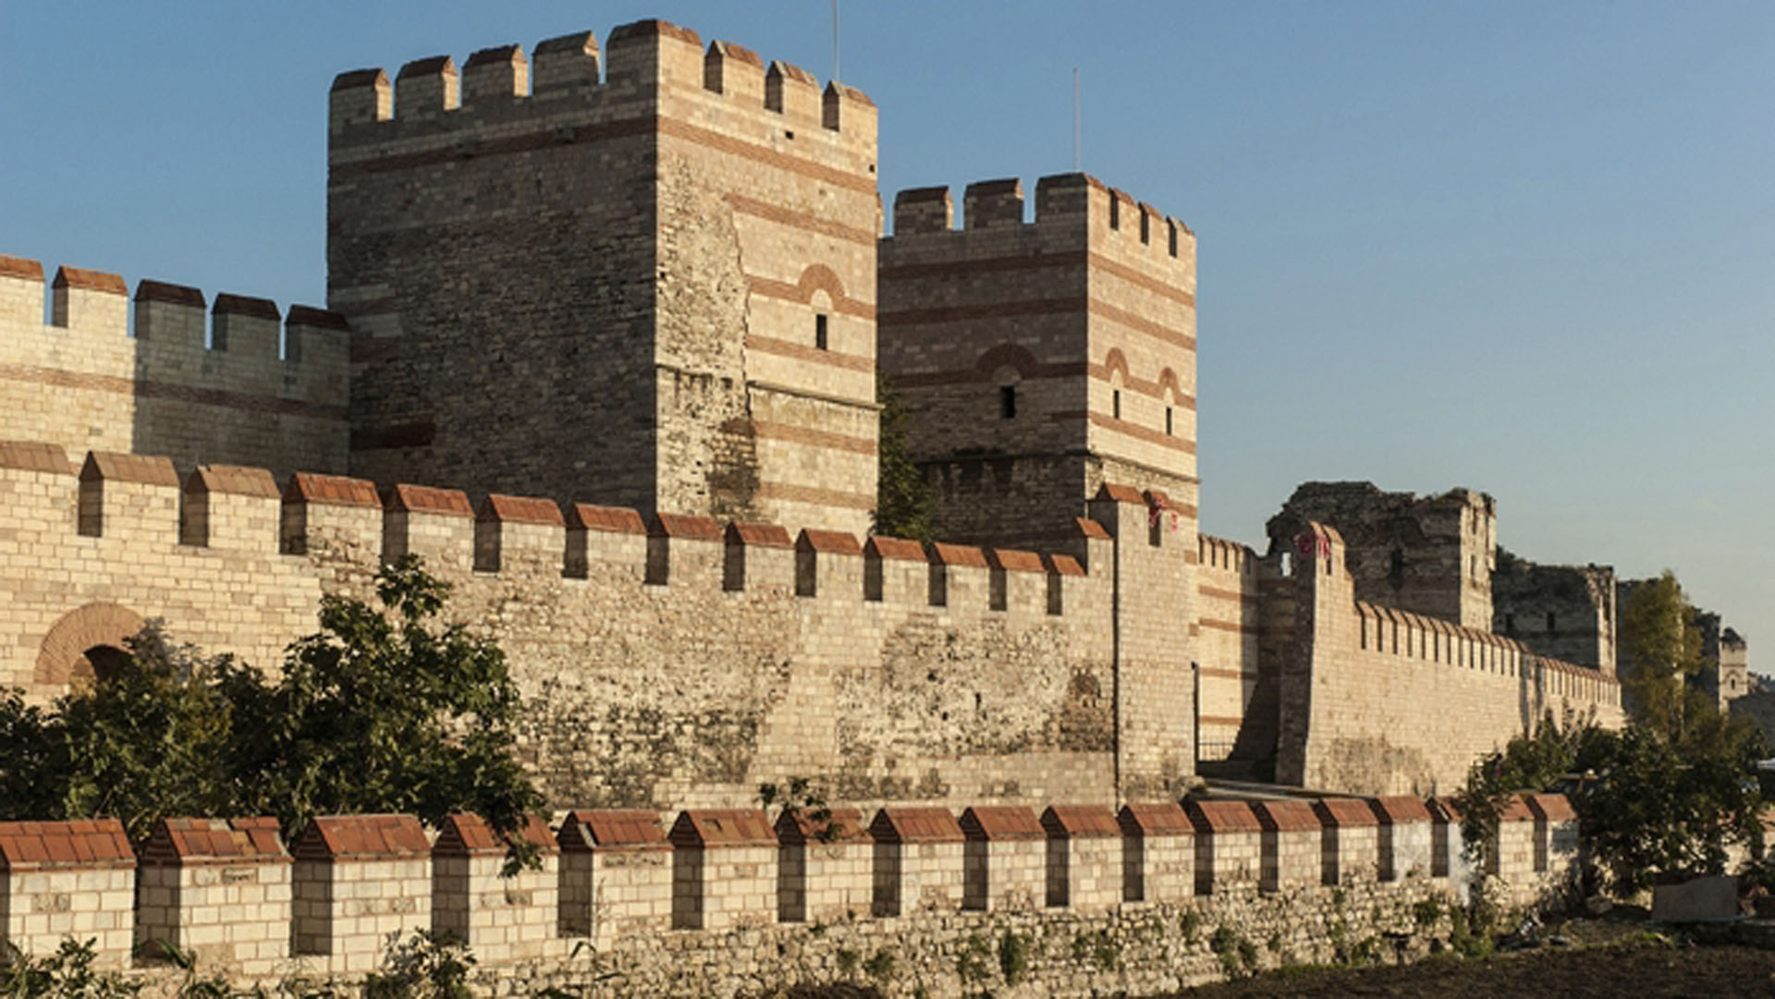
Old City and Kidron Valley from north
Isaiah 26 – The People of God Waiting
Isaiah 26
A message of encouragement given to oppressed people waiting on God’s salvation and deliverance

Slide 7
Old City and Kidron Valley from north
What was life going to be like for God’s people while they waited for his salvation?
Exile and occupation
Persecution for their faith – including death
Effects of living in a fallen world (disease, death, natural disasters, …)
Effects of living in a sinful world (wars, crime, discrimination, poverty, …)
What does it look like to wait in a God-centered, God-focused way?

Slide 8
Old City and Kidron Valley from north
Isaiah 26 – The People of God Waiting
A Picture of God-Centered Waiting
Song of God’s people – 1-6
Isaiah’s Prayer
God-Centered Waiting – 7-11
God-Centered Perspective – 12-19
Isaiah’s Exhortation – 20-21

Slide 9
Old City and Kidron Valley from north
The City of God is already… but not yet!
Total salvation – Not yet
God’s presence & protection – Already!
1 In that day this song will be sung in the land of Judah:
“We have a strong city;
he sets up salvation
as walls and bulwarks.

Slide 10
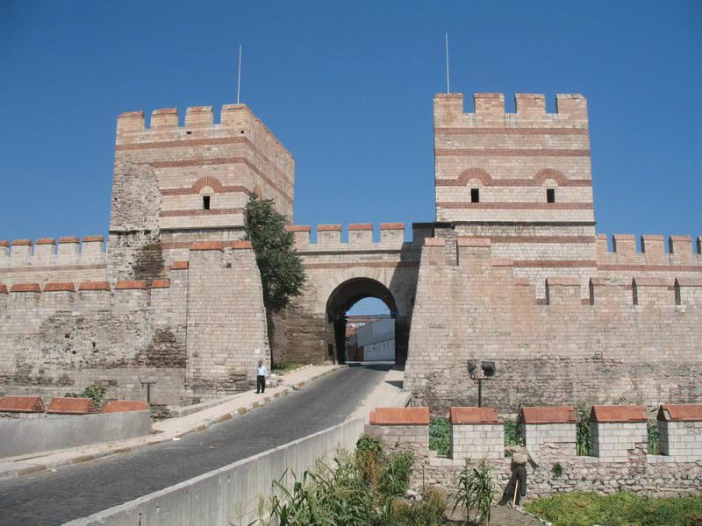
Old City and Kidron Valley from north
Who is this righteous nation?
Remnant from all nations (Isaiah 24:14-16; 25:6)
Those who have experienced God’s salvation (Isaiah 25:9)
2 Open the gates,
that the righteous nation that keeps faith may enter in.

Slide 11
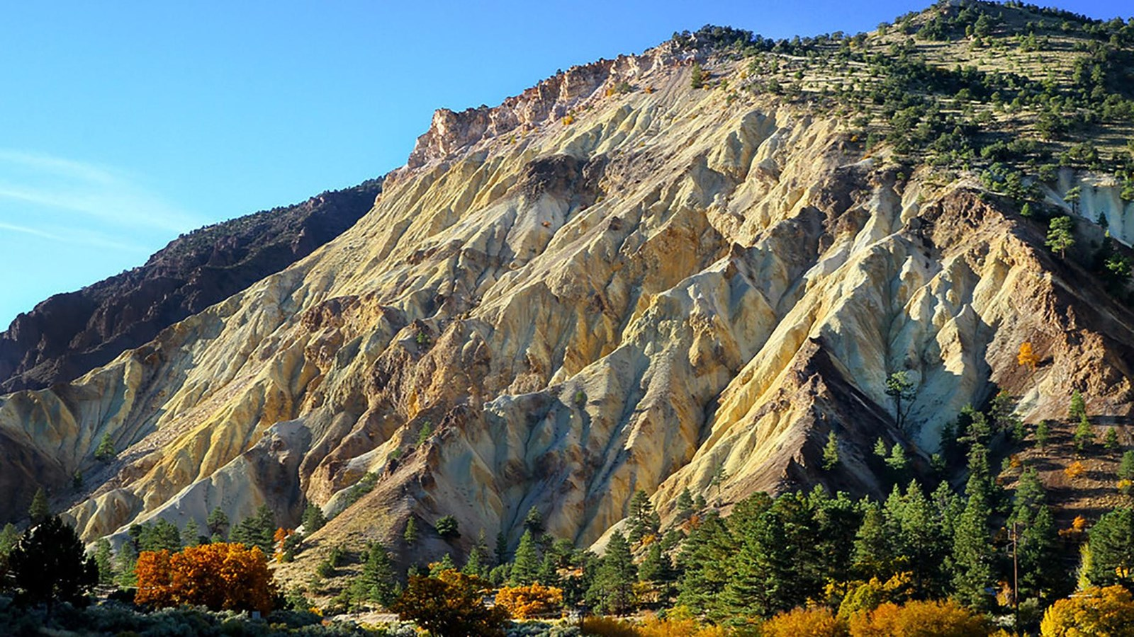
Old City and Kidron Valley from north
3 You keep him in perfect peace
whose mind is stayed on you,
because he trusts in you.
4 Trust in the Lord forever,
for the Lord God is an everlasting rock.

Slide 12
Old City and Kidron Valley from north
Perfect Peace!
Shalom – Total Well-being
Shalom Shalom – Peace that can overcome the worst possible circumstances!
This is a work of God in us – not from us!
3 You keep him in perfect peace
whose mind is stayed on you,
because he trusts in you.
4 Trust in the Lord forever,
for the Lord God is an everlasting rock.

Slide 13
Old City and Kidron Valley from north
“…do not be anxious about anything, but in everything by prayer and supplication with thanksgiving let your requests be made known to God. And the peace of God, which surpasses all understanding, will guard your hearts and your minds in Christ Jesus.” Philippians 4:6-7
3 You keep him in perfect peace
whose mind is stayed on you,
because he trusts in you.
4 Trust in the Lord forever,
for the Lord God is an everlasting rock.

Slide 14
Old City and Kidron Valley from north
How do we get this peace?
God gives it to us
Our part is faith – expressed in prayer, thanksgiving, immersion in God’s Word and obedience
3 You keep him in perfect peace
whose mind is stayed on you,
because he trusts in you.
4 Trust in the Lord forever,
for the Lord God is an everlasting rock.

Slide 15
Old City and Kidron Valley from north
3 You keep him in perfect peace
whose mind is stayed on you,
because he trusts in you.
4 Trust in the Lord forever,
for the Lord God is an everlasting rock.

Slide 16
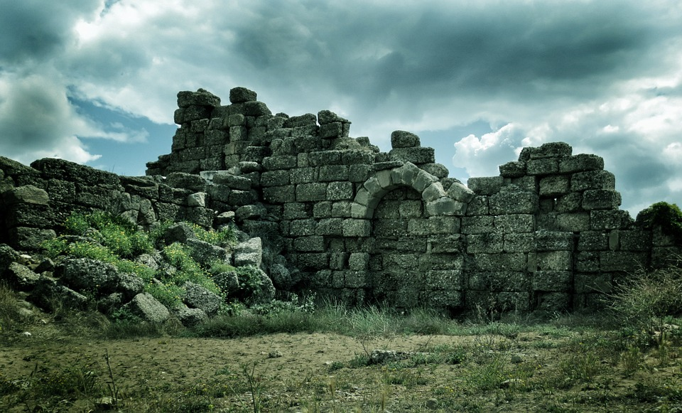
Old City and Kidron Valley from north
⁵ For he has humbled
the inhabitants of the height, the lofty city.
He lays it low, lays it low to the ground,
casts it to the dust.
⁶ The foot tramples it,
the feet of the poor, the steps of the needy.”
City
Of
Man

Slide 17
Old City and Kidron Valley from north
God-Centered Waiting Is…
Finding our peace and security in God alone

Slide 18
Old City and Kidron Valley from north
Isaiah 26 – The People of God…
A Picture of God-Centered Waiting
Song of God’s people – 1-6
Isaiah’s Prayer
God-Centered Waiting – 7-11
God-Centered Perspective – 12-19
Isaiah’s Exhortation – 20-21

Slide 19
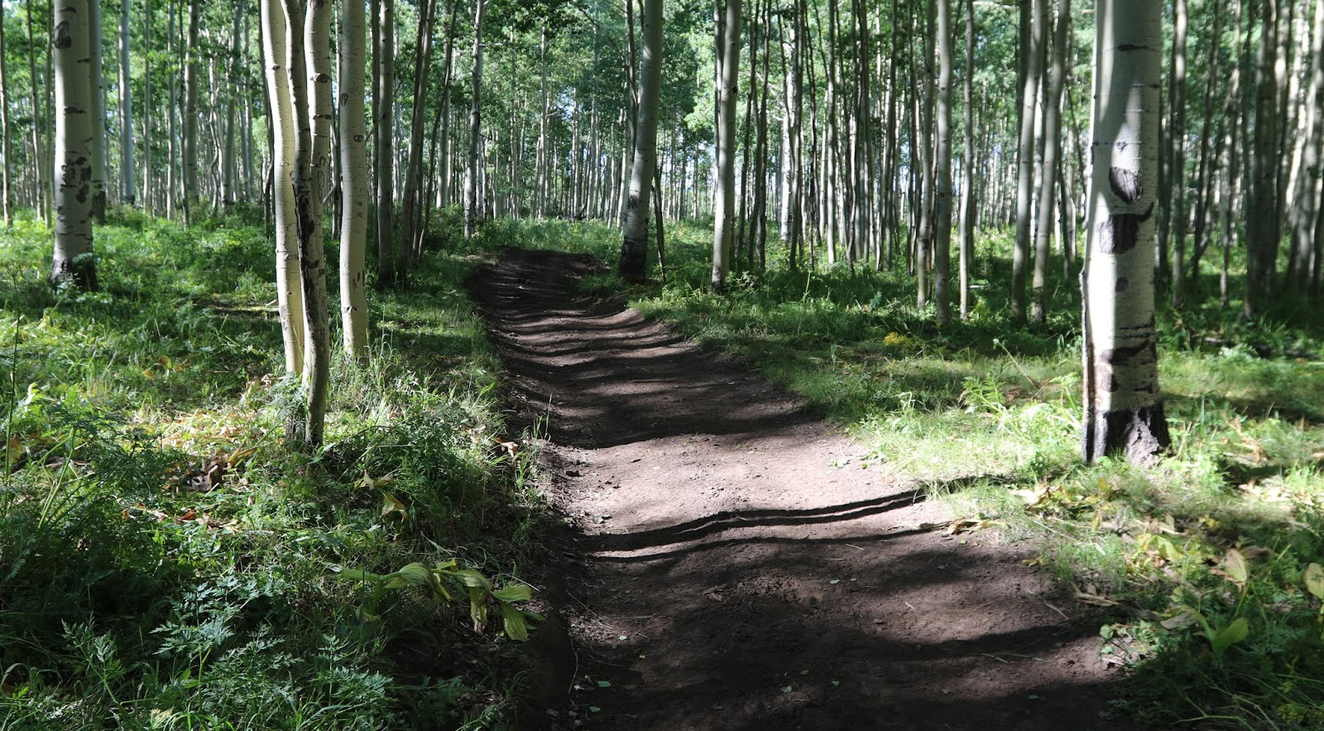
Old City and Kidron Valley from north
The way of a sluggard is like a hedge of thorns,
but the path of the upright is a level highway.
Proverbs 15:19
Living God’s way has a good, reliable outcome
Living God’s way brings God’s help
7 The path of the righteous is level;
you make level the way of the righteous.

Slide 20
Old City and Kidron Valley from north
8 In the path of your judgments,
O Lord, we wait for you;
your name and remembrance
are the desire of our soul.
9 My soul yearns for you in the night;
my spirit within me earnestly seeks you.
For when your judgments are in the earth,
the inhabitants of the world learn
righteousness.

Slide 21
Old City and Kidron Valley from north
8 In the path of your judgments,
O Lord, we wait for you;
your name and remembrance
are the desire of our soul.
9 My soul yearns for you in the night;
my spirit within me earnestly seeks you.
For when your judgments are in the earth,
the inhabitants of the world learn
righteousness.
Waiting for what?
God’s salvation!

Slide 22
Old City and Kidron Valley from north
8 In the path of your judgments,
O Lord, we wait for you;
your name and remembrance
are the desire of our soul.
9 My soul yearns for you in the night;
my spirit within me earnestly seeks you.
For when your judgments are in the earth,
the inhabitants of the world learn
righteousness.
Under what circumstances?
God’s judgments!

Slide 23
Old City and Kidron Valley from north
Waiting with what goal?
God’s glory!
God himself!
8 In the path of your judgments,
O Lord, we wait for you;
your name and remembrance
are the desire of our soul.
9 My soul yearns for you in the night;
my spirit within me earnestly seeks you.
For when your judgments are in the earth,
the inhabitants of the world learn
righteousness.

Slide 24
Old City and Kidron Valley from north
8 In the path of your judgments,
O Lord, we wait for you;
your name and remembrance
are the desire of our soul.
9 My soul yearns for you in the night;
my spirit within me earnestly seeks you.
For when your judgments are in the earth,
the inhabitants of the world learn
righteousness.
God’s judgments are difficult, but effective!

Slide 25
Old City and Kidron Valley from north
10 If favor is shown to the wicked,
he does not learn righteousness;
in the land of uprightness he deals corruptly
and does not see the majesty of the Lord.

Slide 26
Old City and Kidron Valley from north
11 O Lord, your hand is lifted up,
but they do not see it.
Let them see your zeal for your people,
and be ashamed.
Let the fire for your adversaries consume them.

Slide 27
Old City and Kidron Valley from north
God-Centered Waiting Is…
Finding our peace and security in God alone
Seeking God’s glory and God himself instead of a change in circumstances

Slide 28
Old City and Kidron Valley from north
Isaiah 26 – The People of God…
A Picture of God-Centered Waiting
Song of God’s people – 1-6
Isaiah’s Prayer
God-Centered Waiting – 7-11
God-Centered Perspective – 12-19
Isaiah’s Exhortation – 20-21

Slide 29
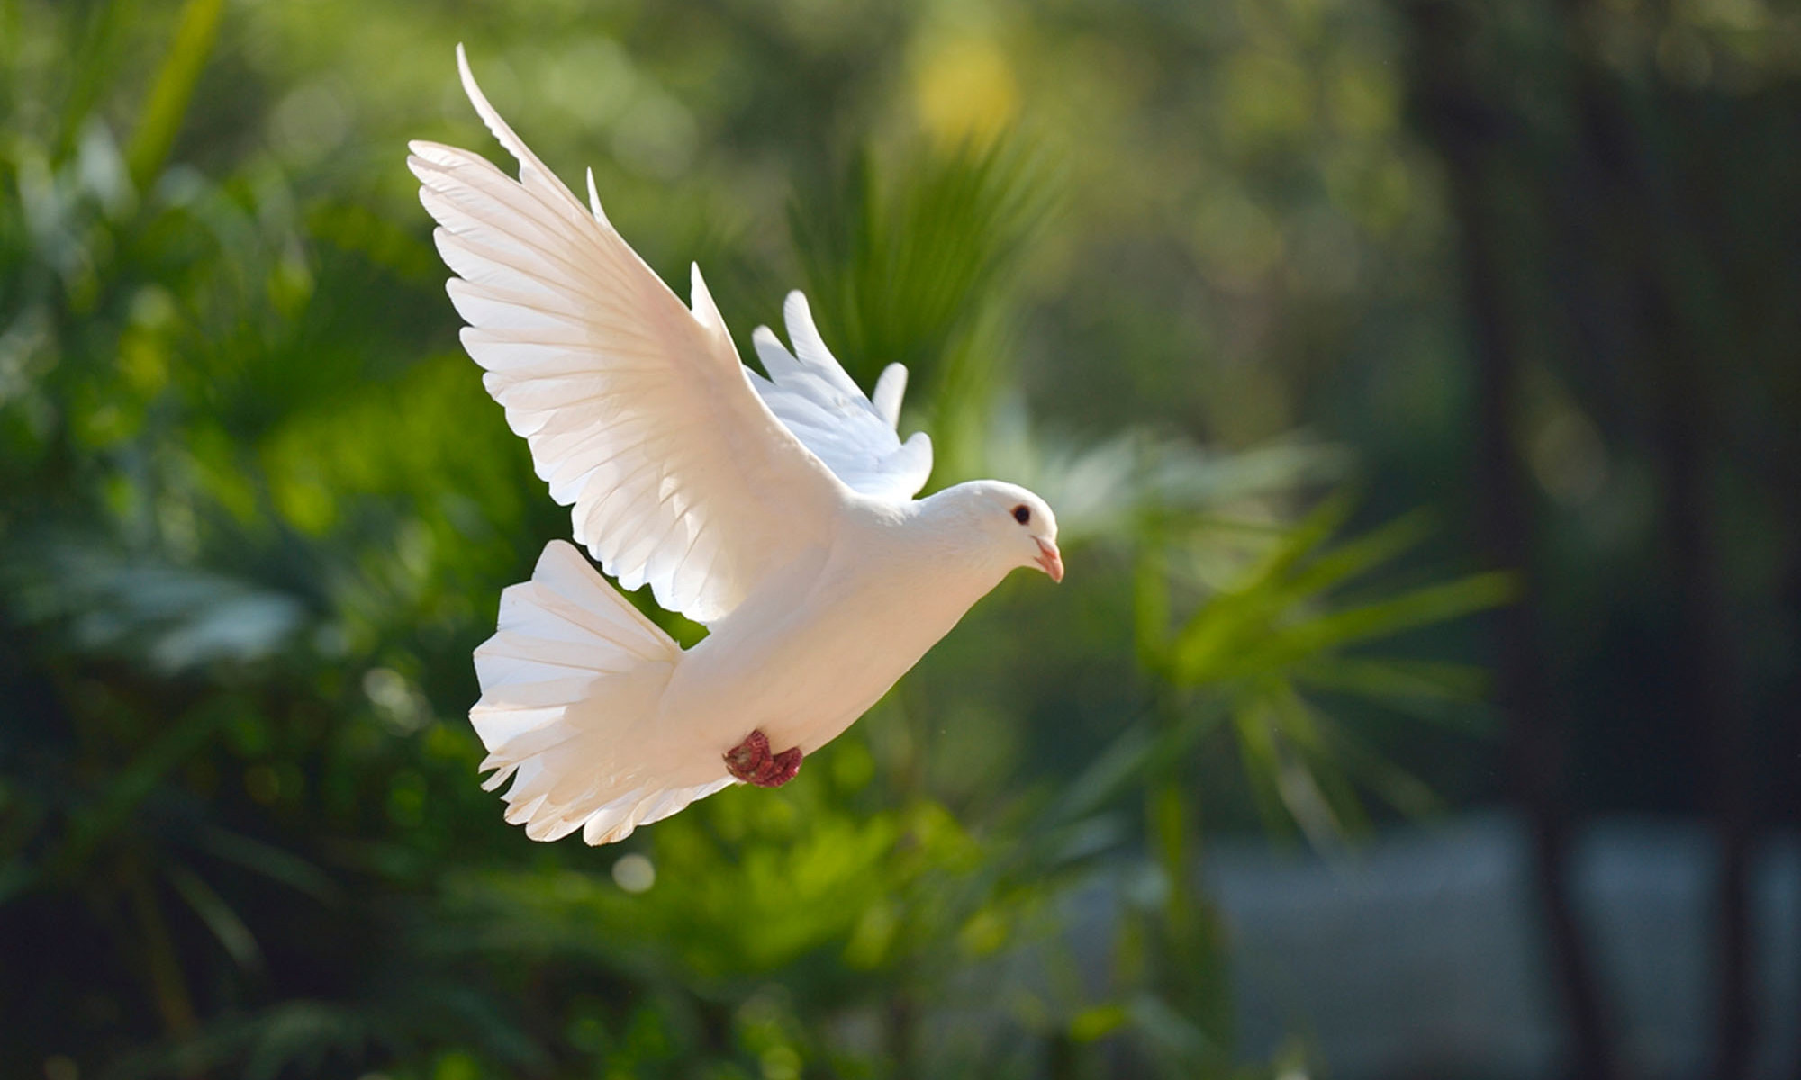
Old City and Kidron Valley from north
12 O Lord, you will ordain peace for us,
for you have indeed done for us all our works.

Slide 30
Old City and Kidron Valley from north
… it is God who works in you, both to will and to work for his good pleasure. Philippians 2:13
Now may the God of peace … equip you with everything good that you may do his will, working in us that which is pleasing in his sight, through Jesus Christ, to whom be glory forever and ever.
Hebrews 13:20-21

Slide 31
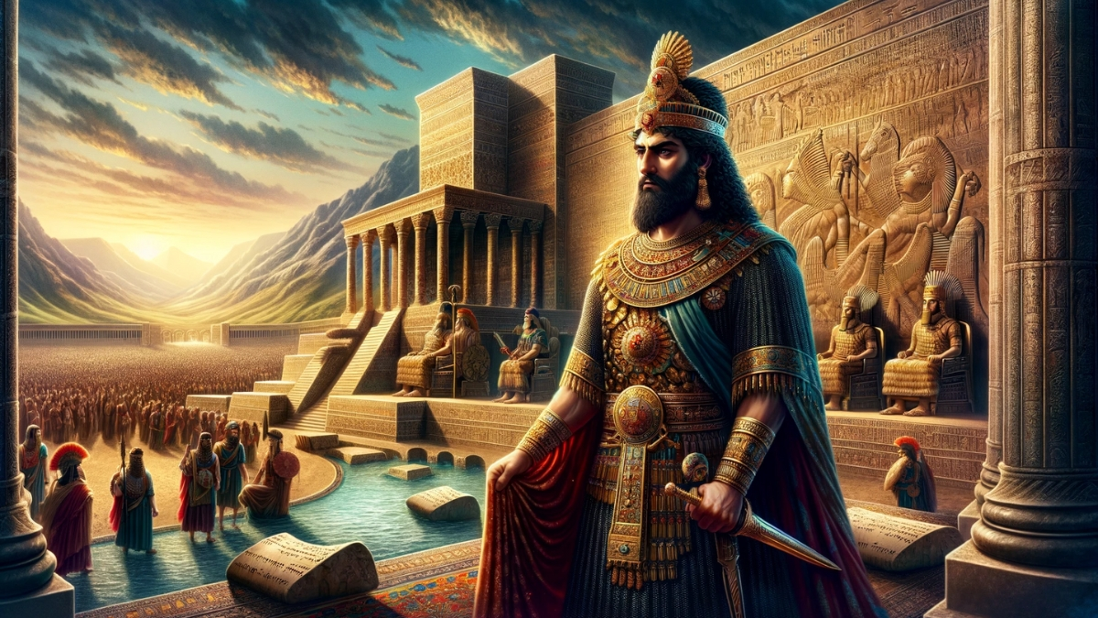
Old City and Kidron Valley from north
Other Rulers: Egyptians, Philistines, Midianites,
Moabites, Ammonites, …
Other gods…
13 O Lord our God,
other lords besides you have ruled over us,
but your name alone we bring to remembrance.
14 They are dead, they will not live;
they are shades, they will not arise;
to that end you have visited them with destruction
and wiped out all remembrance of them.

Slide 32
Old City and Kidron Valley from north
Literally: Only, by Thee we make mention of Thy name.
NASB: “through you alone we confess your name”
13 O Lord our God,
other lords besides you have ruled over us,
but your name alone we bring to remembrance.
14 They are dead, they will not live;
they are shades, they will not arise;
to that end you have visited them with destruction
and wiped out all remembrance of them.

Slide 33
Old City and Kidron Valley from north
God’s destruction of these other lords
13 O Lord our God,
other lords besides you have ruled over us,
but your name alone we bring to remembrance.
14 They are dead, they will not live;
they are shades, they will not arise;
to that end you have visited them with destruction
and wiped out all remembrance of them.

Slide 34
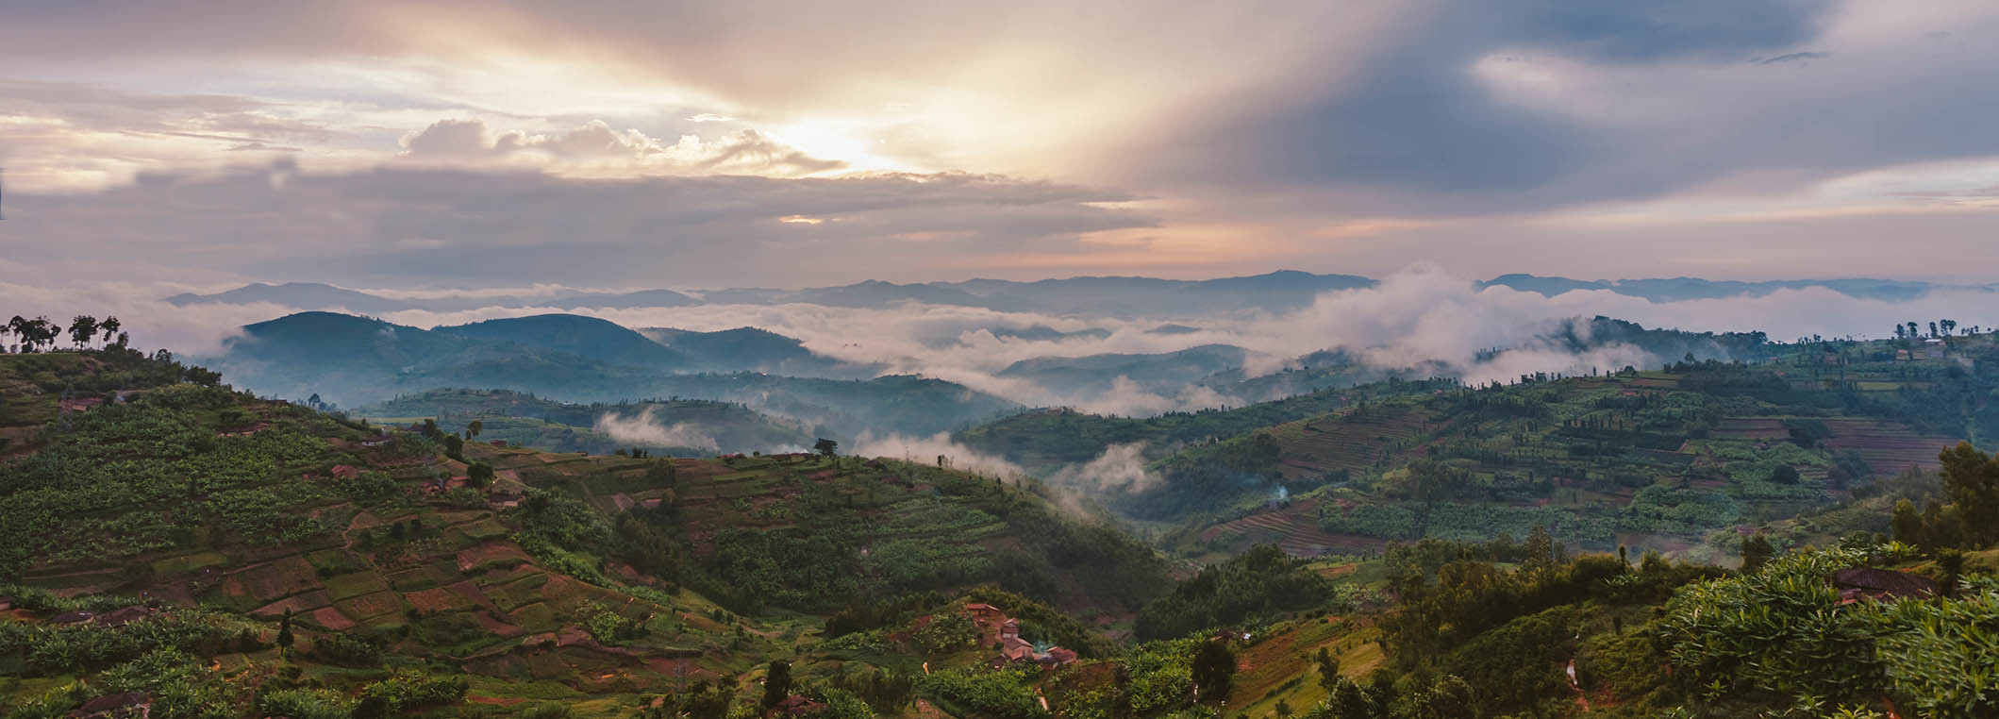
Old City and Kidron Valley from north
15 But you have increased the nation, O Lord,
you have increased the nation; you are glorified;
you have enlarged all the borders of the land.
Had this happened in Isaiah’s day?
Most likely using the “prophetic perfect”

Slide 35
Old City and Kidron Valley from north
2 Enlarge the place of your tent,
and let the curtains of your habitations be
stretched out;
do not hold back; lengthen your cords
and strengthen your stakes.
3 For you will spread abroad to the right and to the left,
and your offspring will possess the nations
and will people the desolate cities. Isaiah 54:2-3
(Speaking of the New Jerusalem and the inclusion of the Gentiles – Galatians 4:26-27)

Slide 36
Old City and Kidron Valley from north
12 O Lord, you will ordain peace for us,
for you have indeed done for us all our works.
13 O Lord our God,
other lords besides you have ruled over us,
but [through you alone we confess your name]NASB .
14 They are dead, they will not live;
they are shades, they will not arise;
to that end you have visited them with destruction
and wiped out all remembrance of them.
15 But you have increased the nation, O Lord,
you have increased the nation; you are glorified;
you have enlarged all the borders of the land.
God’s work on behalf of his people and for his glory!

Slide 37
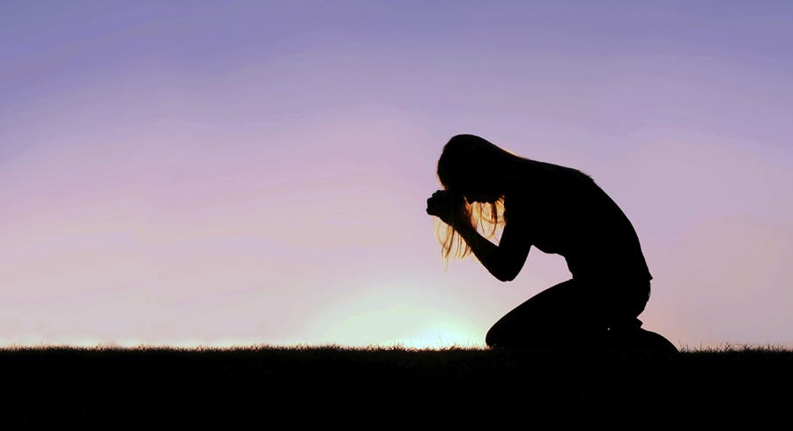
Old City and Kidron Valley from north
16 O Lord, in distress they sought you;
they poured out a whispered prayer
when your discipline was upon them.

Slide 38
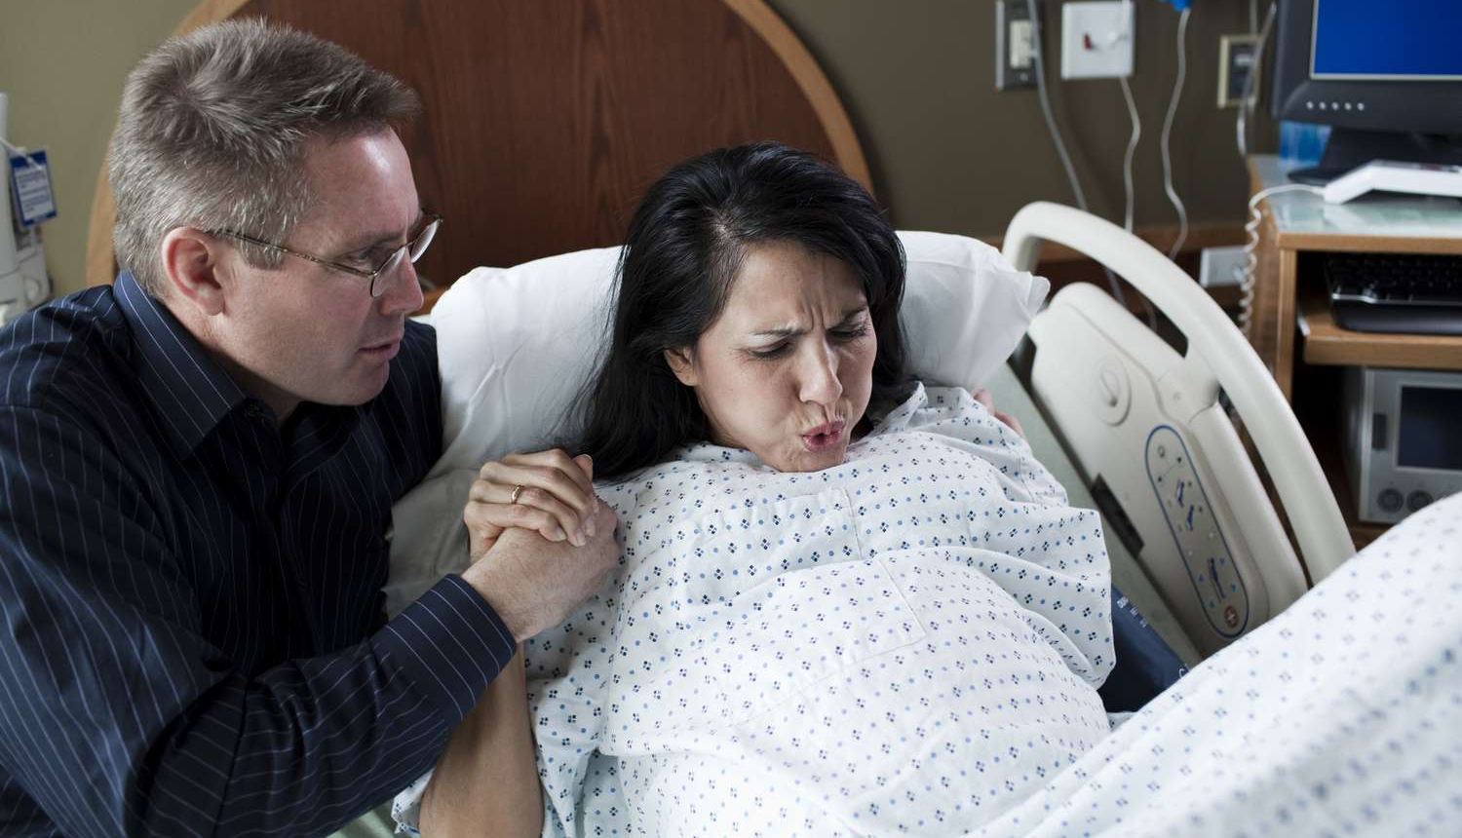
Old City and Kidron Valley from north
17 Like a pregnant woman
who writhes and cries out in her pangs
when she is near to giving birth,
so were we because of you, O Lord;

Slide 39
Old City and Kidron Valley from north
18 we were pregnant, we writhed,
but we have given birth to wind.
We have accomplished no deliverance in the earth,
and the inhabitants of the world have not fallen.

Slide 40
Old City and Kidron Valley from north
Literally: Salvation
18 we were pregnant, we writhed,
but we have given birth to wind.
We have accomplished no deliverance in the earth,
and the inhabitants of the world have not fallen.

Slide 41
Old City and Kidron Valley from north
Isaiah confesses the emptiness of man’s efforts apart from God!
17 Like a pregnant woman
who writhes and cries out in her pangs
when she is near to giving birth,
so were we because of you, O Lord;
18 we were pregnant, we writhed,
but we have given birth to wind.
We have accomplished no deliverance in the earth,
and the inhabitants of the world have not fallen.

Slide 42
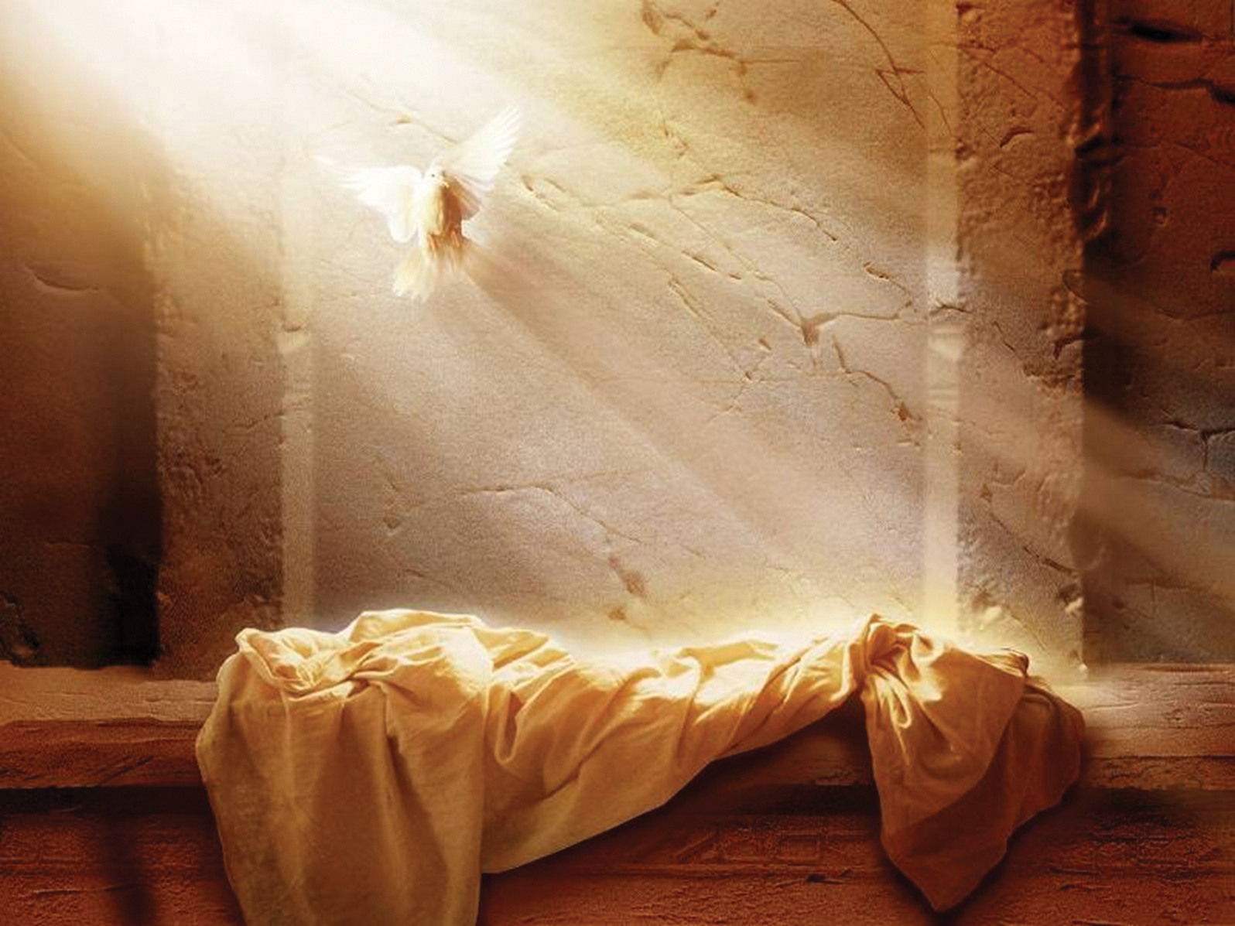
Old City and Kidron Valley from north
19 Your dead shall live; their bodies shall rise.
You who dwell in the dust, awake and sing for joy!
For your dew is a dew of light,
and the earth will give birth to the dead.
God’s Ultimate Victory:
Resurrection from the Dead!

Slide 43
Old City and Kidron Valley from north
God-Centered Waiting Is…
Finding our peace and security in God alone
Seeking God’s glory and God himself instead of a change in circumstances
Maintaining hope because God enables good in us and brings salvation to the world

Slide 44
Old City and Kidron Valley from north
Isaiah 26 – The People of God…
A Picture of God-Centered Waiting
Song of God’s people – 1-6
Isaiah’s Prayer
God-Centered Waiting – 7-11
God-Centered Perspective – 12-19
Isaiah’s Exhortation – 20-21

Slide 45
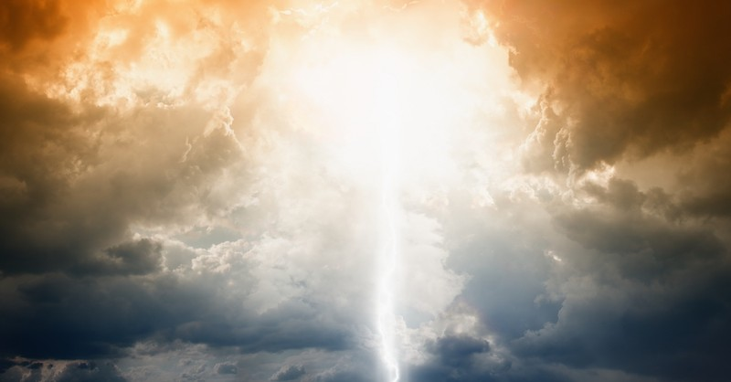
Old City and Kidron Valley from north
20 Come, my people, enter your chambers,
and shut your doors behind you;
hide yourselves for a little while
until the fury has passed by.
21 For behold, the Lord is coming out from his place
to punish the inhabitants of the earth for their iniquity,
and the earth will disclose the blood shed on it,
and will no more cover its slain.

Slide 46
Old City and Kidron Valley from north
20 Come, my people, enter your chambers,
and shut your doors behind you;
hide yourselves for a little while
until the fury has passed by.
21 For behold, the Lord is coming out from his place
to punish the inhabitants of the earth for their iniquity,
and the earth will disclose the blood shed on it,
and will no more cover its slain.
Picture:
Noah entering the ark

Slide 47
Old City and Kidron Valley from north
20 Come, my people, enter your chambers,
and shut your doors behind you;
hide yourselves for a little while
until the fury has passed by.
21 For behold, the Lord is coming out from his place
to punish the inhabitants of the earth for their iniquity,
and the earth will disclose the blood shed on it,
and will no more cover its slain.
Passover verb
Picture:
Noah entering the ark
Israelites staying inside while angel of death passed over

Slide 48
Old City and Kidron Valley from north
20 Come, my people, enter your chambers,
and shut your doors behind you;
hide yourselves for a little while
until the fury has passed by.
21 For behold, the Lord is coming out from his place
to punish the inhabitants of the earth for their iniquity,
and the earth will disclose the blood shed on it,
and will no more cover its slain.
What does verse 20 mean for us?
Jesus is our ark – He is our Passover lamb!

Slide 49
Old City and Kidron Valley from north
20 Come, my people, enter your chambers,
and shut your doors behind you;
hide yourselves for a little while
until the fury has passed by.
21 For behold, the Lord is coming out from his place
to punish the inhabitants of the earth for their iniquity,
and the earth will disclose the blood shed on it,
and will no more cover its slain.
God’s final victory over sin – goes right into chapter 27

Slide 50
Old City and Kidron Valley from north
God-Centered Waiting Is…
Finding our peace and security in God alone
Seeking God’s glory and God himself instead of a change in circumstances
Maintaining hope because God enables good in us and brings salvation to the world
Waiting in Christ for God’s certain victory

Slide 52
OT Preaching link at BibleStudyDownloads.org
Get this presentation for free!
Notes:
OT Preaching (op)

