Slide 1
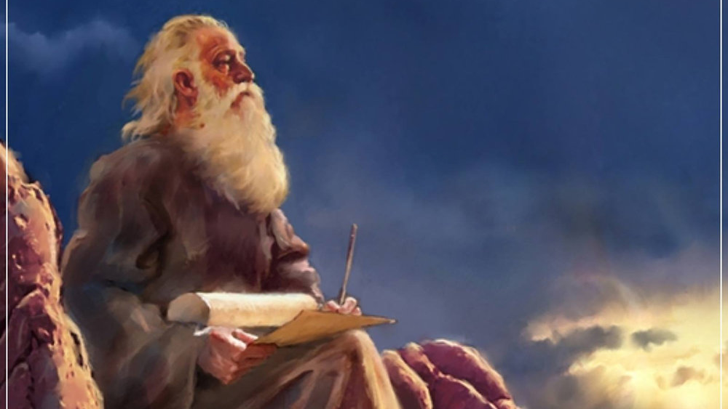
The Prophecy
Of
Isaiah
Isaiah 25
The City of God… For Those Who Need It!
Preached by Dan Bridges at Amman International Church Singapore • AmmanChurch.com Uploaded by Dr. Rick Griffith • Jordan Evangelical Theological Seminary Files in many languages for free download at BibleStudyDownloads.org

Slide 2
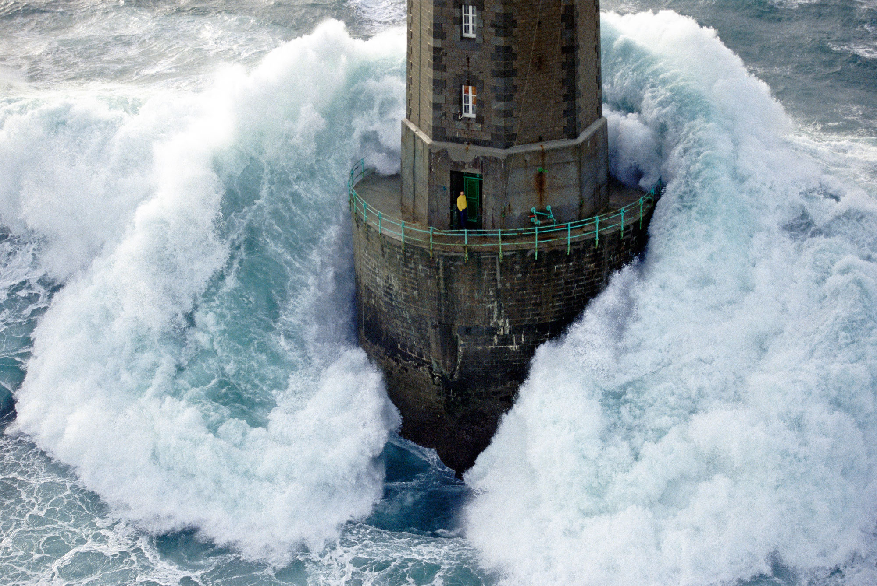
Old City and Kidron Valley from north
¹ God is our refuge and strength,
a very present help in trouble.
⁷ The Lord of hosts is with us;
the God of Jacob is our fortress.
Psalm 46:1,7
Who needs this message?

Slide 3
Old City and Kidron Valley from north
The person who takes refuge in God is the one who knows that their circumstances are beyond their own resources!
¹ God is our refuge and strength,
a very present help in trouble.
⁷ The Lord of hosts is with us;
the God of Jacob is our fortress.
Psalm 46:1,7
Is this your experience with God?

Slide 4
Isaiah 13-27: God’s Universal Kingdom
Chapters 13-23: 10 Oracles Regarding the Nations
Babylon (13:1-14:27)
Philistia (14:28-32)
Moab (15:1-16:14)
Syria/Israel/Cush (17:1-18:7)
Egypt (19:1-20:6)
Babylon (21:1-10)
Edom (21:11-12)
Arabia (21:13-17)
Jerusalem (22:1-25)
Tyre (23:1-18)
Chapter 24: Worldwide Judgment
Chapter 25: Fulfillment of God’s Plans
Chapter 26: The People of God
Chapter 27: Israel Fulfills its Purpose
Isaiah’s Mini Apocalypse

Slide 5
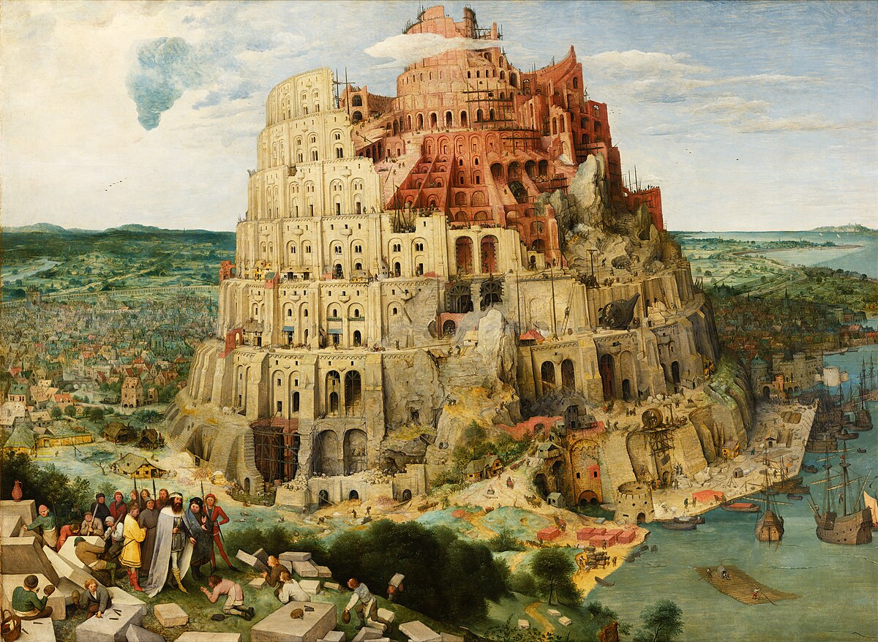
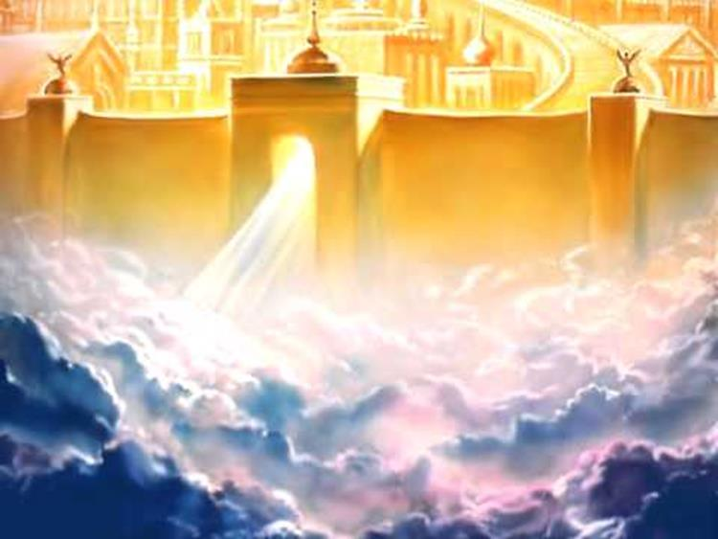
Two Cities
Of
Isaiah 24-27
City of Man
City of God
City of the nations
(Babylon, Tyre, Moab, etc.)
Characterized by pride and self-sufficiency
Represents man apart from God - Glorifies man
End is destruction
Mount Zion
(New Jerusalem)
Characterized by humility and dependence on God
Glorifies God
End is eternal glory

Slide 6
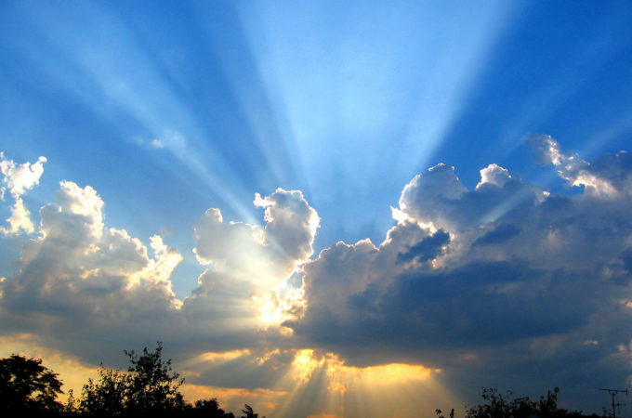
Old City and Kidron Valley from north
Isaiah 25 – Fulfillment of God’s Plans
Psalm of the City of God – Praising God for:
His Sovereign Plan Fulfilled – 1-5
His Eternal Blessings – 6-8
His Salvation – 9
His Victory Over the Proud – 10-12

Slide 7
Old City and Kidron Valley from north
1 O Lord, you are my God;
I will exalt you; I will praise your name,
for you have done wonderful things,
plans formed of old, faithful and sure.
Context from Chapter 24:
God’s judgment on the earth

Slide 8
Old City and Kidron Valley from north
1 O Lord, you are my God;
I will exalt you; I will praise your name,
for you have done wonderful things,
plans formed of old, faithful and sure.

Slide 9
Old City and Kidron Valley from north
1 O Lord, you are my God;
I will exalt you; I will praise your name,
for you have done wonderful things,
plans formed of old, faithful and sure.
Literally: “I will tell of your name.”

Slide 10
Old City and Kidron Valley from north
1 O Lord, you are my God;
I will exalt you; I will praise your name,
for you have done wonderful things,
plans formed of old, faithful and sure.
In both judgment and redemption, God is marching history forward according to his sovereign plans and will.

Slide 11
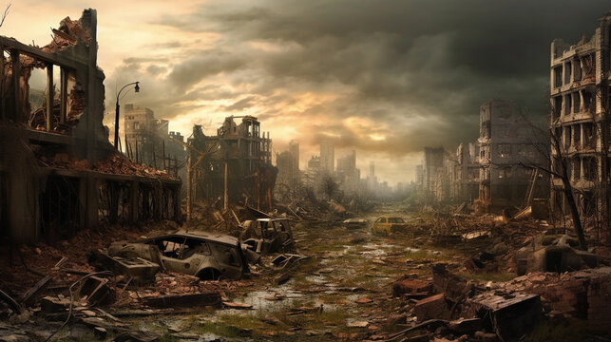
Old City and Kidron Valley from north
Example of God’s Faithful Fulfillment of His Plan: Destruction of Man’s City
² For you have made the city a heap,
the fortified city a ruin;
the foreigners' palace is a city no more;
it will never be rebuilt.
³ Therefore strong peoples will glorify you;
cities of ruthless nations will fear you.
Referring to Chapter 24

Slide 12
Old City and Kidron Valley from north
Example of God’s Faithful Fulfillment of His Plan: Destruction of Man’s City
Literally: “a city” (singular, indefinite)
City
Of
Man
² For you have made the city a heap,
the fortified city a ruin;
the foreigners' palace is a city no more;
it will never be rebuilt.
³ Therefore strong peoples will glorify you;
cities of ruthless nations will fear you.

Slide 13
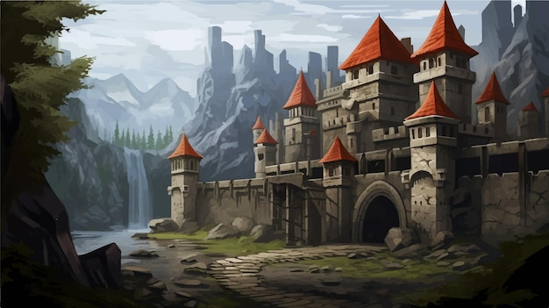
Old City and Kidron Valley from north
Example of God’s Faithful Fulfillment of His Plan: Protection of His People
Who are these poor and needy?
⁴ For you have been a stronghold to the poor,
a stronghold to the needy in his distress,
a shelter from the storm and a shade from the heat;
for the breath of the ruthless is like a storm against a wall,
⁵ like heat in a dry place.

Slide 14
Old City and Kidron Valley from north
Example of God’s Faithful Fulfillment of His Plan: Protection of His People
Who are these poor and needy?
Two Types of People in this Chapter:
The God-dependent experiencing the protection, care and salvation of God
The self-sufficient and proud experiencing the opposition and judgment of God

Slide 15
Old City and Kidron Valley from north
Example of God’s Faithful Fulfillment of His Plan: Protection of His People
Who are these poor and needy?
Two Types of People in this Chapter:
The God-dependent experiencing the protection, care and salvation of God
The self-sufficient and proud experiencing the opposition and judgment of God

Slide 16
Old City and Kidron Valley from north
Think about David’s Relationship with God from the Psalms
3:3 But you, O Lord, are a shield about me,
my glory, and the lifter of my head.
4:8 In peace I will both lie down and sleep;
for you alone, O Lord, make me dwell in safety.
6:4 Turn, O Lord, deliver my life;
save me for the sake of your steadfast love.
9:9 The Lord is a stronghold for the oppressed,
a stronghold in times of trouble.

Slide 17
Old City and Kidron Valley from north
Think about David’s Relationship with God from the Psalms
9:18 For the needy shall not always be forgotten,
and the hope of the poor shall not perish forever.
10:17 O Lord, you hear the desire of the afflicted;
you will strengthen their heart; you will incline your ear
16:1 Preserve me, O God, for in you I take refuge.
18:2 The Lord is my rock and my fortress and my deliverer,
my God, my rock, in whom I take refuge, my shield, and
the horn of my salvation, my stronghold.

Slide 18
Old City and Kidron Valley from north
The Poor and Needy are God’s People!
For the Lord takes pleasure in his people;
he adorns the humble (meek) with salvation.
Psalm 149:4
Blessed are the poor in spirit,
for theirs is the kingdom of heaven.
Blessed are those who mourn, for they shall be comforted.
Blessed are the meek, for they shall inherit the earth.
Matthew 5:3-5

Slide 19
Old City and Kidron Valley from north
The Poor and Needy are God’s People!
²⁶ For consider your calling, brothers: not many of you were wise according to worldly standards, not many were powerful, not many were of noble birth. ²⁷ But God chose what is foolish in the world to shame the wise; God chose what is weak in the world to shame the strong; ²⁸ God chose what is low and despised in the world, even things that are not, to bring to nothing things that are, ²⁹ so that no human being might boast in the presence of God.
1 Corinthians 1:26-29

Slide 20
Old City and Kidron Valley from north
Example of God’s Faithful Fulfillment of His Plan: Protection of His People
Protection from what/whom?
⁴ For you have been a stronghold to the poor,
a stronghold to the needy in his distress,
a shelter from the storm and a shade from the heat;
for the breath of the ruthless is like a storm against a wall,
⁵ like heat in a dry place.

Slide 21
Old City and Kidron Valley from north
Example of God’s Faithful Fulfillment of His Plan: Protection of His People
Protection from what/whom?
The “ruthless”… the godless, the proud, the strong, those who stand against God and his people
⁴ For you have been a stronghold to the poor,
a stronghold to the needy in his distress,
a shelter from the storm and a shade from the heat;
for the breath of the ruthless is like a storm against a wall,
⁵ like heat in a dry place.

Slide 22
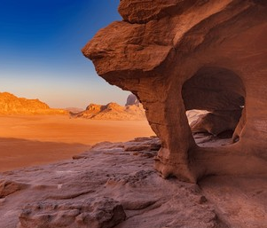
Old City and Kidron Valley from north
⁴ For you have been a stronghold to the poor,
a stronghold to the needy in his distress,
a shelter from the storm and a shade from the heat;
for the breath of the ruthless is like a storm against a wall,
⁵ like heat in a dry place.

Slide 23
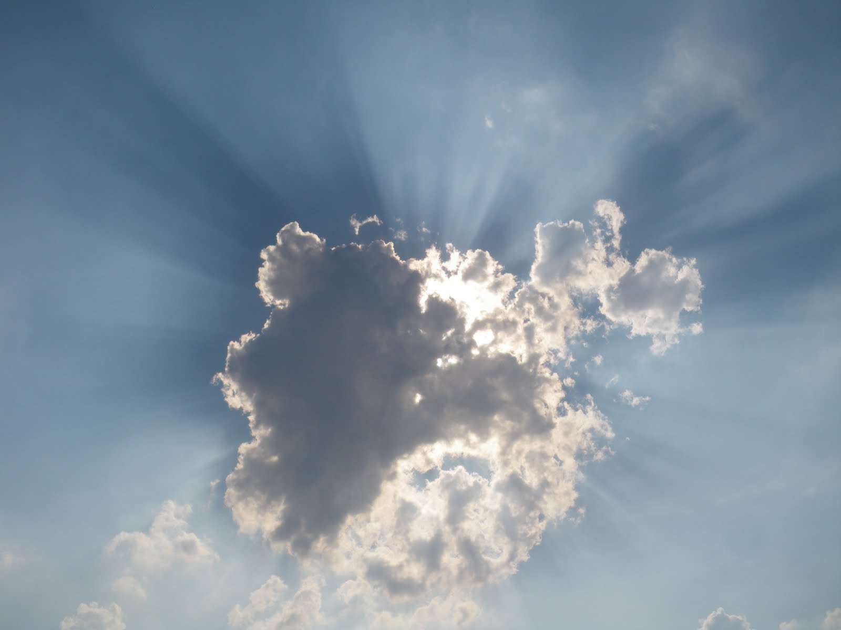
Old City and Kidron Valley from north
⁵ …You subdue the noise of the foreigners;
as heat by the shade of a cloud,
so the song of the ruthless is put down.

Slide 24
Old City and Kidron Valley from north
Example of God’s Faithful Fulfillment of His Plan: Protection of His People
⁴ For you have been a stronghold to the poor,
a stronghold to the needy in his distress,
a shelter from the storm and a shade from the heat;
for the breath of the ruthless is like a storm against a wall,
⁵ like heat in a dry place.
You subdue the noise of the foreigners;
as heat by the shade of a cloud,
so the song of the ruthless is put down.
One of God’s greatest works through history is his care for and protection of his people!

Slide 25
Old City and Kidron Valley from north
Isaiah 25 – Fulfillment of God’s Plans
Psalm of the City of God – Praising God for:
His Sovereign Plan Fulfilled – 1-5
His Eternal Blessings – 6-8
His Salvation – 9
His Victory Over the Proud – 10-12

Slide 26
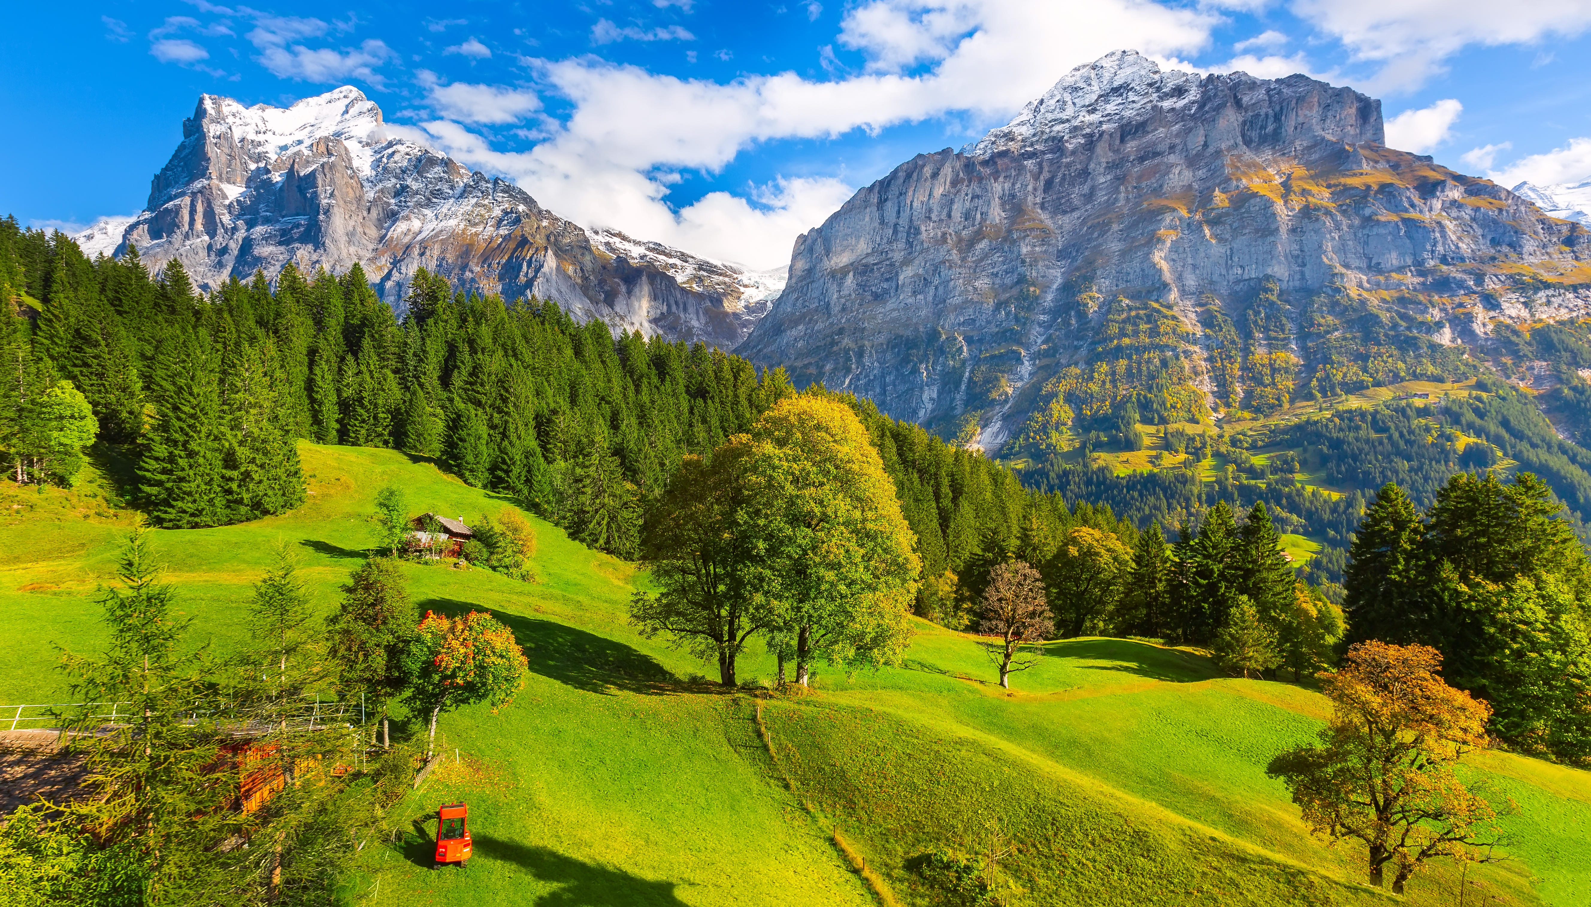
Old City and Kidron Valley from north
⁶ On this mountain the Lord of hosts
will make for all peoples
a feast of rich food,
a feast of well-aged wine,
of rich food full of marrow,
of aged wine well refined.

Slide 27
Old City and Kidron Valley from north
Then the moon will be confounded and the sun ashamed, for the Lord of hosts reigns on Mount Zion and in Jerusalem, and his glory will be before his elders. Isaiah 24:23
⁶ On this mountain the Lord of hosts
will make for all peoples
a feast of rich food,
a feast of well-aged wine,
of rich food full of marrow,
of aged wine well refined.

Slide 28
Old City and Kidron Valley from north
⁶ On this mountain the Lord of hosts
will make for all peoples
a feast of rich food,
a feast of well-aged wine,
of rich food full of marrow,
of aged wine well refined.

Slide 29
Old City and Kidron Valley from north
⁶ On this mountain the Lord of hosts
will make for all peoples
a feast of rich food,
a feast of well-aged wine,
of rich food full of marrow,
of aged wine well refined.

Slide 30
Old City and Kidron Valley from north
⁷ Let us rejoice and exult and give him the glory,
for the marriage of the Lamb has come,
and his Bride has made herself ready…
⁹ And the angel said to me, “Write this: Blessed are those who are invited to the marriage supper of the Lamb.” And he said to me, “These are the true words of God.”
Revelation 19:7,9

Slide 31
Old City and Kidron Valley from north
⁷ And he will swallow up on this mountain
the covering that is cast over all peoples,
the veil that is spread over all nations.
⁸ He will swallow up death forever;
and the Lord God will wipe away tears from all faces,
and the reproach of his people
he will take away from all the earth,
for the Lord has spoken.

Slide 32
Old City and Kidron Valley from north
³ And I heard a loud voice from the throne saying, “Behold, the dwelling place of God is with man. He will dwell with them, and they will be his people, and God himself will be with them as their God. ⁴ He will wipe away every tear from their eyes, and death shall be no more, neither shall there be mourning, nor crying, nor pain anymore, for the former things have passed away.”
Revelation 21:3-4

Slide 33
Old City and Kidron Valley from north
⁷ And he will swallow up on this mountain
the covering that is cast over all peoples,
the veil that is spread over all nations.
⁸ He will swallow up death forever;
and the Lord God will wipe away tears from all faces,
and the reproach of his people
he will take away from all the earth,
for the Lord has spoken.
Yahweh – Adonia
God of the Covenant – Lord of Heaven and Earth!

Slide 34
Old City and Kidron Valley from north
Isaiah 25 – Fulfillment of God’s Plans
Psalm of the City of God – Praising God for:
His Sovereign Plan Fulfilled – 1-5
His Eternal Blessings – 6-8
His Salvation – 9
His Victory Over the Proud – 10-12

Slide 35
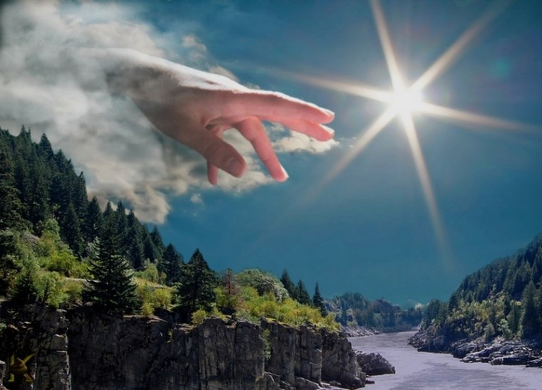
Old City and Kidron Valley from north
⁹ It will be said on that day,
“Behold, this is our God;
we have waited for him, that he might save us.
This is the Lord; we have waited for him;
let us be glad and rejoice in his salvation.”

Slide 36
Old City and Kidron Valley from north
⁹ It will be said on that day,
“Behold, this is our God;
we have waited for him, that he might save us.
This is the Lord; we have waited for him;
let us be glad and rejoice in his salvation.”

Slide 37
Old City and Kidron Valley from north
⁹ It will be said on that day,
“Behold, this is our God;
we have waited for him, that he might save us.
This is the Lord; we have waited for him;
let us be glad and rejoice in his salvation.”

Slide 38
Old City and Kidron Valley from north
Salvation:
Yeshua – Jesus!
⁹ It will be said on that day,
“Behold, this is our God;
we have waited for him, that he might save us.
This is the Lord; we have waited for him;
let us be glad and rejoice in his salvation.”

Slide 39
Old City and Kidron Valley from north
Isaiah 25 – Fulfillment of God’s Plans
Psalm of the City of God – Praising God for:
His Sovereign Plan Fulfilled – 1-5
His Eternal Blessings – 6-8
His Salvation – 9
His Victory Over the Proud – 10-12

Slide 40
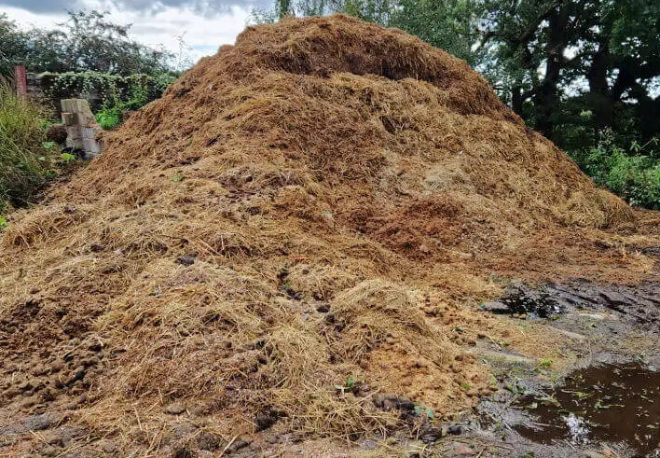
Old City and Kidron Valley from north
¹⁰ For the hand of the Lord will rest on this mountain,
and Moab shall be trampled down in his place,
as straw is trampled down in a dunghill.

Slide 41
Old City and Kidron Valley from north
Real enemy of God’s people…
But also representing the proud and arrogant in general
¹⁰ For the hand of the Lord will rest on this mountain,
and Moab shall be trampled down in his place,
as straw is trampled down in a dunghill.

Slide 42
Old City and Kidron Valley from north
¹¹ And he will spread out his hands in the midst of it
as a swimmer spreads his hands out to swim,
but the Lord will lay low his pompous pride
together with the skill of his hands.

Slide 43
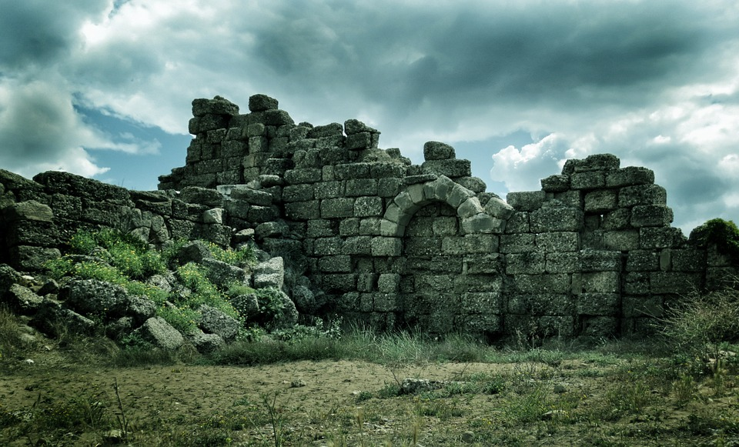
Old City and Kidron Valley from north
City
Of
Man
¹² And the high fortifications of his walls
he will bring down,
lay low, and cast to the ground, to the dust.

Slide 44
Old City and Kidron Valley from north
How is God’s Eternal City Relevant Today?
Those who have trusted in Jesus can already experience it!
Have you…
Experienced God’s provision and protection?
Tasted God’s goodness amidst the tears of life?
Waited for God and then seen him come through?

Slide 45
Old City and Kidron Valley from north
How is God’s Eternal City Relevant Today?
“Behold, this is our God;
we have waited for him, that he might save us.
This is the Lord; we have waited for him;
let us be glad and rejoice in his salvation.”
“Let us fix our eyes on Jesus, the author and perfecter of our faith…” Hebrews 12:2 (NIV)

Slide 47
OT Preaching link at BibleStudyDownloads.org
Get this presentation for free!
Notes:
OT Preaching (op)

