Slide 1
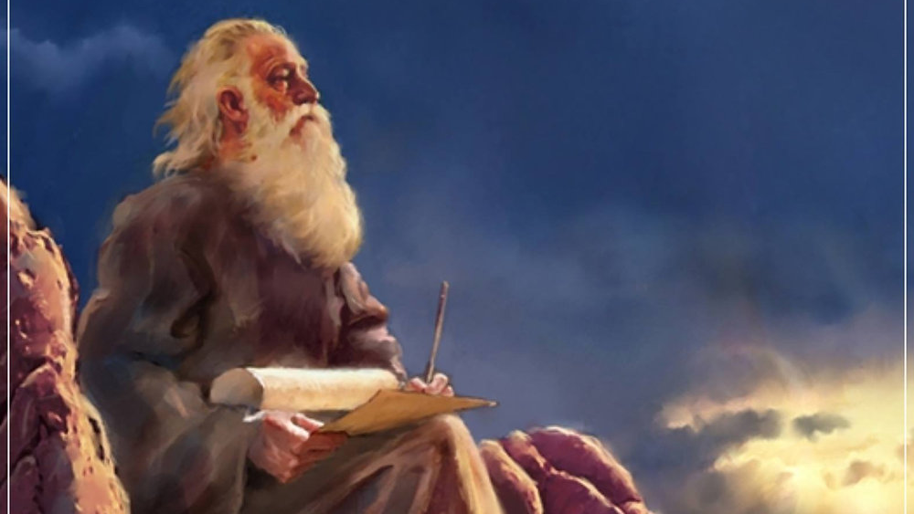
The Prophecy
Of
Isaiah
Isaiah 24
The Reality of God’s Wrath
Preached by Dan Bridges Amman International Church, Jordan (AmmanChurch.org) Uploaded by Dr. Rick Griffith • Jordan Evangelical Theological Seminary Files in many languages for free download at BibleStudyDownloads.org

Slide 2
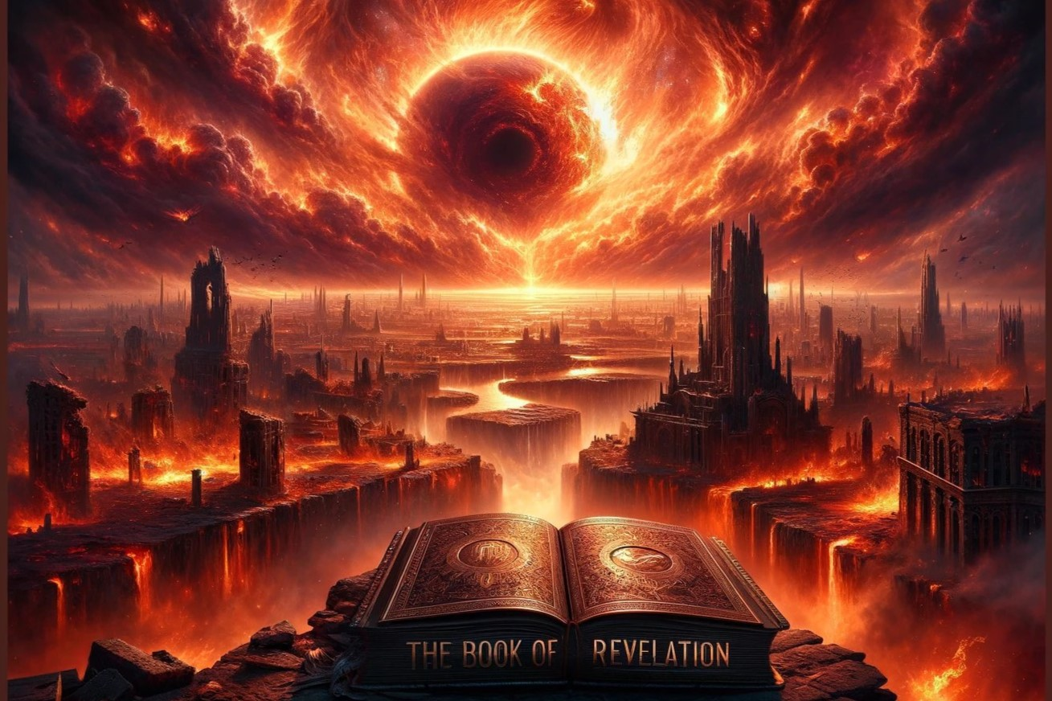
Old City and Kidron Valley from north
God’s wrath:
It is referred to over 600 times in the Old Testament in word or concept.
It is not God losing his temper!
It is God’s willful, chosen response against all that dishonors him, rebels against him or calls him into question.
How do you feel about God’s wrath and judgment?

Slide 3
Old City and Kidron Valley from north
God’s wrath:
It is a necessary act of God based on his absolute holiness and justice.
It is not until we understand God’s wrath that we can really understand the cross.
Distorting or diminishing God’s wrath distorts and diminishes the cross.
How do you feel about God’s wrath and judgment?

Slide 4
Old City and Kidron Valley from north
⁸ Come, behold the works of the Lord,
how he has brought desolations on the earth…
¹⁰ “Be still and know that I am God.
I will be exalted among the nations,
I will be exalted in the earth!”
Psalm 46:8, 10
How do you feel about God’s wrath and judgment?

Slide 5
Isaiah 13–27: God’s Universal Kingdom
Chapters 13–23: 10 Oracles Regarding the Nations
Babylon (13:1-14:27)
Philistia (14:28-32)
Moab (15:1–16:14)
Syria/Israel/Cush (17:1–18:7)
Egypt (19:1–20:6)
Babylon (21:1-10)
Edom (21:11-12)
Arabia (21:13-17)
Jerusalem (22:1-25)
Tyre (23:1-18)
Chapter 24: Worldwide Judgment
Chapter 25: Fulfillment of God’s Plans
Chapter 26: The People of God
Chapter 27: Israel Fulfills its Purpose
Isaiah’s Mini Apocalypse

Slide 6
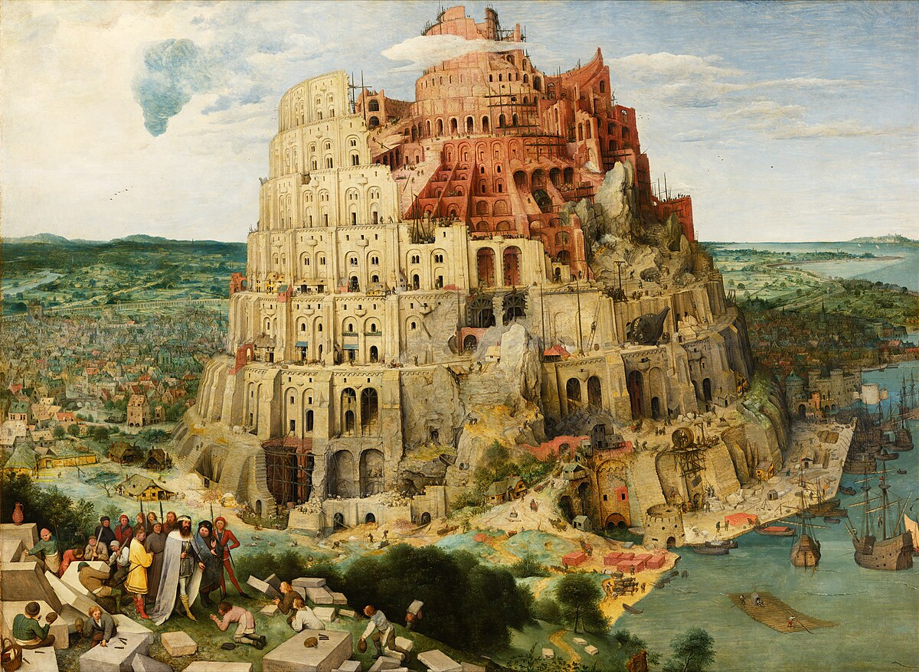
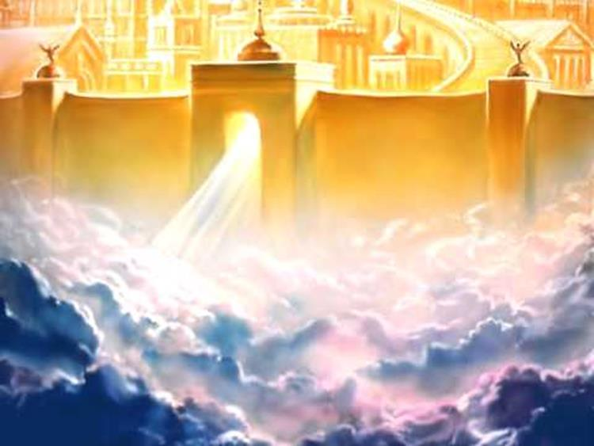
X
Two Cities
Of
Isaiah 24–27
City of Man
City of God
City of the Nations
(Babylon, Tyre, Moab, etc.)
Characterized by pride and self-sufficiency
Represents man apart from God - Glorifies man
End is destruction
Mount Zion
(New Jerusalem)
Characterized by humility and dependence on God
Glorifies God
End is eternal glory

Slide 7
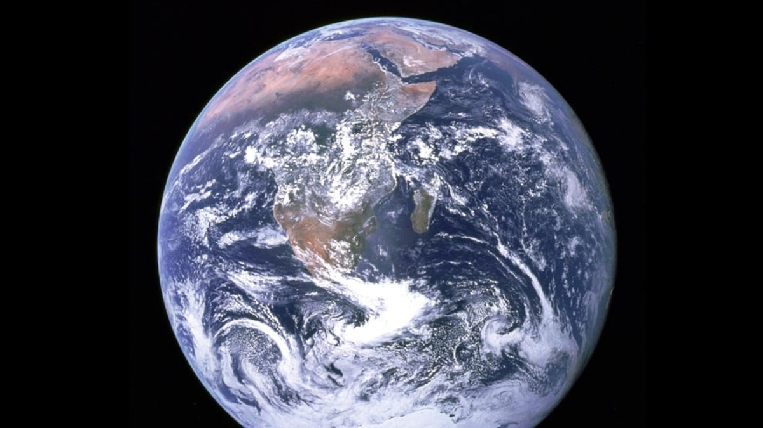
Old City and Kidron Valley from north
Isaiah 24 – God’s Worldwide Judgment
Divine Judgment Summarized (1-6)
Lament for the Ruined City (7-12)
Remnant’s Song of Praise (13-16a)
Divine Judgment Described (16b-23)

Slide 8
Old City and Kidron Valley from north
Isaiah 24 – God’s Worldwide Judgment
¹ Behold, the Lord will empty the earth and make it desolate, and he will twist its surface and scatter its inhabitants.
² And it shall be,
as with the people, so with the priest;
as with the slave, so with his master;
as with the maid, so with her mistress;
as with the buyer, so with the seller;
as with the lender, so with the borrower;
as with the creditor, so with the debtor.

Slide 9
Old City and Kidron Valley from north
Isaiah 24 – God’s Worldwide Judgment
¹ Behold, the Lord will empty the earth and make it desolate, and he will twist its surface and scatter its inhabitants.
² And it shall be,
as with the people, so with the priest;
as with the slave, so with his master;
as with the maid, so with her mistress;
as with the buyer, so with the seller;
as with the lender, so with the borrower;
as with the creditor, so with the debtor.

Slide 10
Old City and Kidron Valley from north
Isaiah 24 – God’s Worldwide Judgment
¹ Behold, the Lord will empty the earth and make it desolate, and he will twist its surface and scatter its inhabitants.
² And it shall be,
as with the people, so with the priest;
as with the slave, so with his master;
as with the maid, so with her mistress;
as with the buyer, so with the seller;
as with the lender, so with the borrower;
as with the creditor, so with the debtor.

Slide 11
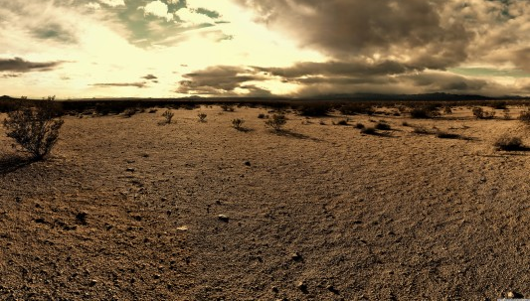
Old City and Kidron Valley from north
¹ Behold, the Lord will empty the earth and make it desolate, and he will twist its surface and scatter its inhabitants…
³ The earth shall be utterly empty and utterly plundered;
for the Lord has spoken this word.

Slide 12
Old City and Kidron Valley from north
¹ Behold, the Lord will empty the earth and make it desolate, and he will twist its surface and scatter its inhabitants…
³ The earth shall be utterly empty and utterly plundered;
for the Lord has spoken this word.

Slide 13
Old City and Kidron Valley from north
⁴ The earth mourns and withers;
the world languishes and withers;
the highest people of the earth languish.

Slide 14
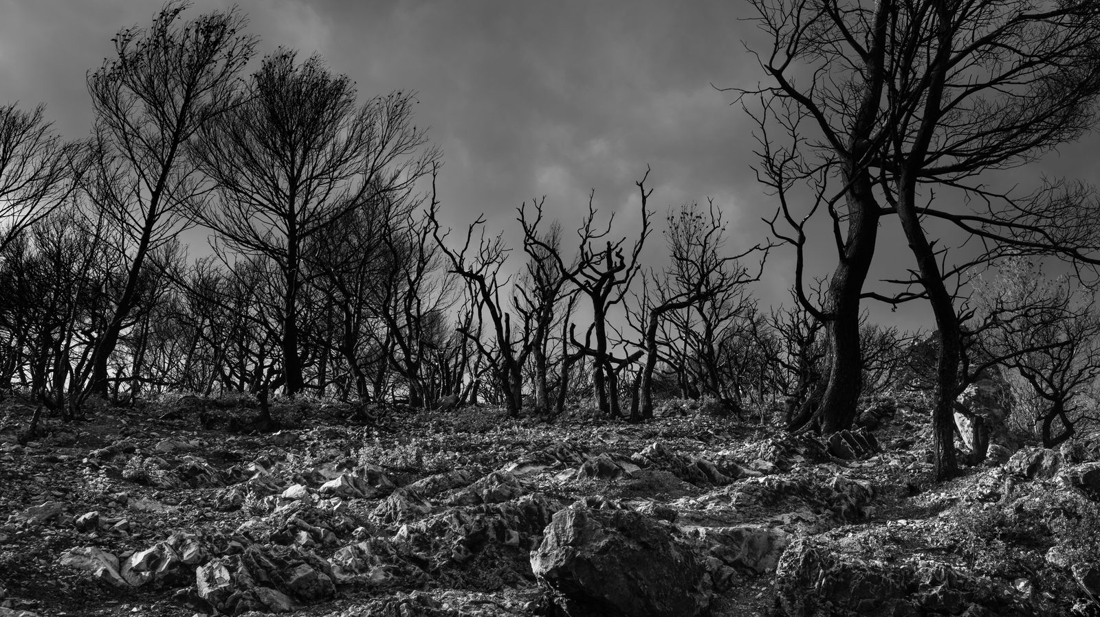
Old City and Kidron Valley from north
⁵ The earth lies defiled
under its inhabitants;
for they have transgressed the laws,
violated the statutes,
broken the everlasting covenant.

Slide 15
Old City and Kidron Valley from north
The difference between the human and the divine perspective on sin!
⁵ The earth lies defiled
under its inhabitants;
for they have transgressed the laws,
violated the statutes,
broken the everlasting covenant.

Slide 16
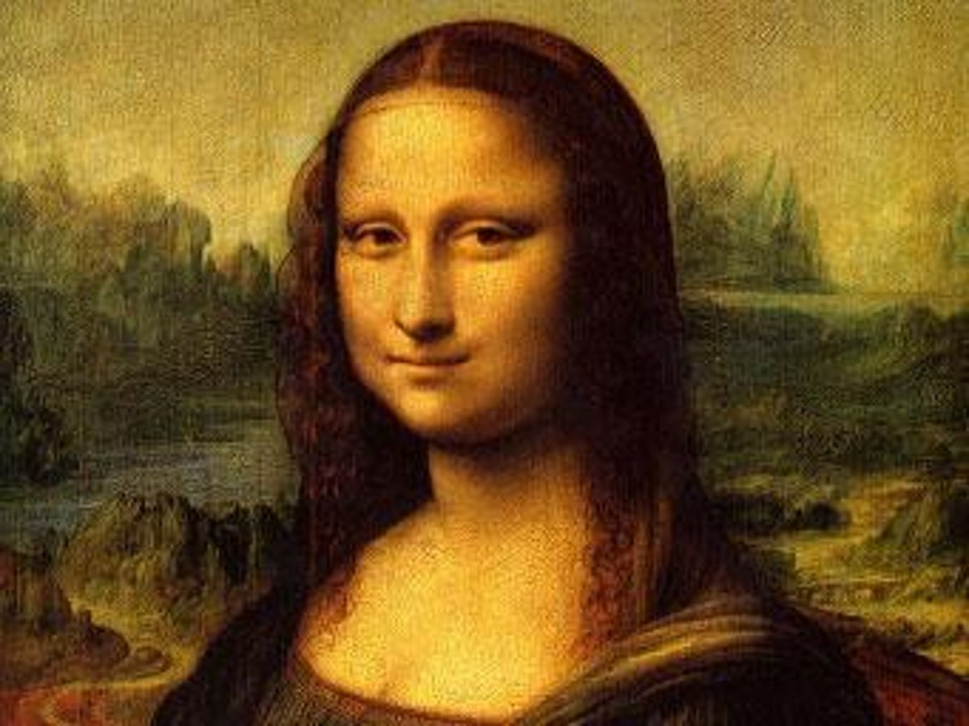
Old City and Kidron Valley from north
Defiled… Like an ink splotch that ruins a beautiful canvas or white dress!

Slide 17
Old City and Kidron Valley from north
The land becomes defiled / polluted by:
Sexual immorality (Leviticus 18:24-25)
Murder (Numbers 35:30-34)
Idolatry (Jeremiah 3:2, 9)
Forsaking God (Jeremiah 2:6-13)

Slide 18
Old City and Kidron Valley from north
Laws: God’s authoritative instruction
Charge #1: Refusal to live by divine
instruction
⁵ The earth lies defiled
under its inhabitants;
for they have transgressed the laws,
violated the statutes,
broken the everlasting covenant.

Slide 19
Old City and Kidron Valley from north
Violate: To alter/replace
Statutes: Carved/Engraved - Perpetual
Charge #2: Introducing a new standard
of morality
⁵ The earth lies defiled
under its inhabitants;
for they have transgressed the laws,
violated the statutes,
broken the everlasting covenant.

Slide 20
Old City and Kidron Valley from north
²⁹ They were filled with all manner of unrighteousness, evil, covetousness, malice. They are full of envy, murder, strife, deceit, maliciousness. They are gossips, ³⁰ slanderers, haters of God, insolent, haughty, boastful, inventors of evil, disobedient to parents, ³¹ foolish, faithless, heartless, ruthless…
Romans 1:29-31

Slide 21
Old City and Kidron Valley from north
Broken: To annul or nullify
Everlasting Covenant: Basic relationship
of God and man given to Adam
Charge #3: Not recognizing God as God
⁵ The earth lies defiled
under its inhabitants;
for they have transgressed the laws,
violated the statutes,
broken the everlasting covenant.

Slide 22
Old City and Kidron Valley from north
¹⁸ For the wrath of God is revealed from heaven against all ungodliness and unrighteousness of men, who by their unrighteousness suppress the truth.
Romans 1:18-21
¹⁹ For what can be known about God is plain to them, because God has shown it to them.
²⁰ For his invisible attributes, namely, his eternal power and divine nature, have been clearly perceived, ever since the creation of the world, in the things that have been made. So they are without excuse.
²¹ For although they knew God, they did not honor him as God or give thanks to him, but they became futile in their thinking, and their foolish hearts were darkened.

Slide 23
Old City and Kidron Valley from north
⁵ The earth lies defiled
under its inhabitants;
for they have transgressed the laws,
violated the statutes,
broken the everlasting covenant.

Slide 24
Old City and Kidron Valley from north
This is the horrible effect of our sin…
⁶ Therefore a curse devours the earth,
and its inhabitants suffer for their guilt;
therefore the inhabitants of the earth are scorched, and few men are left.

Slide 25
Old City and Kidron Valley from north
Reiterates the idea of the emptying of the earth from verses 1 and 3
Introduces the idea of a remnant
(not everyone will be wiped out)
⁶ Therefore a curse devours the earth,
and its inhabitants suffer for their guilt;
therefore the inhabitants of the earth are scorched, and few men are left.

Slide 26
Old City and Kidron Valley from north
Isaiah 24 – God’s Worldwide Judgment
Divine Judgment Summarized (1-6)
Lament for the Ruined City (7-12)
Remnant’s Song of Praise (13-16a)
Divine Judgment Described (16b-23)

Slide 27
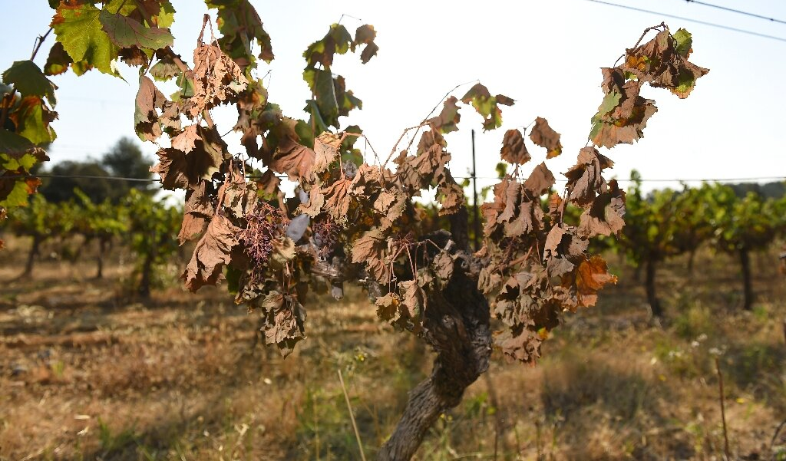
Old City and Kidron Valley from north
⁷ The wine mourns,
the vine languishes,
all the merry-hearted sigh.
⁸ The mirth of the tambourines is stilled,
the noise of the jubilant has ceased,
the mirth of the lyre is stilled.
⁹ No more do they drink wine with singing;
strong drink is bitter to those who drink it.

Slide 28
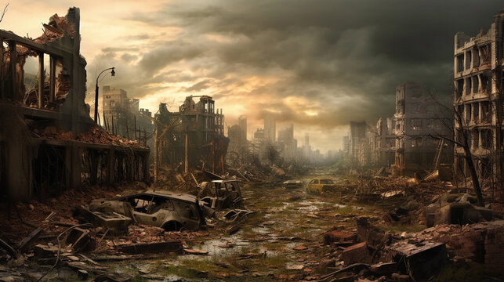
Old City and Kidron Valley from north
wasted city: Literally “formless city”
“The earth was formless and void…”
Genesis 1:2
¹⁰ The wasted city is broken down;
every house is shut up so that none can enter.
¹¹ There is an outcry in the streets for lack of wine;
all joy has grown dark;
the gladness of the earth is banished.
¹² Desolation is left in the city;
the gates are battered into ruins.

Slide 29
Old City and Kidron Valley from north
wasted city: Literally “formless city”
The city was lacking in meaning, purpose, stability and life.
¹⁰ The wasted city is broken down;
every house is shut up so that none can enter.
¹¹ There is an outcry in the streets for lack of wine;
all joy has grown dark;
the gladness of the earth is banished.
¹² Desolation is left in the city;
the gates are battered into ruins.

Slide 30
Old City and Kidron Valley from north
wasted city: Literally “formless city”
The city was lacking in meaning, purpose, stability and life.
City
Of
Man!
¹⁰ The wasted city is broken down;
every house is shut up so that none can enter.
¹¹ There is an outcry in the streets for lack of wine;
all joy has grown dark;
the gladness of the earth is banished.
¹² Desolation is left in the city;
the gates are battered into ruins.

Slide 31
Old City and Kidron Valley from north
Isaiah 24 – God’s Worldwide Judgment
Divine Judgment Summarized (1-6)
Lament for the Ruined City (7-12)
Remnant’s Song of Praise (13-16a)
Divine Judgment Described (16b-23)

Slide 32
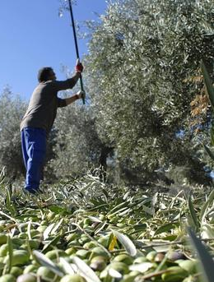
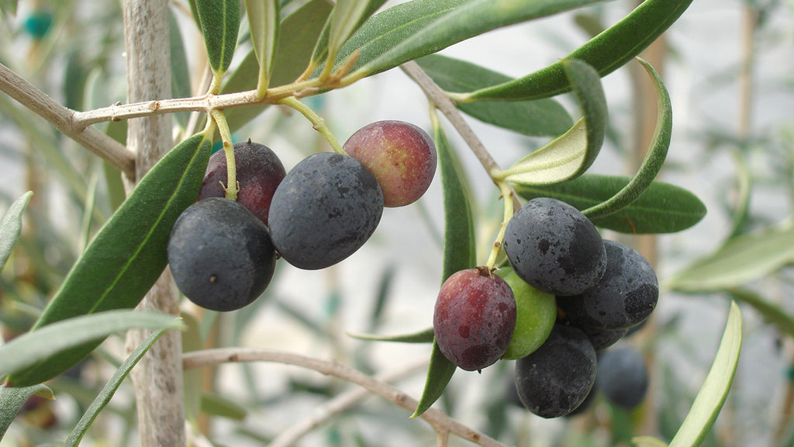
¹³ For thus it shall be in the midst of the earth
among the nations,
as when an olive tree is beaten,
as at the gleaning when the grape harvest is done.
Remnant!

Slide 33
¹³ For thus it shall be in the midst of the earth
among the nations,
as when an olive tree is beaten,
as at the gleaning when the grape harvest is done.
Worldwide
Remnant

Slide 34
Old City and Kidron Valley from north
Who is left?
People from all nations
¹⁴ They lift up their voices, they sing for joy;
over the majesty of the Lord they shout from the west.
¹⁵ Therefore in the east give glory to the Lord;
in the coastlands of the sea,
give glory to the name of the Lord, the God of Israel.
¹⁶ From the ends of the earth we hear songs of praise, of glory to the Righteous One.

Slide 35
Old City and Kidron Valley from north
Who is left?
People from all nations
People who are worshipping God!
¹⁴ They lift up their voices, they sing for joy;
over the majesty of the LORD they shout from the west.
¹⁵ Therefore in the east give glory to the LORD;
in the coastlands of the sea,
give glory to the name of the LORD, the God of Israel.
¹⁶ From the ends of the earth we hear songs of praise, of glory to the Righteous One.

Slide 36
Old City and Kidron Valley from north
These are not random people…
These are people who have trusted in Jesus’ death to save them from God’s wrath!
¹ Therefore, since we have been justified by faith, we have peace with God through our Lord Jesus Christ… ⁸ but God shows his love for us in that while we were still sinners, Christ died for us. ⁹ Since, therefore, we have now been justified by his blood, much more shall we be saved by him from the wrath of God.
Romans 5:1, 8-9

Slide 37
Old City and Kidron Valley from north
Why are they praising God?
Because of his majesty as shown in judgment and justice.
¹⁴ They lift up their voices, they sing for joy;
over the majesty of the LORD they shout from the west.
¹⁵ Therefore in the east give glory to the LORD;
in the coastlands of the sea,
give glory to the name of the LORD, the God of Israel.
¹⁶ From the ends of the earth we hear songs of praise, of glory to the Righteous One.

Slide 38
Old City and Kidron Valley from north
Isaiah 24 – God’s Worldwide Judgment
Divine Judgment Summarized (1-6)
Lament for the Ruined City (7-12)
Remnant’s Song of Praise (13-16a)
Divine Judgment Described (16b-23)

Slide 39
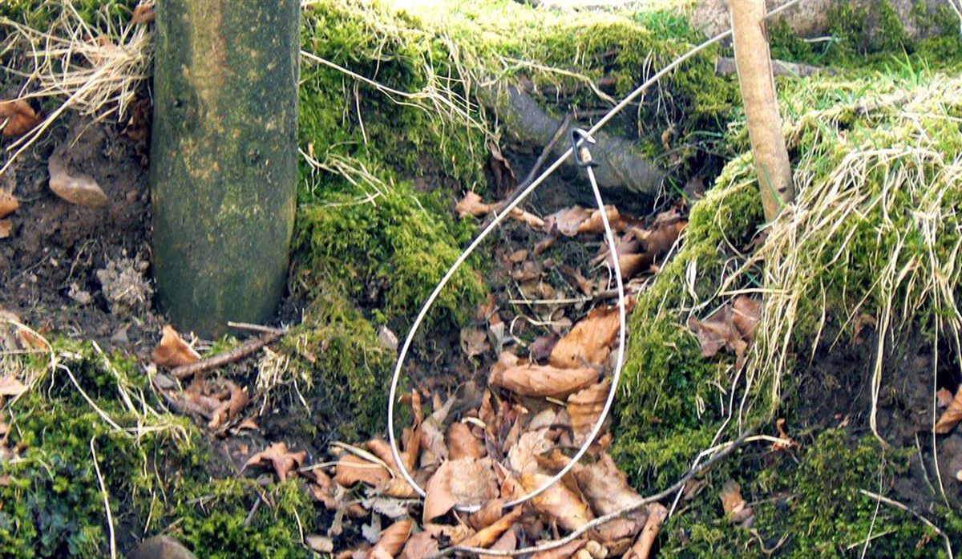
Old City and Kidron Valley from north
Isaiah is overwhelmed by the awfulness of sin around him and the necessary judgment it brings…
¹⁶ But I say, “I waste away,
I waste away. Woe is me!
For the traitors have betrayed,
with betrayal the traitors have betrayed.”

Slide 40
Old City and Kidron Valley from north
No escape from this judgment…
¹⁷ Terror and the pit and the snare
are upon you, O inhabitant of the earth!
¹⁸ He who flees at the sound of the terror
shall fall into the pit,
and he who climbs out of the pit
shall be caught in the snare.

Slide 41
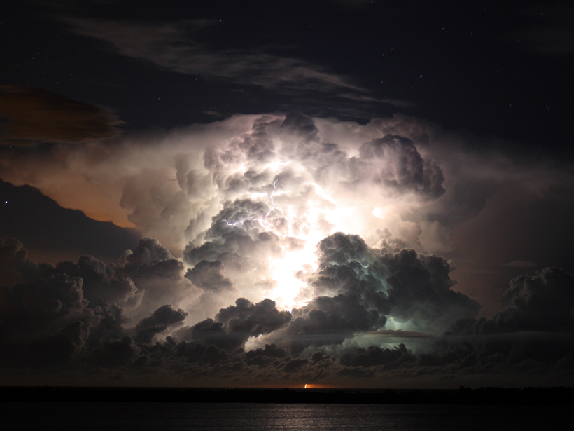
Old City and Kidron Valley from north
18 For the windows of heaven are opened,
and the foundations of the earth tremble.
Flood language from Genesis 7

Slide 42
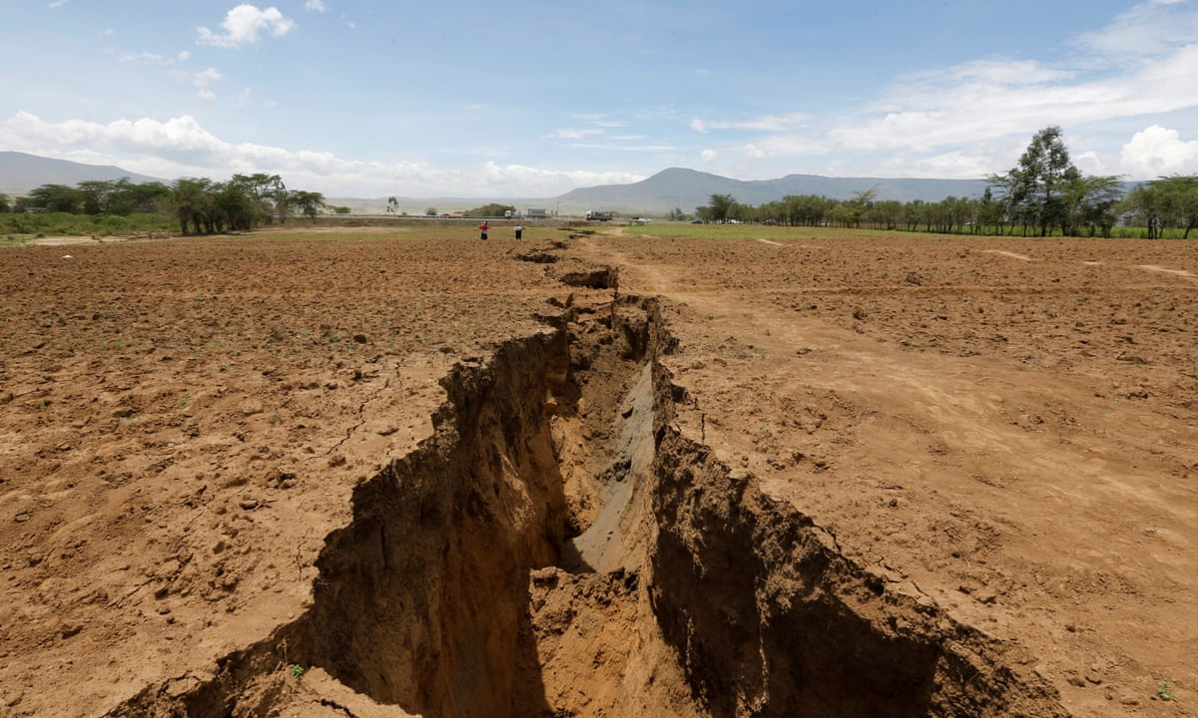
Old City and Kidron Valley from north
19 The earth is utterly broken,
the earth is split apart,
the earth is violently shaken.
20 The earth staggers like a drunken man;
it sways like a hut;
its transgression lies heavy upon it,
and it falls and will not rise again.
Great earthquake…
Revelation 16:18

Slide 43
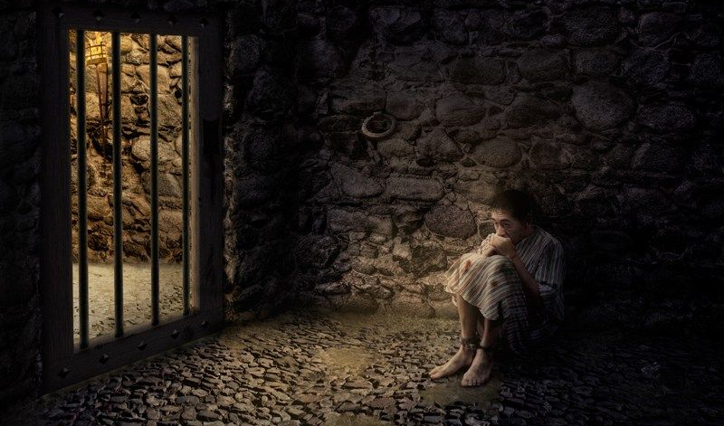
Old City and Kidron Valley from north
21 On that day the Lord will punish
the host of heaven, in heaven,
and the kings of the earth, on the earth.
22 They will be gathered together
as prisoners in a pit;
they will be shut up in a prison,
and after many days they will be punished.

Slide 44
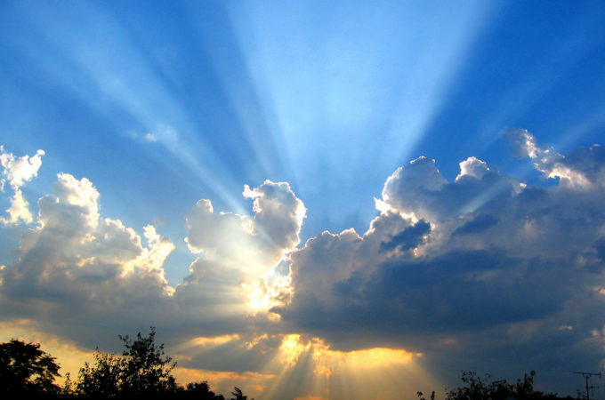
Old City and Kidron Valley from north
23 Then the moon will be confounded
and the sun ashamed,
for the Lord of hosts reigns
on Mount Zion and in Jerusalem,
and his glory will be before his elders.
The New Jerusalem – The City of God Established!

Slide 45
Old City and Kidron Valley from north
Isaiah 24 – God’s Worldwide Judgment
What can we learn from this chapter?
God calls us to live every day in the reality of his ultimate judgment!

Slide 46
Old City and Kidron Valley from north
Living in the Reality of God’s Judgment:
Reminding ourselves regularly of:
The awfulness of our sin before God
God’s necessary wrath poured out on Jesus on our behalf
Coming destruction of all this life has to offer (City of Man)

Slide 48
OT Preaching link at BibleStudyDownloads.org
Get this presentation for free!
Notes:
OT Preaching (op)

