Slide 1
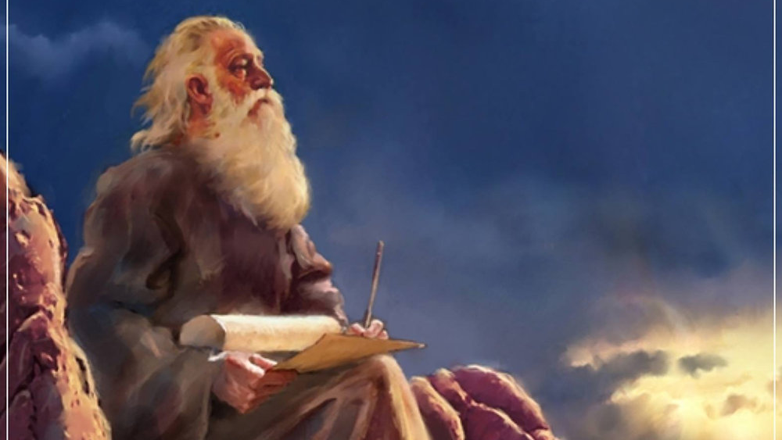
The Prophecy
Of
Isaiah
Isaiah 23
The Problem with Success
Preached by Dan Bridges Amman International Church, Jordan (AmmanChurch.org) Uploaded by Dr. Rick Griffith • Jordan Evangelical Theological Seminary Files in many languages for free download at BibleStudyDownloads.org

Slide 2
What would God say in a message to today’s most successful business leaders or wealthiest nations?

Slide 3
Isaiah 13-27: God’s Universal Kingdom
Chapters 13-23: 10 Oracles Regarding the Nations
Babylon (13:1-14:27)
Philistia (14:28-32)
Moab (15:1-16:14)
Syria/Israel/Cush (17:1-18:7)
Egypt (19:1-20:6)
Babylon (21:1-10)
Edom (21:11-12)
Arabia (21:13-17)
Jerusalem (22:1-25)
Tyre (23:1-18)
Chapter 24: Worldwide Judgment / A Remnant
Chapter 25: Fulfillment of God’s Plans
Chapter 26: The People of God
Chapter 27: Israel Fulfills its Purpose

Slide 4
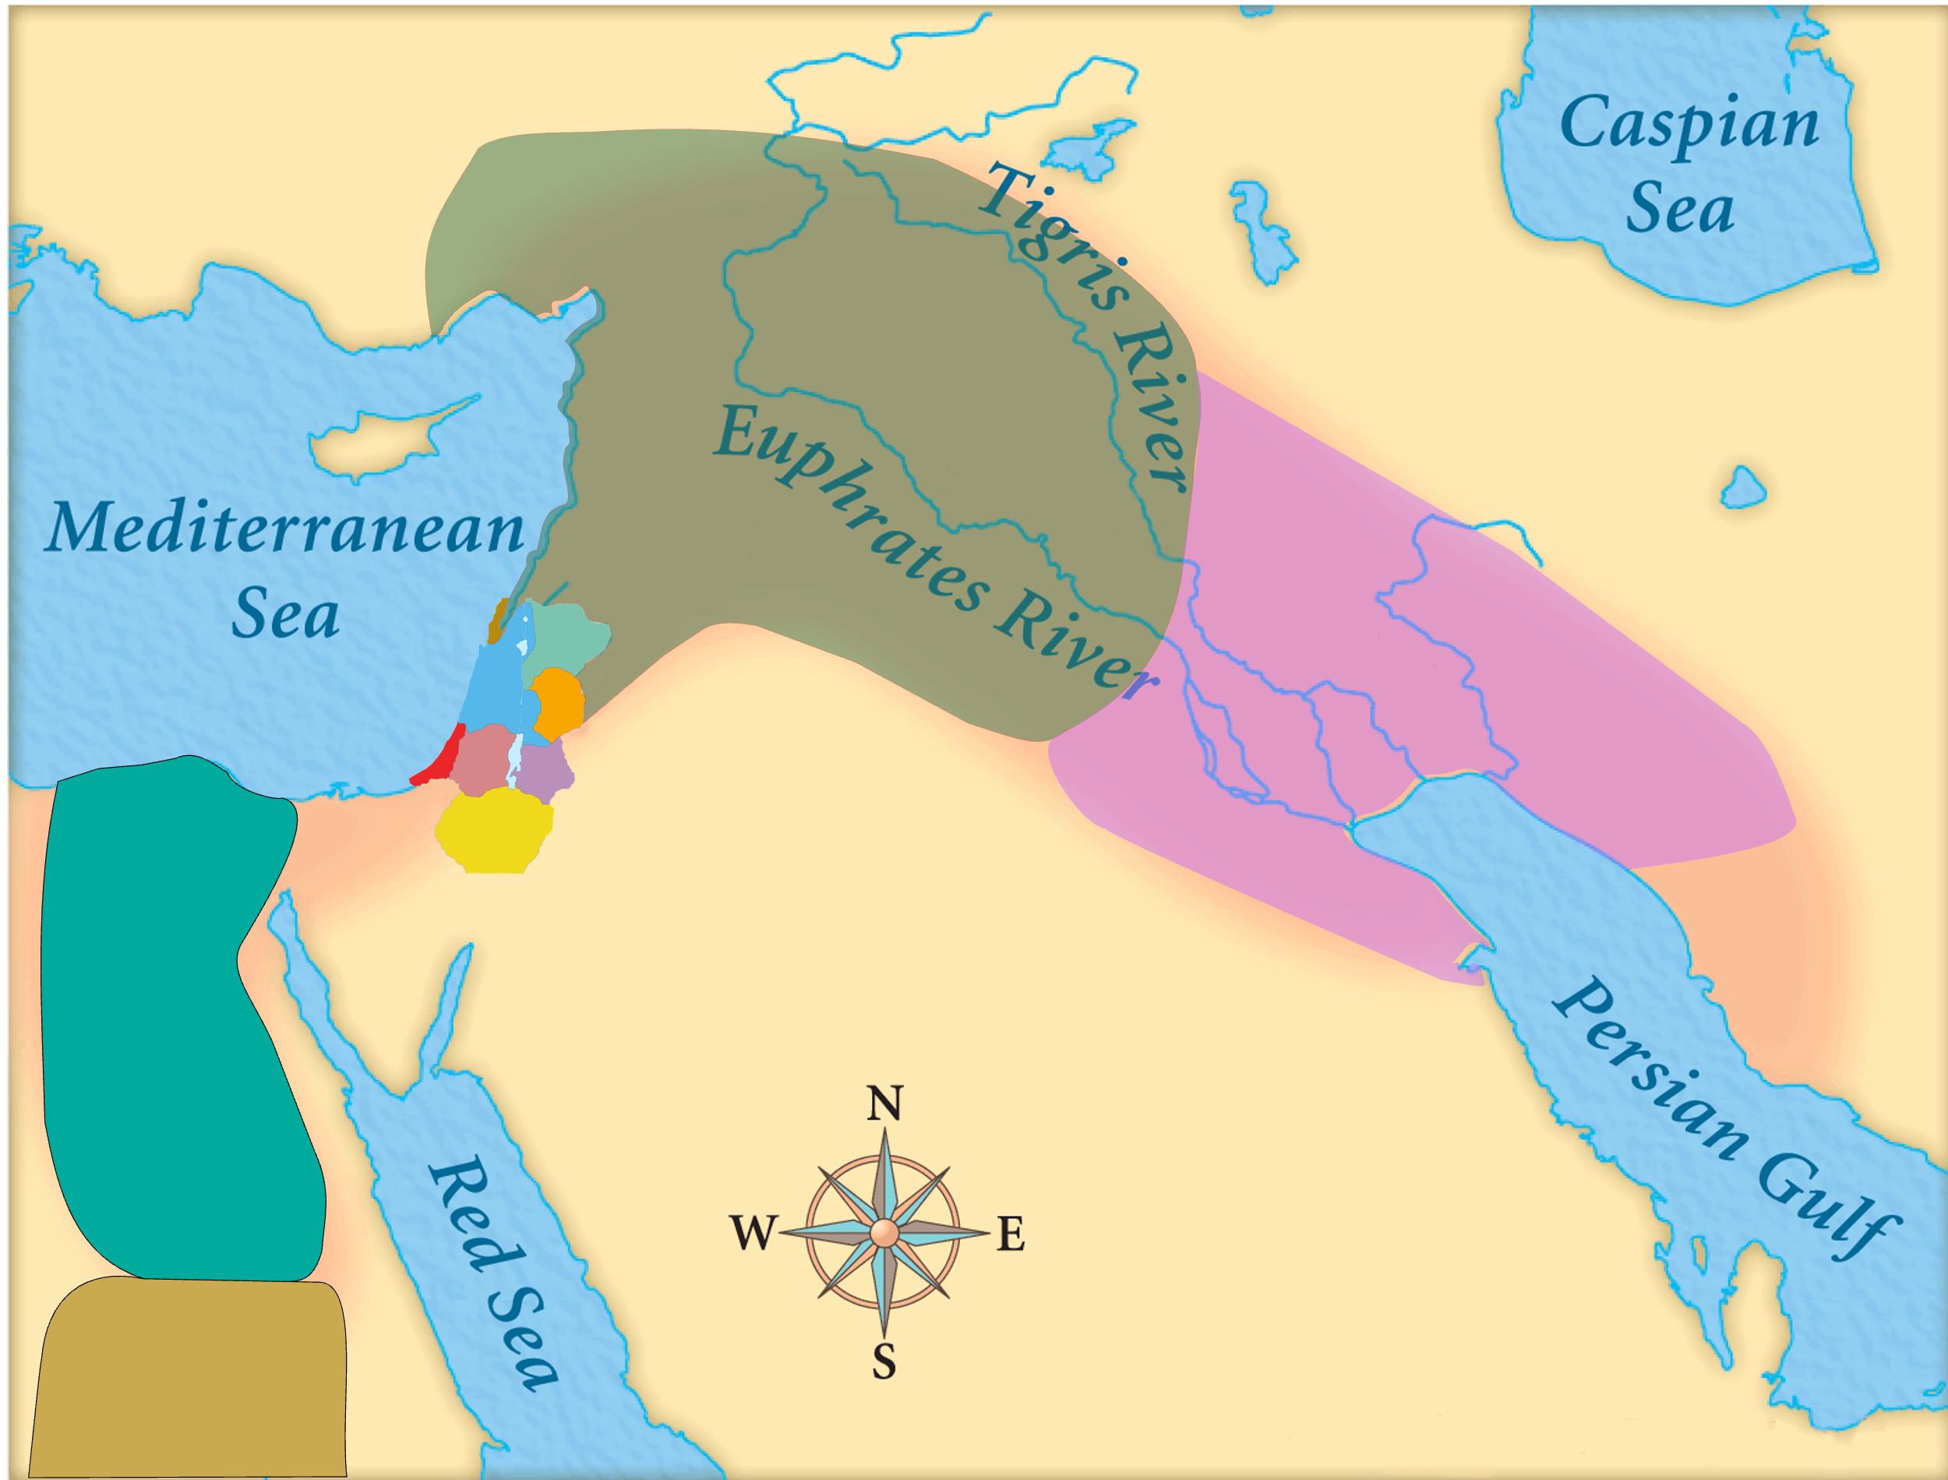
Assyria
Judah
Isaiah’s World
(~740BC)

Slide 5
Assyria
Phoenicia
Israel
Aram (Syria)
Babylon
Philistia
Judah
Moab
Edom
Egypt
Arabia
Isaiah’s World
(~740BC)
Cush

Slide 6
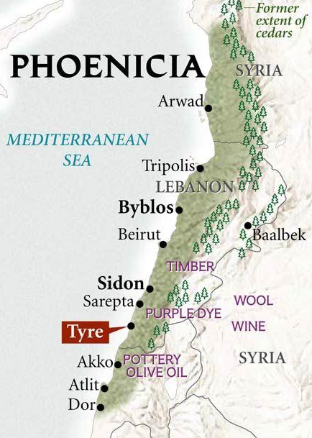
Old City and Kidron Valley from north
Phoenicia
(Canaan)
Sidon
Tyre
Sidon
Jerusalem
Tyre

Slide 7
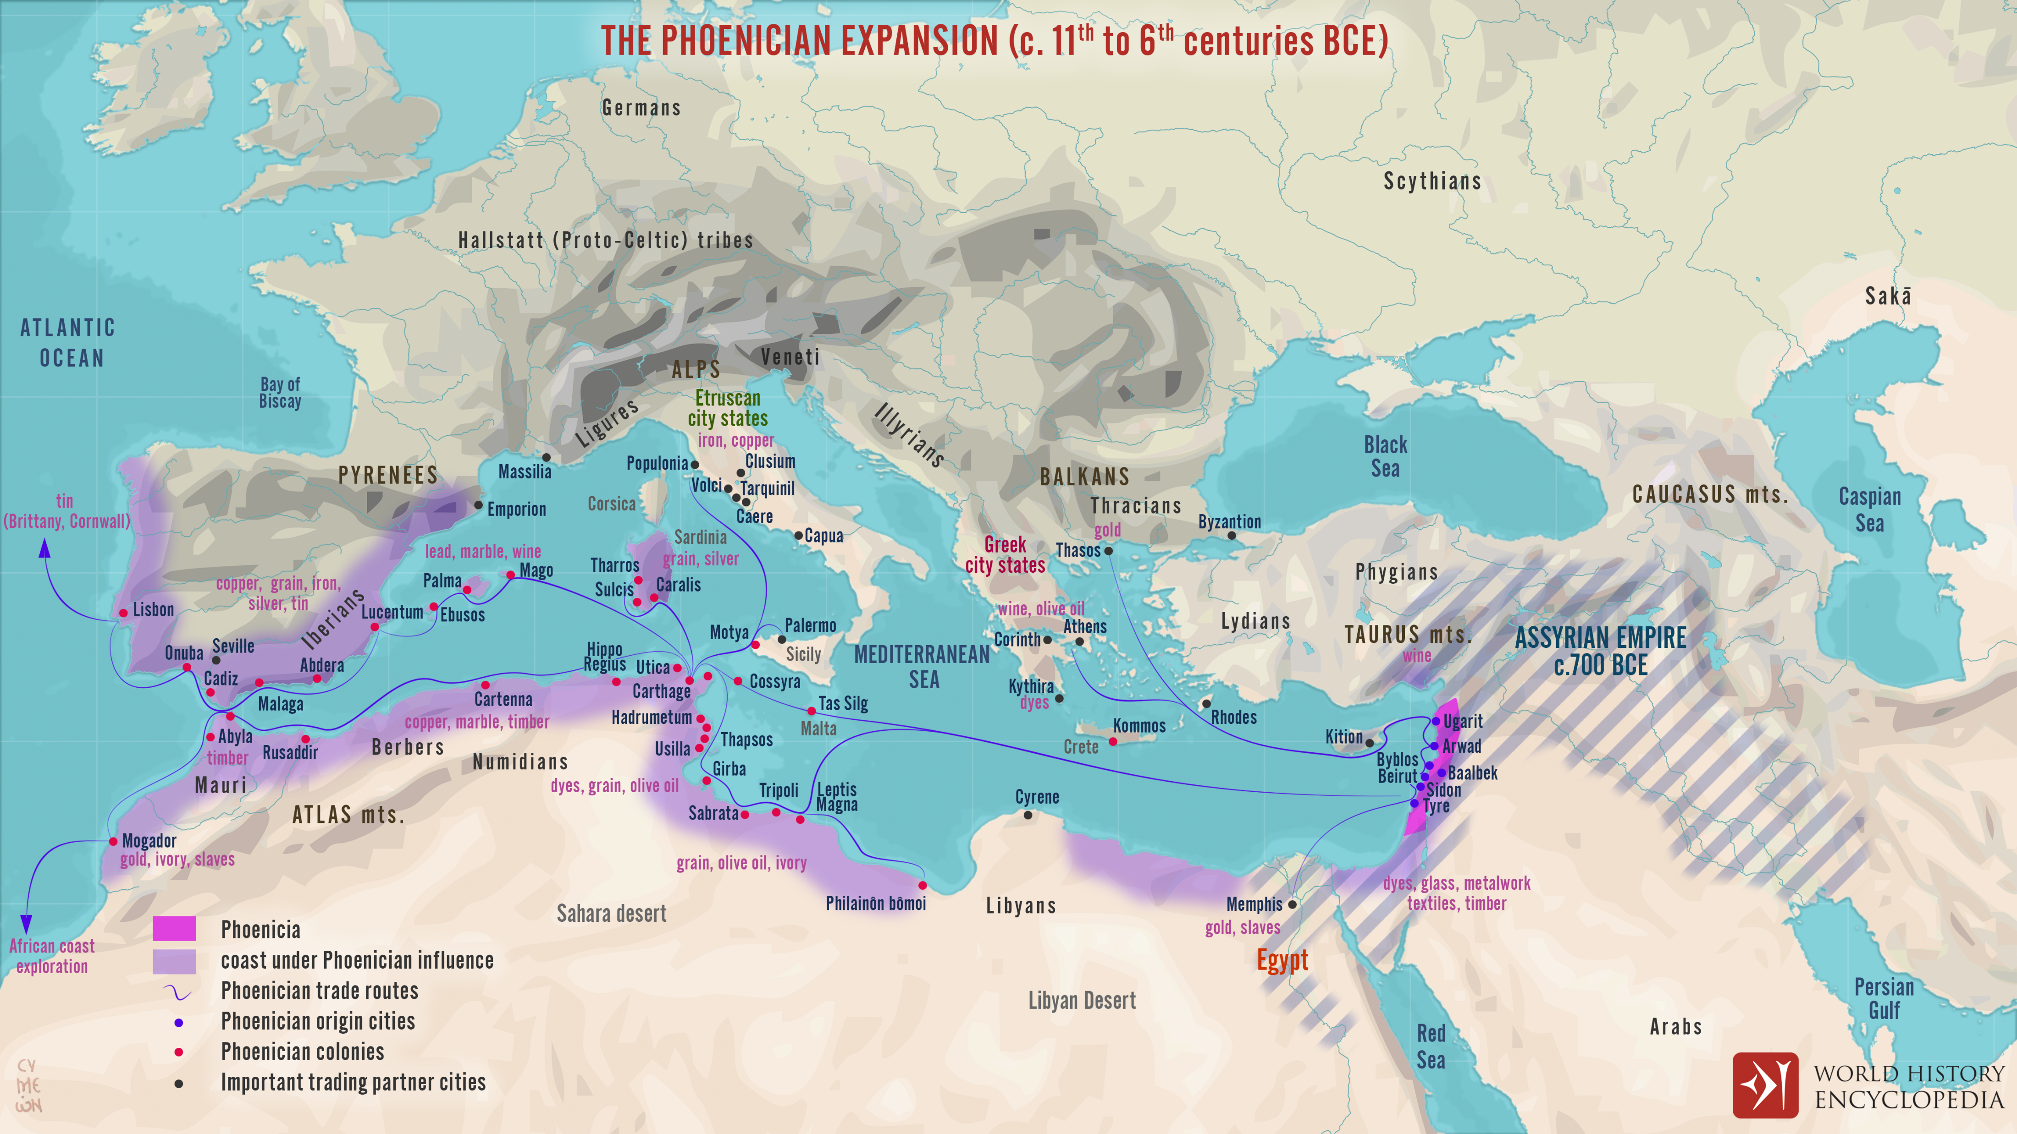
Old City and Kidron Valley from north
Phoenicia in Isaiah’s Time

Slide 8
Old City and Kidron Valley from north
Phoenicia in Isaiah’s Time
Assyria, Egypt, Babylon grew by force
Phoenicia grew by trade

Slide 9
Old City and Kidron Valley from north
Connections with Israel:
King Hiram supplied cedar for Solomon’s temple and palace
Birthplace of Queen Jezebel
Brought worship of Baal and Ashtoreth to Israel
Tyre corrupted nations by exporting her culture!
Phoenicia
(Canaan)
Sidon
Tyre

Slide 10
Old City and Kidron Valley from north
“It was trade, not conquest, which drove Tyrians; not lordship, but money…
Tyre represents the ways of the world exerting their influence.” Alec Motyer

Slide 11
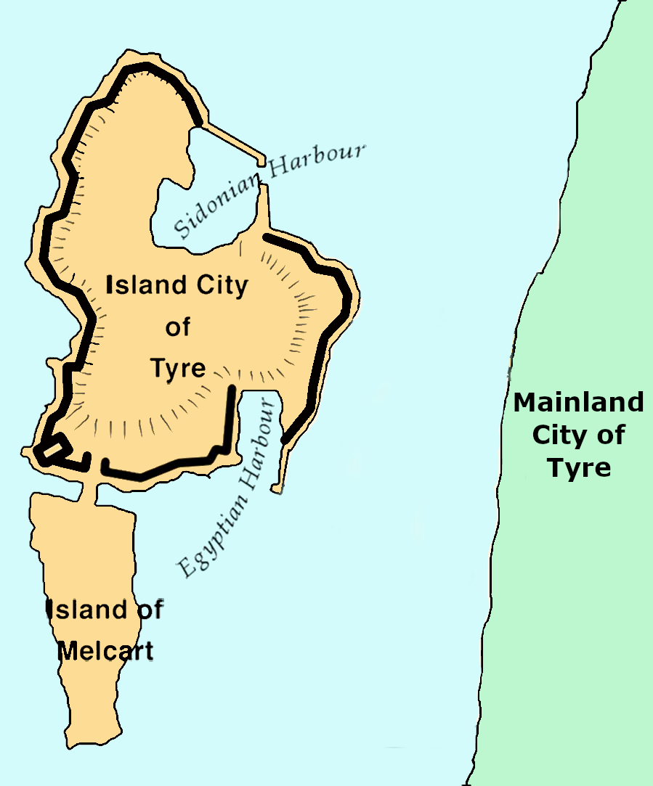
Old City and Kidron Valley from north
Ancient
Tyre
Ancient Tyre:
Mainland City
Island City

Slide 12
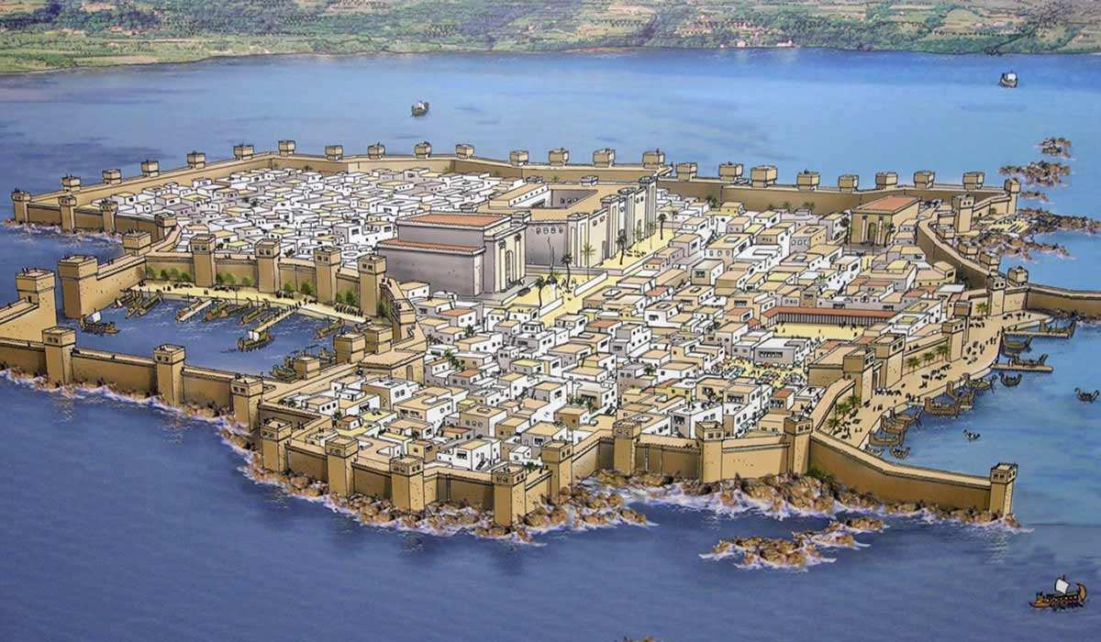
Old City and Kidron Valley from north

Slide 13
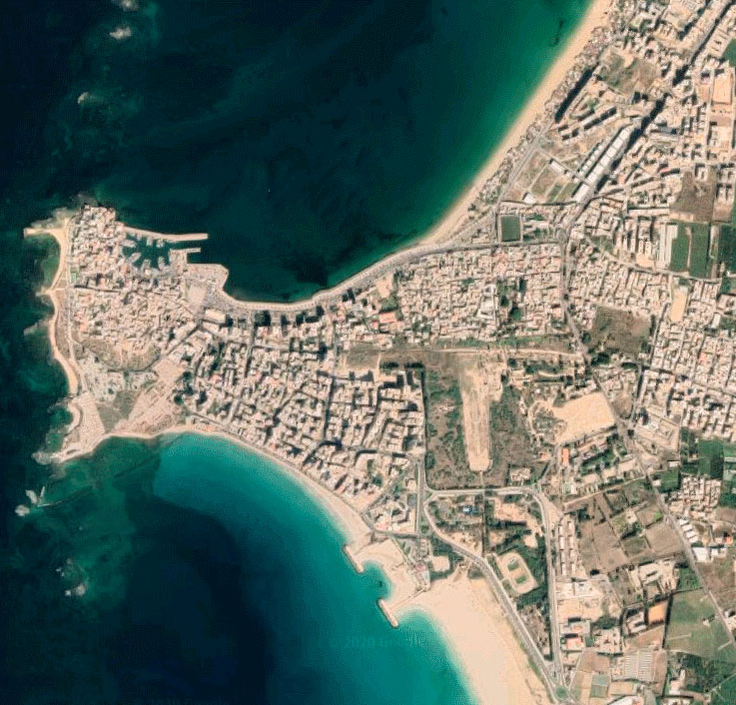
Old City and Kidron Valley from north
Ancient
Tyre
Modern-Day
Tyre
Ancient Tyre:
Mainland City
Island City

Slide 14
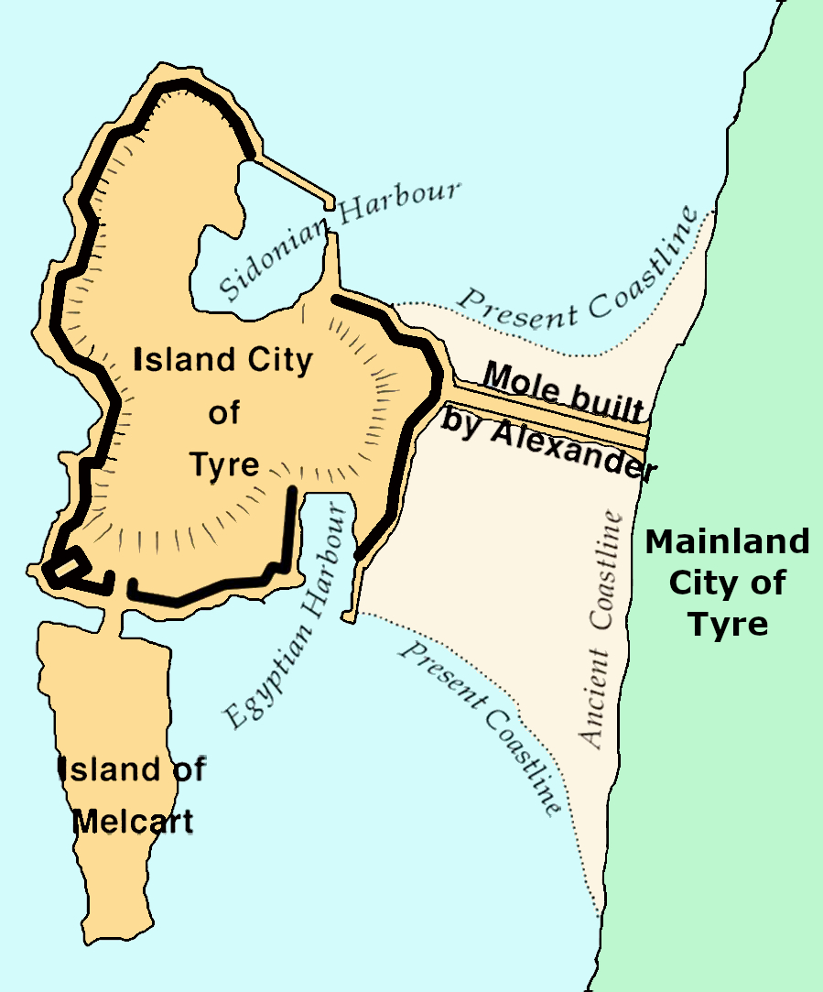
Old City and Kidron Valley from north
Modern-Day
Tyre
332 BC
Alexander
The Great

Slide 15
Old City and Kidron Valley from north
Modern-Day
Tyre
Mainland City Destroyed:
701 BC Sennacherib
586 BC Nebuchadnezzar
332 BC Alexander the Great

Slide 16
Old City and Kidron Valley from north
Island City Captured:
332 BC Alexander the Great

Slide 17
Old City and Kidron Valley from north
Most likely context for Isaiah 23
Mainland City Destroyed:
701 BC Sennacherib
586 BC Nebuchadnezzar
332 BC Alexander the Great

Slide 18
Old City and Kidron Valley from north
Oracle #10 – Tyre (Isaiah 23)
Two Main Sections:
Song of Lament over Tyre (1-14)
Call to Lament (1-7)
God’s Purposes (8-13)
Call to Lament (14)
Rise and Renewal of Tyre (15-18)

Slide 19
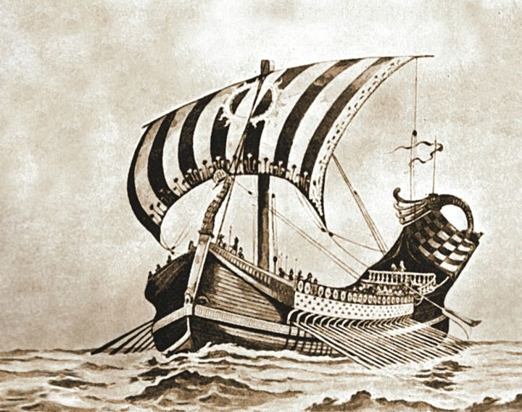
Old City and Kidron Valley from north
Oracle #10 – Tyre (Isaiah 23)
“Ships of Tarshish" refers not to ships from a particular location, but to a class of ships: large vessels for long-distance trade.
¹ The oracle concerning Tyre.
Wail, O ships of Tarshish,
for Tyre is laid waste, without house or harbor!
From the land of Cyprus it is revealed to them.
A Lament!

Slide 20
Old City and Kidron Valley from north
Oracle #10 – Tyre (Isaiah 23)
People of Tyre…
² Be still, O inhabitants of the coast;
the merchants of Sidon, who cross the sea, have
filled you.
³ And on many waters
your revenue was the grain of Shihor,
the harvest of the Nile;
you were the merchant of the nations.

Slide 21
Old City and Kidron Valley from north
Oracle #10 – Tyre (Isaiah 23)
² Be still, O inhabitants of the coast;
the merchants of Sidon, who cross the sea, have
filled you.
³ And on many waters
your revenue was the grain of Shihor,
the harvest of the Nile;
you were the merchant of the nations.
Greatness of Tyre…

Slide 22
Old City and Kidron Valley from north
Oracle #10 – Tyre (Isaiah 23)
Figurative lament of barrenness
Sea itself (sea has spoken) or
City of Tyre (stronghold of the sea)
⁴ Be ashamed, O Sidon, for the sea has spoken,
the stronghold of the sea, saying:
“I have neither labored nor given birth,
I have neither reared young men
nor brought up young women.”

Slide 23
Old City and Kidron Valley from north
Oracle #10 – Tyre (Isaiah 23)
⁵ When the report comes to Egypt,
they will be in anguish over the report about Tyre.
⁶ Cross over to Tarshish;
wail, O inhabitants of the coast!
⁷ Is this your exultant city
whose origin is from days of old,
whose feet carried her
to settle far away?
“Wall Street is gone!”

Slide 24
Old City and Kidron Valley from north
Oracle #10 – Tyre (Isaiah 23)
⁵ When the report comes to Egypt,
they will be in anguish over the report about Tyre.
⁶ Cross over to Tarshish;
wail, O inhabitants of the coast!
⁷ Is this your exultant city
whose origin is from days of old,
whose feet carried her
to settle far away?
Refugees

Slide 25
Old City and Kidron Valley from north
Oracle #10 – Tyre (Isaiah 23)
⁵ When the report comes to Egypt,
they will be in anguish over the report about Tyre.
⁶ Cross over to Tarshish;
wail, O inhabitants of the coast!
⁷ Is this your exultant city
whose origin is from days of old,
whose feet carried her
to settle far away?
Merchant colonies

Slide 26
Old City and Kidron Valley from north
Oracle #10 – Tyre (Isaiah 23)
Two Main Sections:
Song of Lament over Tyre (1-14)
Call to Lament (1-7)
God’s Purposes (8-13)
Call to Lament (14)
Rise and Renewal of Tyre (15-18)

Slide 27
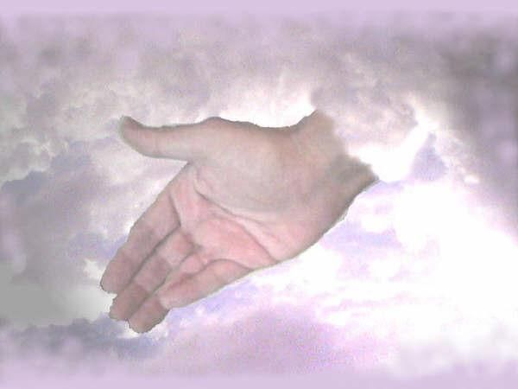
Old City and Kidron Valley from north
Oracle #10 – Tyre (Isaiah 23)
Tyre established colonies and appointed Kings over them…
⁸ Who has purposed this
against Tyre, the bestower of crowns,
whose merchants were princes,
whose traders were the honored of the earth?
⁹ The Lord of hosts has purposed it,
to defile the pompous pride of all glory,
to dishonor all the honored of the earth.

Slide 28
Old City and Kidron Valley from north
Oracle #10 – Tyre (Isaiah 23)
God was going to destroy them due to their pride!
⁸ Who has purposed this
against Tyre, the bestower of crowns,
whose merchants were princes,
whose traders were the honored of the earth?
⁹ The Lord of hosts has purposed it,
to defile the pompous pride of all glory,
to dishonor all the honored of the earth.

Slide 29
Old City and Kidron Valley from north
Oracle #10 – Tyre (Isaiah 23)
Why was God so concerned about pride?
⁸ Who has purposed this
against Tyre, the bestower of crowns,
whose merchants were princes,
whose traders were the honored of the earth?
⁹ The Lord of hosts has purposed it,
to defile the pompous pride of all glory,
to dishonor all the honored of the earth.

Slide 30
Old City and Kidron Valley from north
⁴ by your wisdom and your understanding
you have made wealth for yourself,
and have gathered gold and silver into your treasuries;
⁵ by your great wisdom in your trade
you have increased your wealth,
and your heart has become proud in your wealth—
⁶ therefore thus says the Lord God:
Because you make your heart like the heart of a god,
⁷ therefore, behold, I will bring foreigners upon you,
the most ruthless of the nations;
and they shall draw their swords against the beauty of your wisdom and defile your splendor. Ezekiel 28:4-7

Slide 31
Old City and Kidron Valley from north
Oracle #10 – Tyre (Isaiah 23)
No longer in control over her colonies…
¹⁰ Cross over your land like the Nile,
O daughter of Tarshish;
there is no restraint anymore.
¹¹ He has stretched out his hand over the sea;
he has shaken the kingdoms;
the Lord has given command concerning Canaan
to destroy its strongholds.

Slide 32
Old City and Kidron Valley from north
Oracle #10 – Tyre (Isaiah 23)
¹⁰ Cross over your land like the Nile,
O daughter of Tarshish;
there is no restraint anymore.
¹¹ He has stretched out his hand over the sea;
he has shaken the kingdoms;
the Lord has given command concerning Canaan
to destroy its strongholds.

Slide 33
Old City and Kidron Valley from north
Oracle #10 – Tyre (Isaiah 23)
Refugees fleeing, but not finding rest…
¹² And he said:
“You will no more exult,
O oppressed virgin daughter of Sidon;
arise, cross over to Cyprus,
even there you will have no rest.”

Slide 34
Old City and Kidron Valley from north
Oracle #10 – Tyre (Isaiah 23)
Look what the Assyrians did to the Chaldeans… and fear!
¹³ Behold the land of the Chaldeans! This is the people that was not; Assyria destined it for wild beasts. They erected their siege towers, they stripped her palaces bare, they made her a ruin.

Slide 35
Old City and Kidron Valley from north
Oracle #10 – Tyre (Isaiah 23)
God was going to use ordinary human means
¹³ Behold the land of the Chaldeans! This is the people that was not; Assyria destined it for wild beasts. They erected their siege towers, they stripped her palaces bare, they made her a ruin.

Slide 36
Old City and Kidron Valley from north
Oracle #10 – Tyre (Isaiah 23)
Two Main Sections:
Song of Lament over Tyre (1-14)
Call to Lament (1-7)
God’s Purposes (8-13)
Call to Lament (14)
Rise and Renewal of Tyre (15-18)

Slide 37
Old City and Kidron Valley from north
Oracle #10 – Tyre (Isaiah 23)
¹ Wail, O ships of Tarshish, for Tyre is laid waste, without house or harbor!
¹⁴ Wail, O ships of Tarshish, for your stronghold is laid waste.

Slide 38
Old City and Kidron Valley from north
Oracle #10 – Tyre (Isaiah 23)
Two Main Sections:
Song of Lament over Tyre (1-14)
Call to Lament (1-7)
God’s Purposes (8-13)
Call to Lament (14)
Rise and Renewal of Tyre (15-18)

Slide 39
Old City and Kidron Valley from north
Oracle #10 – Tyre (Isaiah 23)
¹⁵ In that day Tyre will be forgotten for seventy years, like the days of one king. At the end of seventy years, it will happen to Tyre as in the song of the prostitute:
¹⁶ “Take a harp; go about the city,
O forgotten prostitute!
Make sweet melody; sing many songs,
that you may be remembered.”
¹⁷ At the end of seventy years, the Lord will visit Tyre, and she will return to her wages and will prostitute herself with all the kingdoms of the world on the face of the earth.

Slide 40
Old City and Kidron Valley from north
Oracle #10 – Tyre (Isaiah 23)
701 BC – Sennacherib destroyed mainland city
¹⁵ In that day Tyre will be forgotten for seventy years, like the days of one king. At the end of seventy years, it will happen to Tyre as in the song of the prostitute:
¹⁶ “Take a harp; go about the city,
O forgotten prostitute!
Make sweet melody; sing many songs,
that you may be remembered.”
¹⁷ At the end of seventy years, the Lord will visit Tyre, and she will return to her wages and will prostitute herself with all the kingdoms of the world on the face of the earth.

Slide 41
Old City and Kidron Valley from north
Oracle #10 – Tyre (Isaiah 23)
701 BC – Sennacherib destroyed mainland city
¹⁵ In that day Tyre will be forgotten for seventy years, like the days of one king. At the end of seventy years, it will happen to Tyre as in the song of the prostitute:
¹⁶ “Take a harp; go about the city,
O forgotten prostitute!
Make sweet melody; sing many songs,
that you may be remembered.”
¹⁷ At the end of seventy years, the Lord will visit Tyre, and she will return to her wages and will prostitute herself with all the kingdoms of the world on the face of the earth.

Slide 42
Old City and Kidron Valley from north
Oracle #10 – Tyre (Isaiah 23)
701 BC – Sennacherib destroyed mainland city
¹⁵ In that day Tyre will be forgotten for seventy years, like the days of one king. At the end of seventy years, it will happen to Tyre as in the song of the prostitute:
¹⁶ “Take a harp; go about the city,
O forgotten prostitute!
Make sweet melody; sing many songs,
that you may be remembered.”
¹⁷ At the end of seventy years, the Lord will visit Tyre, and she will return to her wages and will prostitute herself with all the kingdoms of the world on the face of the earth.
630 BC
Decline of Assyria & Tyre regained independence

Slide 43
Old City and Kidron Valley from north
Oracle #10 – Tyre (Isaiah 23)
¹⁵ In that day Tyre will be forgotten for seventy years, like the days of one king. At the end of seventy years, it will happen to Tyre as in the song of the prostitute:
¹⁶ “Take a harp; go about the city,
O forgotten prostitute!
Make sweet melody; sing many songs,
that you may be remembered.”
¹⁷ At the end of seventy years, the Lord will visit Tyre, and she will return to her wages and will prostitute herself with all the kingdoms of the world on the face of the earth.
No change of heart…

Slide 44
Old City and Kidron Valley from north
Oracle #10 – Tyre (Isaiah 23)
¹⁸ Her merchandise and her wages will be holy to the Lord. It will not be stored or hoarded, but her merchandise will supply abundant food and fine clothing for those who dwell before the Lord.

Slide 45
Old City and Kidron Valley from north
Oracle #10 – Tyre (Isaiah 23)
Greed replaced by willing generosity!
Picture of Repentance and True Worship!
¹⁸ Her merchandise and her wages will be holy to the Lord. It will not be stored or hoarded, but her merchandise will supply abundant food and fine clothing for those who dwell before the Lord.

Slide 46
Old City and Kidron Valley from north
Oracle #10 – Tyre (Isaiah 23)
When is this referring to?
¹⁸ Her merchandise and her wages will be holy to the Lord. It will not be stored or hoarded, but her merchandise will supply abundant food and fine clothing for those who dwell before the Lord.

Slide 47
Old City and Kidron Valley from north
Oracle #10 – Tyre (Isaiah 23)
630 BC – Tyre regained its independence
~590 BC – Ezekiel’s prophecy against Tyre (still proud)
586 BC – Mainland city destroyed by Nebuchadnezzar
485 BC – Tyre supplied wood for the new temple
332 BC – Mainland and island city destroyed by
Alexander the Great (never recovered)

Slide 48
Old City and Kidron Valley from north
When will this repentance happen?
Syro-Phoenician woman – Matthew 15:21-28
Disciples in Tyre – Acts 21:3-6
Many believers in Lebanon today!
As a nation under the reign of the Messiah!
(Psalm 87; Isaiah 60)

Slide 49
Old City and Kidron Valley from north
⁴ Among those who know me I mention Rahab and Babylon; behold, Philistia and Tyre, with Cush—
“This one was born there,” they say.
⁵ And of Zion it shall be said,
“This one and that one were born in her”;
for the Most High himself will establish her.
⁶ The Lord records as he registers the peoples,
“This one was born there.”
Psalm 87:4-6

Slide 50
Old City and Kidron Valley from north
² …the Lord will arise upon you,
and his glory will be seen upon you.
³ And nations shall come to your light,
and kings to the brightness of your rising.
⁴ Lift up your eyes all around, and see;
they all gather together, they come to you;
your sons shall come from afar,
and your daughters shall be carried on the hip.
⁵ …the abundance of the sea shall be turned to you,
the wealth of the nations shall come to you.
Isaiah 60:2-5

Slide 51
Old City and Kidron Valley from north
⁸ Who are these that fly like a cloud,
and like doves to their windows?
⁹ For the coastlands shall hope for me,
the ships of Tarshish first,
to bring your children from afar,
their silver and gold with them,
for the name of the Lord your God,
and for the Holy One of Israel,
because he has made you beautiful.
Isaiah 60:8-9

Slide 52
Old City and Kidron Valley from north
Oracle #10 – Tyre (Isaiah 23)
How does this happen?
¹⁸ Her merchandise and her wages will be holy to the Lord. It will not be stored or hoarded, but her merchandise will supply abundant food and fine clothing for those who dwell before the Lord.

Slide 53
Old City and Kidron Valley from north
⁹ Or do you not know that the unrighteous will not inherit the kingdom of God? Do not be deceived: neither the sexually immoral, nor idolaters, nor adulterers, nor men who practice homosexuality, ¹⁰ nor thieves, nor the greedy, nor drunkards, nor revilers, nor swindlers will inherit the kingdom of God. ¹¹ And such were some of you. But you were washed, you were sanctified, you were justified in the name of the Lord Jesus Christ and by the Spirit of our God.
1 Corinthians 6:9-11

Slide 54
Old City and Kidron Valley from north
⁹ Or do you not know that the unrighteous will not inherit the kingdom of God? Do not be deceived: neither the sexually immoral, nor idolaters, nor adulterers, nor men who practice homosexuality, ¹⁰ nor thieves, nor the greedy, nor drunkards, nor revilers, nor swindlers will inherit the kingdom of God. ¹¹ And such were some of you. But you were washed, you were sanctified, you were justified in the name of the Lord Jesus Christ and by the Spirit of our God.
1 Corinthians 6:9-11
It only happens when God washes our hearts! He does this when we put our trust in Jesus.

Slide 55
What would God say in a message to today’s most successful business leaders or wealthiest nations?

Slide 56
The problem is not success – it is Pride
A problem for all of us when we succeed at anything!

Slide 57
Old City and Kidron Valley from north
From first to last, life is about what God has done – not what we have done!
For who makes you different from anyone else? What do you have that you did not receive? And if you did receive it, why do you boast as though you did not?
1 Corinthians 4:7

Slide 59
OT Preaching link at BibleStudyDownloads.org
Get this presentation for free!
Notes:
OT Preaching (op)

