Slide 1
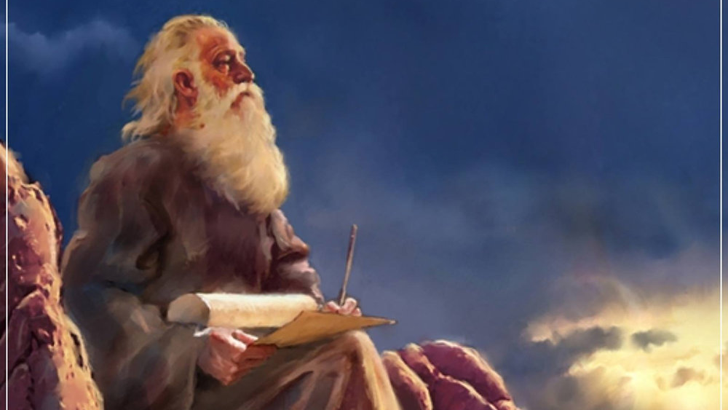
The Prophecy
Of
Isaiah
Isaiah 22
What’s Wrong with Self-Reliance?
Preached by Dan Bridges Amman International Church, Jordan (AmmanChurch.org) Uploaded by Dr. Rick Griffith • Jordan Evangelical Theological Seminary Files in many languages for free download at BibleStudyDownloads.org

Slide 2
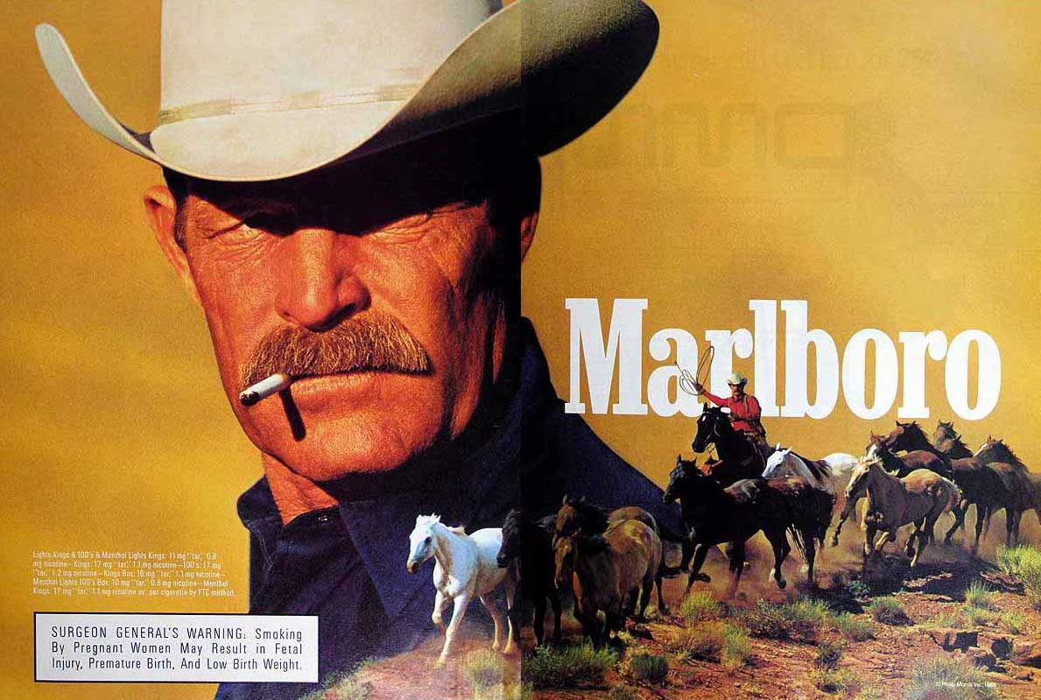
The “Marlboro Man”
Independent
Self-Reliant

Slide 3
The Book of Isaiah
Chapters 1–39 - Judgment
Chapters 40–66 - Restoration
Focus: Isaiah’s Day
1–6: Introduction
7–12: Assyrian Invasion /
Messiah
13–27: God’s Universal
Kingdom
28–39: God as the Lord of
History
Focus: Future

Slide 4
Isaiah 13–27: God’s Universal Kingdom
Chapters 13–23: 10 Oracles Regarding the Nations
Babylon (13:1–14:27)
Philistia (14:28-32)
Moab (15:1-16:14)
Syria/Israel/Cush (17:1–18:7)
Egypt (19:1–20:6)
Babylon (21:1-10)
Edom (21:11-12)
Arabia (21:13-17)
Jerusalem (22:1-25)
Tyre (23:1-18)
Chapter 24: Worldwide Judgment / A Remnant
Chapter 25: Fulfillment of God’s Plans
Chapter 26: The People of God
Chapter 27: Israel Fulfills its Purpose

Slide 5
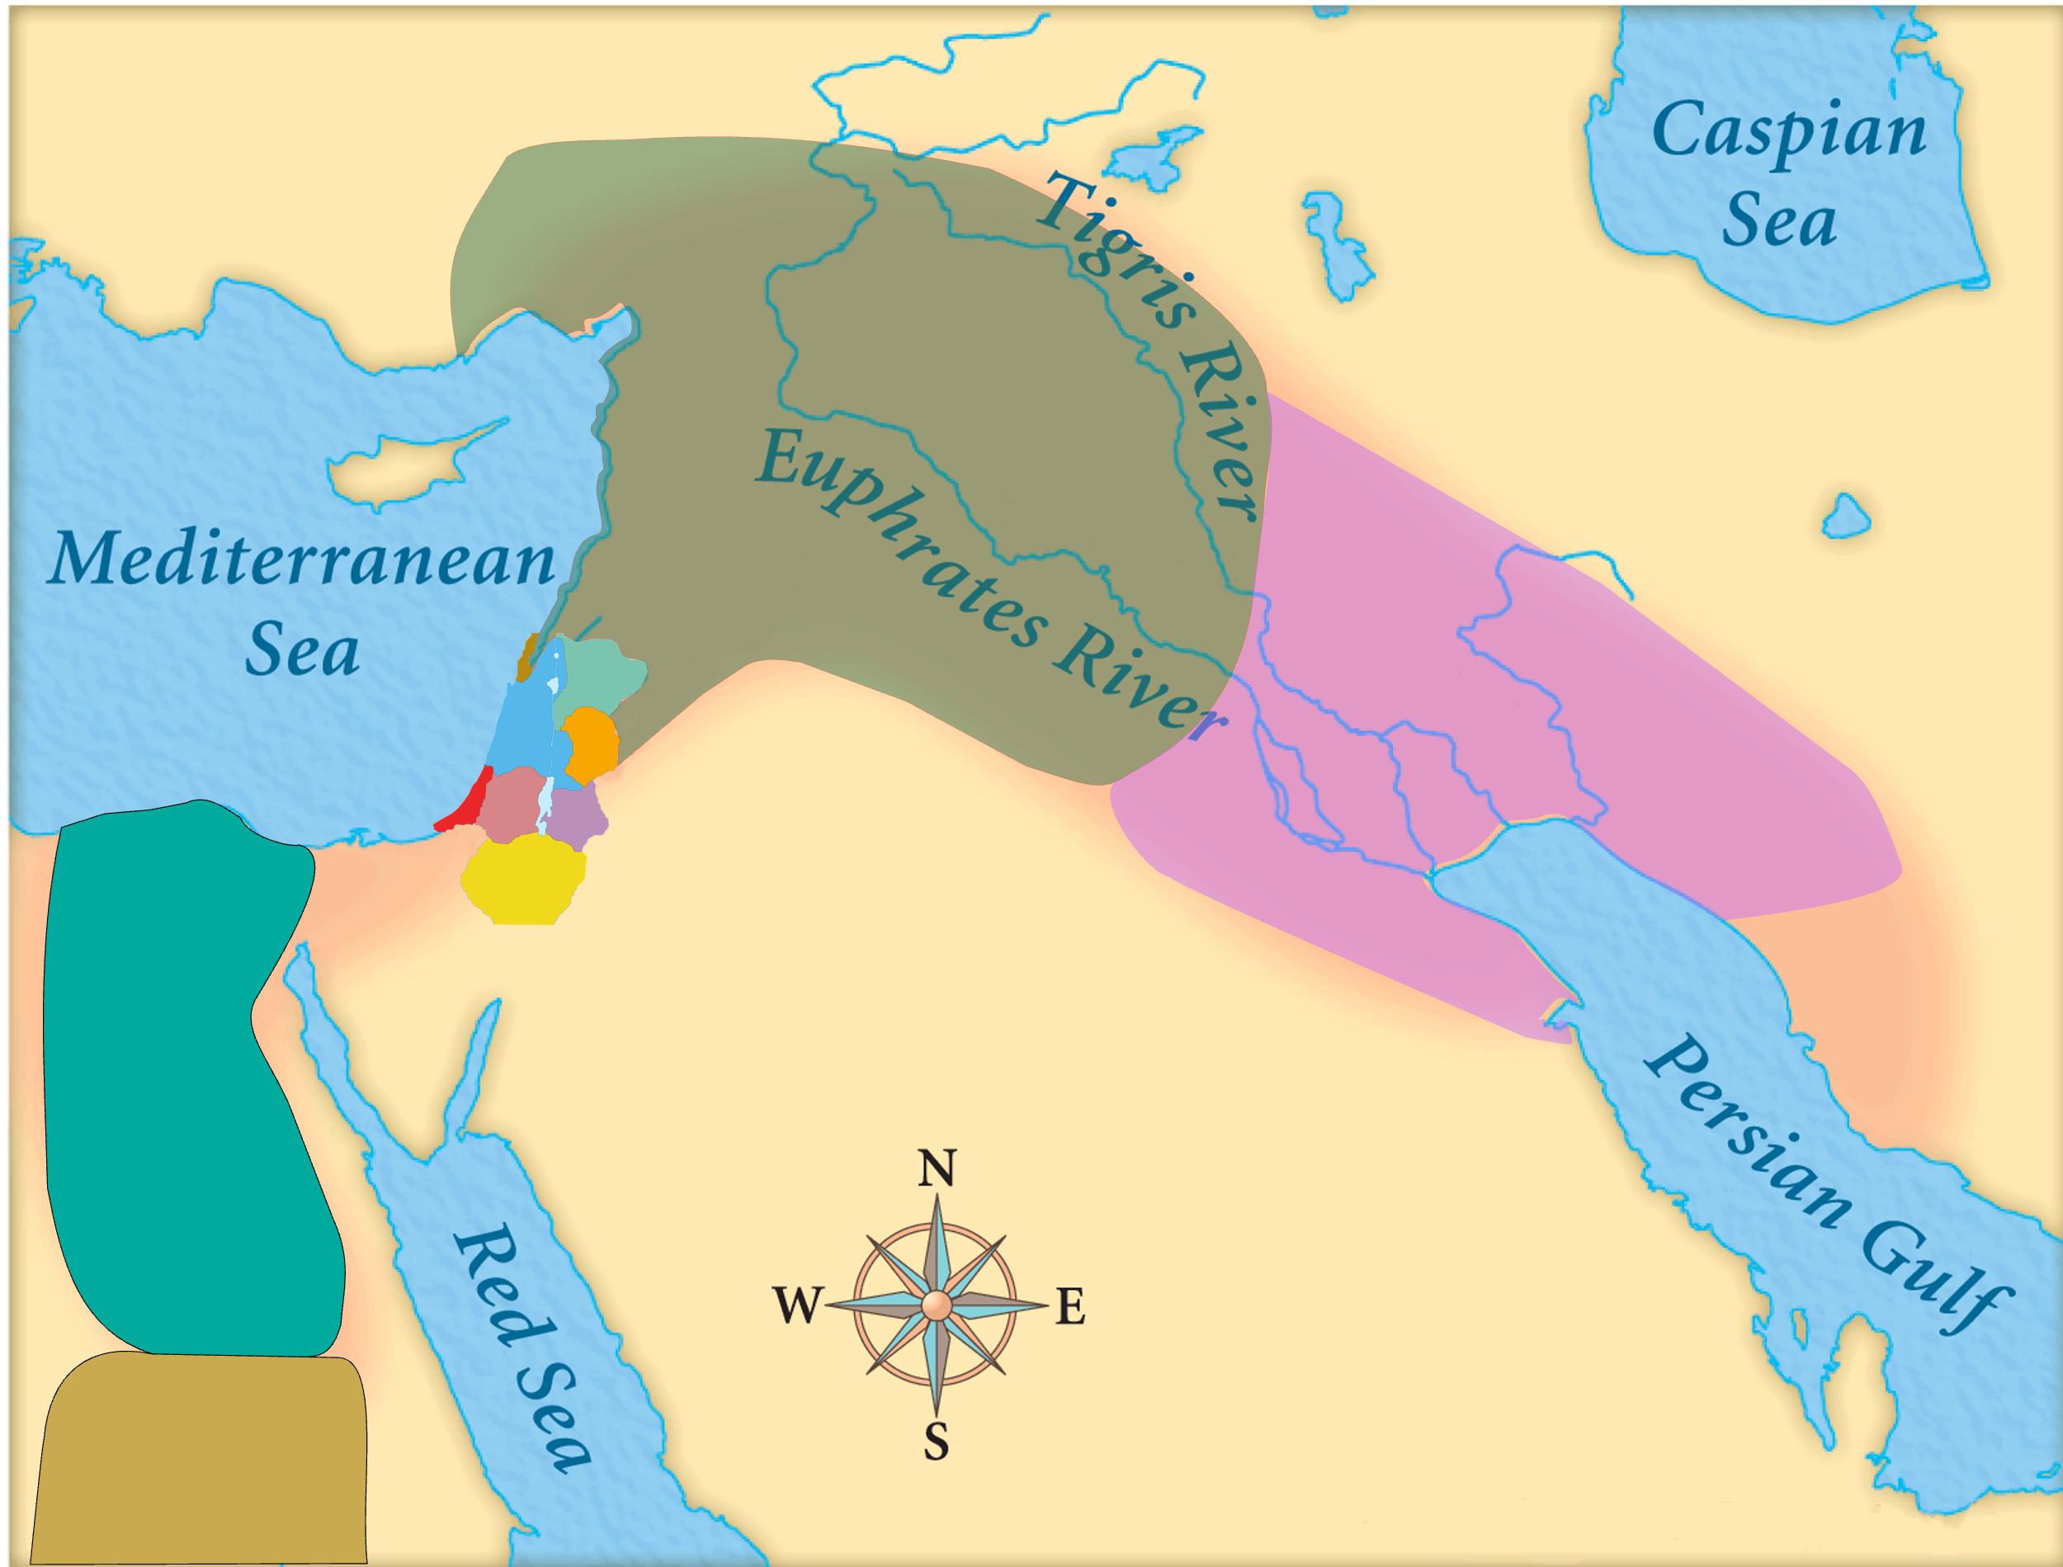
Assyria
Judah
Isaiah’s World
(~740 BC)

Slide 6
Assyria
Phoenicia
Israel
Aram (Syria)
Babylon
Philistia
Judah
Moab
Edom
Egypt
Arabia
Isaiah’s World
(~740 BC)
Cush

Slide 7
Assyria
Phoenicia
Israel
Aram (Syria)
Babylon
Philistia
Why include Judah in all these oracles about / against the nations?
Chapters 1–5: Judah had become just like the other nations…
Judah
Moab
Edom
Egypt
Arabia
Cush

Slide 8
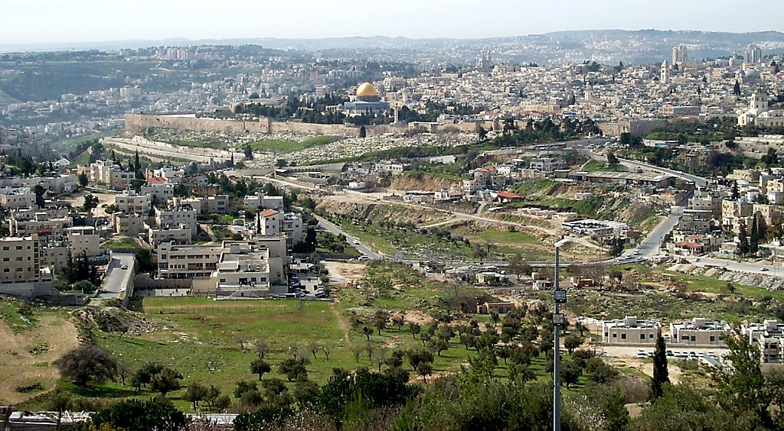
Old City and Kidron Valley from north
Oracle #9 – The Valley of Vision (Isaiah 22)
Four Sections:
Destruction of Jerusalem Described (1-7)
National Self-Reliance Condemned (8-14)
Individual Self-Reliance Exposed (15-19)
Reliance on People Exposed (20-25)

Slide 9
Old City and Kidron Valley from north
Oracle #9 – The Valley of Vision (Isaiah 22)
¹ The oracle concerning the valley of vision.
What do you mean that you have gone up,
all of you, to the housetops,
^{2a} you who are full of shoutings,
tumultuous city, exultant town?

Slide 10
Old City and Kidron Valley from north
Oracle #9 – The Valley of Vision (Isaiah 22)
Verse 8-10 confirm this is Jerusalem
¹ The oracle concerning the valley of vision.
What do you mean that you have gone up,
all of you, to the housetops,
^{2a} you who are full of shoutings,
tumultuous city, exultant town?

Slide 11
Old City and Kidron Valley from north
Oracle #9 – The Valley of Vision (Isaiah 22)
What’s with you???
¹ The oracle concerning the valley of vision.
What do you mean that you have gone up,
all of you, to the housetops,
^{2a} you who are full of shoutings,
tumultuous city, exultant town?

Slide 12
Old City and Kidron Valley from north
Oracle #9 – The Valley of Vision (Isaiah 22)
Atmosphere of excessive celebrating (verse 13)
¹ The oracle concerning the valley of vision.
What do you mean that you have gone up,
all of you, to the housetops,
^{2a} you who are full of shoutings,
tumultuous city, exultant town?

Slide 13
Old City and Kidron Valley from north
Oracle #9 – The Valley of Vision (Isaiah 22)
When is this talking about?
^{2b} Your slain are not slain with the sword
or dead in battle.
³ All your leaders have fled together;
without the bow they were captured.
All of you who were found were captured,
though they had fled far away.

Slide 14
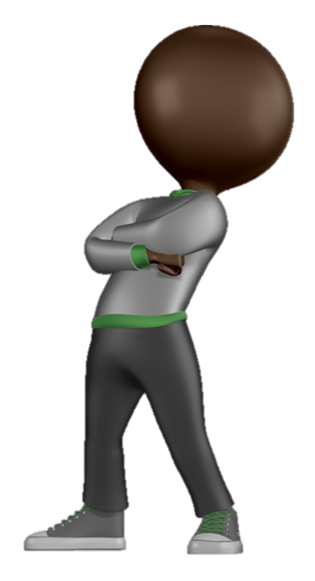
Old City and Kidron Valley from north
Oracle #9 – The Valley of Vision (Isaiah 22)
Destruction of Jerusalem in 586 BC
^{2b} Your slain are not slain with the sword
or dead in battle.
³ All your leaders have fled together;
without the bow they were captured.
All of you who were found were captured,
though they had fled far away.

Slide 15
Old City and Kidron Valley from north
Oracle #9 – The Valley of Vision (Isaiah 22)
“Prophetic Perfect” Tense
^{2b} Your slain are not slain with the sword
or dead in battle.
³ All your leaders have fled together;
without the bow they were captured.
All of you who were found were captured,
though they had fled far away.

Slide 16
Old City and Kidron Valley from north
Oracle #9 – The Valley of Vision (Isaiah 22)
“Prophetic Perfect” Tense
The prophetic perfect tense is a literary technique… which describes future events that are so certain to happen that they are referred to in the past tense as if they had already happened.
Roy Zuck – Basic Bible Interpretation

Slide 17
Old City and Kidron Valley from north
Oracle #9 – The Valley of Vision (Isaiah 22)
Destruction of Jerusalem in 586 BC
^{2b} Your slain are not slain with the sword
or dead in battle.
³ All your leaders have fled together;
without the bow they were captured.
All of you who were found were captured,
though they had fled far away.

Slide 18
Old City and Kidron Valley from north
¹ And in the ninth year of his reign, in the tenth month, on the tenth day of the month, Nebuchadnezzar king of Babylon came with all his army against Jerusalem and laid siege to it. And they built siegeworks all around it. ² So the city was besieged till the eleventh year of King Zedekiah. ³ On the ninth day of the fourth month the famine was so severe in the city that there was no food for the people of the land. ⁴ Then a breach was made in the city, and all the men of war fled by night by the way of the gate between the two walls, by the king's garden, and the Chaldeans were around the city. And they went in the direction of the Arabah.
2 Kings 25:1-7

Slide 19
Old City and Kidron Valley from north
⁵ But the army of the Chaldeans pursued the king and overtook him in the plains of Jericho, and all his army was scattered from him. ⁶ Then they captured the king and brought him up to the king of Babylon at Riblah, and they passed sentence on him. ⁷ They slaughtered the sons of Zedekiah before his eyes, and put out the eyes of Zedekiah and bound him in chains and took him to Babylon.
2 Kings 25:1-7

Slide 20
Old City and Kidron Valley from north
Oracle #9 – The Valley of Vision (Isaiah 22)
Destruction of Jerusalem in 586 BC
^{2b} Your slain are not slain with the sword
or dead in battle.
³ All your leaders have fled together;
without the bow they were captured.
All of you who were found were captured,
though they had fled far away.

Slide 21
Old City and Kidron Valley from north
Oracle #9 – The Valley of Vision (Isaiah 22)
Isaiah’s heartbreak at the unrepentant heart of his people and their coming destruction…
⁴ Therefore I said:
“Look away from me;
let me weep bitter tears;
do not labor to comfort me
concerning the destruction of the daughter
of my people.”

Slide 22
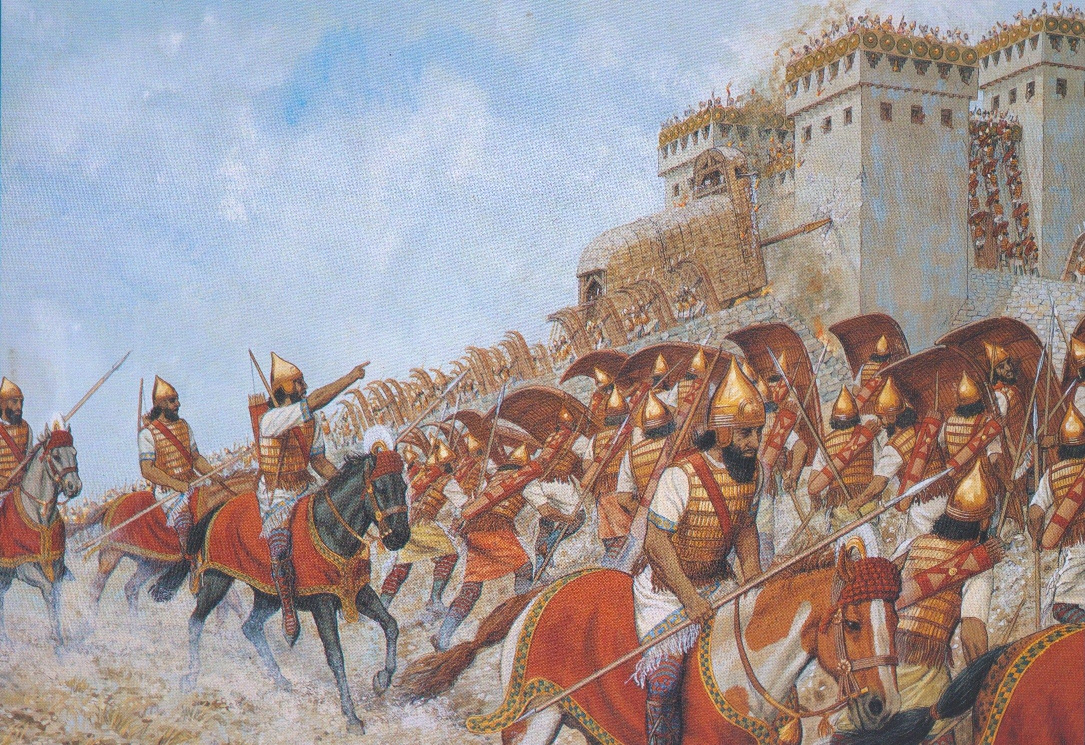
Oracle #9 – The Valley of Vision (Isaiah 22)
⁵ For the Lord God of hosts has a day
of tumult and trampling and confusion
in the valley of vision,
a battering down of walls
and a shouting to the mountains.
⁶ And Elam bore the quiver
with chariots and horsemen,
and Kir uncovered the shield.
⁷ Your choicest valleys were full of chariots,
and the horsemen took their stand at the gates.

Slide 23
Old City and Kidron Valley from north
Oracle #9 – The Valley of Vision (Isaiah 22)
Four Sections:
Destruction of Jerusalem Described (1-7)
Self-Reliance Condemned (8-14)
Individual Self-Reliance Exposed (15-19)
Reliance on People Exposed (20-25)

Slide 24
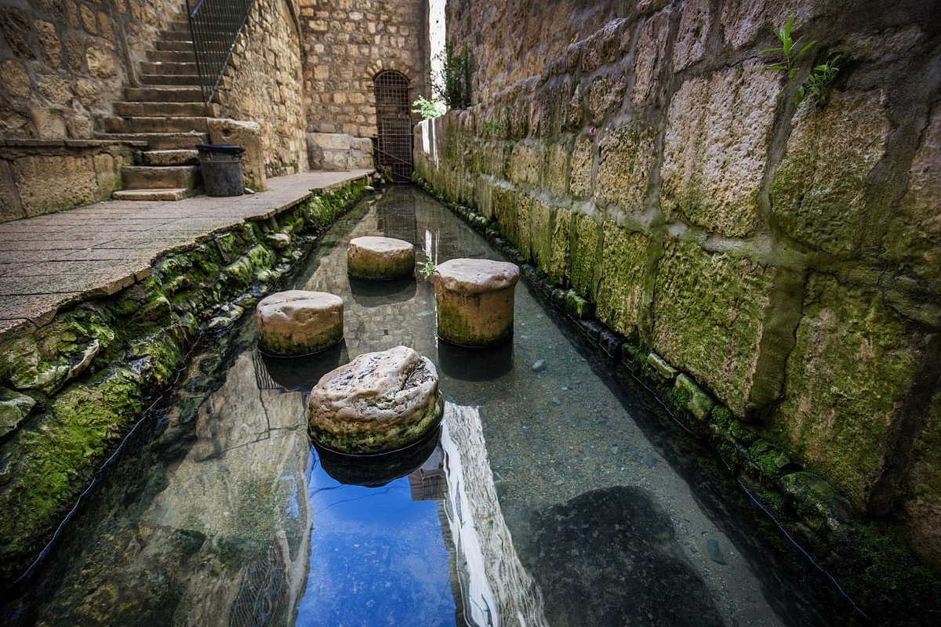
Oracle #9 – The Valley of Vision (Isaiah 22)
⁸ He has taken away the covering of Judah. In that day you looked to the weapons of the House of the Forest, ⁹ and you saw that the breaches of the city of David were many. You collected the waters of the lower pool, ¹⁰ and you counted the houses of Jerusalem, and you broke down the houses to fortify the wall.

Slide 25
Oracle #9 – The Valley of Vision (Isaiah 22)
⁸ He has taken away the covering of Judah. In that day you looked to the weapons of the House of the Forest, ⁹ and you saw that the breaches of the city of David were many. You collected the waters of the lower pool, ¹⁰ and you counted the houses of Jerusalem, and you broke down the houses to fortify the wall.
He has taken away their honor – like captives stripped of their clothes.

Slide 26
Oracle #9 – The Valley of Vision (Isaiah 22)
Preparing for a siege…
⁸ He has taken away the covering of Judah. In that day you looked to the weapons of the House of the Forest, ⁹ and you saw that the breaches of the city of David were many. You collected the waters of the lower pool, ¹⁰ and you counted the houses of Jerusalem, and you broke down the houses to fortify the wall.

Slide 27
Oracle #9 – The Valley of Vision (Isaiah 22)
The Sin of Self-Reliance
¹¹ You made a reservoir between the two walls for the water of the old pool. But you did not look to him who did it, or see him who planned it long ago.

Slide 28
Oracle #9 – The Valley of Vision (Isaiah 22)
What did God want?
¹¹ You made a reservoir between the two walls for the water of the old pool. But you did not look to him who did it, or see him who planned it long ago.

Slide 29
God wanted them to depend on him – to ask him for help!
⁹ Zerah the Ethiopian came out against [Judah] with an army of a million men and 300 chariots, and came as far as Mareshah. ¹⁰ And Asa went out to meet him, and they drew up their lines of battle in the Valley of Zephathah at Mareshah. ¹¹ And Asa cried to the LORD his God, “O LORD, there is none like you to help, between the mighty and the weak. Help us, O LORD our God, for we rely on you, and in your name we have come against this multitude. O LORD, you are our God; let not man prevail against you.” ¹² So the Lord defeated the Ethiopians before Asa and before Judah, and the Ethiopians fled. 2 Chronicles 14:9-12

Slide 30
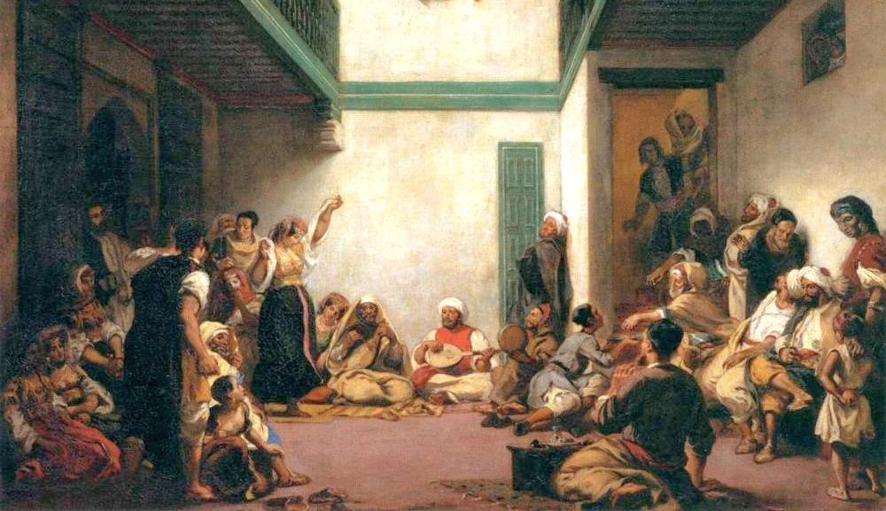
Oracle #9 – The Valley of Vision (Isaiah 22)
¹² In that day the Lord God of hosts
called for weeping and mourning,
for baldness and wearing sackcloth;
¹³ and behold, joy and gladness,
killing oxen and slaughtering sheep,
eating flesh and drinking wine.
“Let us eat and drink,
for tomorrow we die.”
God wanted repentance!

Slide 31
Oracle #9 – The Valley of Vision (Isaiah 22)
¹² In that day the Lord God of hosts
called for weeping and mourning,
for baldness and wearing sackcloth;
¹³ and behold, joy and gladness,
killing oxen and slaughtering sheep,
eating flesh and drinking wine.
“Let us eat and drink,
for tomorrow we die.”

Slide 32
Oracle #9 – The Valley of Vision (Isaiah 22)
Why was God so upset about this sin of self-reliance?
¹⁴ The Lord of hosts has revealed himself in my ears:
“Surely this iniquity will not be atoned for you until you die,”
says the Lord God of hosts.

Slide 33
⁵ Thus says the LORD:
“Cursed is the man who trusts in man
and makes flesh his strength,
whose heart turns away from the Lord…
⁷ “Blessed is the man who trusts in the LORD,
whose trust is the LORD.”
Jeremiah 17:5, 7
We cannot trust in self or other people without our hearts turning from God.
Therefore, it is rebellion against him!

Slide 34
Old City and Kidron Valley from north
Oracle #9 – The Valley of Vision (Isaiah 22)
Four Sections:
Destruction of Jerusalem Described (1-7)
Self-Reliance Condemned (8-14)
Individual Self-Reliance Exposed (15-19)
Reliance on People Exposed (20-25)

Slide 35
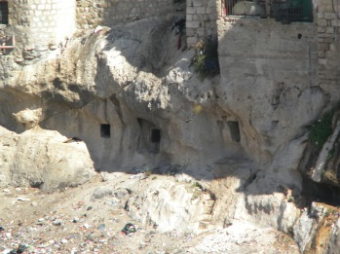
Old City and Kidron Valley from north
Oracle #9 – The Valley of Vision (Isaiah 22)
¹⁵ Thus says the Lord God of hosts, “Come, go to this steward, to Shebna, who is over the household, and say to him:

Slide 36
Old City and Kidron Valley from north
Oracle #9 – The Valley of Vision (Isaiah 22)
¹⁵ Thus says the Lord God of hosts, “Come, go to this steward, to Shebna, who is over the household, and say to him:

Slide 37
Old City and Kidron Valley from north
Oracle #9 – The Valley of Vision (Isaiah 22)
¹⁶ What have you to do here, and whom have you here, that you have cut out here a tomb for yourself, you who cut out a tomb on the height and carve a dwelling for yourself in the rock?
Why this change to focus on an individual?
Shebna was representative of Judah (especially the leaders) – living a life of self-reliance and selfish gain.

Slide 38
Old City and Kidron Valley from north
Oracle #9 – The Valley of Vision (Isaiah 22)
¹⁷ Behold, the LORD will hurl you away violently, O you strong man. He will seize firm hold on you ¹⁸ and whirl you around and around, and throw you like a ball into a wide land. There you shall die, and there shall be your glorious chariots, you shame of your master's house. ¹⁹ I will thrust you from your office, and you will be pulled down from your station.

Slide 39
Old City and Kidron Valley from north
Oracle #9 – The Valley of Vision (Isaiah 22)
Four Sections:
Destruction of Jerusalem Described (1-7)
Self-Reliance Condemned (8-14)
Individual Self-Reliance Exposed (15-19)
Reliance on People Exposed (20-25)

Slide 40
Old City and Kidron Valley from north
Oracle #9 – The Valley of Vision (Isaiah 22)
²⁰ In that day I will call my servant Eliakim the son of Hilkiah, ²¹ and I will clothe him with your robe, and will bind your sash on him, and will commit your authority to his hand. And he shall be a father to the inhabitants of Jerusalem and to the house of Judah. ²² And I will place on his shoulder the key of the house of David. He shall open, and none shall shut; and he shall shut, and none shall open.

Slide 41
Old City and Kidron Valley from north
Oracle #9 – The Valley of Vision (Isaiah 22)
²⁰ In that day I will call my servant Eliakim the son of Hilkiah, ²¹ and I will clothe him with your robe, and will bind your sash on him, and will commit your authority to his hand. And he shall be a father to the inhabitants of Jerusalem and to the house of Judah. ²² And I will place on his shoulder the key of the house of David. He shall open, and none shall shut; and he shall shut, and none shall open.
Eliakim is being honored and lifted up by God!

Slide 42
Old City and Kidron Valley from north
Oracle #9 – The Valley of Vision (Isaiah 22)
²³ And I will fasten him like a peg in a secure place, and he will become a throne of honor to his father's house. ²⁴ And they will hang on him the whole honor of his father's house, the offspring and issue, every small vessel, from the cups to all the flagons. ²⁵ In that day, declares the LORD of hosts, the peg that was fastened in a secure place will give way, and it will be cut down and fall, and the load that was on it will be cut off, for the LORD has spoken.”

Slide 43
Old City and Kidron Valley from north
Oracle #9 – The Valley of Vision (Isaiah 22)
²³ And I will fasten him like a peg in a secure place, and he will become a throne of honor to his father's house. ²⁴ And they will hang on him the whole honor of his father's house, the offspring and issue, every small vessel, from the cups to all the flagons. ²⁵ In that day, declares the Lord of hosts, the peg that was fastened in a secure place will give way, and it will be cut down and fall, and the load that was on it will be cut off, for the LORD has spoken.”
Eliakim’s family is now trusting in him – rather than in God.

Slide 44
Old City and Kidron Valley from north
Oracle #9 – The Valley of Vision (Isaiah 22)
²³ And I will fasten him like a peg in a secure place, and he will become a throne of honor to his father's house. ²⁴ And they will hang on him the whole honor of his father's house, the offspring and issue, every small vessel, from the cups to all the flagons. ²⁵ In that day, declares the Lord of hosts, the peg that was fastened in a secure place will give way, and it will be cut down and fall, and the load that was on it will be cut off, for the LORD has spoken.”

Slide 45
Old City and Kidron Valley from north
Oracle #9 – The Valley of Vision (Isaiah 22)
The Sin of Self-Reliance:
The people of Judah depended on their weapons, walls and water supply to survive the siege
Shebna depended on himself for his reputation and honor
Eliakim’s family depended on him for their family honor and well-being
Why is this such a big deal to God?

Slide 46
Old City and Kidron Valley from north
Oracle #9 – The Valley of Vision (Isaiah 22)
God is our creator and sustainer. In relying on him, we recognize our dependence on him for every breath we take!
Know that the LORD, he is God!
It is he who made us, and we are his;
we are his people, and the sheep of his pasture.
Psalm 100:3

Slide 47
Old City and Kidron Valley from north
Oracle #9 – The Valley of Vision (Isaiah 22)
Reliance on ourselves or others instead of God always leads to sin and rebellion.
Thus says the LORD:
Cursed is the man who trusts in man
and makes flesh his strength,
whose heart turns away from the Lord.
Jeremiah 17:5

Slide 48
Old City and Kidron Valley from north
Oracle #9 – The Valley of Vision (Isaiah 22)
When we ask for God’s help, we are relating to him in the way he has designed for us.
Ask, and it will be given to you; seek, and you will find; knock, and it will be opened to you. For everyone who asks receives, and the one who seeks finds, and to the one who knocks it will be opened.
Matthew 7:7-8

Slide 49
Old City and Kidron Valley from north
Oracle #9 – The Valley of Vision (Isaiah 22)
God’s first priority after bringing the people out of Egypt was to teach them to depend on him.
• Exodus 14:9 – Trapped between the Egyptian army
and the Red Sea
• Exodus 15:23 – No water to drink
• Exodus 16:3 – No food to eat
• Exodus 17:1 – No water to drink
• Exodus 17:8 – Attacked by the Amalekites

Slide 50
Old City and Kidron Valley from north
“God desires our radical, daily dependence. We aren’t self-sufficient, and God doesn’t want us to think we are. God wants us to see His generous provision and to deepen our reliance on Him every day.”
“Overcoming the illusion of self-sufficiency is about being so radically God-centered in our thinking that we use the details of our daily lives to petition, praise, and thank God.”
Andrea Lee – Radical.net

Slide 52
OT Preaching link at BibleStudyDownloads.org
Get this presentation for free!
Notes:
OT Preaching (op)

