Slide 1
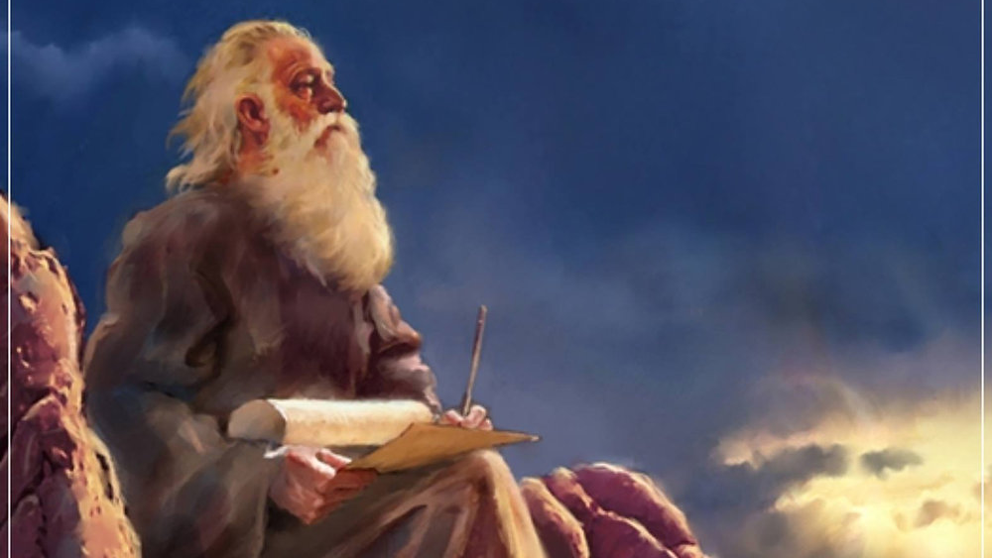
The Prophecy
Of
Isaiah
Isaiah 21
Salvation is Found in No Other Name
Preached by Dan Bridges Amman International Church, Jordan (AmmanChurch.org) Uploaded by Dr. Rick Griffith • Jordan Evangelical Theological Seminary Files in many languages for free download at BibleStudyDownloads.org

Slide 2
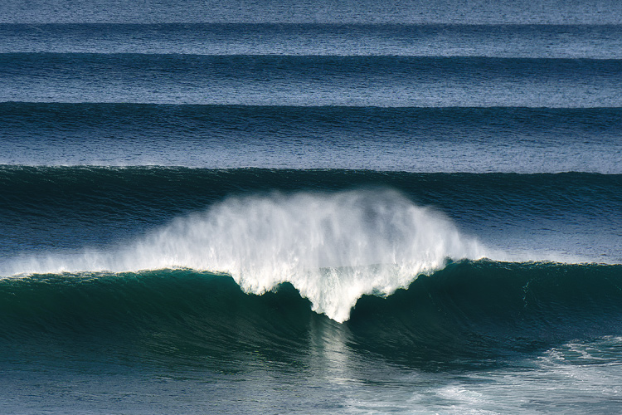
Do you ever feel like the Bible is Repetitive?

Slide 3
The Book of Isaiah
Chapters 1–39 - Judgment
Chapters 40–66 - Restoration
Focus: Isaiah’s Day
1–6: Introduction
7–12: Assyrian Invasion /
Messiah
13–27: God’s Universal
Kingdom
28–39: God as the Lord of
History
Focus: Future

Slide 4
Isaiah 13–27: God’s Universal Kingdom
Chapters 13–23: 10 Oracles Regarding the Nations
Babylon (13:1–14:27)
Philistia (14:28-32)
Moab (15:1-16:14)
Syria/Israel/Cush (17:1–18:7)
Egypt (19:1–20:6)
Babylon (21:1-10)
Edom (21:11-12)
Arabia (21:13-17)
Jerusalem (22:1-25)
Tyre (23:1-18)
Chapter 24: Worldwide Judgment / A Remnant
Chapter 25: Fulfillment of God’s Plans
Chapter 26: The People of God
Chapter 27: Israel Fulfills its Purpose

Slide 5
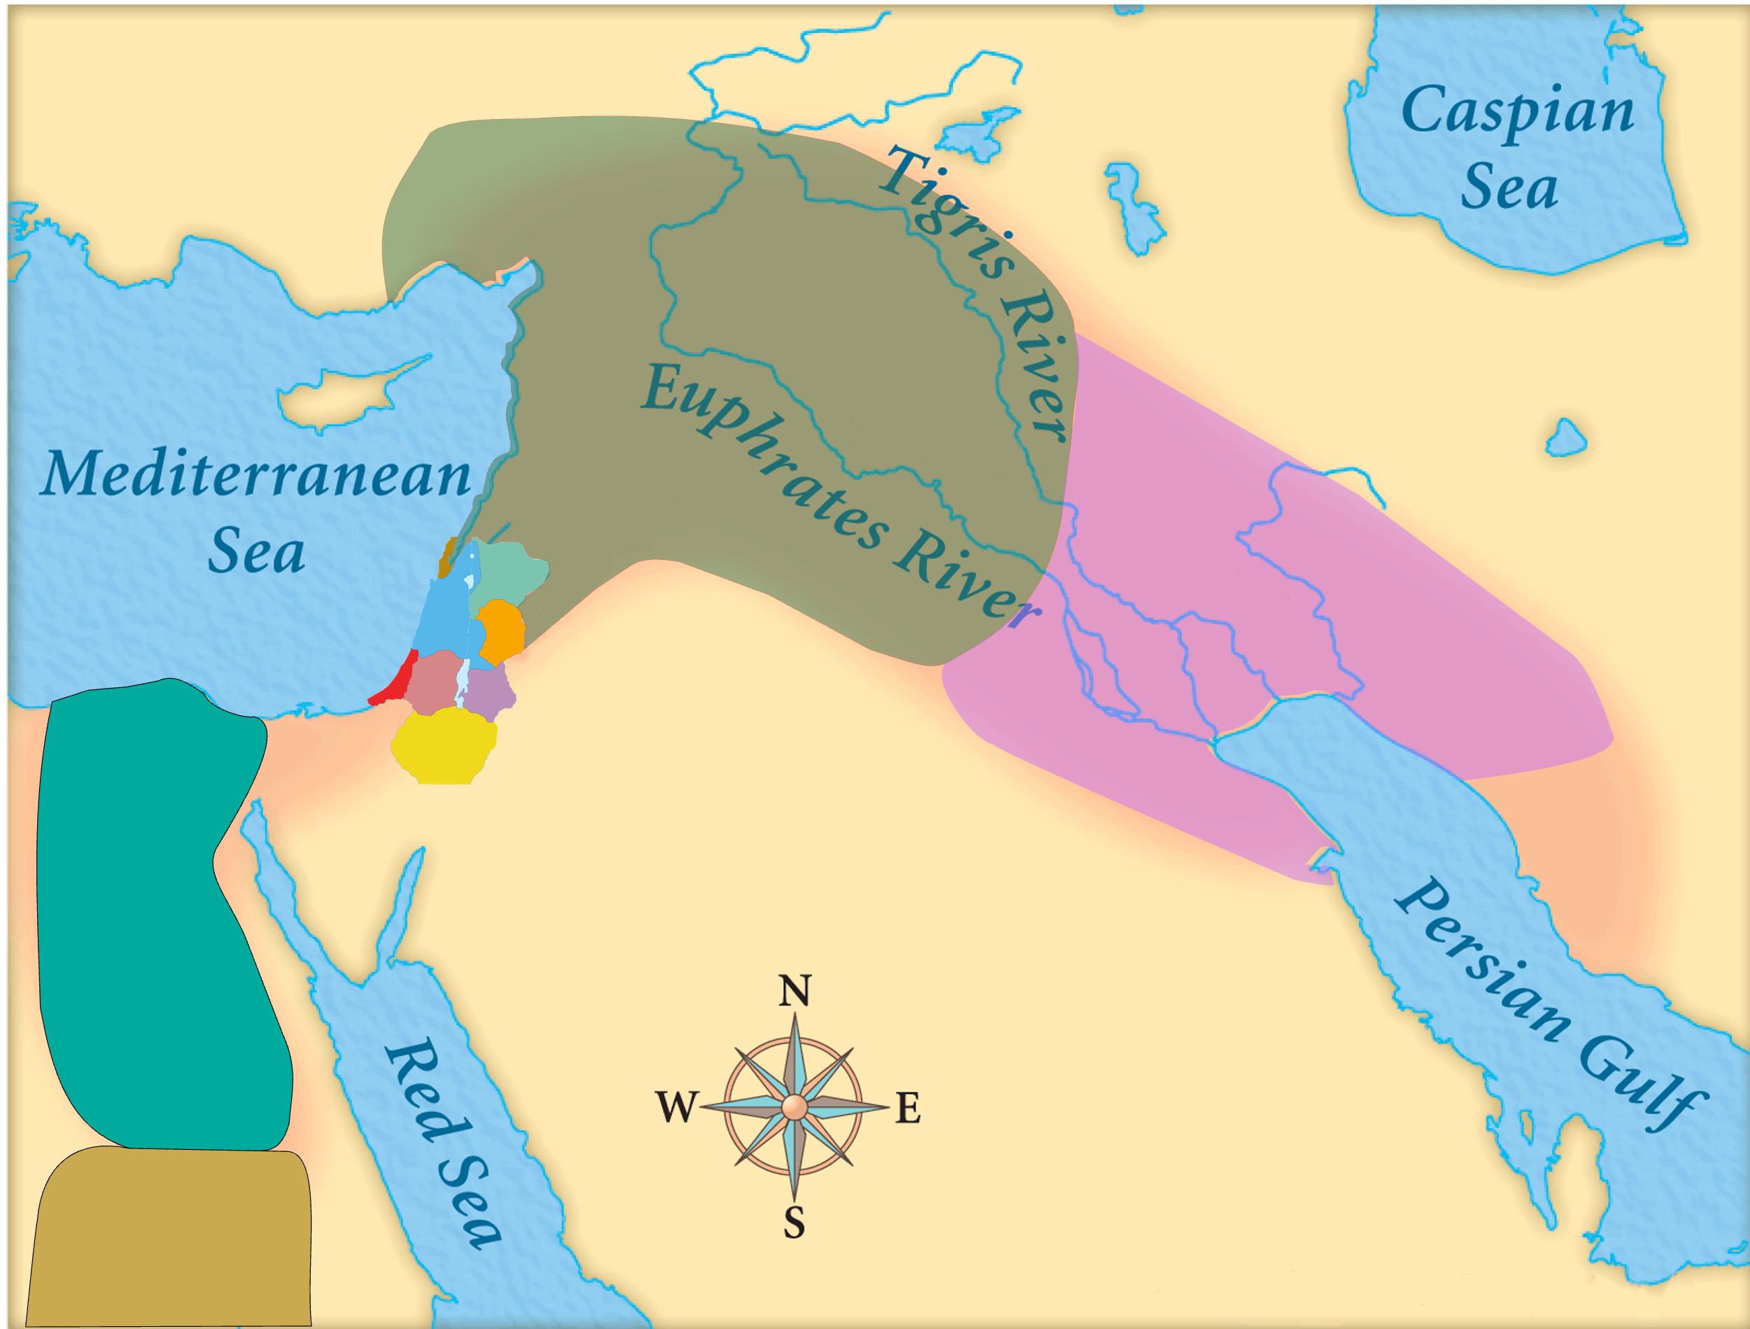
Assyria
Judah
Isaiah’s World
(~740 BC)

Slide 6
Assyria
Phoenicia
Israel
Aram (Syria)
Babylon
Philistia
Judah
What did the “non-Assyrian” nations have in common?
Moab
Edom
Egypt
Arabia
Isaiah’s World
(~740 BC)
Cush

Slide 7
Assyria
Phoenicia
Israel
Aram (Syria)
Babylon
Philistia
Judah
Moab
Edom
Egypt
Arabia
Cush

Slide 8
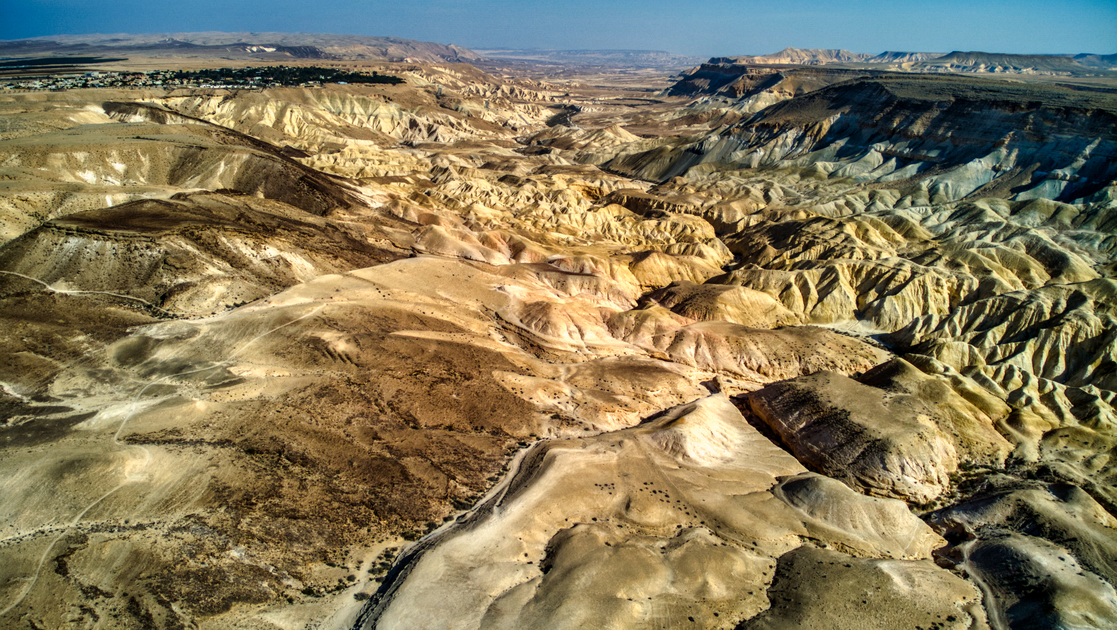
Oracle #6 – The Wilderness of the Sea
Isaiah 21:1-10
¹ The oracle concerning the wilderness of the sea.
As whirlwinds in the Negeb sweep on,
it comes from the wilderness,
from a terrible land.
A stern vision is told to me;

Slide 9
Oracle #6 – The Wilderness of the Sea
Isaiah 21:1-10
¹ The oracle concerning the wilderness of the sea.
As whirlwinds in the Negeb sweep on,
it comes from the wilderness,
from a terrible land.
A stern vision is told to me;
Verse 9:
“Fallen is Babylon…”
So why this title?

Slide 10
Oracle #6 – The Wilderness of the Sea
Isaiah 21:1-10
¹ The vision of the wilderness.
As a whirlwind might pass through a wilderness —
coming from a wilderness, from land — dreadful and harsh is the vision declared to me;
(Septuagint)
Emphasis of verse 1 is more on the vision itself than on the fall of Babylon
(matches context of verses 3-4)

Slide 11
Oracle #6 – The Wilderness of the Sea
² A stern vision is told to me;
the traitor betrays,
and the destroyer destroys.
Go up, O Elam;
lay siege, O Media;
all the sighing she has caused
I bring to an end.

Slide 12
Oracle #6 – The Wilderness of the Sea
³ Therefore my loins are filled with anguish;
pangs have seized me,
like the pangs of a woman in labor;
I am bowed down so that I cannot hear;
I am dismayed so that I cannot see.
⁴ My heart staggers; horror has appalled me;
the twilight I longed for
has been turned for me into trembling.
Isaiah is so affected physically by the vision that he can hardly function…
Why? What did he see?

Slide 13
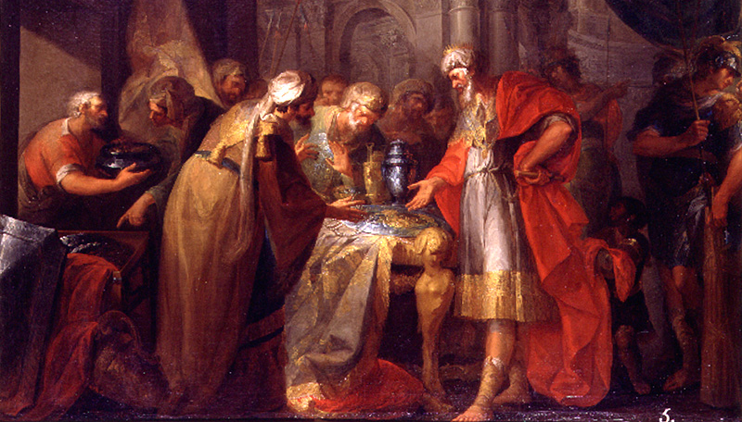
Sometime between 701 & 689 BC…
¹² At that time Merodach-baladan the son of Baladan, king of Babylon, sent envoys with letters and a present to Hezekiah, for he heard that Hezekiah had been sick.
¹³ And Hezekiah welcomed them, and he showed them all his treasure house, the silver, the gold, the spices, the precious oil, his armory, all that was found in his storehouses. There was nothing in his house or in all his realm that Hezekiah did not show them.
2 Kings 20:12-18

Slide 14
Sometime between 701 & 689 BC…
¹⁴ Then Isaiah the prophet came to King Hezekiah, and said to him, “What did these men say? And from where did they come to you?” And Hezekiah said, “They have come from a far country, from Babylon.” ¹⁵ He said, “What have they seen in your house?” And Hezekiah answered, “They have seen all that is in my house; there is nothing in my storehouses that I did not show them.” 2 Kings 20:12-18

Slide 15
Sometime between 701 & 689 BC…
¹⁶ Then Isaiah said to Hezekiah, “Hear the word of the Lord: ¹⁷ Behold, the days are coming, when all that is in your house, and that which your fathers have stored up till this day, shall be carried to Babylon. Nothing shall be left, says the Lord. ¹⁸ And some of your own sons, who will come from you, whom you will father, shall be taken away, and they shall be eunuchs in the palace of the king of Babylon.”
2 Kings 20:12-18

Slide 16
Oracle #6 – The Wilderness of the Sea
² A stern vision is told to me;
the traitor betrays,
and the destroyer destroys.
Go up, O Elam;
lay siege, O Media;
all the sighing she has caused
I bring to an end.

Slide 17
Oracle #6 – The Wilderness of the Sea
Envoys from Babylon who said,
“The traitor betrays,
and the destroyer destroys.
Go up, O Elam;
lay siege, O Media;
all the sighing she has caused
I bring to an end.”
“Assyria continues to betray and destroy…
Elam and Media are ready to join us… I will bring Assyria to an end!”

Slide 18
Oracle #6 – The Wilderness of the Sea
⁵ They prepare the table,
they spread the rugs,
they eat, they drink.
Arise, O princes;
oil the shield!
Hezekiah and his staff entertaining the envoys…

Slide 19
Oracle #6 – The Wilderness of the Sea
⁵ They prepare the table,
they spread the rugs,
they eat, they drink.
Arise, O princes;
oil the shield!
“Anoint the shield”
They think they’re going to war with God’s blessing!

Slide 20
Oracle #6 – The Wilderness of the Sea
Possible causes for Isaiah’s extreme reaction:
Pain of seeing his people ready to join Babylon in war against Assyria
Pain of seeing them reject God to join a hopeless alliance
Seeing this as sowing seeds for a future exile

Slide 21
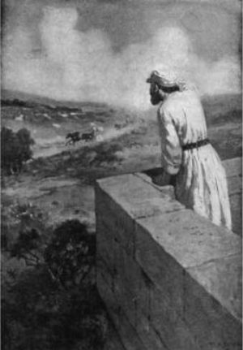
Oracle #6 – The Wilderness of the Sea
⁶ For thus the Lord said to me:
“Go, set a watchman;
let him announce what he sees.
⁷ When he sees riders,
horsemen in pairs, riders on
donkeys, riders on camels,
let him listen diligently,
very diligently.”
Isaiah

Slide 22
Oracle #6 – The Wilderness of the Sea
⁶ For thus the Lord said to me:
“Go, set a watchman;
let him announce what he sees.
⁷ When he sees riders,
horsemen in pairs, riders on
donkeys, riders on camels,
let him listen diligently,
very diligently.”

Slide 23
Oracle #6 – The Wilderness of the Sea
⁸ Then he who saw cried out:
“Upon a watchtower I stand, O Lord,
continually by day,
and at my post I am stationed whole nights.
⁹ And behold, here come riders,
horsemen in pairs!”
And he answered,
“Fallen, fallen is Babylon;
and all the carved images of her gods
he has shattered to the ground.”
What he saw…

Slide 24
Oracle #6 – The Wilderness of the Sea
⁸ Then he who saw cried out:
“Upon a watchtower I stand, O Lord,
continually by day,
and at my post I am stationed whole nights.
⁹ And behold, here come riders,
horsemen in pairs!”
And he answered,
“Fallen, fallen is Babylon;
and all the carved images of her gods
he has shattered to the ground.”
What he saw…
What he heard…

Slide 25
Oracle #6 – The Wilderness of the Sea
⁸ Then he who saw cried out:
“Upon a watchtower I stand, O Lord,
continually by day,
and at my post I am stationed whole nights.
⁹ And behold, here come riders,
horsemen in pairs!”
And he answered,
“Fallen, fallen is Babylon;
and all the carved images of her gods
he has shattered to the ground.”
King Hezekiah and Judah saw Babylon as a desirable ally.
Isaiah saw Babylon as God saw it.

Slide 26
Oracle #6 – The Wilderness of the Sea
¹⁰ O my threshed and
winnowed one,
what I have heard from the
Lord of hosts,
the God of Israel, I announce
to you.

Slide 27
Oracle #6 – The Wilderness of the Sea
What was God’s message for the people of Judah?
Do not ally yourselves with Merodach-Baladan
Your only protection lies in reliance on Yahweh

Slide 28
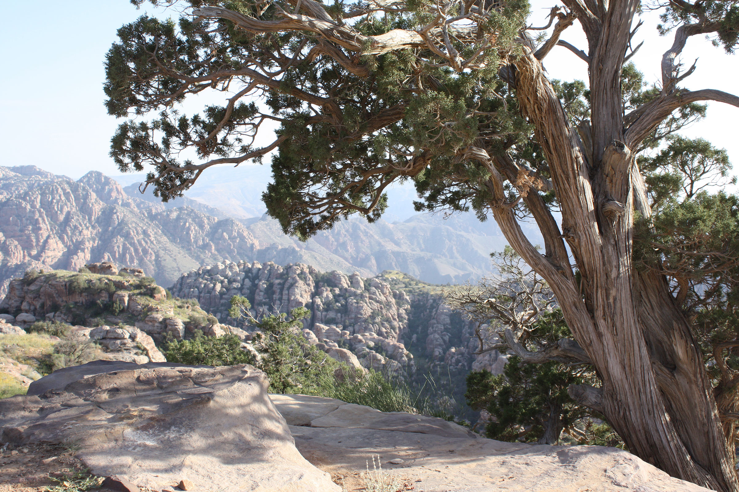
Oracle #7 – Dumah (Isaiah 21:11-12)
¹¹ The oracle concerning Dumah.
One is calling to me from Seir,
“Watchman, what time of the night?
Watchman, what time of the night?”
¹² The watchman says:
“Morning comes, and also the night.
If you will inquire, inquire;
come back again.”

Slide 29
Oracle #7 – Dumah (Isaiah 21:11-12)
Silence – as in death!
¹¹ The oracle concerning Dumah.
One is calling to me from Seir,
“Watchman, what time of the night?
Watchman, what time of the night?”
¹² The watchman says:
“Morning comes, and also the night.
If you will inquire, inquire;
come back again.”

Slide 30
Oracle #7 – Dumah (Isaiah 21:11-12)
Silence – as in death!
¹¹ The oracle concerning Dumah.
One is calling to me from Seir,
“Watchman, what time of the night?
Watchman, what time of the night?”
¹² The watchman says:
“Morning comes, and also the night.
If you will inquire, inquire;
come back again.”
Mountains of Edom
Wadi Dana / Petra!
Play on words?
Edom → Dumah

Slide 31
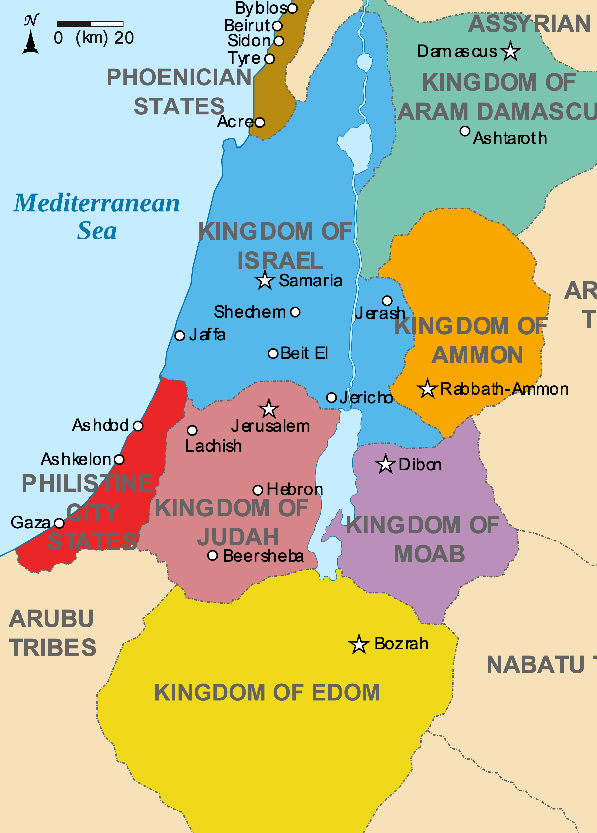
Oracle #7 – Dumah (Isaiah 21:11-12)
¹¹ The oracle concerning Dumah.
One is calling to me from Seir,
“Watchman, what time of the night?
Watchman, what time of the night?”
¹² The watchman says:
“Morning comes, and also the night.
If you will inquire, inquire;
come back again.”
Edom

Slide 32
Oracle #7 – Dumah (Isaiah 21:11-12)
¹¹ The oracle concerning Dumah.
One is calling to me from Seir,
“Watchman, what time of the night?
Watchman, what time of the night?”
¹² The watchman says:
“Morning comes, and also the night.
If you will inquire, inquire;
come back again.”
Watchman – Isaiah
(Known prophet of God)

Slide 33
Oracle #7 – Dumah (Isaiah 21:11-12)
¹¹ The oracle concerning Dumah.
One is calling to me from Seir,
“Watchman, what time of the night?
Watchman, what time of the night?”
¹² The watchman says:
“Morning comes, and also the night.
If you will inquire, inquire;
come back again.”
How much longer will the night (Assyrian destruction) last?

Slide 34
Oracle #7 – Dumah (Isaiah 21:11-12)
¹¹ The oracle concerning Dumah.
One is calling to me from Seir,
“Watchman, what time of the night?
Watchman, what time of the night?”
¹² The watchman says:
“Morning comes, and also the night.
If you will inquire, inquire;
come back again.”
Relief is coming, but also more night!

Slide 35
Oracle #7 – Dumah (Isaiah 21:11-12)
¹¹ The oracle concerning Dumah.
One is calling to me from Seir,
“Watchman, what time of the night?
Watchman, what time of the night?”
¹² The watchman says:
“Morning comes, and also the night.
If you will inquire, inquire;
come back again.”
If you really want to know, you must inquire seriously (with all your heart)

Slide 36
Oracle #7 – Dumah (Isaiah 21:11-12)
¹¹ The oracle concerning Dumah.
One is calling to me from Seir,
“Watchman, what time of the night?
Watchman, what time of the night?”
¹² The watchman says:
“Morning comes, and also the night.
If you will inquire, inquire;
come back again.”
Literally:
“Return, come.”

Slide 37
Oracle #7 – Dumah (Isaiah 21:11-12)
Message for Edom and for Judah:
Edom is doomed – there is no hope
The only answer is repentance and becoming part of Yahweh’s people

Slide 38
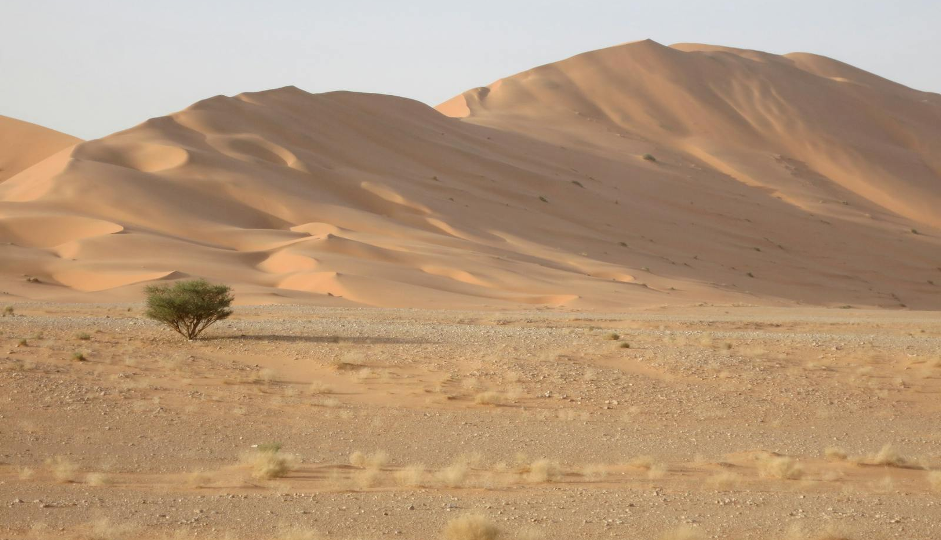
Oracle #8 – Arabia (Isaiah 21:13-17)
¹³ The oracle concerning Arabia.
In the thickets in Arabia you will lodge,
O caravans of Dedanites.
¹⁴ To the thirsty bring water;
meet the fugitive with bread,
O inhabitants of the land of Tema.
¹⁵ For they have fled from the swords,
from the drawn sword,
from the bent bow, and from the press of battle.
All Arabian Tribes:
(Genesis 25)
Dedan – Son of Keturah
Tema – Son of Ishmael
Kedar – Son of Ishmael

Slide 39
Oracle #8 – Arabia (Isaiah 21:13-17)
Picture:
Dedanites hiding and providing food and water to fugitives fleeing the Assyrians
¹³ The oracle concerning Arabia.
In the thickets in Arabia you will lodge,
O caravans of Dedanites.
¹⁴ To the thirsty bring water;
meet the fugitive with bread,
O inhabitants of the land of Tema.
¹⁵ For they have fled from the swords,
from the drawn sword,
from the bent bow, and from the press of battle.

Slide 40
Oracle #8 – Arabia (Isaiah 21:13-17)
The Arabian tribes will also be defeated!
¹⁶ For thus the Lord said to me, “Within a year, according to the years of a hired worker, all the glory of Kedar will come to an end. ¹⁷ And the remainder of the archers of the mighty men of the sons of Kedar will be few, for the Lord, the God of Israel, has spoken.”

Slide 41
Oracles # 6 - 8
A repetitive theme!
Babylon is going to fall
Edom is going to fall – her only hope is repentance and coming to Judah (to Yahweh)
Arabian tribes are going to fall

Slide 42
Oracles # 6 - 8
A repetitive theme!
Babylon is going to fall
Edom is going to fall – her only hope is repentance and coming to Judah (to Yahweh)
Arabian tribes are going to fall

Slide 43
Oracles # 6 - 8
A repetitive theme!
God says again and again,
“Trust me – salvation is found in no one else!”

Slide 44
Oracles # 6 - 8
“Salvation is found in no one else, for there is no other name under heaven given to men by which we must be saved.” Acts 4:12

Slide 45
How is God calling you to trust him more?
What are the challenges in your life (the “Assyrians”)?
What are you trusting in to get you through (the “alliances”)?

Slide 47
OT Preaching link at BibleStudyDownloads.org
Get this presentation for free!
Notes:
OT Preaching (op)

