Slide 1
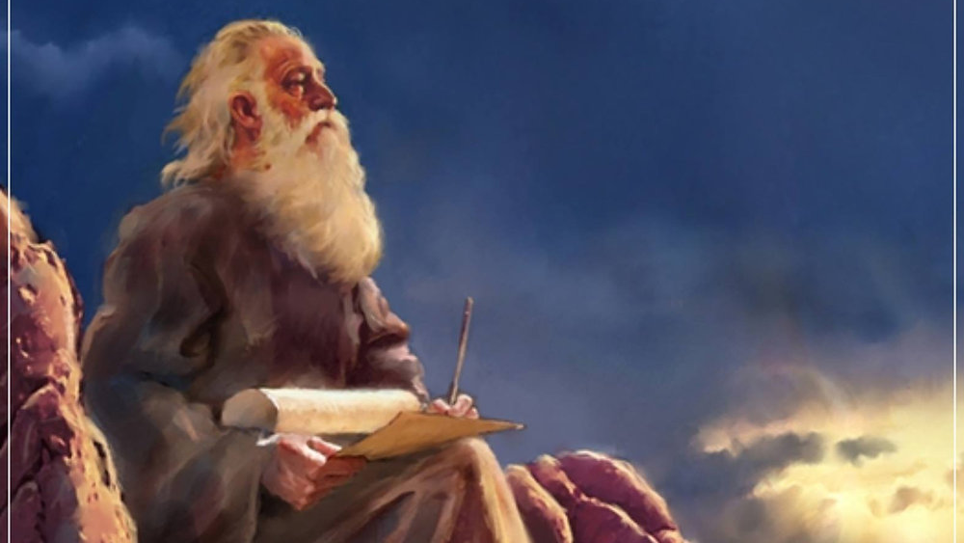
The Prophecy
Of
Isaiah
Isaiah 19–20
The Nations in God’s Eyes!
Preached by Dan Bridges Amman International Church, Jordan (AmmanChurch.org) Uploaded by Dr. Rick Griffith • Jordan Evangelical Theological Seminary Files in many languages for free download at BibleStudyDownloads.org

Slide 2
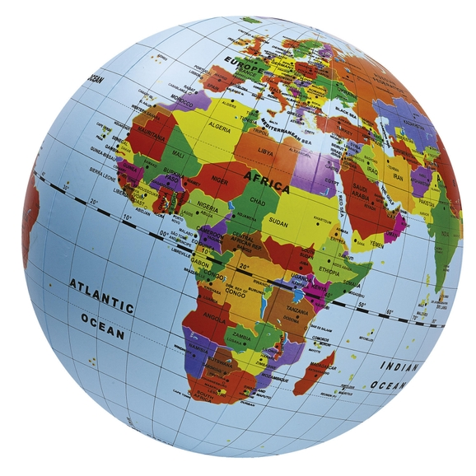
How do you view the nations?
Jordan
Palestine
Israel
Iran
US
Russia
China
…

Slide 3
How does God view the nations?
Jordan
Palestine
Israel
Iran
US
Russia
China
…

Slide 4
The Book of Isaiah
Chapters 1-39 - Judgment
Chapters 40-66 - Restoration
Focus: Isaiah’s Day
1-6: Introduction
7-12: Assyrian Invasion /
Messiah
13-27: God’s Universal
Kingdom
28-39: God as the Lord of
History
Focus: Future

Slide 5
Isaiah 13-27: God’s Universal Kingdom
Chapters 13-23: 10 Oracles Regarding the Nations
Babylon (13:1-14:27)
Philistia (14:28-32)
Moab (15:1-16:14)
Syria/Israel/Cush (17:1-18:7)
Egypt (19:1-20:6)
Babylon (21:1-10)
Edom (21:11-12)
Arabia (21:13-17)
Jerusalem (22:1-25)
Tyre (23:1-18)
Chapter 24: Worldwide Judgment / A Remnant
Chapter 25: Fulfillment of God’s Plans
Chapter 26: The People of God
Chapter 27: Israel Fulfills its Purpose

Slide 6
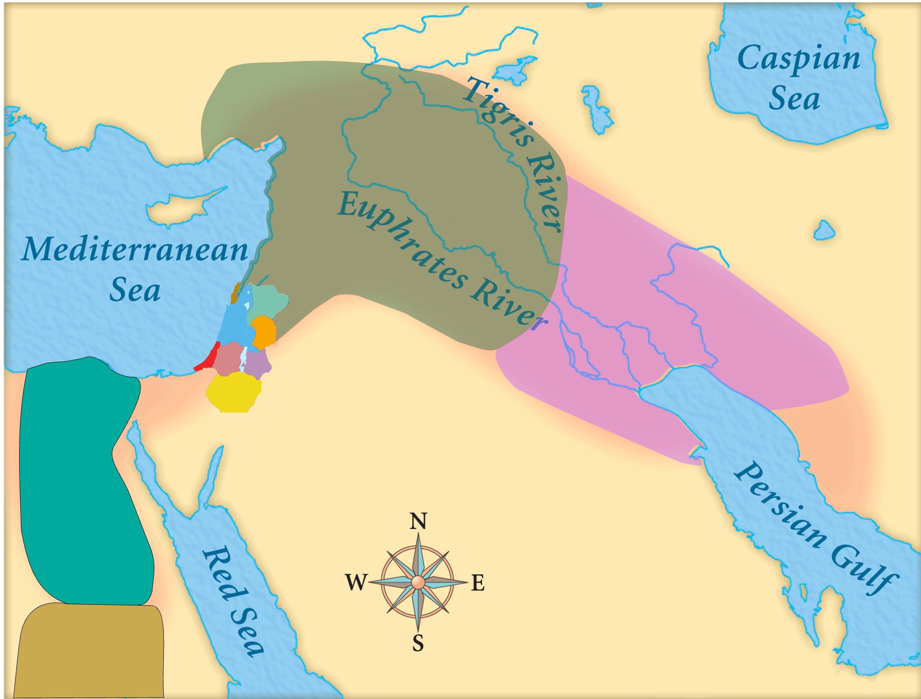
Assyria
Judah
Isaiah’s World
(~740BC)

Slide 7
Assyria
Phoenicia
Israel
Aram (Syria)
Babylon
Philistia
Judah
What did the “non-Assyrian” nations have in common?
Moab
Edom
Egypt
Arabia
Isaiah’s World
(~740BC)
Cush

Slide 8
Assyria
Israel
Aram (Syria)
Philistia
Judah
Moab
Egypt
Oracles 2-5:
Judah’s Neghbors
Cush

Slide 9
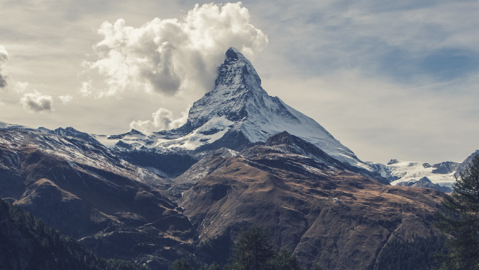
Review - The Purpose of God’s People
“…all the nations shall flow to [the mountain of the house of the Lord], and many peoples shall come, and say:
‘Come, let us go up to the mountain of the Lord, to the house of the God of Jacob, that he may teach us his ways and that we may walk in his paths.’”
Isaiah 2:2-3

Slide 10
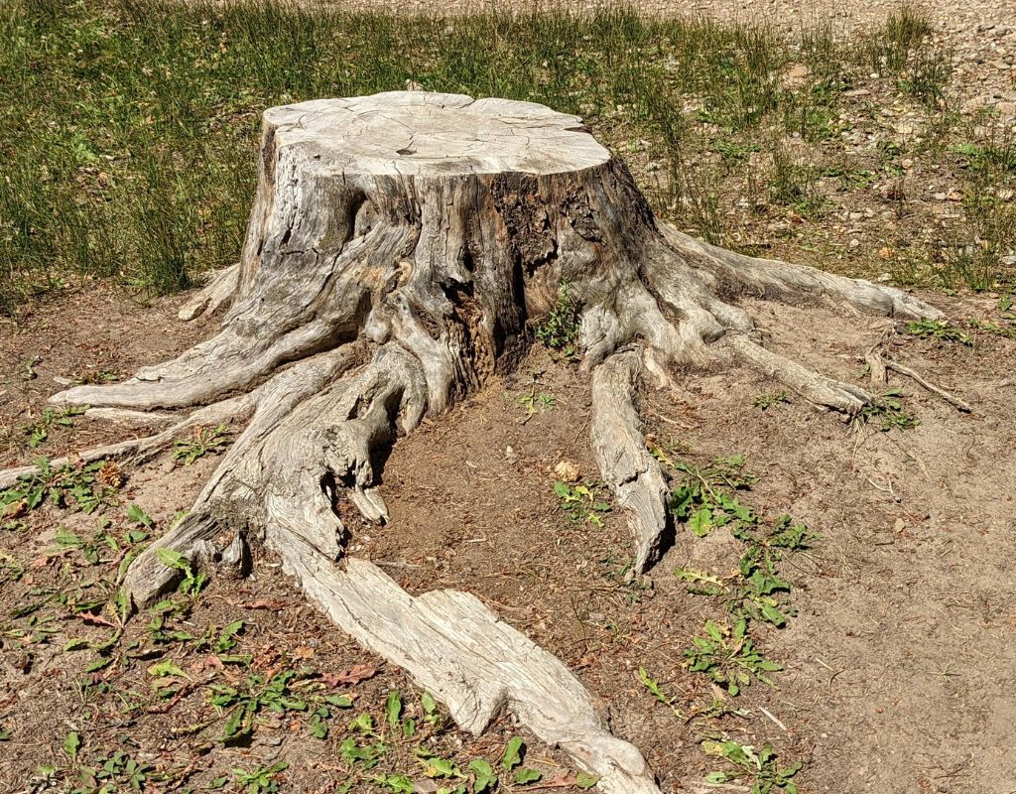
Review - The Purpose of God’s People
In that day the root of Jesse, who shall stand as a signal for the peoples—of him shall the nations inquire, and his resting place shall be glorious. Isaiah 11:10

Slide 11
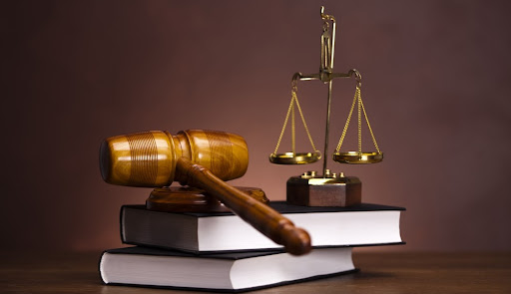
How will this happen? And on what terms – as co-equals with Judah?

Slide 12
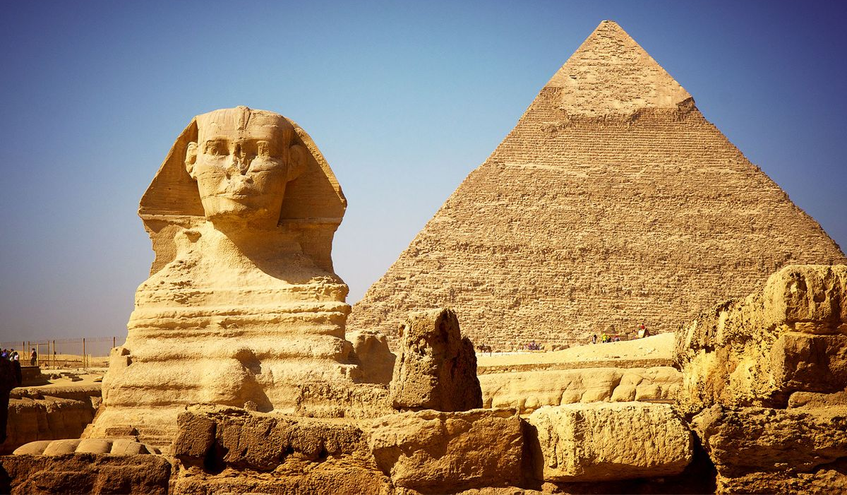
Oracle #5 – Egypt (Isaiah 19-20)
Three Parts:
Judgment on Egypt Predicted (19:1-15)
Healing of Egypt Predicted (19:16-25)
Judgment on Egypt Exemplified (20:1-6)

Slide 13
Oracle #5 – Egypt (Isaiah 19-20)
When King Hezekiah came to power (715BC), Egypt was the primary military hope against Assyria.
There was a strong temptation to trust in Egypt and make an alliance with her!

Slide 14
Isaiah 19:1-15 – A Poem of Judgment
An oracle concerning Egypt.
¹ Behold, the Lord is riding on a swift cloud
and comes to Egypt;
and the idols of Egypt will tremble at his presence,
and the heart of the Egyptians will melt within them.
What was God going to do to Egypt?

Slide 15
What was God going to do to Egypt?
Social Collapse (2-4)
Economic Collapse (5-10)
Political Collapse (11-15)

Slide 16
Social Collapse
² And I will stir up Egyptians against Egyptians,
and they will fight, each against another
and each against his neighbor,
city against city, kingdom against kingdom;
³ and the spirit of the Egyptians within them will be emptied out, and I will confound their counsel;
and they will inquire of the idols and the sorcerers,
and the mediums and the necromancers;

Slide 17
Social Collapse
⁴ and I will give over the Egyptians
into the hand of a hard master,
and a fierce king will rule over them,
declares the Lord God of hosts.
Who?
This was most likely the Assyrian King Esarhaddon, who invaded and conquered Egypt in 680BC

Slide 18
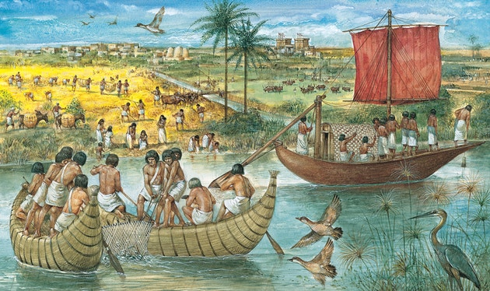
Economic Collapse
⁵ And the waters of the sea will be dried up,
and the river will be dry and parched,
⁶ and its canals will become foul,
and the branches of Egypt's Nile will diminish and dry up, reeds and rushes will rot away.
⁷ There will be bare places by the Nile,
on the brink of the Nile,
and all that is sown by the Nile will be parched,
will be driven away, and will be no more.

Slide 19
Economic Collapse
⁸ The fishermen will mourn and lament,
all who cast a hook in the Nile;
and they will languish
who spread nets on the water.
⁹ The workers in combed flax will be in despair,
and the weavers of white cotton.
¹⁰ Those who are the pillars of the land will be crushed,
and all who work for pay will be grieved.

Slide 20
Political Collapse
¹¹ The princes of Zoan are utterly foolish;
the wisest counselors of Pharaoh give stupid counsel.
How can you say to Pharaoh,
“I am a son of the wise, a son of ancient kings”?
¹² Where then are your wise men?
Let them tell you
that they might know what the Lord of hosts has purposed against Egypt.

Slide 21
Political Collapse
¹³ The princes of Zoan have become fools,
and the princes of Memphis are deluded;
those who are the cornerstones of her tribes
have made Egypt stagger.
¹⁴ The Lord has mingled within her a spirit of confusion,
and they will make Egypt stagger in all its deeds,
as a drunken man staggers in his vomit.

Slide 22
Total Helplessness!
¹⁵ And there will be nothing for Egypt
that head or tail, palm branch or reed, may do.

Slide 23
What Can We Learn?
Problems of society, economics and politics have a spiritual cause – and their only true solution is by a return to God!
Why does God do this?

Slide 24
Oracle #5 – Egypt (Isaiah 19-20)
Three Parts:
Judgment on Egypt Predicted (19:1-15)
Healing of Egypt Predicted (19:16-25)
Judgment on Egypt Exemplified (20:1-6)

Slide 25
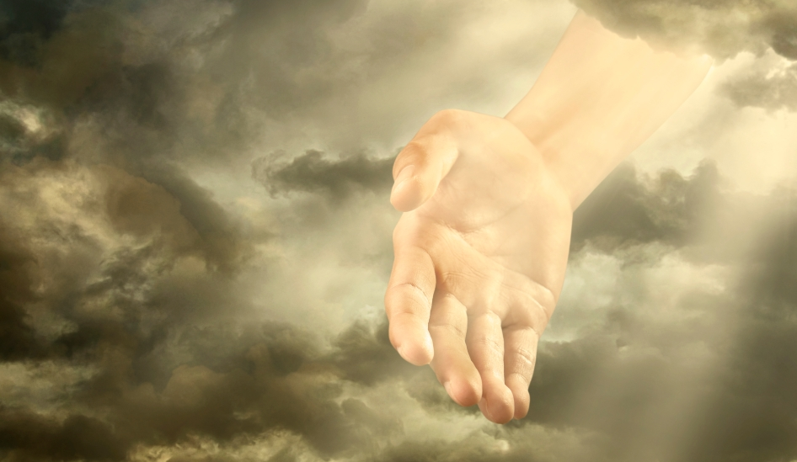
¹⁶ In that day the Egyptians will be like women, and tremble with fear before the hand that the Lord of hosts shakes over them. ¹⁷ And the land of Judah will become a terror to the Egyptians. Everyone to whom it is mentioned will fear because of the purpose that the Lord of hosts has purposed against them.
1. God would break their pride

Slide 26
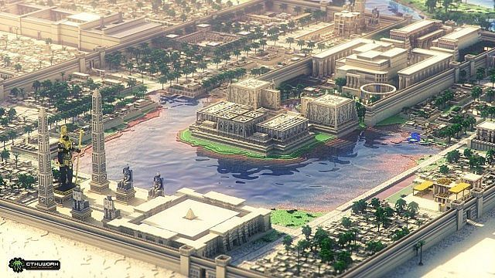
2. Repentance of a few – a small start!
¹⁸ In that day there will be five cities in the land of Egypt that speak the language of Canaan and swear allegiance to the Lord of hosts. One of these will be called the City of Destruction.

Slide 27
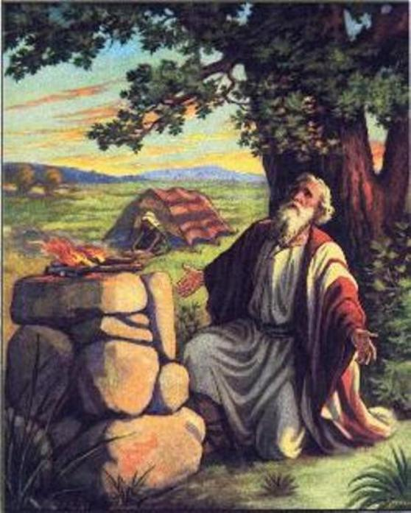
¹⁹ In that day there will be an altar to the Lord in the midst of the land of Egypt, and a pillar to the Lord at its border. ²⁰ It will be a sign and a witness to the Lord of hosts in the land of Egypt. When they cry to the Lord because of oppressors, he will send them a savior and defender, and deliver them.

Slide 28
¹⁹ In that day there will be an altar to the Lord in the midst of the land of Egypt, and a pillar to the Lord at its border. ²⁰ It will be a sign and a witness to the Lord of hosts in the land of Egypt. When they cry to the Lord because of oppressors, he will send them a savior and defender, and deliver them.
Yeshua – Jesus!

Slide 29
²¹ And the Lord will make himself known to the Egyptians, and the Egyptians will know the Lord in that day and worship with sacrifice and offering, and they will make vows to the Lord and perform them. ²² And the Lord will strike Egypt, striking and healing, and they will return to the Lord, and he will listen to their pleas for mercy and heal them.

Slide 30
²¹ And the Lord will make himself known to the Egyptians, and the Egyptians will know the Lord in that day and worship with sacrifice and offering, and they will make vows to the Lord and perform them. ²² And the Lord will strike Egypt, striking and healing, and they will return to the Lord, and he will listen to their pleas for mercy and heal them.
3. Revival in Egypt!

Slide 31
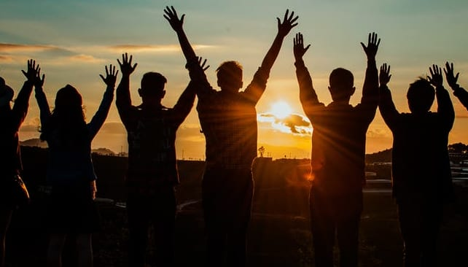
4. World-wide Revival including restored relationships with former enemies!
²³ In that day there will be a highway from Egypt to Assyria, and Assyria will come into Egypt, and Egypt into Assyria, and the Egyptians will worship with the Assyrians.

Slide 32
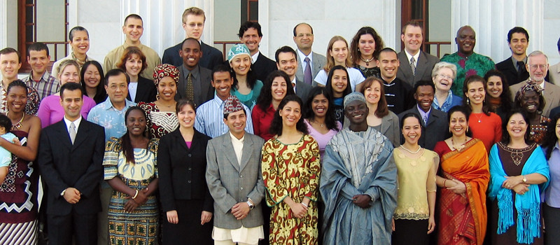
5. Full inclusion with God’s people!
²⁴ In that day Israel will be the third with Egypt and Assyria, a blessing in the midst of the earth, ²⁵ whom the Lord of hosts has blessed, saying, “Blessed be Egypt my people, and Assyria the work of my hands, and Israel my inheritance.”

Slide 33
5. Full inclusion with God’s people!
²⁸ There is neither Jew nor Greek, there is neither slave nor free, there is no male and female, for you are all one in Christ Jesus. ²⁹ And if you are Christ's, then you are Abraham's offspring, heirs according to promise. Galatians 3:28-29

Slide 34
Oracle #5 – Egypt (Isaiah 19-20)
Three Parts:
Judgment on Egypt Predicted (19:1-15)
Healing of Egypt Predicted (19:16-25)
Judgment on Egypt Exemplified (20:1-6)

Slide 35
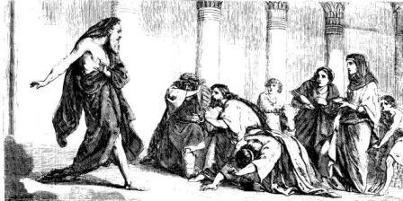
711 BC
¹ In the year that the commander in chief, who was sent by Sargon the king of Assyria, came to Ashdod and fought against it and captured it— ² at that time the Lord spoke by Isaiah the son of Amoz, saying, “Go, and loose the sackcloth from your waist and take off your sandals from your feet,” and he did so, walking naked and barefoot.

Slide 36
Sennacherib defeated the Egyptian/Ethiopian army in 701 BC
³ Then the Lord said, “As my servant Isaiah has walked naked and barefoot for three years as a sign and a portent against Egypt and Cush, ⁴ so shall the king of Assyria lead away the Egyptian captives and the Cushite exiles, both the young and the old, naked and barefoot, with buttocks uncovered, the nakedness of Egypt.

Slide 37
People of God – Judah!
⁵ Then they shall be dismayed and ashamed because of Cush their hope and of Egypt their boast. ⁶ And the inhabitants of this coastland will say in that day, “Behold, this is what has happened to those in whom we hoped and to whom we fled for help to be delivered from the king of Assyria! And we, how shall we escape?”

Slide 38
Why finish the previously hope-filled oracle with this message of doom?
Even with the hope of Isaiah 19, Egypt was still not who they should turn to for help against Assyria!
Isaiah 20 is a shorter-term, interim fulfillment to show that Isaiah 19 was really going to happen!

Slide 39
What can we learn from this “behind the scenes” view of the nations?
Through normal events, God is working for the salvation of the nations!
Eternal salvation – not current physical comfort – is God’s priority!

Slide 40
What can we learn from this “behind the scenes” view of the nations?
In ministry, we can have great hope against seemingly hopeless odds!
Will we view the nations as God does – with faith, hope and love?

Slide 41
All authority in heaven and on earth has been given to me. Go therefore and make disciples of all nations, baptizing them in the name of the Father and of the Son and of the Holy Spirit, teaching them to observe all that I have commanded you. And behold, I am with you always, to the end of the age. Matthew 28:19-20

Slide 43
OT Preaching link at BibleStudyDownloads.org
Get this presentation for free!
Notes:
OT Preaching (op)

