Slide 1
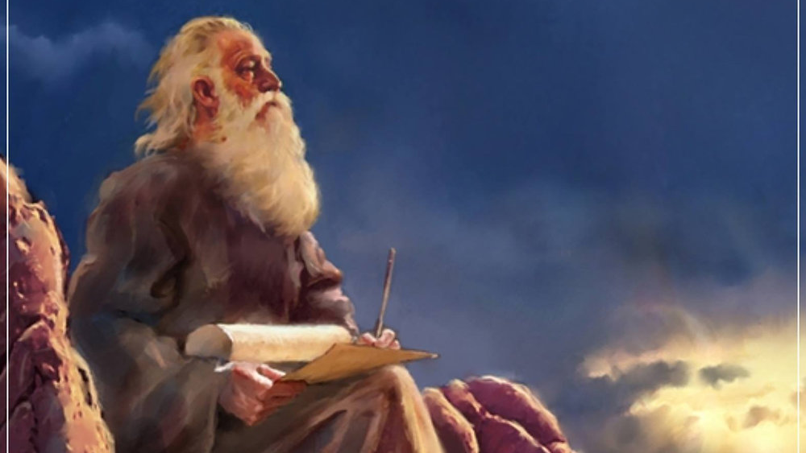
The Prophecy
Of
Isaiah
Isaiah 17:12–18:7
Waiting for God
to Act!
Preached by Dan Bridges Amman International Church, Jordan (AmmanChurch.org) Uploaded by Dr. Rick Griffith • Jordan Evangelical Theological Seminary Files in many languages for free download at BibleStudyDownloads.org

Slide 2
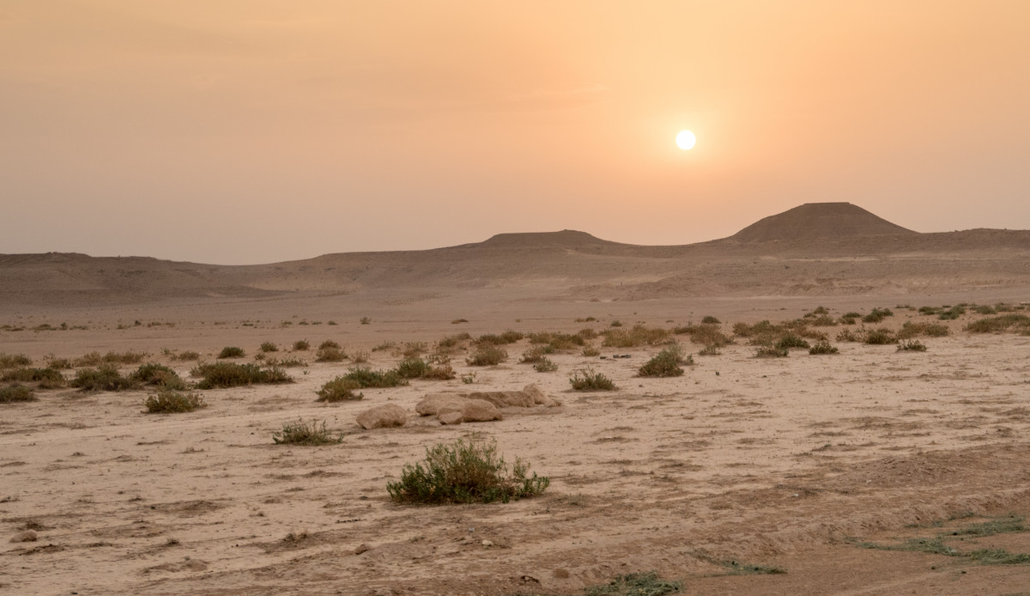
What in your life do you wish you could change?
Relationship?
Educational Opportunity / Job?
Ministry Situation?
Finances?
Other?

Slide 3
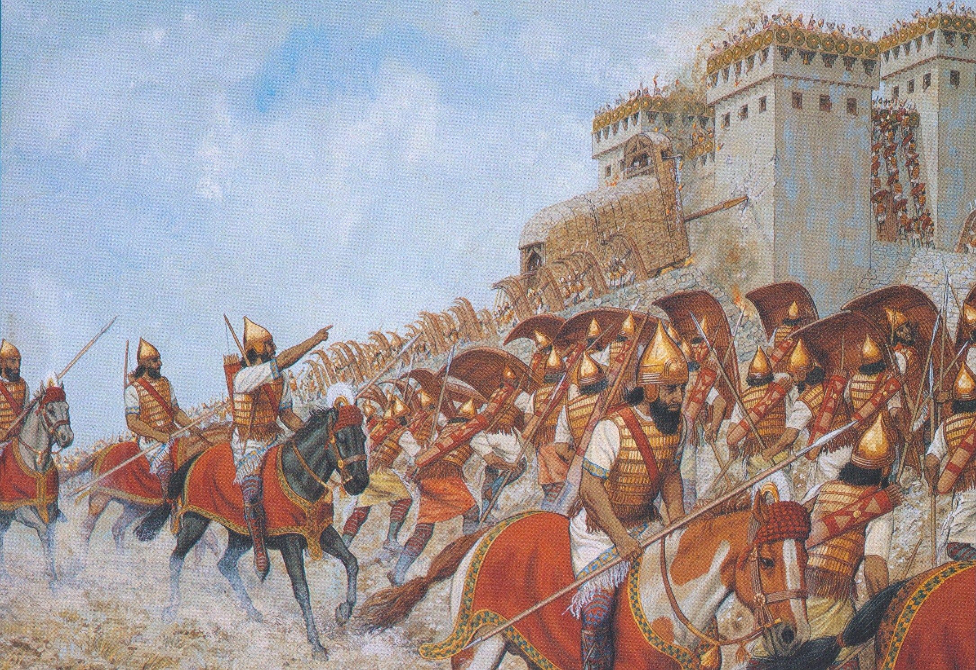
What did the people of Isaiah’s day want to change?

Slide 4
The Book of Isaiah
Chapters 1-39 - Judgment
Chapters 40-66 - Restoration
Focus: Isaiah’s Day
1-6: Introduction
7-12: Assyrian Invasion /
Messiah
13-27: God’s Universal
Kingdom
28-39: God as the Lord of
History
Focus: Future

Slide 5
Isaiah 13-27: God’s Universal Kingdom
Chapters 13-23: 10 Oracles Regarding the Nations
Babylon (13:1-14:27)
Philistia (14:28-32)
Moab (15:1-16:14)
Syria/Israel/Cush (17:1-18:7)
Egypt (19:1-20:6)
Babylon (21:1-10)
Edom (21:11-12)
Arabia (21:13-17)
Jerusalem (22:1-25)
Tyre (23:1-18)
Chapter 24: Worldwide Judgment / A Remnant
Chapter 25: Fulfillment of God’s Plans
Chapter 26: The People of God
Chapter 27: Israel Fulfills its Purpose

Slide 6
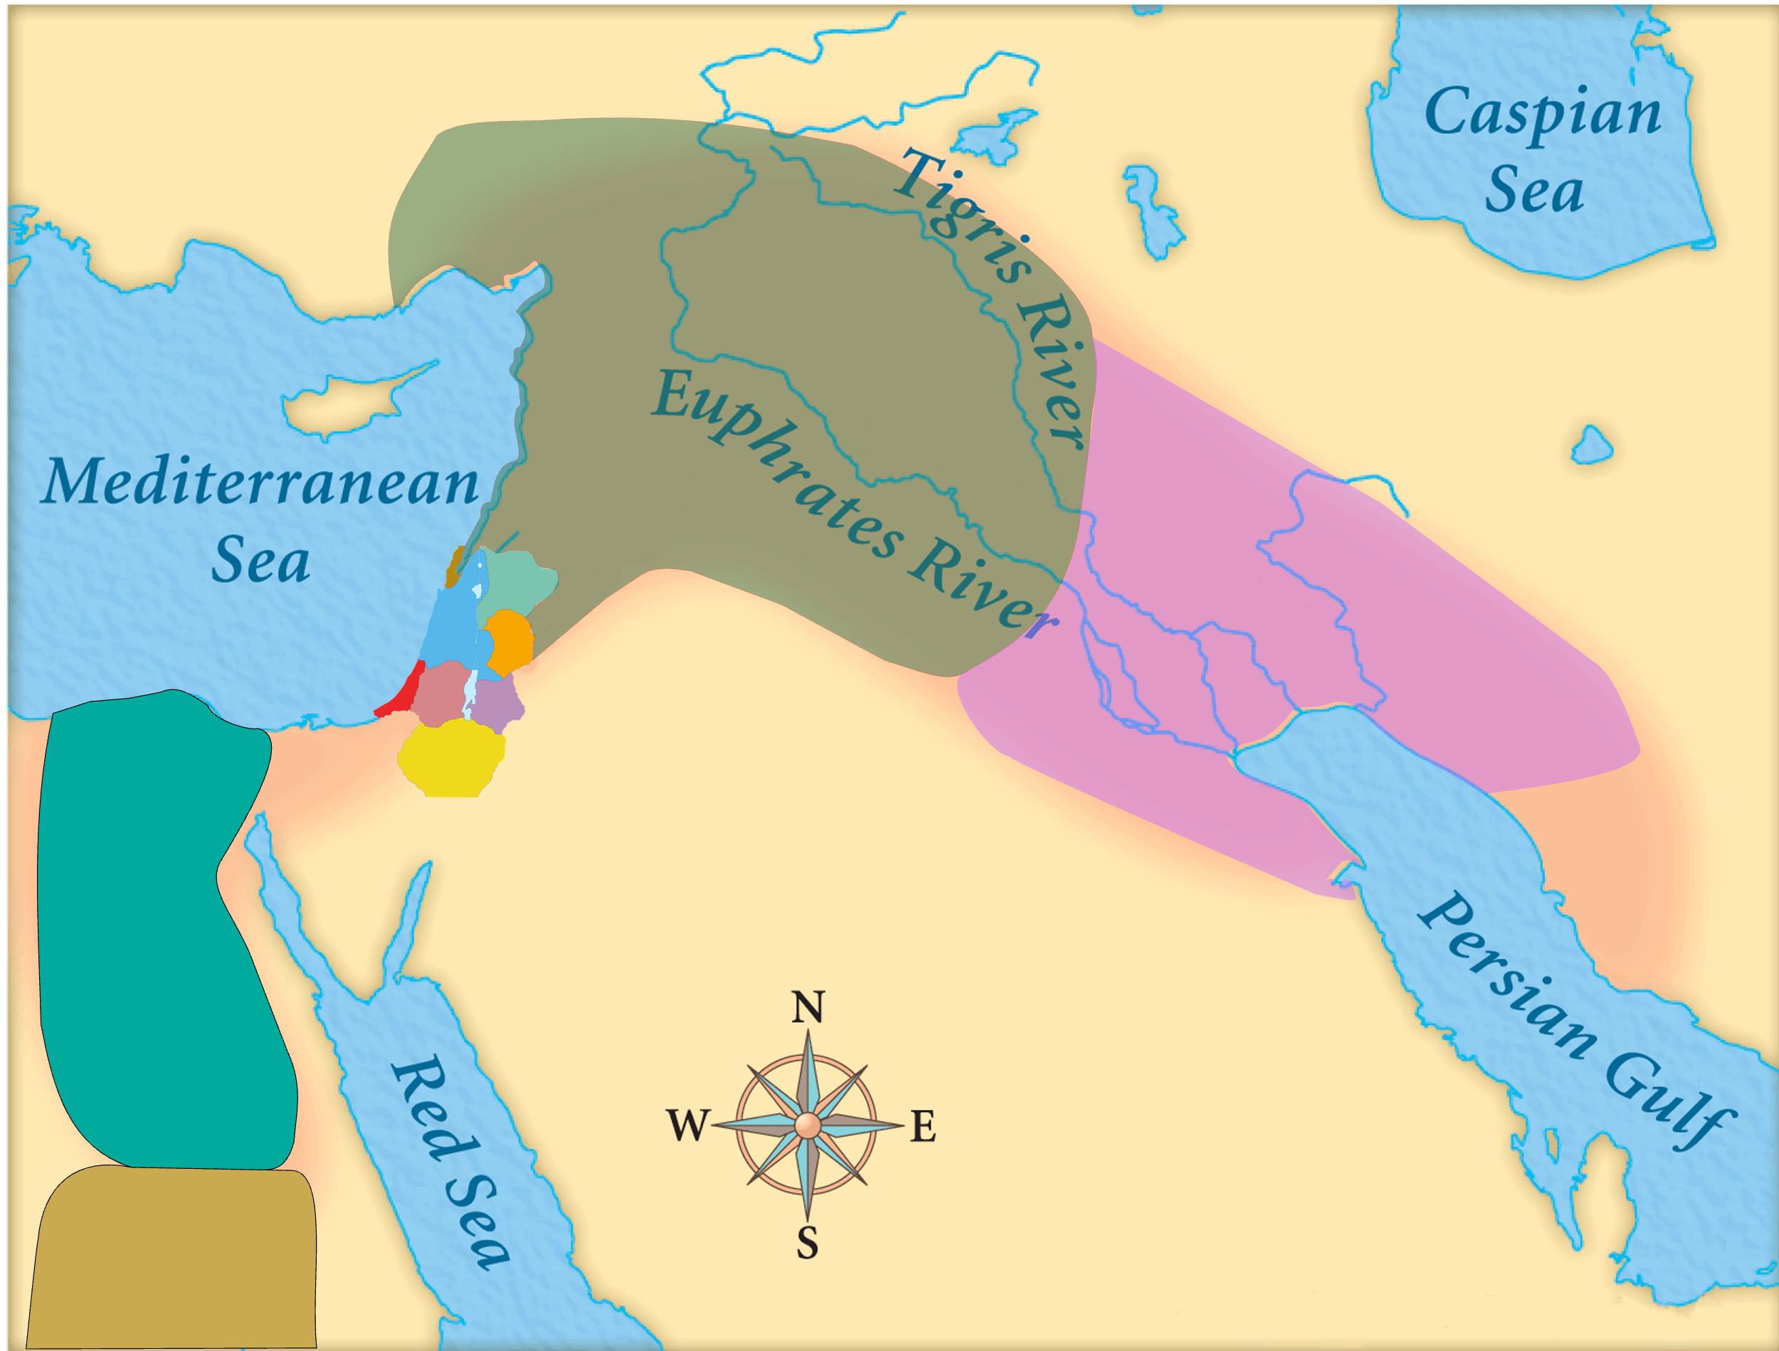
Assyria
Judah
Isaiah’s World
(~740BC)

Slide 7
Assyria
Phoenicia
Israel
Aram (Syria)
Babylon
Philistia
Judah
What did the “non-Assyrian” nations have in common?
Moab
Edom
Egypt
Arabia
Isaiah’s World
(~740BC)
Cush

Slide 8
Assyria
Israel
Aram (Syria)
Philistia
Judah
Moab
Egypt
Oracles 2-5:
Judah’s Neghbors
Cush

Slide 9
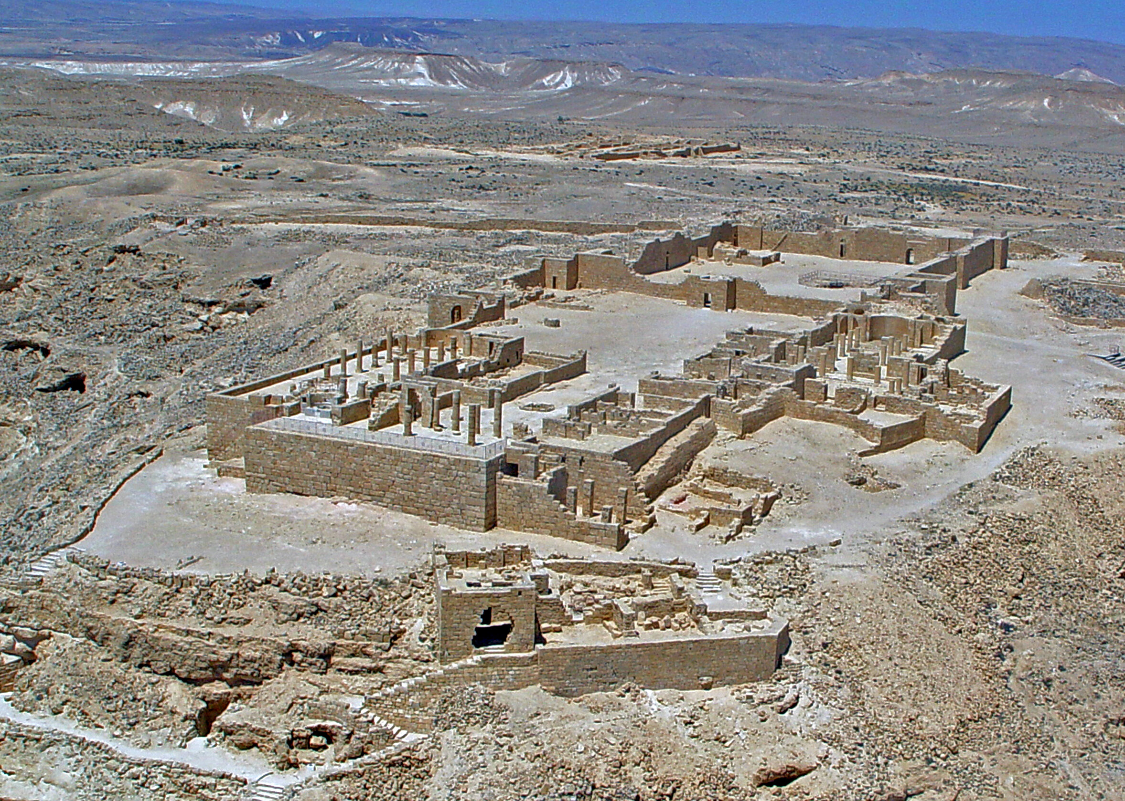
Oracle #4 – Syria / Israel (Isaiah 17-18)
Four Parts:
Coming Destruction (17:1-6)
Repentance of a Remnant (17:7-8)
Reason for Destruction (17:9-11)
The True Source of Power & Protection
For Israel (17:12-14)
For the World (18:1-7)

Slide 10
Oracle #4 – Syria / Israel (Isaiah 17)
The Remnant:
“In that day man will look to his Maker, and his eyes will look on the Holy One of Israel.”
The Rest:
“…you have forgotten the God of your salvation and have not remembered the Rock of your refuge.”

Slide 11
Oracle #4 – Syria / Israel (Isaiah 17-18)
Four Parts:
Coming Destruction (17:1-6)
Repentance of a Remnant (17:7-8)
Reason for Destruction (17:9-11)
The True Source of Power & Protection
For Israel (17:12-14)
For the World (18:1-7)

Slide 12
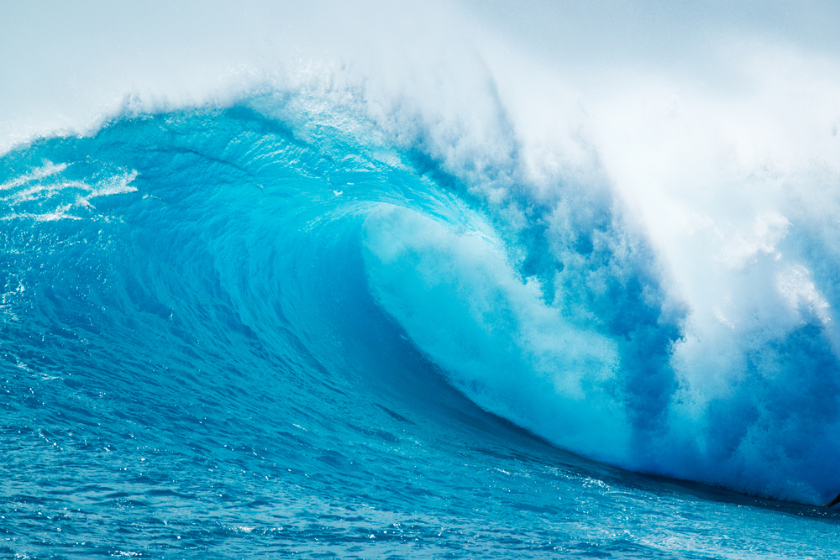
God’s Perspective…
“Ah” calls us to attention…
Connects 17:12-14 with 18:1-7
¹² Ah, the thunder of many peoples;
they thunder like the thundering of the sea!
Ah, the roar of nations;
they roar like the roaring of mighty waters!
¹³ The nations roar like the roaring of many waters…

Slide 13
God’s Perspective…
Roaring of mighty waters… the gathering tide of attack
¹² Ah, the thunder of many peoples;
they thunder like the thundering of the sea!
Ah, the roar of nations;
they roar like the roaring of mighty waters!
¹³ The nations roar like the roaring of many waters…

Slide 14
God’s Perspective…
Who is it talking about?
Assyria – but most likely a more general principle…
¹² Ah, the thunder of many peoples;
they thunder like the thundering of the sea!
Ah, the roar of nations;
they roar like the roaring of mighty waters!
¹³ The nations roar like the roaring of many waters…

Slide 15
God’s Perspective…
God’s commanding voice!
¹³ The nations roar like the roaring of many waters,
but he will rebuke them, and they will flee far away,
chased like chaff on the mountains before the wind
and whirling dust before the storm.

Slide 16
God’s Perspective…
Attack vanishes – like chaff or dust in the wind!
¹³ The nations roar like the roaring of many waters,
but he will rebuke them, and they will flee far away,
chased like chaff on the mountains before the wind
and whirling dust before the storm.

Slide 17
God’s Perspective…
The armies are destroyed overnight!
¹⁴ At evening time, behold, terror!
Before morning, they are no more!
This is the portion of those who loot us,
and the lot of those who plunder us.

Slide 18
God’s Perspective…
This is the protection available to God’s people!
¹⁴ At evening time, behold, terror!
Before morning, they are no more!
This is the portion of those who loot us,
and the lot of those who plunder us.

Slide 19
God’s Perspective…
There is true security…
but it is only found in looking to God!

Slide 20
Oracle #4 – Syria / Israel (Isaiah 17-18)
Four Parts:
Coming Destruction (17:1-6)
Repentance of a Remnant (17:7-8)
Reason for Destruction (17:9-11)
The True Source of Power & Protection
For Israel (17:12-14)
For the World (18:1-7)

Slide 21
Oracle #4 – Cush (Isaiah 18)
Assyria
Judah
¹ Ah, land of whirring wings
that is beyond the rivers of Cush,
² which sends ambassadors by the sea,
in vessels of papyrus on the waters!
Egypt
Cush

Slide 22
Oracle #4 – Cush (Isaiah 18)
Assyria
Septuagint:
“Ah, wings of a land of ships, beyond the rivers of Ethiopia…”
Judah
¹ Ah, land of whirring wings
that is beyond the rivers of Cush,
² which sends ambassadors by the sea,
in vessels of papyrus on the waters!
Egypt
Cush

Slide 23
Oracle #4 – Cush (Isaiah 18)
Assyria
Picture of Ethiopians as emmisaries / ambassadors to the world
Judah
¹ Ah, land of whirring wings
that is beyond the rivers of Cush,
² which sends ambassadors by the sea,
in vessels of papyrus on the waters!
Egypt
Cush

Slide 24
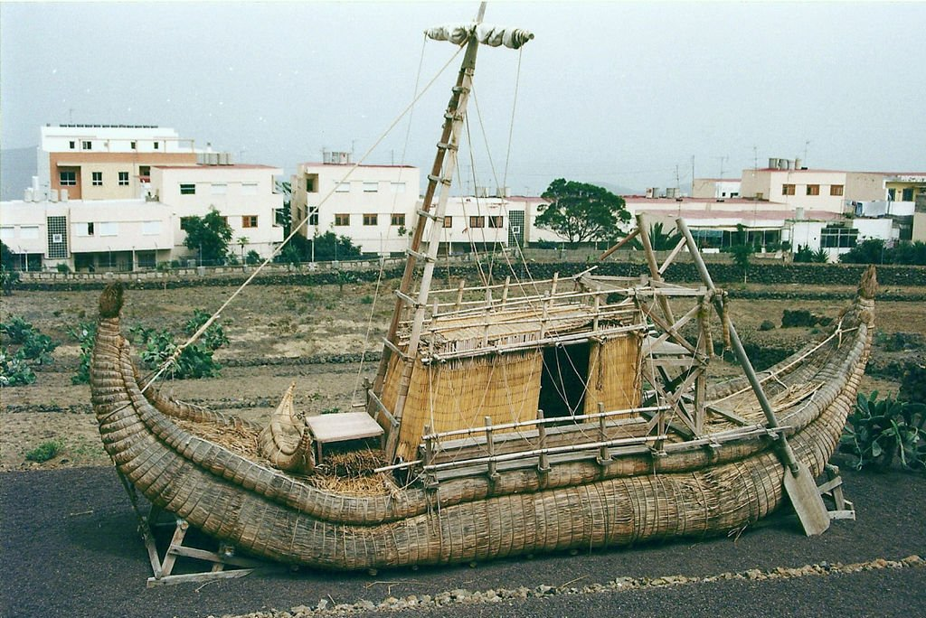
Oracle #4 – Cush (Isaiah 18)
“In 715BC, the Ethiopian Piankhi mastered Egypt, founded the 25th Dynasty and sought to play a part on the world stage. Envoys went to all the Palestinian states promising Egyptian aid in an anti-Assyrian uprising.” Alec Motyer

Slide 25
Oracle #4 – Cush (Isaiah 18)
² Go, you swift messengers,
to a nation tall and smooth,
to a people feared near and far,
a nation mighty and conquering,
whose land the rivers divide.
“Go back to your Ethiopian people (and to the world) to deliver God’s message!”

Slide 26
God’s Message!
³ All you inhabitants of the world,
you who dwell on the earth,
when a signal is raised on the mountains, look!
When a trumpet is blown, hear!

Slide 27
God’s Message!
⁴ For thus the Lord said to me:
“I will quietly look from my dwelling
like clear heat in sunshine,
like a cloud of dew in the heat of harvest.

Slide 28
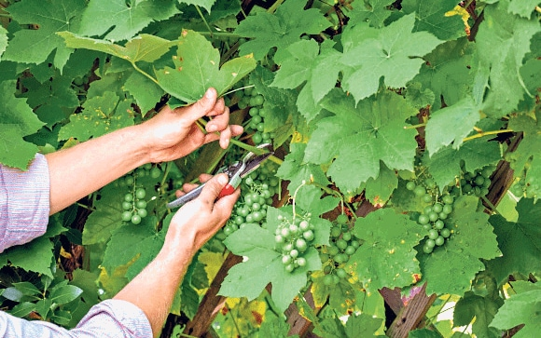
God’s Message!
God chooses his time to act!
⁵ For before the harvest, when the blossom is over,
and the flower becomes a ripening grape,
he cuts off the shoots with pruning hooks,
and the spreading branches he lops off and clears away.”

Slide 29
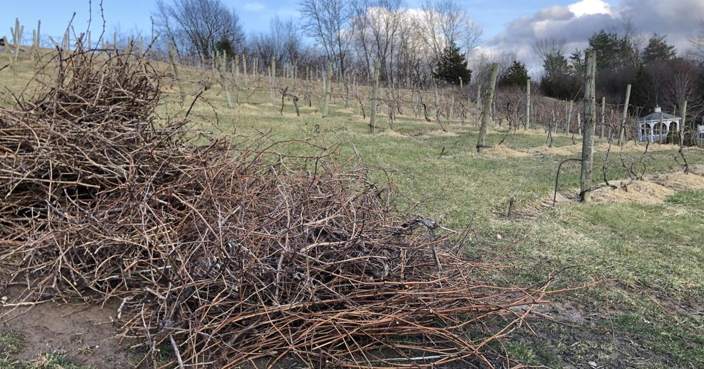
⁶ They shall all of them be left
to the birds of prey of the mountains
and to the beasts of the earth.
And the birds of prey will summer on them,
and all the beasts of the earth will winter on them.

Slide 30
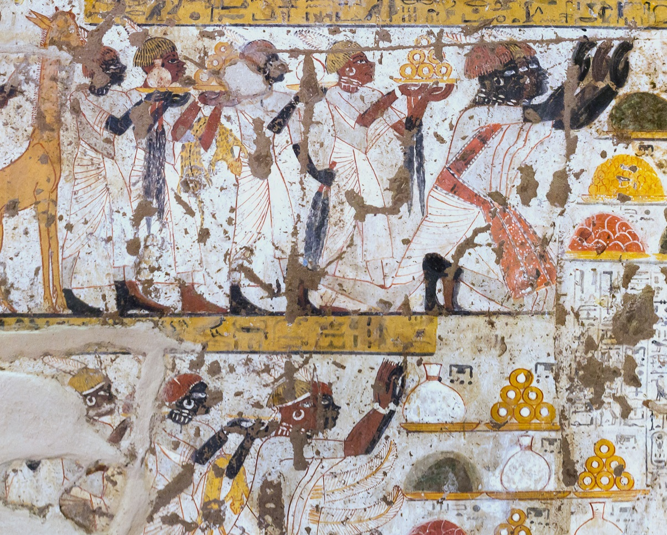
Oracle #4 – Cush (Isaiah 18)
⁷ At that time tribute will be brought to the Lord of hosts
from a people tall and smooth,
from a people feared near and far,
a nation mighty and conquering,
whose land the rivers divide,
to Mount Zion, the place of the name of the Lord of hosts.
When did / will this happen?

Slide 31
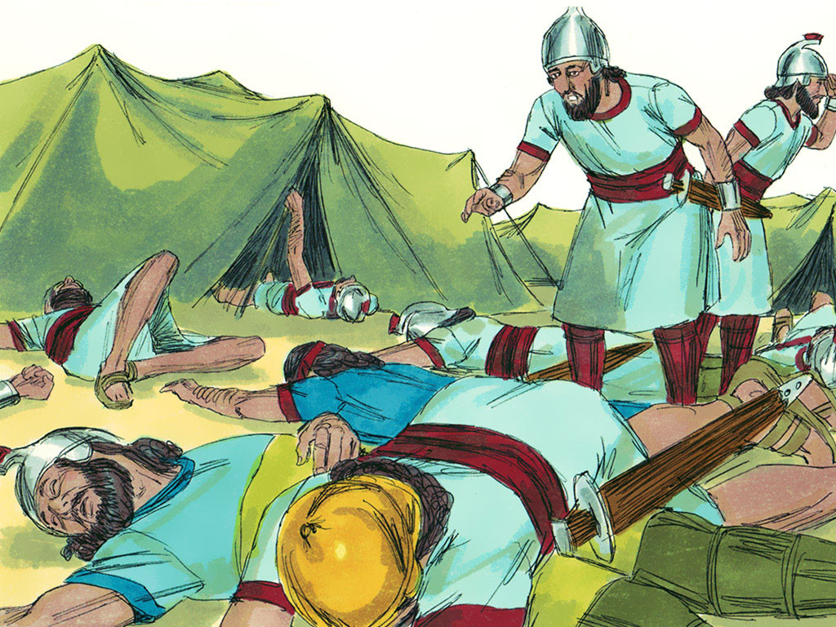
And that night the angel of the Lord went out and struck down 185,000 in the camp of the Assyrians. And when people arose early in the morning, behold, these were all dead bodies. 2 Kings 19:35
How did this affect Yahweh’s reputation?
Notes:
‘Do you understand what you are reading?’ Philip asked.

Slide 32
So the Lord saved Hezekiah and the inhabitants of Jerusalem from the hand of Sennacherib the king of Assyria and from the hand of all others, and guided them on every side. And many were bringing gifts to the Lord at Jerusalem and choice presents to Hezekiah king of Judah, so that he was exalted in the sight of all nations thereafter.
2 Chronicles 32:22-23
Notes:
‘Do you understand what you are reading?’ Philip asked.

Slide 33
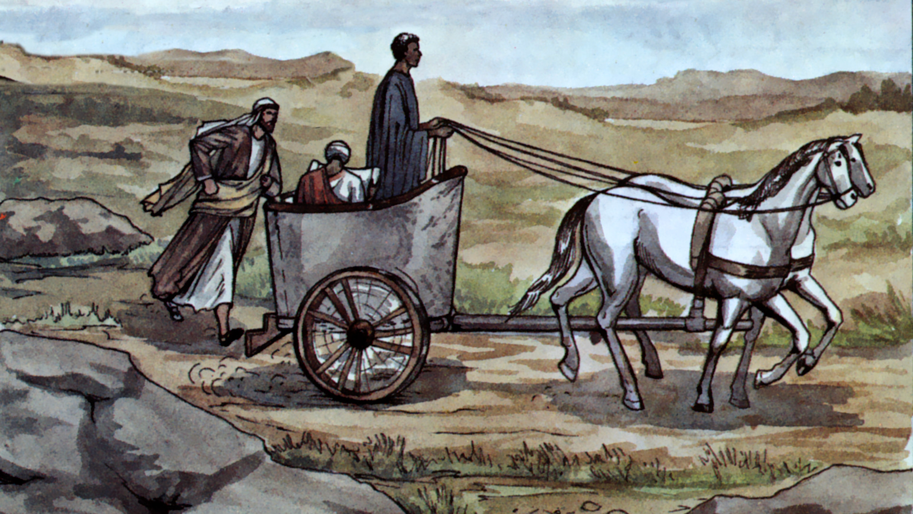
And there was an Ethiopian, a eunuch, a court official of Candace, queen of the Ethiopians, who was in charge of all her treasure. He had come to Jerusalem to worship and was returning, seated in his chariot, and he was reading the prophet Isaiah. Acts 8:27-28
Notes:
‘Do you understand what you are reading?’ Philip asked.

Slide 34
Oracle #4 – Cush (Isaiah 18)
⁷ At that time tribute will be brought to the Lord of hosts
from a people tall and smooth,
from a people feared near and far,
a nation mighty and conquering,
whose land the rivers divide,
to Mount Zion, the place of the name of the Lord of hosts.
This is what God intended his people to be!

Slide 35
Oracle #4 – Cush (Isaiah 18)
⁷ At that time tribute will be brought to the Lord of hosts
from a people tall and smooth,
from a people feared near and far,
a nation mighty and conquering,
whose land the rivers divide,
to Mount Zion, the place of the name of the Lord of hosts.
Whose purposes are accomplished in the end?

Slide 36
Oracle #4 – Cush (Isaiah 18)
When King Hezekiah waited for God to act rather than taking matters into his own hands, what happened?
He had to wait
God delivered him
God received the glory
God’s people (Judah) fulfilled their purpose as a nation drawing other nations to God!

Slide 37
Oracle #4 – Cush (Isaiah 18)
When we wait for God to act rather than taking matters into our own hands, what happens?
We have to wait on God’s timing
God provides what is genuinely best for us
God receives the glory
God’s people (us!) fulfill their purpose in drawing other people to God!

Slide 38
Oracle #4 – Cush (Isaiah 18)
Things we wish we could change…
Relationship?
Educational Opportunity / Job?
Ministry Situation?
Finances?
Other?
What are some ways we try to solve these problems on our own rather than looking to God?

Slide 39
Oracle #4 – Cush (Isaiah 18)
Things we wish we could change…
Relationship?
Educational Opportunity / Job?
Ministry Situation?
Finances?
Other?
Have you obeyed in every way you know how?
Are you now willing to wait – looking to God?

Slide 40
Oracle #4 – Syria / Israel (Isaiah 17)
To you I lift up my eyes,
O you who are enthroned in the heavens!
Behold, as the eyes of servants
look to the hand of their master,
as the eyes of a maidservant
to the hand of her mistress,
so our eyes look to the Lord our God,
till he has mercy upon us.
Psalm 123:1-2

Slide 42
OT Preaching link at BibleStudyDownloads.org
Get this presentation for free!
Notes:
OT Preaching (op)

