Slide 1
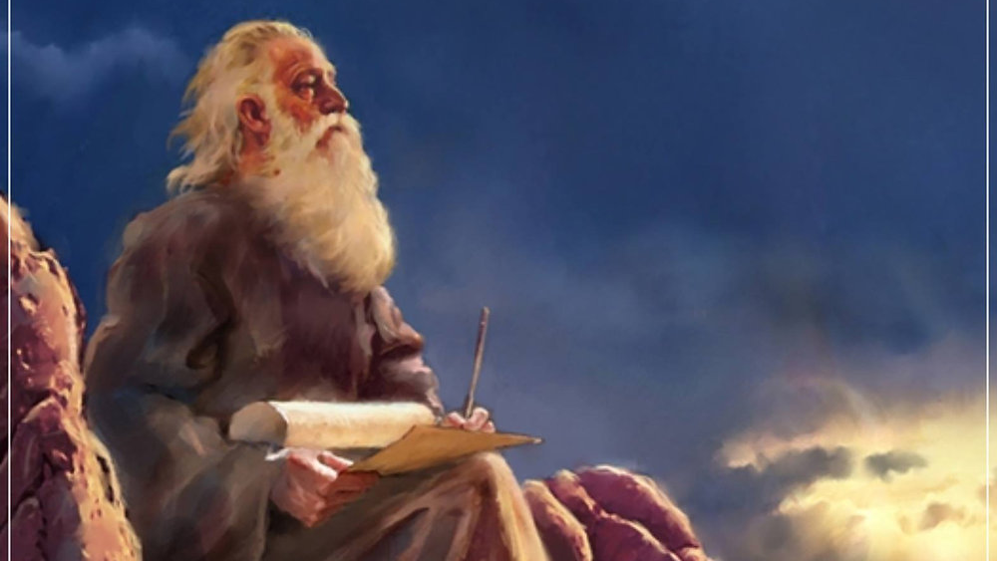
The Prophecy
Of
Isaiah
Isaiah 17:1-11
Looking to God
Preached by Dan Bridges Amman International Church, Jordan (AmmanChurch.org) Uploaded by Dr. Rick Griffith • Jordan Evangelical Theological Seminary Files in many languages for free download at BibleStudyDownloads.org

Slide 2
What do you think the Bible means when it calls us to “look to God”?

Slide 3
The Book of Isaiah
Chapters 1-39 - Judgment
Chapters 40-66 - Restoration
Focus: Isaiah’s Day
1-6: Introduction
7-12: Assyrian Invasion /
Messiah
13-27: God’s Universal
Kingdom
28-39: God as the Lord of
History
Focus: Future

Slide 4
Isaiah 13-27: God’s Universal Kingdom
Chapters 13-23: 10 Oracles Regarding the Nations
Babylon (13:1-14:27)
Philistia (14:28-32)
Moab (15:1-16:14)
Syria/Israel/Cush (17:1-18:7)
Egypt (19:1-20:6)
Babylon (21:1-10)
Edom (21:11-12)
Arabia (21:13-17)
Jerusalem (22:1-25)
Tyre (23:1-18)
Chapter 24: Worldwide Judgment / A Remnant
Chapter 25: Fulfillment of God’s Plans
Chapter 26: The People of God
Chapter 27: Israel Fulfills its Purpose

Slide 5
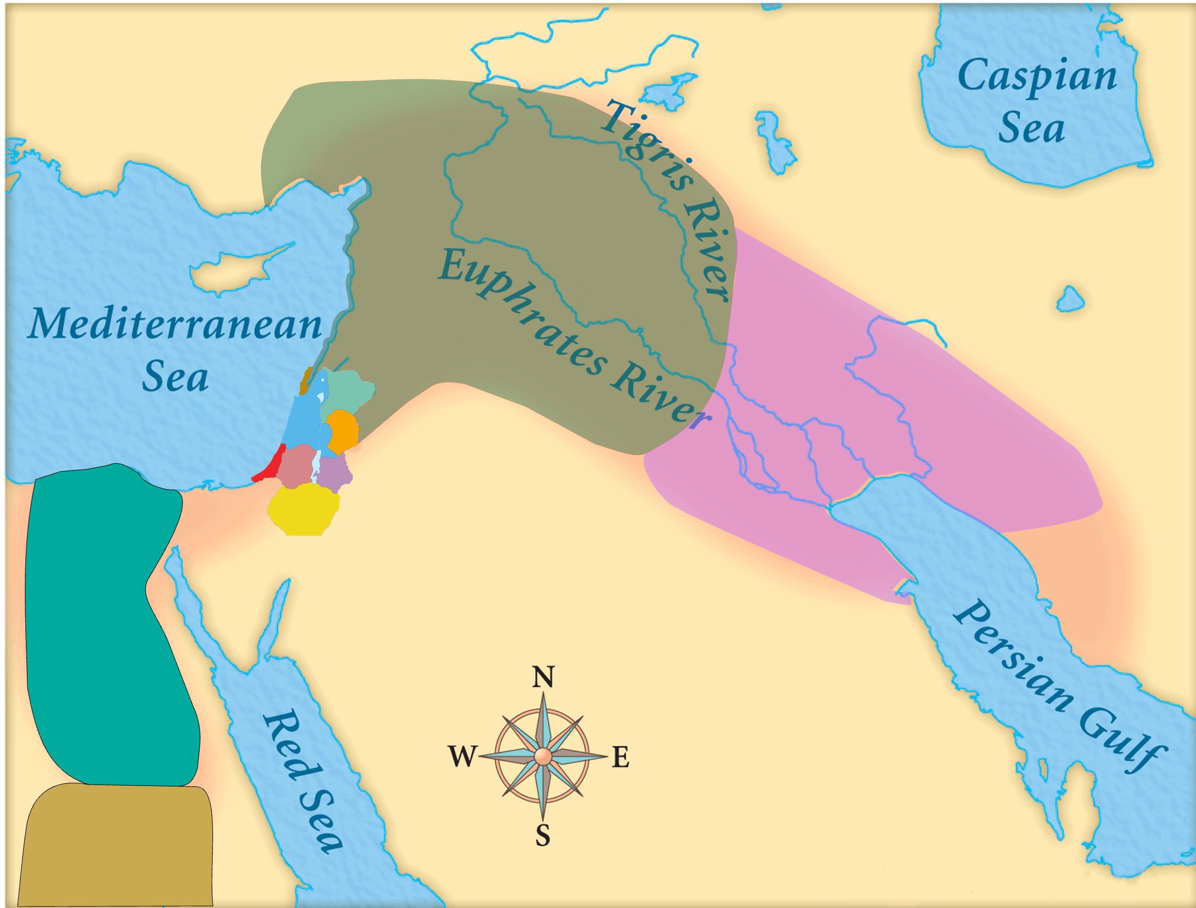
Assyria
Judah
Isaiah’s World
(~740BC)

Slide 6
Assyria
Phoenicia
Israel
Aram (Syria)
Babylon
Philistia
Judah
What did the “non-Assyrian” nations have in common?
Moab
Edom
Egypt
Arabia
Isaiah’s World
(~740BC)
Cush

Slide 7
Assyria
Israel
Aram (Syria)
Philistia
Judah
Moab
Egypt
&
Cush
Oracles 2-5:
Judah’s Neghbors

Slide 8
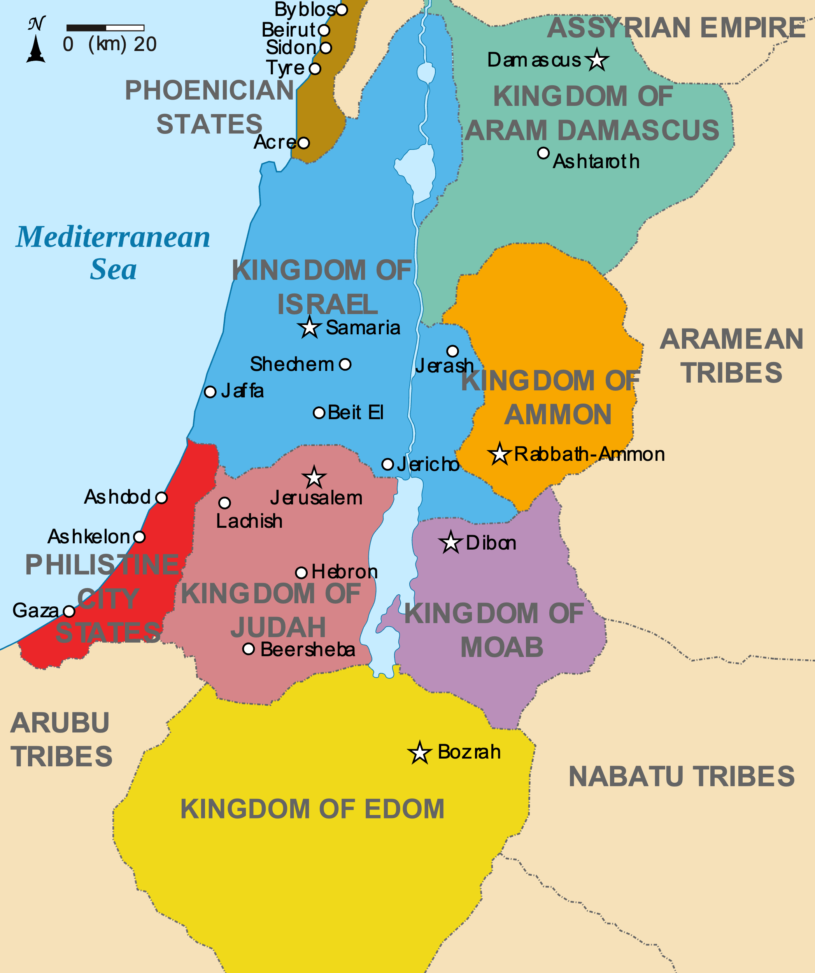
Oracle #4 – Syria / Israel
Syria
(Aram)
735 BC: Syria and Israel had allied together against Assyria; Syria and Israel attacked Judah
Damascus fell to Assyria in 732BC
Samaria fell to Assyria in 722BC
Israel
Judah

Slide 9
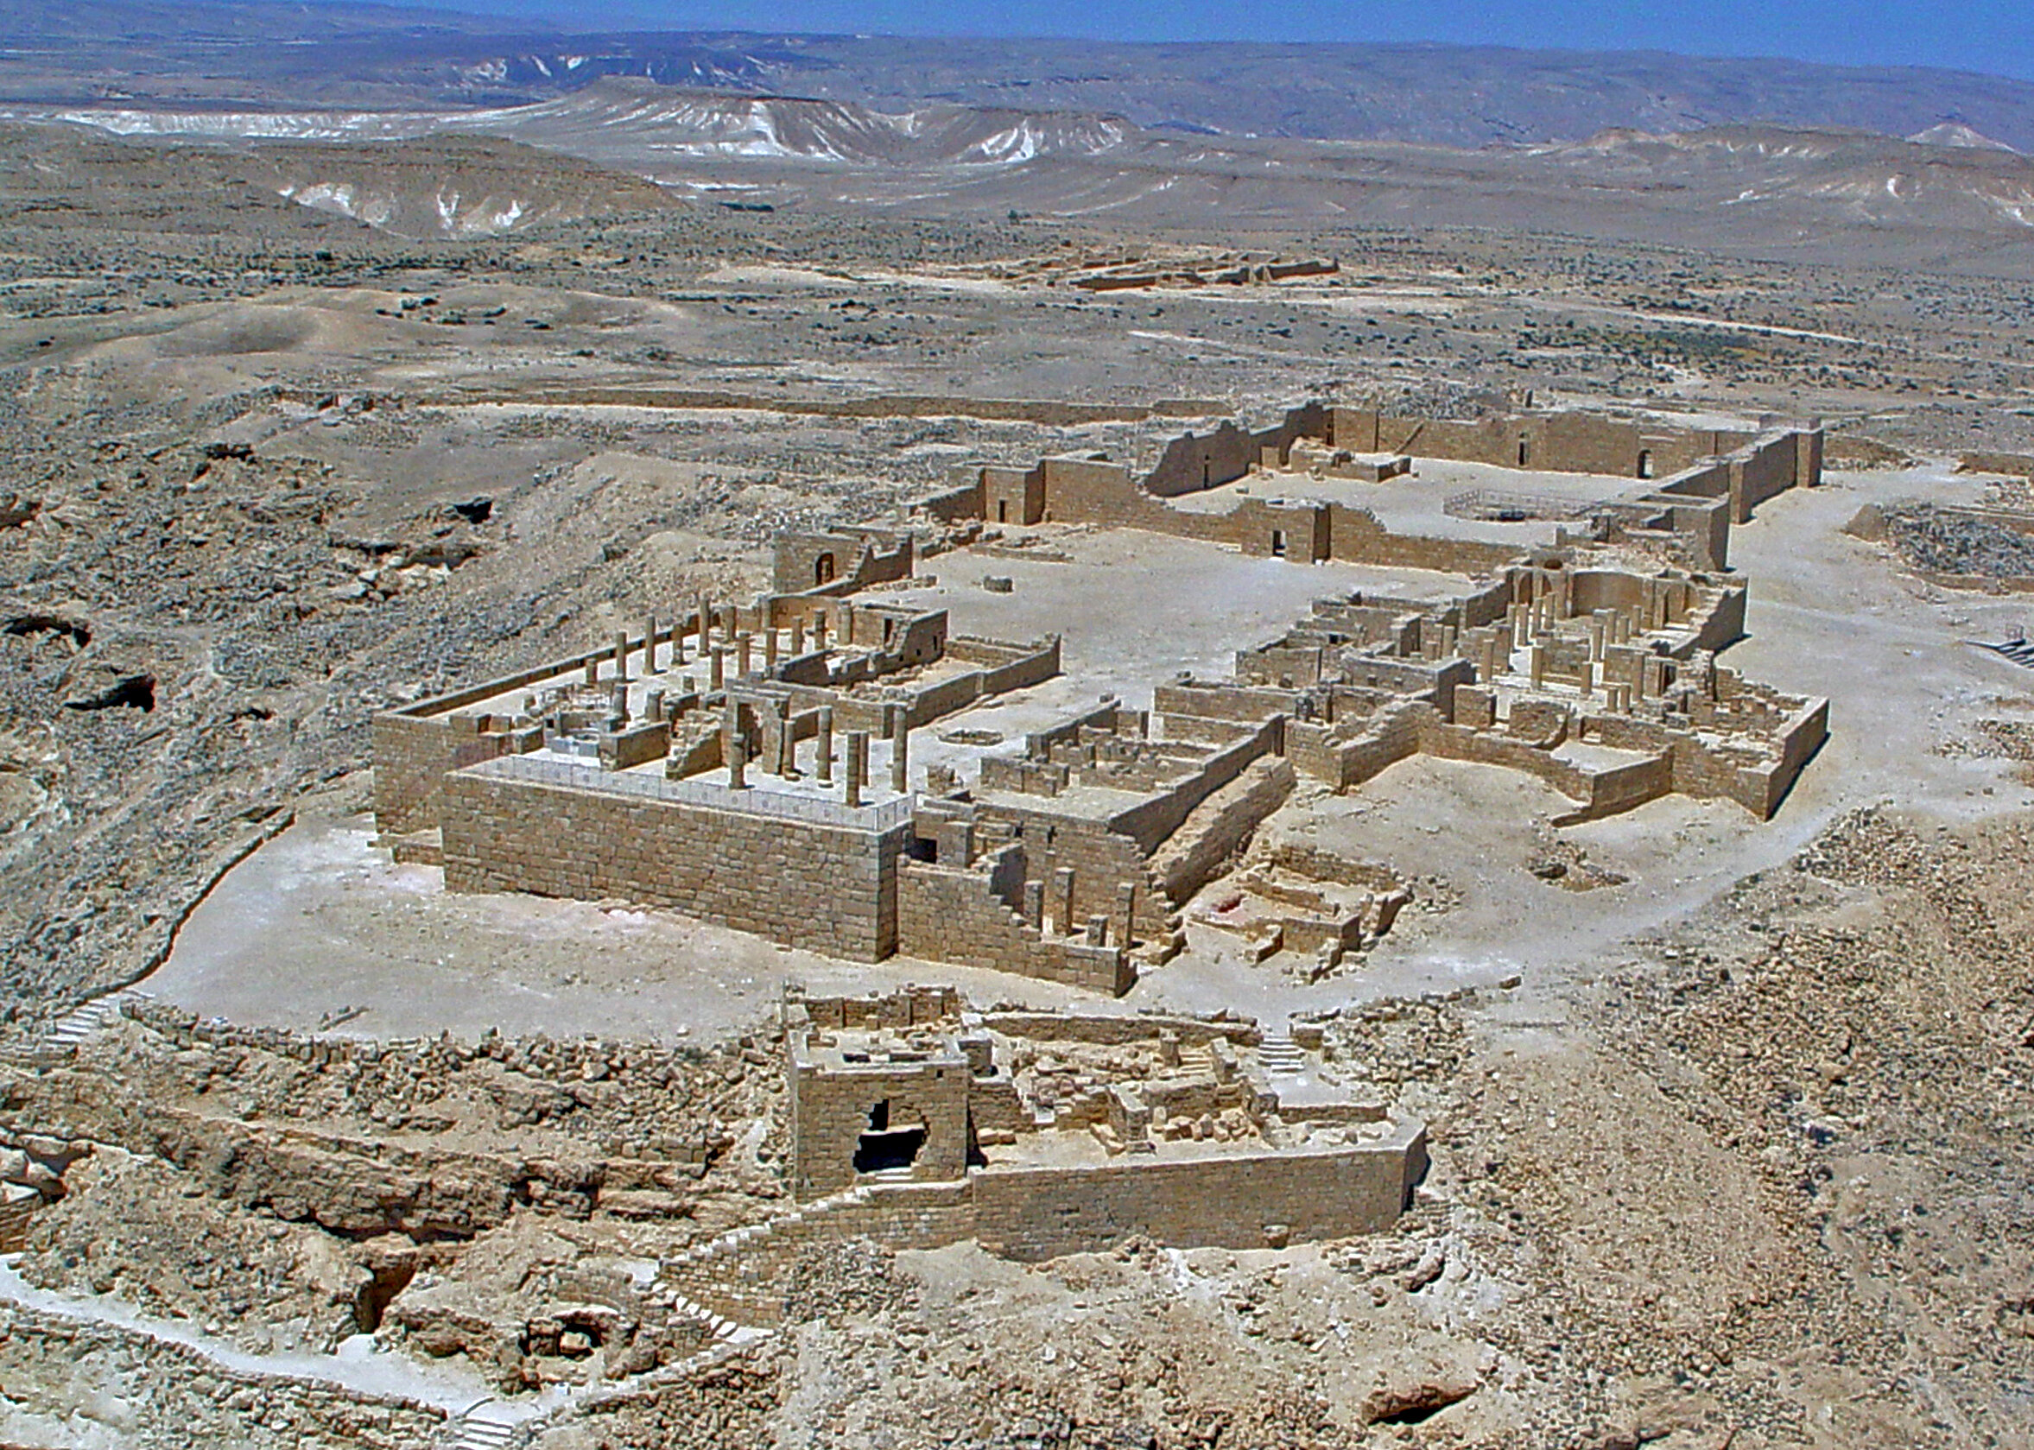
Oracle #4 – Syria / Israel (Isaiah 17-18)
Four Parts:
Coming Destruction (17:1-6)
Repentance of a Remnant (17:7-8)
Reason for Destruction (17:9-11)
The True Source of Power & Protection
For Israel (17:12-14)
For the World (18:1-7)

Slide 10
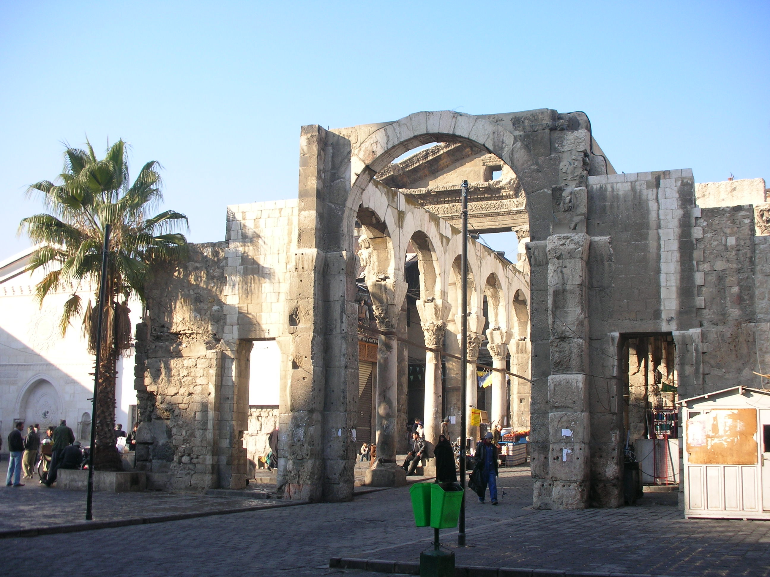
Oracle #4 – Syria / Israel (Isaiah 17)
¹ An oracle concerning Damascus.
Behold, Damascus will cease to be a city
and will become a heap of ruins.
² The cities of Aroer are deserted;
they will be for flocks,
which will lie down,
and none will make them afraid.

Slide 11
Oracle #4 – Syria / Israel (Isaiah 17)
³ The fortress will disappear from Ephraim,
and the kingdom from Damascus;
and the remnant of Syria will be
like the glory of the children of Israel,
declares the Lord of hosts.

Slide 12
Oracle #4 – Syria / Israel (Isaiah 17)
³ The fortress will disappear from Ephraim,
and the kingdom from Damascus;
and the remnant of Syria will be
like the glory of the children of Israel,
declares the Lord of hosts.
Remnant!

Slide 13
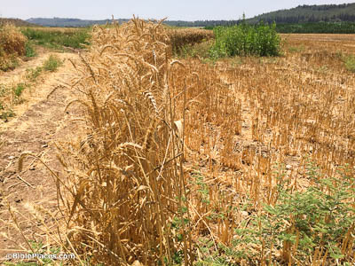
Oracle #4 – Syria / Israel (Isaiah 17)
In that day… (vss 4, 7 and 9)
Here, it means 732-722BC.
⁴ And in that day the glory of Jacob will be brought low,
and the fat of his flesh will grow lean.
⁵ And it shall be as when the reaper gathers standing grain and his arm harvests the ears,
and as when one gleans the ears of grain
in the Valley of Rephaim.

Slide 14
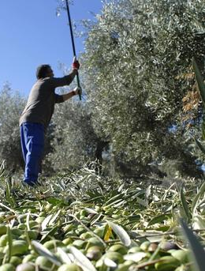
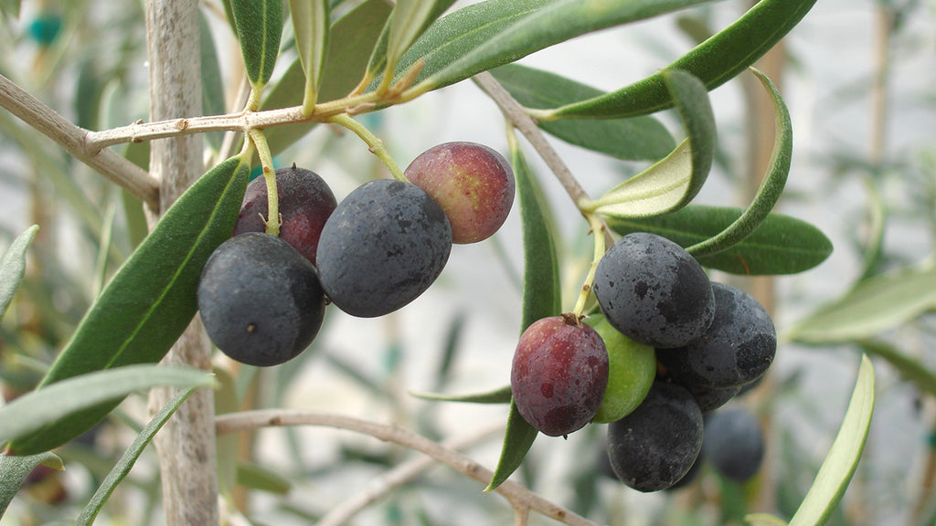
⁶ Gleanings will be left in it,
as when an olive tree is
beaten—
two or three berries in the top of the highest bough,
four or five on the branches of a fruit tree,
declares the
Lord God of
Israel.
Remnant!

Slide 15
Oracle #4 – Syria / Israel (Isaiah 17-18)
Four Parts:
Coming Destruction (17:1-6)
Repentance of a Remnant (17:7-8)
Reason for Destruction (17:9-11)
The True Source of Power & Protection
For Israel (17:12-14)
For the World (18:1-7)

Slide 16
Oracle #4 – Syria / Israel (Isaiah 17)
⁷ In that day man will look to his Maker, and his eyes will look on the Holy One of Israel. ⁸ He will not look to the altars, the work of his hands, and he will not look on what his own fingers have made, either the Asherim or the altars of incense.

Slide 17
Oracle #4 – Syria / Israel (Isaiah 17)
In that day… (vss 4, 7 and 9)
When is this referring to?
⁷ In that day man will look to his Maker, and his eyes will look on the Holy One of Israel. ⁸ He will not look to the altars, the work of his hands, and he will not look on what his own fingers have made, either the Asherim or the altars of incense.

Slide 18
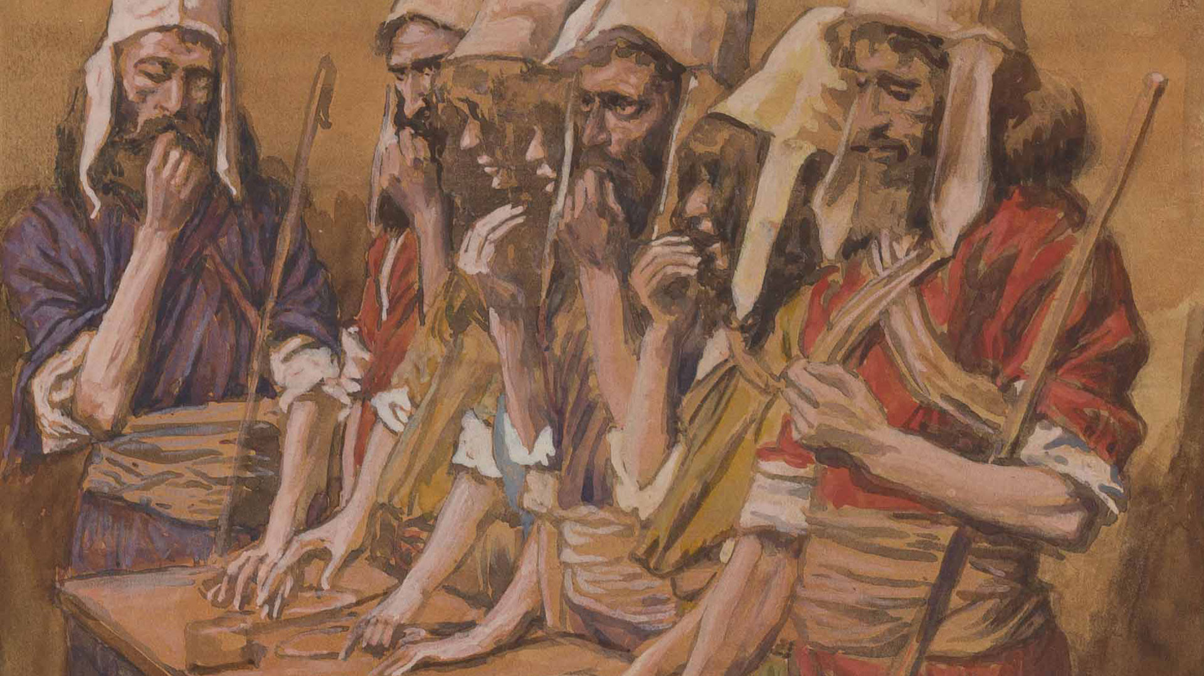
One Example of Fulfillment…
Hezekiah sent to all Israel and Judah, and wrote letters also to Ephraim and Manasseh, that they should come to the house of the Lord at Jerusalem to keep the Passover to the Lord, the God of Israel.
2 Chronicles 30:1

Slide 19
So couriers went throughout all Israel and Judah with letters from the king and his princes, as the king had commanded, saying, “O people of Israel, return to the Lord, the God of Abraham, Isaac, and Israel, that he may turn again to the remnant of you who have escaped from the hand of the kings of Assyria. Do not be like your fathers and your brothers, who were faithless to the Lord God of their fathers, so that he made them a desolation, as you see. 2 Chronicles 30:6-7

Slide 20
So the couriers went from city to city through the country of Ephraim and Manasseh, and as far as Zebulun, but they laughed them to scorn and mocked them. However, some men of Asher, of Manasseh, and of Zebulun humbled themselves and came to Jerusalem.
2 Chronicles 30:10-11

Slide 21
Oracle #4 – Syria / Israel (Isaiah 17)
The remnant from various nations will worship Yahweh and no longer depend on themselves and their own solutions for protection.
⁷ In that day man will look to his Maker, and his eyes will look on the Holy One of Israel. ⁸ He will not look to the altars, the work of his hands, and he will not look on what his own fingers have made, either the Asherim or the altars of incense.

Slide 22
Oracle #4 – Syria / Israel (Isaiah 17-18)
Four Parts:
Coming Destruction (17:1-6)
Repentance of a Remnant (17:7-8)
Reason for Destruction (17:9-11)
The True Source of Power & Protection
For Israel (17:12-14)
For the World (18:1-7)

Slide 23
Oracle #4 – Syria / Israel (Isaiah 17)
⁹ In that day their strong cities will be like the deserted places of the wooded heights and the hilltops, which they deserted because of the children of Israel, and there will be desolation.

Slide 24
Oracle #4 – Syria / Israel (Isaiah 17)
Strong cities were not enough to protect them!
⁹ In that day their strong cities will be like the deserted places of the wooded heights and the hilltops, which they deserted because of the children of Israel, and there will be desolation.

Slide 25
Oracle #4 – Syria / Israel (Isaiah 17)
Pre-Israelite fortifications destroyed by Joshua!
⁹ In that day their strong cities will be like the deserted places of the wooded heights and the hilltops, which they deserted because of the children of Israel, and there will be desolation.

Slide 26
Oracle #4 – Syria / Israel (Isaiah 17)
¹⁰ For you have forgotten the God of your salvation
and have not remembered the Rock of your refuge;
therefore, though you plant pleasant plants
and sow the vine-branch of a stranger,
¹¹ though you make them grow on the day that you plant them, and make them blossom in the morning that you sow, yet the harvest will flee away in a day of grief and incurable pain.

Slide 27
Oracle #4 – Syria / Israel (Isaiah 17)
¹⁰ For you have forgotten the God of your salvation
and have not remembered the Rock of your refuge;
therefore, though you plant pleasant plants
and sow the vine-branch of a stranger,
¹¹ though you make them grow on the day that you plant them, and make them blossom in the morning that you sow, yet the harvest will flee away in a day of grief and incurable pain.

Slide 28
Oracle #4 – Syria / Israel (Isaiah 17)
Description of idol worship
¹⁰ For you have forgotten the God of your salvation
and have not remembered the Rock of your refuge;
therefore, though you plant pleasant plants
and sow the vine-branch of a stranger,
¹¹ though you make them grow on the day that you plant them, and make them blossom in the morning that you sow, yet the harvest will flee away in a day of grief and incurable pain.

Slide 29
Oracle #4 – Syria / Israel (Isaiah 17)
What does it look like to forget God?
¹⁰ For you have forgotten the God of your salvation
and have not remembered the Rock of your refuge;
therefore, though you plant pleasant plants
and sow the vine-branch of a stranger,
¹¹ though you make them grow on the day that you plant them, and make them blossom in the morning that you sow, yet the harvest will flee away in a day of grief and incurable pain.

Slide 30
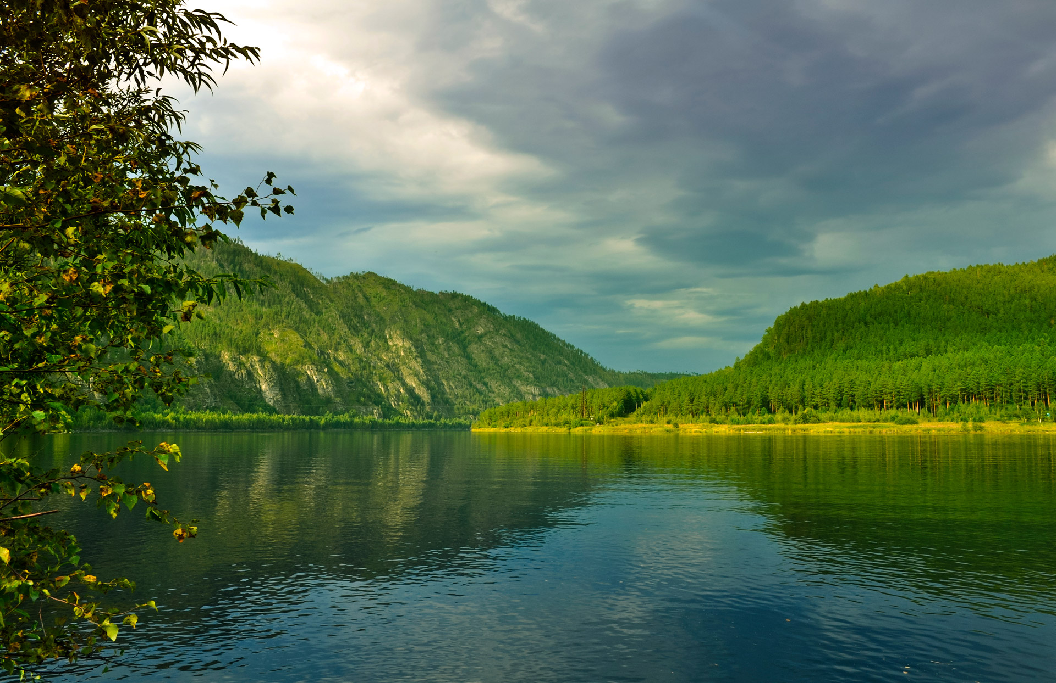
Deuteronomy 8 – Remember God!
Take care lest you forget the Lord your God by not keeping his commandments and his rules and his statutes, which I command you today, lest, when you have eaten and are full and have built good houses and live in them… then your heart be lifted up, and you forget the Lord your God, who brought you out of the land of Egypt, out of the house of slavery… Deuteronomy 8:11-14

Slide 31
Deuteronomy 8 – Remember God!
Beware lest you say in your heart, ‘My power and the might of my hand have gotten me this wealth.’ You shall remember the Lord your God, for it is he who gives you power to get wealth, that he may confirm his covenant that he swore to your fathers, as it is this day.
Deuteronomy 8:17-18

Slide 32
Oracle #4 – Syria / Israel (Isaiah 17)
Evidences that Israel had forgotten God:
They no longer recognized God as the one who had brought them into the land
They had stopped trusting God to protect them and had allied with Syria – a pagan nation
They had stopped bringing sacrifices and offerings to the temple
Idol worship

Slide 33
Oracle #4 – Syria / Israel (Isaiah 17)
What does “looking to God” mean?
The Remnant:
“In that day man will look to his Maker, and his eyes will look on the Holy One of Israel.”
The Rest:
“…you have forgotten the God of your salvation and have not remembered the Rock of your refuge.”

Slide 34
Oracle #4 – Syria / Israel (Isaiah 17)
I lift up my eyes to the hills.
From where does my help come?
My help comes from the Lord,
who made heaven and earth.
He will not let your foot be moved;
he who keeps you will not slumber.
Behold, he who keeps Israel will
neither slumber nor sleep.
Psalm 121:1-4

Slide 35
Oracle #4 – Syria / Israel (Isaiah 17)
To you I lift up my eyes,
O you who are enthroned in the heavens!
Behold, as the eyes of servants
look to the hand of their master,
as the eyes of a maidservant
to the hand of her mistress,
so our eyes look to the Lord our God,
till he has mercy upon us.
Psalm 123:1-2

Slide 36
Oracle #4 – Syria / Israel (Isaiah 17)
When we don’t look to God, but instead forget him, what does this look like?
Attitude of complaining instead of thankfulness
Handling Interpersonal Conflict – Anger, revenge, manipulation
Money – Greed, over-protective of resources, lie, cheat & steal (e.g. taxes, expense accounts)
Desire for love – Compromising in relationships, Loving only as we feel we are being loved

Slide 37
In what area of life is God calling you to look to him more?
The Remnant:
“In that day man will look to his Maker, and his eyes will look on the Holy One of Israel.”
The Rest:
“…you have forgotten the God of your salvation and have not remembered the Rock of your refuge.”

Slide 39
OT Preaching link at BibleStudyDownloads.org
Get this presentation for free!
Notes:
OT Preaching (op)

