Slide 1
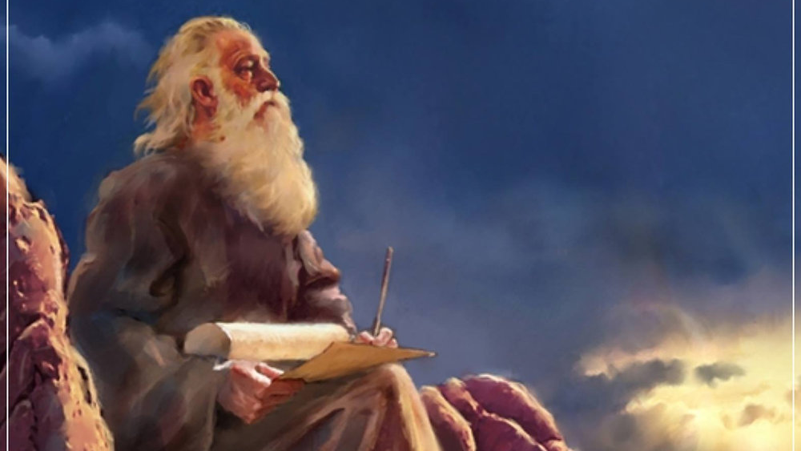
The Prophecy
Of
Isaiah
Isaiah 14:28–16:14
Will you Choose Refuge… or Pride?
Preached by Dan Bridges Amman International Church, Jordan (AmmanChurch.org) Uploaded by Dr. Rick Griffith • Jordan Evangelical Theological Seminary Files in many languages for free download at BibleStudyDownloads.org

Slide 2
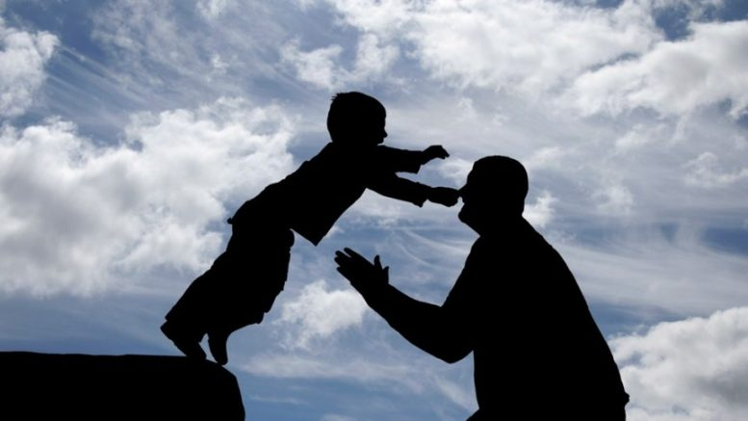
What does it mean to find refuge in God?

Slide 3
The Book of Isaiah
Chapters 1-39 - Judgment
Chapters 40-66 - Restoration
Focus: Isaiah’s Day
1-6: Introduction
7-12: Assyrian Invasion /
Messiah
13-27: God’s Universal
Kingdom
28-39: God as the Lord of
History
Focus: Future

Slide 4
Isaiah 13-27: God’s Universal Kingdom
Chapters 13-23: 10 Oracles Regarding the Nations
Babylon (13:1-14:27)
Philistia (14:28-32)
Moab (15:1-16:14)
Syria/Israel/Cush (17:1-18:7)
Egypt (19:1-20:6)
Babylon (21:1-10)
Edom (21:11-12)
Arabia (21:13-17)
Jerusalem (22:1-25)
Tyre (23:1-18)
Chapter 24: Worldwide Judgment / A Remnant
Chapter 25: Fulfillment of God’s Plans
Chapter 26: The People of God
Chapter 27: Israel Fulfills its Purpose

Slide 5
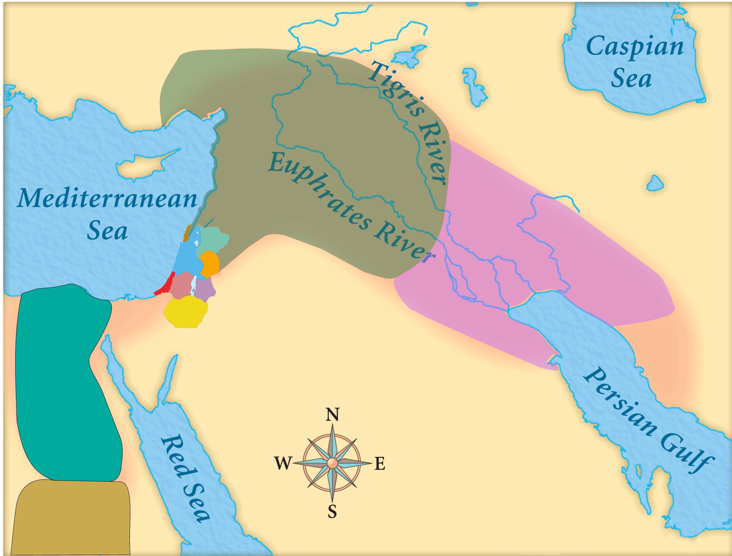
Assyria
Judah
Isaiah’s World
(~740BC)

Slide 6
Assyria
Phoenicia
Israel
Aram (Syria)
Babylon
Philistia
Judah
What did the “non-Assyrian” nations have in common?
Moab
Edom
Egypt
Arabia
Isaiah’s World
(~740BC)
Cush

Slide 7
Assyria
Israel
Aram (Syria)
Philistia
Judah
Moab
Egypt
&
Cush
Oracles 2-5:
Judah’s Neghbors

Slide 8
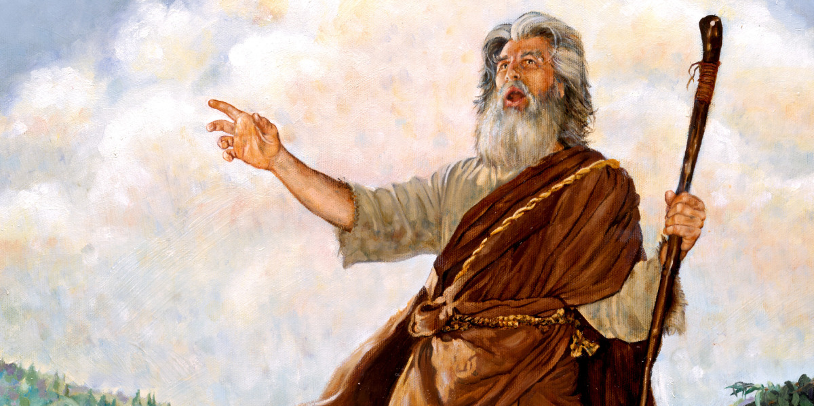
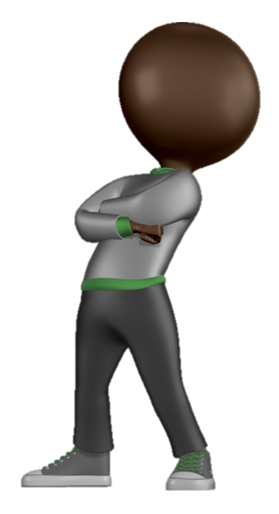
Biblical Oracle: A divine utterance given to man
What is the purpose of these 10 Oracles?
Intended audience?
These nations were all potential allies against Assyria – but they would prove to be useless!
Used to show God’s universal sovereignty
Used to show God’s universal purposes of salvation
People of Judah!

Slide 9
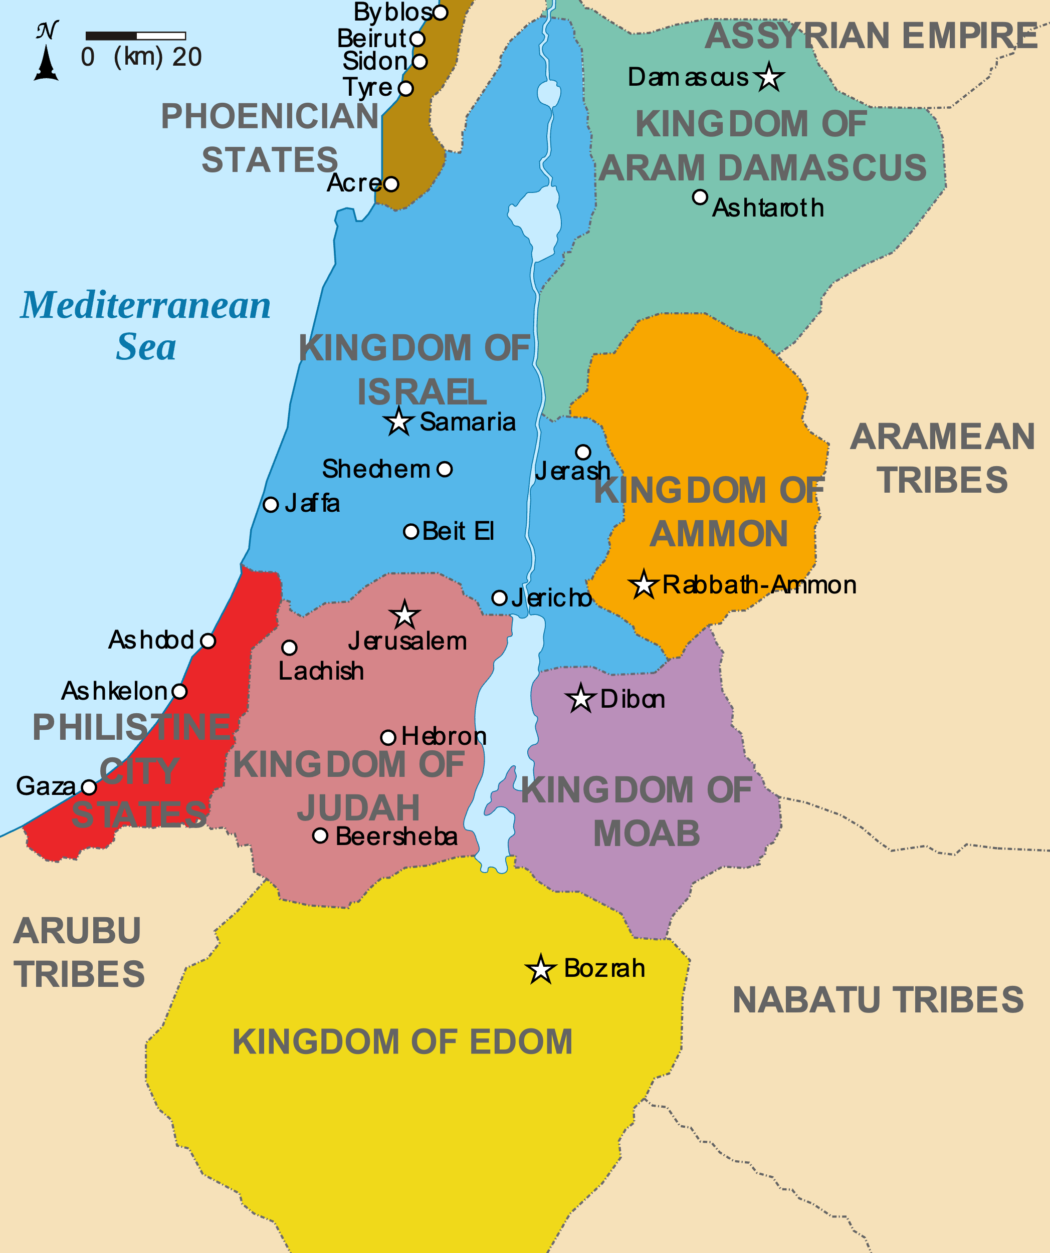
Oracle #2 – Philistia
House of David dominated Philistines from David through Jotham (300 years)
Philistines captured parts of Judah during Ahaz’s reign
Rebelled against Assyria in 734, 720, 711 and 705 BC
Philistia
Judah

Slide 10
Oracle #2 – Philistia
²⁸ In the year that King Ahaz died came this oracle:
715BC
What’s the significance of this for Philistia?
Under Ahaz, Judah had become vassal of Assyria
Philistines felt they were in a position of strength
Chance to get Judah on their side against Assyria (new king)
Philistia
Judah

Slide 11
Oracle #2 – Philistia
²⁸ In the year that King Ahaz died came this oracle:
715BC
What’s the significance of this for Judah?
After Ahaz, Judah was at its weakest point in history
God’s Word came to Isaiah at a critical time of transition
Philistia
Judah

Slide 12
Context of the Oracle – vs 32
Oracle #2 – Philistia
³² What will one answer the messengers of the nation?
“The Lord has founded Zion, and in her the afflicted of his people find refuge.”
Philistia
Judah
These “messengers” were most likely envoys seeking an alliance against Assyria.

Slide 13
Oracle #2 – Philistia
²⁹ Rejoice not, O Philistia, all of you, that the rod that struck you is broken, for from the serpent's root will come forth an adder, and its fruit will be a flying fiery serpent.
³⁰ And the firstborn of the poor will graze, and the needy lie down in safety;
Philistia
Judah

Slide 14
Oracle #2 – Philistia
²⁹ Rejoice not, O Philistia, all of you, that the rod that struck you is broken, for from the serpent's root will come forth an adder, and its fruit will be a flying fiery serpent.
³⁰ And the firstborn of the poor will graze, and the needy lie down in safety;
Philistia
House of David
Judah

Slide 15
Oracle #2 – Philistia
²⁹ Rejoice not, O Philistia, all of you, that the rod that struck you is broken, for from the serpent's root will come forth an adder, and its fruit will be a flying fiery serpent.
³⁰ And the firstborn of the poor will graze, and the needy lie down in safety;
Philistia
Rod of Moses:
Serpent’s Root = Rod
(i.e. House of David)
Judah

Slide 16
Oracle #2 – Philistia
²⁹ Rejoice not, O Philistia, all of you, that the rod that struck you is broken, for from the serpent's root will come forth an adder, and its fruit will be a flying fiery serpent.
³⁰ And the firstborn of the poor will graze, and the needy lie down in safety;
Philistia
Judah
Serpent’s Root – House of David
Adder - Hezekiah
Flying fiery serpent – The Messiah!

Slide 17
Oracle #2 – Philistia
“Thus says the Lord, Israel is my firstborn son…” Exodus 4:22
²⁹ Rejoice not, O Philistia, all of you, that the rod that struck you is broken, for from the serpent's root will come forth an adder, and its fruit will be a flying fiery serpent.
³⁰ And the firstborn of the poor will graze, and the needy lie down in safety;
Philistia
Alternate translation: “And the firstborn – poor though they be…”
Judah

Slide 18
Oracle #2 – Philistia
²⁹ Rejoice not, O Philistia, all of you, that the rod that struck you is broken, for from the serpent's root will come forth an adder, and its fruit will be a flying fiery serpent.
³⁰ And the firstborn of the poor will graze, and the needy lie down in safety;
Philistia
Judah
Promise of restoration & protection for God’s people!

Slide 19
Oracle #2 – Philistia
³⁰ …but I will kill your root with famine, and your remnant it will slay.
³¹ Wail, O gate; cry out, O city; melt in fear, O Philistia, all of you! For smoke comes out of the north, and there is no straggler in his ranks.
Philistia
Judah
Promise of destruction for Philistia…

Slide 20
Oracle #2 – Philistia
³⁰ …but I will kill your root with famine, and your remnant it will slay.
³¹ Wail, O gate; cry out, O city; melt in fear, O Philistia, all of you! For smoke comes out of the north, and there is no straggler in his ranks.
Philistia
Judah
How should Judah answer the envoy’s proposal?

Slide 21
Oracle #2 – Philistia
³² What will one answer the messengers of the nation?
“The Lord has founded Zion, and in her the afflicted of his people find refuge.”
Philistia
Judah
The answer: No deal! We have Yahweh as our protector!

Slide 22
Oracle #2 – Philistia
³² What will one answer the messengers of the nation?
“The Lord has founded Zion, and in her the afflicted of his people find refuge.”
Philistia
Judah
Oracle: 715BC
Salvation from Assyria:
14 Years of Faith!
701BC

Slide 23
Oracle #2 – Philistia
What did finding refuge in God look like for Judah?
God alone was the true refuge for Judah – that meant rejecting the Philistine alliance.
We too can be tempted to “make alliances” – we try to shortcut God’s process of helping us grow!
Philistia
Judah

Slide 24
Oracle #3 – Moab
Isaiah 15-16
Descendants of Lot
Birthplace of Ruth
In modern day Jordan – from Heshbon & Madaba in the north to the south end of the Dead Sea
Moab
Judah

Slide 25
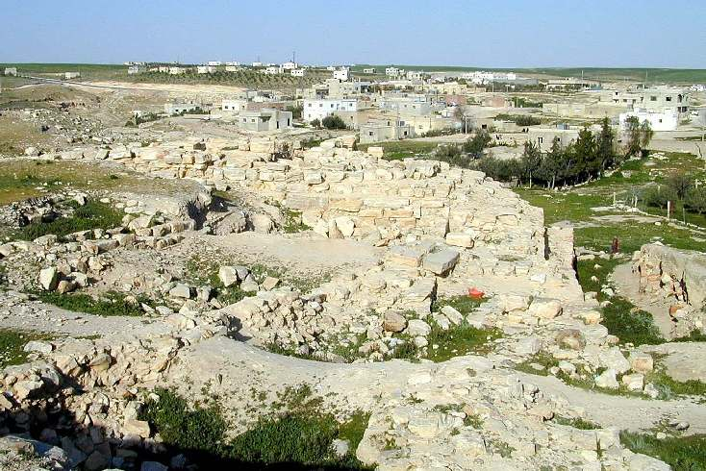
Oracle #3 – Moab (Isaiah 15)
¹ Because Ar of Moab is laid waste in a night,
Moab is undone;
because Kir of Moab is laid waste in a night,
Moab is undone.
² He has gone up to the temple, and to Dibon,
to the high places to weep;
over Nebo and over Medeba Moab wails.
On every head is baldness; every beard is shorn;

Slide 26
Oracle #3 – Moab (Isaiah 15)
³ in the streets they wear sackcloth;
on the housetops and in the squares
everyone wails and melts in tears.
⁴ Heshbon and Elealeh cry out;
their voice is heard as far as Jahaz;
therefore the armed men of Moab cry aloud;
his soul trembles.

Slide 27
Oracle #3 – Moab (Isaiah 15)
⁵ My heart cries out for Moab; her fugitives flee to Zoar, to Eglath-shelishiyah.
For at the ascent of Luhith they go up weeping;
on the road to Horonaim they raise a cry of destruction;
⁶ the waters of Nimrim are a desolation;
the grass is withered, the vegetation fails,
the greenery is no more.

Slide 28
Oracle #3 – Moab (Isaiah 15)
⁵ My heart cries out for Moab; her fugitives flee to Zoar, to Eglath-shelishiyah.
For at the ascent of Luhith they go up weeping;
on the road to Horonaim they raise a cry of destruction;
⁶ the waters of Nimrim are a desolation;
the grass is withered, the vegetation fails,
the greenery is no more.
Who is speaking?

Slide 29
Oracle #3 – Moab (Isaiah 15)
⁷ Therefore the abundance they have gained and what they have laid up they carry away over the Brook of the Willows.
⁸ For a cry has gone around the land of Moab;
her wailing reaches to Eglaim;
her wailing reaches to Beer-elim.
⁹ For the waters of Dibon are full of blood; for I will bring upon Dibon even more, a lion for those of Moab who escape, for the remnant of the land.
God’s heart was crying out – even as he brought punishment!

Slide 30
Oracle #3 – Moab (Isaiah 16)
¹ Send the lamb to the ruler of the land,
from Sela, by way of the desert,
to the mount of the daughter of Zion.
² Like fleeing birds,
like a scattered nest,
so are the daughters of Moab
at the fords of the Arnon.
Lamb: Traditional Moabite Tribute

Slide 31
Oracle #3 – Moab (Isaiah 16)
³ “Give counsel; grant justice;
make your shade like night at the height of noon;
shelter the outcasts; do not reveal the fugitive;
⁴ let the outcasts of Moab sojourn among you;
be a shelter to them from the destroyer.”
Request for protection – For refuge

Slide 32
Oracle #3 – Moab (Isaiah 16)
⁴ “When the oppressor is no more, and destruction has ceased, and he who tramples underfoot has vanished from the land,
⁵ then a throne will be established in steadfast love,
and on it will sit in faithfulness in the tent of David
one who judges and seeks justice and is swift to do righteousness.”
God’s answer

Slide 33
Oracle #3 – Moab (Isaiah 16)
⁴ “When the oppressor is no more, and destruction has ceased, and he who tramples underfoot has vanished from the land,
⁵ then a throne will be established in steadfast love,
and on it will sit in faithfulness in the tent of David
one who judges and seeks justice and is swift to do righteousness.”
God’s covenant love!
God will accept them – and allow them to live under the reign of his Messiah!

Slide 34
Oracle #3 – Moab (Isaiah 16)
⁶ We have heard of the pride of Moab—how proud he is!—of his arrogance, his pride, and his insolence;
in his idle boasting he is not right.
⁷ Therefore let Moab wail for Moab, let everyone wail. Mourn, utterly stricken, for the raisin cakes of Kir-hareseth.
Why continue to wail if God has offered his protection?

Slide 35
Oracle #3 – Moab (Isaiah 16)
⁶ We have heard of the pride of Moab—how proud he is!—of his arrogance, his pride, and his insolence;
in his idle boasting he is not right.
⁷ Therefore let Moab wail for Moab, let everyone wail. Mourn, utterly stricken, for the raisin cakes of Kir-hareseth.
In their pride, Moab refused to accept the authority of Yahweh and his Messiah!

Slide 36
Oracle #3 – Moab (Isaiah 16)
⁹ Therefore I weep with the weeping of Jazer
for the vine of Sibmah;
I drench you with my tears,
O Heshbon and Elealeh;
for over your summer fruit and your harvest
the shout has ceased.
Who is weeping?

Slide 37
Oracle #3 – Moab (Isaiah 16)
The Lord was grieved over the pride of Moab that kept her from experiencing his mercy!
¹⁰ And joy and gladness are taken away from the fruitful field, and in the vineyards no songs are sung,
no cheers are raised;
no treader treads out wine in the presses;
I have put an end to the shouting.
¹¹ Therefore my inner parts moan like a lyre for Moab,
and my inmost self for Kir-hareseth.

Slide 38
Oracle #3 – Moab (Isaiah 16)
¹⁰ And joy and gladness are taken away from the fruitful field, and in the vineyards no songs are sung,
no cheers are raised;
no treader treads out wine in the presses;
I have put an end to the shouting.
¹¹ Therefore my inner parts moan like a lyre for Moab, and my inmost self for Kir-hareseth.
Deep-seated agony of God

Slide 39
Oracle #3 – Moab (Isaiah 16)
¹² And when Moab presents himself, when he wearies himself on the high place, when he comes to his sanctuary to pray, he will not prevail.

Slide 40
Oracle #3 – Moab (Isaiah 16)
¹³ This is the word that the Lord spoke concerning Moab in the past. ¹⁴ But now the Lord has spoken, saying, “In three years, like the years of a hired worker, the glory of Moab will be brought into contempt, in spite of all his great multitude, and those who remain will be very few and feeble.”

Slide 41
Summary of Oracle #3 – Moab
What do we learn from this oracle?
God deeply loved the people of Moab and offered his salvation and protection to them – he wanted to be their refuge too!
Moab was unwilling to turn away from their gods due to their pride and self-reliance.

Slide 42
Big Idea from Oracles 2 & 3
God alone is our refuge in every aspect of life!
It is arrogance and pride that keep us from experiencing that.

Slide 43
How is God asking you to find refuge in him?
Trusting in Jesus alone to be your savior
A difficult relationship with a spouse, child, relative or co-worker
Shame / embarrassment of cross-cultural adjustment, feelings of ineffectiveness
In any area of life where God is not our refuge, we will make sinful alliances – pride and self-reliance will rule.

Slide 45
OT Preaching link at BibleStudyDownloads.org
Get this presentation for free!
Notes:
OT Preaching (op)

