Slide 1
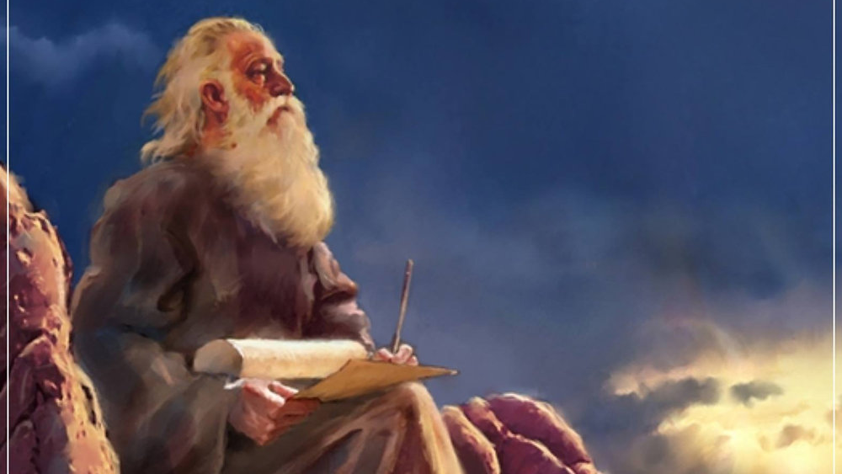
The Prophecy
Of
Isaiah
Isaiah 13:1–14:27
God – the Architect and Ruler of History!
Preached by Dan Bridges Amman International Church, Jordan (AmmanChurch.org) Uploaded by Dr. Rick Griffith • Jordan Evangelical Theological Seminary Files in many languages for free download at BibleStudyDownloads.org

Slide 2
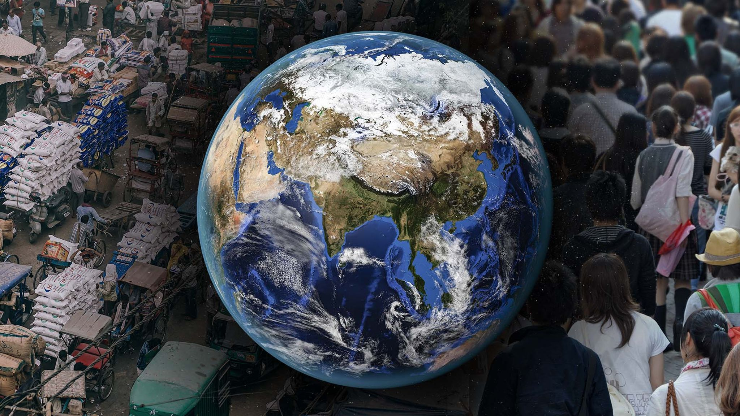
What world events are most on your mind?

Slide 3
What events in your own life worry you?

Slide 4
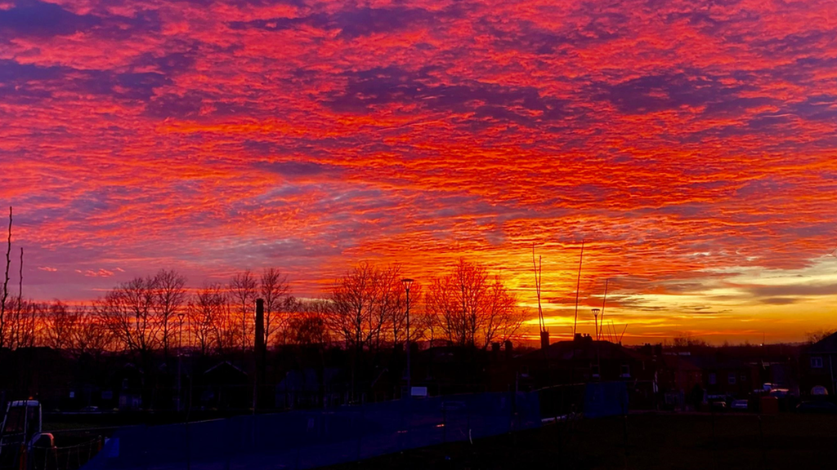
How is God involved in all of this?

Slide 5
The Book of Isaiah
Chapters 1-39 - Judgment
Chapters 40-66 - Restoration
Focus: Isaiah’s Day
1-6: Introduction
7-12: Assyrian Invasion /
Messiah
13-27: God’s Universal
Kingdom
28-39: God as the Lord of
History
Focus: Future

Slide 6
Isaiah 13-27: God’s Universal Kingdom
Chapters 13-23: 10 Oracles Regarding the Nations
Babylon (13:1-14:27)
Philistia (14:28-32)
Moab (15:1-16:14)
Syria/Israel/Cush (17:1-18:7)
Egypt (19:1-20:6)
Babylon (21:1-10)
Edom (21:11-12)
Arabia (21:13-17)
Jerusalem (22:1-25)
Tyre (23:1-18)
Chapter 24: Worldwide Judgment / A Remnant
Chapter 25: Fulfillment of God’s Plans
Chapter 26: The People of God
Chapter 27: Israel Fulfills its Purpose

Slide 7
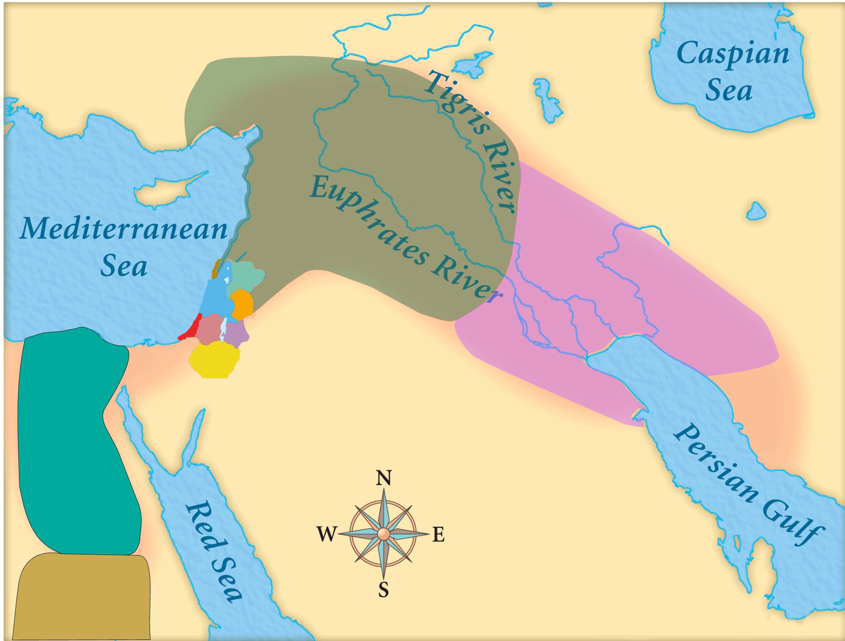
Assyria
Judah
Isaiah’s World
(~740BC)

Slide 8
Assyria
Babylon
Judah
Egypt
Isaiah’s World
(~740BC)
Cush

Slide 9
Assyria
Phoenicia
Israel
Aram (Syria)
Babylon
Philistia
Judah
What did the “non-Assyrian” nations have in common?
Moab
Edom
Egypt
Arabia
Isaiah’s World
(~740BC)
Cush

Slide 10
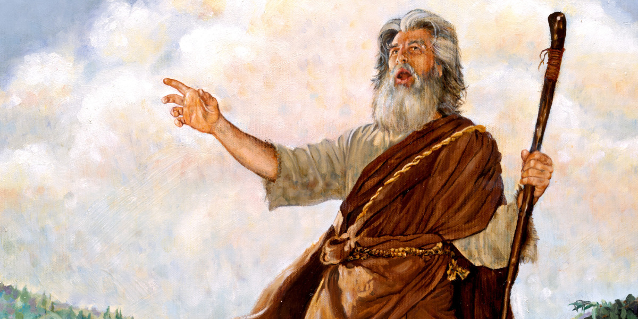
Biblical Oracle: A divine utterance given to man
What is the purpose of these 10 Oracles?
Intended audience?
These nations were all potential allies against Assyria – but they would prove to be useless!
Used to show God’s universal sovereignty
Used to show God’s universal purposes of salvation
People of Judah!

Slide 11
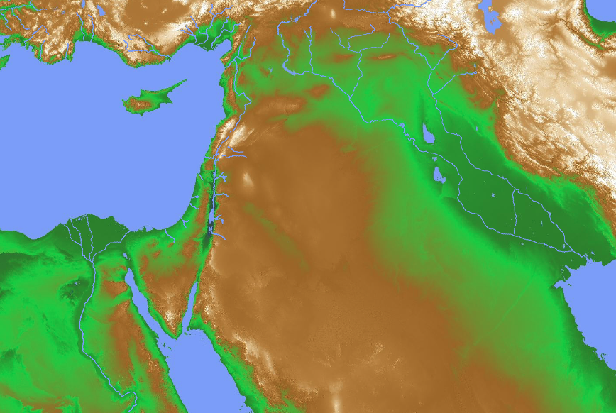
Isaiah 13-23: A “Behind the Scenes” Look at God’s Working in the World
“[This section] seeks to affirm that the Lord is really and truly ruling history and guiding it to a predetermined end.”
“Throughout [this section], Isaiah deals with the present, the impending and the eschatological (end times)”. Alec Motyer

Slide 12
What is this “predetermined end”?
The glory of God’s name (Isaiah 43:7)
To bring all things in heaven and on earth together under Christ (Ephesians 1:10)
To bless all nations through the seed of Abraham (Genesis 12:3)

Slide 13
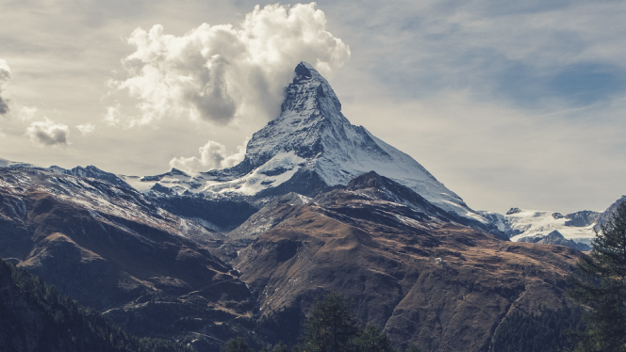
God’s World-Wide Purpose for Salvation
Isaiah 2:1-5
The Nations Streaming to God!

Slide 14
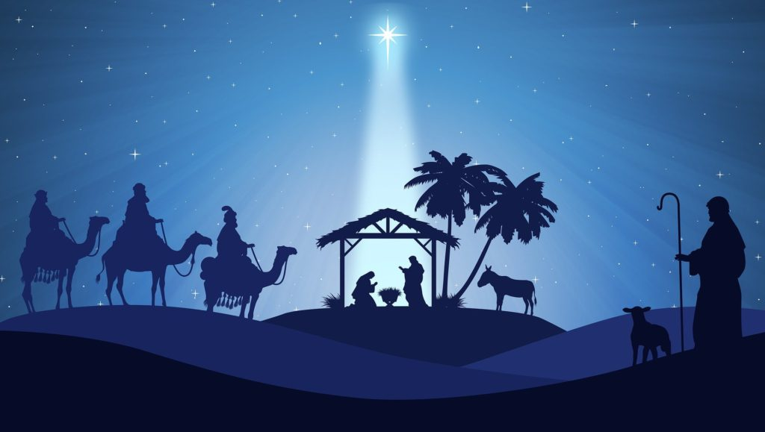
God’s World-Wide Purpose for Salvation
Isaiah 9:6-7
For to us a child is born, to us a son is given…
Of the increase of his government and of peace there will be no end…

Slide 15
God’s World-Wide Purpose for Salvation
Isaiah 11:6-9 A renewed world
Isaiah 11:10-16 A world-wide gathering of
people to God

Slide 16
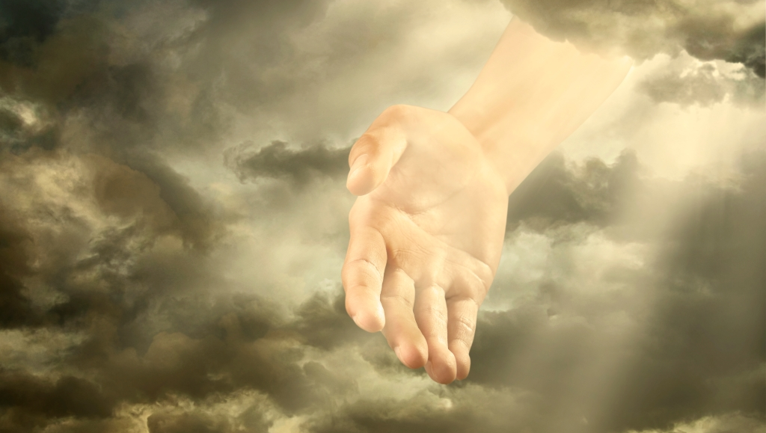
Isaiah 13
¹ The oracle concerning Babylon which Isaiah the son of Amoz saw.
Babylon Oracle (3 time periods):
Babylon is addressed as a current world power that will be destroyed in the future (impending event)
Overall setting of the oracle is eschatological
Interim (present day) fulfillment described is the fall of Assyria

Slide 17
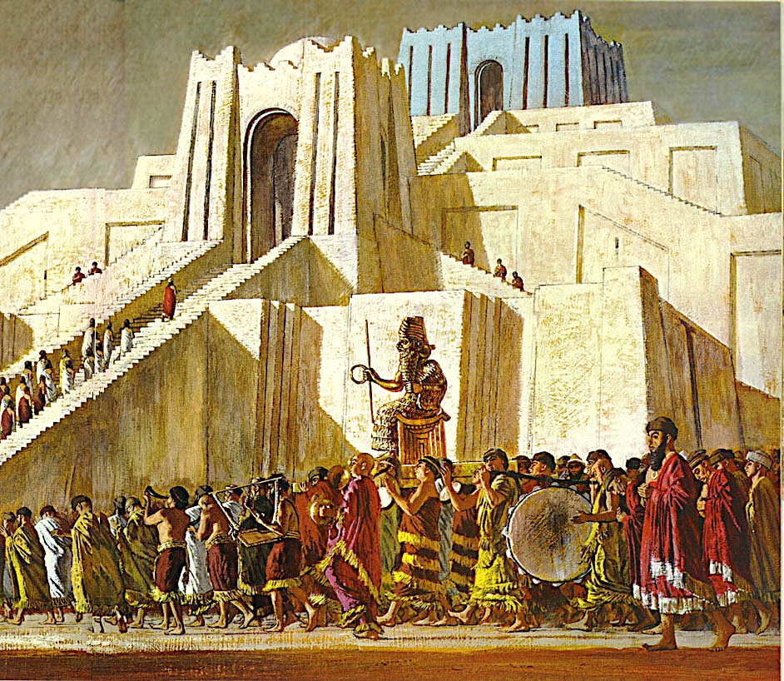
Why Babylon?
World Power in Isaiah’s Day (740-680BC):
Babylon became a military power around 612BC
Jerusalem destroyed in 586BC
Assyria!

Slide 18
Why Babylon?
Babylon was a center for culture and trade
(Assyrian King Tiglath-Pileser crowned as king in Babylon in 729BC)
Babylon was a potential ally against Assyria
Used in the Bible as a symbol for the City of Man

Slide 19
Babylon Oracle – 5 Parts
Day of the Lord (13:2-16)
Divine overthrow of Babylon (13:17-22)
Security and Future of God’s People (14:1-2)
Divine overthrow of Babylon’s king (14:3-23)
Interim fulfillment – Assyrian collapse (14:24-27)

Slide 20
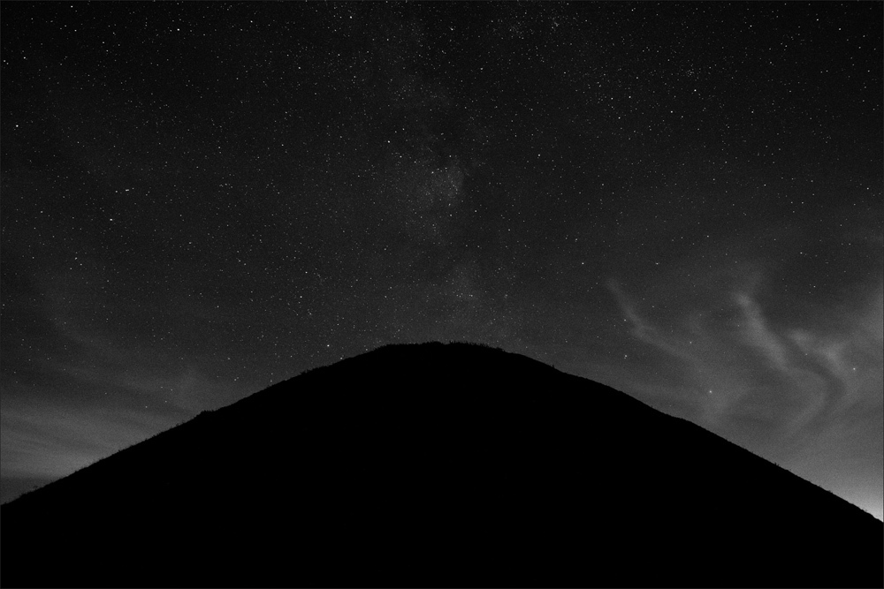
Isaiah 13
God is gathering his army to execute judgment…
² On a bare hill raise a signal;
cry aloud to them;
wave the hand for them to enter
the gates of the nobles.
³ I myself have commanded my consecrated ones,
and have summoned my mighty men to execute my anger,
my proudly exulting ones.

Slide 21
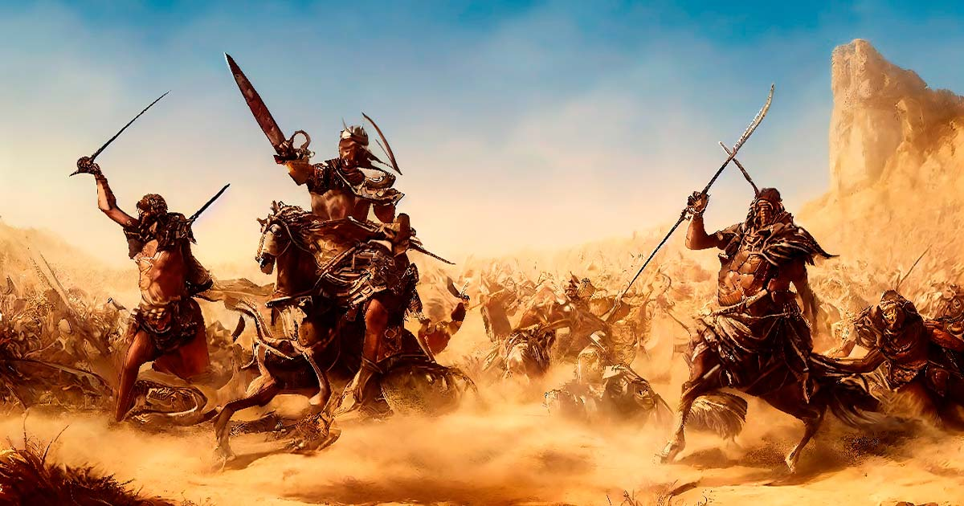
Isaiah 13
⁴ The sound of a tumult is on the mountains
as of a great multitude!
The sound of an uproar of kingdoms,
of nations gathering together!
The Lord of hosts is mustering
a host for battle.
⁵ They come from a distant land,
from the end of the heavens,
the Lord and the weapons of his indignation,
to destroy the whole land.
Yahweh of Hosts
(20x in Chapters 13-23)

Slide 22
Isaiah 13
⁶ Wail, for the day of the Lord is near;
as destruction from the Almighty it will come!
⁷ Therefore all hands will be feeble,
and every human heart will melt.
⁸ They will be dismayed:
pangs and agony will seize them;
they will be in anguish like a woman in labor.
They will look aghast at one another;
their faces will be aflame.

Slide 23
Isaiah 13
⁹ Behold, the day of the Lord comes,
cruel, with wrath and fierce anger,
to make the land a desolation
and to destroy its sinners from it.

Slide 24
Isaiah 13
¹⁰ For the stars of the heavens and their constellations
will not give their light;
the sun will be dark at its rising,
and the moon will not shed its light.

Slide 25
Isaiah 13
Oracle concerning Babylon…
Yet world-wide in its effect!
¹¹ I will punish the world for its evil,
and the wicked for their iniquity;
I will put an end to the pomp of the arrogant,
and lay low the pompous pride of the ruthless.
¹² I will make people more rare than fine gold,
and mankind than the gold of Ophir.

Slide 26
Isaiah 13
¹³ Therefore I will make the heavens tremble,
and the earth will be shaken out of its place,
at the wrath of the Lord of hosts
in the day of his fierce anger.

Slide 27
Isaiah 13
¹⁴ And like a hunted gazelle,
or like sheep with none to gather them,
each will turn to his own people,
and each will flee to his own land.
¹⁵ Whoever is found will be thrust through,
and whoever is caught will fall by the sword.
¹⁶ Their infants will be dashed in pieces
before their eyes;
their houses will be plundered
and their wives ravished.
God will remove his restraining hand – violence and evil will rule.

Slide 28
Babylon Oracle – 5 Parts
Day of the Lord (13:2-16)
Divine overthrow of Babylon (13:17-22)
Security and Future of God’s People (14:1-2)
Divine overthrow of Babylon’s king (14:3-23)
Interim fulfillment – Assyrian collapse (14:24-27)

Slide 29
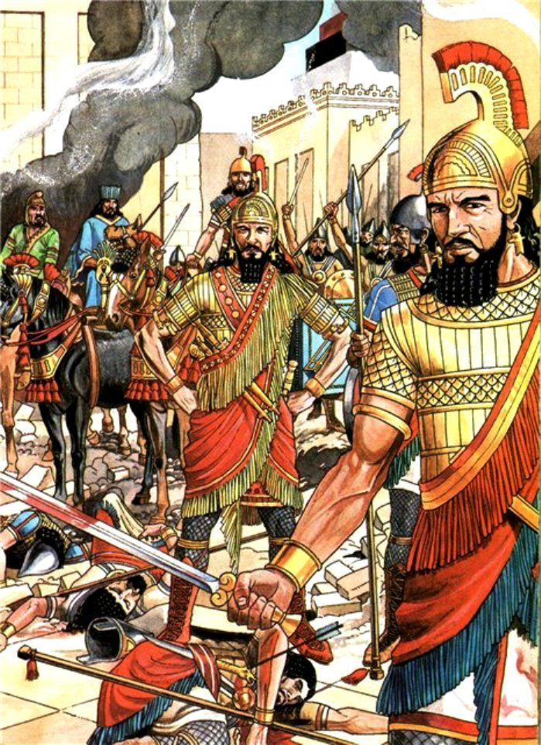
Isaiah 13
¹⁷ Behold, I am stirring up the Medes against them,
who have no regard for silver
and do not delight in gold.
¹⁸ Their bows will slaughter the young men;
they will have no mercy on the fruit of the womb;
their eyes will not pity children.

Slide 30
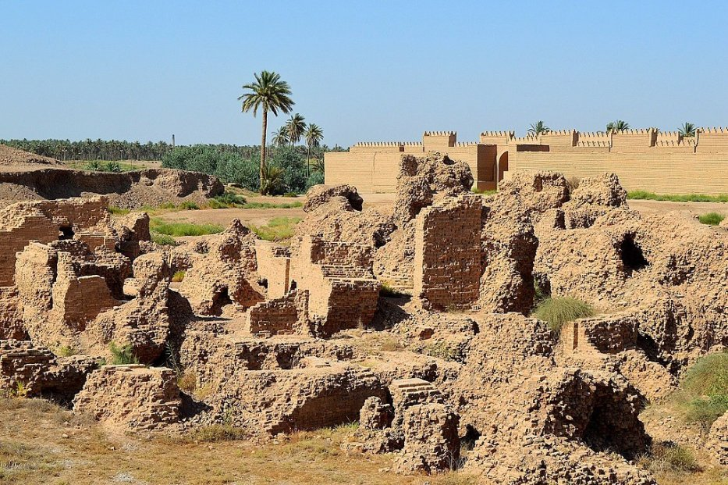
Isaiah 13
¹⁹ And Babylon, the glory of kingdoms,
the splendor and pomp of the Chaldeans,
will be like Sodom and Gomorrah
when God overthrew them.

Slide 31
Isaiah 13
²⁰ It will never be inhabited or lived in for all generations;
no Arab will pitch his tent there;
no shepherds will make their flocks lie down there.
21 But wild animals will lie down there,
and their houses will be full of howling creatures;
there ostriches will dwell, and there wild goats will dance.
22 Hyenas will cry in its towers,
and jackals in the pleasant palaces;
its time is close at hand and its days will not be prolonged.
Total Destruction… Why?
Symbolizes Worldly system opposed to God (Revelation 17-18)

Slide 32
Babylon Oracle – 5 Parts
Day of the Lord (13:2-16)
Divine overthrow of Babylon (13:17-22)
Security and Future of God’s People (14:1-2)
Divine overthrow of Babylon’s king (14:3-23)
Interim fulfillment – Assyrian collapse (14:24-27)

Slide 33
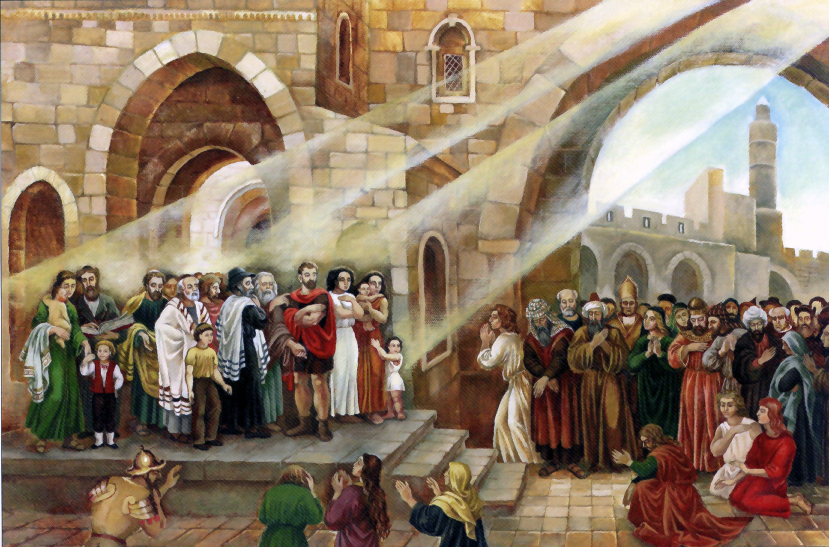
Isaiah 14
¹ For the Lord will have compassion on Jacob and will again choose Israel, and will set them in their own land, and sojourners will join them and will attach themselves to the house of Jacob.

Slide 34
Isaiah 14
¹ For the Lord will have compassion on Jacob and will again choose Israel, and will set them in their own land, and sojourners will join them and will attach themselves to the house of Jacob.

Slide 35
Isaiah 14
¹ For the Lord will have compassion on Jacob and will again choose Israel, and will set them in their own land, and sojourners will join them and will attach themselves to the house of Jacob.

Slide 36
Isaiah 14
² And the peoples will take them and bring them to their place, and the house of Israel will possess them in the Lord's land as male and female slaves. They will take captive those who were their captors, and rule over those who oppressed them.
Bond-servant (voluntary)

Slide 37
Isaiah 14
² And the peoples will take them and bring them to their place, and the house of Israel will possess them in the Lord's land as male and female slaves. They will take captive those who were their captors, and rule over those who oppressed them.
Captive (not voluntary)!

Slide 38
Babylon Oracle – 5 Parts
Day of the Lord (13:2-16)
Divine overthrow of Babylon (13:17-22)
Security and Future of God’s People (14:1-2)
Divine overthrow of Babylon’s king (14:3-23)
Interim fulfillment – Assyrian collapse (14:24-27)

Slide 39
Isaiah 14
³ When the Lord has given you rest from your pain and turmoil and the hard service with which you were made to serve, ⁴ you will take up this taunt (proverb) against the king of Babylon…

Slide 40
Isaiah 14
⁹ Sheol beneath is stirred up
to meet you when you come;
it rouses the shades to greet you,
all who were leaders of the earth;
it raises from their thrones
all who were kings of the nations.

Slide 41
Isaiah 14
¹⁰ All of them will answer
and say to you:
‘You too have become as weak as we!
You have become like us!’
¹¹ Your pomp is brought down to Sheol,
the sound of your harps;
maggots are laid as a bed beneath you,
and worms are your covers.

Slide 42
Isaiah 14
¹² “How you are fallen from heaven,
O Day Star, son of Dawn!
How you are cut down to the ground,
you who laid the nations low!

Slide 43
Isaiah 14
¹³ You said in your heart,
‘I will ascend to heaven;
above the stars of God
I will set my throne on high;
I will sit on the mount of assembly
in the far reaches of the north;
¹⁴ I will ascend above the heights of the clouds; I will make myself like the Most High.’
¹⁵ But you are brought down to Sheol,
to the far reaches of the pit.

Slide 44
Babylon Oracle – 5 Parts
Day of the Lord (13:2-16)
Divine overthrow of Babylon (13:17-22)
Security and Future of God’s People (14:1-2)
Divine overthrow of Babylon’s king (14:3-23)
Interim fulfillment – Assyrian collapse (14:24-27)

Slide 45
Isaiah 14
²⁴ The Lord of hosts has sworn:
“As I have planned,
so shall it be,
and as I have purposed,
so shall it stand,
²⁵ that I will break the Assyrian in my land,
and on my mountains trample him underfoot;
and his yoke shall depart from them,
and his burden from their shoulder.”

Slide 46
Isaiah 14
²⁶ This is the purpose that is purposed
concerning the whole earth,
and this is the hand that is stretched out
over all the nations.
²⁷ For the Lord of hosts has purposed,
and who will annul it?
His hand is stretched out,
and who will turn it back?

Slide 47
Babylon Oracle – 5 Parts
Day of the Lord (13:2-16)
Divine overthrow of Babylon (13:17-22)
Security and Future of God’s People (14:1-2)
Divine overthrow of Babylon’s king (14:3-21)
Interim fulfillment – Assyrian collapse (14:24-27)

Slide 48
How Does This Relate to Us?
The destruction of Babylon is a reminder of the reality of God’s ultimate wrath and judgment.
No matter what happens on the world stage or in our personal lives, we can trust that God is ruling history and guiding it to a predetermined end!
As believers, our security and future is secure. World history is organized in the interests of the people of God!

Slide 50
OT Preaching link at BibleStudyDownloads.org
Get this presentation for free!
Notes:
OT Preaching (op)

