Slide 1
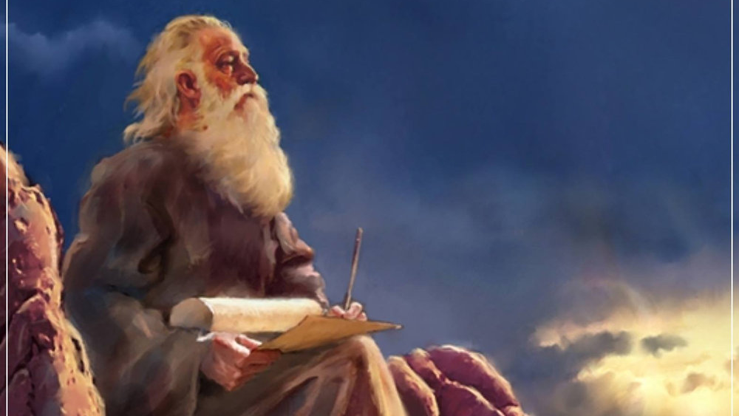
The Prophecy
Of
Isaiah
Isaiah 12
Be Absorbed in Salvation!
Preached by Dan Bridges Amman International Church, Jordan (AmmanChurch.org) Uploaded by Dr. Rick Griffith • Jordan Evangelical Theological Seminary Files in many languages for free download at BibleStudyDownloads.org

Slide 2
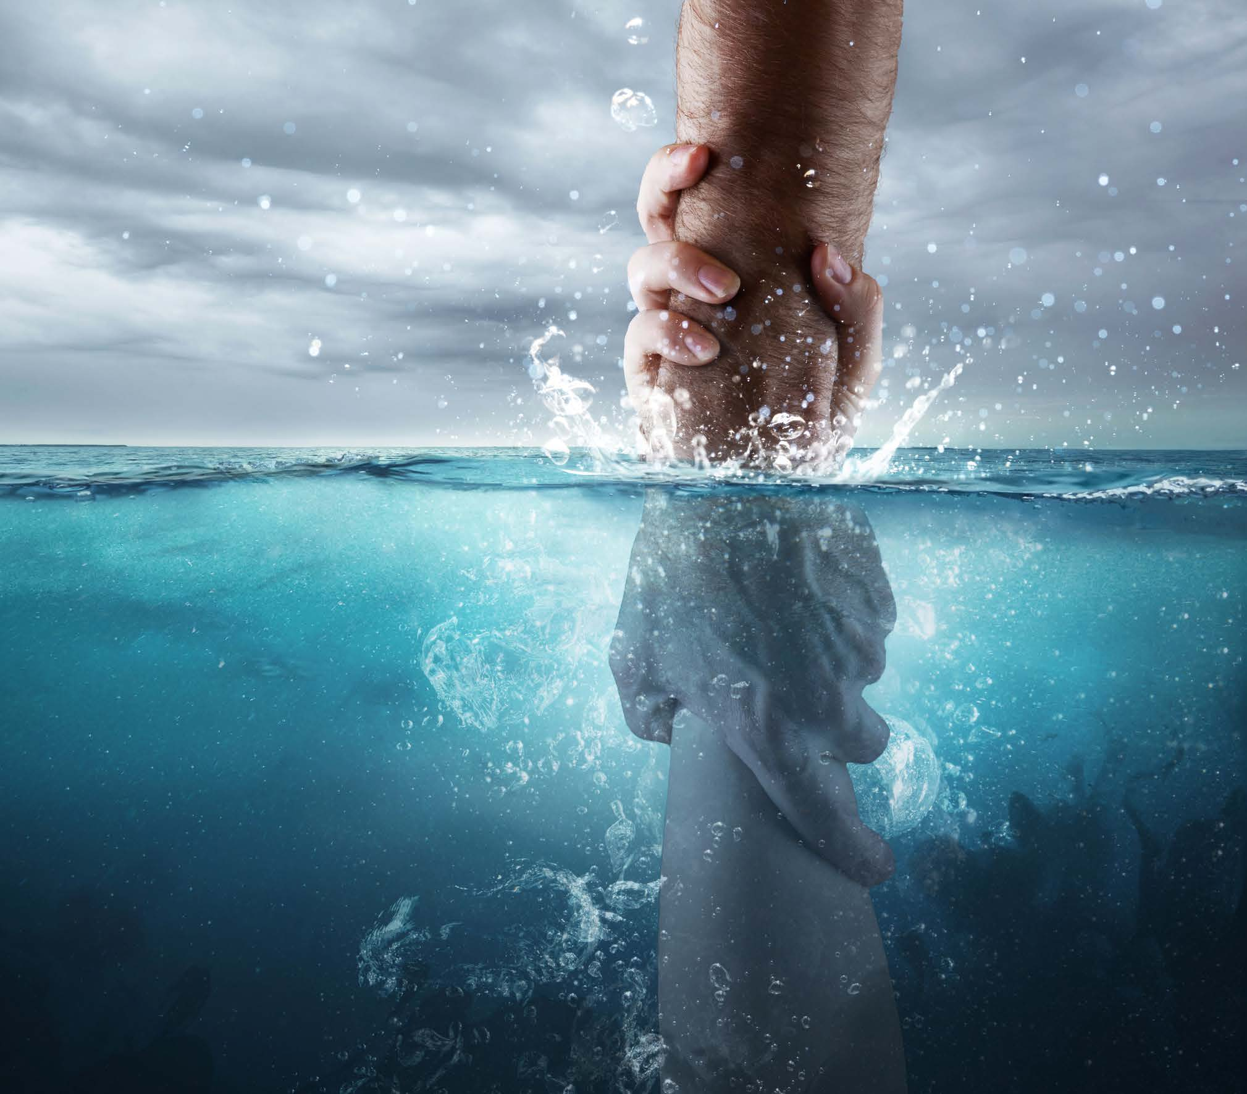
What does the word “Salvation” mean to you?

Slide 3
How about in this context?
The Lord is my strength and my song, and he has become my salvation; this is my God, and I will praise him, my father's God, and I will exalt him. Exodus 15:1-2
Salvation – Hebrew “Yeshua”

Slide 4
Isaiah 7-12: Coming Invasion / Messiah
Isaiah 7 A Last Chance to Trust God
Isaiah 8 Dark Times Coming…
Isaiah 9:1-7 To Us a Child is Born
Isaiah 9:8-10:4 Judgment on Israel
Isaiah 10:5-34 Judgment on Assyria / Remnant
Isaiah 11 Messiah’s Kingdom
Isaiah 12 Praise and Thanksgiving

Slide 5
There shall come forth a shoot from the stump of Jesse, and a branch from his roots shall bear fruit.
Isaiah 11:1

Slide 6
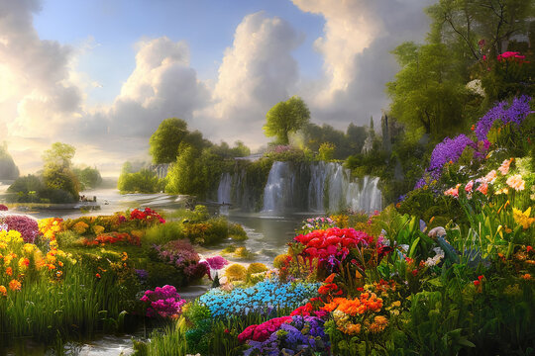
The Fruit of the Branch – Total Restoration!
11:10-16 – The Restoration of People
(Already begun but not complete!)

Slide 7
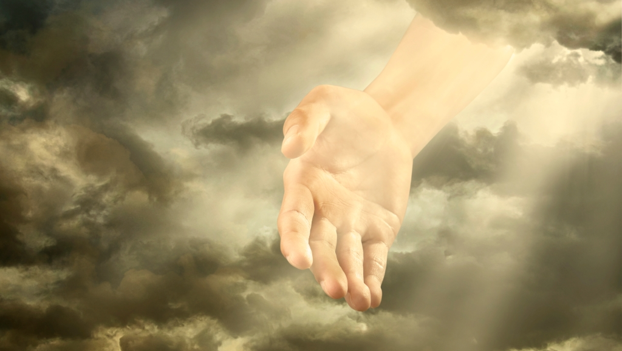
A salvation so great it can only be accomplished by God’s power!
And there will be a highway from Assyria
for the remnant that remains of his people,
as there was for Israel
when they came up from the land of Egypt.
Isaiah 11:16

Slide 8
Isaiah 12
A Call to be Absorbed with God’s Great Salvation!
Be absorbed in salvation
By rejoicing in what God has done (1)
By drinking deeply of God (2-3)
By proclaiming God and his deeds (4-6)

Slide 9
You will say in that day:
“I will give thanks to you, O Lord, for though you were angry with me, your anger turned away, that you might comfort me.”
Isaiah 12:1

Slide 10
You will say in that day:
“I will give thanks to you, O Lord, for though you were angry with me, your anger turned away, that you might comfort me.”
Isaiah 12:1
At the core of salvation is our broken relationship with God.

Slide 11
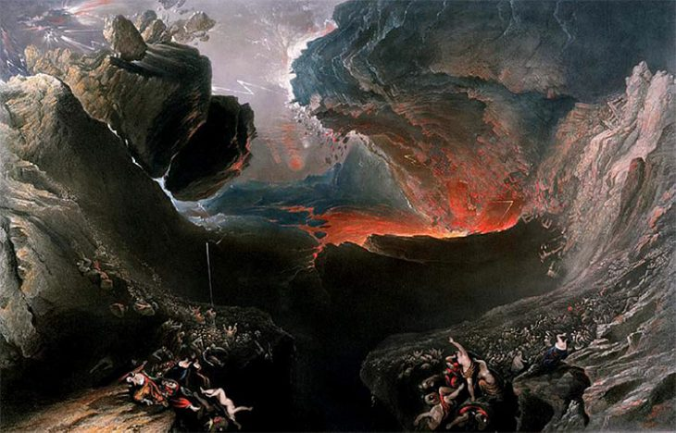
Does God have the right to be angry with you?
How does the Bible describe our sin?
Rebellion against God
Defiance against God
Despising God
Adultery against God
Treason against God

Slide 12
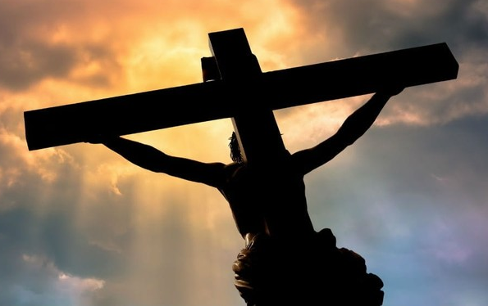
You will say in that day:
“I will give thanks to you, O Lord, for though you were angry with me, your anger turned away, that you might comfort me.”
Isaiah 12:1
How can God turn away his righteous, just anger?
Only by re-directing it…

Slide 13
You will say in that day:
“I will give thanks to you, O Lord, for though you were angry with me, your anger turned away, that you might comfort me.”
Isaiah 12:1
He not only turns away his anger, but he becomes our loving Father!

Slide 14
You will say in that day:
“I will give thanks to you, O Lord, for though you were angry with me, your anger turned away, that you might comfort me.”
Isaiah 12:1
Do you find yourself thanking God for saving you – for redirecting his anger and becoming your Father?

Slide 15
Isaiah 12
A Call to be Absorbed with God’s Great Salvation!
Be absorbed in salvation
By rejoicing in what God has done (1)
By drinking deeply of God (2-3)
By proclaiming God and his deeds (4-6)

Slide 16
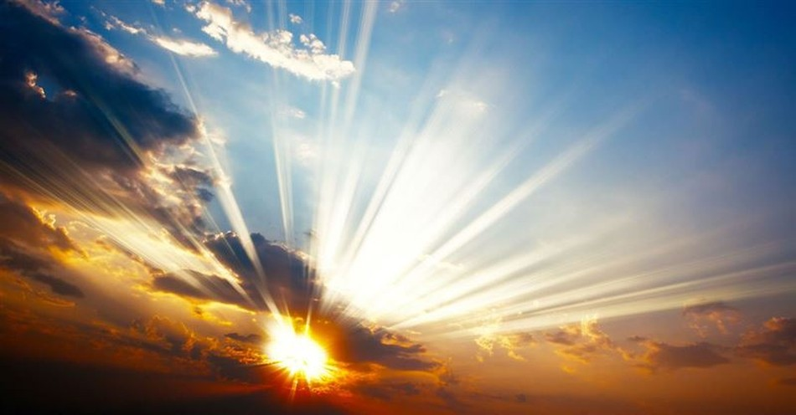
“Behold, God is my salvation;
I will trust, and will not be afraid;
for the Lord God is my strength and my song,
and he has become my salvation.”
With joy you will draw water from the wells of salvation.
Isaiah 12:2-3

Slide 17
(Present Continuous!)
“Behold, God is my salvation;
I will trust, and will not be afraid;
for the Lord God is my strength and my song,
and he has become my salvation.”
Isaiah 12:2

Slide 18
“Behold, God is my salvation;
I will trust, and will not be afraid;
for the Lord God is my strength and my song,
and he has become my salvation.”
Isaiah 12:2
What does God want us to trust him for?

Slide 19
“Behold, God is my salvation;
I will trust, and will not be afraid;
for the Lord God is my strength and my song,
and he has become my salvation.”
Isaiah 12:2

Slide 20
Then Moses and the people of Israel sang this song to the Lord, saying,
“I will sing to the Lord, for he has triumphed gloriously; the horse and his rider he has thrown into the sea.
The Lord is my strength and my song, and he has become my salvation; this is my God, and I will praise him, my father's God, and I will exalt him.”
Exodus 15:1-2

Slide 21
Then Moses and the people of Israel sang this song to the Lord, saying,
“I will sing to the Lord, for he has triumphed gloriously; the horse and his rider he has thrown into the sea.
The Lord is my strength and my song, and he has become my salvation; this is my God, and I will praise him, my father's God, and I will exalt him.”
Exodus 15:1-2
More than a statement of what God had done…
This was a statement of allegiance!

Slide 22
“Behold, God is my salvation;
I will trust, and will not be afraid;
for the Lord God is my strength and my song,
and he has become my salvation.”
Isaiah 12:2
How is the state of your allegiance?

Slide 23
“Behold, God is my salvation;
I will trust, and will not be afraid;
for the Lord God is my strength and my song,
and he has become my salvation.”
Isaiah 12:2
In the weakness of our humanity, our allegiance can falter… We can lose focus, lose heart, lose hope…

Slide 24
“Behold, God is my salvation;
I will trust, and will not be afraid;
for the Lord God is my strength and my song,
and he has become my salvation.”
Isaiah 12:2
What then? Are we left to ourselves?
Does God give us resources to help?

Slide 25
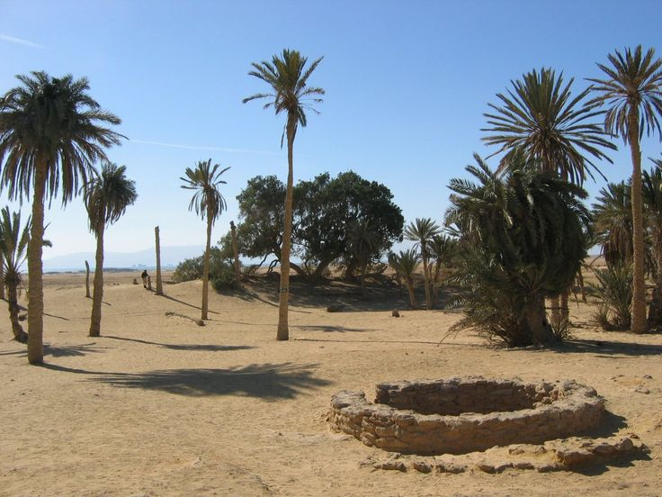
He has given us the wells of salvation!
With joy you will draw water from the wells of salvation.
Isaiah 12:3

Slide 26
The Wells of the Exodus:
Marah (bitter water made sweet) Ex. 15:23-25
Elim (12 springs) Ex. 15:27
Horeb (water from the rock) Ex. 17:6

Slide 27
Why do we need many wells?
When traveling through the wilderness, many wells are needed!

Slide 28
What are these “wells of salvation”?
Verse 2:
“Behold, God is my salvation…
he has become my salvation.”
These are wells of God!

Slide 29
God’s greatest priority for us is to drink deeply from these wells of salvation – otherwise we dry up!

Slide 30
“These wells are the times and places where we draw near to God and drink from the fountain of living water. There are as many wells as there are meetings with God!” John Piper
The wells are also the times when we choose to trust in God and experience his faithful provision – his salvation!

Slide 31
Isaiah 12
A Call to be Absorbed with God’s Great Salvation!
Be absorbed in salvation
By rejoicing in what God has done (1)
By drinking deeply of God (2-3)
By proclaiming God and his deeds (4-6)

Slide 32
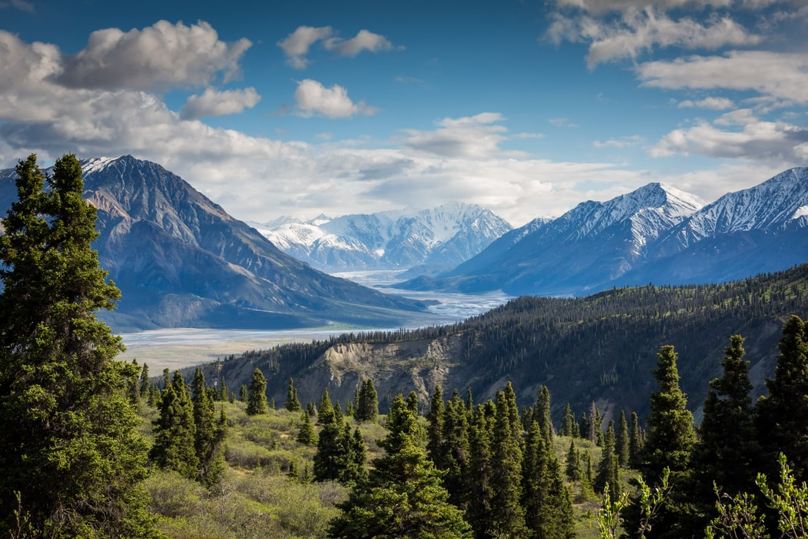
And you will say in that day:
“Give thanks to the Lord,
call upon his name,
make known his deeds among the peoples,
proclaim that his name is exalted.
Isaiah 12:4

Slide 33
“Sing praises to the Lord, for he has done gloriously;
let this be made known in all the earth.
Shout, and sing for joy, O inhabitant of Zion,
for great in your midst is the Holy One of Israel.”
Isaiah 12:5-6

Slide 34
And you will say in that day:
“Give thanks to the Lord,
call upon his name,
make known his deeds among the peoples,
proclaim that his name is exalted.
Isaiah 12:4
Drinking deeply from the wells of God:
Refreshes us with the reality of our salvation
Causes us to exhort one another to praise / missions!

Slide 35
We will exhort each other to:
Give thanks to the Lord
Call upon his name
Make known his deeds among the peoples
Proclaim that his name is exalted
Sing praises to the Lord, for he has done gloriously
Let this be made known in all the earth
Shout and sing for joy – for great in your midst is the Holy One of Israel

Slide 36
We will exhort each other to:
Give thanks to the Lord
Call upon his name
Make known his deeds among the peoples
Proclaim that his name is exalted
Sing praises to the Lord, for he has done gloriously
Let this be made known in all the earth
Shout and sing for joy – for great in your midst is the Holy One of Israel
Call upon his name…
In repentance (initial salvation & ongoing repentance)
In dependence – for help in all of life

Slide 37
We will exhort each other to:
Give thanks to the Lord
Call upon his name
Make known his deeds among the peoples
Proclaim that his name is exalted
Sing praises to the Lord, for he has done gloriously
Let this be made known in all the earth
Shout and sing for joy – for great in your midst is the Holy One of Israel
God is calling us to live in such dependence on him that we have stories to tell of what he’s done!
Then we can make his deeds known!

Slide 38
Isaiah 12
A Call to be Absorbed with God’s Great Salvation!
Be absorbed in salvation
By rejoicing in what God has done (1)
By drinking deeply of God (2-3)
By proclaiming God and his deeds (4-6)

Slide 40
OT Preaching link at BibleStudyDownloads.org
Get this presentation for free!
Notes:
OT Preaching (op)

