Slide 1
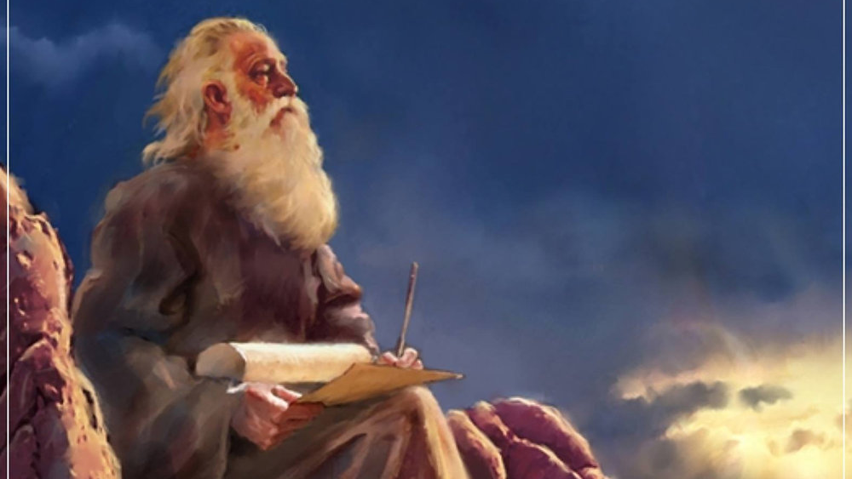
The Prophecy
Of
Isaiah
Isaiah 11
The Fruit of
The Branch!
Preached by Dan Bridges Amman International Church, Jordan (AmmanChurch.org) Uploaded by Dr. Rick Griffith • Jordan Evangelical Theological Seminary Files in many languages for free download at BibleStudyDownloads.org

Slide 2
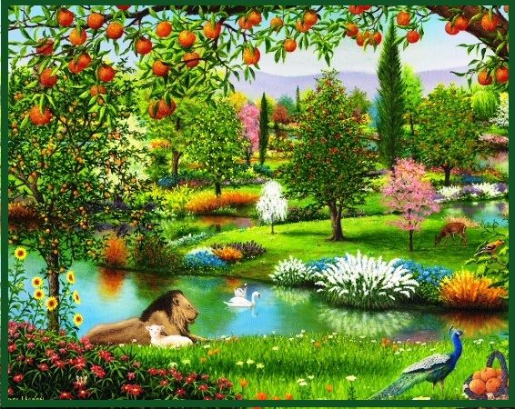
What would your perfect world be like?

Slide 3
Isaiah 7-12: Coming Invasion / Messiah
Isaiah 7 A Last Chance to Trust God
Isaiah 8 Dark Times Coming…
Isaiah 9:1-7 To Us a Child is Born
Isaiah 9:8-10:4 Judgment on Israel
Isaiah 10:5-34 Judgment on Assyria / Remnant
Isaiah 11 Messiah’s Kingdom
Isaiah 12 Praise and Thanksgiving

Slide 4
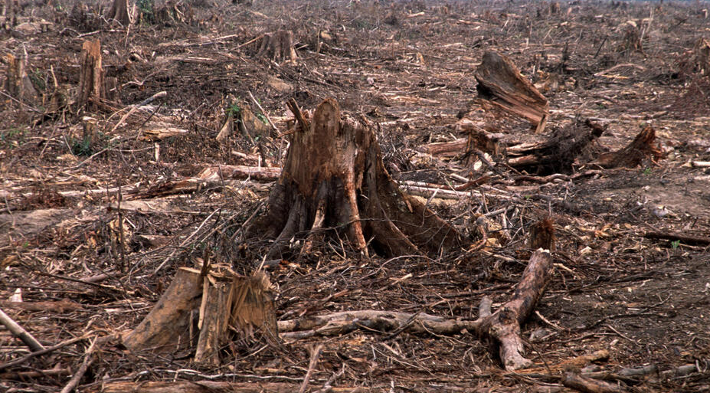
Context (chapters 7-10):
Unbelief of King Ahaz and the people of Judah
Coming invasion of the Assyrian army
Coming destruction of Judah and the Assyrian army
Promise of Emmanuel (7:14)
Coming Son to rule on David’s throne (9:6-7)
The righteous rule of the “Branch” (11)

Slide 5
Behold, the Lord God of hosts
will lop the boughs with terrifying power;
the great in height will be hewn down,
and the lofty will be brought low.
He will cut down the thickets of the forest with an axe, and Lebanon will fall by the Majestic One.
Isaiah 10:33-34

Slide 6
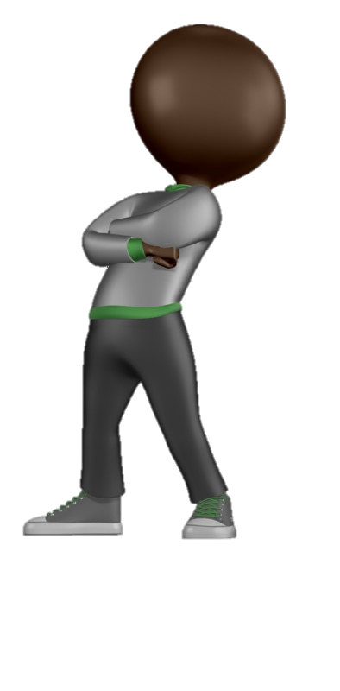
There shall come forth a shoot from the stump of Jesse, and a branch from his roots shall bear fruit.
Isaiah 11:1

Slide 7
A King after the pattern of David
There shall come forth a shoot from the stump of Jesse, and a branch from his roots shall bear fruit.
Isaiah 11:1

Slide 8
There shall come forth a shoot from the stump of Jesse, and a branch from his roots shall bear fruit.
Isaiah 11:1

Slide 9
The Fruit of the Branch – Total Restoration!

Slide 10
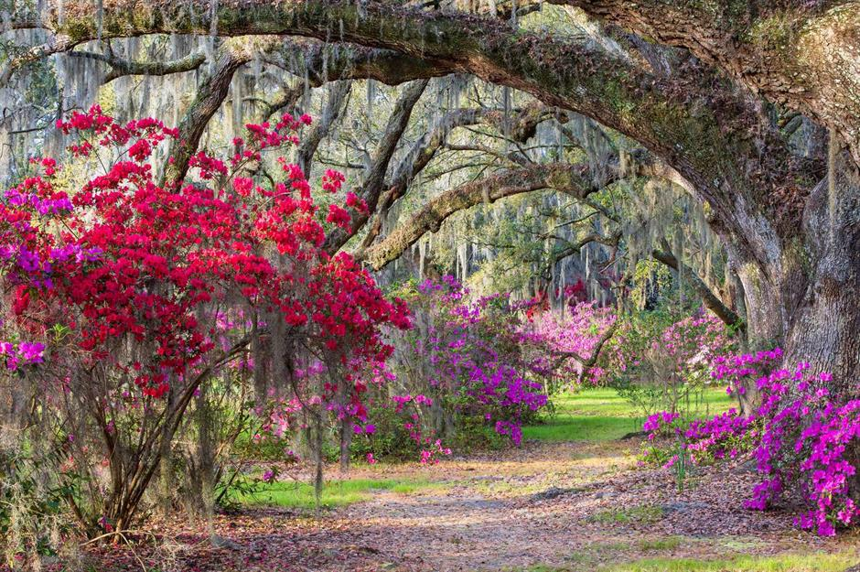
Isaiah 11
Restoration Under the Branch
Restoration of Government (2-5)
Restoration of Creation (6-9)
Restoration of People (10-16)

Slide 11
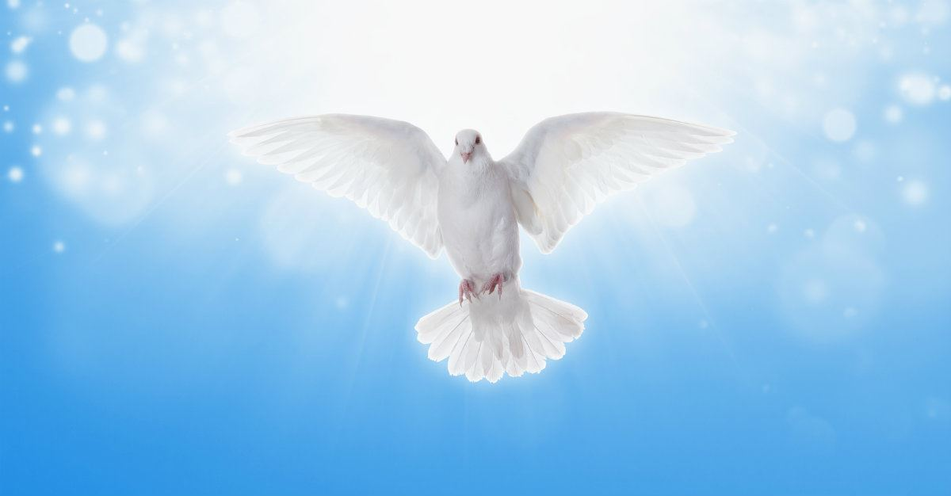
Spirit-led godly rule of law!
And the Spirit of the Lord shall rest upon him,
the Spirit of wisdom and understanding,
the Spirit of counsel and might,
the Spirit of knowledge and the fear of the Lord.
Isaiah 11:2

Slide 12
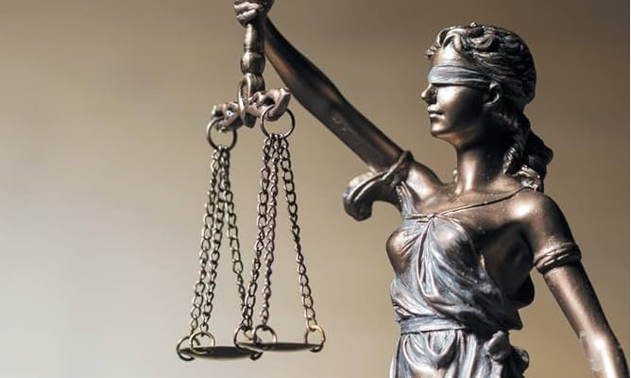
A safe place for everyone!
And his delight shall be in the fear of the Lord.
He shall not judge by what his eyes see,
or decide disputes by what his ears hear, but with righteousness he shall judge the poor,
and decide with equity for the meek of the earth;
Isaiah 11:3

Slide 13
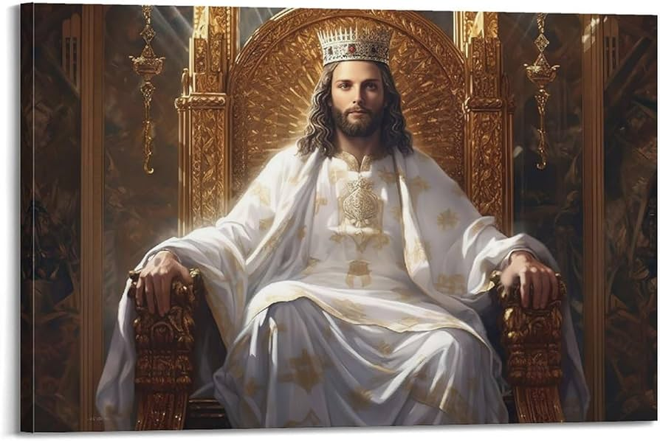
Elimination of the wicked
and he shall strike the earth with the rod of his mouth,
and with the breath of his lips he shall kill the wicked.
Righteousness shall be the belt of his waist,
and faithfulness the belt of his loins.
Isaiah 11:4-5

Slide 14
The Fruit of the Branch – Total Restoration!
Spirit-led rule of law (2)
Safe place for everyone (3-4a)
Elimination of the wicked (4b-5)

Slide 15
Isaiah 11
Restoration Under the Branch
Restoration of Government (2-5)
Restoration of Creation (6-9)
Restoration of People (10-16)

Slide 16
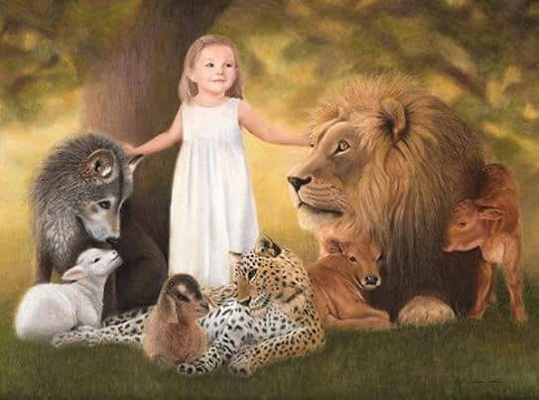
The wolf shall dwell with the lamb,
and the leopard shall lie down with the young goat,
and the calf and the lion and the fattened calf together;
and a little child shall lead them. Isaiah 11:6

Slide 17
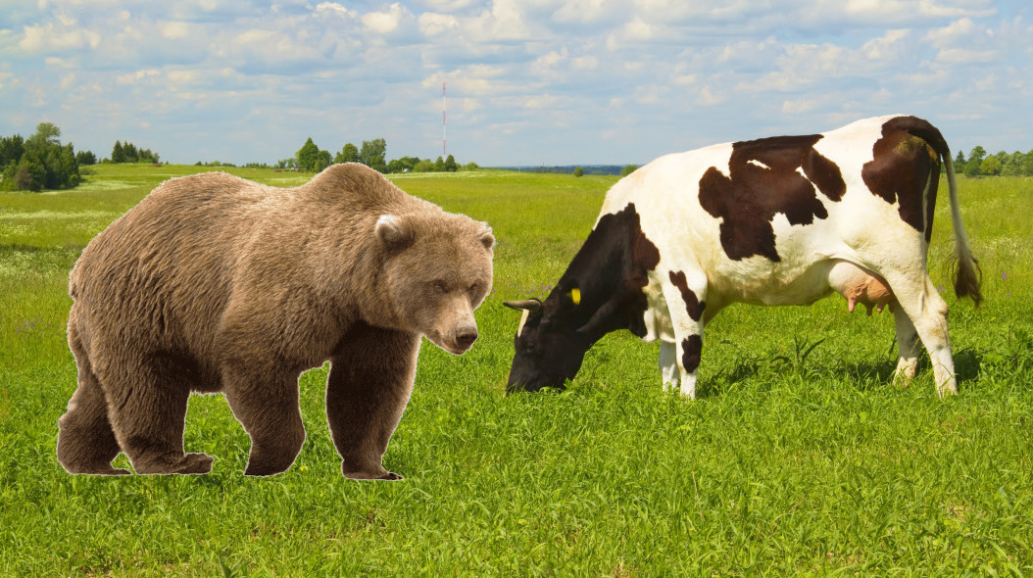
The cow and the bear shall graze;
their young shall lie down together;
Isaiah 11:7a

Slide 18
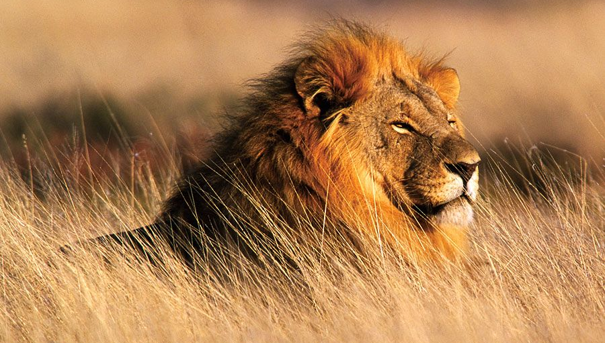
The cow and the bear shall graze;
their young shall lie down together;
and the lion shall eat straw like the ox.
The nursing child shall play over the hole of the cobra,
and the weaned child shall put his hand on the adder's den.
Isaiah 11:7-8
and the lion shall eat straw like the ox.
Isaiah 11:7b

Slide 19
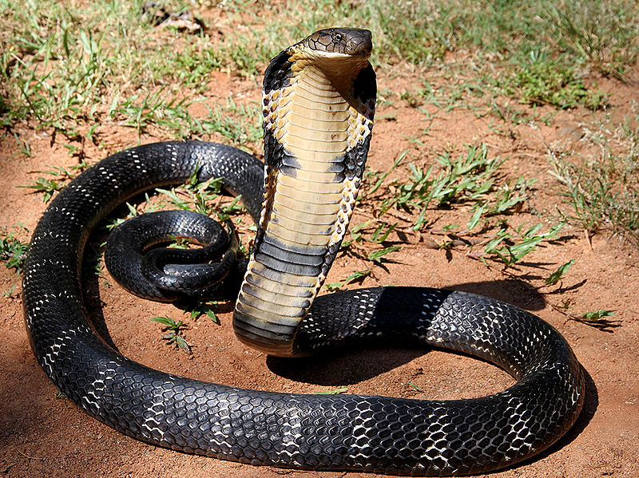
The nursing child shall play over the hole of the cobra,
and the weaned child shall put his hand on the
adder's den. Isaiah 11:8

Slide 20
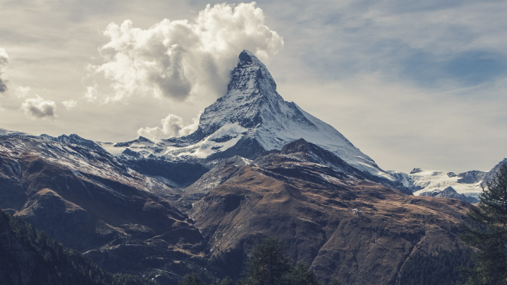
They shall not hurt or destroy
in all my holy mountain;
for the earth shall be full of the knowledge of the Lord
as the waters cover the sea. Isaiah 11:9

Slide 21
The Fruit of the Branch – Total Restoration!
Spirit-led rule of law (2)
Safe place for everyone (3-4a)
Elimination of the wicked (4b-5)
Restored created order (6-8)
Restored knowledge of the Lord (9)

Slide 22
Isaiah 11
Restoration Under the Branch
Restoration of Government (2-5)
Restoration of Creation (6-9)
Restoration of People (10-16)

Slide 23
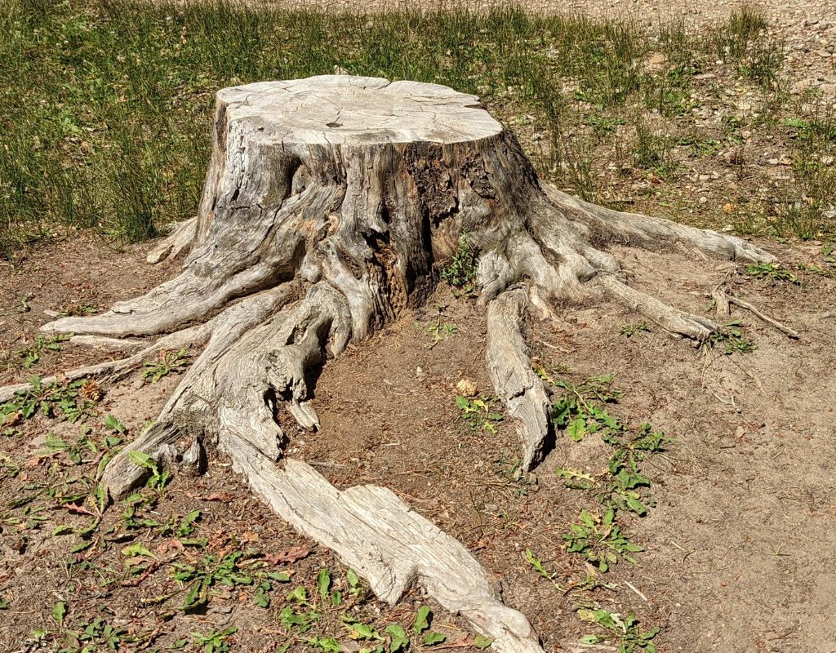
Messiah:
(1) Branch of stump of Jesse
(10) Root of Jesse
In that day the root of Jesse, who shall stand as a signal for the peoples—of him shall the nations inquire, and his resting place shall be glorious. Isaiah 11:10

Slide 24
“I, Jesus, have sent my angel to testify to you about these things for the churches. I am the root and the descendant of David, the bright morning star.”
Revelation 22:16
In that day the root of Jesse, who shall stand as a signal for the peoples—of him shall the nations inquire, and his resting place shall be glorious. Isaiah 11:10

Slide 25
“And I, when I am lifted up from the earth, will draw all people to myself.” John 12:32
In that day the root of Jesse, who shall stand as a signal for the peoples—of him shall the nations inquire, and his resting place shall be glorious. Isaiah 11:10

Slide 26
In that day the root of Jesse, who shall stand as a signal for the peoples—of him shall the nations inquire, and his resting place shall be glorious. Isaiah 11:10

Slide 27
Paul saw the fulfillment of this happening in his day!
And again Isaiah says,
“The root of Jesse will come,
even he who arises to rule the Gentiles;
in him will the Gentiles hope.”
Romans 15:12

Slide 28
Restoration of the Nations:
Began at Pentecost
Continues today
Will happen to a much larger extent
In that day the root of Jesse, who shall stand as a signal for the peoples—of him shall the nations inquire, and his resting place shall be glorious. Isaiah 11:10

Slide 29
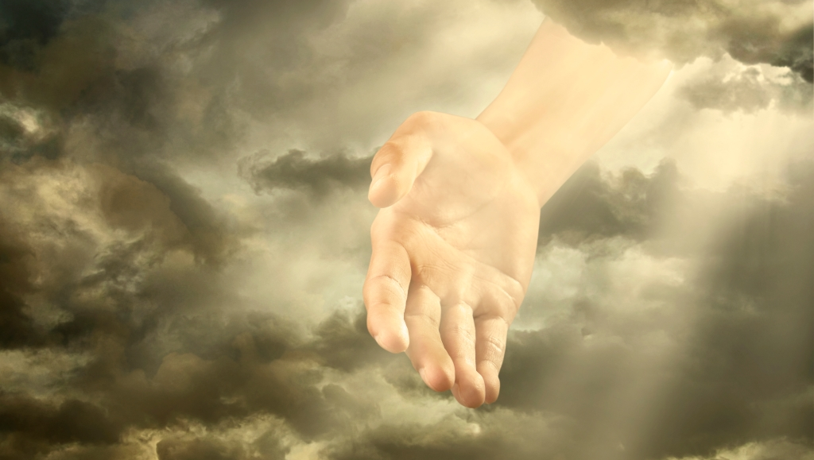
When was the first time?
(Note: No exile – Assyrian or Babylonian – had happened yet!)
Return from Babylonian exile or
When God miraculously led his people
out of Egypt (vs 16)
In that day the Lord will extend his hand yet a second time to recover the remnant that remains of his people, from Assyria, from Egypt, from Pathros, from Cush, from Elam, from Shinar, from Hamath, and from the coastlands of the sea. Isaiah 11:11

Slide 30
In that day the remnant of Israel and the survivors of the house of Jacob will no more lean on him who struck them, but will lean on the Lord, the Holy One of Israel, in truth. A remnant will return, the remnant of Jacob, to the mighty God. Isaiah 10:20-21
In that day the Lord will extend his hand yet a second time to recover the remnant that remains of his people, from Assyria, from Egypt, from Pathros, from Cush, from Elam, from Shinar, from Hamath, and from the coastlands of the sea. Isaiah 11:11

Slide 31
In spite of all their rebellion, God has remained loyal to his covenant people! He will pursue and restore his relationship with a remnant of them!
In that day the Lord will extend his hand yet a second time to recover the remnant that remains of his people, from Assyria, from Egypt, from Pathros, from Cush, from Elam, from Shinar, from Hamath, and from the coastlands of the sea. Isaiah 11:11

Slide 32
Return from Babylon:
“In that day”:
Judah only
Nations, Israel, Judah
He will raise a signal for the nations
and will assemble the banished of Israel,
and gather the dispersed of Judah
from the four corners of the earth.
Isaiah 11:12

Slide 33
The jealousy of Ephraim shall depart,
and those who harass Judah shall be cut off;
Ephraim shall not be jealous of Judah,
and Judah shall not harass Ephraim.
But they shall swoop down on the shoulder of the Philistines in the west,
and together they shall plunder the people of the east.
They shall put out their hand against Edom and Moab,
and the Ammonites shall obey them.
Isaiah 11:13-14
Restoration of relationship between Israel and Judah

Slide 34
The jealousy of Ephraim shall depart,
and those who harass Judah shall be cut off;
Ephraim shall not be jealous of Judah,
and Judah shall not harass Ephraim.
But they shall swoop down on the shoulder of the Philistines in the west,
and together they shall plunder the people of the east.
They shall put out their hand against Edom and Moab,
and the Ammonites shall obey them.
Isaiah 11:13-14
Restoration of peace – The rule of the Branch will extend over traditional enemies of God’s people in addition to Israel and Judah

Slide 35
And the Lord will utterly destroy
the tongue of the Sea of Egypt,
and will wave his hand over the River
with his scorching breath,
and strike it into seven channels,
and he will lead people across in sandals.
And there will be a highway from Assyria
for the remnant that remains of his people,
as there was for Israel
when they came up from the land of Egypt.
Isaiah 11:15-16

Slide 36
And the Lord will utterly destroy
the tongue of the Sea of Egypt,
and will wave his hand over the River
with his scorching breath,
and strike it into seven channels,
and he will lead people across in sandals.
And there will be a highway from Assyria
for the remnant that remains of his people,
as there was for Israel
when they came up from the land of Egypt.
Isaiah 11:15-16
What was the “highway” out of Egypt like?
Miraculous; God-led way out

Slide 37
And the Lord will utterly destroy
the tongue of the Sea of Egypt,
and will wave his hand over the River
with his scorching breath,
and strike it into seven channels,
and he will lead people across in sandals.
And there will be a highway from Assyria
for the remnant that remains of his people,
as there was for Israel
when they came up from the land of Egypt.
Isaiah 11:15-16
Miraculous removal of barriers for his people!

Slide 38
And the Lord will utterly destroy
the tongue of the Sea of Egypt,
and will wave his hand over the River
with his scorching breath,
and strike it into seven channels,
and he will lead people across in sandals.
And there will be a highway from Assyria
for the remnant that remains of his people,
as there was for Israel
when they came up from the land of Egypt.
Isaiah 11:15-16
A deliverance so great it can only be accomplished by God’s power!

Slide 39
Who do you know who needs this type of deliverance?
You will say in that day:
“I will give thanks to you, O Lord, for though you were angry with me, your anger turned away, that you might comfort me.
Isaiah 12:1

Slide 40
The Fruit of the Branch – Total Restoration!
Spirit-led rule of law (2)
Safe place for everyone (3-4a)
Elimination of the wicked (4b-5)
Restored created order (6-8)
Restored knowledge of the Lord (9)
Gentiles reconciled with Branch (10)
Israel/Judah reconciled with God/each other (11-13)
Rule of the Branch over traditional enemies (14)
Traditional barriers to salvation removed (15-16)
Reign of JESUS!!!

Slide 41
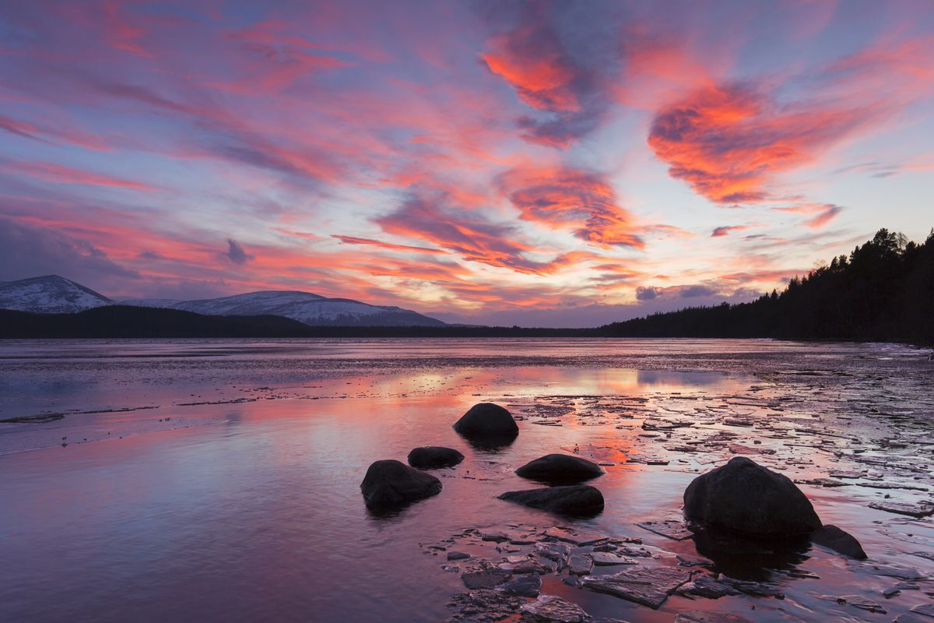
When will all of this happen?
When is “That Day”?
End of Time
OT
Prophet
Messianic Age

Slide 42
Reign of the Messiah
Renewal of the Created Order (6-9)
Destruction of the Wicked (4b)
Repentance / Restoration of the Remnant (11-16)
Repentance of the Gentiles (10)
Coming Messiah (1-2)
Equity & Justice for Poor (4a)

Slide 43
When will all of this happen?
When is “That Day”?
End of Time
OT
Prophet
Messianic Age

Slide 44
The Fruit of the Branch – Total Restoration!
How do these wonderful promises of restoration apply to us today?
Understand that all this renewal will happen only through the kingly rule of Jesus over the world!
Repent and submit to his rule
Acknowledge and thank him as the source of renewal in our lives
Study Chapter 12 as the application of 11!

Slide 46
OT Preaching link at BibleStudyDownloads.org
Get this presentation for free!
Notes:
OT Preaching (op)

