Slide 1
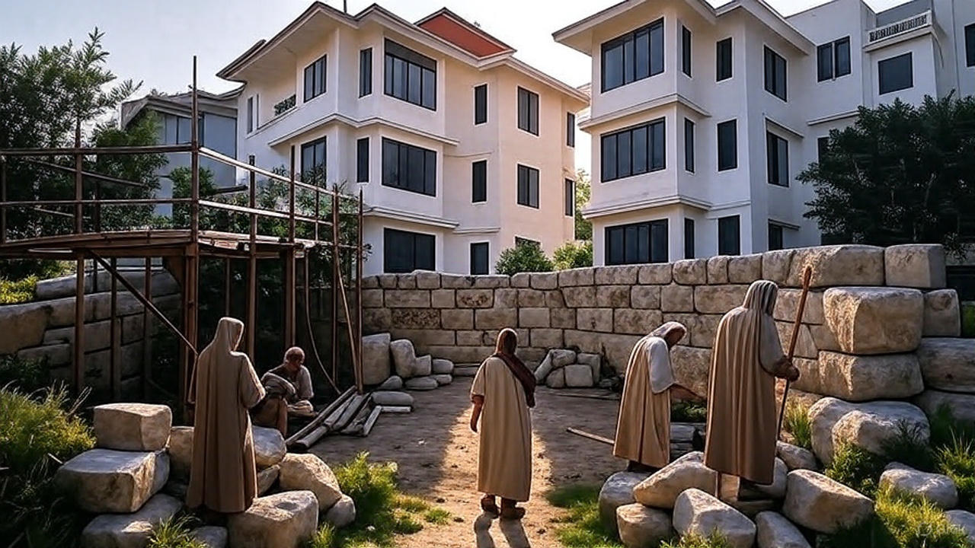
Under Construction!
Rebuilding with God’s Priorities, Presence, Purity, and Promise
Haggai 1-2
Preached by Matthew Lyle
at Crossroads International Church Singapore • CICFamily.com
Uploaded by Dr. Rick Griffith • Jordan Evangelical Theological Seminary
Files in many languages for free download at BibleStudyDownloads.org

Slide 2
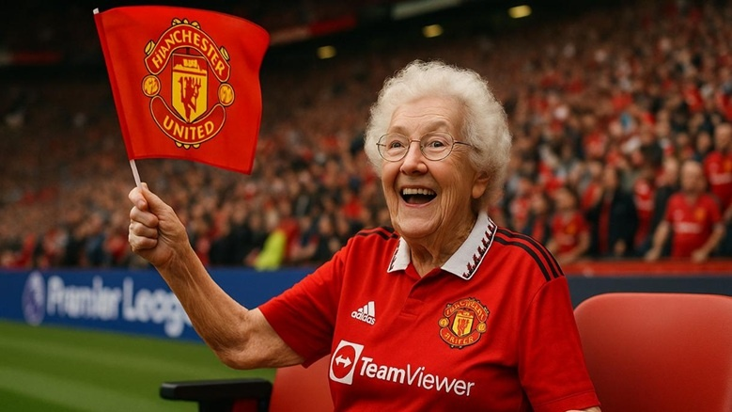

Slide 3
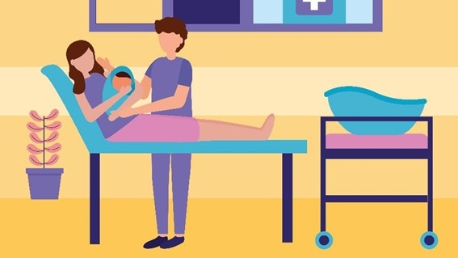
Designed by gstudioimagen / Freepik
Notes:
Designed by gstudioimagen / Freepik
https://www.freepik.com/free-vector/pregnancy-maternity-scene_5604730.htm#fromView=search&page=1&position=16&uuid=eee52ac3-5e69-47ff-9f49-7d9294bed65f&query=giving+birth

Slide 4








I didn’t like hospital food — I left to get take-out.
I put my phone on silent… so I could nap.
I missed it because I had a fantasy-football draft.
I went home to feed the outdoor cat.
I went to the parking lot to talk to my ex.
https://nypost.com/2022/07/19/nurse-reveals-crazy-reasons-dads-missed-birth-of-kids/

Slide 5
Under Construction!
Rebuilding with God’s Priorities, Presence, Purity, and Promise
Haggai 1-2

Slide 6












66 Books of the Bible
GENESIS
EXODUS
JUDGES
ESTHER
1 SAMUEL
1 CHRON
NEHEMIAH
2 SAMUEL
2 KINGS
LEVITICUS
JOSHUA
1 KINGS
2 CHRON
RUTH
EZRA
NUMBERS
DEUTERONOMY
LAW / HISTORY
HISTORY
Old
Testament
JOB
PSALMS
ISAIAH
JEREMIAH
LAMENTATIONS
EZEKIEL
DANIEL
PROVERBS
POETRY
MAJOR PROPHETS
Sin
Judgment
Restoration
Song of
Solomon
HOSEA
JONAH
NAHUM
MALACHI
MICAH
HABAKKUK
JOEL
OBADIAH
ZEPHANIAH
ZECHARIAH
AMOS
HAGGAI
Ecclesiastes
POETRY
MINOR PROPHETS
MATTHEW
New
Testament
MARK
ACTS
1 PETER
REVELATION
1 COR
PHILEMON
JAMES
1 JOHN
2 PETER
ROMANS
2 THES
2 JOHN
1 TIMOTHY
2 COR
1 THES
HEBREWS
PHILIPPIANS
2 TIMOTHY
JUDE
EPHESIANS
3 JOHN
LUKE
GALATIANS
COLOSSIANS
TITUS
JOHN
GOSPELS
HISTORY
PAULINE EPISTLES
GENERAL EPISTLES

Slide 7
Habakkuk: Babylon's Destruction
Judah: 612 – 586 BC (some believe 607-605 BC)
God's Actions Challenged |  |  |  | God's Actions Commended
Doubting | Debating God |  |  | Defending God
Prophets’ 1st Complaint |  | Prophets’ 2nd Complaint |  | Prophets’ Prayer of Trust
Question of God’s Inactivity |  | Question of God’s Inconsistency |  | Affirming God’s Sovereignty and Faithfulness
Habakkuk | God | Habakkuk | God | Habakkuk
Why aren't you judging Judah's sin, God? | I will. I'll judge Judah with the Babylonians! | But can you use a nation more wicked than Judah? | Sure, but I'll judge them too. | Prayer | Praise | Pledge
 |  |  |  | In wrath remember mercy. | Our God is an awesome God! | I'll wait patiently & rejoice
1:1-4 | 1:5-11 | 1:12–2:1 | 2:2-20 | 3:1-2 | 3:3-15 | 3:16-19
Problem: Faith Troubled |  |  | Resolution: Faith Triumphant

Slide 8
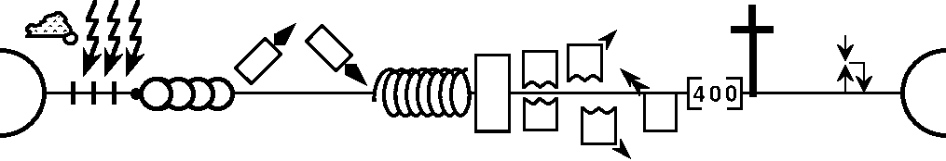
--------------------------------------------------------------------------1 & 2 Chronicles ----------------------------------------------------------
Deuteronomy
1 Samuel
Leviticus
2 Samuel
Nehemiah
Genesis 1-11
Genesis 12-50
Exodus
Numbers
Joshua
Judges
1 Kings
2 Kings
Ruth
Ezra
Esther
Moses
Cycles
S • D • S
Z • E • N
1st Coming
Eternity
Creation
Joshua
J (R) & I (J)
Eternity
Fall
Babel
J (B) & I (A)
Flood
P • G • H • R
2nd Coming
Abraham
Joseph
Isaac
Jacob
1000
1995+
Exodus
Judges
Church
Kingdom
Patriarchs
Conquests
Silent Years
Beginnings
Restoration
United Kingdom
Captivity
Divided Kingdom
Max Anders, Dallas Theological Seminary

Slide 9
--------------------------------------------------------------------------1 & 2 Chronicles ----------------------------------------------------------
Deuteronomy
1 Samuel
Leviticus
2 Samuel
Nehemiah
Genesis 1-11
Genesis 12-50
Exodus
Numbers
Joshua
Judges
1 Kings
2 Kings
Ruth
Ezra
Esther
2000 BC
Moses
Cycles
S • D • S
Z • E • N
1st Coming
Eternity
Creation
Joshua
J (R) & I (J)
Eternity
Fall
Babel
J (B) & I (A)
Flood
P • G • H • R
2nd Coming
Abraham
Joseph
Isaac
Jacob
1000
1995+
Exodus
Judges
Church
Kingdom
Patriarchs
Conquests
Silent Years
Beginnings
Restoration
United Kingdom
Captivity
Divided Kingdom
Max Anders, Dallas Theological Seminary

Slide 10
--------------------------------------------------------------------------1 & 2 Chronicles ----------------------------------------------------------
Deuteronomy
1 Samuel
Leviticus
2 Samuel
Nehemiah
Genesis 1-11
Genesis 12-50
Exodus
Numbers
Joshua
Judges
1 Kings
2 Kings
Ruth
Ezra
Esther
1400 BC
Moses
Cycles
S • D • S
Z • E • N
1st Coming
Eternity
Creation
Joshua
J (R) & I (J)
Eternity
Fall
Babel
J (B) & I (A)
Flood
P • G • H • R
2nd Coming
Abraham
Joseph
Isaac
Jacob
1000
1995+
Exodus
Judges
Church
Kingdom
Patriarchs
Conquests
Silent Years
Beginnings
Restoration
United Kingdom
Captivity
Divided Kingdom
Max Anders, Dallas Theological Seminary

Slide 11
--------------------------------------------------------------------------1 & 2 Chronicles ----------------------------------------------------------
Deuteronomy
1 Samuel
Leviticus
2 Samuel
Nehemiah
Genesis 1-11
Genesis 12-50
Exodus
Numbers
Joshua
Judges
1 Kings
2 Kings
Ruth
Ezra
Esther
1000 BC
Moses
Cycles
S • D • S
Z • E • N
1st Coming
Eternity
Creation
Joshua
J (R) & I (J)
Eternity
Fall
Babel
J (B) & I (A)
Flood
P • G • H • R
2nd Coming
Abraham
Joseph
Isaac
Jacob
1000
1995+
Exodus
Judges
Church
Kingdom
Patriarchs
Conquests
Silent Years
Beginnings
Restoration
United Kingdom
Captivity
Divided Kingdom
Max Anders, Dallas Theological Seminary

Slide 12
--------------------------------------------------------------------------1 & 2 Chronicles ----------------------------------------------------------
Deuteronomy
1 Samuel
Leviticus
2 Samuel
Nehemiah
Genesis 1-11
Genesis 12-50
Exodus
Numbers
Joshua
Judges
1 Kings
2 Kings
Ruth
Ezra
Esther
722 BC
Moses
Cycles
S • D • S
Z • E • N
1st Coming
Eternity
Creation
Joshua
J (R) & I (J)
Eternity
Fall
Babel
J (B) & I (A)
Flood
P • G • H • R
2nd Coming
Abraham
Joseph
Isaac
Jacob
1000
1995+
Exodus
Judges
Church
Kingdom
Patriarchs
Conquests
Silent Years
Beginnings
Restoration
United Kingdom
Captivity
Divided Kingdom
605
BC
Max Anders, Dallas Theological Seminary

Slide 13
--------------------------------------------------------------------------1 & 2 Chronicles ----------------------------------------------------------
Deuteronomy
1 Samuel
Leviticus
2 Samuel
Nehemiah
Genesis 1-11
Genesis 12-50
Exodus
Numbers
Joshua
Judges
1 Kings
2 Kings
Ruth
Ezra
Esther
Moses
Cycles
S • D • S
Z • E • N
1st Coming
Eternity
Creation
Joshua
J (R) & I (J)
Eternity
Fall
Babel
J (B) & I (A)
Flood
P • G • H • R
2nd Coming
Abraham
Joseph
Isaac
Jacob
1000
1995+
Exodus
Judges
Church
Kingdom
Patriarchs
Conquests
Silent Years
Beginnings
Restoration
United Kingdom
Captivity
Divided Kingdom
605
/ 597 / 586
BC
Max Anders, Dallas Theological Seminary

Slide 14
--------------------------------------------------------------------------1 & 2 Chronicles ----------------------------------------------------------
Deuteronomy
1 Samuel
Leviticus
2 Samuel
Nehemiah
Genesis 1-11
Genesis 12-50
Exodus
Numbers
Joshua
Judges
1 Kings
2 Kings
Ruth
Ezra
Esther
539 BC
Moses
Cycles
S • D • S
Z • E • N
1st Coming
Eternity
Creation
Joshua
J (R) & I (J)
Eternity
Fall
Babel
J (B) & I (A)
Flood
P • G • H • R
2nd Coming
Abraham
Joseph
Isaac
Jacob
1000
1995+
Exodus
Judges
Church
Kingdom
Patriarchs
Conquests
Silent Years
Beginnings
Restoration
United Kingdom
Captivity
Divided Kingdom
Max Anders, Dallas Theological Seminary

Slide 15

BibleProject
www.bibleproject.com
Notes:
https://bibleproject.com/guides/book-of-haggai/

Slide 16


Slide 17
66 Books of the Bible
GENESIS
History
EXODUS
JUDGES
ESTHER
1 SAMUEL
1 CHRON
NEHEMIAH
2 SAMUEL
2 KINGS
LEVITICUS
JOSHUA
1 KINGS
2 CHRON
RUTH
EZRA
NUMBERS
DEUTERONOMY
LAW / HISTORY
HISTORY
Old
Testament
JOB
Ezra 1–6 539–515 BC
Esther 483–473 BC
Ezra 7–10 458 BC
Nehemiah 445–433 BC
PSALMS
ISAIAH
JEREMIAH
LAMENTATIONS
EZEKIEL
DANIEL
PROVERBS
POETRY
MAJOR PROPHETS
Song of
Solomon
HOSEA
JONAH
NAHUM
MALACHI
MICAH
HABAKKUK
JOEL
OBADIAH
ZEPHANIAH
ZECHARIAH
AMOS
HAGGAI
Ecclesiastes
POETRY
MINOR PROPHETS
MATTHEW
New
Testament
MARK
ACTS
1 PETER
REVELATION
1 COR
PHILEMON
JAMES
1 JOHN
2 PETER
ROMANS
2 THES
2 JOHN
1 TIMOTHY
2 COR
1 THES
HEBREWS
PHILIPPIANS
2 TIMOTHY
JUDE
EPHESIANS
3 JOHN
LUKE
GALATIANS
COLOSSIANS
TITUS
JOHN
GOSPELS
HISTORY
PAULINE EPISTLES
GENERAL EPISTLES

Slide 18
Haggai
Jerusalem: 520 BC (2nd year of King Darius’ reign)
Oracle #1 |  | Oracle #2 |  | Oracle #3 |  | Oracle #4
1:1-15 |  | 2:1-9 |  | 2:10-19 |  | 2:20-23
29 Aug 520 BC |  | 17 Oct 520 BC |  | 18 Dec 520 BC
Rebuke #1 |  | Promise #1 |  | Rebuke #2 |  | Promise #2
Priorities |  | Presence |  | Purity |  | Promise
Rebuke → Misplaced priorities |  | Encouragement → God is with you |  | Instruction → Holiness matters |  | Promise → Kingdom certainty
Charge | Change | Remember | Reassure | Interrogate (question) | Instruct | Reveal
Consider your ways | They obey | Temple once glorious | Greater glory to come | Defilement spreads | Obedience brings blessing | Davidic hope restored
Rebuild God’s house | God stirs hearts | God is with you | Work, fear not | Past disobedience = lack | From this day I bless you | Zerubbabel = signet ring → Christ

Slide 19
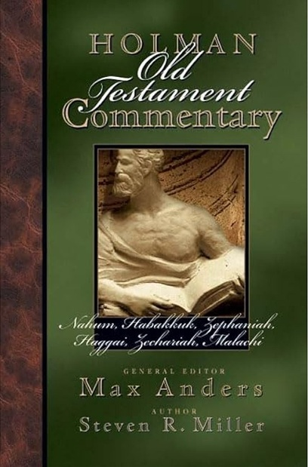
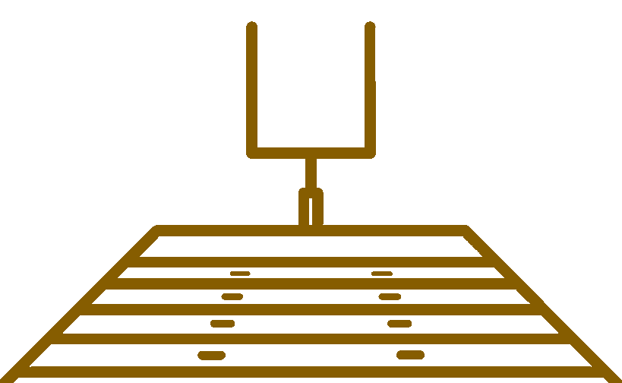


Individuals and nations committed to God will be blessed. God promises victory for them in this life and in the world to come.
Holman Old Testament Commentary Nahum-Malachi Vol 20
Miller, S. R. (2004). Nahum-Malachi (M. Anders, Ed.; p. 118). B&H Publishing Group.
Big Idea

Slide 20
When we align with - God’s Priorities
and pursue - His Purity,
we experience - His Presence
and inherit - His Promise.
Big Idea

Slide 21
BibleProject
1. Priorities
www.bibleproject.com
Notes:
https://bibleproject.com/guides/book-of-haggai/

Slide 22
Ch 1 ¹ In the second year of Darius the king, in the sixth month, on the first day of the month, the word of the Lord came by the hand of Haggai the prophet to Zerubbabel the son of Shealtiel, governor of Judah, and to Joshua the son of Jehozadak, the high priest: ² “Thus says the Lord of hosts: These people say the time has not yet come to rebuild the house of the Lord.” ³ Then the word of the Lord came by the hand of Haggai the prophet, ⁴ “Is it a time for you yourselves to dwell in your paneled houses, while this house lies in ruins? ⁵ Now, therefore, thus says the Lord of hosts: Consider your ways. ⁶ You have sown much, and harvested little. You eat, but you never have enough; you drink, but you never have your fill. You clothe yourselves, but no one is warm. And he who earns wages does so to put them into a bag with holes.
1. Priorities – Charge

Slide 23
⁷ “Thus says the Lord of hosts: Consider your ways. ⁸ Go up to the hills and bring wood and build the house, that I may take pleasure in it and that I may be glorified, says the Lord. ⁹ You looked for much, and behold, it came to little. And when you brought it home, I blew it away. Why? declares the Lord of hosts. Because of my house that lies in ruins, while each of you busies himself with his own house. ¹⁰ Therefore the heavens above you have withheld the dew, and the earth has withheld its produce. ¹¹ And I have called for a drought on the land and the hills, on the grain, the new wine, the oil, on what the ground brings forth, on man and beast, and on all their labors.”
1. Priorities – Charge

Slide 24




Outward Signs of Inner Problem
PROBLEM
These people say the time has not yet come to rebuild the house of the Lord
Is it a time for you yourselves to dwell in your paneled houses, while this house lies in ruins
1. Priorities – Charge

Slide 25





Consider …
Construction …
Consequences …
🤔

Slide 26
¹² Then Zerubbabel the son of Shealtiel, and Joshua the son of Jehozadak, the high priest, with all the remnant of the people, obeyed the voice of the Lord their God, and the words of Haggai the prophet, as the Lord their God had sent him. And the people feared the Lord. ¹³ Then Haggai, the messenger of the Lord, spoke to the people with the Lord's message, “I am with you, declares the Lord.” ¹⁴ And the Lord stirred up the spirit of Zerubbabel the son of Shealtiel, governor of Judah, and the spirit of Joshua the son of Jehozadak, the high priest, and the spirit of all the remnant of the people. And they came and worked on the house of the Lord of hosts, their God, ¹⁵ on the twenty-fourth day of the month, in the sixth month, in the second year of Darius the king.
1. Priorities – Change

Slide 27
Haggai:
Jerusalem: 520 BC (2nd year of King Darius’ reign)
Oracle #1 |  | Oracle #2 |  | Oracle #3 |  | Oracle #4
1:1-15 |  | 2:1-9 |  | 2:10-19 |  | 2:20-23
29 Aug 520 BC |  | 17 Oct 520 BC |  | 18 Dec 520 BC
Rebuke #1 |  | Promise #1 |  | Rebuke #2 |  | Promise #2
Priorities |  | Presence |  | Purity |  | Promise
Rebuke → Misplaced priorities |  | Encouragement → God is with you |  | Instruction → Holiness matters |  | Promise → Kingdom certainty
Charge | Change | Remember | Reassure | Interrogate (question) | Instruct | Reveal
Consider your ways | They obey | Temple once glorious | Greater glory to come | Defilement spreads | Obedience brings blessing | Davidic hope restored
Rebuild God’s house | God stirs hearts | God is with you | Work, fear not | Past disobedience = lack | From this day I bless you | Zerubbabel = signet ring → Christ

Slide 28
BibleProject
2. Presence
www.bibleproject.com
Notes:
https://bibleproject.com/guides/book-of-haggai/

Slide 29
Ch 2 ¹ In the seventh month, on the twenty-first day of the month, the word of the Lord came by the hand of Haggai the prophet: ² “Speak now to Zerubbabel the son of Shealtiel, governor of Judah, and to Joshua the son of Jehozadak, the high priest, and to all the remnant of the people, and say, ³ ‘Who is left among you who saw this house in its former glory? How do you see it now? Is it not as nothing in your eyes?
2. Presence – Remember

Slide 30
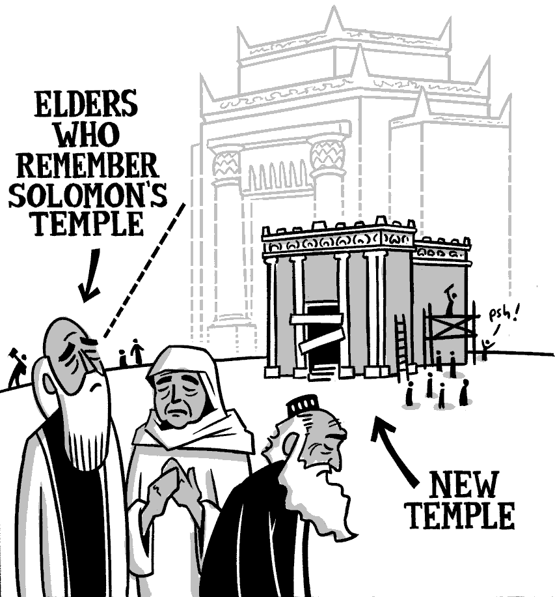
³ ‘Who is left among you who saw this house in its former glory? How do you see it now? Is it not as nothing in your eyes?

Slide 31
⁴ Yet now be strong, O Zerubbabel, declares the Lord. Be strong, O Joshua, son of Jehozadak, the high priest. Be strong, all you people of the land, declares the Lord. Work, for I am with you, declares the Lord of hosts, ⁵ according to the covenant that I made with you when you came out of Egypt. My Spirit remains in your midst. Fear not. ⁶ For thus says the Lord of hosts: Yet once more, in a little while, I will shake the heavens and the earth and the sea and the dry land. ⁷ And I will shake all nations, so that the treasures of all nations shall come in, and I will fill this house with glory, says the Lord of hosts. ⁸ The silver is mine, and the gold is mine, declares the Lord of hosts. ⁹ The latter glory of this house shall be greater than the former, says the Lord of hosts. And in this place I will give peace, declares the Lord of hosts.’”
2. Presence – Reassure

Slide 32

⁴ Yet now
be strong, O Zerubbabel, declares the Lord.
Be strong, O Joshua, son of Jehozadak, the high priest.
Be strong, all you people of the land, declares the Lord. Work, for I am with you, declares the Lord of hosts, ⁵ according to the covenant that I made with you when you came out of Egypt. My Spirit remains in your midst. Fear not. ⁶ For thus says the Lord of hosts: Yet once more, in a little while, I will shake the heavens and the earth and the sea and the dry land. ⁷ And I will shake all nations, so that the treasures of all nations shall come in, and I will fill this house with glory, says the Lord of hosts. ⁸ The silver is mine, and the gold is mine, declares the Lord of hosts. ⁹ The latter glory of this house shall be greater than the former, says the Lord of hosts. And in this place I will give peace, declares the Lord of hosts.’”
2. Presence – Reassure

Slide 33
Deut 28
Blessings & Curses
“If you fully obey the Lord your God and carefully keep all his commands that I am giving you today, the Lord your God will set you high above all the nations of the world. ² You will experience all these blessings if you obey the Lord your God:
¹⁵ “But if you refuse to listen to the Lord your God and do not obey all the commands and decrees I am giving you today, all these curses will come and overwhelm you:

Slide 34
Deut 28
Blessings & Curses
Your towns and your fields
will be blessed (3)
Your towns and your fields
will be cursed (16)
Your children and your crops
will be blessed (4)
Your children and your crops
will be cursed (17)
Your fruit baskets and bread-boards will be blessed (5)
Your fruit baskets and bread-boards will be cursed (18)
Wherever you go and whatever you do, you will be blessed (6)
Wherever you go and whatever you do, you will be cursed (19)
Your enemies will attack you from one direction, but they will scatter from you in seven! (7)
You will attack your enemies from one direction, but you will scatter from them in seven! (25)
You will lend to many nations, but you will never need to borrow from them (12)
They will lend to money to you, but you will not lend to them
(44)

Slide 35
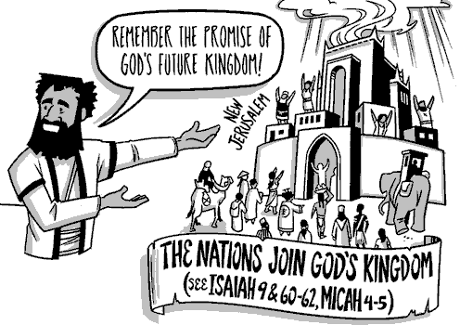
Mosaic Covenant

Slide 36
Haggai:
Jerusalem: 520 BC (2nd year of King Darius’ reign)
Oracle #1 |  | Oracle #2 |  | Oracle #3 |  | Oracle #4
1:1-15 |  | 2:1-9 |  | 2:10-19 |  | 2:20-23
29 Aug 520 BC |  | 17 Oct 520 BC |  | 18 Dec 520 BC
Rebuke #1 |  | Promise #1 |  | Rebuke #2 |  | Promise #2
Priorities |  | Presence |  | Purity |  | Promise
Rebuke → Misplaced priorities |  | Encouragement → God is with you |  | Instruction → Holiness matters |  | Promise → Kingdom certainty
Charge | Change | Remember | Reassure | Interrogate (question) | Instruct | Reveal
Consider your ways | They obey | Temple once glorious | Greater glory to come | Defilement spreads | Obedience brings blessing | Davidic hope restored
Rebuild God’s house | God stirs hearts | God is with you | Work, fear not | Past disobedience = lack | From this day I bless you | Zerubbabel = signet ring → Christ

Slide 37
BibleProject
3. Purity
www.bibleproject.com
Notes:
https://bibleproject.com/guides/book-of-haggai/

Slide 38
¹⁰ On the twenty-fourth day of the ninth month, in the second year of Darius, the word of the Lord came by Haggai the prophet, ¹¹ “Thus says the Lord of hosts: Ask the priests about the law: ¹² ‘If someone carries holy meat in the fold of his garment and touches with his fold bread or stew or wine or oil or any kind of food, does it become holy?’” The priests answered and said, “No.” ¹³ Then Haggai said, “If someone who is unclean by contact with a dead body touches any of these, does it become unclean?” The priests answered and said, “It does become unclean.” ¹⁴ Then Haggai answered and said, “So is it with this people, and with this nation before me, declares the Lord, and so with every work of their hands. And what they offer there is unclean.
3. Purity – Interrogate (question)

Slide 39
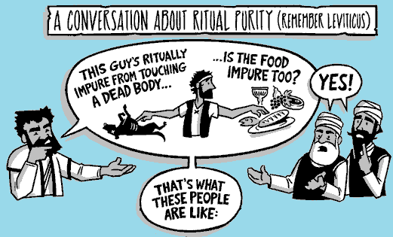

Slide 40
¹⁵ Now then, consider from this day onward. Before stone was placed upon stone in the temple of the Lord, ¹⁶ how did you fare? When one came to a heap of twenty measures, there were but ten. When one came to the wine vat to draw fifty measures, there were but twenty. ¹⁷ I struck you and all the products of your toil with blight and with mildew and with hail, yet you did not turn to me, declares the Lord. ¹⁸ Consider from this day onward, from the twenty-fourth day of the ninth month. Since the day that the foundation of the Lord's temple was laid, consider: ¹⁹ Is the seed yet in the barn? Indeed, the vine, the fig tree, the pomegranate, and the olive tree have yielded nothing. But from this day on I will bless you.”
3. Purity – Instruct

Slide 41
¹⁵ Now then, consider from this day onward. Before stone was placed upon stone in the temple of the Lord, ¹⁶ how did you fare? When one came to a heap of twenty measures, there were but ten. When one came to the wine vat to draw fifty measures, there were but twenty. ¹⁷ I struck you and all the products of your toil with blight and with mildew and with hail, yet you did not turn to me, declares the Lord. ¹⁸ Consider from this day onward, from the twenty-fourth day of the ninth month. Since the day that the foundation of the Lord's temple was laid, consider: ¹⁹ Is the seed yet in the barn? Indeed, the vine, the fig tree, the pomegranate, and the olive tree have yielded nothing. But from this day on I will bless you.”
שׁוּב (shuv) —
Return, Turn back, Come home, Repent
3. Purity – Instruct

Slide 42
Repent and Turn to God
And what is true in the Old Testament
is intensified in the New Testament.
μετανοέω (metanoeō) — to turn, to change direction, to return to God.
John the Baptist —“Repent of your sins and turn to God…” (Matt. 3:1–2)
Jesus —“Repent… and turn to God…” (Matt. 4:17)
Peter —“Repent… and turn to God…” (Acts 2:38; 3:19)
Paul —“All must repent… and turn to God…” (Acts 26:20)

Slide 43
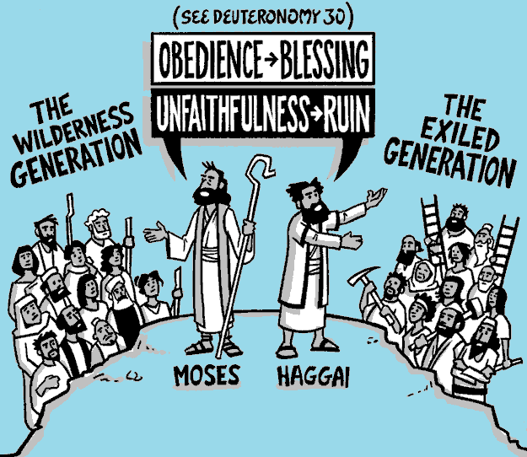


Slide 44
Haggai:
Jerusalem: 520 BC (2nd year of King Darius’ reign)
Oracle #1 |  | Oracle #2 |  | Oracle #3 |  | Oracle #4
1:1-15 |  | 2:1-9 |  | 2:10-19 |  | 2:20-23
29 Aug 520 BC |  | 17 Oct 520 BC |  | 18 Dec 520 BC
Rebuke #1 |  | Promise #1 |  | Rebuke #2 |  | Promise #2
Priorities |  | Presence |  | Purity |  | Promise
Rebuke → Misplaced priorities |  | Encouragement → God is with you |  | Instruction → Holiness matters |  | Promise → Kingdom certainty
Charge | Change | Remember | Reassure | Interrogate (question) | Instruct | Reveal
Consider your ways | They obey | Temple once glorious | Greater glory to come | Defilement spreads | Obedience brings blessing | Davidic hope restored
Rebuild God’s house | God stirs hearts | God is with you | Work, fear not | Past disobedience = lack | From this day I bless you | Zerubbabel = signet ring → Christ

Slide 45
BibleProject
4. Promise
www.bibleproject.com
Notes:
https://bibleproject.com/guides/book-of-haggai/

Slide 46
²⁰ The word of the Lord came a second time to Haggai on the twenty-fourth day of the month, ²¹ “Speak to Zerubbabel, governor of Judah, saying, I am about to shake the heavens and the earth, ²² and to overthrow the throne of kingdoms. I am about to destroy the strength of the kingdoms of the nations, and overthrow the chariots and their riders. And the horses and their riders shall go down, every one by the sword of his brother. ²³ On that day, declares the Lord of hosts, I will take you, O Zerubbabel my servant, the son of Shealtiel, declares the Lord, and make you like a signet ring, for I have chosen you, declares the Lord of hosts.”
4. Promise

Slide 47
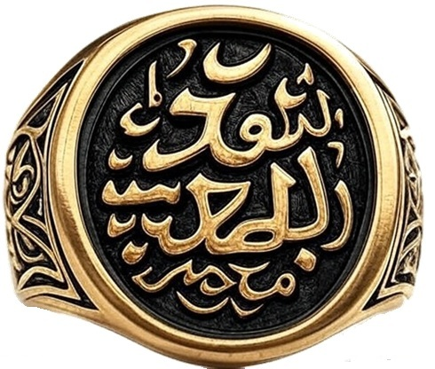
Signet ring = royal authority
David’s line → Messianic hope
Zerubbabel = foreshadow, not fulfillment

Slide 48
BibleProject
Conclusion
www.bibleproject.com
Notes:
https://bibleproject.com/guides/book-of-haggai/

Slide 49
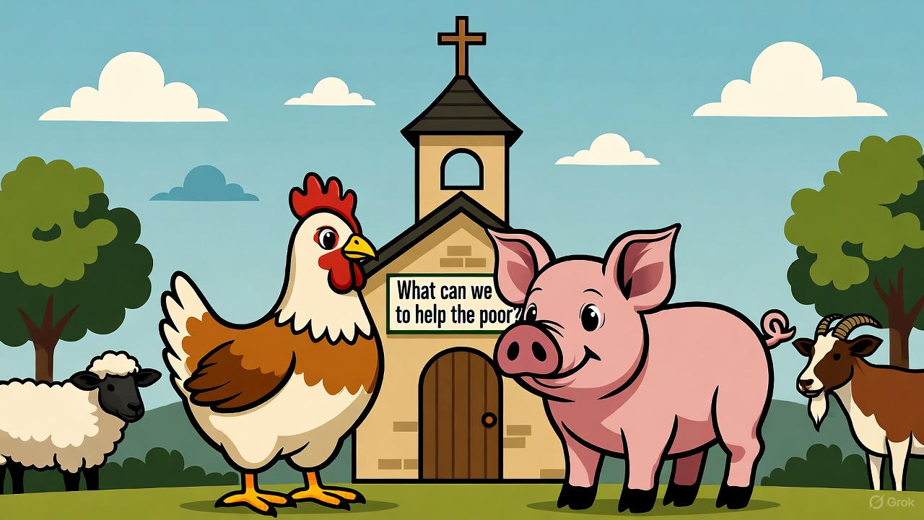

Slide 50


No more excuses.
Put God first.
Turn and be cleansed.
Be faithful where you are.

Slide 52
Black

Slide 53


OT Preaching link at BibleStudyDownloads.org
Get this presentation and notes for free!
Notes:
OT Preaching (op)

