Slide 1

Be Amazed
The Book of Habakkuk
Dr. Rick Griffith • Crossroads International Church Singapore
BibleStudyDownloads.org

Slide 2
What I know.
don't
Notes:
Speakers often tell audiences what they know.
• However, today I will tell you what I do not know.

Slide 3
abbreviate.
Notes:
Why is the word “abbreviate” so long? I don’t know!

Slide 4

pronunciation.
Notes:
Why is the word “pronunciation” so difficult to say? I don’t know!

Slide 5
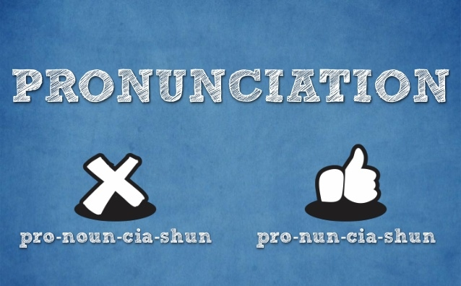
pronunciation.
Notes:
I often hear people say “pro-noun-ci-a-tion,” but I’m not sure why either way is so tough to say.

Slide 6
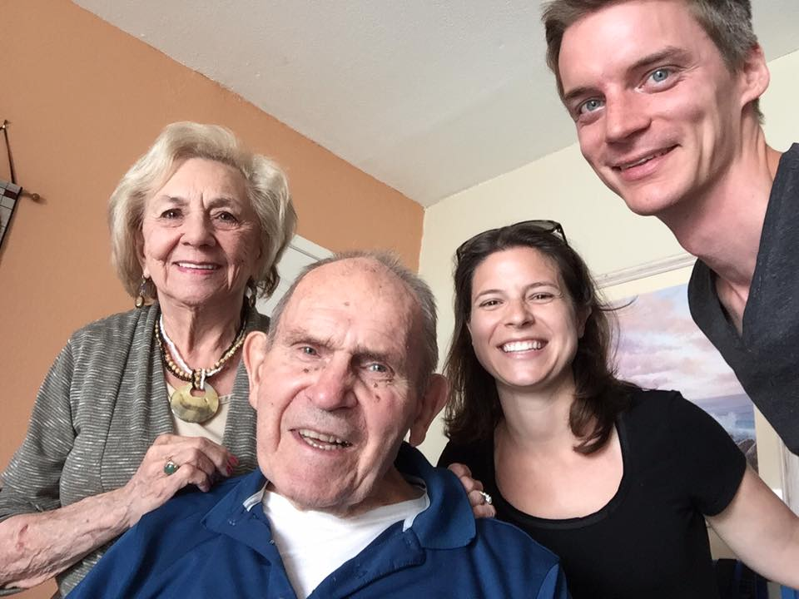
How long, O Lord?
Notes:
On a more serious note, while many here in Singapore see their entire family trust Christ, I don’t know why my parents haven’t learned to genuinely love Jesus even though I have prayed for them for 45 years.

Slide 7
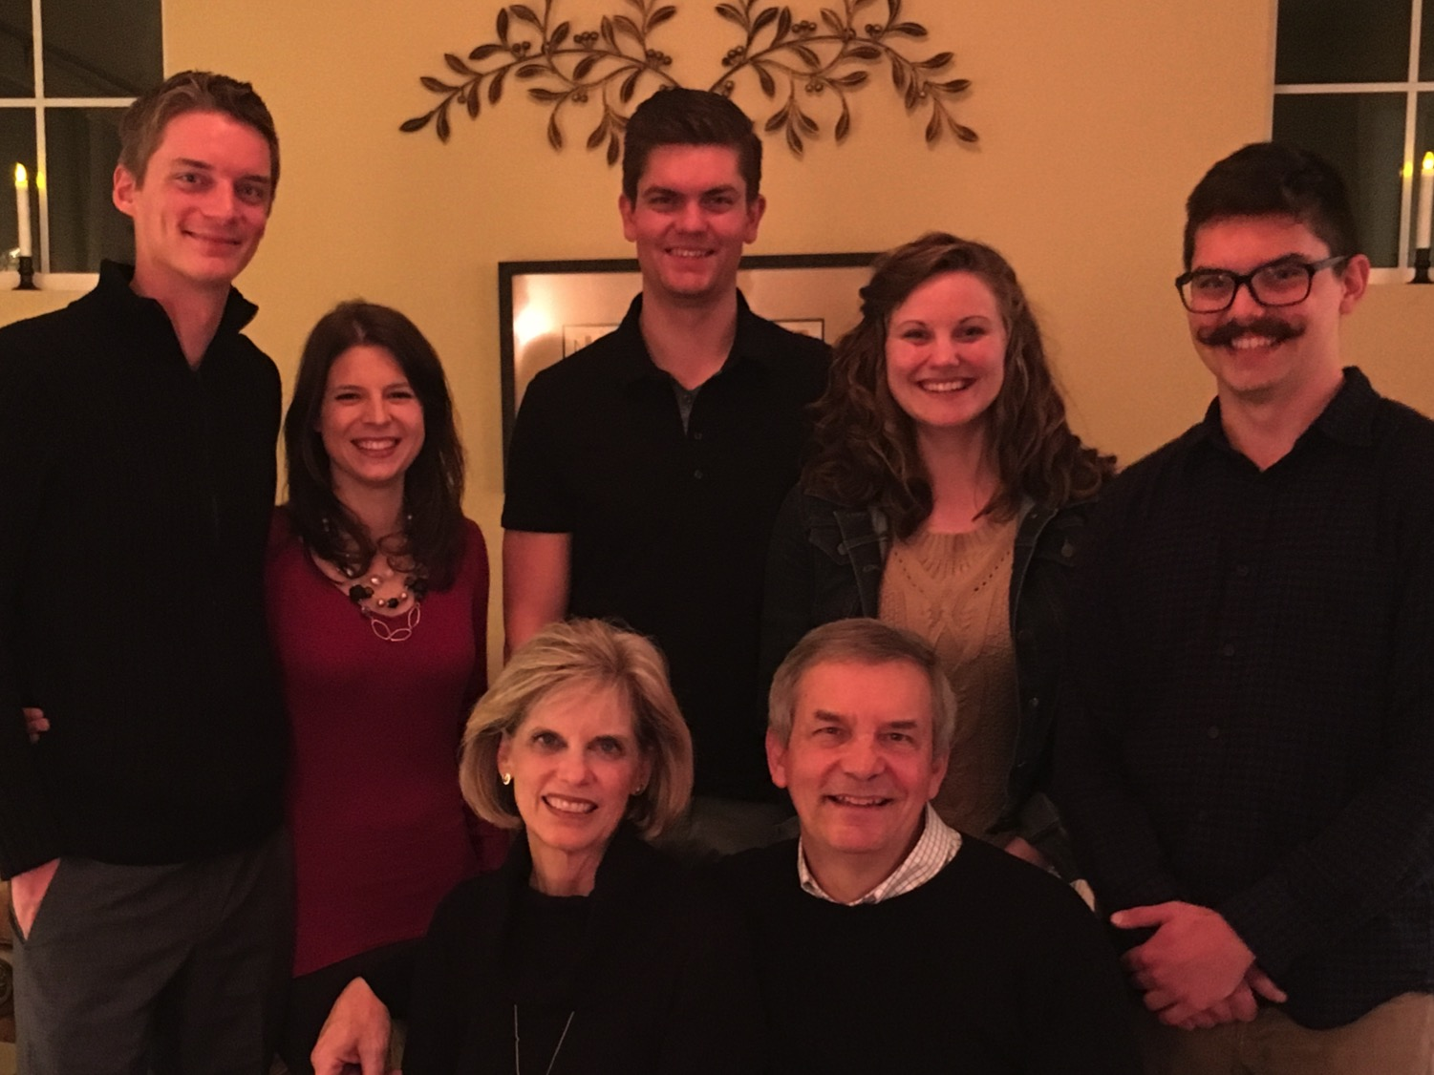
The Griffiths
9 Jan 2016
2017
Stephen & Katie (27)
John
(24)
Kurt & Cara (30)
Susan & Rick
Notes:
Also, why don’t our families passionately love Jesus?

Slide 8
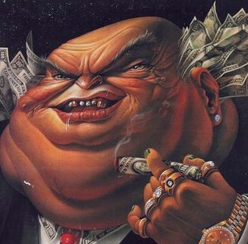
Why do the wicked prosper?
“Behold, these are the wicked;
always at ease, they increase in riches”
(Psalm 73:12).
Notes:
Why do ungodly people always seem to have more money than the godly? I also can’t tell you the answer.

Slide 9
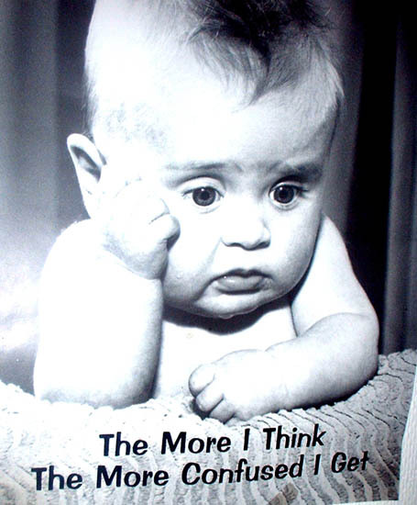
The More I Think,
The More Confused I Get
Notes:
I also can’t tell you the reason for a lot of other things. Honestly, it seems like in some ways, I have more questions than answers!

Slide 10

Perplexed?
Notes:
What issue confounds you right now?

Slide 11
Habakkuk is the only prophet whose entire book is a dialogue with God.
He answers.
If you could converse with God, what would you ask Him?
You ask.
Notes:
If you could ask God a personal question about your life, what would you ask?

Slide 12


GODLY
Mothers
The Foundation of Biblical Wisdom
PROVERBS 22:6
Notes:
We all know the value of a godly mother, so...

Slide 13
"Trust Me."
"God, why did you take my mother?"
Notes:
I can imagine someone saying, “Lord, why did you take my mother when I was young?”

Slide 14
(No answer)
"God, why can't I find a job?"
Notes:
Others might wonder why they can’t find a job—or why their nice boss was replaced with a mean boss.

Slide 15
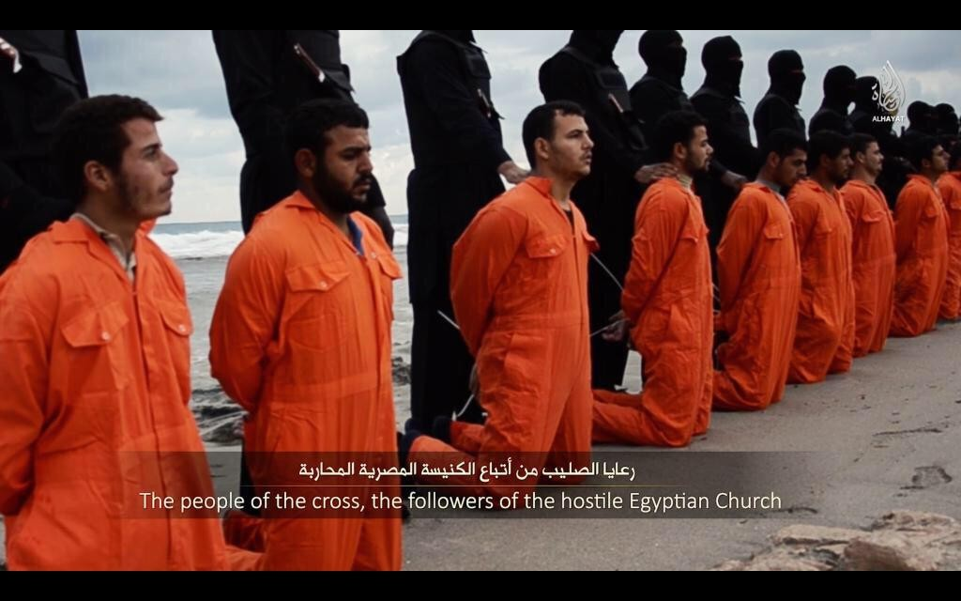
Why so much injustice?
Notes:
On a more global scale, why doesn’t God punish people who blaspheme his name—or kill or rape or cheat others?
How can we handle these injustices without turning into cynics? Basically…

Slide 16
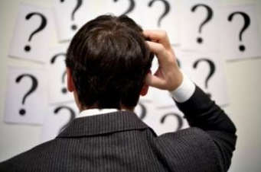
How should we deal with life when perplexed?
Notes:
What should we do when we ask God but our question is met with silence?

Slide 17
Timeline
560
660 650 640 630 620 610 600 590 580 570 560 550 540 530 520
Ashuretililani
Sinsharishkun
Ashuruballit ii
Kings of Assyria
Ashurbanipal
Nahum, Habakkuk
& their contemporaries
663BC
612BC
Fall of Thebes
Fall of Nineveh
609 605 539
World powers
Assyrian
Neo-Babylonian
Persian
Nahum
Judah
Kings of Judah
Jehoiakim
zedekiah
Captivity of Judah to Babylon (586)
Manasseh
Josiah
Restoration from Exile
Amon
Jehoahaz
Jehoiachin
Habakkuk
Notes:
Today we enter into a time in Israel’s divided kingdom when Judah recently saw their godly king Josiah killed.

Slide 18
Slides on
Habakkuk 1

Slide 19

"This is the message that the prophet Habakkuk received in a vision” (1:1 NLT).
—No reign of a king of Judah or Israel
—So how can we date the book?
Notes:
It was in their last years during the time when an obscure prophet named Habakkuk lived. We know that from Habakkuk 1:1—“This is the message that the prophet Habakkuk received in a vision.”

Slide 20
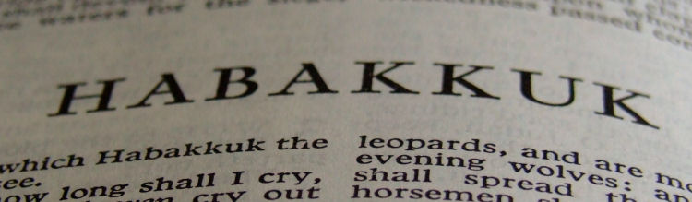
Date
628
The time of the writing of is debated from:
700 BC (too early since Assyrians are in view)
300 BC (too late since Greek forces are in view)
The prophecy names Babylonian invaders (1:6) so it was likely written near the end of Josiah's reign (640-609 BC), probably after the 612 BC destruction of Nineveh by the combined forces of the Babylonians, Medians, and Scythians. This time was 607-605 BC.

Slide 21
An Evil End to Judah
256
1
Josiah
640-609
(31 yrs.)
Good king in white
Evil kings in yellow
3
2
Jehoiakim (Eliakim)
609-597
(11 yrs.)
Jehoahaz
(Shallum)
609
(3 mos.)
Notes:
If Habakkuk prophesied about 600 BC, he lived under King Jehoiakim. The pious Josiah had been slain so the brief era of reform had ended. After a reign of three months Jehoahaz was deposed by Pharaoh Neco, who placed Jehoiakim on the throne. The latter was selfish, tyrannical and godless. In a short time the deplorable conditions of Manasseh's reign returned.

Slide 22
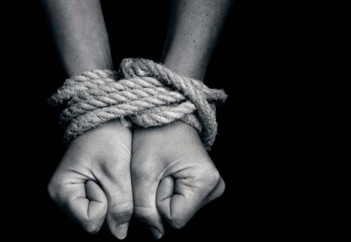
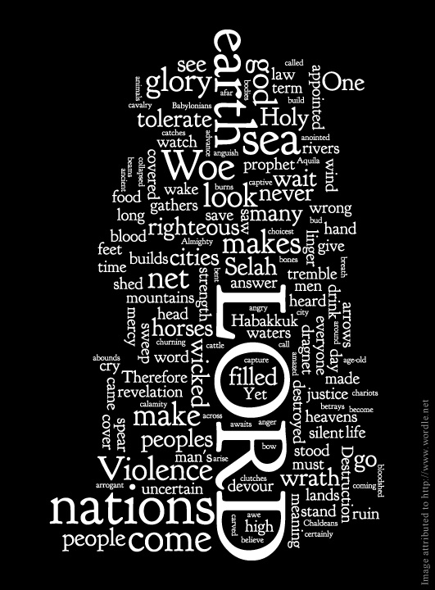
Habakkuk 1:3
"Why must I look on injustice?"

Slide 23
Book Chart
Habakkuk: Babylon's Destruction
Chapters 1–2 |  |  |  | Chapter 3
Punishment of Babylon |  |  |  | Praise Song
Habakkuk's Perplexity |  |  |  | Habakkuk's Praise
God's Actions Challenged |  |  |  | God's Actions Commended
Faith Troubled |  |  |  | Faith Triumphant
Problem |  |  |  | Resolution
Habakkuk | God | Habakkuk | God | Habakkuk
Why aren't you judging Judah's sin, God? | I will. I'll judge Judah with the Babylonians! | But can you use a nation more wicked than Judah? | Sure, but I'll judge them too. | In wrath remember mercy. | Our God is an awesome God! | I'll wait patiently for Babylon's judgment and rejoice in God.
1:1-4 | 1:5-11 | 1:12–2:1 | 2:2-20 | 3:1-2 | 3:3-15 | 3:16-19
Judah
c. 607-605 BC
627

Slide 24
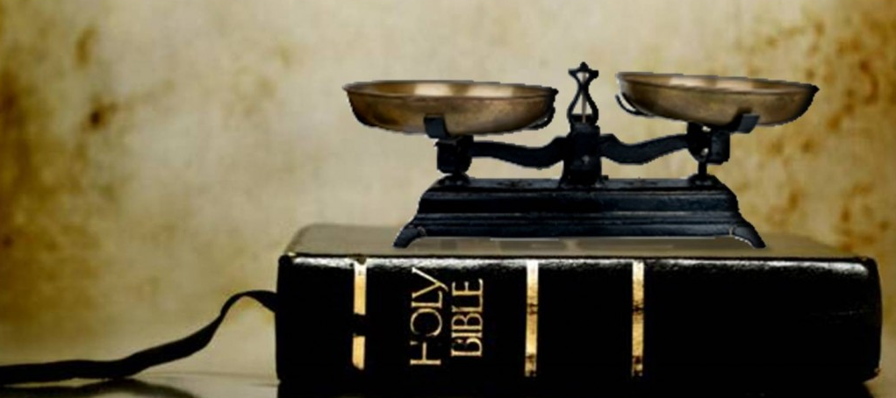
I. We’re often utterly perplexed at God’s plan.

Slide 25
Who
was causing the injustice?
Was it pagans (expected) or God's people (prohibited)?

Slide 26
An Evil End to Judah
256
1
Josiah
640-609
(31 yrs.)
Good king in white
Evil kings in yellow
3
2
Jehoiakim (Eliakim)
609-597
(11 yrs.)
Jehoahaz
(Shallum)
609
(3 mos.)
Evil kings caused the prophet's first perplexity: "How long, O LORD, must I call for help, but you do not listen? Or cry out to you, 'Violence!' but you do not save?" (Hab. 1:2).
Notes:
If Habakkuk prophesied about 600 BC, he lived under King Jehoiakim. The pious Josiah had been slain so the brief era of reform had ended. After a reign of three months Jehoahaz was deposed by Pharaoh Neco, who placed Jehoiakim on the throne. The latter was selfish, tyrannical and godless. In a short time the deplorable conditions of Manasseh's reign returned.

Slide 27
"Must I forever see these evil deeds?
Why must I watch all this misery?
Wherever I look,
I see destruction and violence.
I am surrounded by people who love to argue and fight.
⁴ The law has become paralyzed, and there is no justice in the courts.
The wicked far outnumber the righteous, so that justice has become perverted"
(1:3-4 NLT).

Slide 28

Recipients
628
While the prophecy concerned Babylon, it was directed towards the people of Judah.

Slide 29
Why
is injustice often committed by God's people more than by pagans?
How would you answer this question?

Slide 30
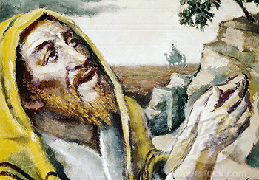
How should we deal with injustice right inside the family of faith?
Have faith that God will address this issue in his time and way.
Key Word for Habakkuk: Faith

Slide 31
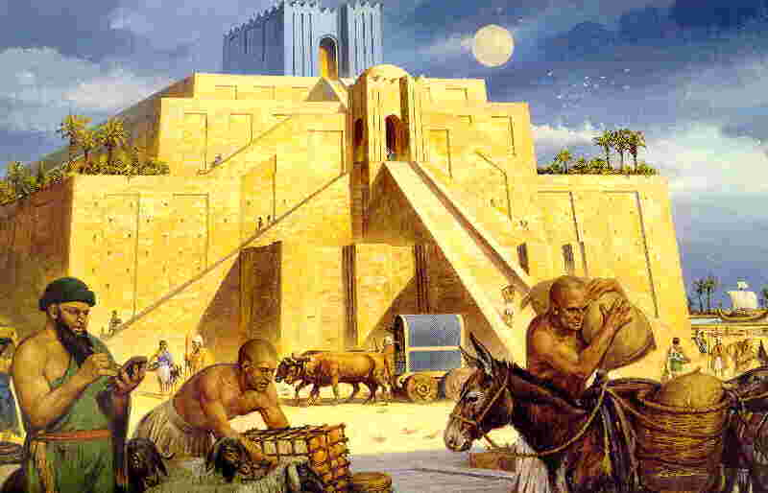
Habakkuk 1:5-11: God's Unexpected Response
I will use the Chaldeans (Babylonians) to punish the ungodly nation of Israel.

Slide 32
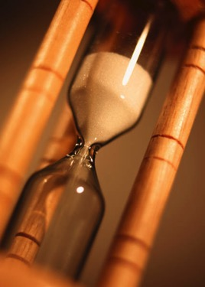
"The LORD replied,
'Look around at the nations; look and be amazed!
For I am doing something in your own day, something you wouldn't believe even if someone told you about it'"
(1:5 NLT).

Slide 33
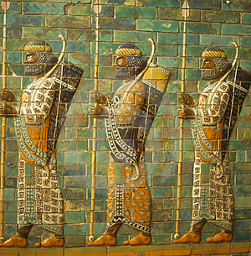
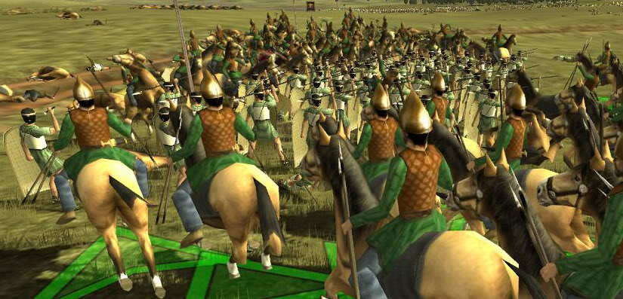
Habakkuk 1:6
"I am raising up the Babylonians, that ruthless and impetuous people, who sweep across the whole earth to seize dwelling places not their own."

Slide 34

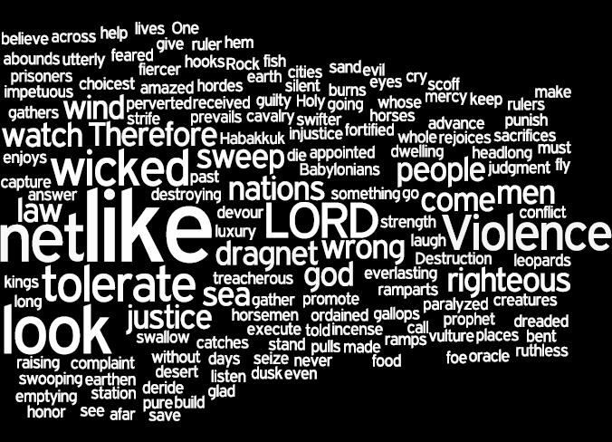
Literary Structure of Habakkuk

Slide 35
Book Chart
Habakkuk: Babylon's Destruction
Chapters 1–2 |  |  |  | Chapter 3
Punishment of Babylon |  |  |  | Praise Song
Habakkuk's Perplexity |  |  |  | Habakkuk's Praise
God's Actions Challenged |  |  |  | God's Actions Commended
Faith Troubled |  |  |  | Faith Triumphant
Problem |  |  |  | Resolution
Habakkuk | God | Habakkuk | God | Habakkuk
Why aren't you judging Judah's sin, God? | I will. I'll judge Judah with the Babylonians! | But can you use a nation more wicked than Judah? | Sure, but I'll judge them too. | In wrath remember mercy. | Our God is an awesome God! | I'll wait patiently for Babylon's judgment and rejoice in God.
1:1-4 | 1:5-11 | 1:12–2:1 | 2:2-20 | 3:1-2 | 3:3-15 | 3:16-19
Judah
c. 607-605 BC
627

Slide 36
"They are notorious for their cruelty and do whatever they like.
⁸ Their horses are swifter than cheetahs
and fiercer than wolves at dusk.
Their charioteers charge from far away.
Like eagles, they swoop down to devour their prey"
(1:7-8 NLT).

Slide 37
"On they come, all bent on violence.
Their hordes advance like a desert wind, sweeping captives ahead of them like sand.
¹⁰ They scoff at kings and princes and scorn all their fortresses.
They simply pile ramps of earth against their walls and capture them!"
(1:9-10 NLT).

Slide 38
"They sweep past like the wind and are gone. But they are deeply guilty, for their own strength is their god"
(1:11 NLT).

Slide 39
"O LORD my God, my Holy One, you who are eternal— surely you do not plan to wipe us out?
O LORD, our Rock, you have sent these Babylonians to correct us, to punish us for our many sins"
(1:12 NLT).

Slide 40
The Babylonian Threat
Babylonian Expansion
Mediterranean
Sea
Syria
Babylon
Israel
Judah
586 BC
Persian
Gulf
Egypt

Slide 41
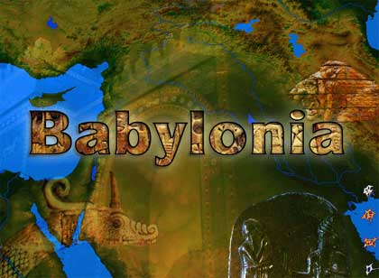

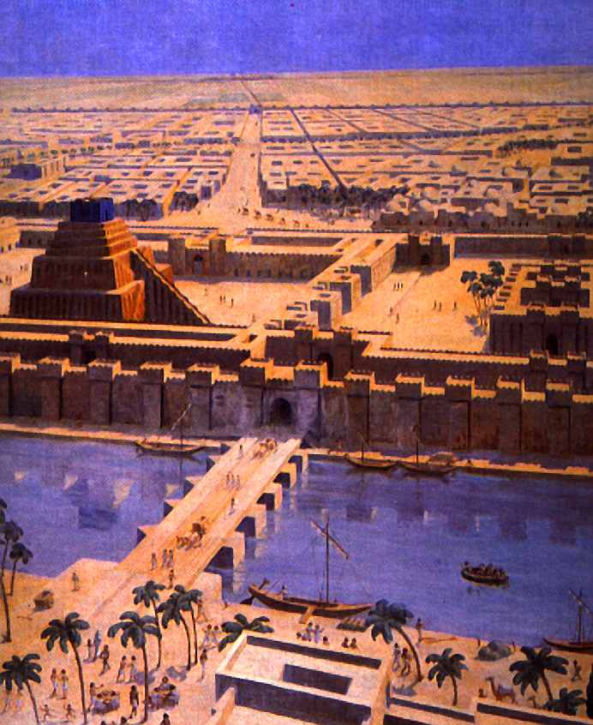
The Babylonians
(Neo-Babylonian Empire)
625-539 BC

Slide 42
Ancient Near East
136
Dominant Peoples in Mesopotamian History
Proto-Literate (3200-2850)
Early Dynastic (2850-2360)
Akkad (2360-2180)
Guti (2180-2082)
Ur III (2070-1960)
Isin-Larsa (1960-1700)
Old Babylonian (1830-1531)
Old Assyrian
Hurrian Invasions (1700-1500)
Kassites (1600-1150)
Mitanni (1500-1380)
Middle Assyrian (1366-1078)
Aramean & Chaldean (1078-935)
Neo-Assyrian (935-612)
Neo Babylonian (625-539)
Persian (539-332)
Alexander (332- )
Neo-Babylonian
625-539 BC

Slide 43
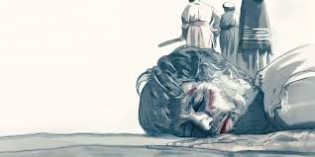
Habakkuk 1:13 NLT
"But you are pure and cannot stand the sight of evil. Will you wink at their treachery? Should you be silent while the wicked swallow up people more righteous than they?"

Slide 44
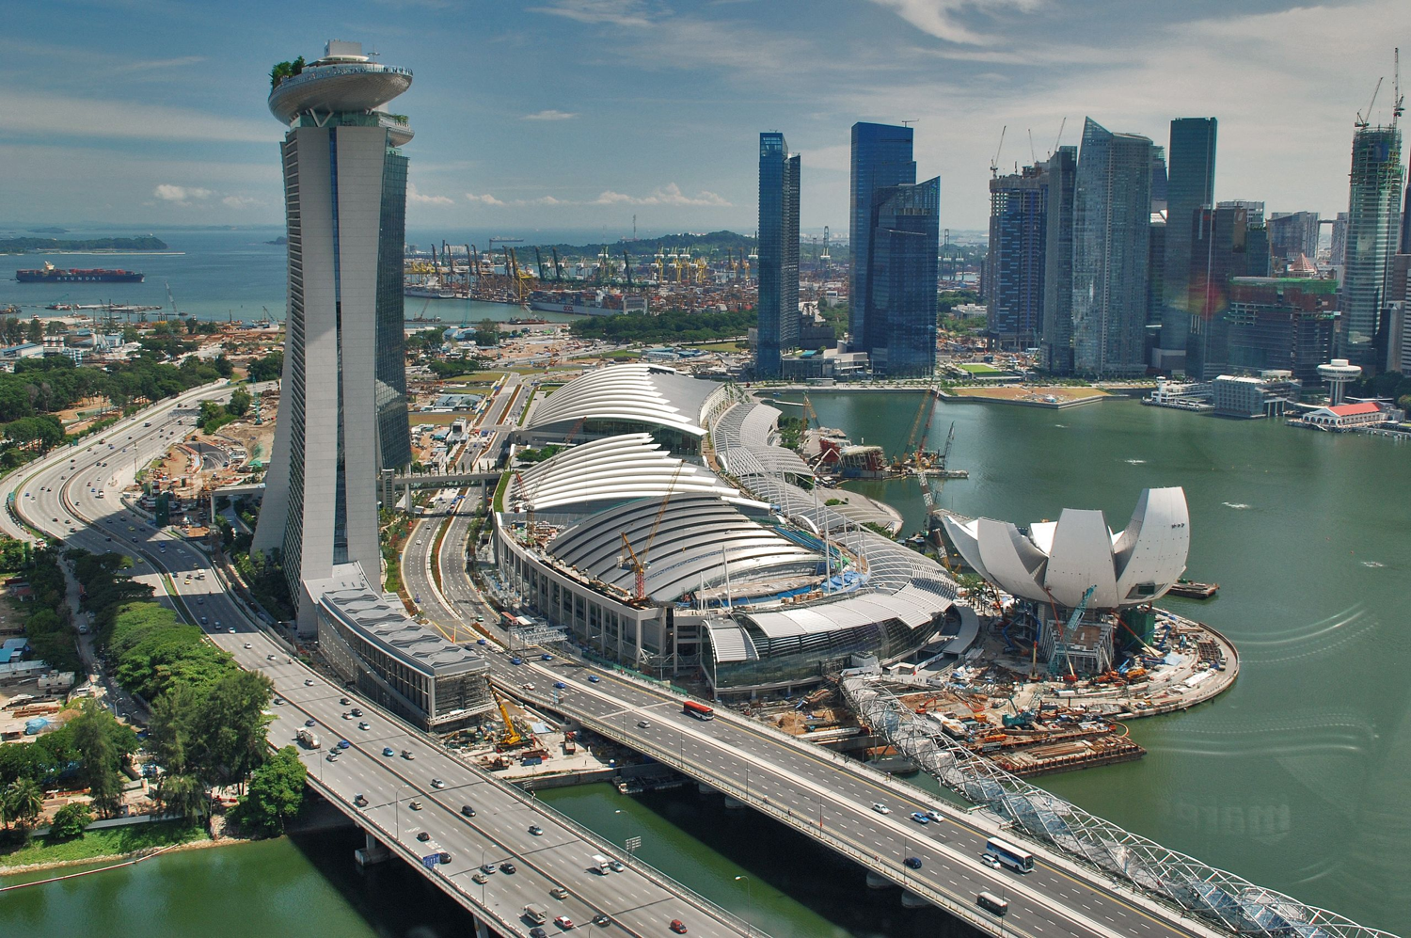
Marina Bay

Slide 45
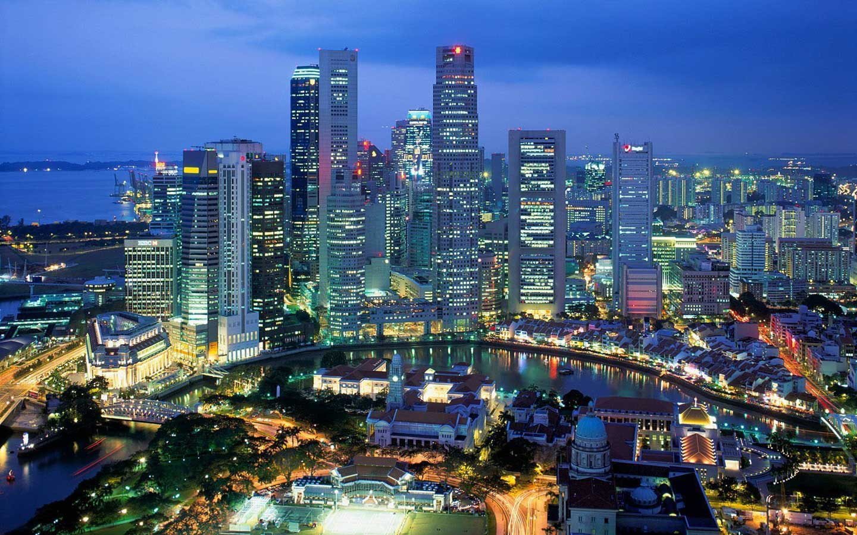
How would the LORD do the same today?
I will. I will have ISIS destroy the city.
God, punish the injustice in Singapore!

Slide 46
"Are we only fish to be caught and killed?
Are we only sea creatures that have no leader?
¹⁵ Must we be strung up on their hooks and caught in their nets while they rejoice and celebrate?"
(1:14-15 NLT).

Slide 47
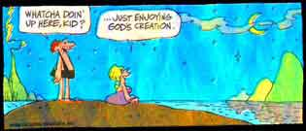
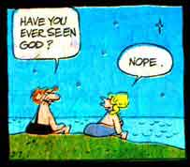
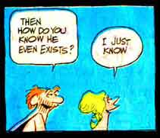
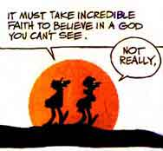
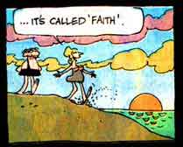
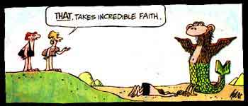
Self-Made Idols Are Useless
Babylon & Us
Whatcha doin' here, kid?
…Just enjoying God's creation.
Have you ever seen God?
It must take incredible faith to believe in a God you can't see.
Then how do you know that he even exists?
…It's called faith.
THAT, TAKES INCREDIBLE FAITH.
Nope.
I just know.
Not really.

Slide 48
"Then they will worship their nets and burn incense in front of them.
'These nets are the gods who have made us rich!' they will claim.
¹⁷ Will you let them get away with this forever? Will they succeed forever in their heartless conquests?"
(Hab 1:16-17 NLT).

Slide 49
Slides on
Habakkuk 2

Slide 50
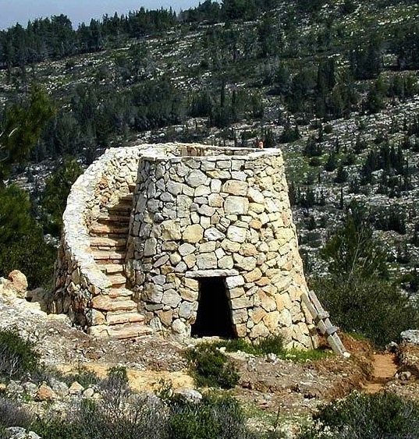
Waiting for an Answer (Hab. 2:1 NLT)
"I will stand on my guard post And station myself on the rampart; And I will keep watch to see what He will speak to me, And how I may reply when I am reproved."

Slide 51

Getting an Answer (Hab. 2:2 NLT)
"Then the LORD said to me,
'Write my answer plainly on tablets,
so that a runner can carry the correct message to others.'"

Slide 52
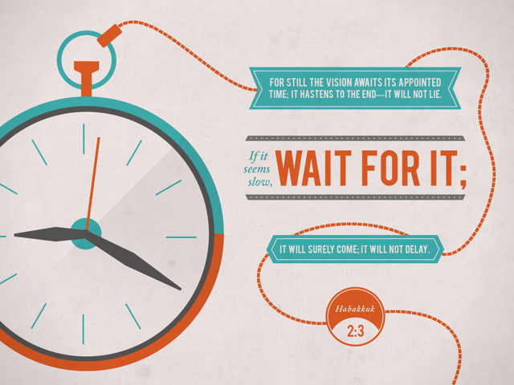

Habakkuk 2:3
FOR STILL THE VISION AWAITS ITS APPOINTED TIME: IT HASTENS TO THE END—IT WILL NOT LIE.
If it seems slow,
WAIT FOR IT:
IT WILL SURELY COME; IT WILL NOT DELAY

Slide 53
The Heart of the Oracle (2:4)
Heart
God contrasts
the demise
of the
proud,
debauched, greedy, bloodthirsty Babylonians
with the preservation of the righteous remnant of Judah
to encourage His people to trust Him

Slide 54
The Heart of the Oracle (2:4)
Heart
The contrast:
"Look at the proud!
They trust in themselves, and their lives are crooked.
But the righteous will live by their faithfulness to God"
(NLT).

Slide 55
"Wealth is treacherous, and the arrogant are never at rest.
They open their mouths as wide as the grave, and like death, they are never satisfied. In their greed they have gathered up many nations and swallowed many peoples"
(2:5 NLT).

Slide 56
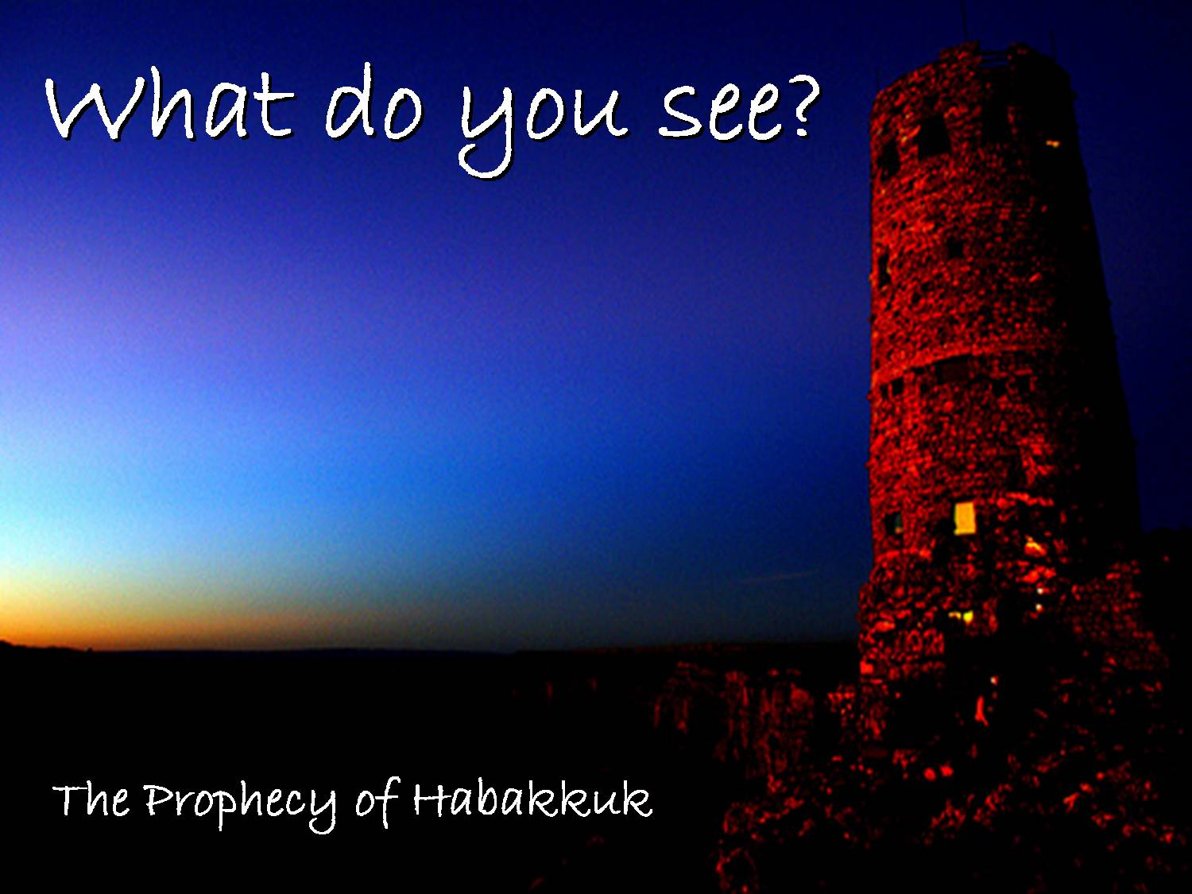
Habakkuk 2:1
5 Woes
Greed (2:6-8)

Slide 57
"But soon their captives will taunt them.
They will mock them, saying,
'What sorrow awaits you thieves!
Now you will get what you deserve!
You've become rich by extortion, but how much longer can this go on?'
⁷ Suddenly, your debtors will take action.
They will turn on you and take all you have, while you stand trembling and helpless" (2:6-7 NLT).

Slide 58
"'Because you have plundered many nations; now all the survivors will plunder you.
You committed murder throughout the countryside and filled the towns with violence" (2:8 NLT).

Slide 59
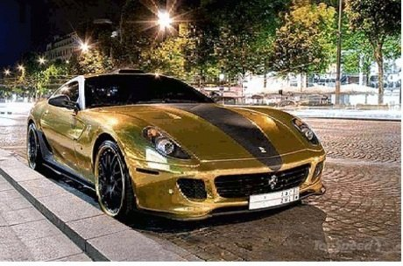
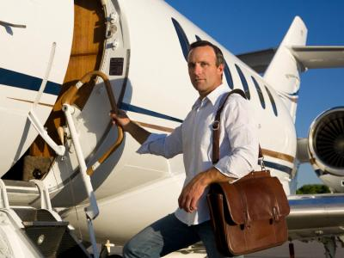
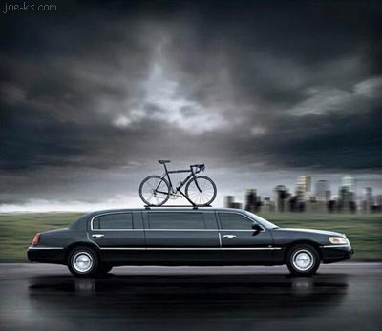
Habakkuk 2:9
"Woe to him who builds his realm by unjust gain to set his nest on high, to escape the clutches of ruin!"

Slide 60
Habakkuk 2:1
5 Woes
Greed (2:6-8)
Exploitation (2:9-11)

Slide 61
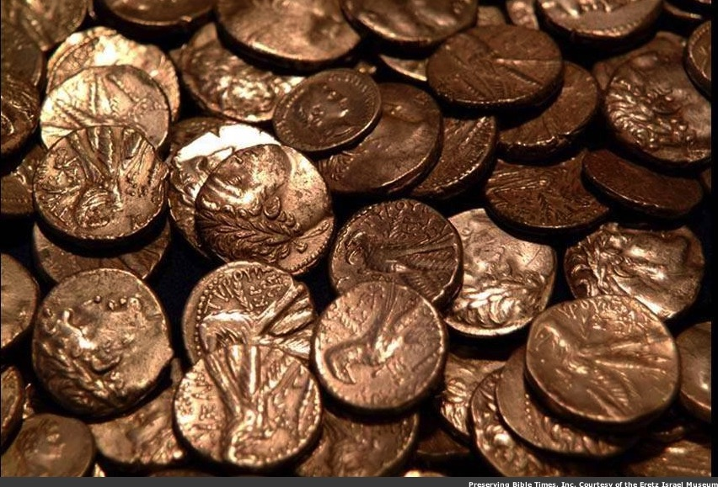
Habakkuk 2:9-11 NLT
"What sorrow awaits you who build big houses with money gained dishonestly! You believe your wealth will buy security, putting your family's nest beyond the reach of danger.
¹⁰But by the murders you committed, you have shamed your name and forfeited your lives.
¹¹The very stones in the walls cry out against you, and the beams in the ceilings echo the complaint"

Slide 62
Habakkuk 2:1
5 Woes
Greed (2:6-8)
Exploitation (2:9-11)
Violence (2:12-14)

Slide 63
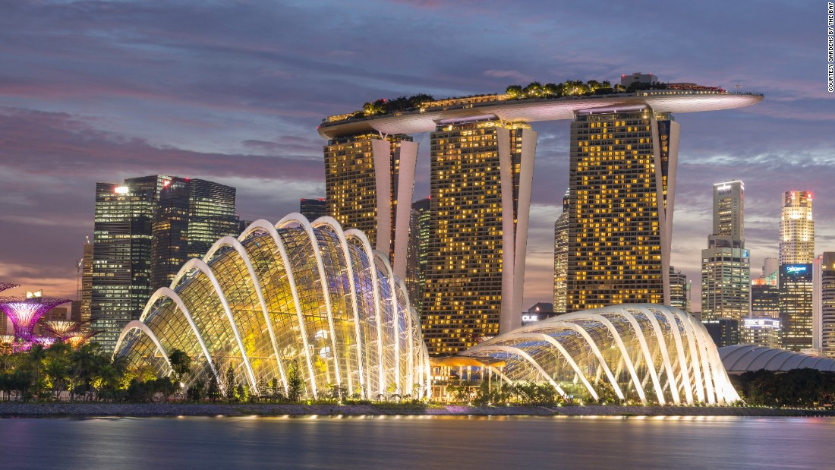
Habakkuk 2:12-13 NLT
"What sorrow awaits you who build cities with money gained through murder and corruption!
¹³Has not the LORD of Heaven's Armies promised that the wealth of nations will turn to ashes?
They work so hard, but all in vain!"
Notes:
Singapore is home to two of the world's three most expensive buildings

Slide 64
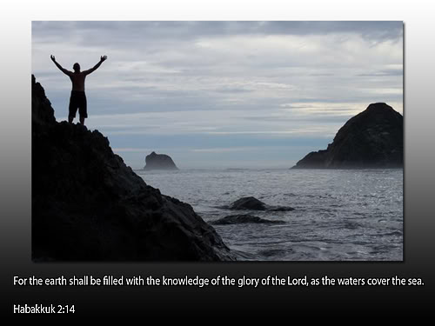
Habakkuk 2:14
"For the earth shall be filled with the knowledge of the LORD, as the waters cover the sea."
– Habakkuk 2:14

Slide 65
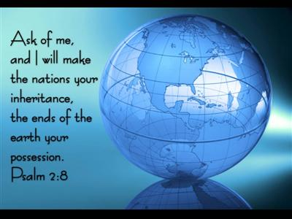
Habakkuk 2:14 = Psalm 2:8?
"Ask of me,
and I will make the nations your inheritance,
the ends of the earth your possession."
Ps. 2:8 NLT

Slide 66
Habakkuk 2:1
5 Woes
Greed (2:6-8)
Exploitation (2:9-11)
Violence (2:12-14)
Immorality (2:15-17)

Slide 67
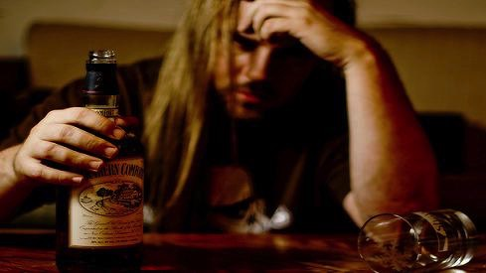
Habakkuk 2:15
"Woe to him who gives drink to his neighbors, pouring it from the wineskin till they are drunk, so that he can gaze on their naked bodies."

Slide 68
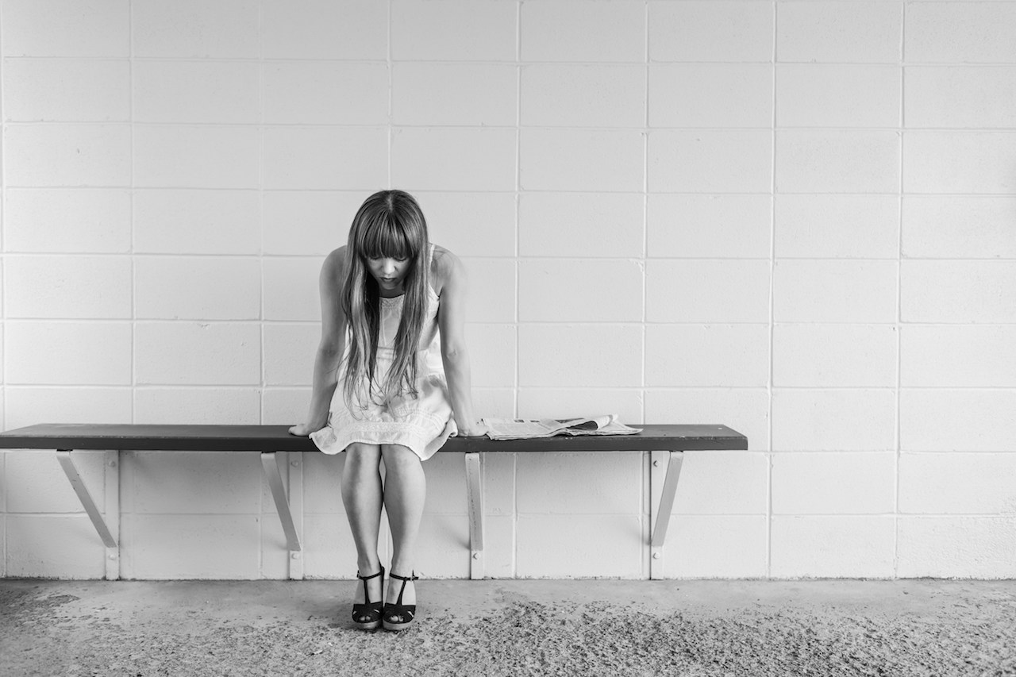
Habakkuk 2:16
"But soon it will be your turn to be disgraced. Come, drink and be exposed!
Drink from the cup of the LORD's judgment, and all your glory will be turned to shame."

Slide 69
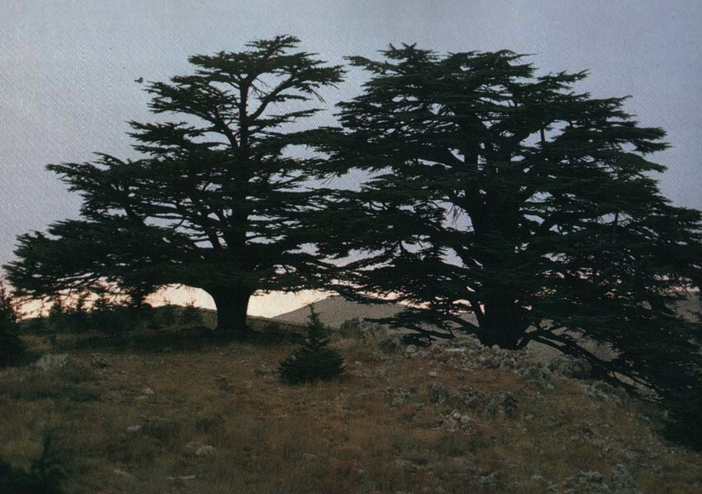
Habakkuk 2:17
"You cut down the forests of Lebanon. Now you will be cut down. You destroyed the wild animals, so now their terror will be yours. You committed murder throughout the countryside and filled the towns with violence."

Slide 70
Habakkuk 2:1
5 Woes
Greed (2:6-8)
Exploitation (2:9-11)
Violence (2:12-14)
Immorality (2:15-17)
Idolatry (2:18-20)

Slide 71
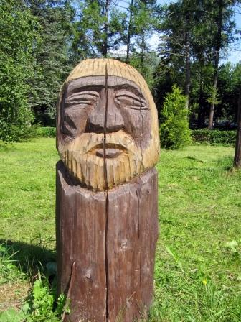
"What good is an idol carved by man, or a cast image that deceives you?
How foolish to trust in your own creation—a god that can't even talk!" (2:18 NLT).

Slide 72
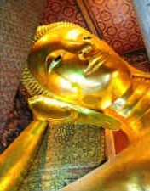
"What sorrow awaits you who say to wooden idols, 'Wake up and save us!' To speechless stone images you say, 'Rise up and teach us!'
Can an idol tell you what to do? They may be overlaid with gold and silver, but they are lifeless inside"
(2:19 NLT).

Slide 73
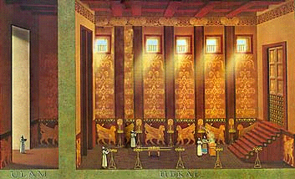
Habakkuk 2:20
"But the LORD is in his holy Temple.
Let all the earth be silent before him."

Slide 74
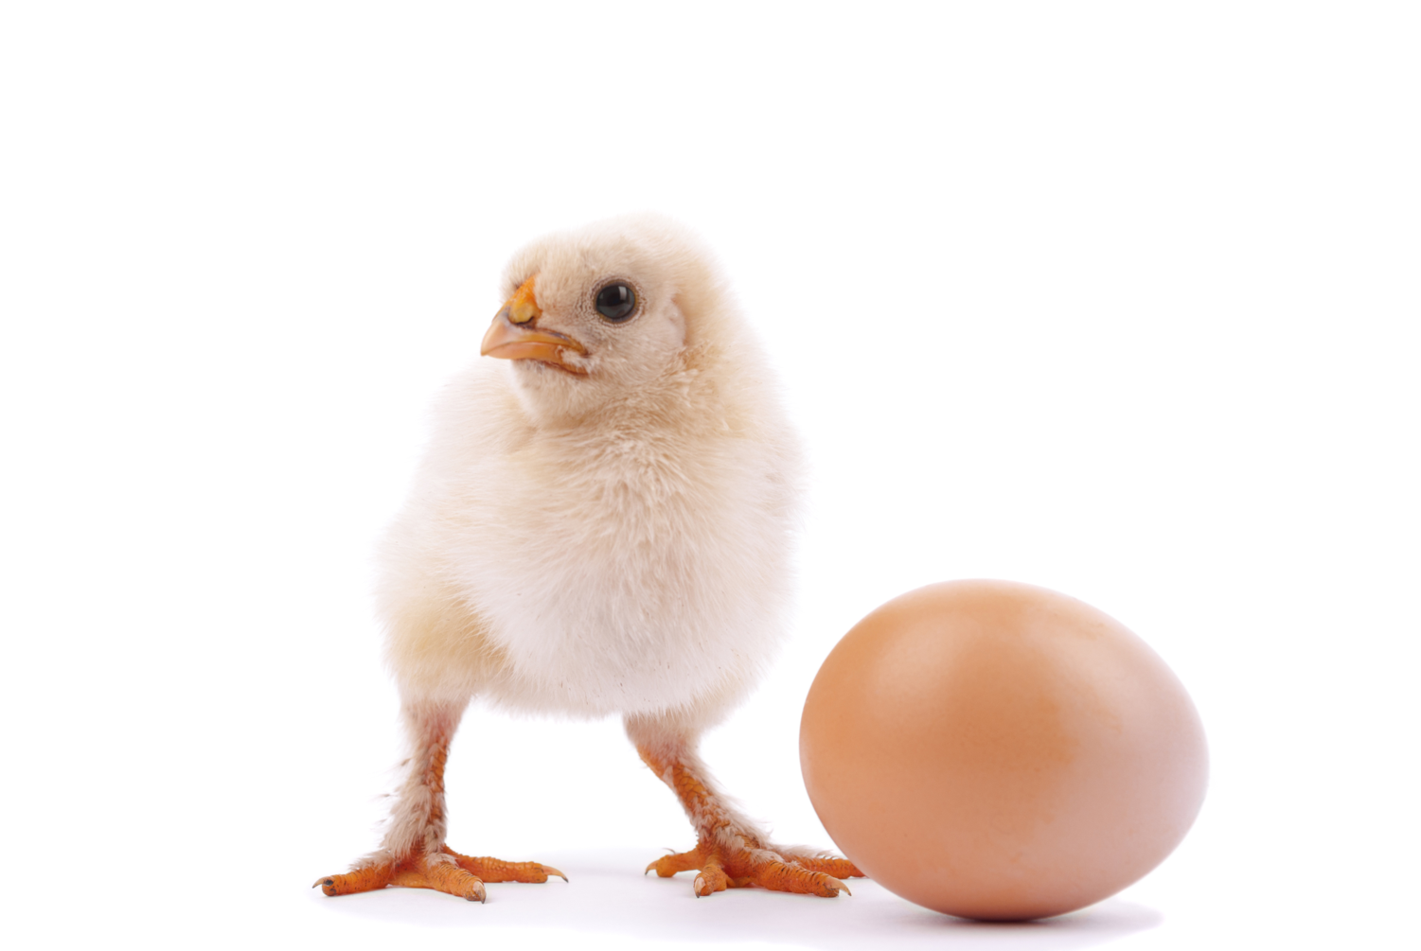
We also have a lot of things that we can’t grasp.
Which came first?

Slide 75
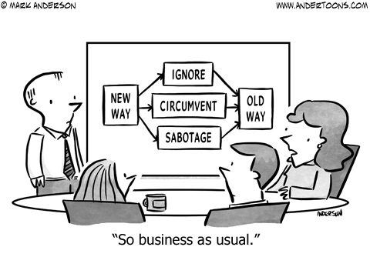
"So business as usual."
IGNORE
NEW WAY
OLD WAY
CIRCUMVENT
SABOTAGE

Slide 76
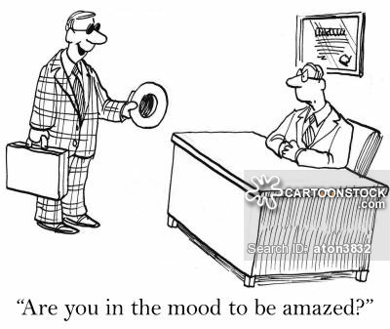
"Are you in the mood to be amazed?"

Slide 77
How should we deal with life when perplexed?

Slide 78
I. We’re often utterly perplexed at God’s plan.

Slide 79
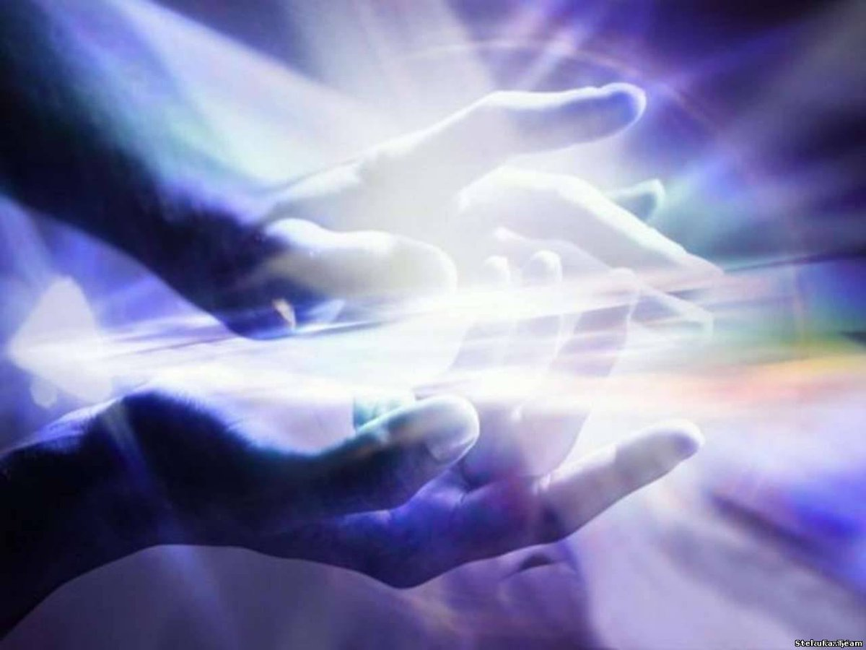
II. When perplexed, be amazed with God’s ways
(Main Idea).
Notes:
At the time you are mystified by how the LORD works, also be astonished.

Slide 80
Slides on
Habakkuk 3

Slide 81
Book Chart
Habakkuk: Babylon's Destruction
Chapters 1–2 |  |  |  | Chapter 3
Punishment of Babylon |  |  |  | Praise Song
Habakkuk's Perplexity |  |  |  | Habakkuk's Praise
God's Actions Challenged |  |  |  | God's Actions Commended
Faith Troubled |  |  |  | Faith Triumphant
Problem |  |  |  | Resolution
Habakkuk | God | Habakkuk | God | Habakkuk
Why aren't you judging Judah's sin, God? | I will. I'll judge Judah with the Babylonians! | But can you use a nation more wicked than Judah? | Sure, but I'll judge them too. | In wrath remember mercy. | Our God is an awesome God! | I'll wait patiently for Babylon's judgment and rejoice in God.
1:1-4 | 1:5-11 | 1:12–2:1 | 2:2-20 | 3:1-2 | 3:3-15 | 3:16-19
Judah
c. 607-605 BC
627

Slide 82
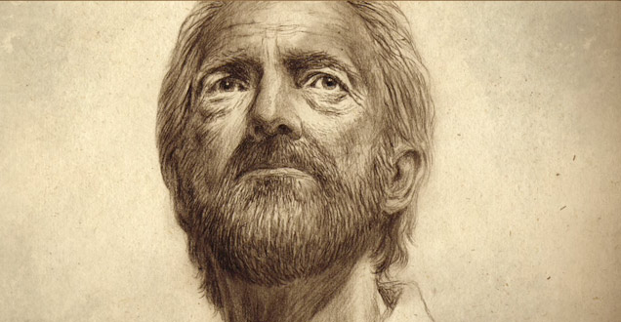
Habakkuk 3
The Prophet's Hope

Slide 83

The Answer to "Why" is…
"Who"

Slide 84
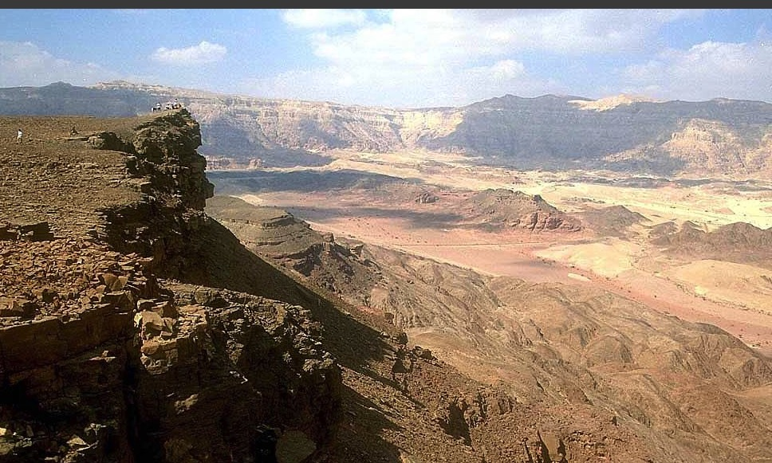
Habakkuk 3:1-2
"A prayer of Habakkuk the prophet.
On shigionoth.
²LORD, I have heard of your fame;
I stand in awe of your deeds, O LORD.
Renew them in our day,
in our time make them known;
in wrath remember mercy."

Slide 85

"I have heard all about you, LORD.
I am filled with awe by your amazing works.
In this time of our deep need, help us again as you did in years gone by.
And in your anger, remember your mercy"
(3:2 NLT).

Slide 86

"I see God moving across the deserts from Edom, the Holy One coming from Mount Paran.
His brilliant splendor fills the heavens, and the earth is filled with his praise" (3:3 NLT).
140
Judah
Edom

Slide 87

"His coming is as brilliant as the sunrise.
Rays of light flash from his hands, where his awesome power is hidden"
(3:4 NLT).

Slide 88

"Pestilence marches before him; plague follows close behind" (3:5 NLT).

Slide 89
"When he stops, the earth shakes.
When he looks, the nations tremble.
He shatters the everlasting mountains and levels the eternal hills.
He is the Eternal One!" (3:6 NLT).

Slide 90

"I see the people of Cushan in distress, and the nation of Midian trembling in terror”
(3:7 NLT).
Mt. Sinai
Midian
Cushan

Slide 91


The Sea
Exodus 12

Slide 92

The Leader
Exodus 12

Slide 93

"Was it in anger, LORD, that you struck the rivers and parted the sea?
Were you displeased with them?
No, you were sending your chariots of salvation!"
(3:8 NLT).

Slide 94
"You brandished your bow and your quiver of arrows.
You split open the earth with flowing rivers.
¹⁰ The mountains watched and trembled.
Onward swept the raging waters.
The mighty deep cried out, lifting its hands to the LORD"
(3:9-10 NLT).

Slide 95
"The sun and moon stood still in the sky as your brilliant arrows flew and your glittering spear flashed” (3:11 NLT).

Slide 96
"You marched across the land in anger and trampled the nations in your fury.
¹³ You went out to rescue your chosen people, to save your anointed ones. You crushed the heads of the wicked and stripped their bones from head to toe" (3:12-13 NLT).

Slide 97
"With his own weapons, you destroyed the chief of those who rushed out like a whirlwind, thinking Israel would be easy prey.
¹⁵ You trampled the sea with your horses, and the mighty waters piled high"
(3:14-15 NLT).

Slide 98
"I trembled inside when I heard this; my lips quivered with fear.
My legs gave way beneath me, and I shook in terror.
I will wait quietly for the coming day when disaster will strike the people who invade us" (3:16 NLT).

Slide 99

Habakkuk 3:17 Expected Budding

Slide 100

Hab. 3:17-18
"Though the fig tree does not bud and there are no grapes on the vines, though the olive crop fails and the fields produce no food,
though there are no sheep in the pen and no cattle in the stalls,
¹⁸yet I will rejoice in the LORD,
I will be joyful in God my Savior."

Slide 101

The Glory of Singapore

Slide 102

The Destruction of Singapore
"Though Marina Bay, Orchard Road and every building is destroyed and not even one bank remains on Shenton Way, though NTUC, Cold Storage and every store has no food, though every dollar of every one of my accounts is lost, though there is no meat in the fridge and no noodles in the cabinets,
¹⁸yet I will rejoice in the LORD,
I will be joyful in God my Savior."
Hesitations 3:17-18

Slide 103

Habakkuk 3:18
"yet I will rejoice in the LORD,
I will be joyful in God my Savior."

Slide 104

Habakkuk 3:19
"The Sovereign LORD is my strength;
He makes my feet like the feet of a deer,
He enables me to go on the heights."
– Habakkuk 3:19

Slide 105

Belshazzar Humbled
Rembrandt

Slide 106



Fall of Babylon
BABYLON FELL (539 BC)
Cyrus entered under the water gates
Daniel 5
(Belshazzar's Feast)
I heard and my heart pounded, my lips quivered at the sound; decay crept into my bones, and my legs trembled. Yet I will wait patiently for the day of calamity to come on the nation invading us (Hab. 3:16).

Slide 107

Don’t let your confusion stop you from being amazed at how God works.

Slide 108

Be Amazed

Slide 109

Be Amazed

Slide 110

Be Amazed
Pico do Arieiro: Miradouro Ninho da Manta, look down and be amazed!

Slide 111

Be Amazed

Slide 112

Be Amazed

Slide 113

Be Amazed

Slide 114

A Prayer
O, God of wonder, enlarge my capacity to be amazed at what is amazing, and end my attraction with the insignificant.
—John Piper—

Slide 115
How should we deal with life when perplexed?

Slide 116

Main Idea
When perplexed, be amazed with God’s ways.
Habakkuk

Slide 117
I. We’re often utterly perplexed at God’s plan.

Slide 118
II. When perplexed, be amazed with God’s ways
(Main Idea).

Slide 119

What issue most baffles you where you need hope?

Slide 120

Key Word
627
343
Faith
Habakkuk

Slide 121
Key Verse
627
(God regarding Babylon) "See, he is puffed up; his desires are not right—but the righteous will live by his faith" (2:4).
Habakkuk

Slide 122

Rest in the LORD
"Be still in the presence of the LORD, and wait patiently for him to act. Don’t worry about evil people who prosper or fret about their wicked schemes"
(Psalm 37:7 NLT).

Slide 123
Black

Slide 124


OT Sermons link at BibleStudyDownloads.org
Get this presentation for free!
Notes:
OT Survey (os)

