Slide 1
Habakkuk 1:12 – 2:1
Really… Them?
When God uses the wicked to judge His people.
Preached by Manik Corea at Crossroads International Church Singapore • CICFamily.com Uploaded by Dr. Rick Griffith • Jordan Evangelical Theological Seminary Files in many languages for free download at BibleStudyDownloads.org

Slide 2
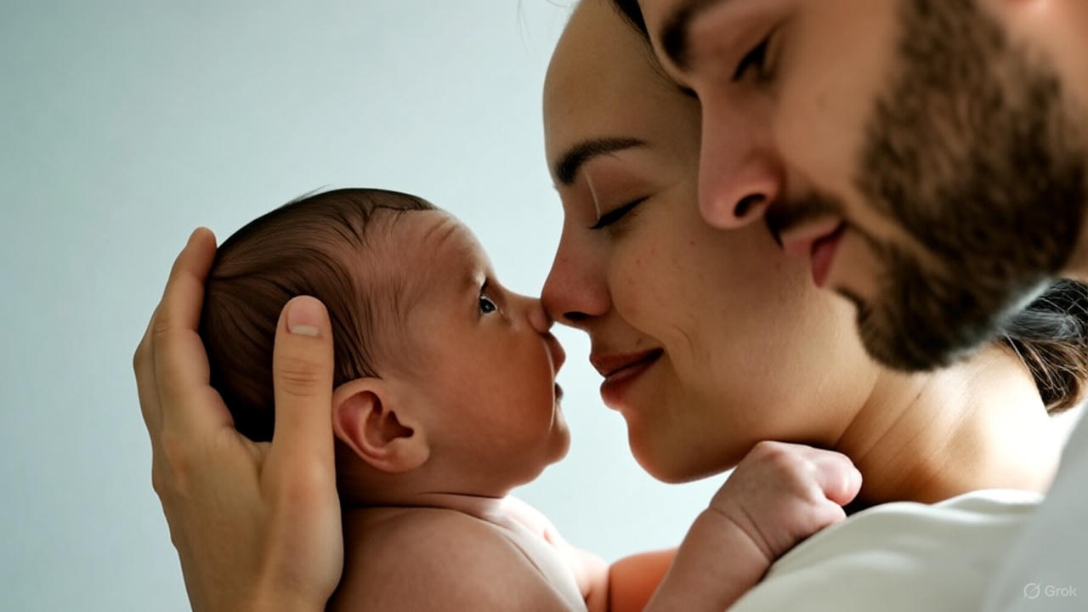

Slide 3
Habakkuk 1:12 – 2:1
Really… Them?
When God uses the wicked to judge His people.

Slide 4
What in the World, God….
Habakkuk

Slide 5
Mesopotamia
Canaan
Egypt
Fertile Crescent

Slide 6
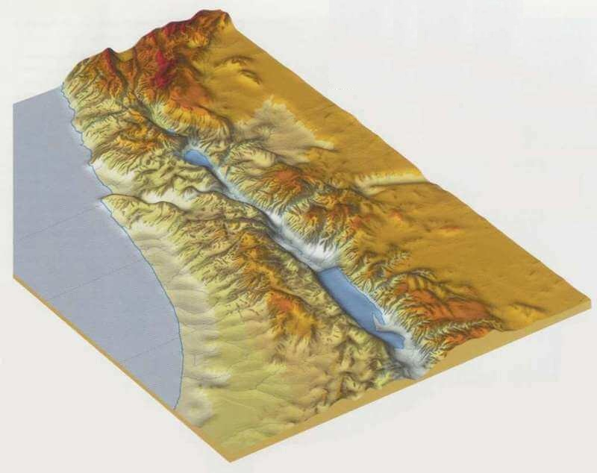
Canaan Topography
Arabian Desert
Egypt
https://www.studylight.org/pastoral-resources/bible-maps-archive.html?pn=3&

Slide 7
Anatolia (Hittites)
Mesopotamia
Canaan
City States
Egypt
Bronze Age (~3300 to ~1100 BC)

Slide 8
Anatolia (Hittites)
🔥
🔥
🔥
Mesopotamia
🔥
Canaan
🔥
City States
🔥
🔥
🔥
Egypt
🔥
🔥
Bronze Age Collapse (~1100 to ~900 BC)

Slide 9
Anatolia (City States)
Mesopotamia
Empires
Canaan
Egypt
Iron Age (~900 to ~500 BC)

Slide 10
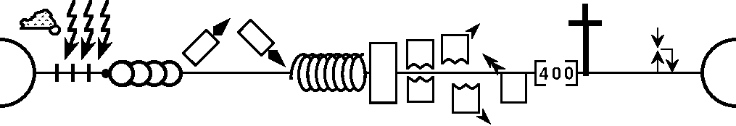
--------------------------------------------------------------------------1 & 2 Chronicles ----------------------------------------------------------
Deuteronomy
1 Samuel
Leviticus
2 Samuel
Nehemiah
Genesis 1-11
Genesis 12-50
Exodus
Numbers
Joshua
Judges
1 Kings
2 Kings
Ruth
Ezra
Esther
2,000 BC
Moses
Cycles
S • D • S
Z • E • N
1st Coming
Eternity
Creation
Joshua
J (R) & I (J)
Eternity
Fall
Babel
J (B) & I (A)
Flood
P • G • H • R
2nd Coming
Abraham
Joseph
Isaac
Jacob
1000
1990+
Exodus
Judges
Church
Kingdom
Patriarchs
Conquests
Silent Years
Beginnings
Restoration
United Kingdom
Captivity
Divided Kingdom
Max Anders, Dallas Theological Seminary

Slide 11
--------------------------------------------------------------------------1 & 2 Chronicles ----------------------------------------------------------
Deuteronomy
1 Samuel
Leviticus
2 Samuel
Nehemiah
Genesis 1-11
Genesis 12-50
Exodus
Numbers
Joshua
Judges
1 Kings
2 Kings
Ruth
Ezra
Esther
1,000 BC
Moses
Cycles
S • D • S
Z • E • N
1st Coming
Eternity
Creation
Joshua
J (R) & I (J)
Eternity
Fall
Babel
J (B) & I (A)
Flood
P • G • H • R
2nd Coming
Abraham
Joseph
Isaac
Jacob
1000
1990+
Exodus
Judges
Church
Kingdom
Patriarchs
Conquests
Silent Years
Beginnings
Restoration
United Kingdom
Captivity
Divided Kingdom
Max Anders, Dallas Theological Seminary

Slide 12
--------------------------------------------------------------------------1 & 2 Chronicles ----------------------------------------------------------
Deuteronomy
1 Samuel
Leviticus
2 Samuel
Nehemiah
Genesis 1-11
Genesis 12-50
Exodus
Numbers
Joshua
Judges
1 Kings
2 Kings
Ruth
Ezra
Esther
600 BC
Moses
Cycles
S • D • S
Z • E • N
1st Coming
Eternity
Creation
Joshua
J (R) & I (J)
Eternity
Fall
Babel
J (B) & I (A)
Flood
P • G • H • R
2nd Coming
Abraham
Joseph
Isaac
Jacob
1000
1990+
Exodus
Judges
Church
Kingdom
Patriarchs
Conquests
Silent Years
Beginnings
Restoration
United Kingdom
Captivity
Divided Kingdom
Max Anders, Dallas Theological Seminary

Slide 13
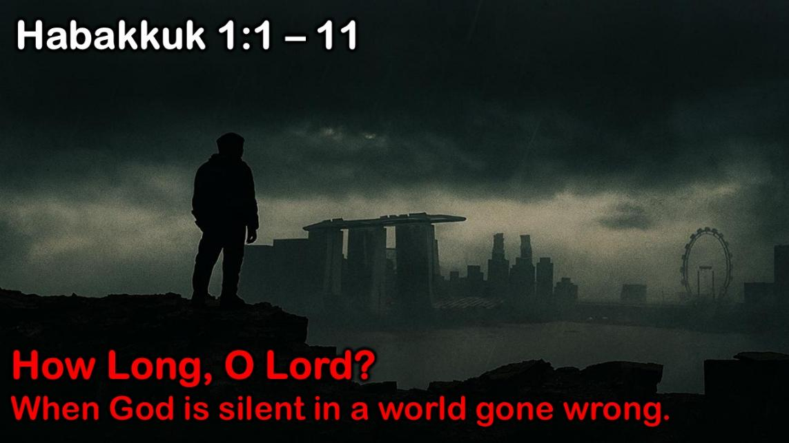
Habakkuk: Babylon's Destruction
Judah: 612 – 586 BC (some believe 607-605 BC)
God's Actions Challenged
Doubting | Debating God |  |  | Defending God
Prophets’ 1st Complaint
Question of God’s Inactivity
Habakkuk | God
Why aren't you judging Judah's sin, God? | I will. I'll judge Judah with the Babylonians!
1:1-4 | 1:5-11
Problem: Faith Troubled

Slide 14
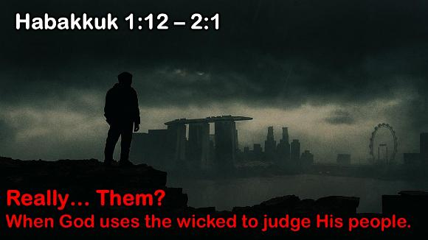
Habakkuk: Babylon's Destruction
Judah: 612 – 586 BC (some believe 607-605 BC)
God's Actions Challenged
Doubting | Debating God |  |  | Defending God
Prophets’ 1st Complaint |  | Prophets’ 2nd Complaint
Question of God’s Inactivity |  | Question of God’s Inconsistency
Habakkuk | God | Habakkuk
Why aren't you judging Judah's sin, God? | I will. I'll judge Judah with the Babylonians! | But can you use a nation more wicked than Judah?
1:1-4 | 1:5-11 | 1:12–2:1
Problem: Faith Troubled

Slide 15
Habakkuk: Babylon's Destruction
Judah: 612 – 586 BC (some believe 607-605 BC)
God's Actions Challenged
Doubting | Debating God |  |  | Defending God
Prophets’ 1st Complaint |  | Prophets’ 2nd Complaint
Question of God’s Inactivity |  | Question of God’s Inconsistency
Habakkuk | God | Habakkuk | God
Why aren't you judging Judah's sin, God? | I will. I'll judge Judah with the Babylonians! | But can you use a nation more wicked than Judah?
1:1-4 | 1:5-11 | 1:12–2:1 | 2:2-20
Problem: Faith Troubled |  |  | Resolution: Faith __________

Slide 16
Habakkuk: Babylon's Destruction
Judah: 612 – 586 BC (some believe 607-605 BC)
God's Actions Challenged |  |  |  | God's Actions Commended
Doubting | Debating God |  |  | Defending God
Prophets’ 1st Complaint |  | Prophets’ 2nd Complaint |  | Prophets’ Prayer of Trust
Question of God’s Inactivity |  | Question of God’s Inconsistency |  | Affirming God’s Sovereignty and Faithfulness
Habakkuk | God | Habakkuk | God | Habakkuk
Why aren't you judging Judah's sin, God? | I will. I'll judge Judah with the Babylonians! | But can you use a nation more wicked than Judah? | Sure, but I'll judge them too. | In wrath remember mercy. | Our God is an awesome God! | I'll wait patiently for Babylon's judgment and rejoice in God.
1:1-4 | 1:5-11 | 1:12–2:1 | 2:2-20 | 3:1-2 | 3:3-15 | 3:16-19
Problem: Faith Troubled |  |  | Resolution: Faith Triumphant

Slide 17
Habakkuk: Babylon's Destruction
Judah: 612 – 586 BC (some believe 607-605 BC)
God's Actions Challenged
Doubting | Debating God |  |  | Defending God
Prophets’ 1st Complaint
Question of God’s Inactivity
Habakkuk | God
Why aren't you judging Judah's sin, God? | I will. I'll judge Judah with the Babylonians!
1:1-4 | 1:5-11
Problem: Faith Troubled

Slide 18
JOHN
ORTBERG
The most important word in the title
is the one in the middle
FAITH
&
DOUBT

Slide 19
JOHN
ORTBERG
Every child is a testimony to God’s desire
that the world go on
FAITH
&
DOUBT

Slide 20
JOHN
ORTBERG
The death of a single child calls into question
the existence of God
FAITH
&
DOUBT

Slide 21
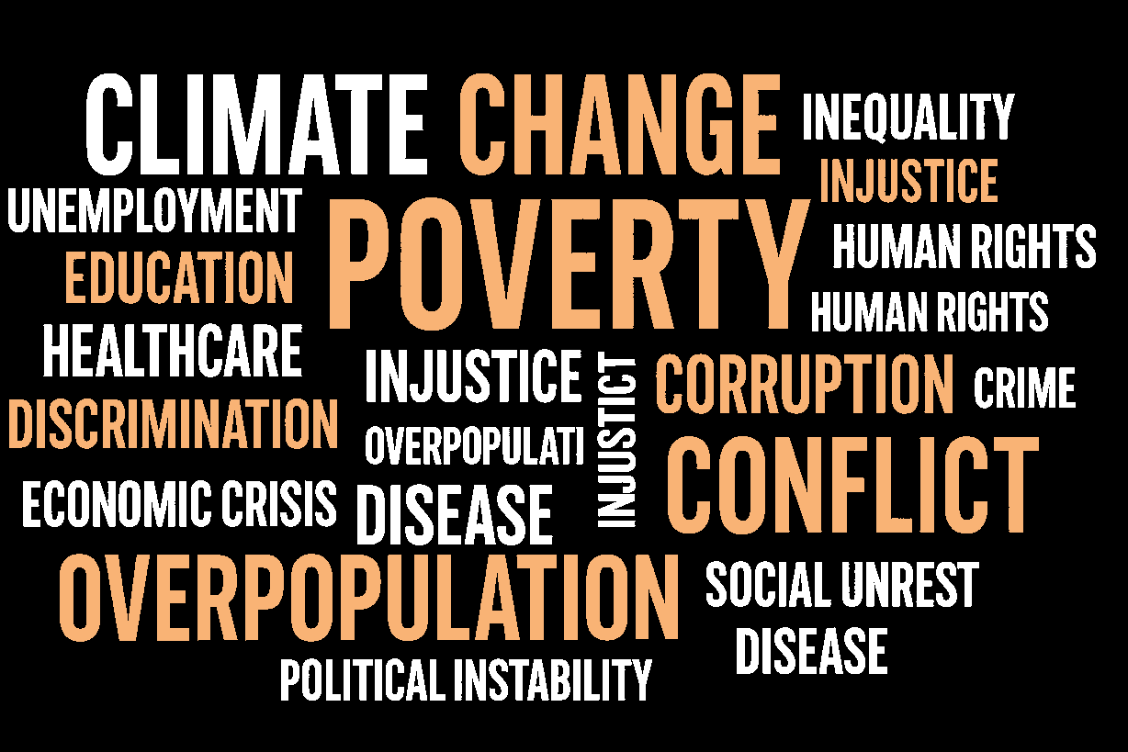

Slide 22

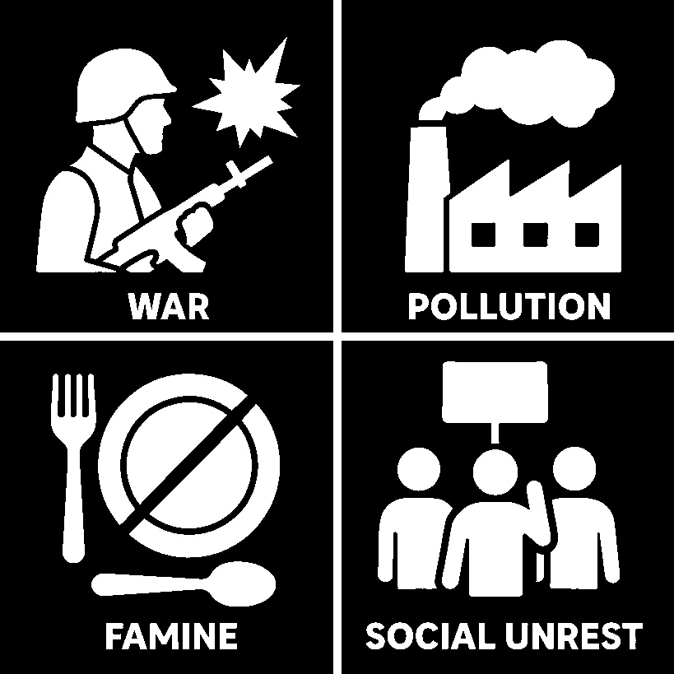
United Nations

Slide 23

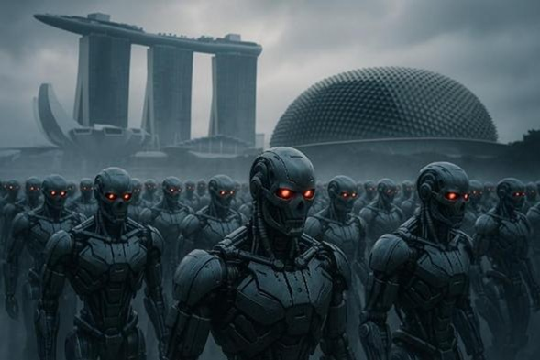

Slide 24
Faith Can Question Honestly (1:12–13)
Real faith doesn’t pretend that it is easy
Faith Can Struggle Deeply (1:14–17)
Real faith brings hard questions to God
Faith Waits Expectantly (2:1)
Real faith then chooses to wait for His response
Habakkuk 1:12 – 2:1 Really… Them?
When God uses the wicked to judge His people.

Slide 25
¹² Are you not from everlasting, O Lord my God, my Holy One? We shall not die. O Lord, you have ordained them as a judgment, and you, O Rock, have established them for reproof. ¹³ You who are of purer eyes than to see evil and cannot look at wrong,

Slide 26
Faith Can Question Honestly (1:12–13)
Real faith …
A. Acknowledges God’s sovereignty
• Affirm what you know to be true before expressing what you don’t understand
• Real faith starts with WHO GOD IS,
not HOW LIFE FEELS.

Slide 27
¹² Are you not from everlasting, O Lord my God, my Holy One? We shall not die. O Lord, you have ordained them as a judgment, and you, O Rock, have established them for reproof. ¹³ You who are of purer eyes than to see evil and cannot look at wrong, why do you idly look at traitors and remain silent when the wicked swallows up the man more righteous than he?

Slide 28
Faith Can Question Honestly (1:12–13)
Real faith …
A. Acknowledges God’s sovereignty
• Affirm what you know to be true before expressing what you don’t understand
• Real faith starts with WHO GOD IS,
not HOW LIFE FEELS.
B. Appeals to God’s Character
• Habakkuk’s question flows from his faith
• The stronger your belief in God’s goodness,
the harder it is to reconcile with evil

Slide 29
God Is Eternal — From Everlasting to Everlasting (Psalm 90:2; Habakkuk 1:12)
Eternal = No beginning, no end.
Everything that begins has a cause — but God never began.
The universe had a beginning → it must have a cause.
Only an eternal, uncaused Being fits that cause — God.

Slide 30



Slide 31
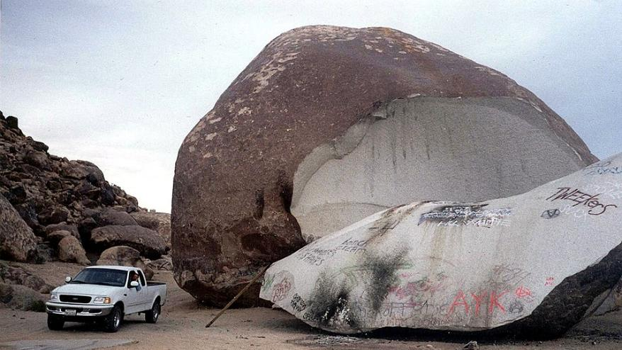
Notes:
https://en.wikipedia.org/wiki/Giant_Rock#/media/File:Giant_Rock-1.jpg
CC BY-SA 4.0

Slide 32
"We Shall Not Die"— God’s Covenant Faithfulness to Israel
God’s promises to Israel will be fulfilled for everyone.
Unfulfilled Promises to Israel: 1️⃣ Full possession and lasting peace in the land 2️⃣ National repentance and salvation 3️⃣ The New Covenant fully realized in Israel 4️⃣ Israel’s future role among the nations
Promises Shared with the Church: 1️⃣ Restoration of the Davidic Kingdom 2️⃣ The Messianic Kingdom of peace and justice
“God’s covenant faithfulness remains unbroken — what He began with Israel, He will complete.”

Slide 33
Faith Can Question Honestly (1:12–13)
Real faith doesn’t pretend that it is easy
Faith Can Struggle Deeply (1:14–17)
Real faith brings hard questions to God
Faith Waits Expectantly (2:1)
Real faith then chooses to wait for His response
Habakkuk 1:12 – 2:1 Really… Them?
When God uses the wicked to judge His people.

Slide 34
¹⁴ You make mankind like the fish of the sea, like crawling things that have no ruler. ¹⁵ He brings all of them up with a hook; he drags them out with his net; he gathers them in his dragnet; so he rejoices and is glad. ¹⁶ Therefore he sacrifices to his net and makes offerings to his dragnet; for by them he lives in luxury, and his food is rich. ¹⁷ Is he then to keep on emptying his net and mercilessly killing nations forever?

Slide 35
Faith Can Question Honestly (1:12–13)
Real faith doesn’t pretend that it is easy
Faith Can Struggle Deeply (1:14–17)
Real faith brings hard questions to God
Faith Waits Expectantly (2:1)
Real faith then chooses to wait for His response
Habakkuk 1:12 – 2:1 Really… Them?
When God uses the wicked to judge His people.

Slide 36
Faith Can Struggle Deeply (1:14–17)
Real faith brings hard questions to God
Real Faith …
A. Wrestles with God’s Plan
Real faith doesn’t hide frustration — it brings confusion into prayer.
Faith sometimes means trusting when the scoreboard looks wrong.
B. Waits through Apparent Injustice
Faith continues to trust in God rather than blame God.
Even when evil seems unchecked, faith keeps talking to God, not about Him.
Faith that struggles honestly can still cling tenaciously.

Slide 37
Faith Can Struggle Deeply (1:14–17)
Real faith brings hard questions to God
Real Faith …
A. Wrestles with God’s Plan
Real faith doesn’t hide frustration — it brings confusion into prayer.
Faith sometimes means trusting when the scoreboard looks wrong.
B. Waits through Apparent Injustice
Faith continues to trust in God rather than blame God.
Even when evil seems unchecked, faith keeps talking to God, not about Him.
Faith that struggles honestly can still cling tenaciously.

Slide 38
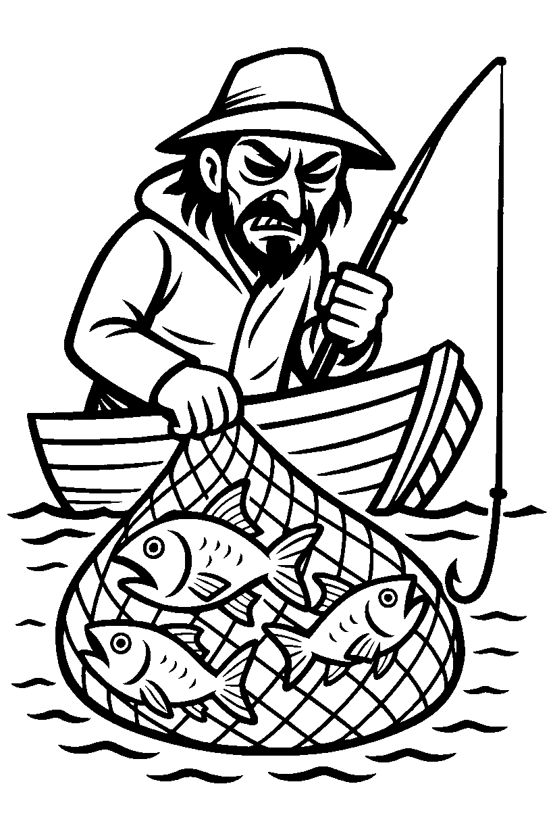
What does the fish think?

Slide 39

God’s Transcendence and Immanence
He is far above us … yet fully present with us..

Slide 40
Faith Can Question Honestly (1:12–13)
Real faith doesn’t pretend that it is easy
Faith Can Struggle Deeply (1:14–17)
Real faith brings hard questions to God
Faith Waits Expectantly (2:1)
Real faith then chooses to wait for His response
Habakkuk 1:12 – 2:1 Really… Them?
When God uses the wicked to judge His people.

Slide 41
2 I will take my stand at my watchpost and station myself on the tower, and look out to see what he will say to me, and what I will answer concerning my complaint.

Slide 42
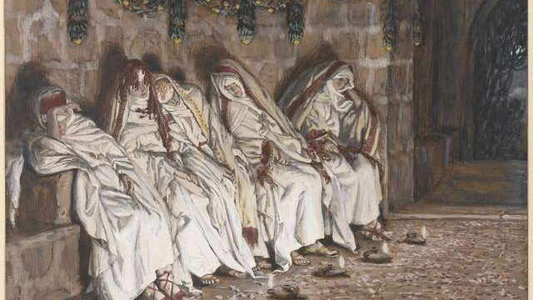
The wise took oil in their flasks with their lamps.”
Matthew 25:4
Faith waits expectantly
Notes:
https://picryl.com/media/brooklyn-museum-the-wise-virgins-les-vierges-sages-james-tissot-08aa3d

Slide 43
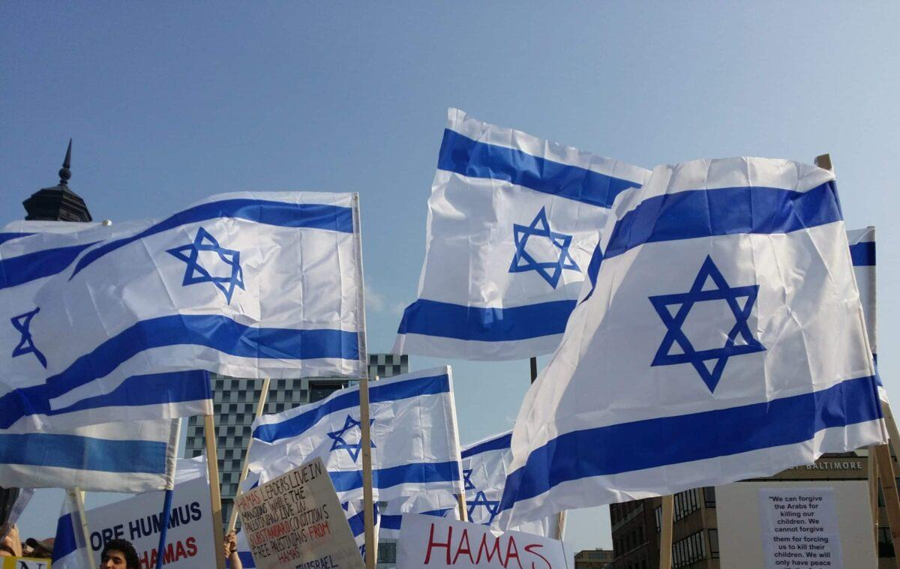
Notes:
https://www.whctemple.org/event/release-the-hostages-rally/2024-01-14/

Slide 44


Slide 45
Faith Can Question Honestly (1:12–13)
Real faith doesn’t pretend that it is easy
Faith Can Struggle Deeply (1:14–17)
Real faith brings hard questions to God
Faith Waits Expectantly (2:1)
Real faith then chooses to wait for His response
Habakkuk 1:12 – 2:1 Really… Them?
When God uses the wicked to judge His people.

Slide 46
How Do We Receive His Faithfulness?
Believe that Jesus Christ — God’s Son — took your sin to the cross and rose again.
Trust not in what you’ve done, but in what He has finished.
When you place your faith in Him, you become part of God’s family — the people He will never leave or forsake.
“Great is Thy faithfulness…

Slide 47
Black

Slide 48


OT Preaching link at BibleStudyDownloads.org
Get this presentation and notes for free!
Notes:
OT Preaching (op)

