Slide 1
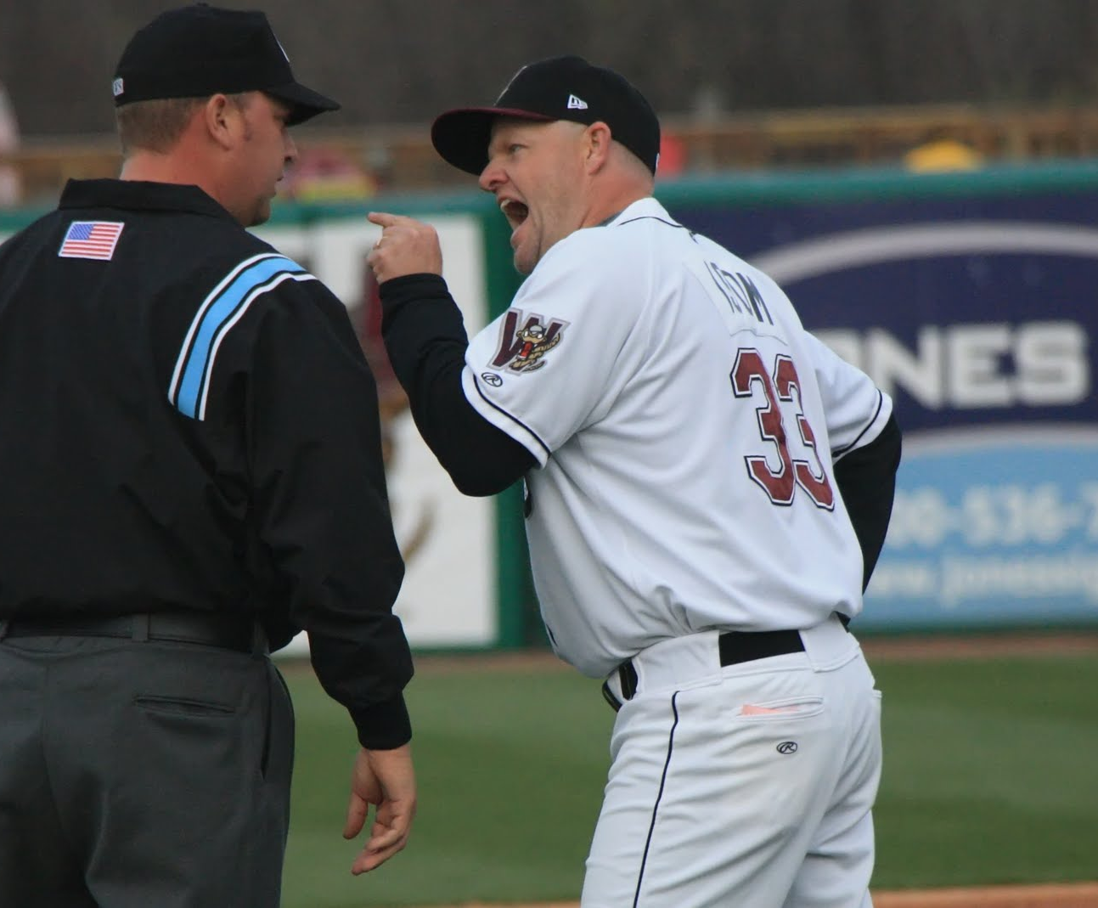
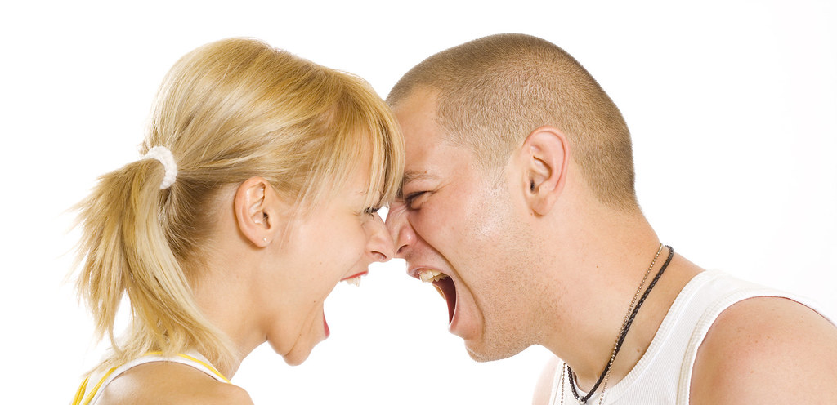
GENESIS 42–50
JOSEPH
Tearing Down Irreconcilable Differences
Dr Scott Wooddell Eastridge Park Christian Church, Mesquite, Texas Uploaded by Dr. Rick Griffith Jordan Evangelical Theological Seminary Files in many languages for free download at BibleStudyDownloads.org

Slide 2
GENESIS 42–50
JOSEPH
How do we tear down the wall of irreconcilable differences?

Slide 3
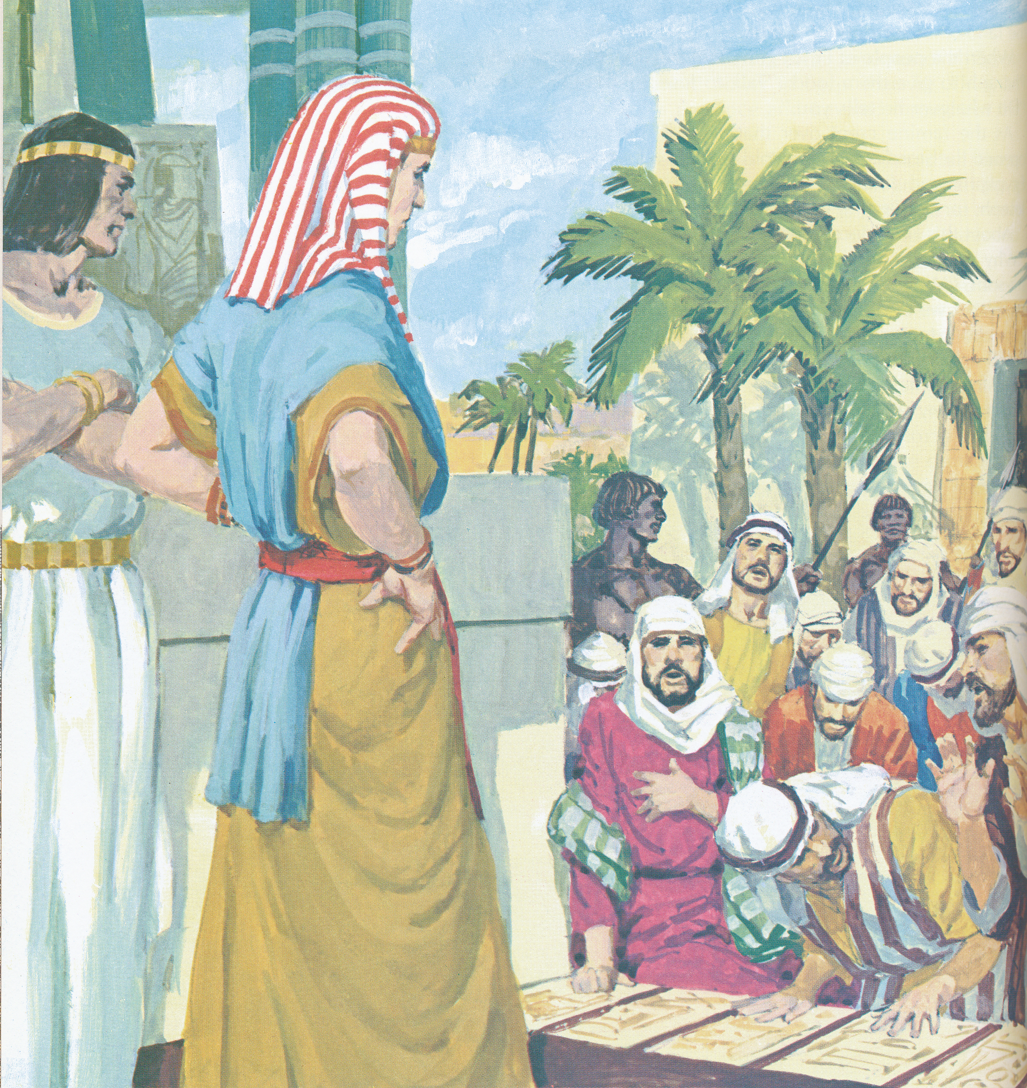
1. THE TRANSGRESSOR’S PATH TO RECONCILIATION
JOSEPH
THE HONESTY TEST
The silver in their bags
(Genesis 43:19-22)
THE JEALOUSY TEST
Showing favoritism to Benjamin (Genesis 43:34)
THE LOYALTY TEST
Joseph’s cup in Benjamin’s sack (Genesis 44:12)

Slide 4
2. THE VICTIM’S PATH TO RECONCILIATION
SUBMIT TO GOD’S AUTHORITY
(Genesis 50:19)
SEE ADVERSITY FROM GOD’S PERSPECTIVE
(Genesis 50:20)
LOVE WITH GOD’S AFFECTION
(Genesis 50:21)

Slide 5
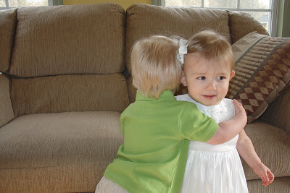
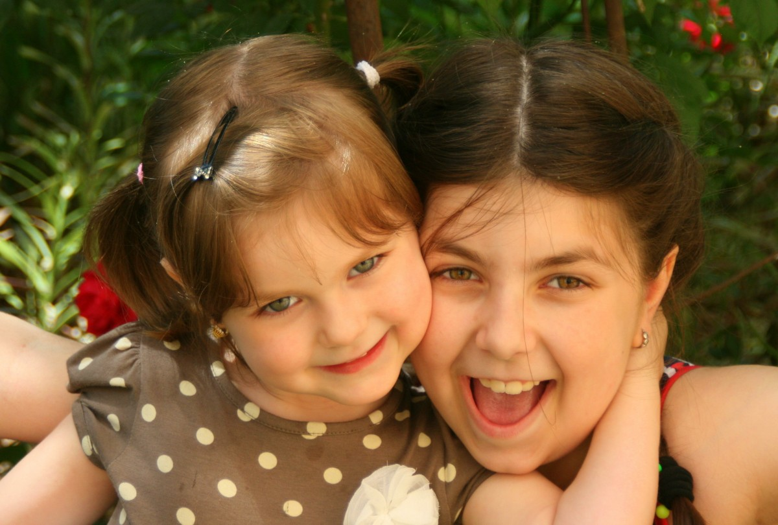
TAKE HOME TRUTH
We confess our transgressions and forgive our transgressors.

Slide 6
Black

Slide 7
OT Preaching link at BibleStudyDownloads.org
Get this presentation for free!
Notes:
OT Preaching (op)

