Slide 1
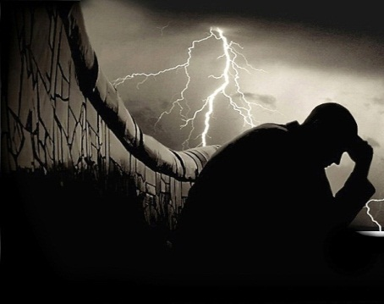
GENESIS 40
Dealing With Adversity
Dr Scott Wooddell Eastridge Park Christian Church, Mesquite, Texas Uploaded by Dr. Rick Griffith • Jordan Evangelical Theological Seminary Files in many languages for free download at BibleStudyDownloads.org

Slide 2
GENESIS 40
How do we deal with the adversities of life?

Slide 3
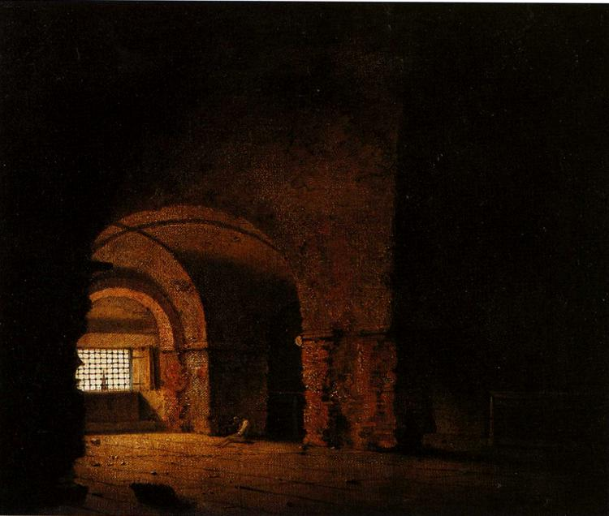
1. WE LOOK FOR GOD’S PROVIDENCE IN OUR CIRCUMSTANCES
“Pharaoh was angry with his two officials, the chief cupbearer and the chief baker, and put them in custody in the house of the captain of the guard, in the same prison where Joseph was confined. The captain of the guard assigned them to Joseph, and he attended them.”
Genesis 40:2-3

Slide 4
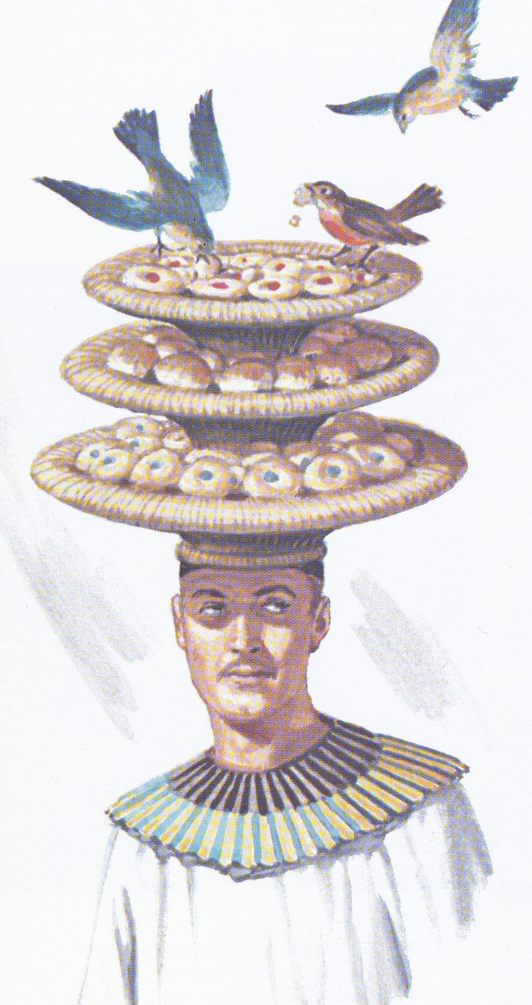
2. WE LOOK FOR GOD’S PRESENCE IN OUR LONELINESS
“…the cupbearer and the baker of the king of Egypt, who were being held in prison had a dream… ‘We both had dreams’ they answered, ‘but there is no one to interpret them.’ Then Joseph said to them, ‘do not interpretations belong to God? Tell me your dreams.’”
(Genesis 40:5b-8)

Slide 5
3. WE LOOK FOR GOD’S ENCOURAGEMENT IN OUR DESPAIR
“The chief cupbearer, however, did not remember Joseph. He forgot him.” (Genesis 40:23)

Slide 6
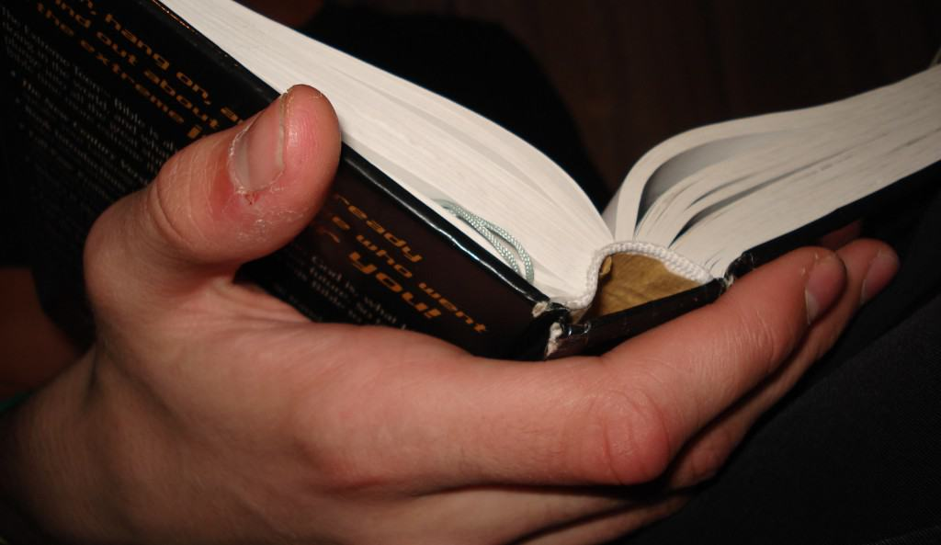
TAKE HOME TRUTH
We trust in God’s providence in times of dire circumstance.

Slide 7
Black

Slide 8
OT Preaching link at BibleStudyDownloads.org
Get this presentation for free!
Notes:
OT Preaching (op)

