Slide 1
GENESIS 39
Denying Ourselves Pleasure
Dr Scott Wooddell Eastridge Park Christian Church, Mesquite, Texas Uploaded by Dr. Rick Griffith • Jordan Evangelical Theological Seminary Files in many languages for free download at BibleStudyDownloads.org

Slide 2
GENESIS 39
Why deny ourselves some of life’s pleasures?

Slide 3
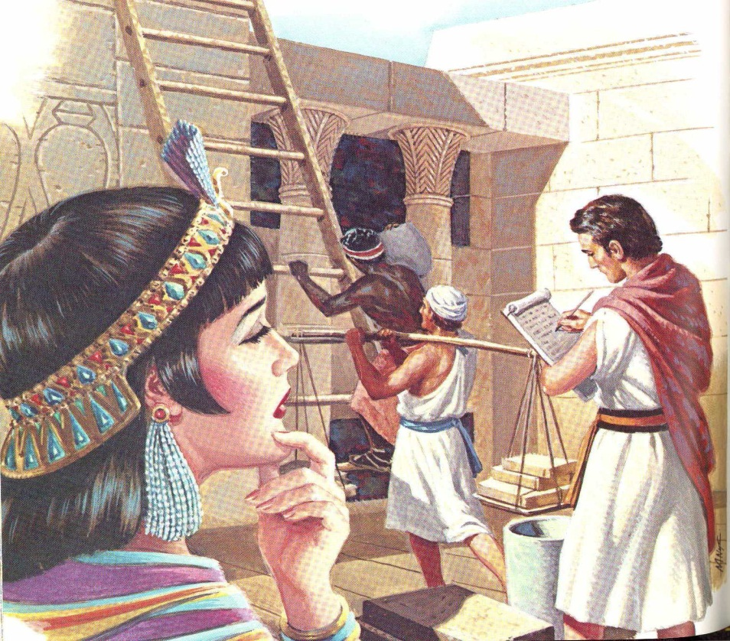
1. THE LORD IS WITH US AND PROSPERS US IN OUR ADVERSITY.
“The LORD was with Joseph and he prospered…” (Genesis 39:2a)
“…the LORD gave him success in everything he did…” (Genesis 39:3b)
“The blessing of the LORD was on everything Potiphar had, both in the house and in the field.” (Genesis 39:5b)
The LORD – This is God’s most holy and personal name. It defines Him as the self existent, eternal, unchanging, covenant keeping creator of all things.

Slide 4
2. THE LORD IS WITH US AND STRENGTHENS US IN OUR TEMPTATIONS.
“Now Joseph was well built and handsome, and after a while his master’s wife took notice of Joseph…” (Genesis 6:b-7a)
“How can I do such a wicked thing and sin against God?” (Genesis 39:9b)

Slide 5
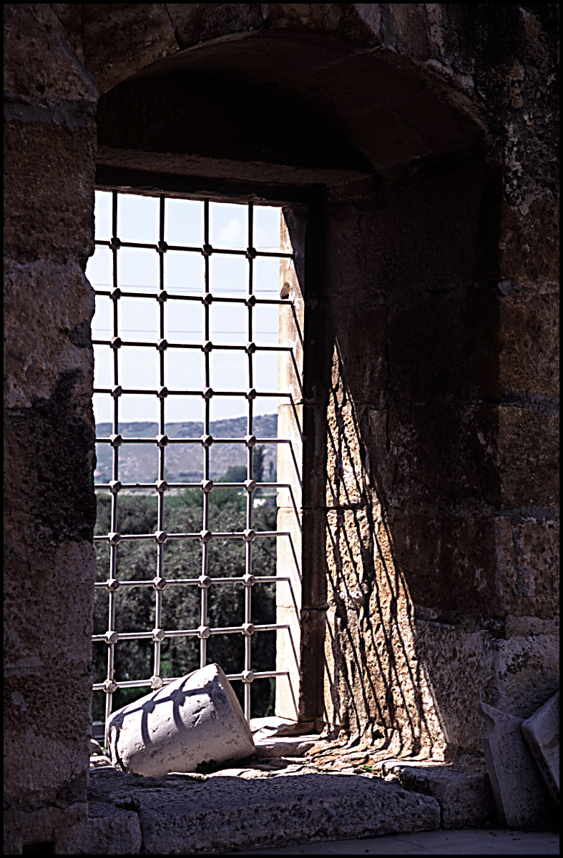
3. THE LORD IS WITH US AND ENCOURAGES US IN OUR DESPAIR.
“But while Joseph was there in the prison, the LORD was with him; He showed him kindness and granted him favor in the eyes of the prison warden. So the warden put Joseph in charge of all those held in the prison…the LORD was with Joseph and the LORD gave him success in whatever he did.” (Genesis 39:20b-23)

Slide 6
TAKE HOME TRUTH
We choose purity for ourselves that we might bring delight to the Lord and blessings to others.

Slide 7
Black

Slide 8
OT Preaching link at BibleStudyDownloads.org
Get this presentation for free!
Notes:
OT Preaching (op)

