Slide 1
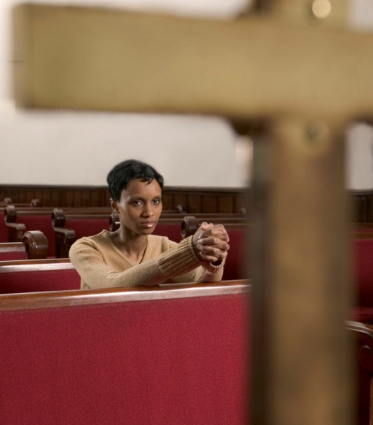
GENESIS 26
Can I really trust God to keep His promises?
Dr Scott Wooddell Eastridge Park Christian Church, Mesquite, Texas Uploaded by Dr. Rick Griffith • Jordan Evangelical Theological Seminary Files in many languages for free download at BibleStudyDownloads.org

Slide 2
1. A STRUGGLING FAITH WILL DOUBT GOD’S PROMISES (vs. 1-14)
“I will be with you and will bless you…” (v. 3)
“So Isaac stayed in Gerar. When the men of that place asked him about his wife, he said, ‘She is my sister,’ because he was afraid…” (vs. 6-7)

Slide 3
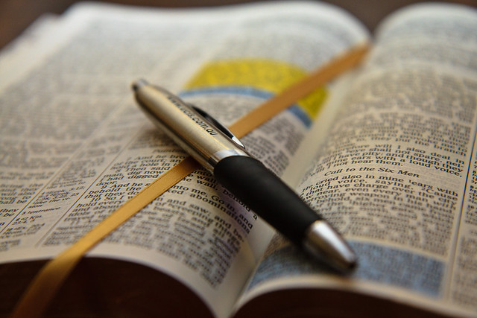
2. A STRONG FAITH TRUSTS GOD’S PROMISES (vs. 15-33)
“Now the Lord has given us room and we will flourish in the land.” (v. 22b)

Slide 4
TAKE HOME TRUTH
When it comes to promises made and promises kept, God is faithful one hundred percent.

Slide 5
Black

Slide 6
OT Preaching link at BibleStudyDownloads.org
Get this presentation for free!
Notes:
OT Preaching (op)

