Slide 1

GENESIS 21
Does God always keep His promises?
Can we really depend on God?
Dr Scott Wooddell
Eastridge Park Christian Church, Mesquite, Texas
Uploaded by Dr. Rick Griffith • Jordan Evangelical Theological Seminary
Files in many languages for free download at BibleStudyDownloads.org

Slide 2

1. THE PROBLEMS WE CREATE WHEN WE DOUBT GOD’S PROMISES
GOD’S PROMISE. “Then the word of the Lord came to him…a son from your own body will be your heir.” (Genesis 15:4)
DOUBT. “Now Sarah…said to Abraham, ‘The Lord has kept me from having children. Go sleep with my maidservant; perhaps I can build a family through her.’” (Genesis 16:1-2)

Slide 3

2. THE PEACE WE ENJOY WHEN WE BELIEVE GOD’S PROMISES.
“Now the Lord was gracious to Sarah as He had said, and the Lord did for Sarah what He had promised. Sarah became pregnant and bore a son to Abraham in his old age, at the very time God had promised.” (Genesis 21:1-2)

Slide 4
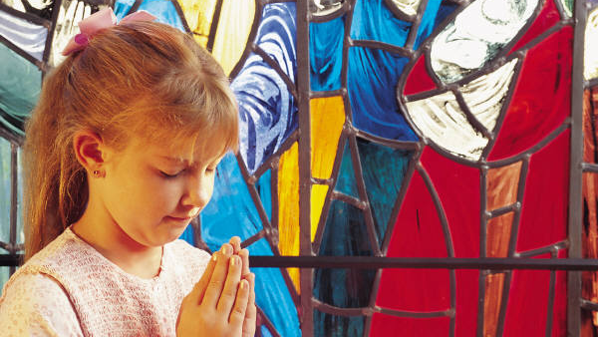
TAKE HOME TRUTH
Our faithless doubts never nullify God faithful promises.

Slide 5
Black

Slide 6


OT Preaching link at BibleStudyDownloads.org
Get this presentation for free!
Notes:
OT Preaching (op)

