Slide 1
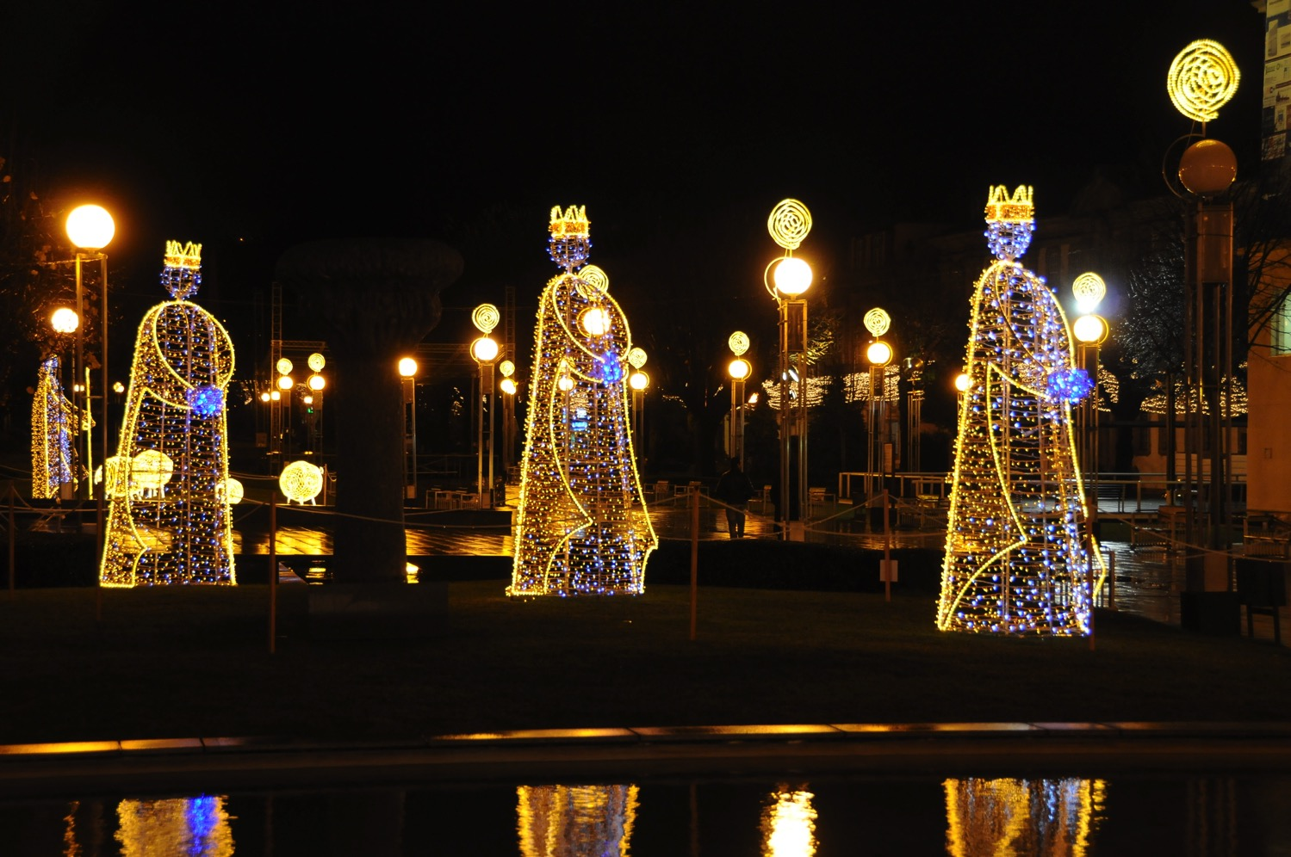
Why Worship a King?
The Christmas You Never Knew
Genesis 1; John 1; Matthew 1
Dr. Rick Griffith, Crossroads International Church Singapore cicfamily.com & BibleStudyDownloads.org

Slide 2
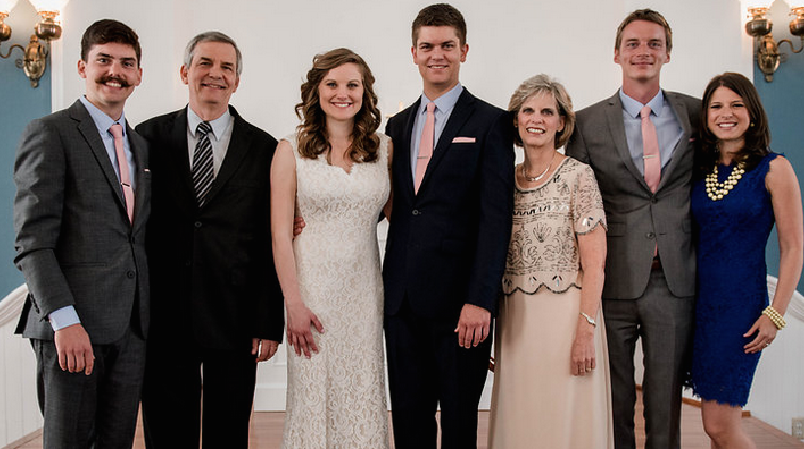
The Griffiths May 2015
2015
Kurt & Cara (28)
John (23)
Rick
Susan
Stephen & Katie (26)
Notes:
What a joy to be with you all again. This is our first time to see you twice in a year as we returned in May to conduct the wedding of our second son Stephen. Now both he and our oldest, Kurt, are married.

Slide 3
Our Youngest, John (23)
Notes:
On Friday John will graduate from Biola and plans either to serve as a graphic designer at Compassion International in Colorado Springs or at ESRI in Redlands, CA.

Slide 4
Tidings of Joy!
Notes:
Alas, the Christmas season is upon us once again

Slide 5
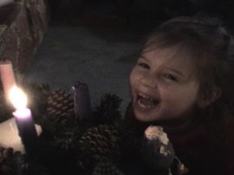
Advent
Notes:
This is a favorite time of the year for kids—me too

Slide 6
Christmas Stress
Notes:
Christmas, of course, has its stresses…

Slide 7
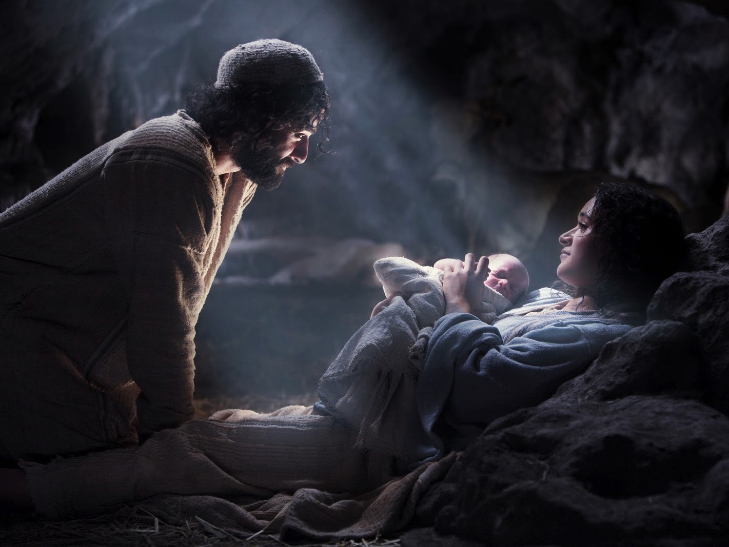
Light from Heaven
Notes:
But the story of the Babe in a manger and all the events surrounding is an amazing story. Unfortunately, it is so familiar story that it's easy to think we really know it well.

Slide 8
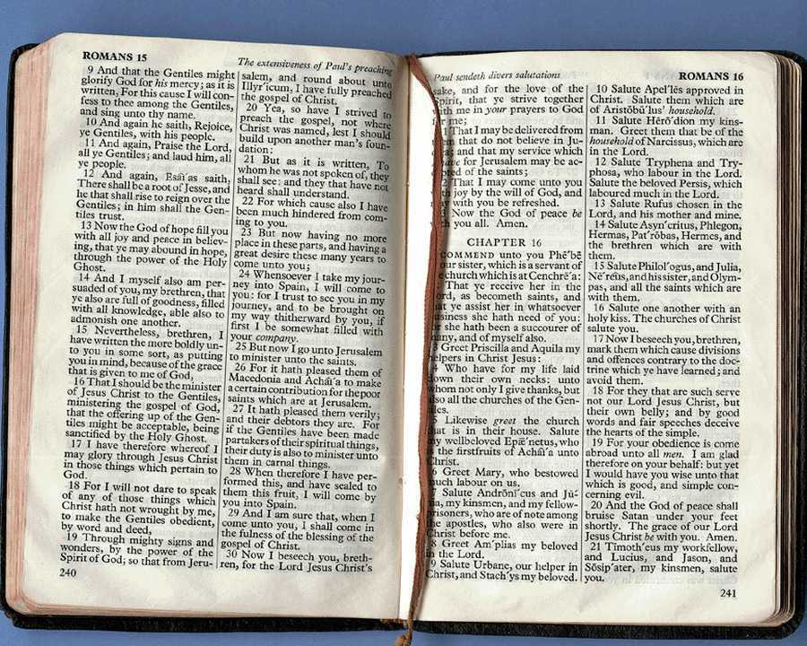
How much of the Bible precedes the Christmas story?
22.8%
New Testament
77.2%
Old Testament
Notes:
Normally we address only the New Testament (NT) aspects of Christmas.
However, the NT covers less than a quarter of our Bible—the first three quarters lay the OT foundation that we often assume that we know well—but we don't.
OT Survey
00-Intro & Biblical Theology-62
Slide 33

Slide 9
The Christmas You Never Knew
Notes:
We need to know the foundations of Christmas story.
Therefore, my Christmas messages this month focus on "The Christmas You Never Knew."

Slide 10
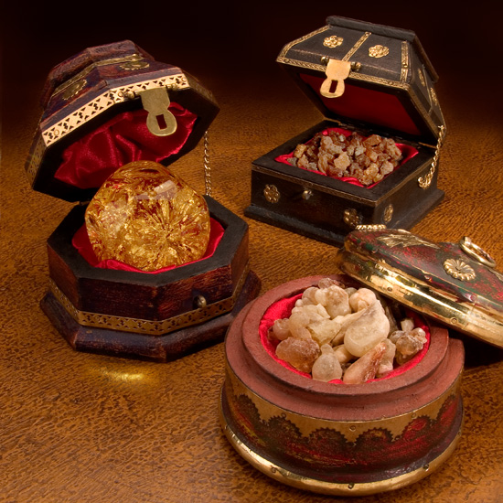
Magi Gifts:
Frankincense
Gold
Myrrh
Notes:
How is this? This short series will address three important titles of Christ as seen in the three gifts the magi gave at Christ's birth—gold, frankincense, and myrrh.

Slide 11
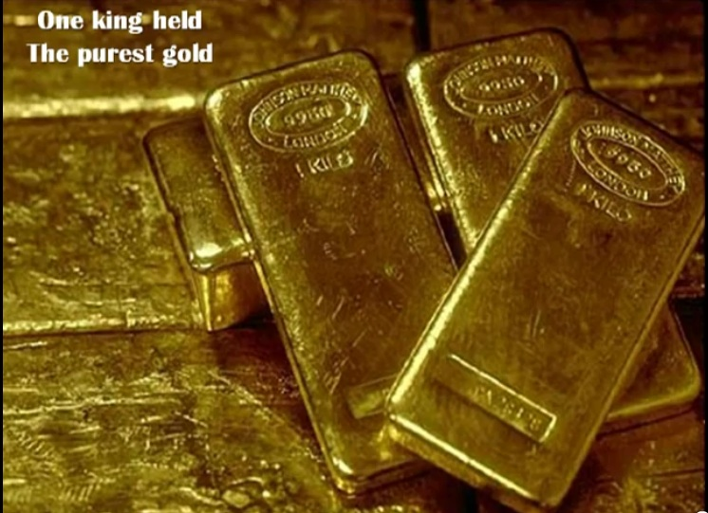
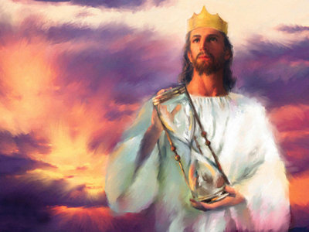
Gold
King
Notes:
Each gift points to a different aspect of the person of Christ—and all three begin in Genesis! I suspect that you haven't heard of Christmas in Genesis, right?
We will start first with the gift of gold that is fit for a king.
Gold is the most precious metal, fit for a King.
Gold represents royalty (some say deity or purity).

Slide 12
Matt. 2:1-2 NLT
"Jesus was born in Bethlehem in Judea, during the reign of King Herod. About that time some wise men from eastern lands arrived in Jerusalem, asking, ²'Where is the newborn king of the Jews? We saw his star as it rose, and we have come to worship him'"
Notes:
These magi clearly identified Jesus as king since they asked, "Where is the one who has been born king of the Jews? We saw his star in the east and have come to worship him" (Matt. 2:2 NLT). Now it's appropriate to give respect to a king, but worship? Isn't that a bit much?

Slide 13
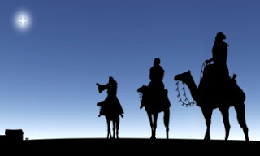
Why did they worship Jesus as king?
Notes:
Why did the magi worship Jesus as king?

Slide 14
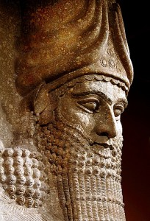
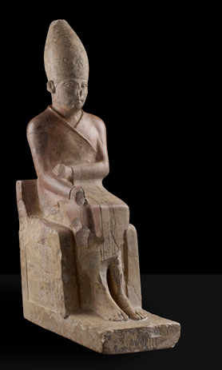
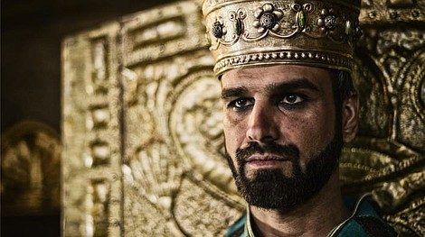
Ancient Near East Kings
Notes:
Monarchies are dying out today, but the ancient world was one ruled by kings.
Life focused on the question of who was the greatest king.

Slide 15
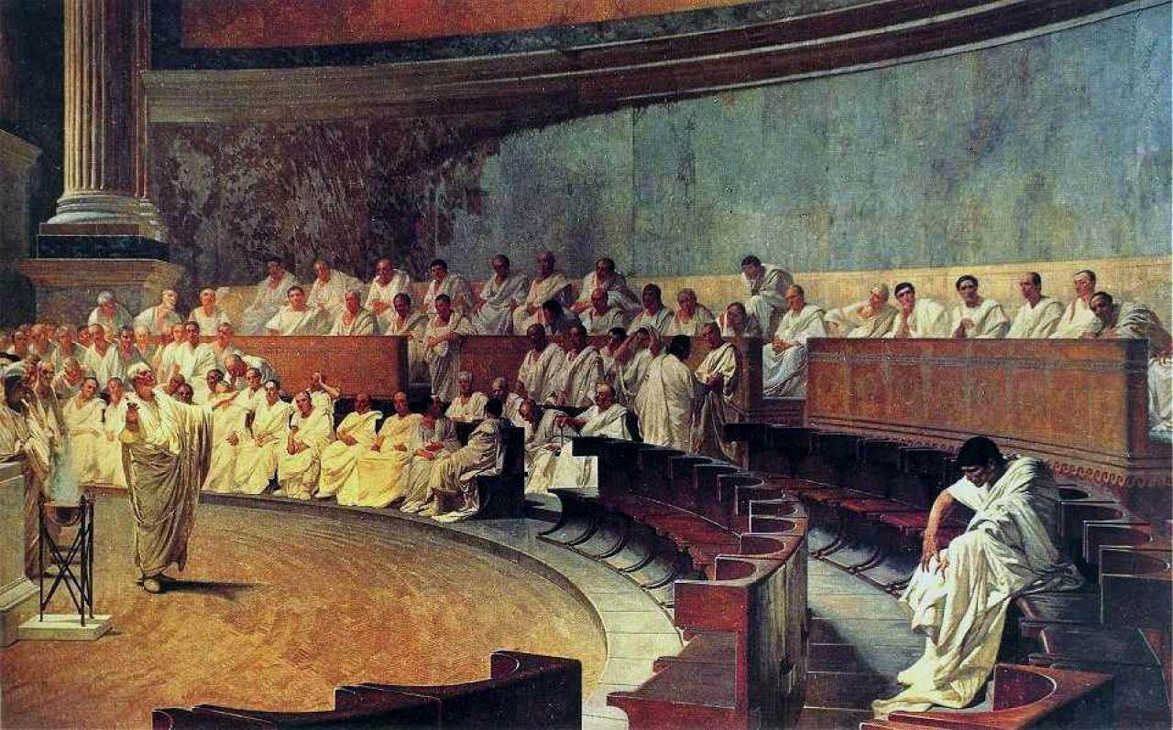
The Roman Republic (500s BC–AD 476)
Notes:
The concepts of a republic and a democracy didn't begin until about 500-300 BC—and these were far away in Rome and Greece so they still hadn't been accepted in the East.

Slide 16
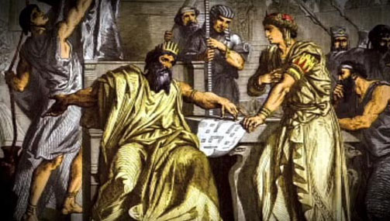
The Bible supports monarchies more than any other form of government
Notes:
In fact, contrary to what many want to believe, the Bible has far greater support for monarchies than other governments

Slide 17
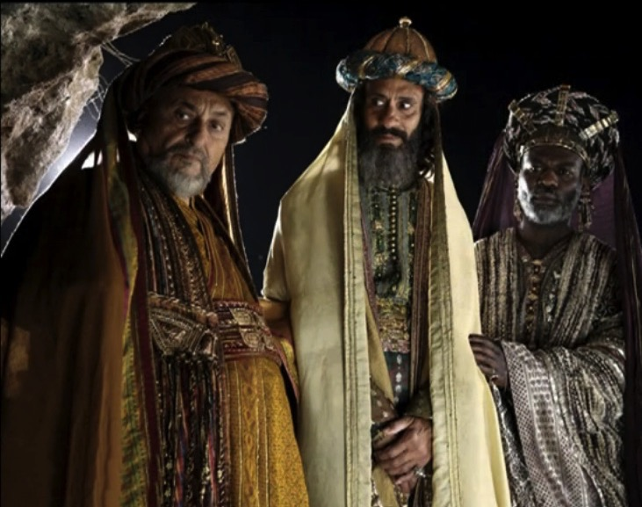
The Wise Men Were Wise
Notes:
In other words, the magi were right to worship Christ as king.

Slide 18
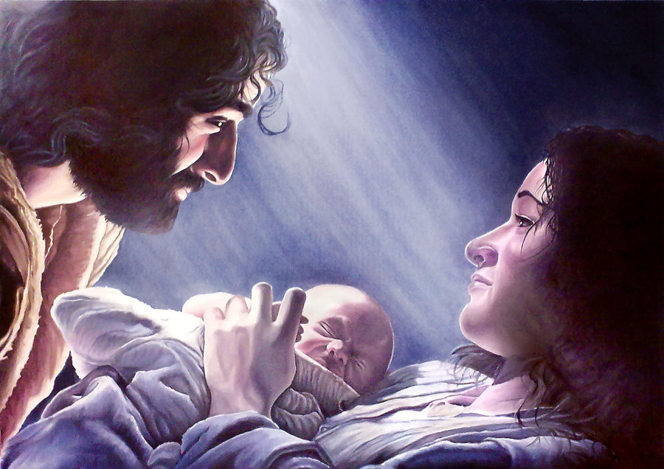
Why should we worship Christ as king?
Genesis ➔ John ➔ Matthew
Notes:
So today we will see three passages to unpack why we should worship Jesus as the rightful ruler of the world. We will start in Genesis, then move to John and Matthew to answer why worship of Christ is the appropriate response.
Our first text about kings brings us right to the beginning of the Bible…
Really? The creation account in Genesis 1 teaches about kings? How do we see the concept of kingship in Genesis 1? Here we see that…

Slide 19
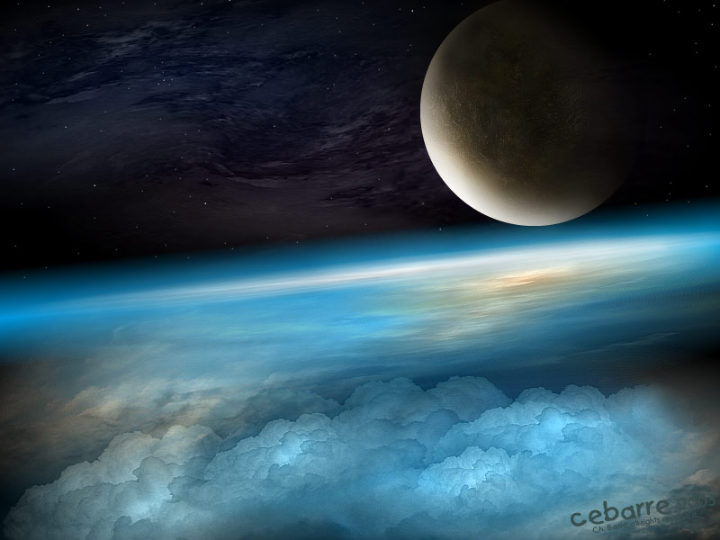
I. The Creator is King (Gen. 1:1–2:3).
Notes:
Genesis 1 shows God not only as Creator but as Sovereign Ruler over everything.

Slide 20
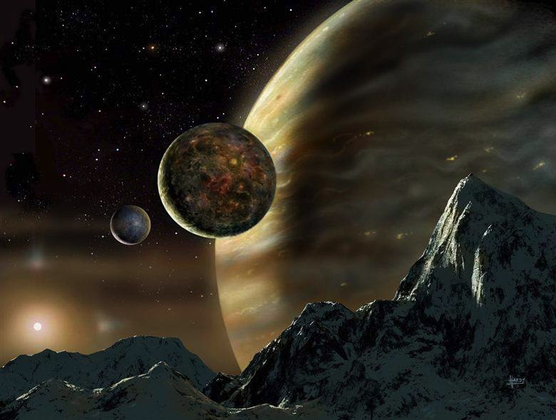
The creation account portrays God as the Creator so Israel might see their God as sovereign LORD of the universe.
Notes:
Gen. 1:1–2:3

Slide 21
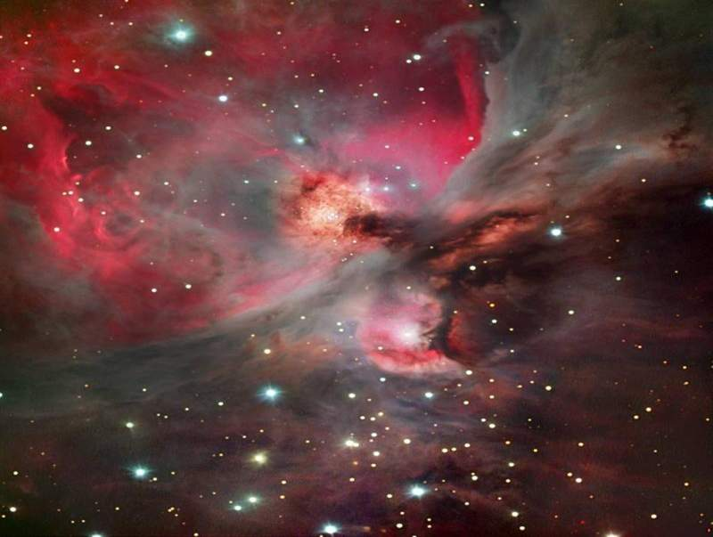
Day 1
God's Creation…Day 1
In the beginning God created the heavens and the earth (1a).
Notes:
The introduction shows God's creative ability as King in contrast to powerless Canaanite deities (1:1-2)

Slide 22
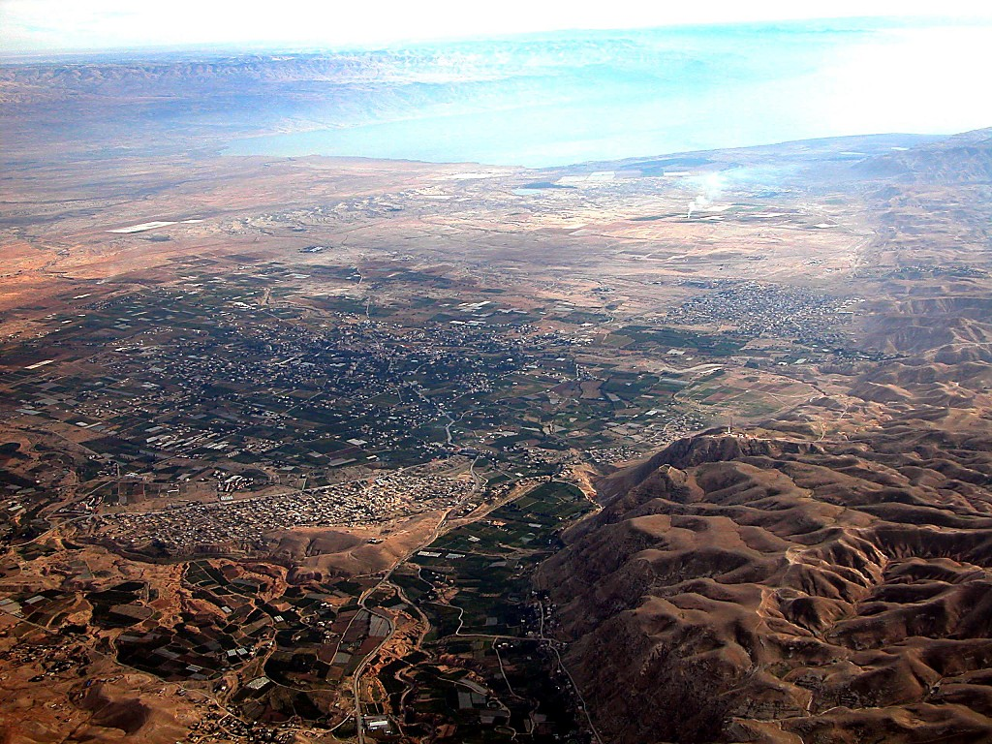
Jericho
DEAD SEA
JORDAN RIVER
MODERN JERICHO
JOSHUA
Jericho/Ai
ANCIENT JERICHO
From Jericho...
Looking East Across the Jordan River
Handbook pg. 26-29
42
Notes:
Israel was finishing the 40 years of wilderness wanderings and about to cross the Jordan.

Slide 23
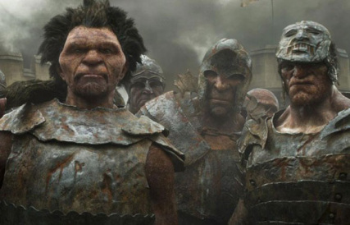
Giants in Canaan
Notes:
Here they would face giants in Canaan. Moses wanted Israel to see that they would face huge men with little bitty gods!

Slide 24
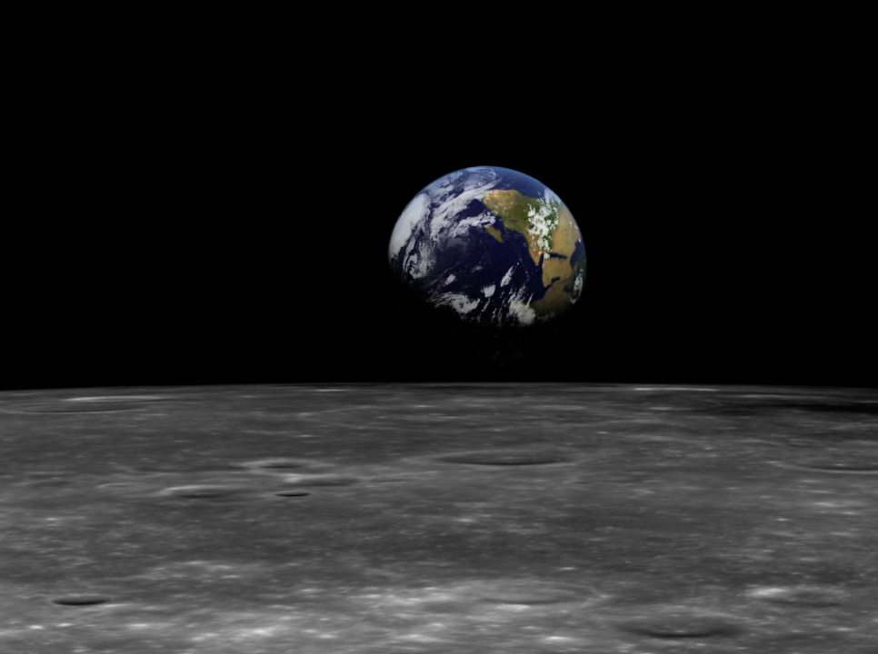
God as King in Genesis 1
Uncreated God (1:1)
Creation by Word alone (1:4)
Notes:
Genesis 1 shows God as King in many ways:
1 Since he was not created, then he must be the highest of all beings!
2 Also, kings back then spoke laws into existence.

Slide 25
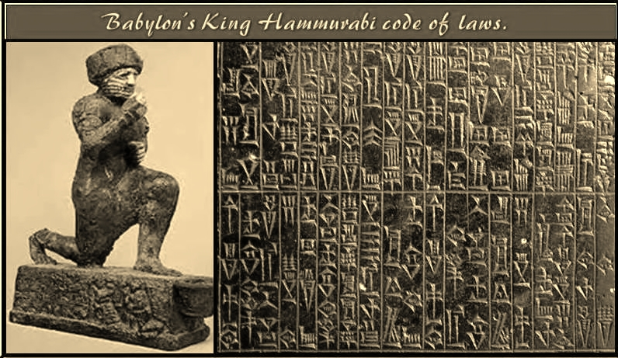
King Hammurabi Law Code (Babylon 1800 BC)
Notes:
Few monarchs had written law codes that guided them. No, their word was law. In kingly manner, God spoke not just laws into existence, but everything that exists into existence!

Slide 26
God as King in Genesis 1
Uncreated God (1:1)
Creation by Word alone (1:4)
Creation with ease
Sun and moon [gods] created (1:16)
Notes:
Instead of battles with other gods that made the world, God created so easily—something only the highest King could do.

Slide 27
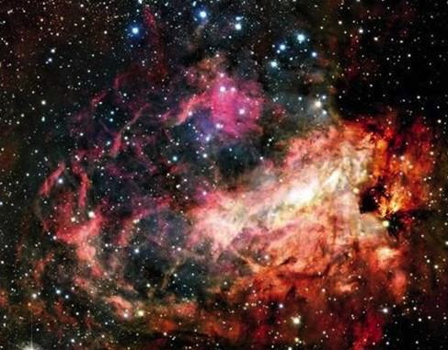
Sun & Moon
God's Creation…Day 4
"And let them be for lights in the expanse of the heavens to give light on the earth"; and it was so (15).

Slide 28
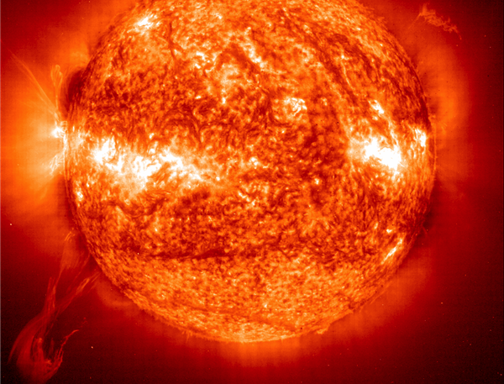
Sun
God's Creation…Day 4
God made the two great lights, the greater light to govern the day (16a)…

Slide 29
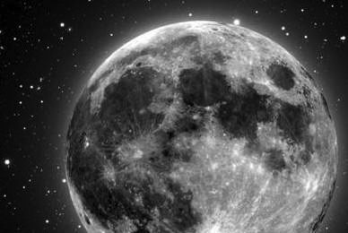
Moon
God's Creation…Day 4
…and the lesser light to govern the night (16b)…

Slide 30
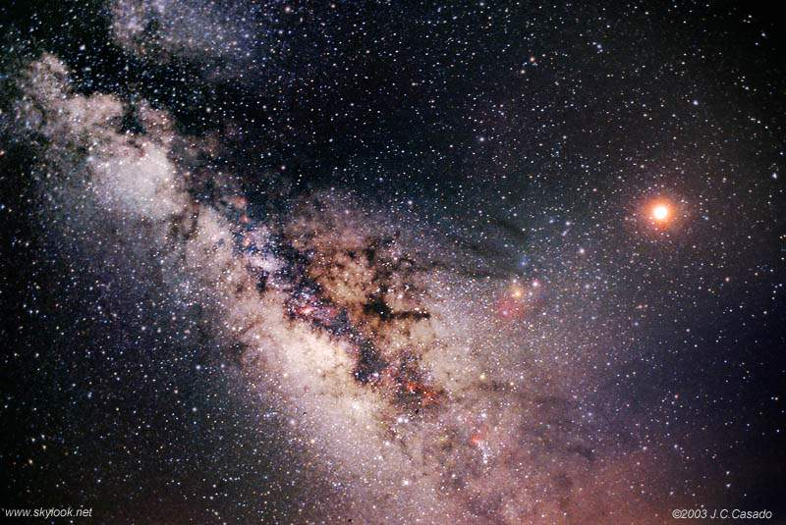
Stars
God's Creation…Day 4
He made the stars also (16c).

Slide 31
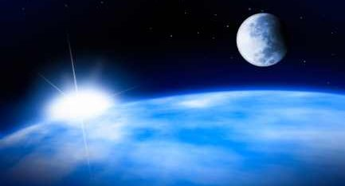
"The greater light" ("sun" = Ra)
"The lesser light" ("moon" = Sin)
Notes:
Also, the names of the sun and moon were not given—Ra and Sin—as these also were the names of pagan gods. Referring to them as "the greater light" and "the lesser light" cleverly shows that God made these objects but he didn't create any lesser gods! Why? Because he is the only King of all.

Slide 32
God as King in Genesis 1
Uncreated God (1:1)
Creation by Word alone (1:4)
Creation with ease
Sun and moon [gods] created (1:16)
Shared rule with man (1:26)
Notes:
Only a king can share his rule…

Slide 33
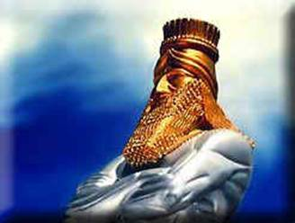
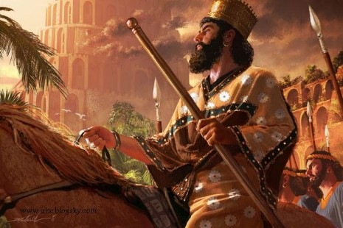
King & Image
Notes:
Kings also put images of themselves throughout their realm as if to say, "Hey, you may not see me, but when you see this image, remember that I rule this area too!"

Slide 34
King & Image
Notes:
As king, God placed his image throughout his realm—in you and me, made in the image of God!

Slide 35
God as King in Genesis 1
Uncreated God (1:1)
Creation by Word alone (1:4)
Creation with ease
Sun and moon [gods] created (1:16)
Shared rule with man (1:26)
Notes:
So Genesis 1 gives us at least 5 reasons that God is King over all he created.

Slide 36
I. The Creator is King (Gen. 1:1–2:3).
Notes:
Genesis 1 shows God not only as Creator but as Sovereign Ruler over everything.

Slide 37
The Father, Son & Spirit
Notes:
But which person of the godhead created the world?

Slide 38
The Trinity
Notes:
We know that the one God exists as three persons: Father, Son and Spirit. Genesis 1 even hints at the Trinity by saying, "Let us make…" but which person was this specifically who made all we see? John 1 says that…

Slide 39
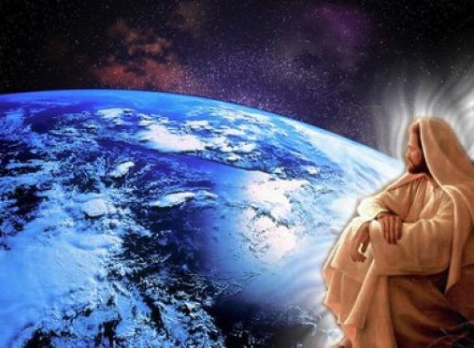
II. The Creator is Jesus (John 1:1-3).
Notes:
Genesis 1 is unclear which person of the Trinity made everything—but the NT says it was Christ!

Slide 40
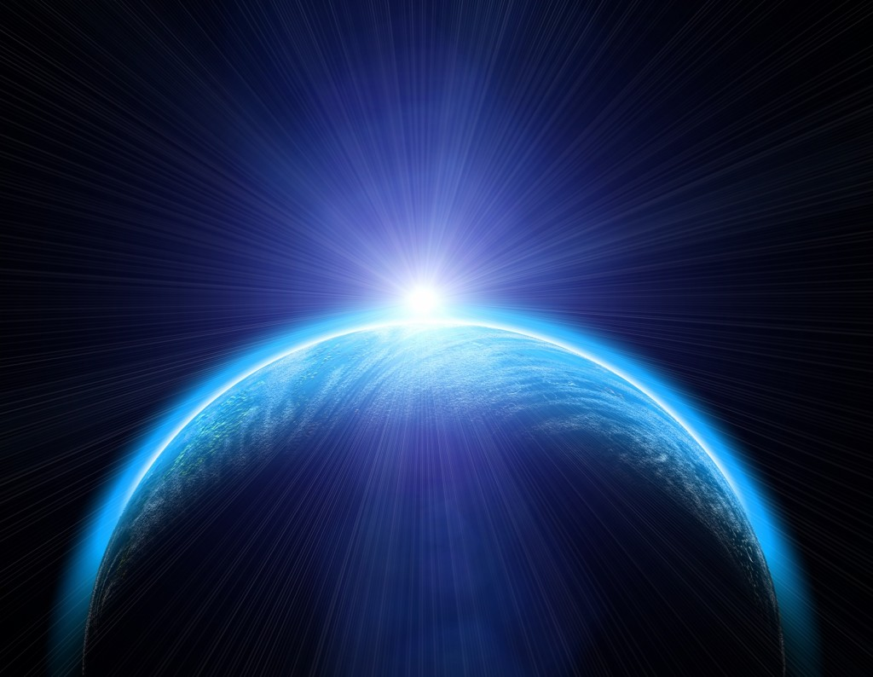
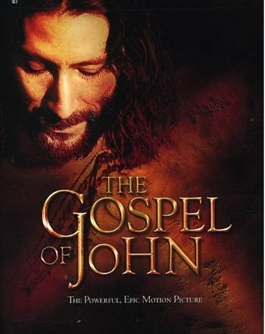
Exact Beginnings
"In the beginning was the Word" (John 1:1)
"In the beginning God created the heavens and the earth" (Genesis 1:1)
Notes:
John presents Jesus as God to identify him as the same creator of the world as God in Genesis 1 (John 1:1-3)
____________
This does NOT say that Jesus' existence began with Gen 1:1. "The word 'was' (imperfect tense) implies timelessness. Jesus existed before Gen 1:1. He has a beginning of no beginning" [Jeffrey Khoo, “The Story of Jesus,” www.febc.edu.sg).

Slide 41
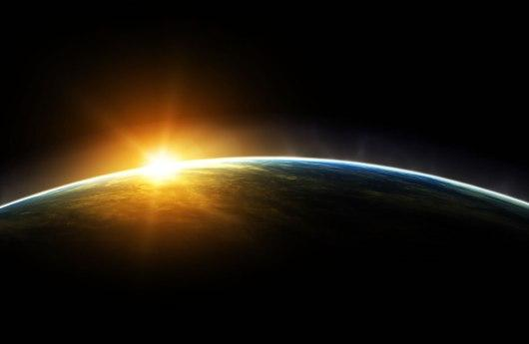
Jesus (logos) had no beginning (1a)
"In the beginning
was the Word,
and the Word was with God,
and the Word was God"
(John 1:1 NIV)
Notes:
Jesus is the Word who spoke to create the world in Genesis 1 since he has eternally been God himself (John 1:1-2)
_________
Scripture is very clear that Jesus is God. Christians have always believed this key doctrine called the deity of Christ.

Slide 42
Jesus created all things (John 1:3).
"God created everything through him, and nothing was created except through him" (NLT)
Notes:
Jesus proved his deity by creating everything in the world (1:3)

Slide 43
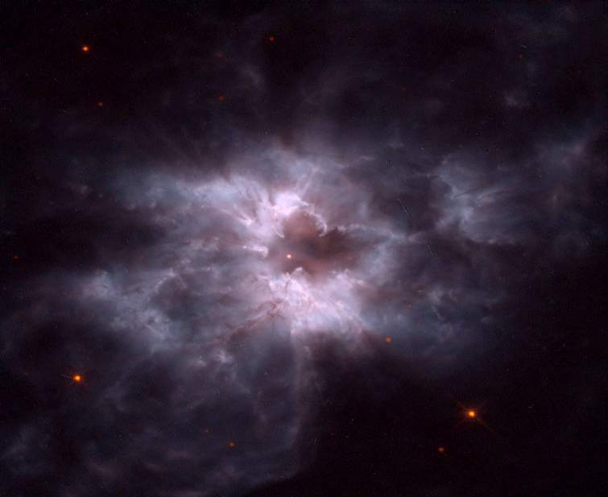
Light
God's Creation…Day 1
Then God said, "Let there be light"; and there was light. God saw that the light was good, and he separated the light from the darkness (Gen. 1:4).
Notes:
This means John is equating Jesus with God at creation.
The "God" who created light…

Slide 44
Light
God's Creation…Day 1
Then Jesus said, "Let there be light"; and there was light. Jesus saw that the light was good, and he separated the light from the darkness (Gen. 1:3-4).
Notes:
…was none other than Jesus (Gen. 1:3-4).

Slide 45
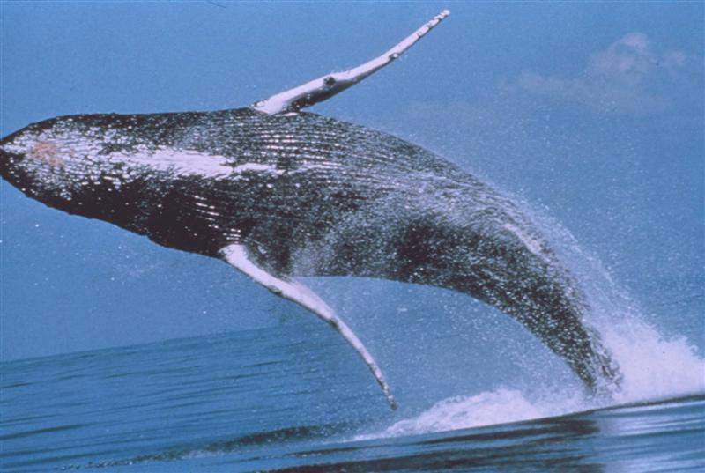
Whales
God's Creation…Day 5
God created the great sea monsters and every living creature that moves, with which the waters swarmed after their kind (Gen. 1:21a)…
Notes:
The "God" who created great sea monsters…

Slide 46
Whales
God's Creation…Day 5
Jesus created the great sea monsters and every living creature that moves, with which the waters swarmed after their kind (Gen. 1:21a)…
Notes:
…was none other than Jesus (Gen. 1:21).

Slide 47
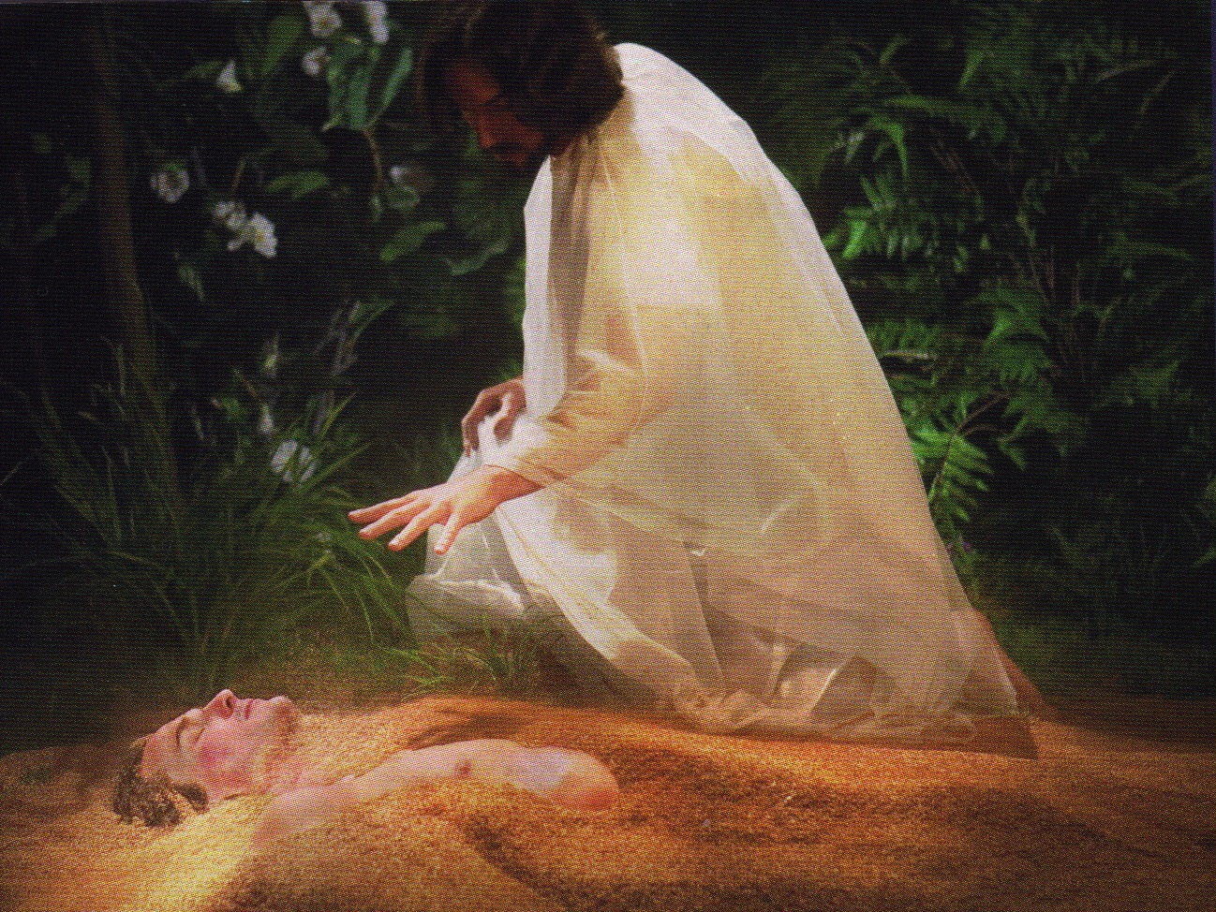
Jesus formed Adam from the dust (John 1:3; Gen. 2:7).
Notes:
The "God" who made Adam from dust was none other than Jesus (Gen. 2:7).

Slide 48
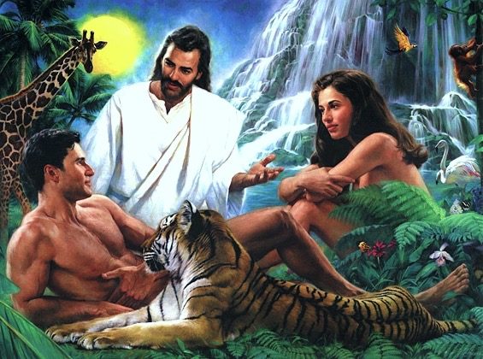
Jesus Created Adam and Eve (John 1:3; Gen. 2:21-23)
Notes:
The "God" who made Eve for Adam was none other than Jesus (Gen. 1:21-23).

Slide 49
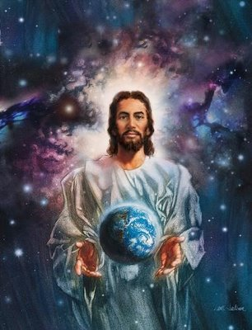
Other NT texts also reveal Bethlehem's baby boy as Creator!

Slide 50
Hebrews 1:1-2 NLT
"Long ago God spoke many times and in many ways to our ancestors through the prophets. ²And now in these final days, he has spoken to us through his Son. God promised everything to the Son as an inheritance, and through the Son he created the universe."
Notes:
Hebrews 1:1-2 also shows Jesus as Creator.

Slide 51
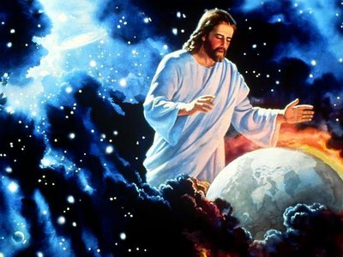
Jesus also sustains his creation
Notes:
Colossians 1:15-17 notes that he not only created everything but continues to sustain it

Slide 52
Christ in Colossians
"Christ is the visible image of the invisible God. He existed before anything was created and is supreme over all creation" (Col. 1:15).

Slide 53
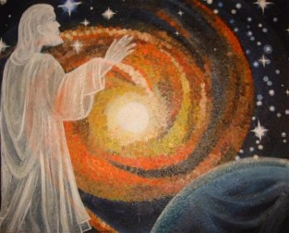
Col. 1:16-17
"for through him God created everything in the heavenly realms and on earth.
He made the things we can see
and the things we can't see—
such as thrones, kingdoms, rulers, and authorities in the unseen world.
Everything was created through him and for him.
¹⁷He existed before anything else, and he holds all creation together" (Col. 1:16-17 NLT).

Slide 54
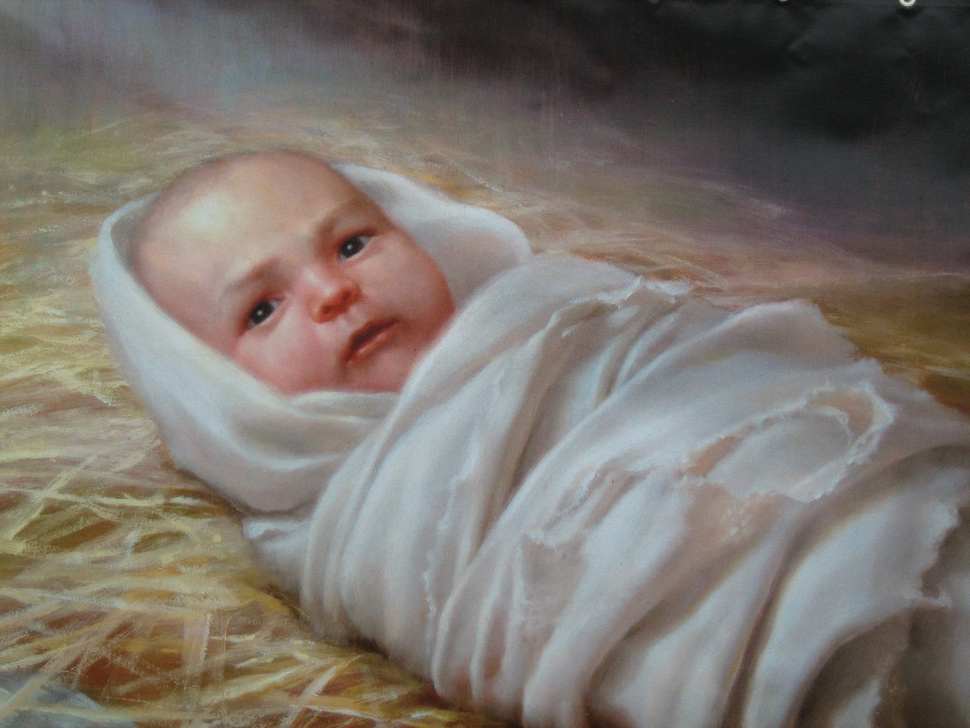
If Jesus made the world, then what authority does he have?
Notes:
Now if Jesus actually made the world, then what authority does he have?

Slide 55
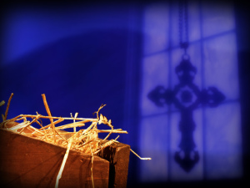
III. Jesus is the rightful King of the world (Matt. 1:1-17).
Notes:
[Christ stems from David as Ruler not just of Israel but of all creation.]

Slide 56
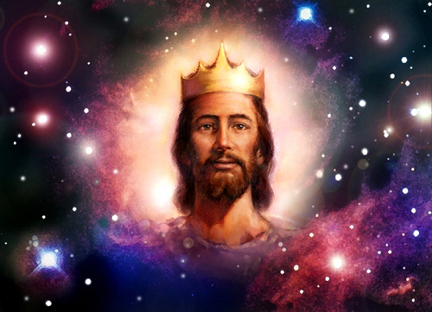
Matthew says Jesus is King!
Notes:
The reason Matthew presents the geneaology of Jesus is to show that his lineage back to David qualifies him as the rightful King of the Jews.

Slide 57
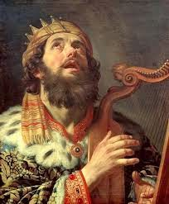
David Listed Before Abraham
"This is a record of the ancestors of Jesus the Messiah, a descendant of David and of Abraham" (Matt. 1:1 NLT)
Notes:
The introduction reverses the typical order to present Christ as the Davidic ruler even before showing his Jewish heritage (Matt. 1:1).

Slide 58
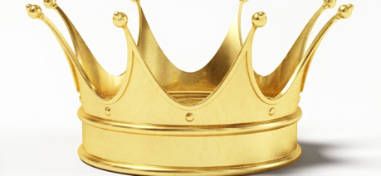
The Kingly Line
Abraham
Isaac
Jacob
Reuben
Simeon
Levi
Gad
Asher
Issachar
Zebulun
Dan
Naphtali
Joseph
Benjamin
Judah
10 generations
David
Kileab (Daniel)
Shephatiah
Ibhar
Elpelet
Amnon
Adonijah
Elishua
Nepheg
Absalom
Ithream
Nogah
Eliphelet
Japhia
Eliada
Solomon
Elishama
28 generations
Jesus
Notes:
But Matthew puts David before Abraham, even though David came 1000 years later!
This narrows the kingly line to David and his son Solomon all the way to Jesus.

Slide 59
The Kingdom in Matthew 1
ABRAHAM
Solomon
Shealtiel
Isaac
Rehoboam
Zerubbabel
Jacob
Abijah
Abiud
Judah
Asa
Eliakim
Perez
Jehoshaphat
Azor
Thus there were fourteen generations in all from Abraham to David, fourteen from David to the exile to Babylon, and fourteen from the exile to Christ.
Matthew 1:17
Hezron
Jehoram
Zadok
Ram
Uzziah
Akim
Amminadab
Jotham
Eliud
Nahshon
Ahaz
Eleazar
Salmon
Hezekiah
Matthan
Boaz
Manasseh
Jacob
Obed
Amon
Joseph +
Mary
Rise of the Kingdom
Jesse
Josiah
KING DAVID
JECONIAH (EXILE)
JESUS CHRIST
Notes:
Christ's lineage from Abraham to Joseph shows his lineage through David to prove his legal right to the throne of Israel (1:2-17).
God said the world's king would come from Abraham (Gen. 17:6; 2060 BC).

Slide 60
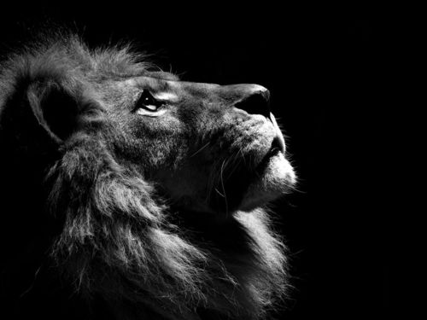
How does Jacob's blessing relate to Jesus?
Jesus descends from Judah
Notes:
God said the world's king would come from Judah (Gen. 49:6; 1828 BC).

Slide 61
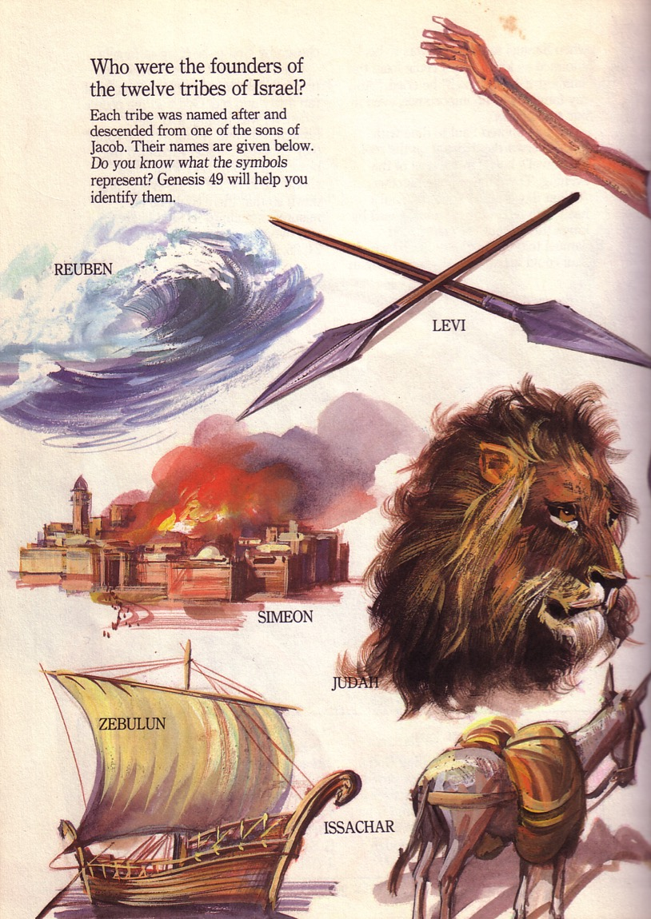
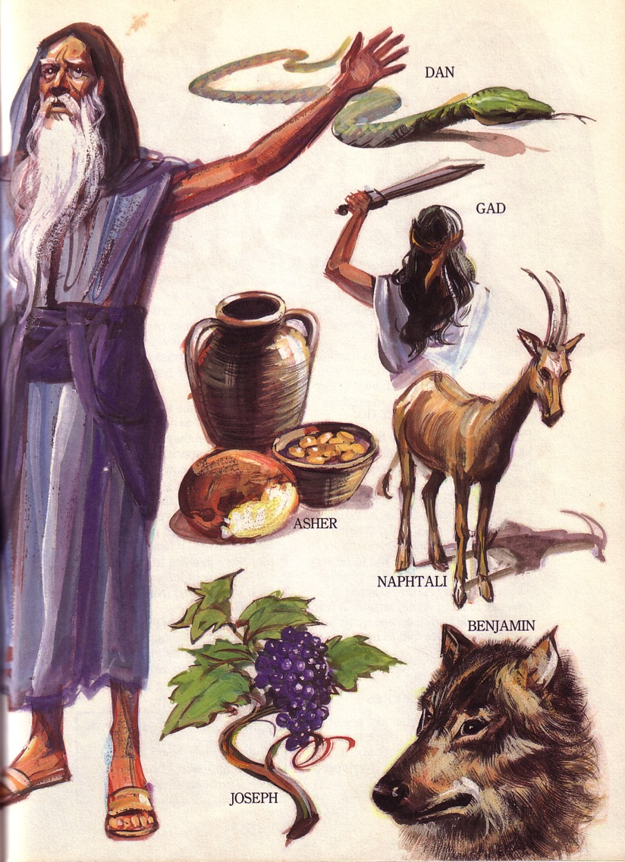
Jacob's Blessing His 12 Sons Was Prophetic (Gen. 49)
Notes:
Jacob blessed all his sons before his death (Gen. 49).

Slide 62
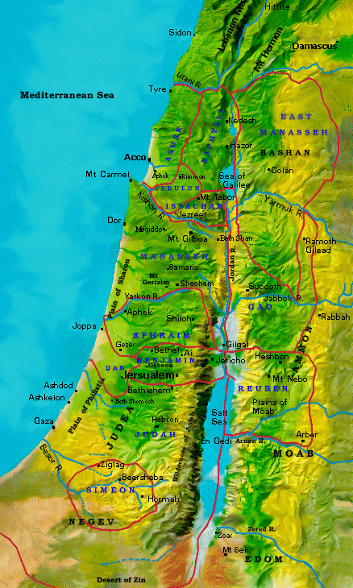
Blessing Judah & the Lesser Tribes
Jacob's Blessing His 12 Sons Was Prophetic (Gen. 49)
Levi
Reuben
Judah
Simeon
Notes:
After prophecies for Reuben, Simeon, Levi, Jacob predicted about Judah an amazing promise…

Slide 63
Descendant of Judah
"Judah, my son, is a young lion that has finished eating its prey. Like a lion he crouches and lies down; like a lioness—who dares to rouse him?
¹⁰The scepter will not depart from Judah, nor the ruler's staff from his descendants, until the coming of the one to whom it belongs, the one whom all nations will honor" (NLT).
Since Jacob's blessing in Genesis 49:9-10, the lion has depicted a king…

Slide 64
The Lineage of David
ABRAHAM
Isaac
Jacob
Judah
Perez
Hezron
Ram
Amminadab
Nahshon
Salmon
Boaz
Obed
Jesse
DAVID
Notes:
God said the world's king would come from David (2 Sam. 7:14; 1000 BC).

Slide 65
David's House: "I want to build a house for you…"
D
A
V
I
D
Notes:
David wanted to build a house for God

Slide 66
But who would build the Temple ?
God's House: "I want to build a house for you…"
Notes:
Instead, God said he would build a house for David!

Slide 67
KEY VERSE: 2 Samuel 7:11-13
"…the LORD declares that he will make a house for you—a dynasty of kings! For when you [David] die, I will raise up one of your descendants, and I will make his kingdom strong. He is the one who will build a house—a temple—for my name. And I will establish the throne of his kingdom forever."
Notes:
So the Davidic covenant promised an eternal throne for David (2 Sam. 7:14)

Slide 68
Promised Seed
David met the lineage requirements of
the Judah's line (Gen. 49:10; Num. 24:17)
Notes:
In other words, David met the lineage requirement of Judah's line

Slide 69
How does the Davidic Covenant relate to Jesus?

Slide 70
Jesus is the Promised Son of David
Nine times Jesus is called "son of David" in Matthew.
Jesus' birthplace, Bethlehem, is recalled as "the city of David" (Matt. 2:1; 1 Sam. 20:6)

Slide 71
Bethlehem is only 8 kilometers (6 miles) south of Jerusalem
Bethlehem
Close Jews
Distant Gentiles
Notes:
In fact, Jesus was born in David's city only 8 kilometers south of Jerusalem!

Slide 72
The Kingdom in Matthew 1
Fall of the Kingdom
Establishing the Eternal Kingdom
ABRAHAM
Solomon
Shealtiel
Isaac
Rehoboam
Zerubbabel
Jacob
Abijah
Abiud
Judah
Asa
Eliakim
Perez
Jehoshaphat
Azor
Thus there were fourteen generations in all from Abraham to David, fourteen from David to the exile to Babylon, and fourteen from the exile to Christ.
Matthew 1:17
Hezron
Jehoram
Zadok
Ram
Uzziah
Akim
Amminadab
Jotham
Eliud
Nahshon
Ahaz
Eleazar
Salmon
Hezekiah
Matthan
Boaz
Manasseh
Jacob
Obed
Amon
Joseph +
Mary
Rise of the Kingdom
Jesse
Josiah
KING DAVID
JECONIAH (EXILE)
JESUS CHRIST
Notes:
God preserved the kingly line to just a few descendants of David to establish the eternal kingdom!

Slide 73
Pagan scholars worshipped the King!
Notes:
Gentiles worshipped Christ as King (Matt. 2).

Slide 74
Jesus will Rule the World
"Judah, my son, is a young lion that has finished eating its prey. Like a lion he crouches and lies down; like a lioness—who dares to rouse him?
¹⁰The scepter will not depart from Judah, nor the ruler's staff from his descendants, until the coming of the one to whom it belongs, the one whom all nations will honor" (NLT).
Since Jacob's blessing in Genesis 49:9-10, the lion has depicted a king…

Slide 75
Jesus is King over all nations
Notes:
But the OT says that this king will rule all nations.
So the magi must have seen that Jesus was more than a Jewish ruler—they saw Him as John saw Him—that he was God made man.

Slide 76
Why should we worship Christ as king?
Genesis ➔ John ➔ Matthew
Notes:
So let's return to our question: Why should we worship Jesus as king? What's the Bible's answer?

Slide 77
Main Idea
Jesus deserves our worship because he is Creator God.
Notes:
We should ascribe deity to him and the natural response then is to adore him. After all, he made the world and is God himself!

Slide 78
I. The Creator is King (Gen. 1:1–2:3).
Notes:
Genesis 1 shows God not only as Creator but as Sovereign Ruler over everything.

Slide 79
II. The Creator is Jesus (John 1:1-3).
Notes:
Genesis 1 is unclear which person of the Trinity made everything—but the NT says it was Christ!

Slide 80
III. Jesus is the rightful King of the world (Matt. 1:1-17).

Slide 81
Gold
How should we worship Christ as King of the world?

Slide 82
Joy to the world 1/4
Joy to the world! the Lord is come;
let earth receive her King;
let ev'ry heart prepare Him room,
and heav'n and nature sing,
and heav'n and nature sing,
and heav'n and heav'n and nature sing.

Slide 83
Give Jesus first place as King in your Christmas this year!

Slide 84
OT Sermons link at biblestudydownloads.com
Get this presentation and script for free!

Slide 85
Black

