Slide 1
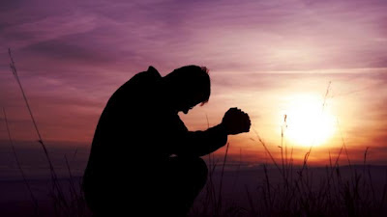
GENESIS 18
How can I be encouraged that God hears and answers my prayers?
Dr Scott Wooddell Eastridge Park Christian Church, Mesquite, Texas Uploaded by Dr. Rick Griffith • Jordan Evangelical Theological Seminary Files in many languages for free download at BibleStudyDownloads.org

Slide 2
1. THE LORD ALWAYS KEEPS HIS PROMISES (vs. 1-15)
“Then the Lord said, ‘I will surely return to you about this time next year, and Sarah your wife will have a son’” (v. 10).

Slide 3
2. THE LORD IS OUR CLOSEST FRIEND (vs. 16-21)
“Then the Lord said, 'Shall I hide from Abraham what I am about to do?'”
“Abraham was called the friend of God” (James 2:23).
“I have called you friends, for everything I have learned from my Father I have made known to you” (John 15:15).

Slide 4
3. THE LORD RESPONDS TO OUR PRAYERS (vs. 22-33)
POWERFUL PRAYERS ARE:
PERSISTENT
SPECIFIC
HUMBLE
THOUGHTFUL

Slide 5
TAKE HOME TRUTH
The closer our friendship with the Lord, the more encouraged we are to pray.

Slide 6
Black

Slide 7
OT Preaching link at BibleStudyDownloads.org
Get this presentation for free!
Notes:
OT Preaching (op)

