Slide 1
Will you believe God will do something
Genesis 18
Preached by Dr. Jim Harmeling at Crossroads International Church Singapore • CICFamily.com Uploaded by Dr. Rick Griffith • Jordan Evangelical Theological Seminary Files in many languages for free download at BibleStudyDownloads.org

Slide 2
Understanding God
Statements
Poetry
Stories
Conversations
Creation

Slide 3
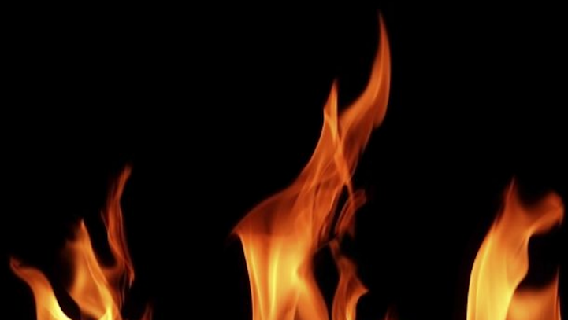
T h e T e s t I n g
D e v e l o p i n g A b r a h a m ’ s R i g h t e o u s n e s s

Slide 4
Will you believe God will do something
Genesis 18

Slide 5
Child to old people? = laughter
Abraham laughs
Sarah laughs
Destroy a major city? = laughter
Sons-in-laws of Lot laugh
"too hard" for God? = extraordinary

Slide 6
God brings hope to the future by creating life out of nothing (Gen 18:1-15)
God controls timing
God controls process

Slide 7
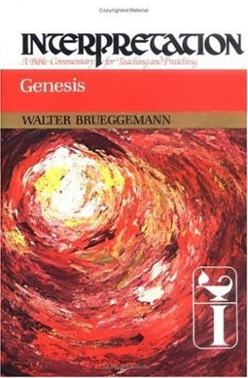
"Abraham, and especially Sarah, are not offered here as models of faith but as models of disbelief. For them, the powerful promise of God outdistances their ability to receive it."

Slide 8
Israel waited for deliverance 400 years
Israel waited for their Messiah 400 years
We've waited for Christ's return 2000 years

Slide 9
1 Corinthians 15:51-52
51 Behold! I tell you a mystery. We shall not all sleep, but we shall all be changed, 52 in a moment, in the twinkling of an eye, at the last trumpet. For the trumpet will sound, and the dead will be raised imperishable, and we shall be changed.
1 Thessalonians 5:2-4
2 For you yourselves are fully aware that the day of the Lord will come like a thief in the night. 3 While people are saying, “There is peace and security,” then sudden destruction will come upon them as labor pains come upon a pregnant woman, and they will not escape. 4 But you are not in darkness, brothers, for that day to surprise you like a thief.

Slide 10
He brings justice by meting out gracious judgment (Gen 18:16-33)

Slide 11
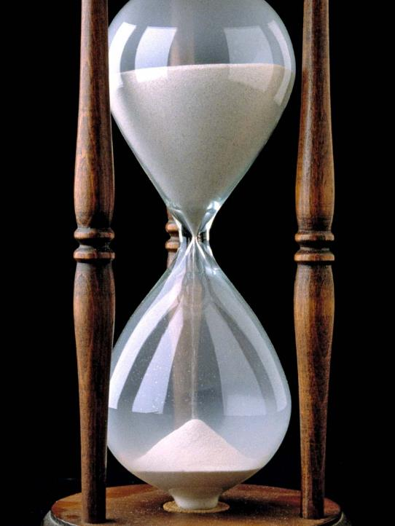
God does not rush judgment

Slide 12
Exodus 34:6-7​
"The Lord, the Lord, a God merciful and gracious, slow to anger, and abounding in steadfast love and faithfulness, keeping steadfast love for thousands, forgiving iniquity and transgression and sin, but who will by no means clear the guilty"

Slide 13
God does not rush judgment
God listens to interceding prayer

Slide 14
Black

Slide 15
OT Preaching link at BibleStudyDownloads.org
Get this presentation and script for free!
Notes:
OT Preaching (op)

