Slide 1
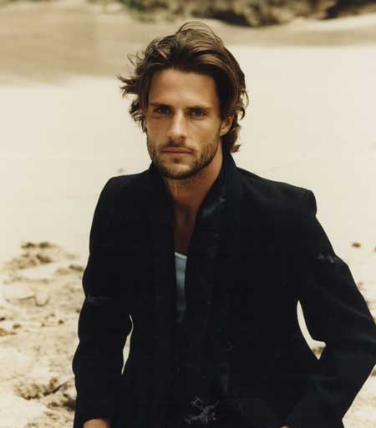
GENESIS 14
Can I trust the Lord in any situation?
Dr Scott Wooddell Eastridge Park Christian Church, Mesquite, Texas Uploaded by Dr. Rick Griffith • Jordan Evangelical Theological Seminary Files in many languages for free download at BibleStudyDownloads.org

Slide 2
1. WE TRUST THE LORD IN EARTHLY MATTERS.
“When Abram learned that his relative had been taken captive, he called out his 318 trained men born in his household and went in pursuit as far as Dan.” (v. 14)

Slide 3
2. WE TRUST THE LORD IN HEAVENLY MATTERS.
“Then Melchizedek king of Salem brought out bread and wine. He was priest of God Most High, and he blessed Abraham, saying, ‘Blessed be Abram by God Most High, Creator of heaven and earth.
Christ saves us eternally.
Christ helps us infinitely.
Christ forgives us completely.

Slide 4
TAKE HOME TRUTH
We can trust the Lord from here to eternity.

Slide 5
Black

Slide 6
OT Preaching link at BibleStudyDownloads.org
Get this presentation for free!
Notes:
OT Preaching (op)

