Slide 1
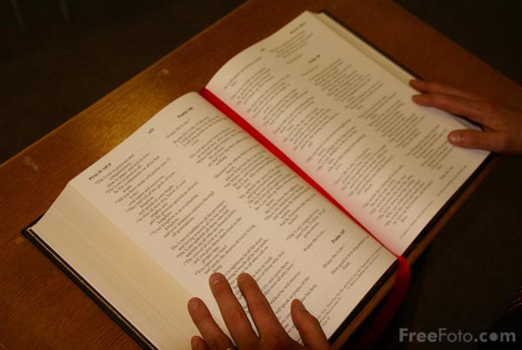
GENESIS 13
Why should I seek God’s purpose for my life?
Dr Scott Wooddell Eastridge Park Christian Church, Mesquite, Texas Uploaded by Dr. Rick Griffith • Jordan Evangelical Theological Seminary Files in many languages for free download at BibleStudyDownloads.org

Slide 2
1. THE BURDEN OF PURSUING OUR OWN PURPOSE IN LIFE
“Lot looked up and saw that the whole plain of the Jordan was well watered like the Garden of the Lord...So Lot chose for himself…”

Slide 3
2 THE BLESSING OF CHOOSING GOD’S PLAN FOR OUR LIFE
“The Lord said to Abram after Lot had parted from him, ‘Lift up your eyes from where you are and look north and south, east and west. All the land that you see I will give you and your offspring forever.’”

Slide 4
TAKE HOME TRUTH
Those who embrace God’s path in life enjoy God’s blessings for eternity.

Slide 5
Black

Slide 6
OT Preaching link at BibleStudyDownloads.org
Get this presentation for free!
Notes:
OT Preaching (op)

