Slide 1
Where Do You Place Your Trust? (Genesis 13–14)
Preached by Dr. Jim Harmeling at Crossroads International Church Singapore • CICFamily.com Uploaded by Dr. Rick Griffith • Jordan Evangelical Theological Seminary Files in many languages for free download at BibleStudyDownloads.org

Slide 3
T h e T e s t I n g
D e v e l o p i n g A b r a h a m ’ s R i g h t e o u s n e s s

Slide 4
Where Do You Place Your Trust?
Lot
4 Kings
2 Kings
Genesis 13–14

Slide 5
Temptation 1: Impulsively take for yourself (Genesis 13)

Slide 6
Abraham
Not impulsive
Not deceptive
Relationship priority
Generous
Moves towards God
Lot
Focused on initial impression
Impulsive
Moves towards Sodom

Slide 8
What do we value in life?
Are we impulsive purchasers like Lot who do not recognize spiritual danger in our eagerness to gain more of this world?

Slide 9
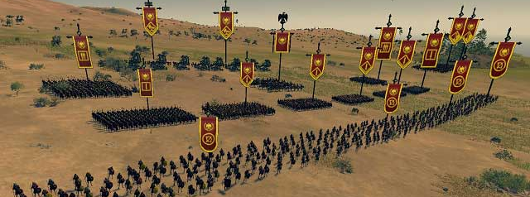
Temptation 2: Rely on your strength and force the issue of acquisition
(Genesis 14:1-16)

Slide 10
How has your workplace shaped you?
Are you becoming a tyrant playing by the world's rules to gain worldly wealth?

Slide 11
Do you leave lives in your wake?
Do you truly trust in God’s might and hold to principles of integrity even if you risk much by doing so?

Slide 12
Temptation 3: Compromise principle for temporary gain
(Genesis 14:17-24)

Slide 13
What principle are you tempted to compromise when surrounded by others who do not share your faith?
How do you give credit to God when He grants you success?

Slide 14
Black

Slide 15
OT Preaching link at BibleStudyDownloads.org
Get this presentation and script for free!
Notes:
OT Preaching (op)

