Slide 1

Screwtape
Strategies
Sarah Lim • Homiletics 1 Class Sermon
Uploaded by Dr. Rick Griffith • Singapore Bible College
All files in many languages for free download at BibleStudyDownloads.org
Notes:
Screwtape Strategies
Ezra 4:1-24 (Cyclical Inductive)
Interest:
How many of you have read “Screwtape letters” by CS Lewis? In the book, an imaginary devil named “Screwtape,” writes to mentor his nephew on how to harass and bring about the spiritual destruction of a Christian.
I would like you to imagine now, that you are Screwtape. Standing in Satan’s shoes, and you look at yourself: what strategy will you employ to achieve your own spiritual downfall … or that of your local church?
Need: Are you aware of the opposition you really face in doing God’s work?
Subject: As God’s people, do we know how Satan wages warfare against us?

Slide 2


As God’s people
Are you aware
of the opposition
you really face
in doing God’s work?
do we know
how Satan
wages war
against us?
Notes:
Need: Are you aware of the opposition you really face in doing God’s work?
Subject: As God’s people, do we know how Satan wages warfare against us?

Slide 3
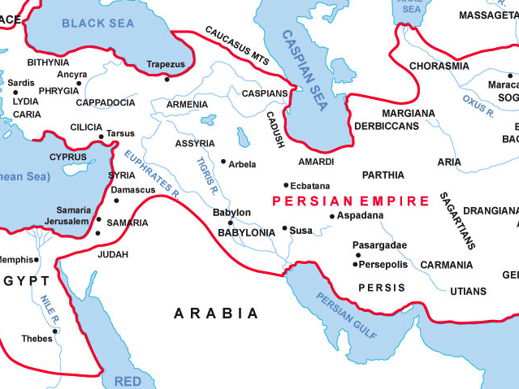










Ezra 3:13 “…the people could not distinguish the sound of the joyful shout
from the sound of the people's weeping, for the people shouted with a great shout,
and the sound was heard far away…”
EZRA 2
EZRA 3
EZRA 1
EZRA 4
“Judah was perhaps carved out of adjacent districts
and newly granted an identity of its own…
the ruffled feelings of officials shorn
of part of their command
may have helped to set the
hostile tone.” Kidner, TOTC
EZRA-NEHEMIAH
Israel
vs.
ADVERSARIES
background
Notes:
Background:
Ezra-Nehemiah revolves around the conflict between Israel as a collective whole and their enemies.
In Ezra 1, Cyrus issues an edict to build the temple. In Ezra 2, the Israelites return and settle back into Jerusalem. By the end of chapter 3, the altar and foundation has been constructed. In Ezra 3:10-13 we see a mini climax in the story of the temple reconstruction! God is praised for His goodness and steadfast love towards Israel in restoring His people.
But this celebration is intermingled with sorrow, which sets the tone of what is to come in the rest of the book. In 3:13 – the scene zooms out, away from the Israelites’ celebration and mini victory, and in Ezra 4 we come face to face… with Israel’s enemies.
Who were these guys anyway? Well, Kidner writes in his commentary on Ezra-Nehemiah that when the Jews returned, “Judah was perhaps carved out of adjacent districts and newly granted an identity of its own…the ruffled feelings of officials shorn of part of their command may have helped to set the hostile tone.” I mean, imagine that after the issuance of a new government policy, I move in, knock down part of your house and set up my own home on what use to be part of your land – you would be really upset too.

Slide 4
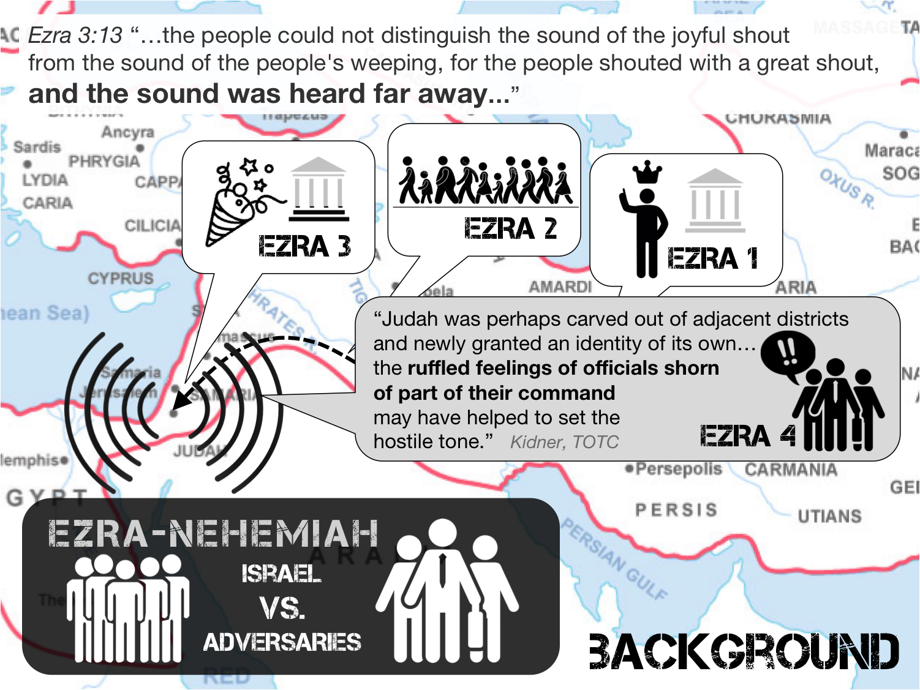


Ezra 4: How the enemies of God’s people
seek to oppose the saints in our work for the LORD.
EZRA 4:6
EZRA 4:7-23
City Walls (Nehemiah)
EZRA 4:1-5, 24
Temple Construction
background
Notes:
Now what’s interesting about Ezra 4, is that it covers 3 separate time frames. 4:1-5, 24 (Reign of Cyrus until 2nd year of Darius); 4:6 (Reign of Ahasuerus); 4:7-23 (Reign of Artaxerxes; time of Nehemiah). But no matter what time frame is being spoken about, we see Israel’s adversaries using all sorts of ways to oppose their restoration and building works!
Preview: In chapter 4, the author of Ezra relates how the adversaries of Israel sought to oppose them in their building works. Restatement: Ezra 4 reveals how the enemies of God’s people seek to oppose the saints in our work for the Lord.

Slide 5



Satan opposes us
Persistently through
Deceit & fear
4:1-3
4:4-5
v2 “Let us build with you,
for we worship your God as you do,
and we have been sacrificing to him
since the days of Esarhaddon king of Assyria…”
infiltration through DECEPTION
2 Kings 17:29-41 “So they feared the LORD
but also served their own gods...”
Ezra 4:1-5
Notes:
Satan opposes us persistently through the use of deceit and fear (4:1-5)
When the adversaries of Judah heard that the Israelites were building a temple to the Lord, they approached them directly and said “Let us build with you, for we worship your God as you do, and we have been sacrificing to him ever since the days of Esarhaddon king of Assyria…” (4:2)
In other words, they tried to infiltrate the Israelite community. This is a most deceitful strategy, because it is done under the guise of friendship. But the narrator plainly tells us that behind their sweet words, they are “the adversaries of Judah” (4:1).
Furthermore, the reasons they gave are very persuasive. “We worship your God as you do!” But what they did not say is that they were concurrently worshipping other gods besides Yahweh. We see this from 2 Kings 17:29-41.
Using half-truths and the pretense of friendship, they hoped to deceive the Israelites and infiltrate their community. And you know – that just like in a marriage – the closer someone gets to you, the more say and influence they have on you. What would happen if these people, who are not actually loyal to Yahweh, end up having a say in building Yahweh’s temple??
Fortunately the leaders of Israel stood their ground. But the adversaries did not give up. Since their attempt to deceive through friendly measures did not work, they instead resorted to the use of discouragement and fear/threat [v4].
But that’s not all, in v5, they even bribed counselors to frustrate the building process! If we turn to Haggai 1:2 you will see just how cunning the counsel was. [Haggai 1:2] Wow?! It sounds so holy! “we must wait for God’s timing…”
Lastly, we read that they employed these tactics “All the days of Cyrus king of Persia, even until the reign of Darius king of Persia” That’s from 539BC – 522BC, 18 years!! You get a sense of just how persistent these guys were!
(So what do we learn from v1-5 about how the enemy works? We learn that…)
(4:1-3) Our enemy seeks to deceive through infiltration
(4:4-5) Our enemy seeks to instill crippling fear and deceive us through counsel
(4:4-5) Our enemy seeks to oppose us persistently

Slide 6


Satan opposes us
Persistently through
Deceit & fear
4:1-3
4:4-5
Haggai 1:2
“These people say the time has not yet come to rebuild the house of the LORD”
v4 “Then the people of the land
discouraged the people of Judah
and made them afraid to build…”
V5 “and bribed counselors against them to frustrate their purpose…
“all the days of Cyrus … until the reign of Darius”
16 years
Ezra 4:1-5
Notes:
Fortunately the leaders of Israel stood their ground. But the adversaries did not give up. Since their attempt to deceive through friendly measures did not work, they instead resorted to the use of discouragement and fear/threat [v4].
But that’s not all, in v5, they even bribed counselors to frustrate the building process! If we turn to Haggai 1:2 you will see just how cunning the counsel was. [Haggai 1:2] Wow?! It sounds so holy! “we must wait for God’s timing…”
Lastly, we read that they employed these tactics “All the days of Cyrus king of Persia, even until the reign of Darius king of Persia” That’s from 539BC – 522BC, 18 years!! You get a sense of just how persistent these guys were!
(So what do we learn from v1-5 about how the enemy works? We learn that…)
(4:1-3) Our enemy seeks to deceive through infiltration
(4:4-5) Our enemy seeks to instill crippling fear and deceive us through counsel
(4:4-5) Our enemy seeks to oppose us persistently

Slide 7
Satan opposes us
Persistently through
Deceit & fear
4:1-3
4:4-5
Infiltrate through DECEPTION
Instill crippling fear and deceive through counsel
Oppose us persistently
Our enemy seeks to . . .
Ezra 4:1-5
Notes:
(So what do we learn from v1-5 about how the enemy works? We learn that…)
(4:1-3) Our enemy seeks to deceive through infiltration
(4:4-5) Our enemy seeks to instill crippling fear and deceive us through counsel
(4:4-5) Our enemy seeks to oppose us persistently
These tactics sound familiar don’t they? For example, if we talk about discouragement and fear, think - when was the last time you felt discouraged in your walk with the Lord? When was the last time you just felt like giving up because serving (and studying) is just so painful?
Or if we talk about infiltration, we recall Paul’s words in Acts 20 to the Elders of Ephesians. [Acts 20:28-31] Even before it happened, Paul knew the opposition that would tear at the church… would come from within. The church had been infiltrated.
But infiltration can also take place on a personal level. The devil can infiltrate our heart. Infiltration is basically to get a foothold on someone, or something, and so veer it in a different direction. Dr Rick shared with another class of how a final year student from SBC did not finish his studies because while the church was using his laptop once, pornographic media un-intentionally got played instead. The enemy had infiltrated this student’s heart.
A pastor once shared with me “if the devil cannot scare you, he will cover you with candy floss.” If he cannot stop us through fear and discouragement, he will try to stop us by deceiving us, through false counsel, or infiltrating our community… or infiltrating our hearts. And he doesn’t give up.

Slide 8

Satan opposes us
Persistently through THE
MANIPULATION of
EXTERNAL POWERS
V6 “they wrote an accusation against
the inhabitants of Judah…”
V7 “Bishlam andMithredath… wrote to Artaxerxes”
V8 “Rehum… and Shimshai wrote… to Artaxerxes”
v6-8
v9-11
v12-16
Ezra 4:6-16
Notes:
Satan (also) opposes us persistently via the manipulation of external powers (4:6-16)
In v6, the narrator fast forwards to the reign of Ahasuerus (486-464BC) – This time the adversaries write an accusation against the Israelites, which means they bring false charges against them. Then in v7-8, during the reign of Artaxerxes (464-423BC), 2 different groups of adversaries write to the reigning king. By now, it is already 75 years since the opposition first started and they are still going at it…!
Furthermore, the opposition against God’s people has suddenly escalated tremendously in magnitude because the most powerful man in the land is now involved.

Slide 9

Satan opposes us
Persistently through THE
MANIPULATION of
EXTERNAL POWERS
They attempt to manipulate the political structures
of their day, using external power structures
to suppress God’s community
OUR enemy manipulates through persistent accusation of God’s people
v6-8
v9-11
v12-16
Ezra 4:6-16
Notes:
Essentially we see the adversaries employing yet another different method to oppose the Israelites – they attempt to manipulate the power/political structures of their day to control the Israelites. It’s a use of the external power structures of the day to oppress God’s community.
So we see that…
(4:6-8) Our enemy manipulates through persistent accusation of God’s people

Slide 10

Satan opposes us
Persistently through THE
MANIPULATION of
EXTERNAL POWERS
List of adversaries represented by letter
V9 Judges, governors, officials etc.
V9 Persians, Babylonians, men of Susa etc.
V10 “the rest of the nations … settled in the
cities of Samaria and in the rest of the province Beyond the River”
v11 “the men of the province Beyond the River.”
v6-8
v9-11
v12-16
Ezra 4:6-16
Notes:
In v9-10, we have a list of those whose opinions are represented by the letter.
We see a formidable list of adversaries consisting of…
Those who are in positions of power and influence: judges, governors, officials etc.
Multiple people groups: Persians, Babylonians, men of Susa etc. and…
“the rest of the nations … settled in the cities of Samaria and in the rest of the province Beyond the River”/ “the men of the province Beyond the River.” In other words… everyone in the region except the Jews!! The sheer magnitude of the opposition is overwhelming! It feels just like what we are up against today isn’t it? The whole world against God’s people

Slide 11
Satan opposes us
Persistently through THE
MANIPULATION of
EXTERNAL POWERS
OUR enemy manipulates through
a show of power through numbers
v6-8
v9-11
v12-16
Ezra 4:6-16
Notes:
so we see that…
(4:9-11) Our enemy manipulates through a show of power and numbers

Slide 12

Satan opposes us
Persistently through THE
MANIPULATION of
EXTERNAL POWERS
Adversaries
lay out
their case
V12 Accuse Jerusalem
“a rebellious and wicked city”
V14-15 Used Israel’s track record as a weapon against her
“We send to inform the king, in order that search may be made in the book of the records… You will find… that this city is a rebellious city, hurtful to kings and provinces, and that sedition
was stirred up in it from of old. That was why this city was laid waste.”
v6-8
v9-11
v12-16
Ezra 4:6-16
Notes:
Finally, in v12-16, the adversaries lay out their case against the Jews.
To cut the long story short, they essentially accused Jerusalem of being a “rebellious and wicked city.” (v12)
They supported their claim by using Israel’s tragic history and track record as a weapon against her. (v15) “we send and inform the king, in order that search may be made in the book of the record of your fathers. You will find…from of old”
In fact, their choice of accusation is brilliant because they so poignantly played on Artarxerxes fears. Artaxerxes became king by murdering his older brother. And during the earlier part of his reign the Egyptian revolt supported by the Greeks took place and lasted 12 years! This major challenge to Persian rule is likely to have caused Artaxerxes to pay serious attention to any charge of rebellion.
And so we see that …
(4:12-16) Our enemy manipulates by leveraging upon the desires/fear of those in power
Mervin Breneman, Ezra Nehemiah Esther, NAC (Nashville, TN: Broadman & Holman, 1993), 101.

Slide 13
Satan opposes us
Persistently through THE
MANIPULATION of
EXTERNAL POWERS
OUR enemy manipulates through
leveraging upon the desires/fear of those in power
v6-8
v9-11
v12-16
Ezra 4:6-16
Notes:
And so we see that …
(4:12-16) Our enemy manipulates by leveraging upon the desires/fear of those in power
Mervin Breneman, Ezra Nehemiah Esther, NAC (Nashville, TN: Broadman & Holman, 1993), 101.

Slide 14
Satan opposes us
Persistently through THE
MANIPULATION of
EXTERNAL POWERS
Our enemy OPPOSES US THROUGH. . .
v6-8
persistent accusation
v9-11
a show of power through numbers
leveraging upon the desires/fear
of those in power
v12-16
Ezra 4:6-16
Notes:
So through persistent accusation, through a show of power and numbers, through leveraging upon the fears/desires of those in power – the enemies of God’s people are able to oppose us persistently via the manipulation of external powers.

Slide 15




We can be
Paralyzed
In doing God’s work
4:17-23
4:24
Artaxerxes completely buys into the arguments of the adversaries.
V21 “make a decree that these men be made to cease,
and the city be not built”
Ezra 4:17-24
Notes:
We can be paralyzed in doing God’s work (4:17-24)
Ezra 4:17-23 narrates how Artarxerxes basically buys into the adversaries’ arguments completely. He did as they proposed, made a search of Jerusalem’s track records, and concluded as the adversaries did that Jerusalem is indeed a city of rebellion. Artarxerxes’ conclusion is simple: the works are to stop at once.

Slide 16
We can be
Paralyzed
In doing God’s work
4:17-23
4:24
V24 “the work on the house of God… stopped, and it ceased until the second year of the reign of Darius king of Persia”
16 yrs
EZRA 4 :17-23
Ezra 4:17-24
Notes:
Likewise, in Ezra 4:24, we zoom back in time and we are told that the work on the temple stopped until the 2nd year of the reign of Darius. By then, the work on the temple had been stopped for 18 years.

Slide 17
We can be
Paralyzed
In doing God’s work
4:17-23
4:24
The work of God by his people was paralyzed by the enemies’ schemes
Ezra 4:17-24
Notes:
In either case, the point is the same: the work of God by His people was paralyzed by the schemes of the enemy.

Slide 18
We can be
Paralyzed
In doing God’s work
"…I was much followed by this Scripture
'Simon, Simon, behold,
Satan hath desired to have you' (Luke 22:31)"
"Sometimes I have endeavored to argue against these suggestions, and to set some of the sentences
of blessed Paul against them;
But…How could I tell, but that in very deed
he being a subtle and cunning man might give himself up to deceive with strong delusions …."
…a month after, a very great storm came down upon me…
whole floods of blasphemies, both against God, Christ, and the Scriptures, were poured upon my spirit, to my great confusion…
these blasphemous thoughts… also stirred up questions in me, against the very being of God, and of his only beloved Son; as, whether there were, in truth, a God, or Christ, or no? and whether the holy Scriptures were not rather a fable, and cunning story?...
John Bunyan, Grace Abounding
to the Chief of Sinners
Ezra 4:17-24
Notes:
…a month after, a very great storm came down upon me…
whole floods of blasphemies, both against God, Christ, and the Scriptures, were poured upon my spirit, to my great confusion… these blasphemous thoughts… also stirred up questions in me, against the very being of God, and of his only beloved Son; as, whether there were, in truth, a God, or Christ, or no? and whether the holy Scriptures were not rather a fable, and cunning story?...

Slide 19
Satan
USES
VARIED & PERSISTENT
STRATEGIES to
Paralyze
Our work for GOD
Main Idea: Ezra 4
Notes:
Conclusion
Satan uses varied and persistent strategies to paralyze our work for God (MI).
He uses deceit and fear to frustrate us. He manipulates external powers to stop our work for God.

Slide 20

Satan
USES
VARIED & PERSISTENT
STRATEGIES to
Paralyze
What strategies is the enemy using …
in your own life, in your local church,
or even the global church?
Pray for the Lord’s deliverance
& ask for a greater awareness of
the warfare waged against you
and the rest of God’s people.
Our work for GOD
Main Idea: Ezra 4
Notes:
Application: From today’s sermon, what strategies is the enemy using in your own life, in your local church, or even the global church? Pray for the Lord’s deliverance and ask for a greater awareness of the warfare waged against you and the rest of God’s people.

Slide 21
Black

Slide 22


OT Preaching link at BibleStudyDownloads.org
Get this presentation and script for free!
Notes:
NT Preaching (np)

