Slide 1


Idols of the Heart
Transforming the Control Center of Life
Preached by Dr Troy Josey
Amman International Church, Jordan (AmmanChurch.org)
Uploaded by Dr. Rick Griffith • Jordan Evangelical Theological Seminary
Files in many languages for free download at BibleStudyDownloads.org

Slide 2

Saleem's Story: The Internal Struggle
Surface Success, Internal Exhaustion
Saleem is an outstanding university student with top grades. Yet behind his high achievements lies crippling anxiety, constant exhaustion, and a relentless fear of failure.
Though he prays for relief, his panic persists. Why? Because the core issue isn't his workload—it is what his heart depends on for ultimate identity and worth.

Slide 3

What is the Biblical "Heart"?
"Guard your heart with all diligence, for from it flow the springs of life.”
Proverbs 4:23
More Than Emotions
The Control Center
In Scripture, the heart is not merely the source of emotions. It represents the entirety of your inner person—the source of all human life and choices.
Every action, word, reaction, and priority originates in the unseen commitments of the heart.

Slide 4





How the Heart Functions
Thinking
Desiring
Deciding
The mind and imagination. What you dwell on, believe, and process as true regarding yourself, God, and the world.
The passions and longings. What you love, crave, treasure, and fear losing above all else in daily life.
The volition and will. The practical choices, habits, and active commitments that direct your daily journey.

Slide 5
The Heart is Sinful and Deceitful
“For from within, out of the heart of man, come evil thoughts, sexual immorality, theft, murder, adultery, covetousness, wickedness, deceit, sensuality, envy, slander, pride, foolishness. These things defile a person.” Mark 7:21-22
The heart is deceitful above all things, and desperately sick;
who can understand it?
“I the Lord search the heart and test the mind,
to give every man according to his ways,
according to the fruit of his deeds.” Jeremiah 17:9-10

Slide 6
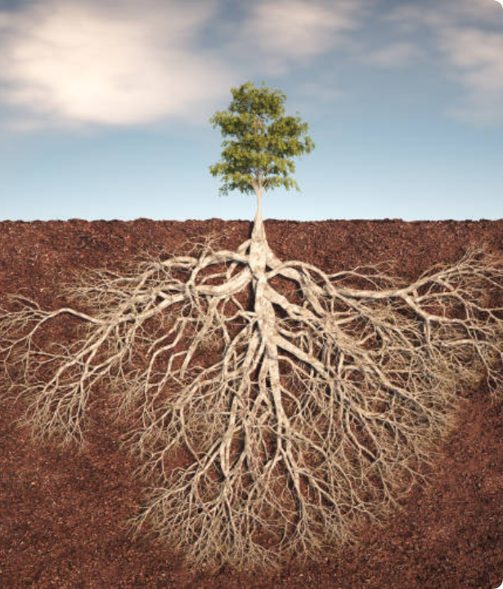
Fruit vs. Root
Behavior is Merely the Fruit
We often try to resolve anger, worry, addiction, or burnout by changing external habits alone. But behavior is only the visible fruit on the branches.
The heart is the invisible root system. If the roots are drinking from functional idols, the tree will continuously produce sinful fruit, no matter how hard you prune the exterior (try to change behavior).
In fact, if we try to resolve to just do better—to change outward behavior — we not only will generally fail, but we also will not address the deeper issues.

Slide 7
Defining Heart Idols
"
An idol is anything that means more to you than God. It is anything good elevated to ultimate status—anything we rely on for security, identity, or value apart from God.

Slide 8
Surface Gods vs. Heart Idols
"Son of man, these men have taken their idols into their hearts, and set the stumbling block of their iniquity before their faces. Should I indeed let myself be consulted by them?" (Ezekiel 14:3)
Context | External Object (Surface) | Heart Idol (Root Motive)
Ancient World | Wood, stone, or bronze statues | Control (over weather, rain, and fertility), Security/Comfort (harvest), Approval/Acceptance (from god[s])
Modern | Career title, bank balance, body image | Security/Comfort (life without pain), Control (over future, appearance, health), power (reputation, achievements), and approval (status, reputation)
Religious | Moral perfection, ministry duties | Control (self-righteousness), approval (fear of man), power (reputation)

Slide 9


The Four Core Heart Idols
Comfort Idol
Approval Idol
Core Desire: Ease, pleasure, stress-free life.
Driving Fear: Pain, hardship, excessive demands.
Core Desire: Acceptance, reputation, praise, belonging.
Driving Fear: Rejection, criticism, conflict.
Control Idol
Power Idol
Core Desire: Predictability, absolute order.
Driving Fear: Uncertainty, chaos, helplessness.
Core Desire: Influence, dominance, success.
Driving Fear: Humiliation, weakness, insignificance.

Slide 10
Consider four students studying for exams…
One does it for Approval (to make their parents happy);
the second does it for Comfort (to secure a high-paying job and easy life);
the third does it for Control (to leave nothing in life to chance);
the fourth does it for Power (to gain fame and avoid the humiliation of failure).
The action – and many of the emotions (anxiety, fear, even anger) – is identical, but the hearts are worshipping different idols.

Slide 11
Heart Renewal: Diagnosing the Heart
Worry: What do you fear the most? What do you worry about?
Anger: What triggers your defensive outbursts, frustration, or resentment?
Escape: Where do you instinctively turn to find refuge when stressed or hurt? Where do you find comfort or relief?
Success: What must happen today for you to feel satisfied with your worth?
👤
Identity: How do you see your identity?

Slide 12
"Search me, O God, and know my heart!
Try me and know my thoughts!
²⁴ And see if there be any grievous way in me,
and lead me in the way everlasting."
Psalm 139:23-24

Slide 13
"...to put off your old self, which belongs to your former manner of life and is corrupt through deceitful desires, and to be renewed in the spirit of your minds, and to put on the new self, created after the likeness of God in true righteousness and holiness."
Ephesians 4:22-24

Slide 14


The Path to Gospel Renewal
2. Repent/Put Off
4. Re-enthrone/Worship
Acknowledge false worship and turn back to Christ. This is ongoing throughout our lives!
Walk in joyful obedience. And repeat —discover, repent, receive, re-enthrone.
1. Discover
3. Receive/Put On
Identify the root idol driving your struggles/sin; pray Psalm 139:23-24.
Rest in God's grace and complete unconditional acceptance. There is nothing you can do to make God love you less; he loves you perfectly in Christ Jesus.

Slide 15


Benjamin's Story: Rest and Freedom
From Performance to Peace
Benjamin realized his crippling stress came from worshipping the idol of Approval—measuring his worth and identity by people's opinions.
When he anchored his identity in God's secure love, the fear of man shattered.
He discovered genuine peace and the freedom to serve others joyfully.

Slide 16
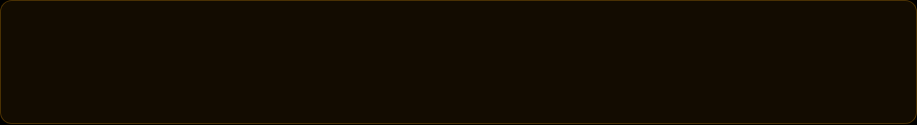
Conclusion
An idol of the heart (Ezekiel 14:3) is anything that means more to you than God.
Real change is heart change (Proverbs 4:23).
Discover - ask God to reveal your heart (Psalm 139:23-24) – and then follow the repent/put-off and receive/put-on pattern of change.
"Little children, keep yourselves from idols."
— 1 John 5:21 —

Slide 17


Image Sources
https://www.shutterstock.com/search/arabic-man-sad?dd_referrer=https%3A%2F%2Fwww.google.com%2F
Source: www..shutterstock.com
https://media.istockphoto.com/id/2181191277/photo/a-vibrant-tree-stands-tall-above-the-ground.jpg?s=612x612&w=0&k=20&c=8ny3JSYi8x6_3T13K1PreBFRSABfXukEFHsGjspiLLY=
Source: www.istockphoto.com
https://media.istockphoto.com/id/2232576205/photo/young-woman-on-viewpoint-above-calm-bay-and-islands-at-sunrise.jpg?s=612x612&w=0&k=20&c=a7m_Zj1lKtZu_Uc7btIiSRqENyCggN526fHcL-BTG88=
Source: www.istockphoto.com

Slide 19
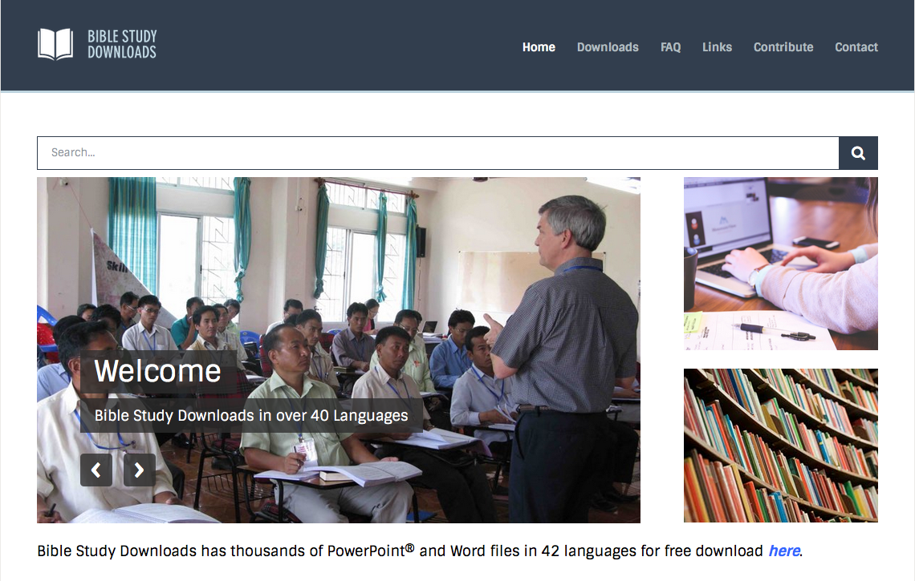
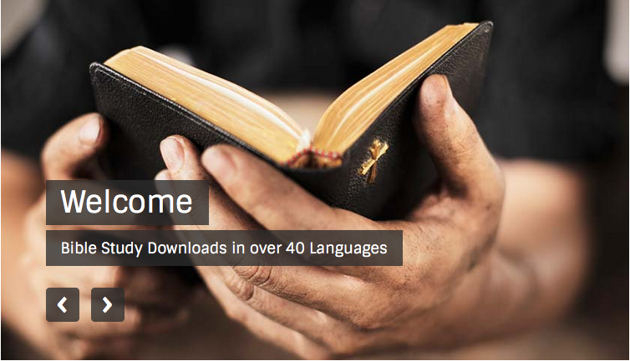
OT Preaching link at BibleStudyDownloads.org
Get this presentation for free!
Notes:
OT Preaching (op)

