Slide 1
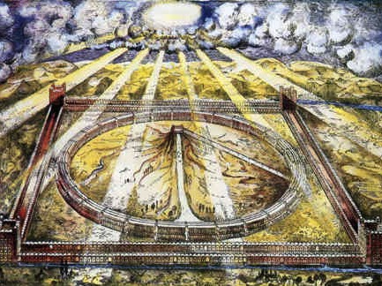
Ezekiel 40–48
Anticipate
Glory
in a New Order
Dr. Rick Griffith • Jordan Evangelical Theological Seminary • BibleStudyDownloads.org

Slide 2
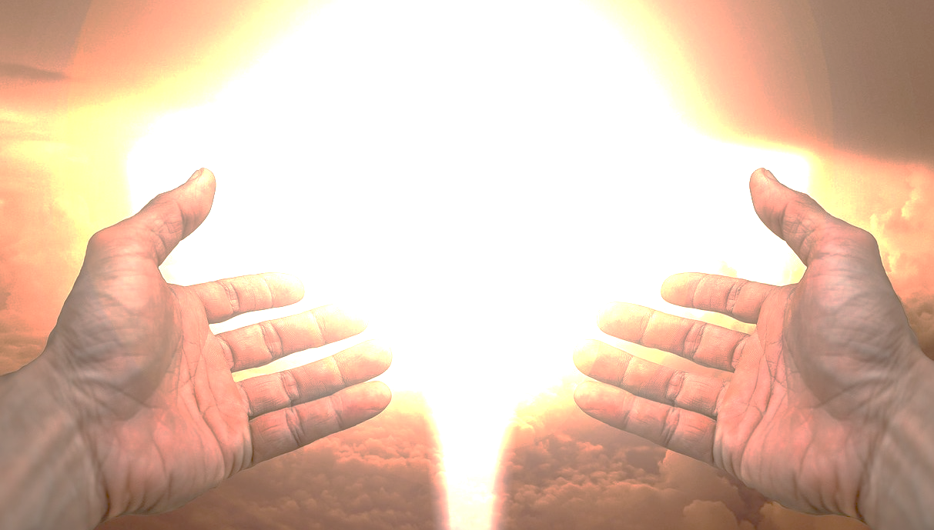
God has always been as close as we have wanted.
Agree or Disagree?
Notes:
God has always been as close as we have wanted. Do you agree or disagree? Tell the person next to you for 30 seconds.

Slide 3

Far from God?
Who moved?
Notes:
As a new Christian, I used to see the bumper sticker that read “Far from God? Who moved?”

Slide 4
"Now the earth was formless and empty, darkness was over the surface of the deep…"
"…and the Spirit of God was hovering over the waters."
Genesis 1:2 NIV
Notes:
From Eden to Exile, the LORD was faithful to be as present as the people allowed.
His Spirit hovered over creation even before he created man.
_________
The Spirit presided over creation (Gen 1:2).
But what is God’s glory? The idea is one of God’s weight or God’s presence. Remember where his presence is first mentioned in the second verse of the Bible?

Slide 5
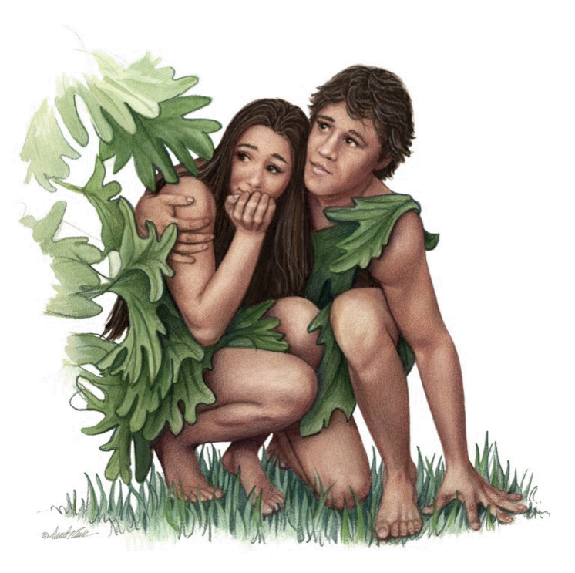
"When the cool evening breezes were blowing, the man and his wife heard the LORD God walking about in the garden. So they hid from the LORD God among the trees. ⁹Then the LORD God called to the man, 'Where are you?'" (Gen 3:8-9 NLT).
Notes:
God went looking for Adam—not Adam looking for God (3:8-11).

Slide 6

The Tabernacle
7
God sets up a place for Him to dwell as King
MOSES
Exodus
Sinai
M - C - C
Kadesh Barnea
40
The Tabernacle in the Wilderness
Handbook pg. 26-29
2
16
Notes:
God’s glory or presence then appeared at the tabernacle made for him to dwell as king.

Slide 7
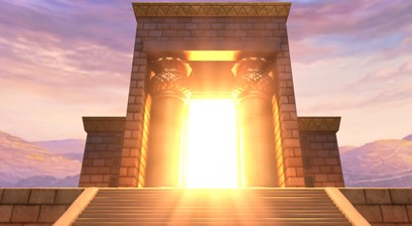
Glory in Solomon's Temple
Notes:
God then set up a home in the temple to be with his people.

Slide 8
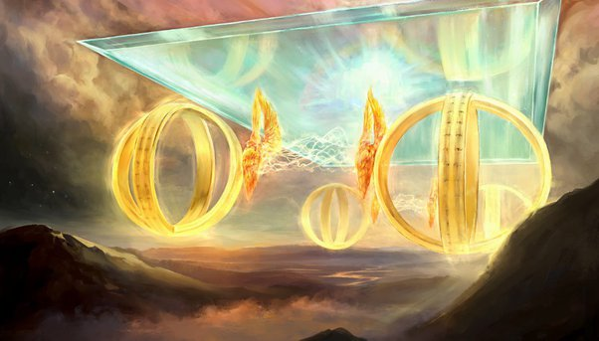
Ezekiel 1:28a
"This is what the glory of the LORD looked like to me. When I saw it, I fell face down on the ground, and I heard someone’s voice speaking to me."
Notes:
Ezekiel saw God’s glory.

Slide 9
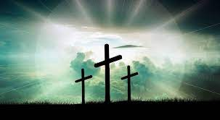
Has God been faithful to you in the past? How?
Notes:
God has been faithful to be close to us.
Has God been faithful to you in the past? How?
He provided forgiveness in Jesus.
He has met all my needs.
He gave my life purpose.

Slide 10

Will God be faithful to you in the future? How?
Notes:
Will God be faithful to you in the future? How?
He will continue to give me eternal life.
He will give me a glorified body.

Slide 11
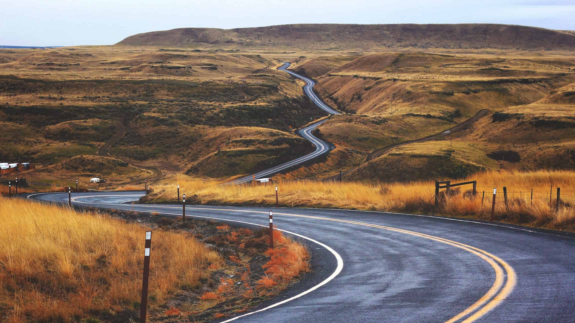
How will God show us his faithfulness in the future?
Notes:
In what ways will we see the goodness of the LORD in the days ahead?

Slide 12

2 Kings 25:1-21
DRESSING
THE
STAGE
MS
N(A)
H
SG
C
ER
B
J
MN
ROYALTY
DS
S - D - S
••• SPLIT •••
E
North South
Israel
Judah
KB
U
10 2
THE SOUTHERN KINGDOM:
JUDAH (586 B.C.)
THE BABYLONIAN EXILE
THE PROPHETS
20-J 20-R
200
350
Assyria
Babylon
MS
PG
RS
Handbook pg. 32-37
51
2
Notes:
Then, in the terrible onslaught of 586 BC, JUDAH, herself,
//// faces the invasion of the BABYLONIANS under King Nebuchadnezzar. All of Jerusalem -- including SOLOMON's great Temple -- is completely destroyed by the Babylonians. This is that second and important specific date to remember…586 B.C.
//// The SOUTHERN KINGDOM OF JUDAH is carried away into the famous Babylonian CAPTIVITY, sometimes called the EXILE.

Slide 13
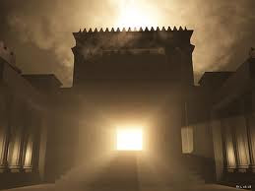
God's Glory Left Solomon's Temple

Slide 14

Solomon's Temple
502
Ezekiel 10:18-19
Notes:
“Then the glory of the Lord moved out from the door of the Temple and hovered above the cherubim. 19 And as I watched, the cherubim flew with their wheels to the east gate of the Lord’s Temple. And the glory of the God of Israel hovered above them” (Ezek 10:18-19 NLT).

Slide 15

The Glory Left
502
656
Ezekiel 11:23
Notes:
“Then the glory of the Lord went up from the city and stopped above the mountain to the east” (Ezek 11:23 NLT).

Slide 16
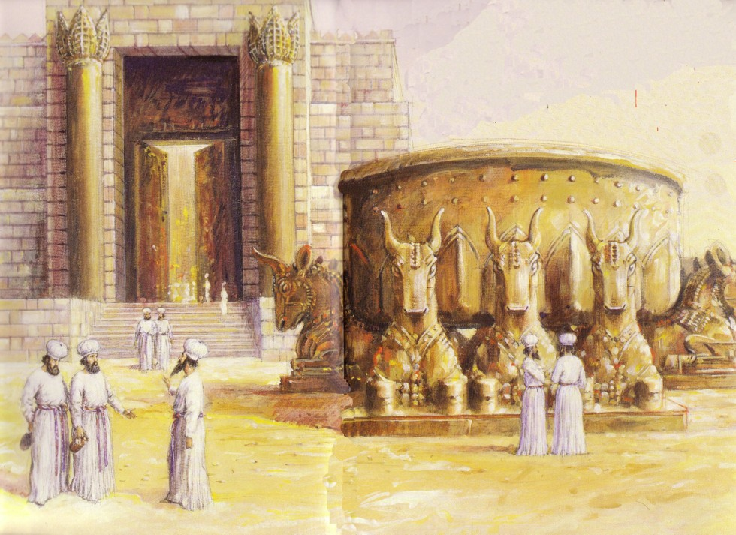
Jews Maintained Holiness at the Basin
586 BC: Temple Destroyed!

Slide 17
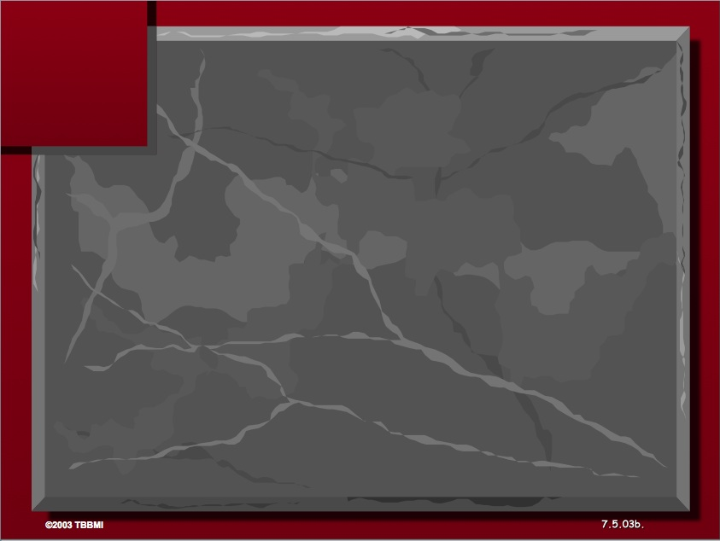
The Elements Expanded
60
7
Abrahamic Covenant
Gen. 12:1-3
LAND SEED BLESSING
ABRAHAM
The CALL
L - S - B
12:1
12:2
12:3
"L-S-B"
Handbook pg. 19-24
15
Notes:
Yet God’s promise to Abraham remained for a place to live for offspring, a king to rule, and blessing with all people.

Slide 18
Deut. 28: Blessings & Curses
Your towns and your fields
will be blessed (3)
Your towns and your fields
will be cursed (16)
Your children and your crops
will be blessed (4)
Your children and your crops
will be cursed (18)
Your fruit baskets and bread-boards will be blessed (5)
Your fruit baskets and bread-boards will be cursed (17)
Wherever you go and whatever you do, you will be blessed (6)
Wherever you go and whatever you do, you will be cursed (19)
Your enemies will attack you from one direction, but they will scatter from you in seven! (7)
You will attack your enemies from one direction, but you will scatter from them in seven! (25)
You will lend to many nations, but you will never need to borrow from them (12)
They will lend to money to you, but you will not lend to them
(44)
Notes:
Around 1400 BC, God warned in Deut 28 not to have any other gods….
The parallels between the individual blessings and cursings are just too obvious!
———————
OS-05-Deuteronomy-242
OS-12-2 Kings-97
OS-14-2 Chron-62

Slide 19
Prophetic Curses
154
220
Why?
Exile
Deut. 28
Notes:
Later in the OT we see justification for God's judgment on Israel. The leaders and the people sinned through ungodliness and idolatry, and true to the curses of Deut. 28, God gave the people the consequences of their obedience by exiling them to Babylon.
———————
OS-05-Deuteronomy-243
OS-12-2 Kings-98

Slide 20
Grace in Exile
256
Jehoiachin
(Jeconiah/Coniah)
597 (ruled 3 mos.)
Shealtiel
Pedaiah
Jekamiah
Nedabiah
Malkiram
Shenazzar
Hoshama
Zerubbabel
1 Chronicles 3:17-19
Notes:
His promise to David of his line forever was still valid through their king living among them.
Even though the king was in exile, he wasn't in prison by himself! Judah's King Jehoiachin fathered SEVEN sons! God was preserving the line of David, just as he said he would until that line came to Jesus.
______
1Chr. 3:16 The successors of Jehoiakim were his son Jehoiachin and his brother Zedekiah.ª
Descendants of Jehoiachin
1Chr. 3:17 The sons of Jehoiachin,ª who was taken prisoner by the Babylonians, were Shealtiel, 18 Malkiram, Pedaiah, Shenazzar, Jekamiah, Hoshama, and Nedabiah.
1Chr. 3:19 The sons of Pedaiah were Zerubbabel and Shimei.
The sons of Zerubbabel were Meshullam and Hananiah. (Their sister was Shelomith.) 20 His five other sons were Hashubah, Ohel, Berekiah, Hasadiah, and Jushab-hesed.
1Chr. 3:21 The sons of Hananiah were Pelatiah and Jeshaiah. Jeshaiah’s son was Rephaiah. Rephaiah’s son was Arnan. Arnan’s son was Obadiah. Obadiah’s son was Shecaniah.
1Chr. 3:22 The descendants of Shecaniah were Shemaiah and his sons, Hattush, Igal, Bariah, Neariah, and Shaphat—six in all.
1Chr. 3:23 The sons of Neariah were Elioenai, Hizkiah, and Azrikam—three in all.
1Chr. 3:24 The sons of Elioenai were Hodaviah, Eliashib, Pelaiah, Akkub, Johanan, Delaiah, and Anani—seven in all.
_____
OS-12-2Kings-231
OS-14-2Chron-82

Slide 21

The Lineage of
Jehoiachin/ Jeconiah/
Coniah
(1 Chron 3:17-24)
Jehoiachin
Pedaiah
+ 6 brothers
Zerubbabel
+ 1 brother (Shimei)
Hananiah
+ 6 brothers + 1 sister
Shecaniah
+ 5 brothers
Shemaiah
+ 0 brothers
Neariah
+ 5 brothers
Elioenai
+ 2 brothers
Hodaviah
+ 6 brothers
Notes:
This Davidic line actually is recorded in 1 Chronicles for nine generations to the end of OT history. God promised David an eternal dynasty never to be wiped out, so we see if continue here until Matthew 1 and Luke 3 continue it further to Jesus.
_____
It is difficult to tell if 3:21 mentions Hananiah’s 6 sons (Shecaniah + 5 brothers) or whether these 6 men were descendants in 6 generations. As Chronicles ends around 440-400 BC and the above has 9 generations (9 x 25 years old at son’s birth=175 years), this would already bring the account from Jehoiachin’s exile in 597 to around 422 BC (597 – 175 = 422 BC). Adding another 5 generations would bring the genealogy to about 300 BC. This is possible but unlikely and would be problematic to reconcile with the other Bible genealogies.
———————
“2. DESCENDANTS OF SOLOMON (3:10-24)
3:10-24. This list of Solomon’s descendants is in effect a list of Judah’s kings from Solomon through Zedekiah (vv. 10-16) and their exilic and postexilic continuation (vv. 17-24). Athaliah, the queen who ruled between Ahaziah and Joash, is not mentioned (v. 11). That is because she was only a political usurper and was not in the true dynastic succession (cf. 2 Kings 11). Of the sons of Josiah, Johanan (1 Chron. 3:15) is otherwise unknown. He cannot be Jehoahaz (2 Kings 23:31) because Jehoahaz was [Vol. 1, p. 595] younger than Jehoiakim (cf. 2 Kings 23:36). This means that Shallum (1 Chron. 3:15) is identical to Jehoahaz who, though the next-to-youngest son of Josiah, preceded his brothers on the throne (cf. Jer. 22:11-12).
The remainder of the succession followed by the chronicler is Jeconiah (Heb.; cf. NIV marg. of 1 Chron. 3:16; also known as Jehoiachin; cf. v. 17 and 2 Kings 24:8, and Coniah, Jer. 22:24, marg.). Then came Pedaiah (1 Chron. 3:18), Zerubbabel (v. 19), Hananiah (v. 19), Shecaniah (v. 21), Shemaiah (v. 22), Elioenai (v. 23), and Hodaviah (v. 24).
Three difficulties here must be addressed. First, Zerubbabel (v. 19) is elsewhere called the son of Shealtiel, not the son of Pedaiah (Ezra 3:2, 8; 5:2; Neh. 12:1; Hag. 1:12, 14; 2:2, 23; Matt. 1:12; Luke 3:27). Since Shealtiel and Pedaiah were brothers (1 Chron. 3:17-18) the best solution seems to be that Shealtiel died early on and his role of dynastic succession was assumed by his younger brother Pedaiah. The second problem concerns Luke’s account of the genealogy in which he identifies Shealtiel as the son of Neri, whose descent is not from Solomon but from David’s son Nathan (Luke 3:27-31). The answer may lie in the possibility that since Jeconiah had no male heir to sit on the throne (cf. Jer. 22:30), a daughter of Jeconiah married Neri, son of Melki (Luke 3:27-28; not the Melki of Luke 3:24), of the line of Nathan. Legally Shealtiel, as grandson of Jeconiah, would continue the Davidic dynasty through Solomon, a viewpoint espoused by Matthew (Matt. 1:6-12).
The third conflict appears in Zerubbabel’s line. The chronicler lists Zerubbabel’s seven sons and one daughter (1 Chron. 3:19b-20). But none of them is mentioned in the genealogies of either Matthew or Luke. Matthew, who traces Jesus’ descent from David through Solomon, wrote that the son of Zerubbabel was Abiud (Matt. 1:13). Luke, viewing it through Nathan, said Rhesa was that son (Luke 3:27). It is entirely possible, of course, that the Shealtiel and Zerubbabel of Luke are not the same as those of 1 Chronicles and that Luke preserves a genealogy of Mary straight from David through Nathan, a line of succession that has no other connection with the chronicler’s genealogy (cf. comments on Luke 3:27). This would preclude the suggested solution to the second problem previously mentioned (and would, in fact, eliminate the problem altogether). This still leaves the variance between 1 Chronicles 3:19b-20 and Matthew 1:13. One may conjecture that Abiud is another name for one of the seven sons of Zerubbabel listed in Chronicles or that his name is missing from that list to begin with. That such a thing is possible may be seen in 1 Chronicles 3:22 where the historian wrote that Shemaiah had six sons but listed only five names” (Eugene Merrill, “1 Chronicles,” in The Bible Knowledge Commentary [Wheaton, IL: Victor, 1985], 1:594-95).

Slide 22
God's Future Plan
OT Survey page 437
Great White
Throne
(Rev 20:11-14)
Rapture
(1 Thess 4:13-18)
2nd Advent
(Zech 14:3-5)
Day of the LORD
Church Age
Tribulation
(Zech 14:1-2)
Millennium
(Zech 14:6-21)
Gog & Magog
(Armageddon)
(Ezek 38–39)
Gog and Magog
Revisited
(Rev 20:7-10)
Notes:
22
Most of us have heard a lot about the various periods ahead but the one least studied is the Millennium.
________
OS-23-Isaiah 1-12-Slide 87
OS-26-Ezekiel 1-39-Slide 247
OS-29-Joel-87
OS-31-Obadiah-142
OS-39-Zechariah-158, 168, 184
NS-22-Rev20-22

Slide 23
How will God show us his faithfulness in the future?
3 ways
Notes:
Ezekiel 40–48 addresses that middle era between our present age and the eternal state. In this period, God will show his faithfulness once again.

Slide 24
Ezekiel 40–48
God's Future Faithfulness
God will live with us again
(40–43)
Notes:
(What is the first way we will see God’s faithfulness in the future?)
I. God will live with us again (Ezek 40–43).
[His people will experience his presence on earth.]
The millennial temple will be filled with God's glory (Ezek 40–43).

Slide 25
Slides on
Ezekiel 40

Slide 26
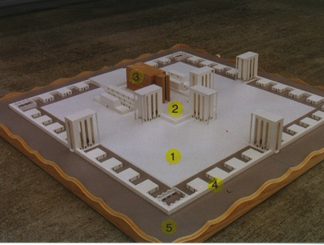
The Five Sections
517
1. Outer Court - 40:17-19
2. Inner Court - 40:44-47
3. The Temple or Sanctuary - 41:1-26
4. Wall around the outside of the temple - 40:5 (42:15-20; 45:2)
5. Fifty cubits of open space - 45:2
www.pauljab.net/temple/ TemplePictures.html
Notes:
Ezekiel's temple will be like the first two temples in that it will be surrounded by both inner and outer courts, although the height of the gates is not given and thus is left to the imagination.

Slide 27
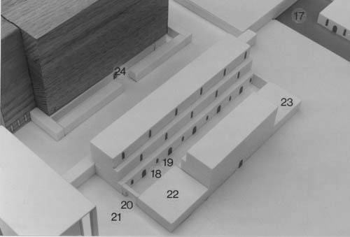
Rooms Next to the Temple
"The room beside the south inner gate is for the priests in charge of the altar—the descendants of Zadok—for they alone of all the Levites may approach the LORD to minister to him"
(Ezek 40:46 NLT).

Slide 28
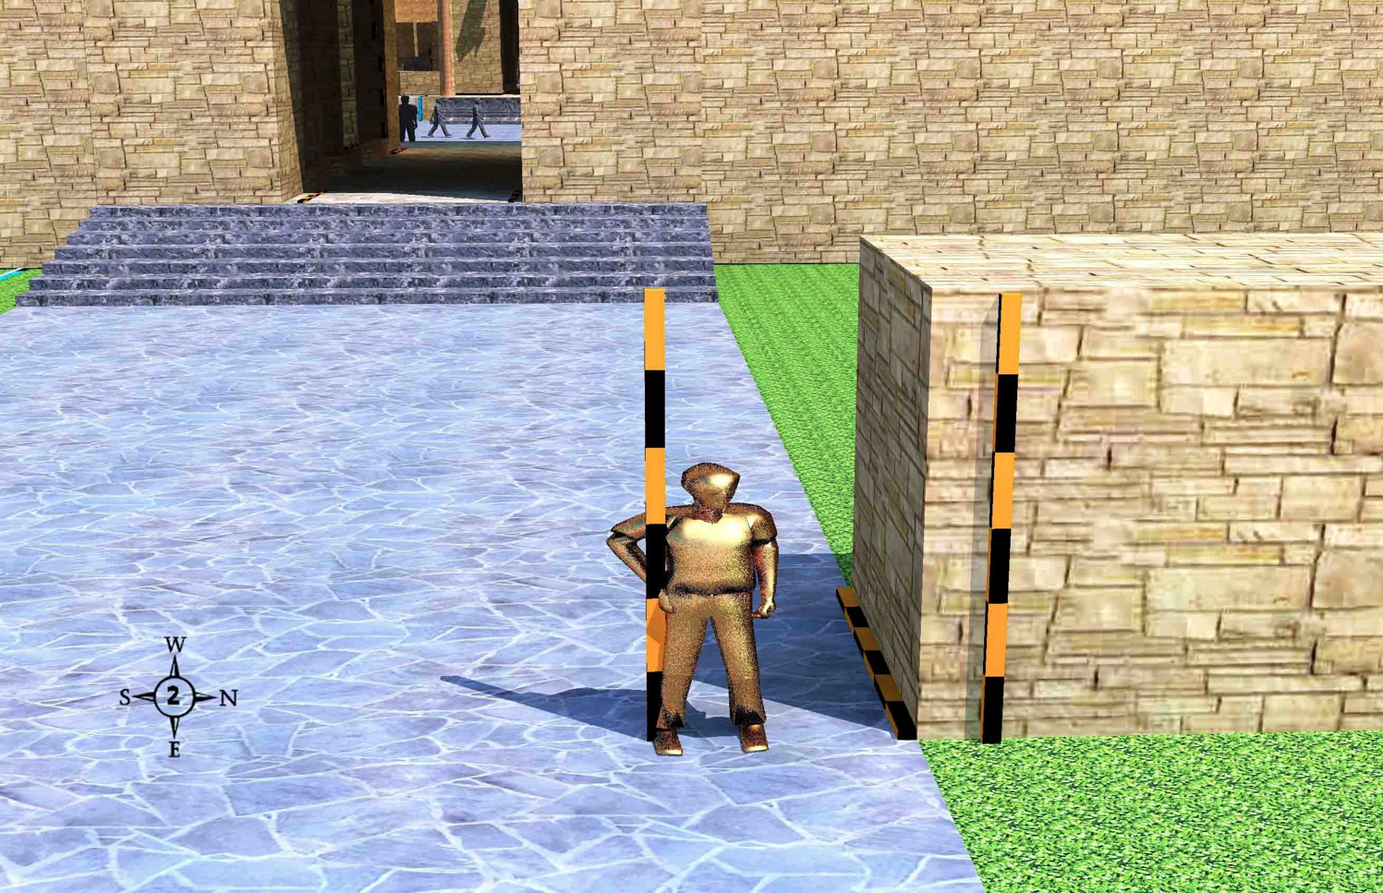
The Outer East Gate (40:3-12)
519
An angel with a measuring rod and a flax cord by the border wall outside the outer east gate
Wayne ODonnell • "Ezekiel 40–48: Tour of Ezekiel's Temple" • http://bible.ag/en/enezekieltranscript.htm
Notes:
"Ezekiel 40:3-12. The Outer East Gate
See Picture #2. An angel with a measuring rod and a flax cord standing by the border wall outside the outer east gate.
After seeing the mountain, the next thing Ezekiel saw as he got close to the temple compound was an angel standing by a wall. Ezekiel 40:3-5, "He brought me thither, and, behold, there was a man, whose appearance was like the appearance of brass." That means he was an angel. He looked like a man, but he was shining brightly. Most angels don't have wings, or they wouldn't look like men. Only cherubim and seraphim have wings.
He had, "a line of flax in his hand," which was for measuring long distances, "and a measuring reed," which was for measuring short distances. "And he stood in the gate, ... and behold a wall on the outside of the house round about, and in the man's hand a measuring reed of six cubits long by the cubit and an hand breadth." There were three kinds of cubits in Israel during that time, a short, medium, and a long cubit. The short cubit was about 15", the medium cubit was a short cubit plus one handbreadth, or about 18", and the long cubit was a medium cubit plus one handbreadth, or about 21". If the medium cubit was the most commonly-used cubit, then the measuring stick the angel had was probably of long cubits, which was the medium cubit "and an hand breadth," Ez40:5. So to get a general idea how long things are as we go through this tour, just multiply the cubits by 2; each long cubit equals almost two feet.
Ezekiel 40:5, "So he measured the breadth of the building, one reed," see the 6-cubit rod lying on the ground, "and the height one reed," see the vertical 6-cubit rod against the front of the wall. 'Building' in verse 5 means something built, including a wall. It doesn't have to have a room and a roof."
Wayne ODonnell, "Ezekiel 40–48: Tour of Ezekiel's Temple"
http://bible.ag/en/mr4web.html#EZanchor-anchor
Recorded December 30, 2007
Accessed 30 Aug 2016

Slide 29
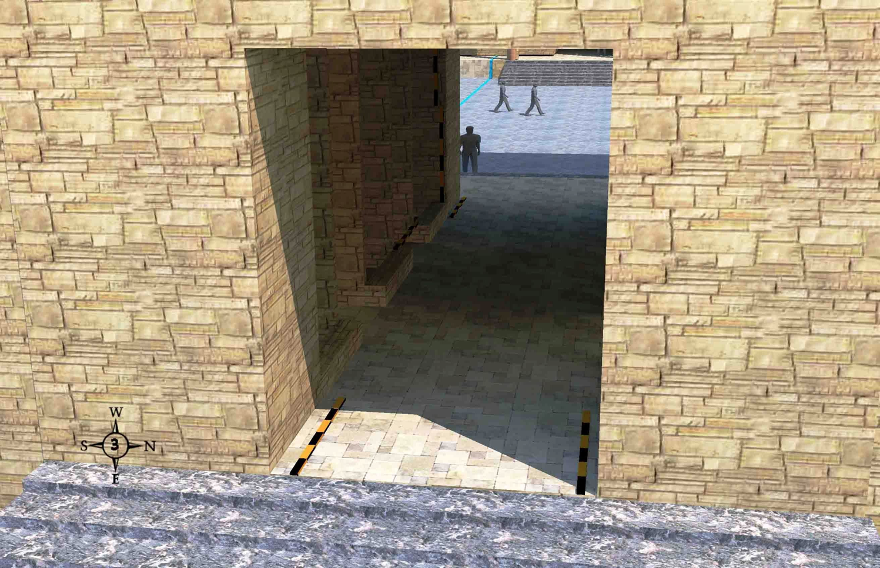
Threshold of the Outer East Gate
(Ezekiel 40:6)
519
Outside the temple, approaching from the east, and facing west, 7 stairs lead up to the gate, but not all are visible at the bottom of the picture.
Wayne ODonnell • "Ezekiel 40–48: Tour of Ezekiel's Temple" • http://bible.ag/en/enezekieltranscript.htm
Notes:
"See Picture #3. The threshold of the outer east gate. We are outside the temple compound, approaching it from the east, and facing west. There are 7 stairs leading up to the gate, though they are not all visible at the bottom of the picture.
The angel moves from the low border wall to the outer east gate of the temple compound. "Then came he unto the gate which looketh toward the east, and went up the stairs thereof, and measured the threshold of the gate, which was one reed broad; and the other threshold of the gate, which was one reed broad," Ez40:6. Although 40:3 said that "he stood in the gate," he must have been standing at the low wall just outside the gate that we just looked at, because only now the angel "came" to the gate "and went up the stairs." Notice there are stairs, but no porch, here on the outside of the gate.
I interpreted "the other threshold" to mean 'the other side of the threshold' (like in Ez:40:48), as you see from the measuring rods in the picture."
Wayne ODonnell, "Ezekiel 40–48: Tour of Ezekiel's Temple"
http://bible.ag/en/mr4web.html#EZanchor-anchor
Recorded December 30, 2007
Accessed 30 Aug 2016

Slide 30
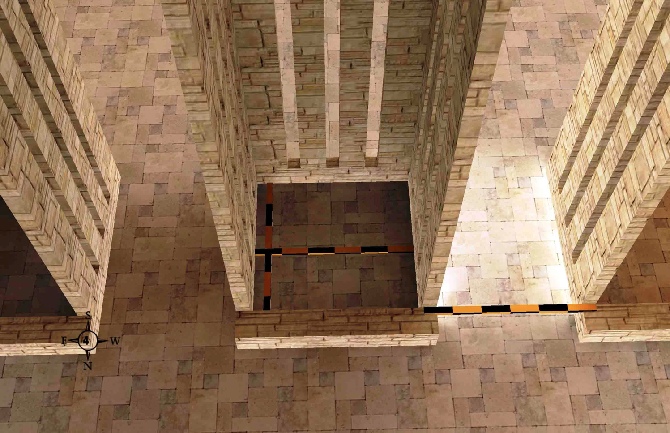
The Guardrooms (40:7)
519
Wayne ODonnell • "Ezekiel 40–48: Tour of Ezekiel's Temple" • http://bible.ag/en/enezekieltranscript.htm
Text
Notes:
"See Picture #4. 6x6 cubit guardrooms with 5 cubit spaces between them inside the outer east gate.
Inside the gate, the angel measures some small rooms. Ezekiel 40:7, "Every little chamber was one reed long, and one reed broad." So the inside dimensions of each chamber are six cubits long and six cubits broad, as shown by the crossed measuring rods in the picture. These are probably guard rooms, because when you have a lot of people in an area, you need to keep things orderly.
"And between the little chambers were five cubits." The five cubit spaces between the chambers are probably so you can exit the gate onto the pavement along the sides of the gate without necessarily going all the way through the gate. As you can see from the rod in the picture, if you include the half cubit walls on each side of the space between the guardrooms, the total is 6 cubits; but not counting the thickness of the walls, the side passageways are 5 cubits wide."
Wayne ODonnell, "Ezekiel 40–48: Tour of Ezekiel's Temple"
http://bible.ag/en/mr4web.html#EZanchor-anchor
Recorded December 30, 2007
Accessed 30 Aug 2016

Slide 31
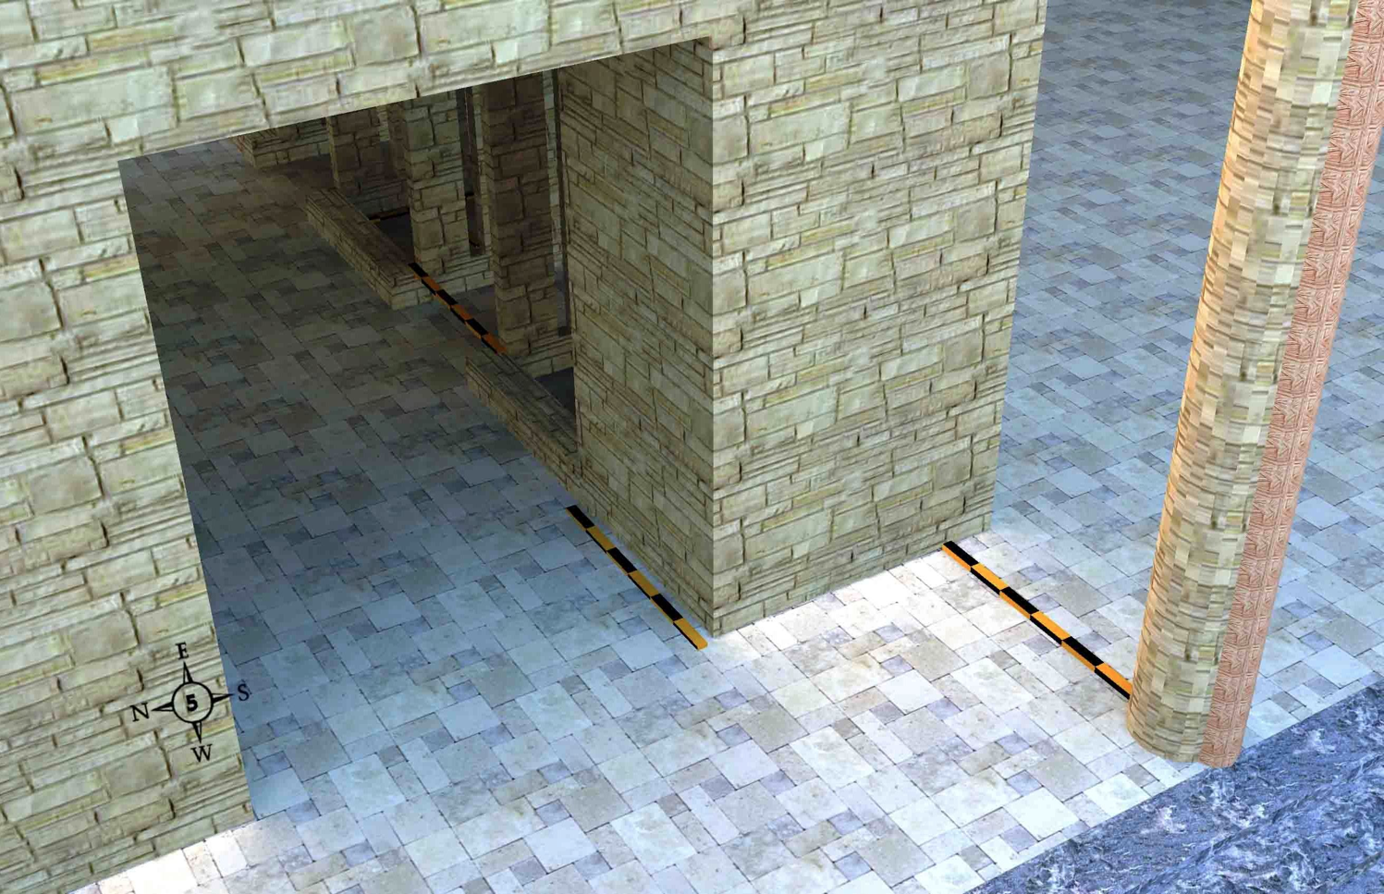
The Inner Threshold (40:7-9)
519
The inner threshold, porch, and one of the two posts on the temple compound side of the outer east gate
Wayne ODonnell • "Ezekiel 40–48: Tour of Ezekiel's Temple" • http://bible.ag/en/enezekieltranscript.htm
Notes:
"See Picture #5. The inner threshold, porch, and one of the two posts on the temple compound side of the outer east gate. We are inside the temple compound and facing southeast.
Proceeding on through the outer east gate, in Ezekiel 40:7-9, the angel measures the porch and threshold "within," meaning towards the inside of the temple compound. "The threshold of the gate by the porch of the gate within was one reed. He measured also the porch of the gate within, one reed. Then measured he the porch of the gate, eight cubits; and the posts thereof, two cubits." The picture shows a two cubit post. You add on one reed, six cubits, for the porch; so the total breadth of the porch is eight cubits.
"And the porch of the gate was inward." The gate has only one porch, and it is on the inside end of the gateway, the part that is towards the center of the temple compound. Remember that when we first approached the gate, there was no porch at the outside doorway.
Just a word of warning here so you don't get confused later: although this porch is on the inside end of the gate, when you step down from this porch, you are in the 'outer' court, because there is another courtyard at the very center of the temple compound called the 'inner' court. So remember that the outer courtyard is still inside the temple compound. We had to come through this outer gate to get into the outer courtyard."
Wayne ODonnell, "Ezekiel 40–48: Tour of Ezekiel's Temple"
http://bible.ag/en/mr4web.html#EZanchor-anchor
Recorded December 30, 2007
Accessed 30 Aug 2016

Slide 32
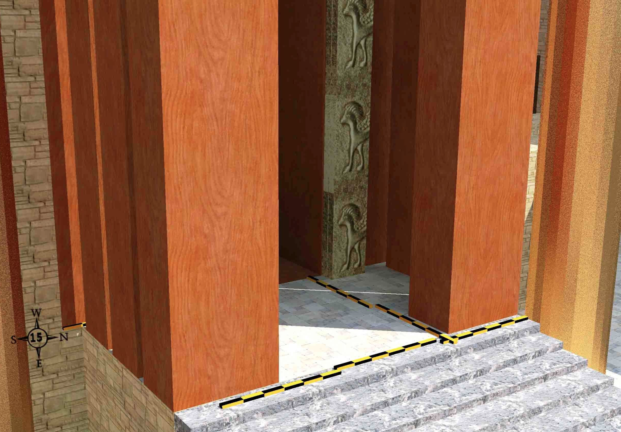
The Temple Porch (40:48-49)
519
Wayne ODonnell • "Ezekiel 40–48: Tour of Ezekiel's Temple" • http://bible.ag/en/enezekieltranscript.htm
Notes:
"Ezekiel 41. The Temple
See Picture #15. The temple porch.
Ezekiel 40:48-49, "And he brought me to the porch of the house, and measured each post of the porch, five cubits on this side, and five cubits on that side: and the breadth of the gate was three cubits on this side, and three cubits on that side. The length of the porch was twenty cubits, and the breadth eleven cubits, and he brought me by the steps whereby they went up to it: and there were pillars by the posts, one on this side, and another on that side." Verse 48 should start a new chapter, because Ezekiel begins talking about the temple in that verse.
In the picture, you can see from the measuring rods, that the rectangular posts on each side of the porch are 5 cubits by 3 cubits. The length of the porch is 20 cubits across the front of the temple. 'Length' is always the long measurement for any particular area under consideration, no matter which direction it faces. And the breadth, the shorter measurement of the porch, is 11 cubits deep. And there is one large, special pillar beside the porch on each side."
Wayne ODonnell, "Ezekiel 40–48: Tour of Ezekiel's Temple"
http://bible.ag/en/mr4web.html#EZanchor-anchor
Recorded December 30, 2007
Accessed 30 Aug 2016

Slide 33
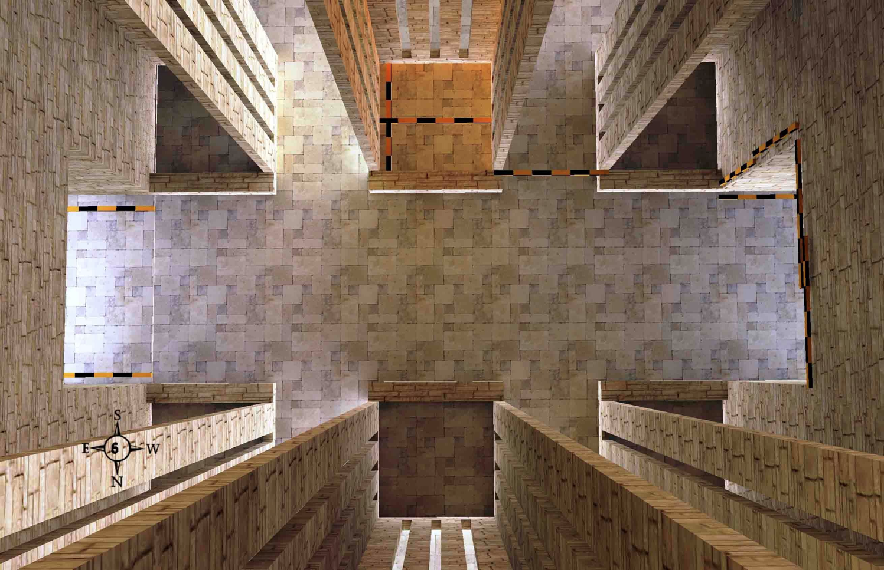
Five Problems with Non-Literal Views
522
Difficulty: Symbolism is impossible to determine without indicators in the text
Inconsistency: Seeing 6x6 as church stability means 5x6 is church instability
Inefficiency: Why say the church is stable over and over?
Uncertainty: Does "many chambers" mean "many mansions" (John 14:1) or churches?
Partiality: If "5 cubits" = "5 covenants" then why not 6 separate 6x6 chambers equals Antichrist (cf. Rev. 13:18)?
Wayne ODonnell • "Ezekiel 40–48: Tour of Ezekiel's Temple" • http://bible.ag/en/enezekieltranscript.htm
Notes:
"Problems with Non-Literal Interpretations
I want to pause, now, to consider some principles of Biblical interpretation. I believe that the literal method is the correct method of interpretation, and that it is incorrect to use a symbolical method of interpretation. I want to present five problems with the non-literal, symbolical, or spiritualizing, method of interpretation; and I will use some quotes from Matthew Henry's Concise Commentary and a quote from Dr. Peter Pett, whose writings I found on the internet, to illustrate these problems.
1. Difficulty: The first problem is difficulty. Matthew Henry says, "Here is a vision beginning at chapter 40 which is justly looked upon to be one of the most difficult portions in all the book of God." Yes, Matthew Henry and all interpreters who use the symbolic approach have great difficulty with chapters 40 through 48 of Ezekiel. It causes them a lot of pain, because it is very difficult to give symbolic meaning to all these cubits.
Now if you use the literal method, the interpretation is quite easy. The 6x6 room, as shown in the picture above, represents a 6x6 room. And this should be easier than, say, Romans or Ephesians, but not for people who approach this passage symbolically. Their problem is that they are using the wrong approach, and they are using the wrong approach because their doctrinal biases don't allow them to believe that God could have a temple in store for Israel in the future.
2. Inconsistency: The second problem is inconsistency. Matthew Henry says, "The chambers, as they were each of them foursquare, denoting their stability." So, he says that because the chamber is 6x6, it is less likely to fall over, and therefore it denotes the stability of the Church. Well, he is being inconsistent, because right next to each 6x6 room, we have a 5x6 area, called the "space between the chambers," as shown above, and he doesn't say those non-square areas denote the instability of the Church, for good reason.
3. Inefficiency: Matthew Henry's interpretation is also inefficient, because if the first 6x6 chamber means the church is stable, then the second one means the church is stable, the third one means the church is stable, the fourth one means the church is stable, the fifth one means the church is stable, and the sixth one means the church is stable. And there are five more gates we have yet to go through, each with six 6x6 rooms. And every other square area of the temple compound means the same thing. So it is very inefficient, because God could have said it in a much simpler way. Ezekiel could have just written, "I saw the temple, and it was foursquare," and then we would know the Church is stable. Or God could have just said, "The Church is stable." But the scribes through all the years have copied this, and people have been memorizing these chapters, and all these cubits would really be unnecessary here if it was just teaching that the Church is stable.
4. Uncertainty: The fourth problem is uncertainty. Matthew Henry says, "The chambers were very many." I'm not sure 6 is very many, or even counting the other 5 gates, I'm not sure 36 is very many. But Matthew Henry says, "For in our Father's house there are many mansions." I hope there's more than 36. Then he says, "Some make these chambers to represent the particular congregations of believers which are parts of the great temple, the universal Church." So some non-literal interpreters think that these chambers represent separate congregations on earth. I hope there's more than 36 of these, too.
But Matthew Henry has a problem. His problem is that he likes his own interpretation, about the rooms in heaven, but he also really likes this other interpretation about particular congregations of believers on earth, and he can't decide which is right. And that is the problem with symbolic interpretation; nobody knows who is right. We can come up with another hundred possible meanings for what these chambers might represent, and no one would ever know which interpretation was right.
You can basically make a passage mean anything you want it to mean if you use symbolic interpretation. And if something can mean anything, then it really means nothing. Now, the Bible does use symbolism sometimes, but it explains the symbolism it uses. It doesn't make us resort to guesswork.
5. Partiality: The fifth problem is partiality. Dr. Peter Pett says, "Five cubits," and he is referring to those five cubits in the spaces between the guard rooms. "Five is the number of covenant. It is, thus, prominent in this heavenly temple. There were five fingers to the hand with which covenants were confirmed." So Peter is very into covenants, and so this five cubit length attracted his attention. But that is the problem with symbolic interpretation. No person who uses the symbolic method is capable of giving meaning to all the cubits in the temple compound, so they only give meaning to some that catch their fancy. But a person who uses a literal method of interpretation has no problem using all the cubits, because if you leave any out, the building has gaps.
And Peter is convinced that 5 is the number of covenant. I'm not convinced of that, but I am convinced that the Bible teaches that 6 is the number of man. And Peter failed to point out that there are six 6x6 chambers in each gateway. In picture #6, there are three 6 cubit long areas on one side of the gateway passage, 6, 6, 6, which we know is the number of Antichrist; and there are three 6 cubit long areas on the other side of the passage. So with the Antichrist on both sides of all the entrances to the temple, does that mean the temple is a trap? Obviously, I'm being sarcastic, but these are the kinds of inconsistencies and problems we get into if we don't interpret the Word of God literally."
Wayne ODonnell, "Ezekiel 40–48: Tour of Ezekiel's Temple"
http://bible.ag/en/mr4web.html#EZanchor-anchor
Recorded December 30, 2007
Accessed 30 Aug 2016

Slide 34
Slides on
Ezekiel 41

Slide 35
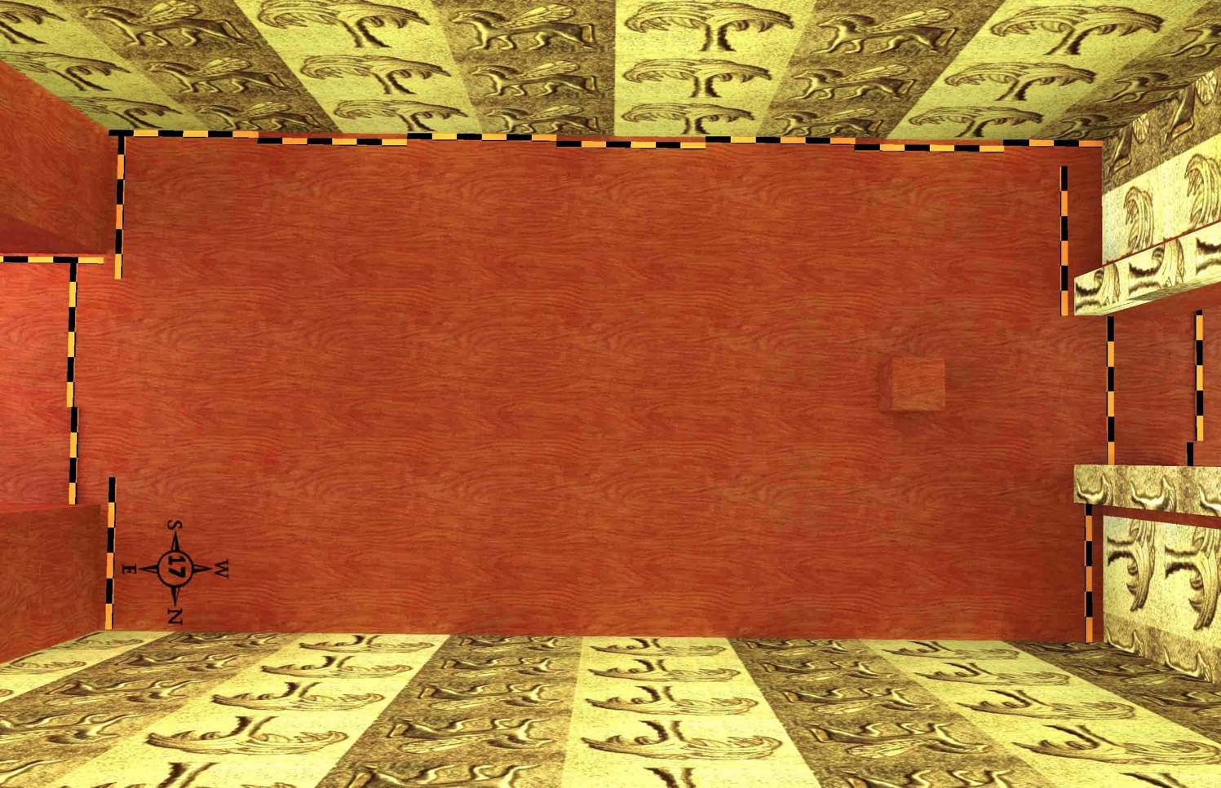
The Holy Place (41:2b)
519
The 20x40 cubit temple room from above
Wayne ODonnell • "Ezekiel 40–48: Tour of Ezekiel's Temple" • http://bible.ag/en/enezekieltranscript.htm
Notes:
"See Picture #17. Looking down on the 20 x 40 cubit holy place in the temple.
"And he measured the length thereof, forty cubits: and the breadth, twenty cubits," Ez41:2b. The whole room of the holy place is two 20 x 20 cubit square areas; in other words, 40 cubits by 20 cubits."
Wayne ODonnell, "Ezekiel 40–48: Tour of Ezekiel's Temple"
http://bible.ag/en/mr4web.html#EZanchor-anchor
Recorded December 30, 2007
Accessed 30 Aug 2016

Slide 36
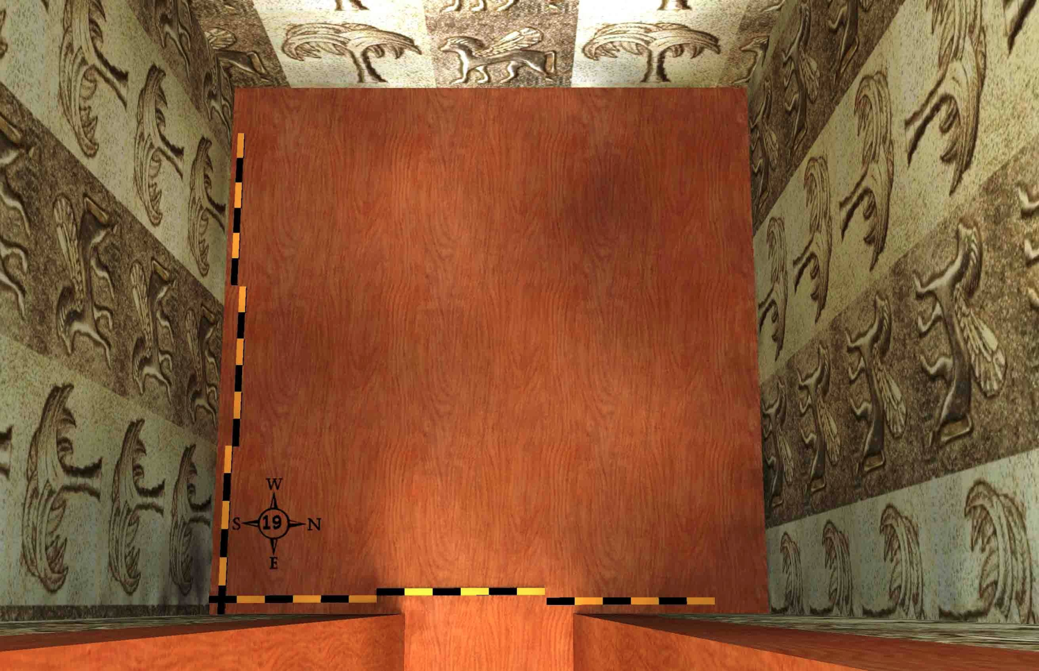
The Most Holy Place (41:4)
519
The 20x20 cubit sacred room from above
Wayne ODonnell • "Ezekiel 40–48: Tour of Ezekiel's Temple" • http://bible.ag/en/enezekieltranscript.htm
Notes:
"See Picture #19. The most holy place.
"So he measured the length thereof, twenty cubits; and the breadth, twenty cubits, before the temple: and he said unto me, This is the most holy place," Ez41:4. Inside the most holy place, the length is 20 cubits and the breadth 20 cubits."
Wayne ODonnell, "Ezekiel 40–48: Tour of Ezekiel's Temple"
http://bible.ag/en/mr4web.html#EZanchor-anchor
Recorded December 30, 2007
Accessed 30 Aug 2016

Slide 37
Slides on
Ezekiel 42

Slide 38
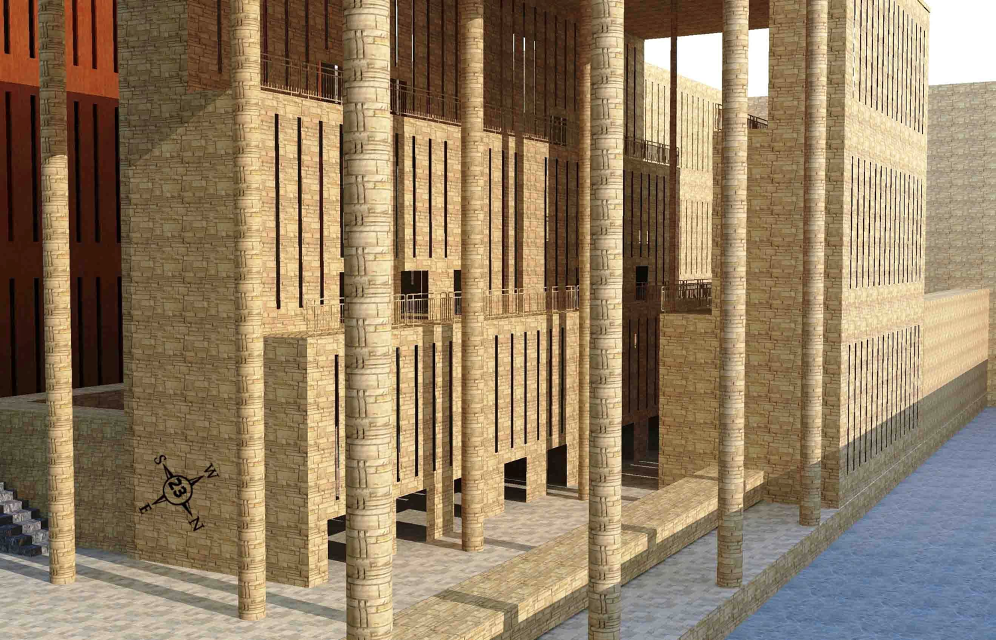
3-Tiered Priest Chambers &
Overall Dimensions (42:7-8, 13-14)
519
A 50-cubit 3-tiered building and a 100-cubit 3-tiered building of priests' chambers face each other with a walkway between them. These northern ones on the west side of the inner north gate are between the outer court and the separate place of the temple.
Wayne ODonnell • "Ezekiel 40–48: Tour of Ezekiel's Temple" • http://bible.ag/en/enezekieltranscript.htm
Notes:
"Ezekiel 42. 3-Tiered Priests' Chambers & Overall Dimensions
See Picture #23. A 50-cubit 3-tiered building and a 100-cubit 3-tiered building of priests' chambers facing each other with a walkway between them. These in the picture are the northern ones on the west side of the inner north gate between the outer court and the separate place of the temple.
Ezekiel 42:7-8, "The wall that was without over against the chambers, toward the utter [outer] court on the forepart of the chambers, the length thereof was fifty cubits. For the length of the chambers that were in the utter [outer] court was fifty cubits: and, lo, before the temple were an hundred cubits." In picture 23, we are looking at two buildings on the upper pavement on the west side of the inner north gate. The two buildings are not the same length. The one "toward the utter [outer] court" is only 50 cubits long, while the one along the separate place "before the temple" is 100 cubits long.
Ezekiel 42:13-14, "Then said he unto me, The north chambers and the south chambers," there is a mirror image of them on the west side of the inner south gate also, "which are before the separate place, they be holy chambers, where the priests that approach unto the LORD shall eat the most holy things ... When the priests enter therein, then shall they not go out of the holy place into the utter [outer] court, but there they shall lay their garments wherein they minister; for they are holy; and shall put on other garments, and shall approach to those things which are for the people." So we have some locker rooms for the priests here. They have to leave their holy clothes in the inner court area, and put on other clothes, before going out to the people in the outer court.
Perhaps the 50-cubit long building by the outer court, in picture #23, should be slid to the left (east), in my model, since the purpose of these buildings is to separate the priests from the people, rather than to provide space for interaction between the priests and the people.
After the angel measures the 3-tiered priest's chambers on the upper pavement, he takes Ezekiel outside the outer eastern gate, the one by which he had first entered the temple compound. This is Ezekiel's first time out of the temple compound since he started the tour. And the reason the angel now takes him outside, is that he had finished measuring the inside. There are still a few details that will be measured, in relation to sacrifices, but he is done measuring all the temple compound buildings. "Now when he had made an end of measuring the inner house, he brought me forth toward the gate whose prospect is toward the east, and measured it round about," Ez42:15.
What does Ezekiel mean by saying the angel measured "it round about?" If he means the gate and the wall the gate goes through, the wall of the temple compound, then we know from adding the internal measurements, as we did in pictures #14 and #22, that the wall of the temple compound is 500 cubits square. But while some versions, like the NIV, which follow the Greek Septuagint translation, use the word "cubits" in the following verses; the KJV and ASV, follow the Masoretic Hebrew text, and use the word "rods" in the following verses.
"He measured the east side with the measuring reed, five hundred reeds [unit of measure omitted, Septuagint], with the measuring reed round about. He measured the north side, five hundred reeds [cubits, Septuagint] ... the south side, five hundred reeds [unit of measure omitted, Septuagint] ... the west side ... five hundred reeds [cubits, Septuagint] ... it had a wall round about, five hundred reeds [unit of measure added by translators] long, and five hundred broad, to make a separation between the sanctuary and the profane place," Ez42:16-20. Five hundred reeds would be 3,000 cubits, since the angel's measuring reed is six cubits long (Ez40:5). So if the angel is measuring a 3,000 cubit wall, he must be measuring another wall out around the temple compound, rather than measuring the outside of the temple compound itself.
However, if the angel is not providing the overall dimensions of the temple compound here, then it is not provided anywhere; and the normal pattern in the book is to give the detailed dimensions, and then provide the overall dimensions.
For example, in Ezekiel 40:6-12, we learned the detailed measurements of the parts of the outer east gate: outer threshold, 6; guardrooms and spaces between, 6+5+6+5+6; inner threshold, 6; porch, 6; and porch pillars, 2; equals 48 cubits long. Then in verse 13, we learned the overall length of 50 cubits, and could thereby determine that the 4 walls of the guardrooms along the spaces are each 1/2 cubit thick to total 50 cubits.
And in Ezekiel 40:48 - 41:12, we learned the detailed measurements of the temple: porch, 11; door posts, and front temple wall, 6; holy place, 40; most holy place, 20; back temple wall, 6; side chambers, 4; walkway, 5; wall around side chambers, 5; equals 97 cubits. Then in verse 13, we learned the overall length of the temple is 100 cubits, and could thereby determine that the wall between the holy place and the most holy place is 3 cubits thick.
Also, although we haven't covered it yet, Ezekiel gives the detailed dimensions of the parts of the holy district in 48:9-19, and then gives the overall dimensions in 48:20. So, it would make sense, after having given us all the details of the interior of the temple compound, that he would then also confirm the overall measurement to be 500 cubits all around.
It is commonly agreed, that there is at least one scribal error in the Hebrew in this passage. In the Hebrew, verse 16 says, "He measured the east side with the measuring reed, five cubit reeds." It looks like a scribe accidentally wrote the word "emot," meaning "cubit," in place of "meot," meaning "hundred." It's probably a scribal error, and not an indication that the angel now started to use a 5-cubit rod instead of a 6-cubit rod, because then we would have no length provided for the east side, even though the north, south, and west sides were said to be 500 reeds.
Perhaps a scribe copied the word "reeds" from the marginal notes of a manuscript, into the Hebrew text, in verses 16 through 19. If the word "reeds" was not in the original, verse 16 would read, "He measured the east side with the measuring reed; five hundred with the measuring reed round about." Then the interpretation would be that the angel measured 500 cubits, but with the emphasis that he used the long-cubit reed, and not, as might be supposed since the measurement is long, the flax line, which could possibly be in regular-length cubits.
It would seem most straightforward and simple, to assume that when the angel finished measuring the interior of the temple compound, and exited it via the outer east gate, and measured "it all around," vs. 15, that he measured the outside of the temple compound, especially since the measurement came out to 500 x 500, which is the overall size of the temple compound, and especially since that overall measurement is provided nowhere else in the book.
However, while it might be understandable that a scribe could write "emot" for "meot," it is not as likely a scribe would have added the word "reeds" four times in verses 16 to 19. Nevertheless, there are additional difficulties with the idea of a 500 reed wall, as we will see later.
The Hebrew text is to be preferred over the Septuagint translation whenever possible, because God not only inspired the words of the scriptures, but also preserved them to every generation. "The words of the LORD are pure words, ... O LORD, thou shalt preserve them from this generation for ever," Ps12:6-7. The Holy Spirit didn't just inspire and preserve, the 'ideas' of scripture, but the very words. "Not in the words which man's wisdom teacheth, but [in the words] which the Holy Ghost teacheth," 1Cor2:13.
That's also why it's not possible that the New Testament was originally written in Hebrew, as some of our beloved Messianic Jewish brethren suggest. It just seems that way, because the writers were Jewish, and thought in Aramaic, but they wrote in Greek. The New Testament couldn't have been written in Hebrew, because there are no Hebrew New Testament manuscripts, except for some late medieval works of the Gospel of Matthew, that may have been translated from Greek to Hebrew for the benefit of Jewish people, as our Messianic Jewish brethren do today."
Wayne ODonnell, "Ezekiel 40–48: Tour of Ezekiel's Temple"
http://bible.ag/en/mr4web.html#EZanchor-anchor
Recorded December 30, 2007
Accessed 30 Aug 2016

Slide 39
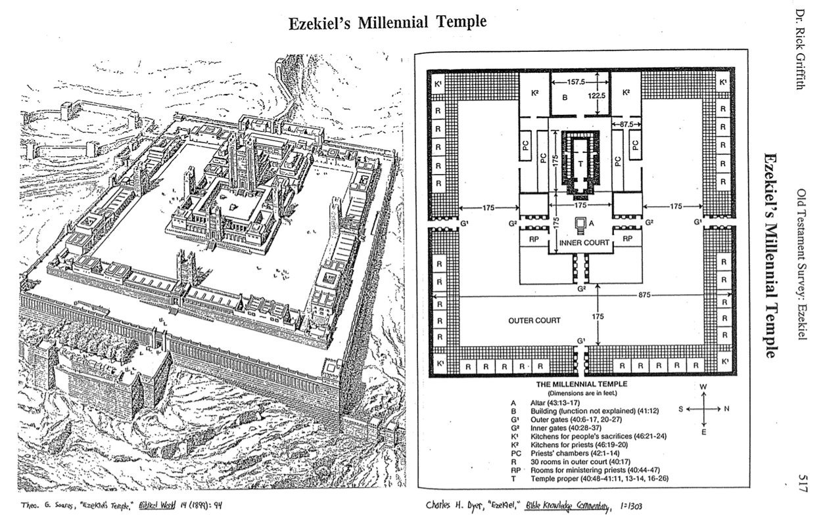
Ezekiel's Millennial Temple (42:15-20)
517
Theo. G. Soares, "Ezekiel's Temple"
Biblical World 14 (1899): 94
Charles Dyer, "Ezekiel,"
in The Bible Knowledge Commentary, 1:1303

Slide 40
Slides on
Ezekiel 43

Slide 41

The Glory Returns
502
Ezekiel 43
656

Slide 42
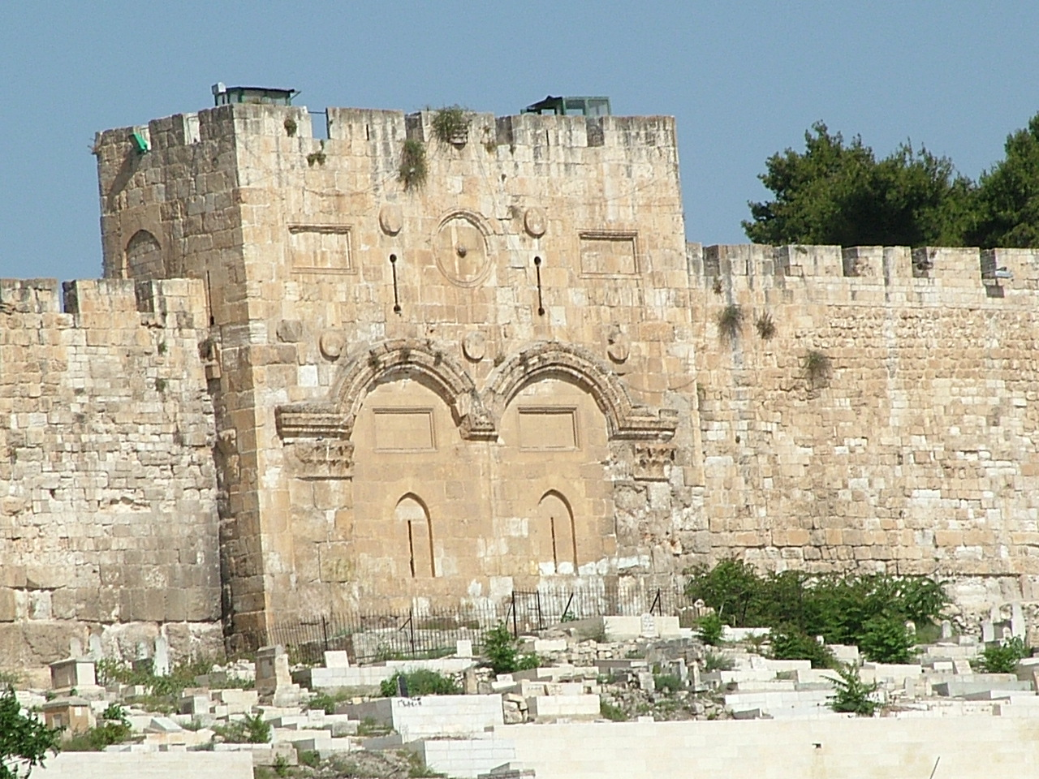
The Eastern Gate (Ezekiel 43:1 NLT)
"After this, the man brought me back around to the east gateway."

Slide 43
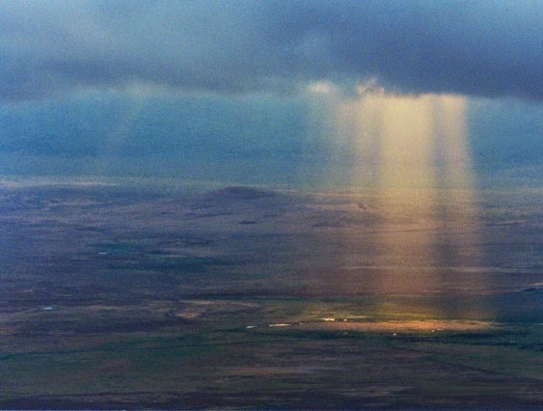
God's Glory Will Return (43:1-2)!
The Eastern Gate (Ezekiel 43:2-3 NLT)
"Suddenly, the glory of the God of Israel appeared from the east. The sound of his coming was like the roar of rushing waters, and the whole landscape shone with his glory.
³ This vision was just like the others I had seen, first by the Kebar River and then when he came to destroy Jerusalem. I fell face down on the ground."

Slide 44
The Eastern Gate (Ezekiel 43:4 NLT)
"And the glory of the LORD came into the Temple through the east gateway."

Slide 45






The Spirit Leaves & Returns
656
Ezek. 8:4; 9:3; 10:4; 10:18-19; 11:23
Luke 19:37; 24:50; Acts 1:10
Acts 1:11; Zech. 14:4; Ezek. 43:1-5

Slide 46
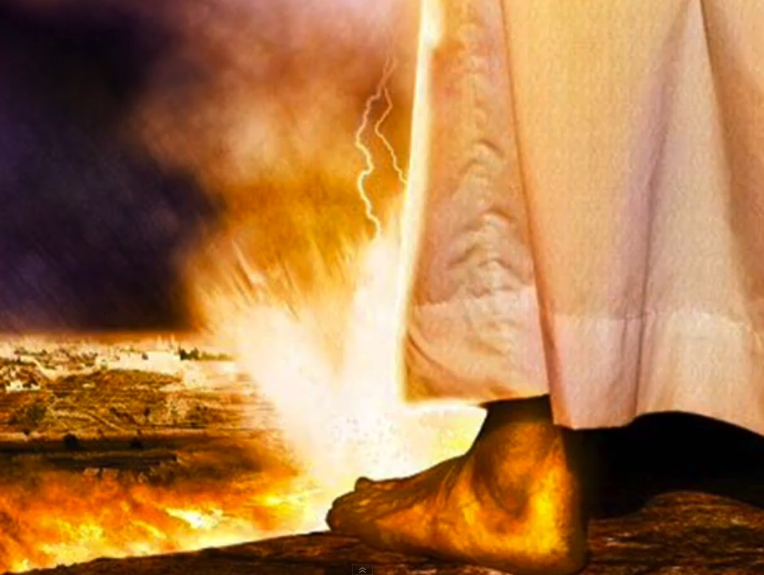
The Second Coming
"On that day, his feet will stand on the Mount of Olives east of Jerusalem…"
(Zechariah 14:4a).

Slide 47
Key Verse
500
(God to Israel) "For I will take you out of the nations; I will gather you from all the countries and bring you back into your own land. I will sprinkle clean water on you, and you will be clean; I will cleanse you from all your impurities and from all your idols. I will give you a new heart and put a new spirit within you; I will remove your heart of stone and give you a heart of flesh. And I will put my Spirit in you and move you to follow my decrees and be careful to keep my laws" (36:24-27).
Ezekiel

Slide 48
Where would we be without God's…
Presence?
Notes:
Believers underestimate God’s presence with us. We haven’t really grasped how fantastic the Spirit indwelling us is God truly among us.

Slide 49
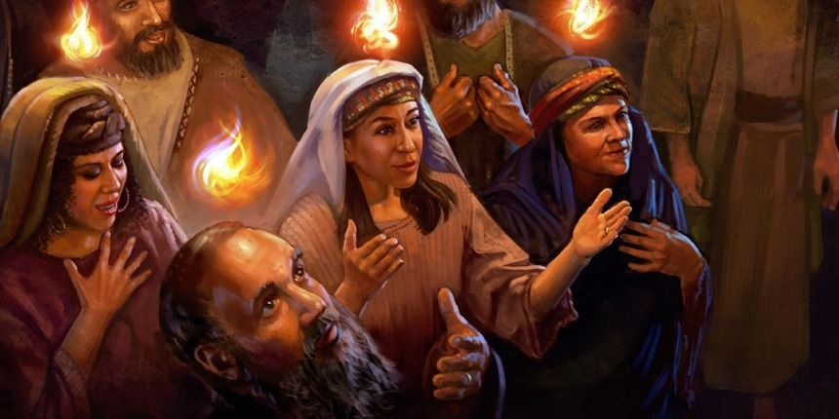
Tongues of Fire (Acts 2:3)

Slide 50
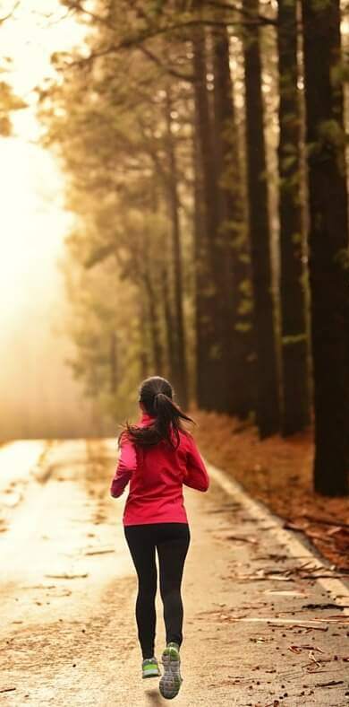
"Do you not know that your body is a temple of the Holy Spirit, who is in you, whom you have received from God? You are not your own; ²⁰ you were bought at a price. Therefore honor God with your body"
(1 Cor 6:19-20 NIV).
Notes:
One of the greatest ways we witness for Jesus is how we treat our bodies.

Slide 51
How will God show us his faithfulness in the future?

Slide 52
Ezekiel 40–48
God's Future Faithfulness
God will live with us again
(40–43)
God will help people confess sin
(44–46)

Slide 53

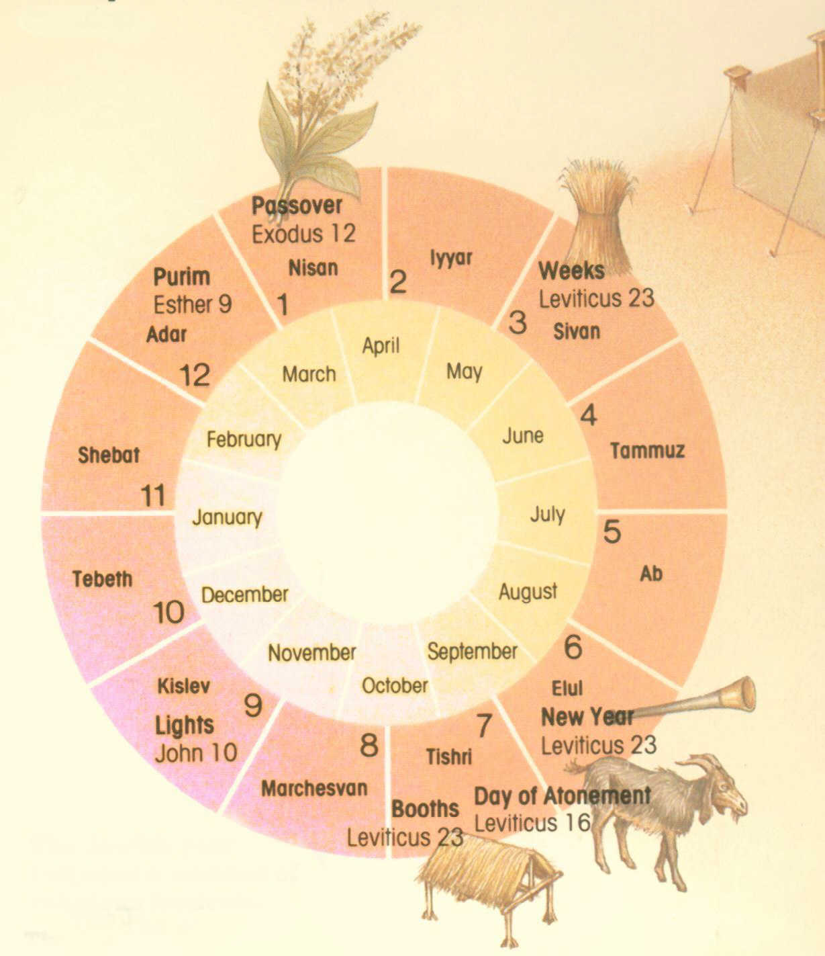
The Seven Feasts
Leviticus 23;
Deuternonomy 16
Passover
Unleavened Bread
Firstfruits
Pentecost
Trumpets
Atonement
Tabernacles
1 Nisan
2 Iyar
3 Sivan
4 Tammuz
5 Av
6 Ellul
7 Tishri
8 Cheshvan
9 Kislev
10 Tevet
11 Shevat
12 Adar
Notes:
#80 in original file

Slide 54
Slides on
Ezekiel 44

Slide 55
Feasts Contrasted
530
Mosaic Order
(Lev 23)
Millennial Order
(Ezek 40–45)
Passover (Lamb Offered)
Passover
1 Nisan
2 Iyar
3 Sivan
4 Tammuz
5 Av
6 Elul
7 Tishri
8 Cheshvan
9 Kislev
10 Tevet
11 Shevat
12 Adar
Unleavened Bread
Unleavened Bread
1 Nisan
2 Iyar
3 Sivan
4 Tammuz
5 Av
6 Elul
7 Tishri
8 Cheshvan
9 Kislev
10 Tevet
11 Shevat
12 Adar
Firstfruits
Sin Offering
Pentecost
Tabernacles
Tabernacles
Atonement
Trumpets
Sin Offering
Notes:
The annual Hebrew calendar of Leviticus 23 will find a partial repetition in the millennium.
• This was especially seen at the Day of Atonement among the seven annual feasts (Lev 23; Deut 16).
• But in the millennium only the first and last will be celebrated. Passover with Unleavened Bread will occur annually for seven days as in the past (Ezek 45:21), as will Tabernacles (Zech 14:16).
• As the sin offering in the Day of Atonement was central to the year, so this offering will be central to millennial worship. However, there will be no Day of Atonement then as the blood of Jesus is the final atonement for sin.
• Instead, the sin offering will be offered to commemorate Christ’s death, yet at Passover (Ezek 45:21-25). This is because there will be no ark of the covenant in the millennial temple (Jer 3:16, “’And when your land is once more filled with people,’ says the Lord, ‘you will no longer wish for ‘the good old days’ when you possessed the Ark of the Lord’s Covenant. You will not miss those days or even remember them, and there will be no need to rebuild the Ark”). Passover will be a fitting time to look back on Israel’s redemption from Egypt (Exod 12) as well as redemption from sin through Christ (1 Cor 5:7).
The Passover Lamb previously offered at Passover will have been fulfilled by Christ, yet the need for ongoing forgiveness related to ongoing sin will require a sin offering for the prince and those in mortal bodies (Ezek 40:39; 43:19, 21-22, 25).
One must not take the prophecy of Ezekiel in isolation, for millennial sacrifices are affirmed elsewhere in the prophetic writings. Isaiah notes that God will accept burnt offerings from both Israelites (Isa. 60:7; 66:20) and foreigners who bind themselves to the LORD (Isa. 56:6-7). Zechariah's last verse of his prophecy after the return of Christ (Zech 14:4) also affirms the presence of millennial sacrifices in the temple (Zech. 14:21).

Slide 56
Slides on
Ezekiel 45

Slide 57
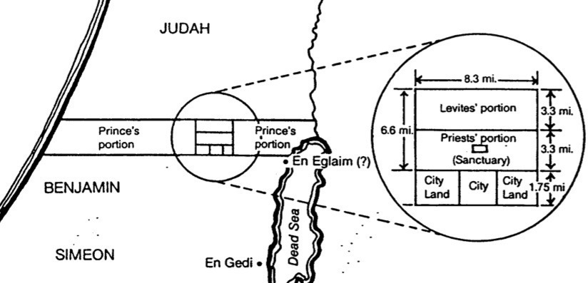
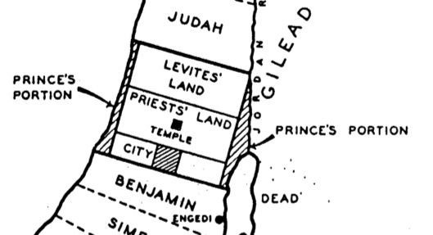
Priests, Levites & Prince Comparisons
531d-e
Charles Dyer, ”Ezekiel,” in Bible Knowledge Commentary, 1:1314
Highlighted in blue from
Ezek. 45:1-8; 48:9-22
R. Ludwigson, A Survey of Bible Prophecy, 56
Notes:
This is the minimum measurement based upon Ezekiel 41:13 using Ezekiel's long (21-inch) cubit explained in 40:5 (cf. 43:13) where a rod is equal to 6 long cubits, each of which is an 18-inch cubit plus a 3-inch handbreadth; therefore, a rod must be 10.5 feet long since 6 cubits at 21 inches equals 126 inches, or 10.5 feet. Nowhere does the account provide the height of the temple although the entire temple area is enclosed by a wall one rod (hn<q;, "stalk, reed" BDB 889d) in height (40:5), or 10.5 feet. (If the measurement is with the normal, or shorter [18-inch] cubit, the temple dimensions must be adjusted slightly to 150 feet by 75 feet.) This issue becomes even more confusing as the temple area measurements in 42:16-19 are plagued with textual difficulties. In each verse the MT measures in "rods" (~ynIq;; cf. NASB, NIV margin, KJV, NKJV, Ampl), but the LXX follows the Qere which reads the transposed "cubits" (twam; cf. NIV, RSV, GNB). Therefore, a single temple court side in the MT is "500 rods" (~ynIq; t/mae-vmej}) or 5250 feet, but in the LXX it is "500 cubits" (pentakosi,ouς) or 875 feet (using the long cubit). Furthermore, the situation is complicated by the fact that Ezekiel uses the cubit (40:5b, 9, 11–42:20; etc.), the rod (40:3, 5a-7; 42:16-19), and an ellipsis (45:1-6; 48:8-21, 30-35) for measurement. Most commentators agree that the cubit is the proper unit since use of the rod would make four sides of the temple area nearly one mile in length, an unlikely size. For further study on the measurements of the temple in cubits see Theo G. Soares, "Ezekiel's Temple," BW 14 (1899): 93-103. Adhering to the rod view is Cameron M. MacKay, "The City and the Sanctuary: Ezekiel 48," PTR 20 (1922): 399-417 (cf. MacKay, "Prolegomena to Ezekiel 40–48," ET 55 (1943/44): 292-95), who advocates an enormous temple situated in the Valley of Shechem (cf. MacKay, "Ezekiel's Sanctuary and Wellhausen's Theory," PTR 20 [1922]: 661-65, which argues against the documentary hypothesis). MacKay's first article (pp. 399-417) is critiqued by W. F. Lofthouse, "The City and the Sanctuary," ET 34 (1922/23): 198-202 and rebutted by MacKay in "The City and the Sanctuary," ET 34 (1922/23): 475-76. In either case, whether rods or cubits are used, the temple is one that has never been constructed in Israel.

Slide 58
Slides on
Ezekiel 46

Slide 59
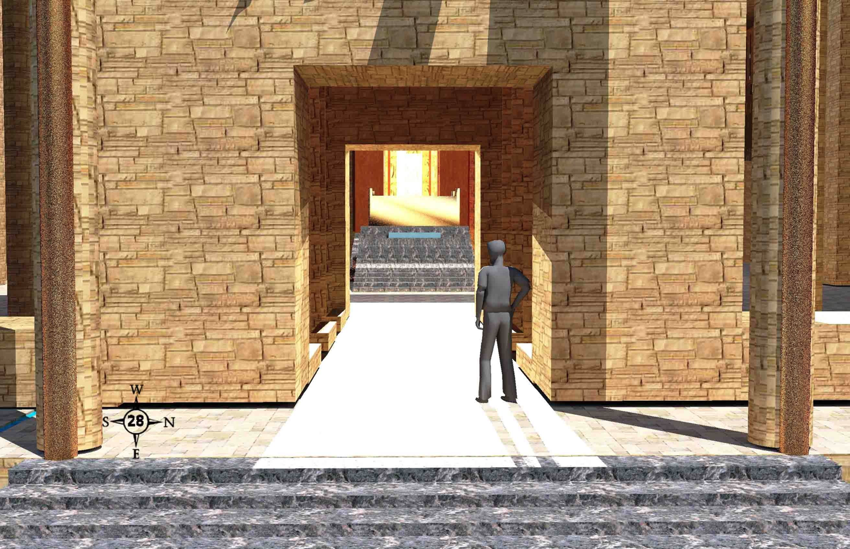
Seeing Shekinah Glory (46:1-3)
519
Prince David stands on the inner east gate porch. Light is from the shekinah glory in the temple as we look west into the inner court and the temple.
Wayne ODonnell • "Ezekiel 40–48: Tour of Ezekiel's Temple" • http://bible.ag/en/enezekieltranscript.htm
Notes:
"See Picture #28. Prince David standing on the porch of the inner east gate. The light is from the shekinah glory in the temple. We are looking west into the inner court and the temple.
Ezekiel 46:1-3,"The gate of the inner court that looketh toward the east shall be shut the six working days; but on the sabbath it shall be opened, and in the day of the new moon it shall be opened. And the prince shall enter by the way of the porch of that gate without, and shall stand by the post of the gate, and the priests shall prepare his burnt offering and his peace offerings, and he shall worship at the threshold of the gate: then he shall go forth; but the gate shall not be shut until the evening. Likewise the people of the land shall worship at the door of this gate before the LORD in the sabbaths and in the new moons." Most of the time, the inner east gate will be closed. But on Sabbaths and new moons, it will be open. Then the prince can go up on the porch, and watch as the priests offer his sacrifices. But that means he can't go into the inner court, even though he is in his resurrected and glorified body, and so we won't be able to either."
Wayne ODonnell, "Ezekiel 40–48: Tour of Ezekiel's Temple"
http://bible.ag/en/mr4web.html#EZanchor-anchor
Recorded December 30, 2007
Accessed 30 Aug 2016

Slide 60
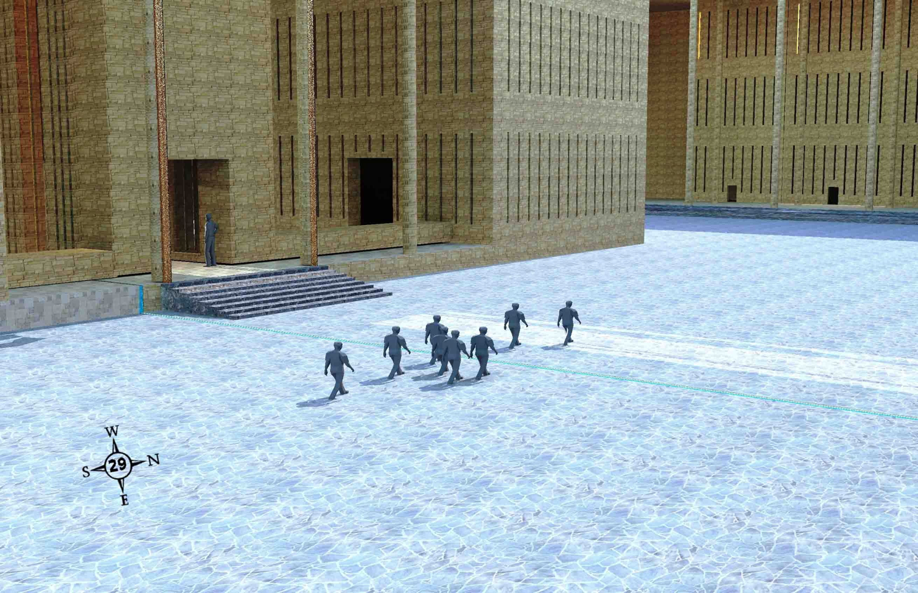
Exit Opposite Outer Gate (46:8-12)
519
People who enter the outer court of the temple compound by the outer south gate walk past the inner east gate, to exit by the outer north gate.
Wayne ODonnell • "Ezekiel 40–48: Tour of Ezekiel's Temple" • http://bible.ag/en/enezekieltranscript.htm
Notes:
"See Picture #29. People who entered the outer court of the temple compound by the outer south gate, walking past the inner east gate, to exit by the outer north gate.
Ezekiel 46:8-12, "When the people of the land shall come before the LORD in the solemn feasts, he that entereth in by the way of the north gate to worship shall go out by the way of the south gate; and he that entereth by the way of the south gate shall go forth by the way of the north gate: he shall not return by the way of the gate whereby he came in." People will enter the temple compound by the north gate and go out by the south, or they will go in by the south and out by the north. Do you remember why no one will enter or exit by the outer east gate?
Ezekiel 46:8 only talks about "the people of the land," meaning the Jewish people and probably the Gentiles who dwell among them in Israel. But Zechariah says that the Gentiles outside the land will go to Jerusalem to celebrate the feast of tabernacles. Zechariah 14:16-17, "It shall come to pass, that every one that is left of all the nations which came against Jerusalem, shall even go up from year to year to worship the King, the LORD of hosts, and to keep the feast of tabernacles. And it shall be, that whoso will not come up of all the families of the earth unto Jerusalem to worship the King, the LORD of hosts, even upon them shall be no rain." So I don't expect to be living in the land of Israel during the Messianic Kingdom. I expect to be laboring in one of the Gentile nations, but I expect to come up for the feast of tabernacles with other people from my nation whenever it's my turn.
Isaiah 66:20-21 may indicate some Gentiles may serve as priests and 'Levites' in the temple. "And they [saved Gentiles] shall bring all your brethren for an offering unto the LORD out of all nations ... to my holy mountain Jerusalem, and I will also take of them for priests and for Levites." More likely, "take of them" refers to taking priests and Levites from among the Jewish people brought back by the Gentiles. Would Gibeonites and Nethinim (temple servants) be referred to as 'Levites?' If God does take any Gentiles as priests and 'Levites', they will at least need to be born again spiritually, and circumcised physically, according to Ezekiel 44:9.
"Thus saith the Lord GOD; No stranger, uncircumcised in heart, nor uncircumcised in flesh, shall enter into my sanctuary, of any stranger that is among the children of Israel," Ez44:9. This probably indicates that no unsaved men, even descendants of Zadok, will be able to serve as priests and Levites in the temple. It probably does not indicate exclusion of anyone from the temple compound. It would be more feasible to verify circumcision of heart and flesh as a prerequisite to priesthood than to temple compound access.
Zechariah concludes and summarizes his book by saying, "Every pot in Jerusalem and in Judah shall be holiness unto the LORD of hosts: and all they that sacrifice shall come and take of them, and seethe therein: and in that day there shall be no more the Canaanite in the house of the LORD of hosts," Zech14:21. There will certainly be some people of Canaanite descent in the kingdom, who enter by resurrection, and who enter in unglorified bodies at the end of the tribulation period and their descendants born during the kingdom, and they will probably have entrance to the temple compound, though perhaps none any longer as temple servants. Probably this verse means that, whereas most priests and Levites in the temple throughout history have been unbelievers, and to God this was equivalent to Canaanites like the Gibeonites serving in the temple, in the kingdom the priests and Levites will be both descendants of Levi and, more importantly, regenerate of heart."
Wayne ODonnell, "Ezekiel 40–48: Tour of Ezekiel's Temple"
http://bible.ag/en/mr4web.html#EZanchor-anchor
Recorded December 30, 2007
Accessed 30 Aug 2016

Slide 61
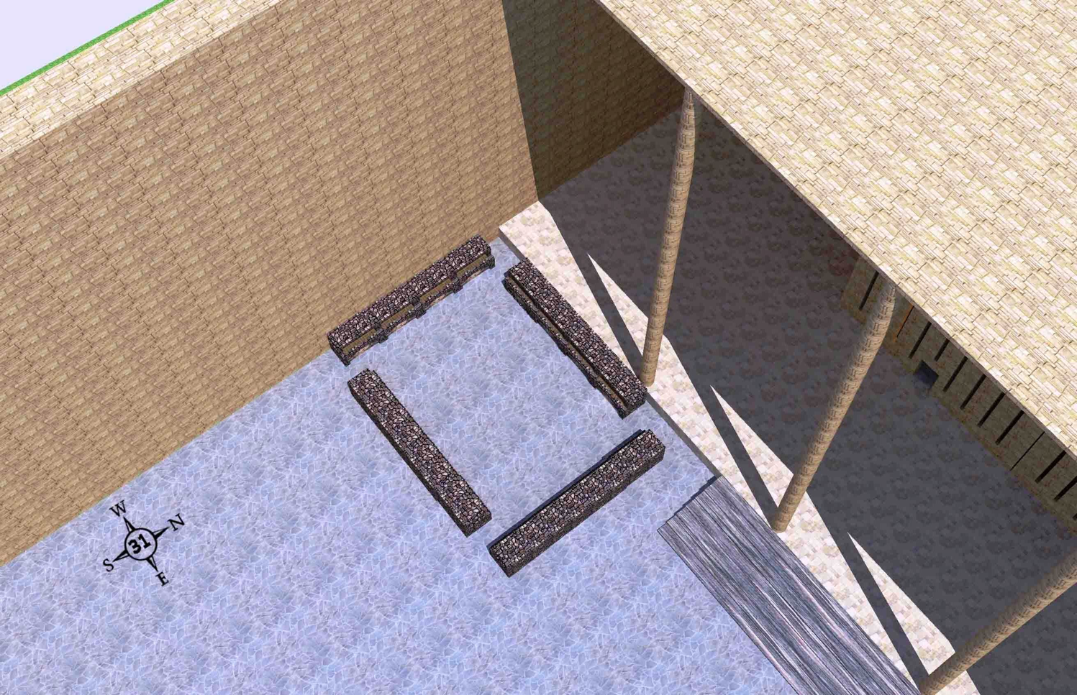
Northwest Boiling Place
(46:21-24)
519
The northwest boiling place for the peoples' sacrifices with 4 mini-courts like this one in each corner of the outer court
Wayne ODonnell • "Ezekiel 40–48: Tour of Ezekiel's Temple" • http://bible.ag/en/enezekieltranscript.htm
Notes:
"See Picture #31. The northwest boiling place for the peoples' sacrifices. There are 4 mini-courts like this one; one in each corner of the outer court.
Ezekiel 46:21-24, "Then he brought me forth into the utter [outer] court, and caused me to pass by the four corners of the court; and, behold, in every corner of the court there was a court ... forty cubits long and thirty broad .... And there was a row of building round about in them, ... and it was made with boiling places under the rows round about. Then said he unto me, These are the places of them that boil, where the ministers of the house shall boil the sacrifice of the people." Four 40x30 cubit mini-courts, one in each corner of the outer court, for the priests to come out and boil the peoples' sacrifices, because the people cannot enter into the inner court, where the priests offer other sacrifices."
Wayne ODonnell, "Ezekiel 40–48: Tour of Ezekiel's Temple"
http://bible.ag/en/mr4web.html#EZanchor-anchor
Recorded December 30, 2007
Accessed 30 Aug 2016

Slide 62

Solomon's & Ezekiel's Temples Contrasted
518
Notes:
62
One suggestion is that this is Solomon's temple (Adam Clarke, "Ezekiel," in Clarke's Commentary, 4:535), but this view has several flaws.
First, the dimensions of these two temples are different. While Solomon's temple was fairly small (90 feet long, 30 feet wide, and 45 feet high), Ezekiel's temple measures much larger (175 feet long and 87.5 feet wide). This is the minimum measurement based upon Ezekiel 41:13 using Ezekiel's long (21-inch) cubit explained in 40:5 (cf. 43:13) where a rod is equal to 6 long cubits, each of which is an 18-inch cubit plus a 3-inch handbreadth; therefore, a rod must be 10.5 feet long since 6 cubits at 21 inches equals 126 inches, or 10.5 feet. Nowhere does the account provide the height of the temple although the entire temple area is enclosed by a wall one rod ("stalk, reed" BDB 889d) in height (40:5), or 10.5 feet. (If the measurement is with the normal, or shorter [18-inch] cubit, the temple dimensions must be adjusted slightly to 150 feet by 75 feet.) This issue becomes even more confusing as the temple area measurements in 42:16-19 are plagued with textual difficulties. In each verse the MT measures in "rods" (NASB, NIV margin, KJV, NKJV, Ampl), but the LXX follows the Qere which reads the transposed "cubits" (NIV, RSV, GNB). Therefore, a single temple court side in the MT is "500 rods" or 5250 feet, but in the LXX it is "500 cubits" or 875 feet (using the long cubit). Furthermore, the situation is complicated by the fact that Ezekiel uses the cubit (40:5b, 9, 11–42:20; etc.), the rod (40:3, 5a-7; 42:16-19), and an ellipsis (45:1-6; 48:8-21, 30-35) for measurement. Most commentators agree that the cubit is the proper unit since use of the rod would make four sides of the temple area nearly one mile in length, an unlikely size. For further study on the measurements of the temple in cubits see Theo G. Soares, "Ezekiel's Temple," BW 14 (1899): 93-103. Adhering to the rod view is Cameron M. MacKay, "The City and the Sanctuary: Ezekiel 48," PTR 20 (1922): 399-417 (cf. MacKay, "Prolegomena to Ezekiel 40–48," ET 55 (1943/44): 292-95), who advocates an enormous temple situated in the Valley of Shechem (cf. MacKay, "Ezekiel's Sanctuary and Wellhausen's Theory," PTR 20 [1922]: 661-65, which argues against the documentary hypothesis). MacKay's first article (pp. 399-417) is critiqued by W. F. Lofthouse, "The City and the Sanctuary," ET 34 (1922/23): 198-202 and rebutted by MacKay in "The City and the Sanctuary," ET 34 (1922/23): 475-76. In either case, whether rods or cubits are used, the temple is one that has never been constructed in Israel.
Solomon's temple measurements in 1 Kings 6:2 are noted at 60, 20, and 30 cubits; the above measurements in feet were obtained by multiplying these three lengths by the standard 18 inches per cubit. "The square of the temple in 42:20 is six times as large as the circuit of the wall enclosing the old temple, and, in fact, is larger than the former city itself” (Hobart E. Freeman, An Introduction to the Old Testament Prophets, 313).
Second, if this description depicted the former temple, it must be asked what hope Ezekiel could offer his oppressed brethren by reminding them of the glory of Solomon's temple which at that time lay in ruins. Third, the Books of Kings and Chronicles already provide detailed descriptions of Solomon's temple, so another record would be unnecessary. For these reasons, Ezekiel's temple is not the same as Solomon's.

Slide 63
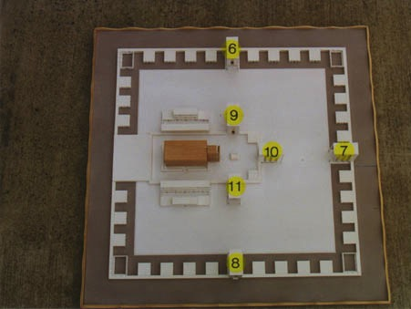
View from Above
517
6. Outer Court Northern Gateway - 40:20-23
7. Outer Court Eastern Gateway - 40:6-16
8. Outer Court Southern Gateway - 40:24-27
9. Inner Court Northern Gateway - 40:35-37
10. Inner Court Eastern Gateway - 40:32-34
11. Inner Court Southern Gateway - 40:28-31
www.pauljab.net/temple/ TemplePictures.html
Notes:
63
Note that at least 4 of Solomon’s temples fit into Ezekiel’s—maybe even 5-6 of them. Ezekiel is obviously not describing the first temple built by Solomon.

Slide 64

Ezekiel's temple is larger than the Old City!
521
656
www.pauljab.net/temple/ TemplePictures.html
Notes:
If we take the larger view (see previous two slides), the side of Ezekiel’s temple court would be nearly a mile long. Even the shorter rod view is too large.

Slide 65
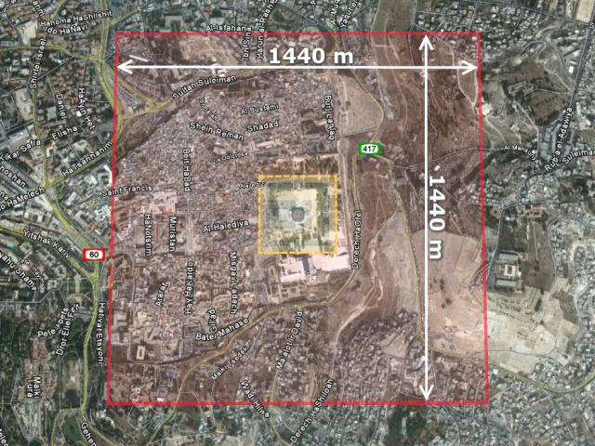
The Temple Area Over Present Jerusalem
521
656
"Ezekiel's Temple: Tour of the Temple of Ezekiel's Vision" • http://ezekiel-temple.narod.ru/ezekiel_45.htm • This group plans to build the temple in the desert of Israel!
Notes:
The larger (rod) view would make the temple area about the size of the modern city.
——————_
Accessed 31 August 2016

Slide 66
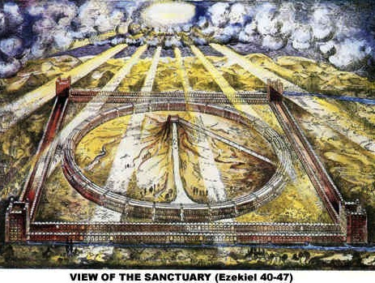
View of the Sanctuary (Ezekiel 40-48)
521
www.antipas.org/.../ezekiels_temple/ ezekiels_temple.html
Notes:
Ezekiel's depiction matches Isaiah 2…
Is. 2:2 In the last days, the mountain of the LORD’s house
will be the highest of all—
the most important place on earth.
It will be raised above the other hills,
and people from all over the world will stream there to worship.
³ People from many nations will come and say,
“Come, let us go up to the mountain of the LORD,
to the house of Jacob’s God.
There he will teach us his ways,
and we will walk in his paths.”
For the LORD’s teaching will go out from Zion;
his word will go out from Jerusalem.
⁴ The LORD will mediate between nations
and will settle international disputes.
They will hammer their swords into plowshares
and their spears into pruning hooks.
Nation will no longer fight against nation,
nor train for war anymore.

Slide 67
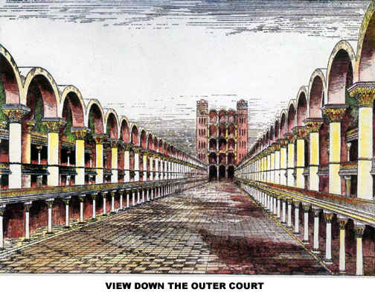
View Down the Outer Court
Notes:
If you think Solomon's temple was glorious, how much more so Ezekiel's!

Slide 68
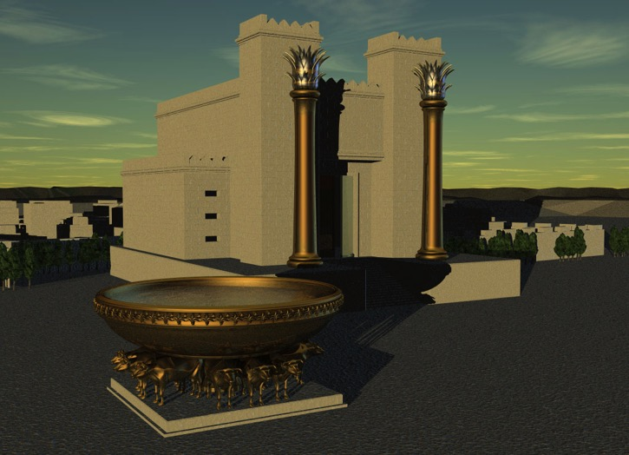
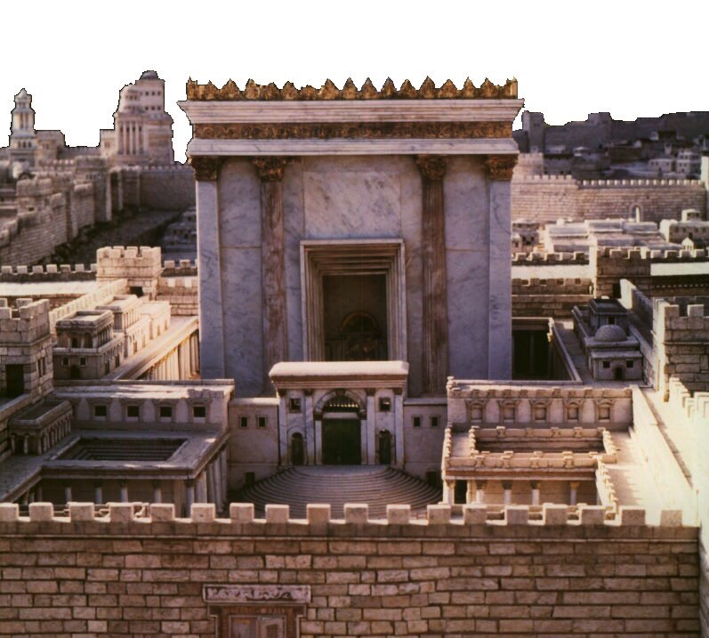
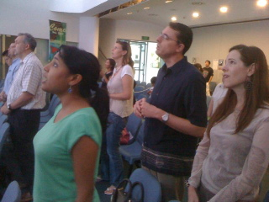
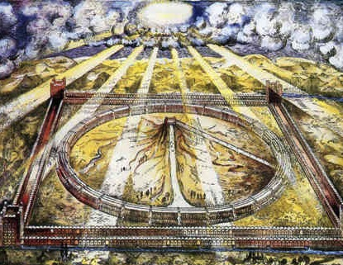
Which temple for Ezekiel?
520
Solomon
Zerubbabel/Herod
Three
Literal
Views
Conditional
Millennial
Church
Notes:
Ezekiel 40–46 has at least five different interpretations but the only one that takes the text at face value is that this temple with these dimensions has not yet been built—so it must happen in the future millennium.
The conditional view says that the people did not truly believe in the Lord sufficiently, so God never built it and will not do so in the future. But hundreds of verses in the Prophets speak of a believing Israel in the future. See the Isaiah 60–66 slides on the restoration of Israel.

Slide 69
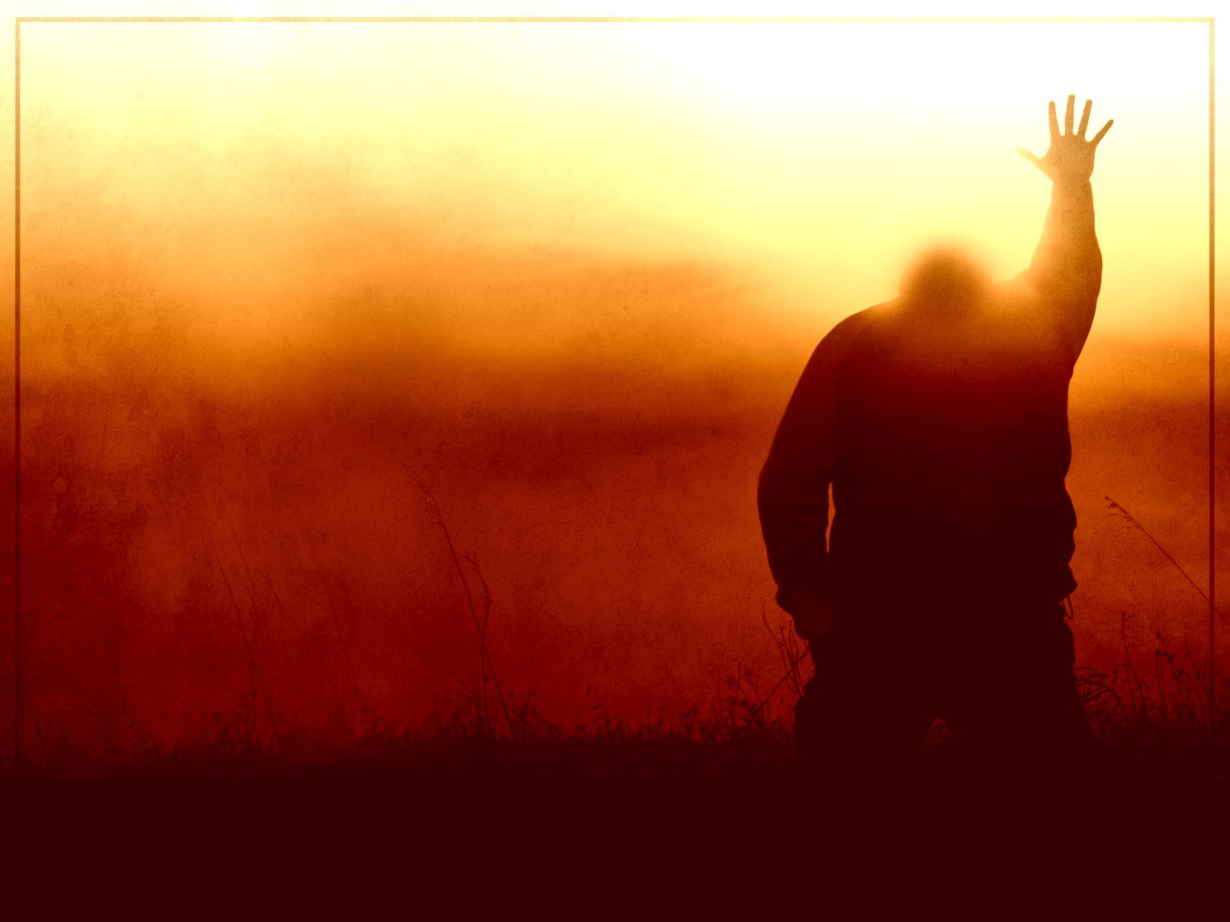
"And when sins have been forgiven, there is no need to offer any more sacrifices"
(Heb. 10:18 NLT).

Slide 70
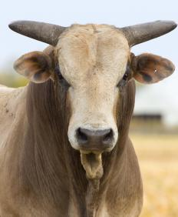
"For without the shedding of blood, there is no forgiveness"
(Heb. 9:22b NLT).

Slide 71
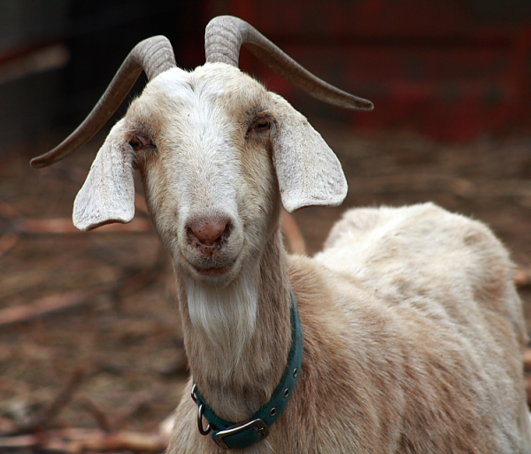
"But instead, those sacrifices actually reminded them of their sins year after year. ⁴For it is not possible for the blood of bulls and goats to take away sins"
(Heb. 10:3-4 NLT).

Slide 72
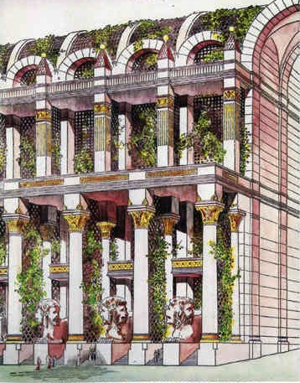
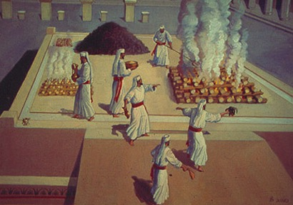
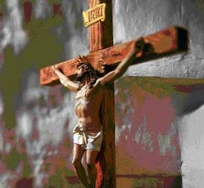
Problems Either Way!
525
Premillennial:
Sacrifices for Sin
(Ezek. 40:39) in Light of Christ's Death
Amillennial:
Abandon Normal Meaning of Gates, Doors, Walls, Sacrifices
Notes:
We should not stop the normal way we read words in Ezekiel just because we feel uncomfortable with the idea of future sacrifices. Spiritualizing these chapters leads to even greater problems in determining what is meant by these parts of the temple and sacrifices when the Bible does not tell us what else they mean other than the plain use of words and phrases.

Slide 73
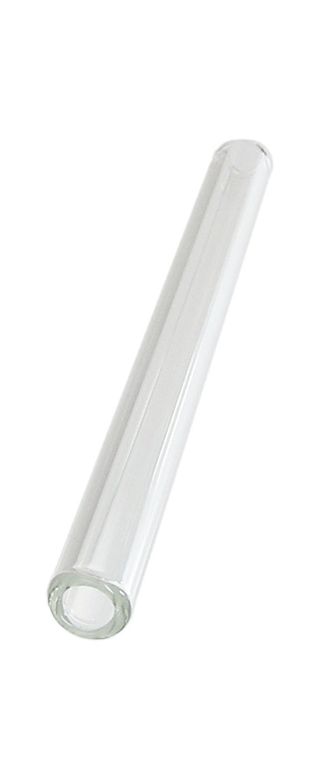
OT Forgiveness of Sin
121b
Pipe = Relationship with God (never changing)
Sin
Clog = Fellowship with God (hindered by sin)
Sacrifices = Confession of Sin (sin was forgiven to restore fellowship but relationship was never threatened)
Notes:
The Israelite relationship with God can be compared to a pipe.
Occasionally the pipe got a clog—like sin—that hindered their fellowship with God.
Did OT believers still have a relationship with God when they sinned? Yes!
Sin did not hinder their relationship with God but their fellowship with Him.
OT sacrifices did not establish a relationship with God but rather they restored their fellowship with God
_____
OP-02-Lev-28
OS-04-Num-29
OS-26-Ezek40-43-slide 73
NS-23-1Jn-58
SA-03-Biblical Terms-9

Slide 74
NT Forgiveness of Sin
121b
"If we confess our sins,
He is faithful and righteous to forgive us our sins and to cleanse us from all unrighteousness"
(1 John 1:9 NAU)
Pipe = Relationship with God (never changing)
Sin
Clog = Fellowship with God (hindered by sin)
Christ's Sacrifice = The Basis for Confession of Sin (sin is forgiven to restore fellowship but relationship has never been never threatened)
Notes:
Our relationship with God can be compared to a pipe.
Occasionally the pipe gets a clog—like sin—that hinders our fellowship with God.
Do we still have a relationship with God when we sin? Yes!
Sin does not hinder our relationship with God but our fellowship with Him.
_________
OB-38-Salvation-11
OS-03-Leviticus-56, 72, 130
OS-04-Numbers-30
NS-23-1Jn-59
SA-03-Biblical Terms-9

Slide 75
Millennial Forgiveness of Sin
121b
"The man said to me, ‘These are the kitchens to be used by the Temple assistants to boil the sacrifices offered by the people’"
(Ezekiel 46:24 NLT)
Pipe = Relationship with God (never changing)
Sin
Clog = Fellowship with God (hindered by sin)
Christ's Sacrifice = The Basis for Confession of Sin (sin is forgiven to restore fellowship but relationship has never been never threatened)
Notes:
Sacrifices in the millennium—like all sacrifices throughout history—will not in themselves forgive sin. They will—like all sacrifices throughout history—only point to the Lord Jesus as the final sacrifice for sin. Offering them will be a form of confession of sin.

Slide 76
Why Millennial Sacrifices?
527
Pre-Cross:
Looked toward Christ's Death
Post-Cross:
Look back on Christ's Death
Theocratic: like confession of sin (1 John 1:9)
Memorial: like Lord's Supper that looks back
Paul offered a temple sacrifice in AD 57 (Acts 21:26) without seeing a "digression problem"
Notes:
Since Paul offered a sacrifice, he was indicating that sacrifices in and of themselves are not the problem. They all look to Jesus, so they are not needed (Heb 10:18) as only Christ's sacrifice atones for sin. Yet they can be used for confession of sin both pre-cross and post-cross.

Slide 77
Where would we be without God's…
Presence?
Forgiveness?
Notes:
Believers underestimate the power of God’s forgiveness. We take sin for granted but God wants to remind us that every sin has a cost and Jesus paid it all for us.
Jesus has forgiven our sins to establish a relationship with him.

Slide 78

All my sins were canceled—so why continue to confess?
Notes:
Confession is like washing hands. We never say, "Well, I don't need to wash my hands today. I just washed them yesterday." We all know that the normal process of living gets our hands dirty. So we should admit that and do something about it—wash your hands.
It is easy to take sin for granted. Imagine it costing you money every time you sinned—like money to buy an animal to sacrifice. I suspect such a price would motivate us to sin less.
So fellowship now requires us to confess sin. Do you?

Slide 79
How will God show us his faithfulness in the future?

Slide 80
Ezekiel 40–48
God's Future Faithfulness
God will live with us again
(40–43)
God will help people confess sin
(44–46)
God will allot his land justly
(47–48)

Slide 81
Slides on
Ezekiel 47

Slide 82

Borders of the Land Promised to Abraham
531e
Syria
Lebanon
Israel
Genesis 15:18
"On that day the LORD made a covenant with Abram, saying, 'To your offspring I give this land, from the river of Egypt to the great river, the river Euphrates'" (ESV)
India
Egypt
Notes:
God’s promised land stretched northward from the small wadi of Egypt south in the Sinai to the large Euphrates River in the far north—a HUGE piece of real estate! When today’s boundaries are placed over this land we can see the struggle modern Israel has to claim land from Egypt, Lebanon, and Syria.
—————
OS-01-Gen4-20-slide
OS-26-Ezek44-47-slide 82 on Ezek 47

Slide 83
Eternal Land for Abraham’s Descendants
Genesis 17:7-8 (NIV)
"I will establish my covenant as an everlasting covenant between me and you and your descendants after you for the generations to come, to be your God and the God of your descendants after you. ⁸The whole land of Canaan, where you are now an alien, I will give as an everlasting possession to you and your descendants after you; and I will be their God."
Israel
Notes:
The only way that this could be an eternal possession of Abraham's descendants is for the nation to return to the land, live there in the millennium, and then the eternal state renovation be one of this actual earth so that the new Jerusalem lies at this same spot.

Slide 84


Tribal Redistribution
Dan
531d
531e
Asher
After Conquest
(Josh. 13)
Millennial Israel
(Ezekiel
47-48)
Naphtali
Manasseh
Ephraim
Reuben
Judah
Leaders & Temple
Benjamin
Simeon
Issachar
Zebulun
Gad
Notes:
The tribes are the same, but all allotments lie west of the Jordan River and in equal divisions.

Slide 85
Where would we be without God's…
Presence?
Forgiveness?
Fairness?
Notes:
We might think that we are fair, but each of our judgments is flawed and biased. Only God can judge and he will choose to allocate fair boundaries.
But what about Gentiles? Is this land only for Jews? Not at all…

Slide 86
Shared Land with Jews & Gentiles
"You are to distribute this land among yourselves according to the tribes of Israel. ²²You are to allot it as an inheritance for yourselves and for the aliens who have settled among you and who have children. You are to consider them as native-born Israelites; along with you, they are to be allotted an inheritance among the tribes of Israel. ²³In whatever tribe the alien settles, there you are to give him his inheritance,’ declares the Sovereign LORD"
(Ezekiel 47:21-23 NLT).
Notes:
As there exist no distinctions between Jews and Gentiles today in the Church (Galatians 3:28), so the same will be true in the land shared between these groups in the Millennium. God's plan has no second-class citizens.

Slide 87
How will God show us his faithfulness in the future?
We will see God's glory in a new order in the millennium.
Notes:
This is not the pagan, man-centered "New World Order" espoused today. No, this is God-centered based on his faithful design. So how should we live now?

Slide 88
Ezekiel 40–48
Anticipate
Glory
in a New Order
Notes:
Look forward to God's own presence in a totally new system where sin can still be confessed by those in mortal bodies and where we live together in a fair land allotment.

Slide 89
Ezekiel 40–48
God's Future Faithfulness
God will live with us again
(40–43)
God will help people confess sin
(44–46)
God will allot his land justly
(47–48)
Notes:
God's presence will be among us.
God's provision for sin will help those in their mortal flesh.
God's place of rest will be allocated for Jew and Gentile.

Slide 90

God's glory will be seen in your life to the extent to which you are willing.
Notes:
—He is faithful to be the ultimate gentleman who will not force himself into your life.
—But he is also faithful to remain the King of the Universe who does not need your permission.
—Are you drawing closer to God? What evidence is there for that? How is he speaking to you to better anticipate his faithfulness in the future?

Slide 91
Black

Slide 92


OT Preaching link at BibleStudyDownloads.org
Get this presentation and script for free!

