Slide 1
EXODUS 4:18-31
Why Study Theology?
Dr Scott Wooddell Eastridge Park Christian Church, Mesquite, Texas Uploaded by Dr. Rick Griffith • Jordan Evangelical Theological Seminary Files in many languages for free download at BibleStudyDownloads.org

Slide 2
EXODUS 4:18-31
Why study Theology?
What are the relevant reasons for studying about God?

Slide 3
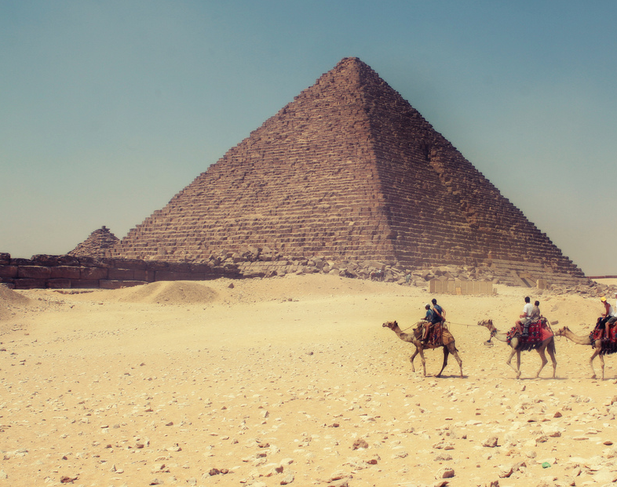
1. GOD REVEALS HIS SOVEREIGNTY OVER ALL THINGS (Exodus 4:18-23)
EGYPT
“The Lord said to Moses, ‘When you return to Egypt, see that you perform before Pharaoh all the wonders I have given you the power to do. But I will harden his heart so that he will not let the people go.’” (Exodus 4:21)

Slide 4
2. GOD REVEALS HIS LORDSHIP OVER US (4:24-31)
“Then God said to Abraham, ‘As for you, you must keep my covenant, you and your descendants after you for the generations to come. This is my covenant with you and your descendants after you, the covenant you are to keep. Every male among you shall be circumcised.’” (Genesis 17:9-10)

Slide 5
2. GOD REVEALS HIS LORDSHIP OVER US (4:24-31)
“Go therefore and make disciples of all nations, baptizing them in the Name of the Father, and of the Son, and of the Holy Spirit, teaching them to observe all that I have commanded you.” (Matthew 28:19-20)

Slide 6
2. GOD REVEALS HIS LORDSHIP OVER US (4:24-31)
“The Lord Jesus, on the night He was betrayed, took bread, and when He had given thanks, He broke it and said, ‘This is my body which is for you, do this in remembrance of me.’ In the same manner He took the cup saying, ‘This cup is the New Covenant in my blood, do this as often as you drink it in remembrance of me.’”
1 Corinthians 11:23-26

Slide 7
3. GOD REVEALS HIS FAITHFULNESS TO HIS PROMISES (Exodus 6:3-8)
“Therefore say to the Israelites, ‘I am the Lord.’”
“I will bring you out…”
“I will free you…”
“I will redeem you…”
“I will take you as my own people.”
“I will be your God”
“I will bring you to the land…”
“I will give it to you as a possession. I am the Lord.”

Slide 8
TAKE HOME TRUTH
Those who know God trust His sovereignty, embrace His Lordship, and claim His promises.

Slide 9
Black

Slide 10
OT Preaching link at BibleStudyDownloads.org
Get this presentation for free!
Notes:
OT Preaching (op)

