Slide 1
EXODUS 3:1-10
Finding Your Life Purpose
Dr Scott Wooddell Eastridge Park Christian Church, Mesquite, Texas Uploaded by Dr. Rick Griffith • Jordan Evangelical Theological Seminary Files in many languages for free download at BibleStudyDownloads.org

Slide 2
EXODUS 3:1-10
Why am I here?
What is the purpose of my life?

Slide 3
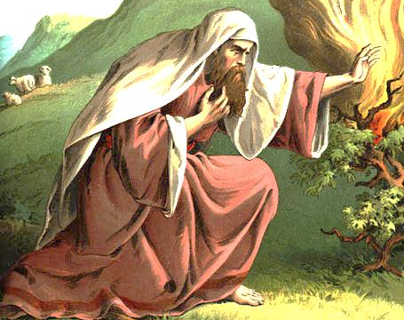
1. GOD CALLS US TO A PURPOSEFUL AND MEANINGFUL LIFE (3:1-10)
moses
“So now, go. I am sending you to Pharaoh to bring my people the Israelites out of Egypt.” (Exodus 3:10)

Slide 4
2. WE SOMETIMES RESIST GOD’S CALL, CHOOSING RATHER OUR OWN AGENDA (3:11-4:17)
moses
I am inadequate for the job (3:11-12)

Slide 5
2. WE SOMETIMES RESIST GOD’S CALL, CHOOSING RATHER OUR OWN AGENDA (3:11-4:17)
moses
I am inadequate for the job (3:11-12)
I don’t have all the answers (3:13-14)

Slide 6
2. WE SOMETIMES RESIST GOD’S CALL, CHOOSING RATHER OUR OWN AGENDA (3:11-4:17)
moses
I am inadequate for the job (3:11-12)
I don’t have all the answers (3:13-14)
I’m worried about things that might go wrong (4:1)

Slide 7
2. WE SOMETIMES RESIST GOD’S CALL, CHOOSING RATHER OUR OWN AGENDA (3:11-4:17)
moses
I am inadequate for the job (3:11-12)
I don’t have all the answers (3:13-14)
I’m worried about things that might go wrong (4:1)
I lack natural talent (4:10-11)

Slide 8
2. WE SOMETIMES RESIST GOD’S CALL, CHOOSING RATHER OUR OWN AGENDA (3:11-4:17)
moses
I am inadequate for the job (3:11-12)
I don’t have all the answers (3:13-14)
I’m worried about things that might go wrong (4:1)
I lack natural talent (4:10-11)
I don’t want to go (4:13)

Slide 9
TAKE HOME TRUTH
God created us for His purpose and
He leads us in His providence.

