Slide 1
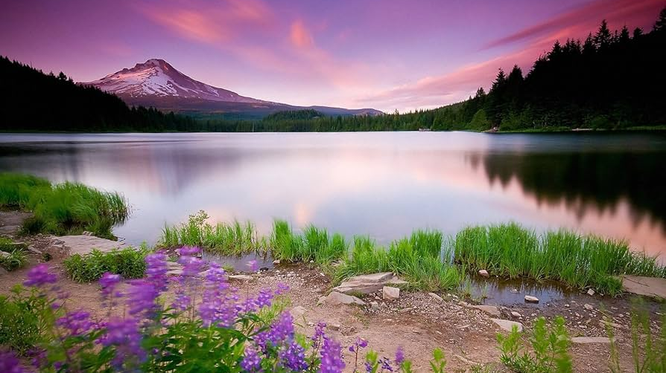
God’s Amazing Khesed!
Exodus 34:5-9
Preached by Dan Bridges
Amman International Church, Jordan (AmmanChurch.org)
Uploaded by Dr. Rick Griffith • Jordan Evangelical Theological Seminary
Files in many languages for free download at BibleStudyDownloads.org

Slide 2
“I will give thanks to you, O LORD, among the peoples;
I will sing praises to you among the nations.
For your steadfast love is great to the heavens,
your faithfulness to the clouds.” Psalm 57:9-10
What’s the Reason for Praise?
God’s steadfast love, his faithfulness

Slide 3
“It is good to give thanks to the LORD,
to sing praises to your name, O Most High;
to declare your steadfast love in the morning,
and your faithfulness by night…”
Psalm 92:1-2
What would we talk about in order to “declare God’s steadfast love”?

Slide 4
“Oh give thanks to the LORD,
for he is good,
for his steadfast love endures forever!”
Psalm 107:1
What does the Bible mean when it talks about God’s “steadfast love”?

Slide 5
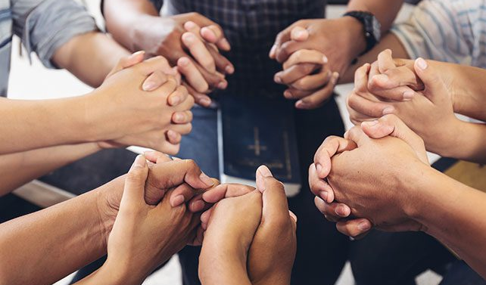
May 2025 Elders’ Prayer Time
24 Hours of Prayer focused around Khesed

Slide 6
Khesed
Appears more than 240 times in the Old Testament
One of the most common words used to describe God
Appears 125 times in the Psalms as a description of God!

Slide 7
What does khesed mean?
Meaning cannot be captured in a single English word
Includes ideas of love, faithfulness, loyalty, commitment, kindness, goodness, generosity, mercy and grace

Slide 8
What does khesed mean?
Some words cannot be adequately defined by words alone…
Beauty –
Loyal or just –
Defined by pictures
Defined by stories

Slide 9
Our Story – Exodus 34:5-9
The Context
Defining the name Yahweh (5-7)
Moses’ Response to God’s Khesed (8-9)
Applying this to Us!

Slide 10
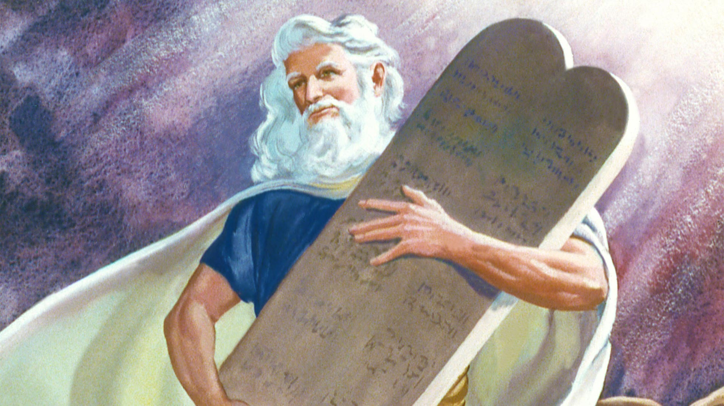
Context of
Exodus 34:5-9
Exodus 20 – Giving of the 10 Commandments
Exodus 31:18 – Tablets (10 Commandments) given to Moses on Mount Sinai

Slide 11
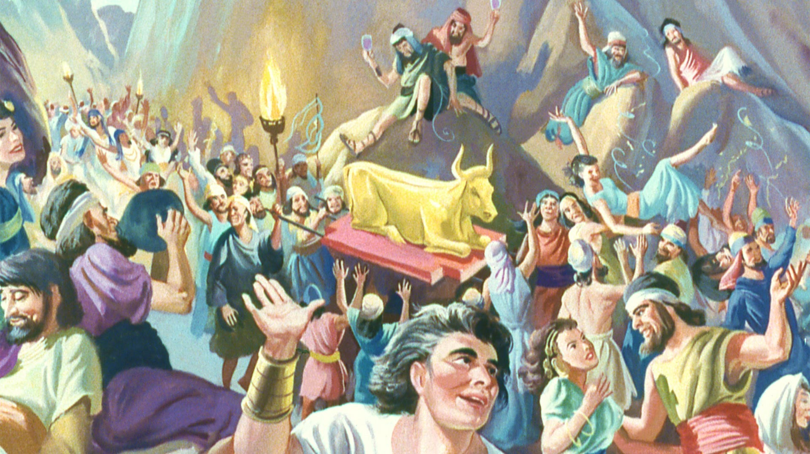
Context of
Exodus 34:5-9
Exodus 32 – Dealing with the golden calf…

Slide 12
Context of
Exodus 34:5-9
Exodus 33:1-3 – Moses is commanded to lead the people to the Promised Land…
but God said he would not go with them!

Slide 13
Context of
Exodus 34:5-9
Exodus 33:12-16 – Discussion between Moses and God about God going with them on the journey…
God says he’ll go, but Moses has lingering doubts…

Slide 14
Context of
Exodus 34:5-9
Exodus 33:18 – Moses boldly asks to see God’s glory!

Slide 15
Our Story – Exodus 34:5-9
The Context
Defining the name Yahweh (5-7)
Moses’ Response to God’s Khesed (8-9)
Applying this to Us!

Slide 16
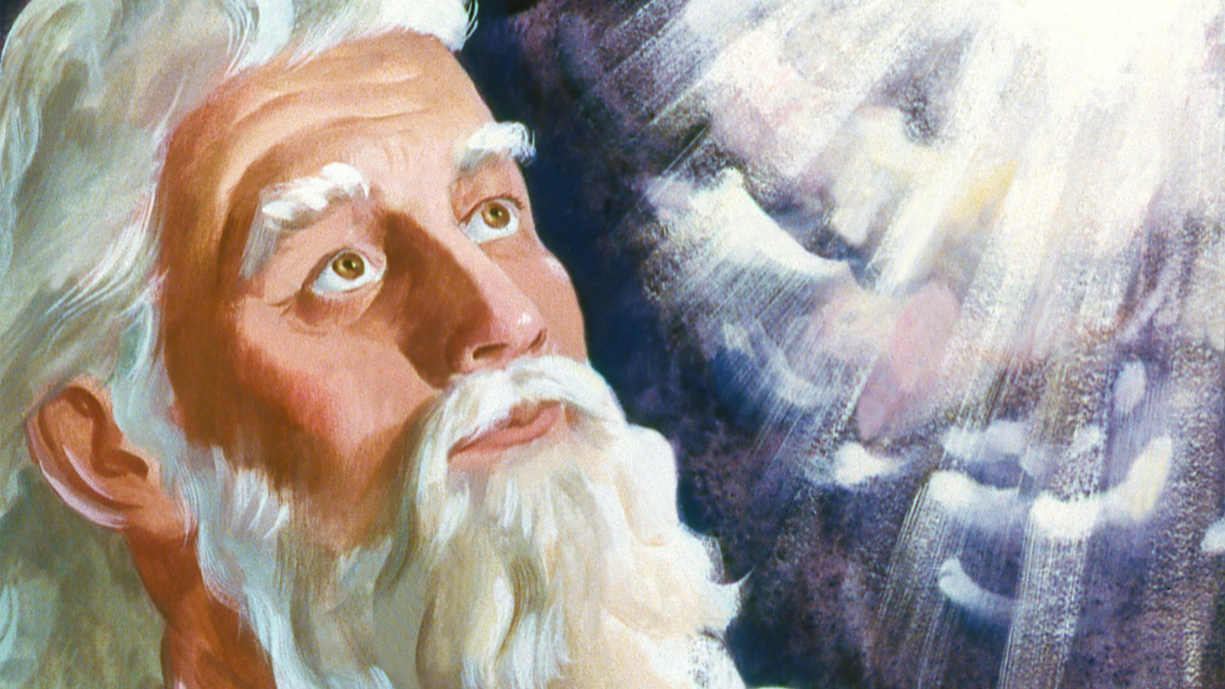
Defining the name Yahweh
“The LORD passed before him and proclaimed, ‘The LORD, the LORD, a God merciful and gracious, slow to anger, and abounding in steadfast love and faithfulness, keeping steadfast love for thousands, forgiving iniquity and transgression and sin, but who will by no means clear the guilty, visiting the iniquity of the fathers on the children and the children's children, to the third and the fourth generation.’” Exodus 34:6-7

Slide 17
Defining the name Yahweh
LORD = Yahweh
“The LORD passed before him and proclaimed, ‘The LORD, the LORD, a God merciful and gracious, slow to anger, and abounding in steadfast love and faithfulness, keeping steadfast love for thousands, forgiving iniquity and transgression and sin, but who will by no means clear the guilty, visiting the iniquity of the fathers on the children and the children's children, to the third and the fourth generation.’” Exodus 34:6-7

Slide 18
Defining the name Yahweh
God is describing how he wants to be known!
“The LORD passed before him and proclaimed, ‘The LORD, the LORD, a God merciful and gracious, slow to anger, and abounding in steadfast love and faithfulness, keeping steadfast love for thousands, forgiving iniquity and transgression and sin, but who will by no means clear the guilty, visiting the iniquity of the fathers on the children and the children's children, to the third and the fourth generation.’” Exodus 34:6-7

Slide 19
Defining the name Yahweh
Merciful… but also just!
“The LORD passed before him and proclaimed, ‘The LORD, the LORD, a God merciful and gracious, slow to anger, and abounding in steadfast love and faithfulness, keeping steadfast love for thousands, forgiving iniquity and transgression and sin, but who will by no means clear the guilty, visiting the iniquity of the fathers on the children and the children's children, to the third and the fourth generation.’” Exodus 34:6-7

Slide 20
Defining the name Yahweh
Khesed
(Strong’s # H2617)
“The LORD passed before him and proclaimed, ‘The LORD, the LORD, a God merciful and gracious, slow to anger, and abounding in steadfast love and faithfulness, keeping steadfast love for thousands, forgiving iniquity and transgression and sin, but who will by no means clear the guilty, visiting the iniquity of the fathers on the children and the children's children, to the third and the fourth generation.’” Exodus 34:6-7

Slide 21
Defining the name Yahweh
Translations of Khesed in Exodus 34:6-7…
ESV: Steadfast love
KJV: Goodness / Mercy
NASB: Lovingkindness or Faithfulness
NIV: Love
NLT: Unfailing love
Khesed
(Strong’s # H2617)

Slide 22
Defining the name Yahweh
What did God want to communicate about the name Yahweh?
He defined himself based on how he related to people (not his power, abilities, wisdom, etc.)
Defining Characteristics:
God is abounding in love that is loyal, steadfast, unfailing
God keeps this love – it endures in any circumstance because it is an essential part of who he is

Slide 23
Our Story – Exodus 34:5-9
The Context
Defining the name Yahweh (5-7)
Moses’ Response to God’s Khesed (8-9)
Applying this to Us!

Slide 24
Moses’ Response to God’s Khesed
Worship is his first response
“And Moses quickly bowed his head toward the earth and worshiped. And he said, ‘If now I have found favor in your sight, O LORD, please let the LORD go in the midst of us, for it is a stiff-necked people, and pardon our iniquity and our sin, and take us for your inheritance.’”
Exodus 34:8-9

Slide 25
Moses’ Response to God’s Khesed
Moses has the confidence to finalize the question of
God’s presence going with them!
He now uses the truth of God’s khesed as the reason
for his request!
“And Moses quickly bowed his head toward the earth and worshiped. And he said, ‘If now I have found favor in your sight, O LORD, please let the LORD go in the midst of us, for it is a stiff-necked people, and pardon our iniquity and our sin, and take us for your inheritance.’”
Exodus 34:8-9

Slide 26
Numbers 14 – People’s Refusal to Enter the Land
Once again, Moses’ boldly asked for forgiveness based on God’s khesed!
God’s khesed is seen most clearly in the context of our unfaithfulness!
“And now, please let the power of the LORD be great as you have promised, saying, ‘The LORD is slow to anger and abounding in steadfast love, forgiving iniquity and transgression, but he will by no means clear the guilty, visiting the iniquity of the fathers on the children, to the third and the fourth generation.’ Please pardon the iniquity of this people, according to the greatness of your steadfast love, just as you have forgiven this people, from Egypt until now.”
Numbers 14:17-19

Slide 27
Our Story – Exodus 34:5-9
The Context
Defining the name Yahweh (5-7)
Moses’ Response to God’s Khesed (8-9)
Applying this to Us!

Slide 28

Old City and Kidron Valley from north
What Does God Want Us to Learn?
God’s basic nature:
Forgiving – he does not treat us as our sins deserve
Kind – he treats us with kindness and tenderness
(Psalm 33 – Creation itself is an act of his khesed!)
Loving – he pursues relationship with us; he loves us based on our need – not on what we’ve earned
Faithful – he keeps his word and fulfills his promises
What are specific examples in your life of God treating you in these ways?

Slide 29
Old City and Kidron Valley from north
What Does God Want Us to Learn?
“‘For the mountains may depart
and the hills be removed,
but my steadfast love shall not depart from you,
and my covenant of peace shall not be removed,’
says the LORD, who has compassion on you.”
Isaiah 54:10
His khesed is rock solid!
We can always count on it!

Slide 30
Old City and Kidron Valley from north
What Does God Want Us to Learn?
“For while we were still weak, at the right time Christ died for the ungodly… God shows his love for us in that while we were still sinners, Christ died for us.” Romans 5:6,8
Jesus is the ultimate outworking of God’s khesed!

Slide 31
Old City and Kidron Valley from north
How Does God Want us to Respond?
To Trust him…
To obey his commands because of his khesed
To take risks with our time, money and relationships because he is faithful

Slide 32
Old City and Kidron Valley from north
How Does God Want us to Respond?
To Enjoy him…
To respond to his invitation to relationship
To enjoy his presence
To thank him and speak of his faithfulness

Slide 33
Old City and Kidron Valley from north
How Does God Want us to Respond?
To Express Khesed toward others…
Value relationships
Be quick to forgive and resolve conflicts
Love based on God’s love for us rather than on the merit of the other person

Slide 34
Old City and Kidron Valley from north
Applying the Truths of God’s Khesed
Work to understand God’s basic nature and the implications of khesed
Respond to God’s khesed:
Trust him
Enjoy him
Express khesed toward others

Slide 36


OT Preaching link at BibleStudyDownloads.org
Get this presentation for free!
Notes:
OT Preaching (op)

