Slide 1
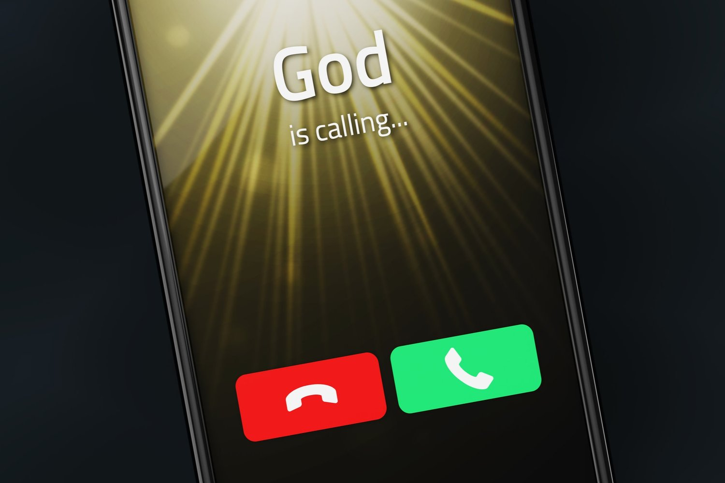
When God Calls
Exodus 3–4
Dr. Rick Griffith • Jordan Evangelical Theological Seminary • BibleStudyDownloads.org

Slide 2
God
is calling...
Dr. Rick Griffith • Jordan Evangelical Theological Seminary • BibleStudyDownloads.org
Notes:
We are all used to ignoring spam calls, but what if God calls us?

Slide 3

God is calling believers today to obey him.
Do you want to follow God’s calling for your life?
Notes:
God is calling believers today to obey him. If he has called you to serve him, raise your hand.
• Do you want to follow God’s calling for your life?
How many of us want to obey the Lord?
Raise your hand again if that includes you.
Good. Willingness is the first step.

Slide 4

How can you follow God’s calling?
Notes:
Now the question is how to obey.

Slide 5
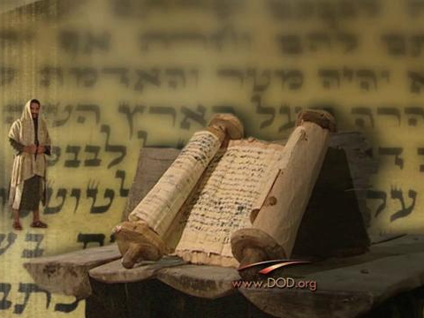
Background to Exodus 3–4
Notes:
Exodus 1–2 shows how God prepared the scene to call his servant Moses in Exodus 3–4.

Slide 6
Slides on
Exodus 1

Slide 7
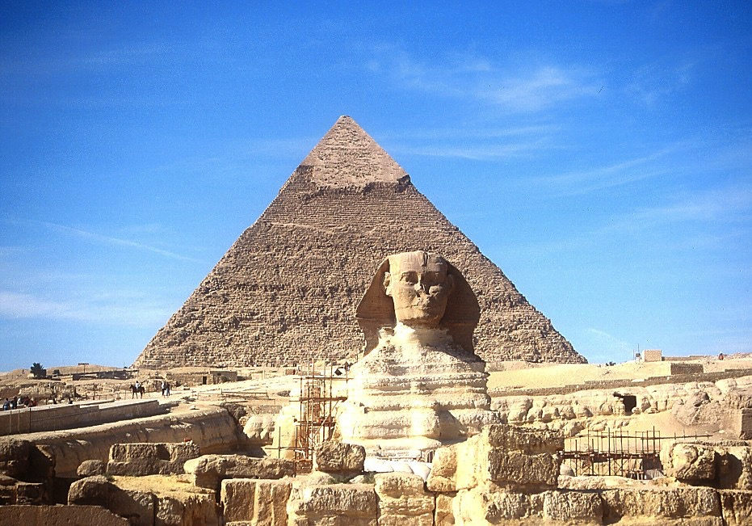
The Sphinx and the Great Pyramid
7
JOSEPH
Handbook pg. 24-25
57
Notes:
The Sphinx and the Great Pyramid still visible today remind us of Egypt’s great power.

Slide 8
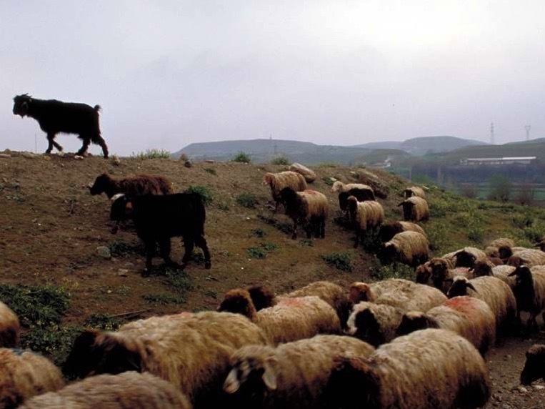
Egyptians Despised Israelites for being Shepherds
Notes:
In contrast, Egyptians despised Israelites for being shepherds.

Slide 9
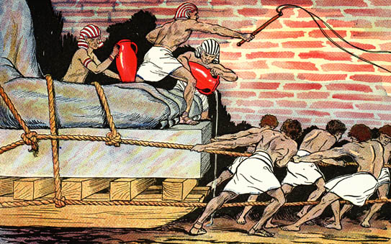
Egyptians Ruthlessly Oppressed Israel

Slide 10
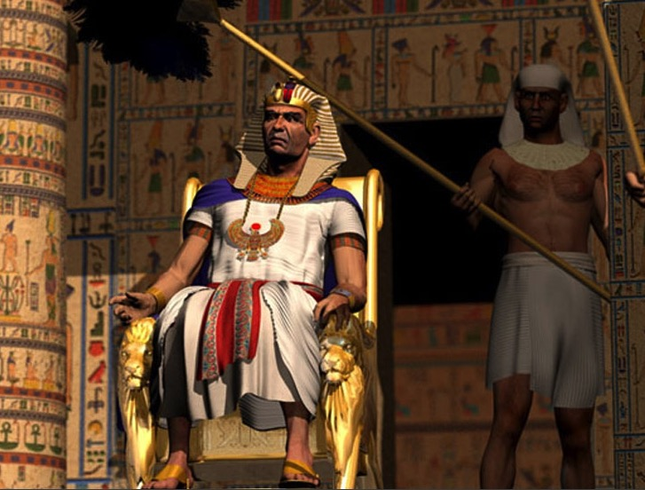
"Ultimate" Power
Notes:
Pharaoh was viewed as the ultimate power.

Slide 11
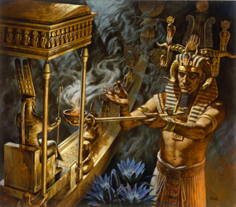
Who has greater power – Pharaoh or Yahweh?
Notes:
This raised the question of who had the greater power—Pharaoh or Yahweh, the Lord of the Hebrews.

Slide 12
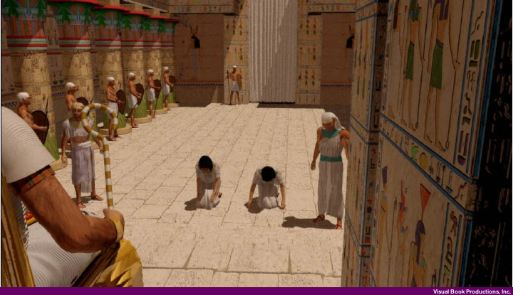
Hebrew Midwives appear before Pharaoh (Exodus 1:15-22)
Notes:
Pharaoh even abused his power by commanding the Hebrew midwives to kill the baby Hebrew boys.

Slide 13
Slides on
Exodus 2

Slide 14
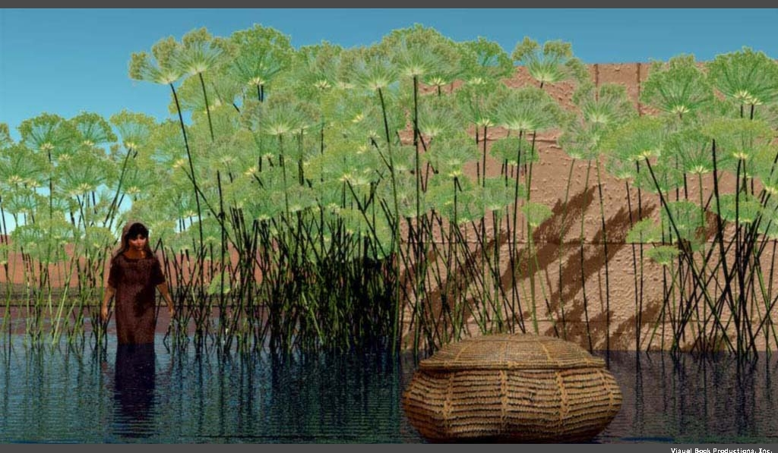
Moses was "thrown into the Nile" (Exod. 1:22)
Notes:
So the mother of Moses “obeyed” Pharaoh’s command and gently tossed Moses into the Nile!

Slide 15

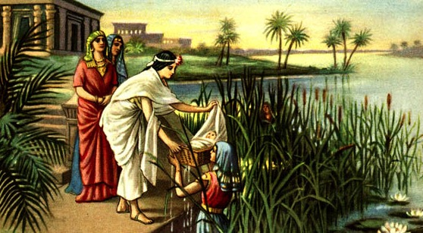
Moses sounds like the Hebrew for draw out (2:10)
Queen Hatshepsut
Notes:
But God worked amazingly so Pharaoh’s own daughter found the baby Moses.

Slide 16
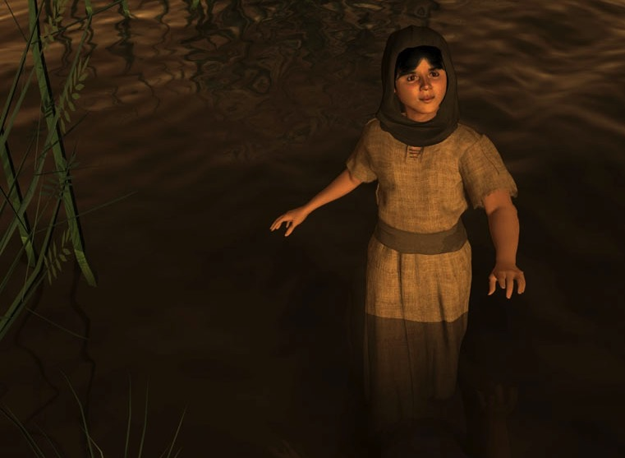
Miriam (Exod. 2:4)
Notes:
God even used Miriam—the older sister of Moses—to pay the mother of Moses to nurse him!

Slide 17
Acts 7:20-21 (NIV)
"At that time Moses was born, and he was no ordinary child. For three months he was cared for in his father's house. When he was placed outside, Pharaoh's daughter took him and brought him up as her own son."
Notes:
Acts 7 notes that Pharaoh’s daughter raised Moses as if he were her own son!

Slide 18

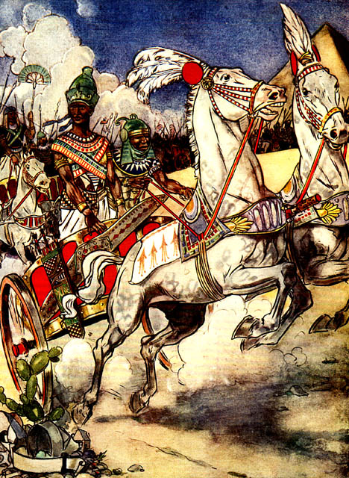
Moses Flees
Thutmose III
Notes:
But Moses grows up and takes matters into his own hands and Pharaoh seeks to kill him, so Moses flees.

Slide 19

Location of Midian
Canaan
Goshen
Nile River
Mt. Sinai
Egypt
Midian
Notes:
In Exodus 3, we find Moses far away in Midian, traveling to Mount Sinai with his sheep.

Slide 20
How can you follow God’s calling?
How can Moses follow God’s calling?
Notes:
• How can you follow God's calling?

Slide 21
Our role
God's role
Notes:
Today, in Exodus 3–4, we will first see God’s role
• and then our role regarding God’s call on our lives.
We will summarize Exodus 3–4 in two principles relating to (1) God’s calling and (2) our response.

Slide 22
Slides on
Exodus 3
Notes:
(How does the LORD convince us to respond to Him? It starts when…)

Slide 23
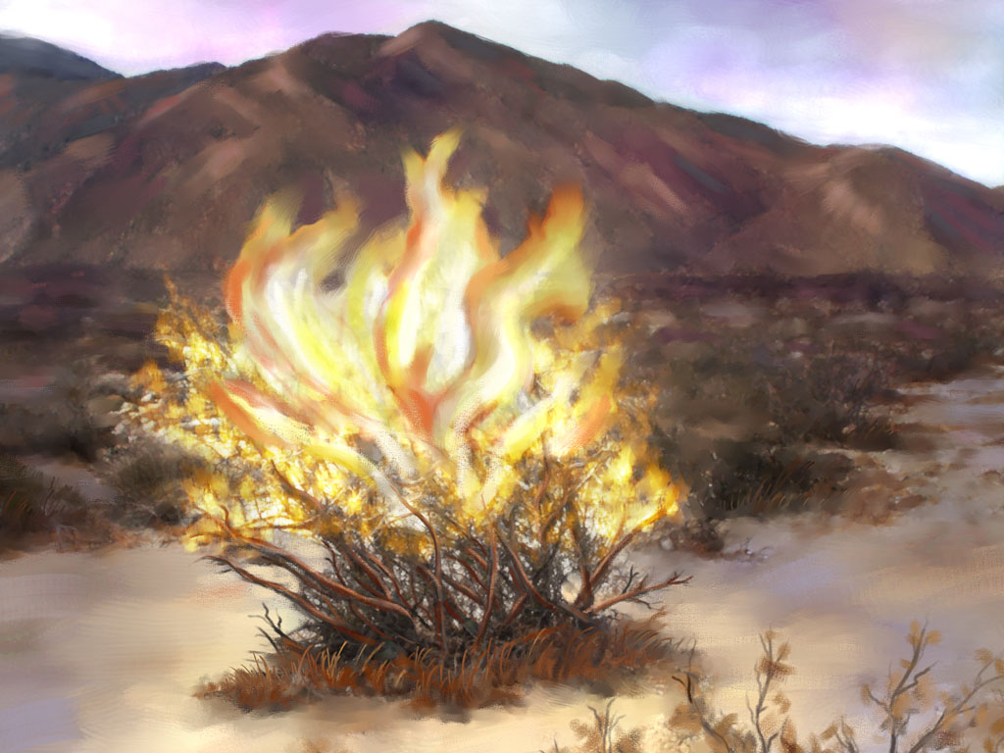
God calls His servant
(Exodus 3)
Notes:
[The Lord tells us to do the impossible to show us our inadequacy and need.]

Slide 24
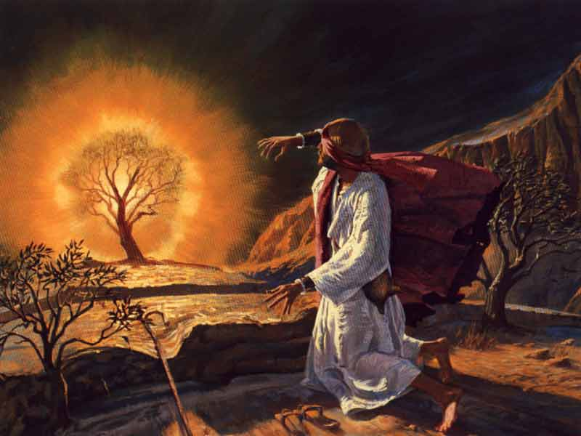
The Burning Bush
(Exod. 3:1–4:17)
Notes:
God called Moses to lead all Israel out of Egypt (3:1-10).

Slide 25
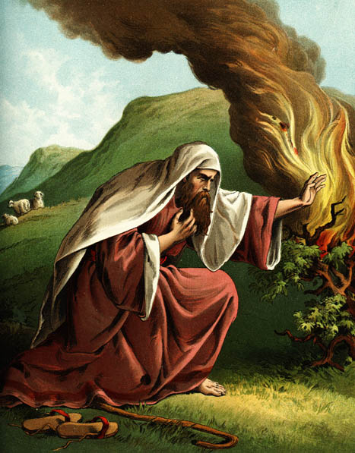
EXCUSES
1. Who am I (3:11)?
Notes:
Moses gave excuses instead of obeying God’s call (3:11–4:17).
• 1. "Who am I?"
This is not a relevant question, but Moses asked it.
God could have focused on Moses, "You are my chosen servant with the perfect balance of 40 years in Egypt and 40 in the wilderness."
But God answered, “I will be with you. And this is your sign that I am the one who has sent you: When you have brought the people out of Egypt, you will worship God at this very mountain” (3:12).

Slide 26
EXCUSES
1. Who am I (3:11)?
2. Who are You (3:13)?
"God replied to Moses, 'I Am Who
I Am. Say this to the people of Israel:
I Am has sent me to you'"
(Exodus 3:14 NLT).
Notes:
God didn't accept this excuse of who Moses was.
• 2. So Moses then questioned who God was!
But this wasn't any better an excuse.
• "God replied to Moses, 'I Am Who
I Am. Say this to the people of Israel:
I Am has sent me to you'"
(Exodus 3:14 NLT).

Slide 27
EXCUSES
1. Who am I (3:11)?
2. Who are You (3:13)?
3. What if I fail (4:1)?
Notes:
3. "What if they do not believe me?" is essentially, "What if I fail?"

Slide 28

God Doesn't Call the Qualified
He Qualifies the Called

Slide 29
EXCUSES
1. Who am I (3:11)?
2. Who are You (3:13)?
3. What if I fail (4:1)?
4. I'm not gifted (4:10)
Notes:
Ex. 4:10 But Moses pleaded with the LORD, “O Lord, I’m not very good with words. I never have been, and I’m not now, even though you have spoken to me. I get tongue-tied, and my words get tangled.”
This is like saying, “But God, I need a translator!”

Slide 30
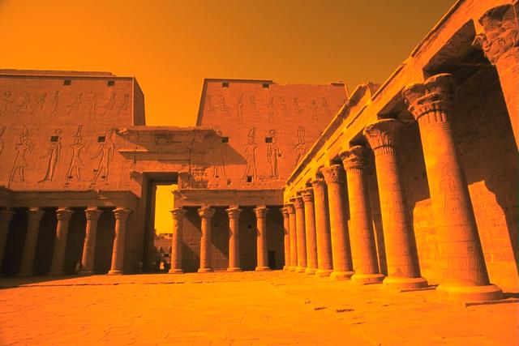
Acts 7:22 (NIV)
"Moses was educated in all the wisdom of the Egyptians and was powerful in speech and action."
Notes:
His self-perception was poor, but Stephen in Acts 7 notes, “Moses was educated in all the wisdom of the Egyptians and was powerful in speech and action."

Slide 31
EXCUSES
1. Who am I (3:11)?
2. Who are You (3:13)?
3. What if I fail (4:1)?
4. I'm not gifted (4:10)
5. I don't want to get involved (4:13)
Notes:
Ex. 4:13 But Moses again pleaded, “Lord, please! Send anyone else.”
This is like saying, “Here am I, Lord! But please, send Aaron!”

Slide 32
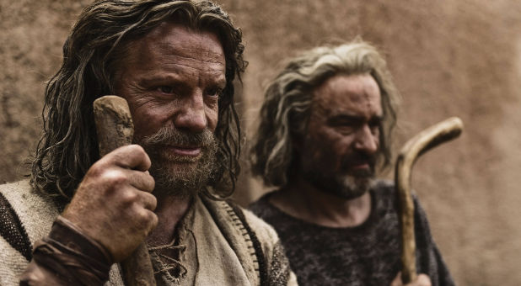
The conversation between Moses and God ended only after Aaron's appointment as ministry partner
(Exod. 4:13-17)

Slide 33
God calls His servant
(Exodus 3)
Notes:
[The Lord tells us to do the impossible to show us our inadequacy and need.]
This is God's role—to call us.
What is our role?
How should we respond to God’s calling?

Slide 34
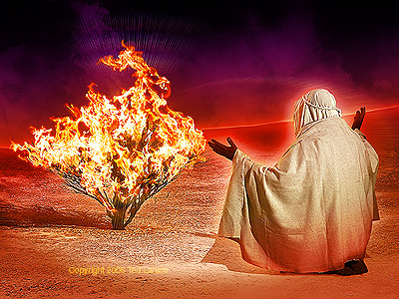
God's servant must present himself as God's instrument
(Exodus 4:18-31)
Notes:
[Offer yourself to God as an inadequate vessel trusting in God’s sufficiency.]
Moses finally obeyed God’s call by returning to Egypt (4:18-31).

Slide 35
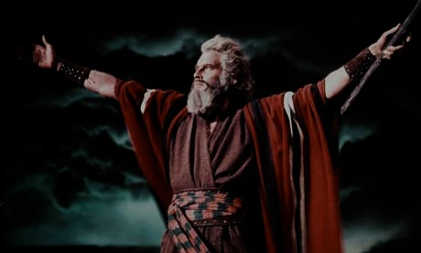
Moses' Life
100
Period
Reference
Dates
Location
40 years Prince
Exod. 2:1-10
1525-1485 BC
Egypt
(Academic)
40 years Shepherd
Exod. 2:11-25
1485-1445 BC
Midian
(Field Ed.)
40 years Leader
Exod. 3:1– Deut. 34:8
1445-1405 BC
Midian Egypt Wilderness
Notes:
Moses’ life had three distinct periods that helped him see God’s sufficiency.
• To lead Israel, God gifted Moses with a typical lifetime in his era to understand palace life, undoubtedly including speaking Egyptian.
• Yet that would not prepare him to lead two million Israelites in the desert, so God gave Moses another typical lifetime leading sheep in the wilderness.
• God promised that Moses would return to Mount Sinai, so he invested his final 40-year period to lead people wandering in the desert, which was far more complex than leading sheep.
Moses spent the perfect balance of 40 years in the palace and 40 years in the desert, beginning at age 80 when he began his life's most arduous calling.

Slide 36
How can you follow God’s calling?
Notes:
Now, back to the question of how to obey.

Slide 37
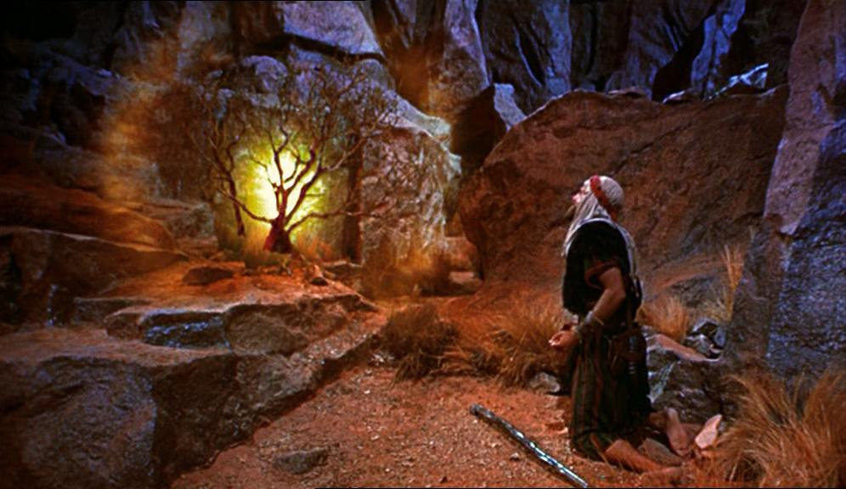
    Admit your inadequacy to know God’s sufficiency.
Main Idea
Notes:
God's servant who understands his own inadequacy will show God's sufficiency
(Exodus 3–4 restated).

Slide 38
God calls His servant
(Exodus 3)
Notes:
[The Lord tells us to do the impossible to show us our inadequacy and need.]

Slide 39
God's servant must present himself as God's instrument
(Exodus 4:18-31)
Notes:
[Offer yourself to God as an inadequate vessel trusting in God’s sufficiency.]
Moses finally obeyed God’s call by returning to Egypt (4:18-31).

Slide 40
God's Sufficiency Over My Inadequacy
High school witness
High school Bible teacher
Music evangelist in the Philippines
Student at Dallas Seminary
Pastor during seminary
Professor at Singapore Bible College
School planter in Singapore
Church planter in Singapore
Professor at JETS
Academic Dean at JETS
Notes:
Witness at Hayward High School—but my parents opposed it.
Teacher in Barnabas Brothers—but I knew only one more week of the Bible than them.
Music evangelist in Crossroads—but I had never preached before.
Student at DTS—but it took me much more time to learn than it did others.
Pastor at Grace Fellowship—but the people were 75% divorced with many issues.
Professor at Singapore Bible College—but I never fit the academic mold as an author.
School planter at ICS—but I had never had a child in primary school before.
Church planter at CIC—but I had too little time and no idea how to start a church.
Professor at JETS—but I started teaching five days after arrival and have little capacity to learn Arabic.
Academic Dean at JETS—but I am closest to retirement and know Arabic the least of anyone at JETS.

Slide 41

How is God calling you?
What is he telling you to do that shows your inadequacy and his sufficiency?
Will you tell him YES?

Slide 42
Black

Slide 43


OT Preaching link at BibleStudyDownloads.org
Get this presentation and script for free!

